Slide 1

Public Hearing on the Proposed
2025-2026 School Budget
Presentation #6
Presented on:
May 13, 2025

Slide 2
2025-26 Budget Supports Continuity of Instruction
Science of Reading Workshop PreK-8 | Spanish: K-8
Science of Writing Workshop: PreK-8 | PBIS: K-8
Eureka Math: K-8 | iPads: Art & STEM Programs
Vocabulary & Grammar Workshop: 1-8 | Student 1:1 Initiative: K-8 (Chromebooks/iPads)
UFLI Phonics K-2 | IXL Math/ELA: 3-8
Project Lead the Way: K-8 | Achieve 3000: 2-8
Wilson Reading: K-8 | Reading A-Z Teachers Resource
FastForwords K-8 | RAZ Kids
Amplify - DIBELS - MCLASS | Keyboarding & Handwriting Without Tears
Heggerty Phonemic Awareness Pre K-3 | Before/After School Tutoring

Slide 3
Key Budget Additions for 2025-26
Additions | Description
High School Contracts | Special Education Tuition Rate Changes (Special Class/Self-Contained)
C-TEC Tuition Increase | Increased enrollment in C-TEC Programs
+2 Teaching Assistants | CSE / IEP Mandated Services
Contract Transportation Increase | Additional Special Education Bus Routes
1:1 Devices: K iPads | Replacement Rotation (2019)
MS Boiler | TRANE Service Contract Increase
UPK Transportation Monitor Costs | Bus Monitor for UPK Program September through December
Transfer to Special Aid Fund | Special Aid Fund - Special Education Summer School Costs
Field Trips | Increased cost of trips
Additions Total | $1,703,135
Notes:
Here’s a breakdown of the new expenditure categories totaling $1.7 million.
This includes increased tuition rates, increases in C-TEC enrollment, 1:1 device rotation for kindergarten, and a boiler service contract.
We’re also accounting for special education summer school through a transfer to the Special Aid Fund.

Slide 4
Expenditures by Component
1.Program
2.Capital
3.Administration

Slide 5
Expenditures by Component
PROGRAM
The program budget includes salaries and benefits for all teachers, guidance counselors, teaching assistants, aides, psychologists, nurses, social workers and speech therapists. It also includes in-service training, library costs, student supplies, co-curricular programs, interscholastic athletics and transportation costs for in and out of district students.
CAPITAL
The capital budget includes equipment purchases, debt service on buildings, security, operations and maintenance costs, including salaries and benefits for all custodial staff members.
ADMINISTRATIVE
The administrative budget includes salaries and benefits for all other staff members. It includes administrators, clerical staff, public information, business office, central office, curriculum development and supervision, research, planning and evaluation, legal services and Board of Education related costs.

Slide 6
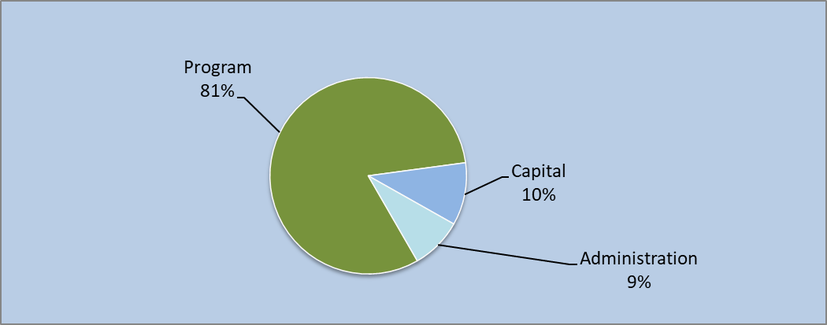
Expenditure Summary by Component

Slide 7
Expenditure Comparison
Component | 2024-2025 | 2025-2026 | $ Change | % Budget
Program | 23,416,835 | 25,157,180 | 1,740,344 | 81.2%
Capital | 3,371,200 | 3,191,580 | (179,620) | 10.3%
Administration | 2,401,985 | 2,631,655 | 229,671 | 8.5%
Total Appropriations | $ 29,190,020 | $ 30,980,415 | $ 1,093,835 | 100.0%
As per the Bus Replacement Fleet Schedule:
No new bus purchases are required

Slide 8
Revenues By Component

Slide 9
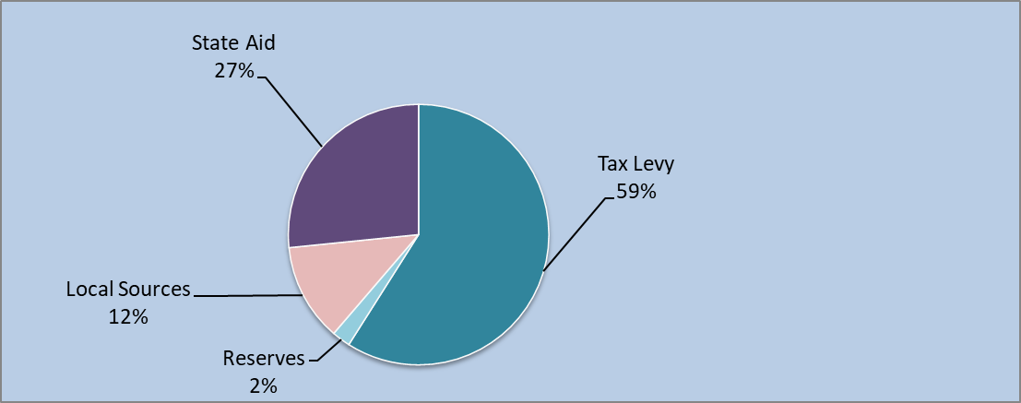
Revenue Summary by Component
Notes:
Local Sources = Fund balance and reserves:
Other = Interest earnings & High Cost Aid Reimbursement from our High school partners

Slide 10
Revenues
Revenues accounts | 2024-25 Original Budget | 2025-26 Proposed Budget | Increase (Decrease)
State Aid | 7,863,433 | 8,229,455 | 393,022
Tax levy | 17,888,484 | 18,290,975 | 402,491
Fund Balance Appropriation | 2,184,538 | 3,318,636 | 1,134,098
ERS Reserve | 230,000 | 230,000 | -
Capital for Bus Purchases | 160,060 | - | (160,060)
Debt Reserve | 218,450 | 213,800 | (4,650)
Interest Earnings | 307,370 | 307,370 | -
Other Revenue | 364,685 | 390,179 | 25,494
Total Estimated Revenues | 29,190,020 | 30,980,415 | 1,790,395
Final
State Aid 5/6/25
To minimize impact on GWL taxpayers there will be a 2.25% increase for the 2025-26 school year.
Property Tax Levy Limit or Tax Cap calculation authorizes the District to levy from $17,888,484 up to $18,590,995. If the District was to levy to the maximum, the increase of $702,511 would be a 3.93% increase.
Notes:
Overall revenue also increases by $1.79 million over the current year.
State aid is expected to rise slightly, though final numbers are pending.
The biggest jump is in our use of fund balance to maintain service levels while minimizing the impact on GWL taxpayers.

Slide 11
Proposed Tax Increase: 2.25%
The Greenwood Lake UFSD & Board of Education continue their commitment to keep tax increases to a minimum. With that in mind, the Board is adopting a budget with a 2.25% tax increase, well below the tax levy limit of 3.93%.
Proposed Budget:
$30,980,415
Proposed Tax Levy, as a portion of that total budget:
$18,290,975
For the average GWL household, this means ~$114.05 increase over the course of the year
($9.50 / month)
Notes:
The district is allowed to levy up to 3.93% under the Property Tax Cap Levy Limit.
However, to minimize the impact on taxpayers, we propose a 2.25% increase.
This translates to approximately $114 more annually per average household—or just under $10 per month.

Slide 12
*Estimated
Tax Rate increase per $1,000 Assessed Value
How Will The Budget Impact Taxes?
Per $1,000 | Increase | Total Increase | Estimated Total Cost
10 | 3.80 | 38.02 | 1,727.68
20 | 3.80 | 76.03 | 3,455.35
30 | 3.80 | 114.05 | 5,183.03
40 | 3.80 | 152.07 | 6,910.71
50 | 3.80 | 190.09 | 8,638.39
60 | 3.80 | 228.10 | 10,366.06
70 | 3.80 | 266.12 | 12,093.74
80 | 3.80 | 304.14 | 13,821.42
90 | 3.80 | 342.16 | 15,549.09
100 | 3.80 | 380.17 | 17,276.77
Average GWL Home Assessment
*Town of Warwick Assessor finalizes all property assessments in August.

Slide 13
Proposition I
Shall the Greenwood Lake Union Free School District Budget for 2025–2026 in the amount of $30,980,415 be approved?

Slide 14
Tax Relief

Slide 15

Tax Relief
STAR & Enhanced STAR
Senior Citizen
Veterans Exemption
Qualified Volunteer Firefighters & Ambulance Workers

Slide 16

STAR Program (School Tax Relief Program)
Maximum STAR Tax Savings
Maximum STAR tax savings cannot exceed more than 2% of the prior year maximum savings.
The 2025-26 savings amounts are calculated by the Office of Real Property for the NYS Department of Taxation and Finance.
The published maximums are:
Basic STAR savings of $612.00
Enhanced STAR savings of $1,744.00
https://www.tax.ny.gov/star/default.htm

Slide 17
Senior Citizen Tax Exemption
INCOME | % REDUCTION IN ASSESSED VALUATION
Less than $19,500 | 50%
More than $19,500 but less than $20,499 | 45%
More than $20,499 but less than $21,499 | 40%
More than $21,499 but less than $22,499 | 35%
More than $22,499 but less than $23,399 | 30%
More than $23,399 but less than $24,299 | 25%
More than $24,299 but less than $25,199 | 20%
More than $25,199 but less than $26,099 | 15%
More than $26,099 but less than $26,999 | 10%
More than $26,999 but less than $27,899 | 5%
Approved by the Board of Education on 8/18/2010
Notes:
For property owners 65 years of age and older, with income levels from $19,500 to $27,899 the BOE has approved a senior citizen reduction from assessed valuation on a sliding scale from 50% to 5%

Slide 18

Veterans’ Exemption - Real Property Tax Law (RPTL) 458-a; Alternative Veterans’ Exemption
Exemptions | Assessed Property Value Maximum Exemption |  | Calculated Tax Exemption based on Property Value | Estimated Savings with a tax rate of $172.77
Basic Exemption | 12,000. | 15.00% | 1,800. | $310.
Combat Zone | 20,000. | 25.00% | 5,000. | $863.
Disabled Veterans | 40,000. | 50.00% | 20,000. | $3,455.
Implemented and approved by the Board of Education 2/26/2014

Slide 19


Firefighters & Ambulance Workers Exemption - Real Property Tax Law (RPTL) § 466-a Partial Exemption on Real Property Owned by Qualified Volunteer Firefighters & Ambulance Workers
Exemption Amount - Volunteer Firefighters and Volunteer Ambulance Workers who have at least two (2) years of applicable service in an incorporated volunteer fire company/department or incorporated voluntary ambulance service located within the School District, are eligible for a partial tax exemption from school taxes of 10% of the assessed value of the property
Lifetime Exemption - Volunteer Firefighters and Volunteer Ambulance Workers that accrue more than 20 years of active service are eligible for the 10% exemption from school taxes for the remainder of their life as long as their primary residence is located within the School District
Un-remarried Spouse of a deceased Volunteer Firefighter and Volunteer Ambulance Worker - the law extends the tax exemption to the un-remarried spouse, as long as the deceased Volunteer Firefighter or Volunteer Ambulance Worker had at least 20 years of service within the School District and had been receiving the exemption prior to their death
Un-remarried Spouse of a Volunteer Firefighter and Volunteer Ambulance Worker killed in the line of duty - the law extends or reinstates the exemption, as long as the Volunteer Firefighter or Volunteer Ambulance Worker had at least five (5) years of active service within the School District and had been receiving the exemption prior to their death
Example:
Exemptions | Assessed Property Value |  | Calculated Tax Exemption based on Property Value | Estimated Savings with a tax rate of $172.77
Basic Exemption | 30,000 | 10.00% | 3,000 | $518.
Implemented and approved by the Board of Education 2/12/2024

Slide 20
For additional tax information contact:
Town of Warwick
Assessor's Office
132 Kings Highway
Warwick, New York 10990
845-986-1125
www.townofwarwick.org
Or
NYS Department of Taxation and Finance
www.tax.ny.gov/pit/property/default.htm
Email: real.property@tax.ny.gov
Call 518-457-9053

Slide 21
Contingent Budget Overview

Slide 22
Proposed Budget vs. Contingent Budget
Proposed Budget $30,980,415
VS
Contingent Budget $30,868,515
Contingent Budget is $111,900 less than the 2025-26 Proposed Budget.

Slide 23
What happens if the budget is not approved?
Potential Contingent Budget Reductions
All equipment & student computers
Athletic & Instructional Equipment
Some salaries including summer enrichment programs
Professional Development
Athletics, Co-Curricular Clubs & Advisors
Student Materials & Supplies
Field Trips w/ Transportation
Community Use of Buildings & Security - would need to charge for use
Overall reduction in Printing, Supplies and Building Repairs

Slide 24
Board of Education Trustee Election

Slide 25

The Board of Education Candidates are:
There are two candidates running for two open seats on the Greenwood Lake Board of Education. Each seat holds a 3-year term. Candidates are listed below as they will appear on the ballot. Incumbents are marked with an asterisk.
Kevin Holder
David Clifford*

Slide 26
Absentee Ballots
Registered voters who would like to receive an absentee ballot should contact Mary DePietro, District Clerk, at 845-782-8678 at extn. 51100 or email mdepietro@gwlufsd.org
Your ballot can be mailed or personally delivered to the District Clerk but MUST be received by 5 pm on the day of the vote.

Slide 27

Next Steps:
BoE Annual Budget Vote & Election
will be held in person at the Greenwood Lake Elementary School,
on Tuesday, May 20, 2025 from 11 am – 9 pm.

Slide 28
Thank You!
Sarah Hadden Ann Lierow
Superintendent Asst Superintendent
shadden@gwlufsd.org alierow@gwlufsd.org

