Slide 1



Feaster Charter School 2015-2016 School Year

Slide 2
Demographics
1234 Students in Grades TK-8th
89.6% Hispanic
3.5% White
2.7% Black or African American
Filipino 2.3%
52% English Learners
0.5% Foster Students
0.25% Homeless
5.3% Students with Disabilities

Slide 3
Personnel
Classroom Teachers
Specialty Teachers
Art -Music
Instructional Assistants
English Learner Aid
43 Classroom Teachers in Grades TK-6th
2 Resource Specialists
8 Middle School Teachers
Dance -Physical Education
Technology -Science -Engineering
Administration & Coaches
1 Principal STEM and VAPA/Dual Immersion Academies
2 Curriculum Coaches
1 Executive Director
1 Associate Principal Middle School
Support Staff
2 Counselors -1 Behavior Specialist
1 Psychologist
Director of Finance
9 Classroom Instructional Aids

Slide 4
School structure
Executive Director
Principal & Associate Principal
Curriculum Coaches
Lead Classroom Teachers
Classroom
teachers
Students & Families

Slide 5
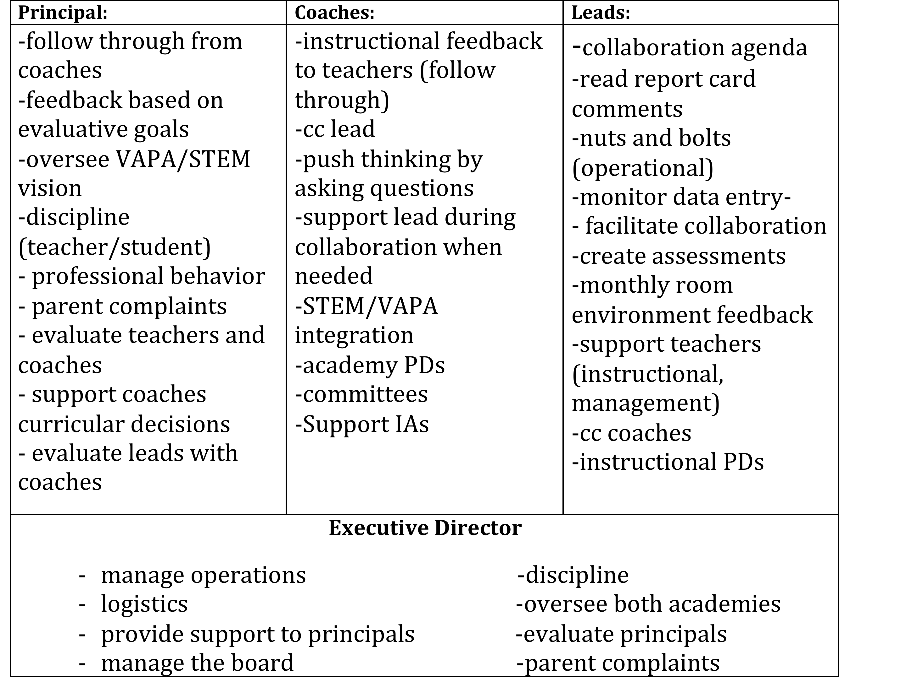
Roles and responsibilities

Slide 6
K-2 Local Measures

Slide 11
Similar School Data

Slide 12
Similar School Data Middle School

Slide 13
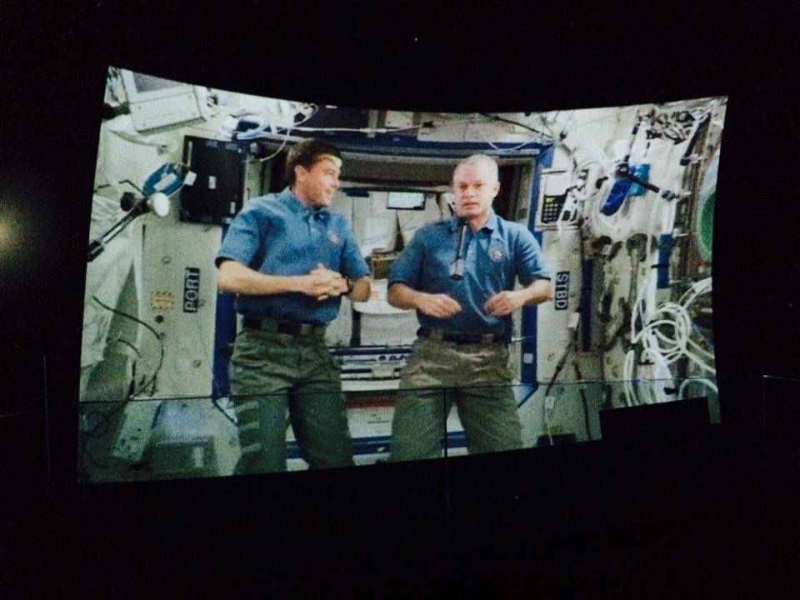
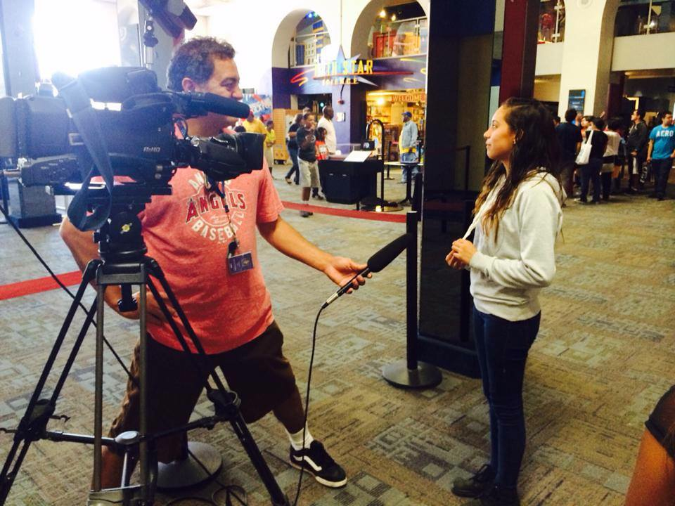
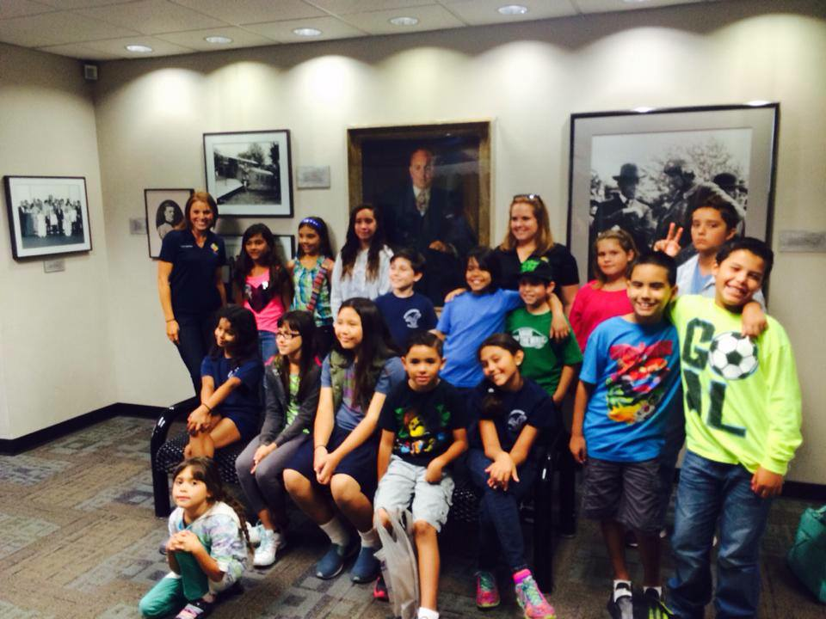
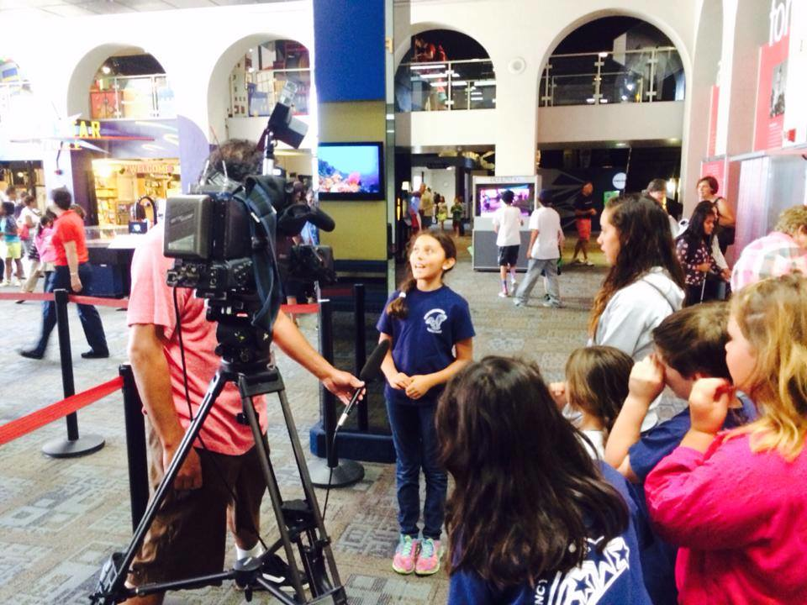
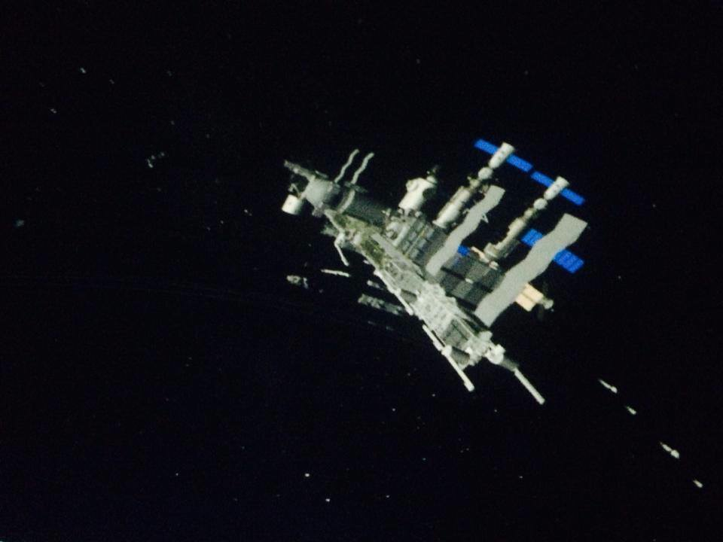
STEM Academy
NASA Downlink Event
Talking live with astronauts in space at the Rueben H. Fleet over summer break.

Slide 14
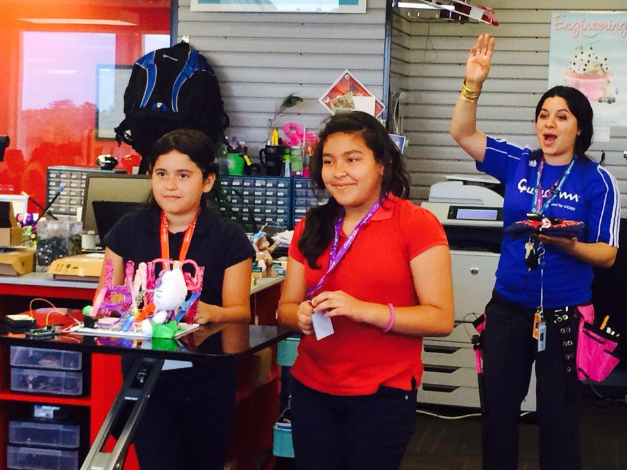
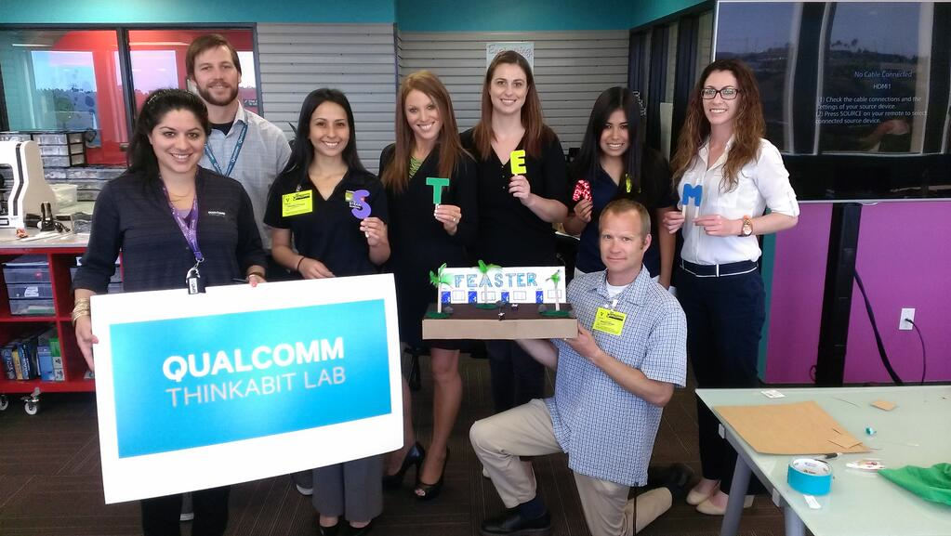

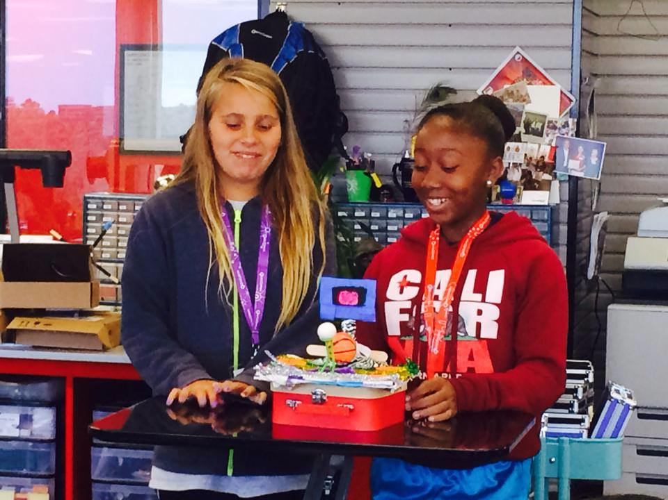
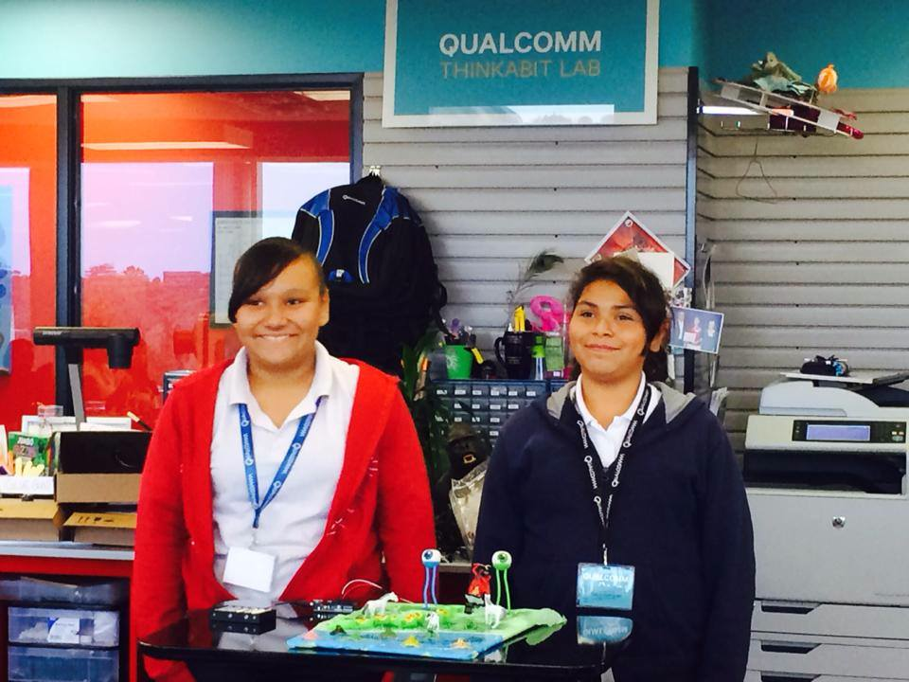
STEM ACADEMY

Slide 15
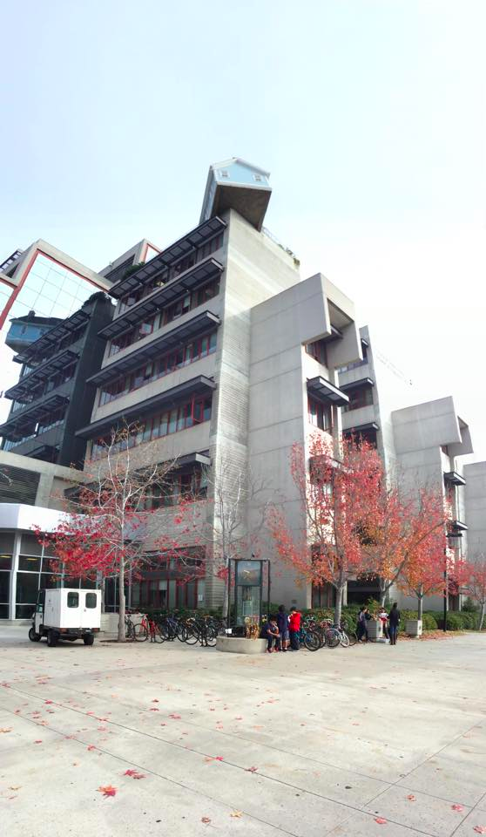
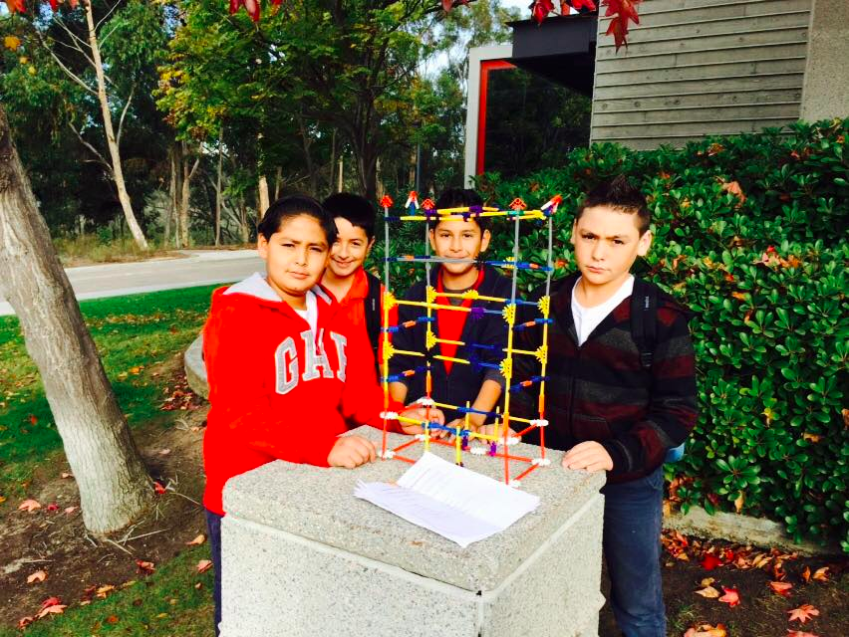

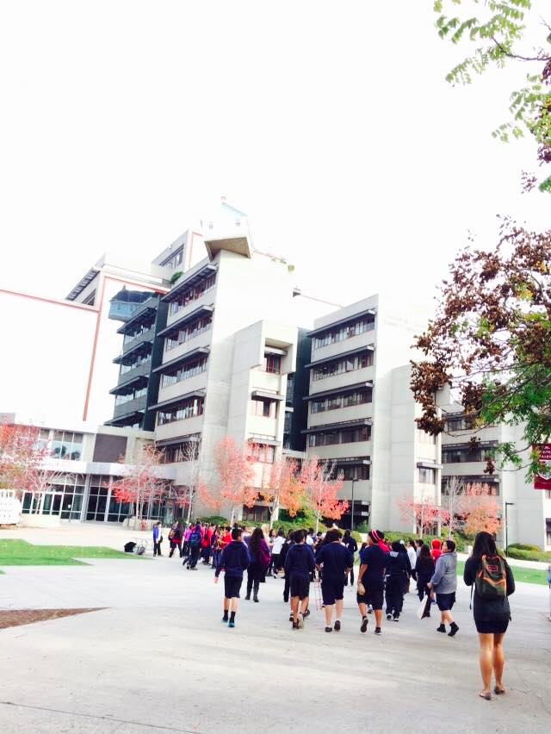
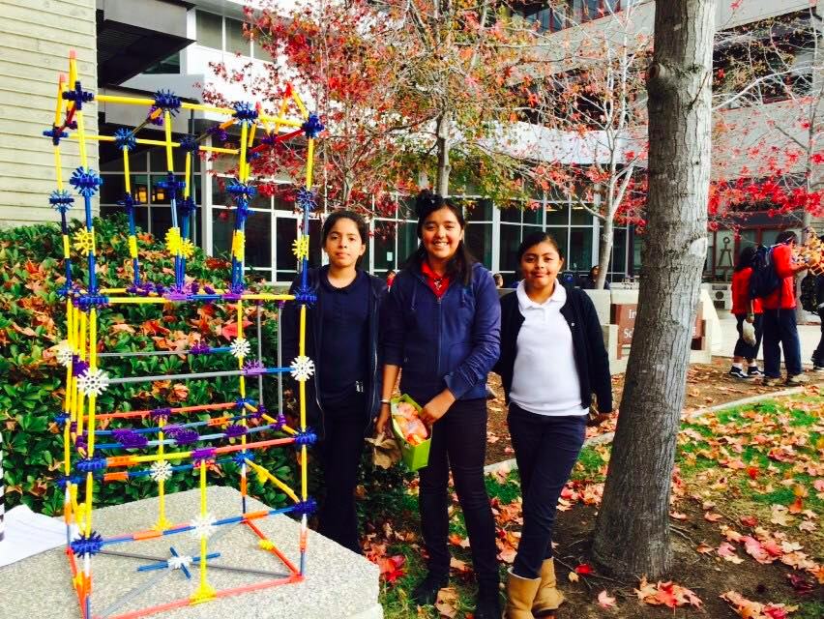
STEM academy

Slide 16



STEM ACADEMY
After School Clubs
Robotics Team
Mad Science
So Wild San Diego
MOUSE Squad
Maker Mondays in Engineering Lab

Slide 17

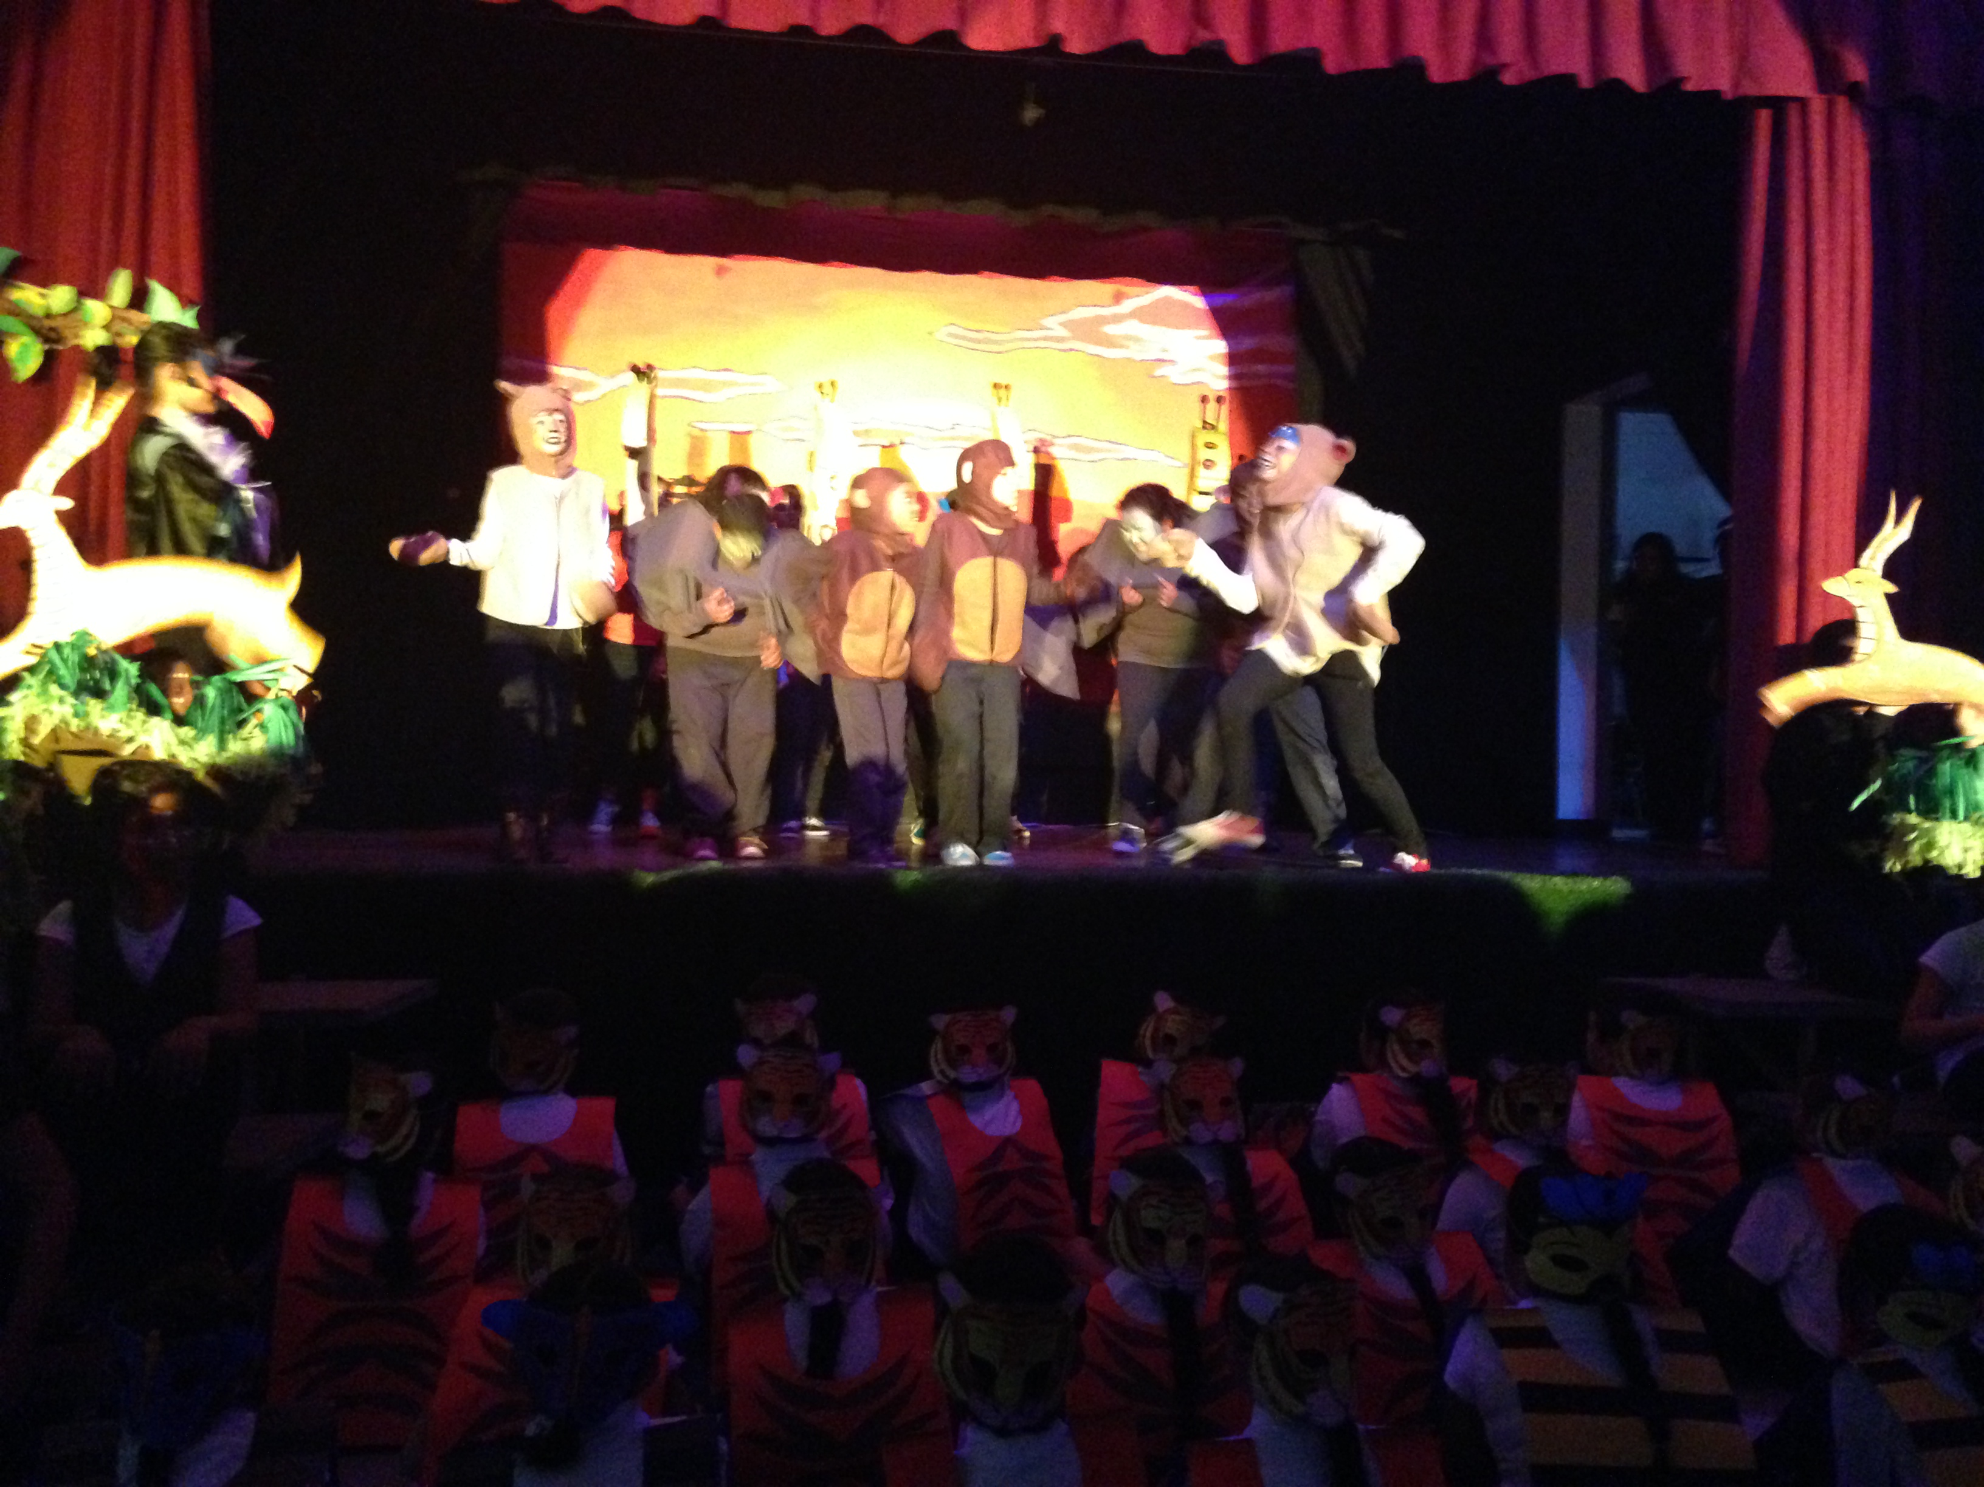
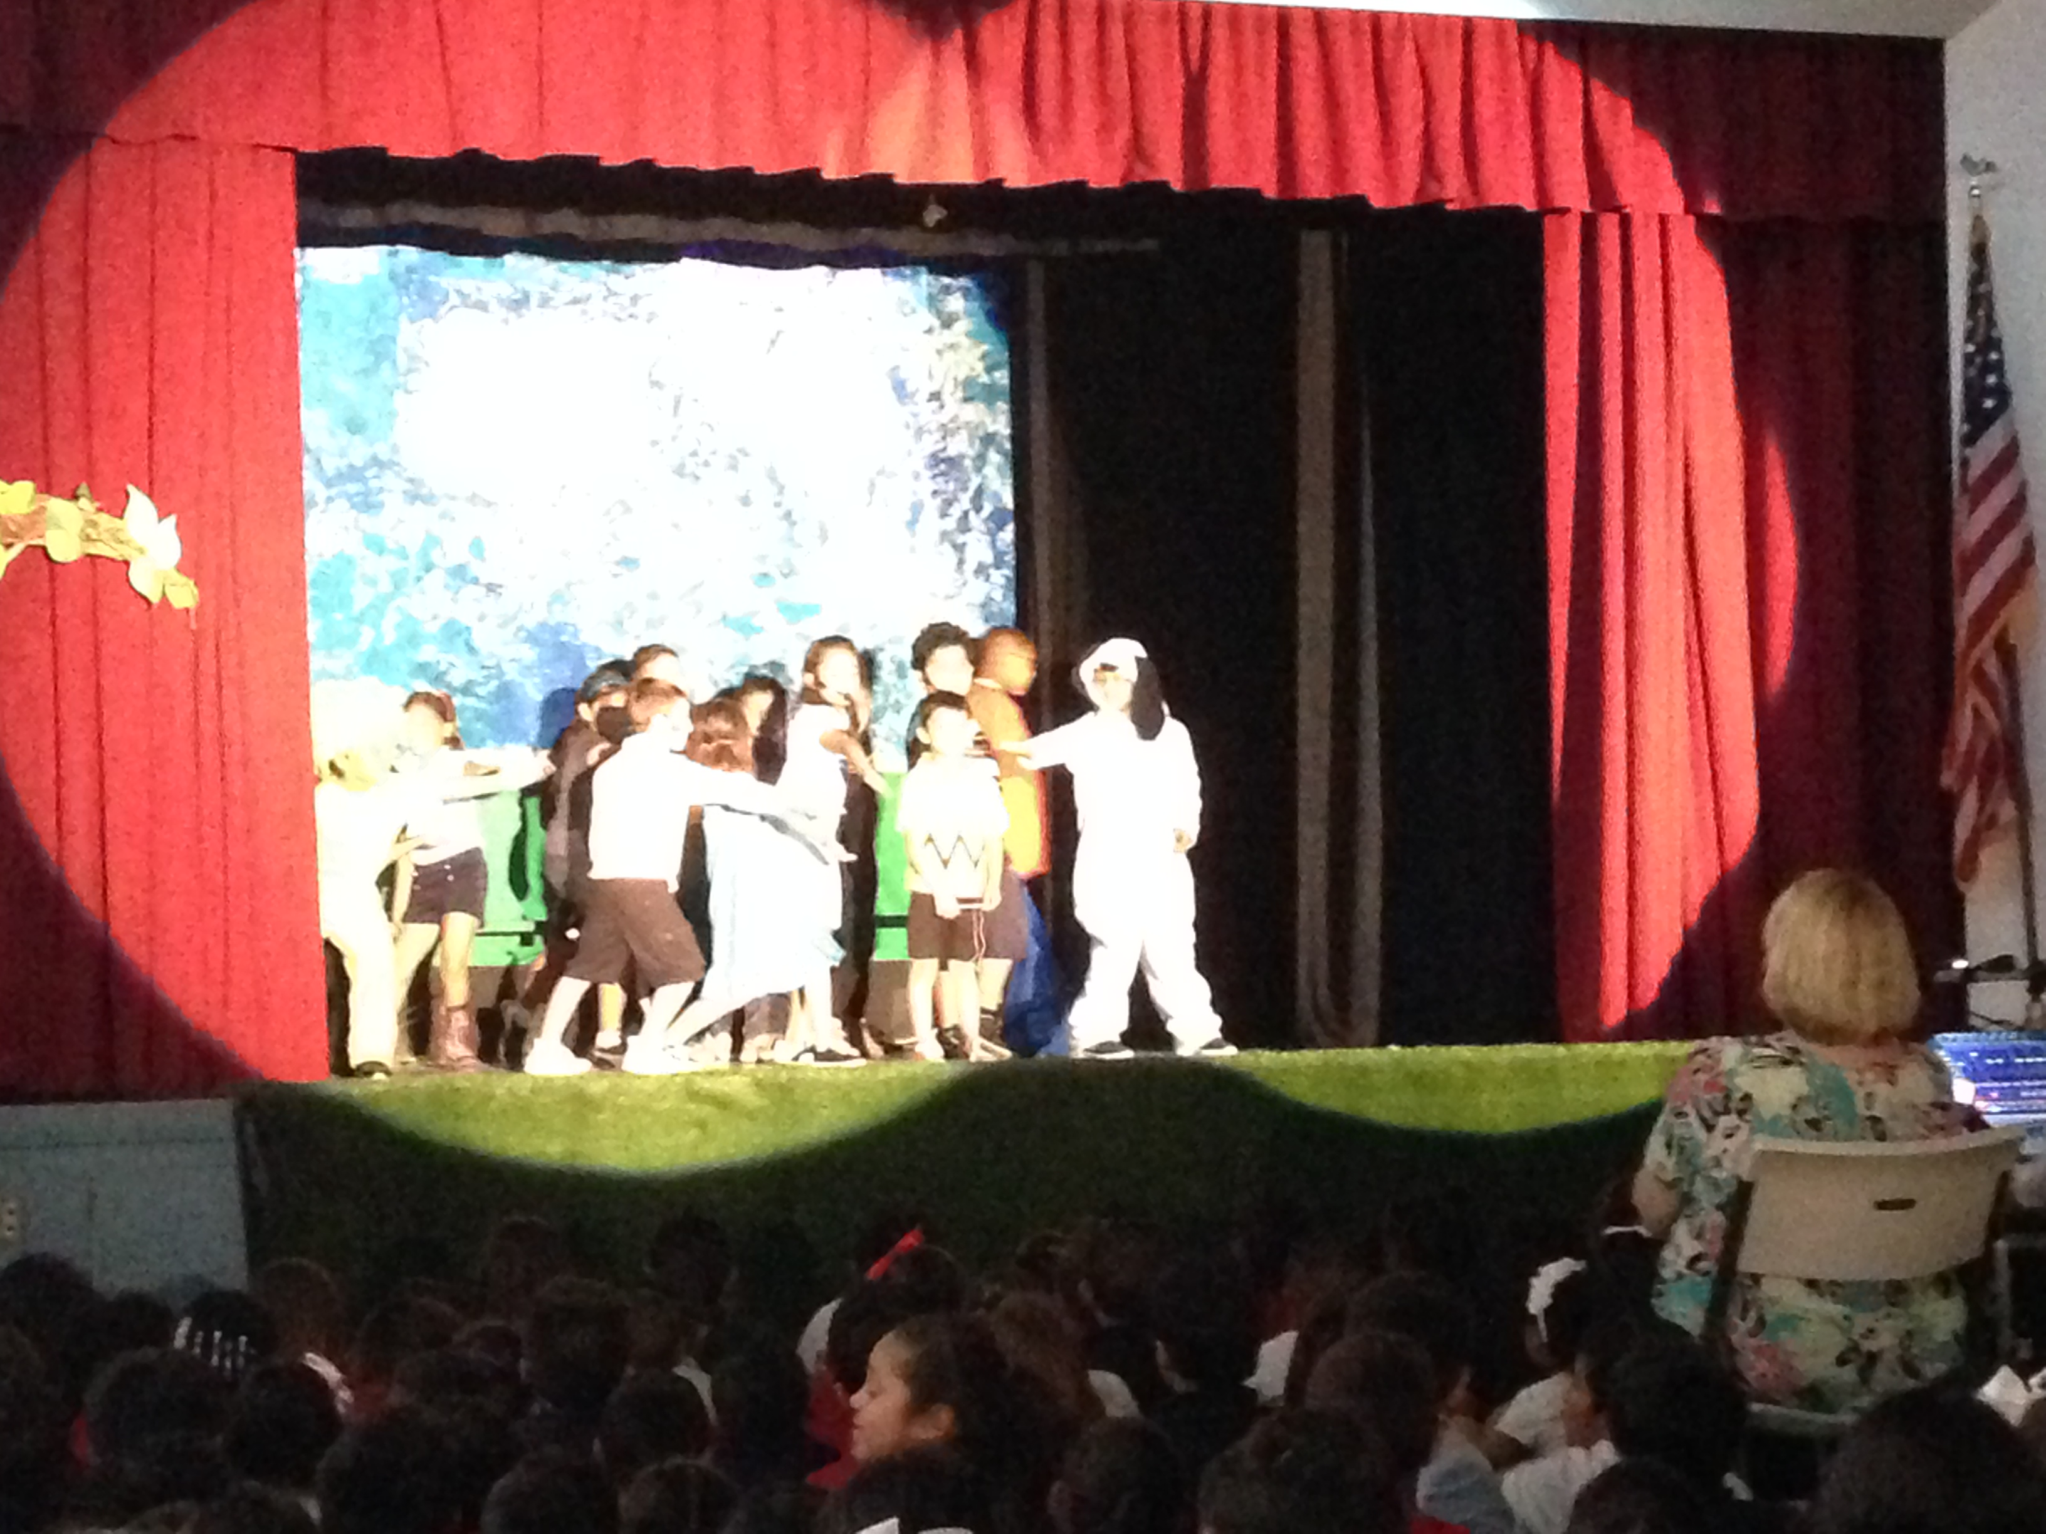

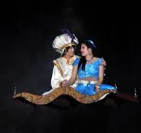
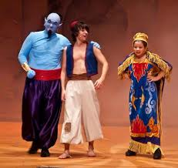
VAPA ACADEMY
Performances since inception
Theater
Arts
Lion King
Grades 4-6
Charlie Brown
Grades 2-3
Grades 4-8th

Slide 18
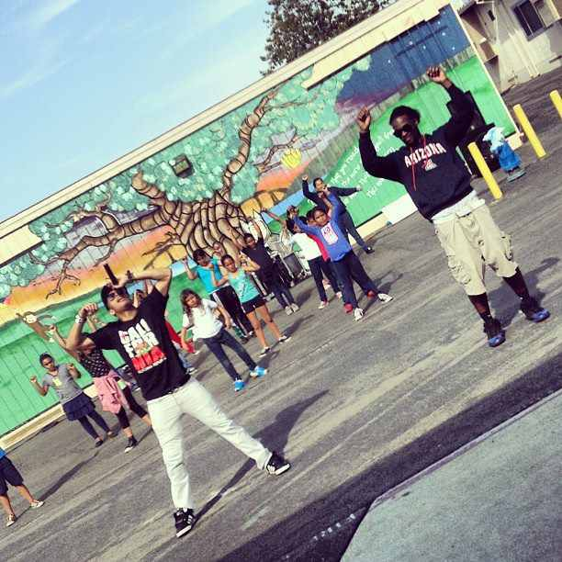
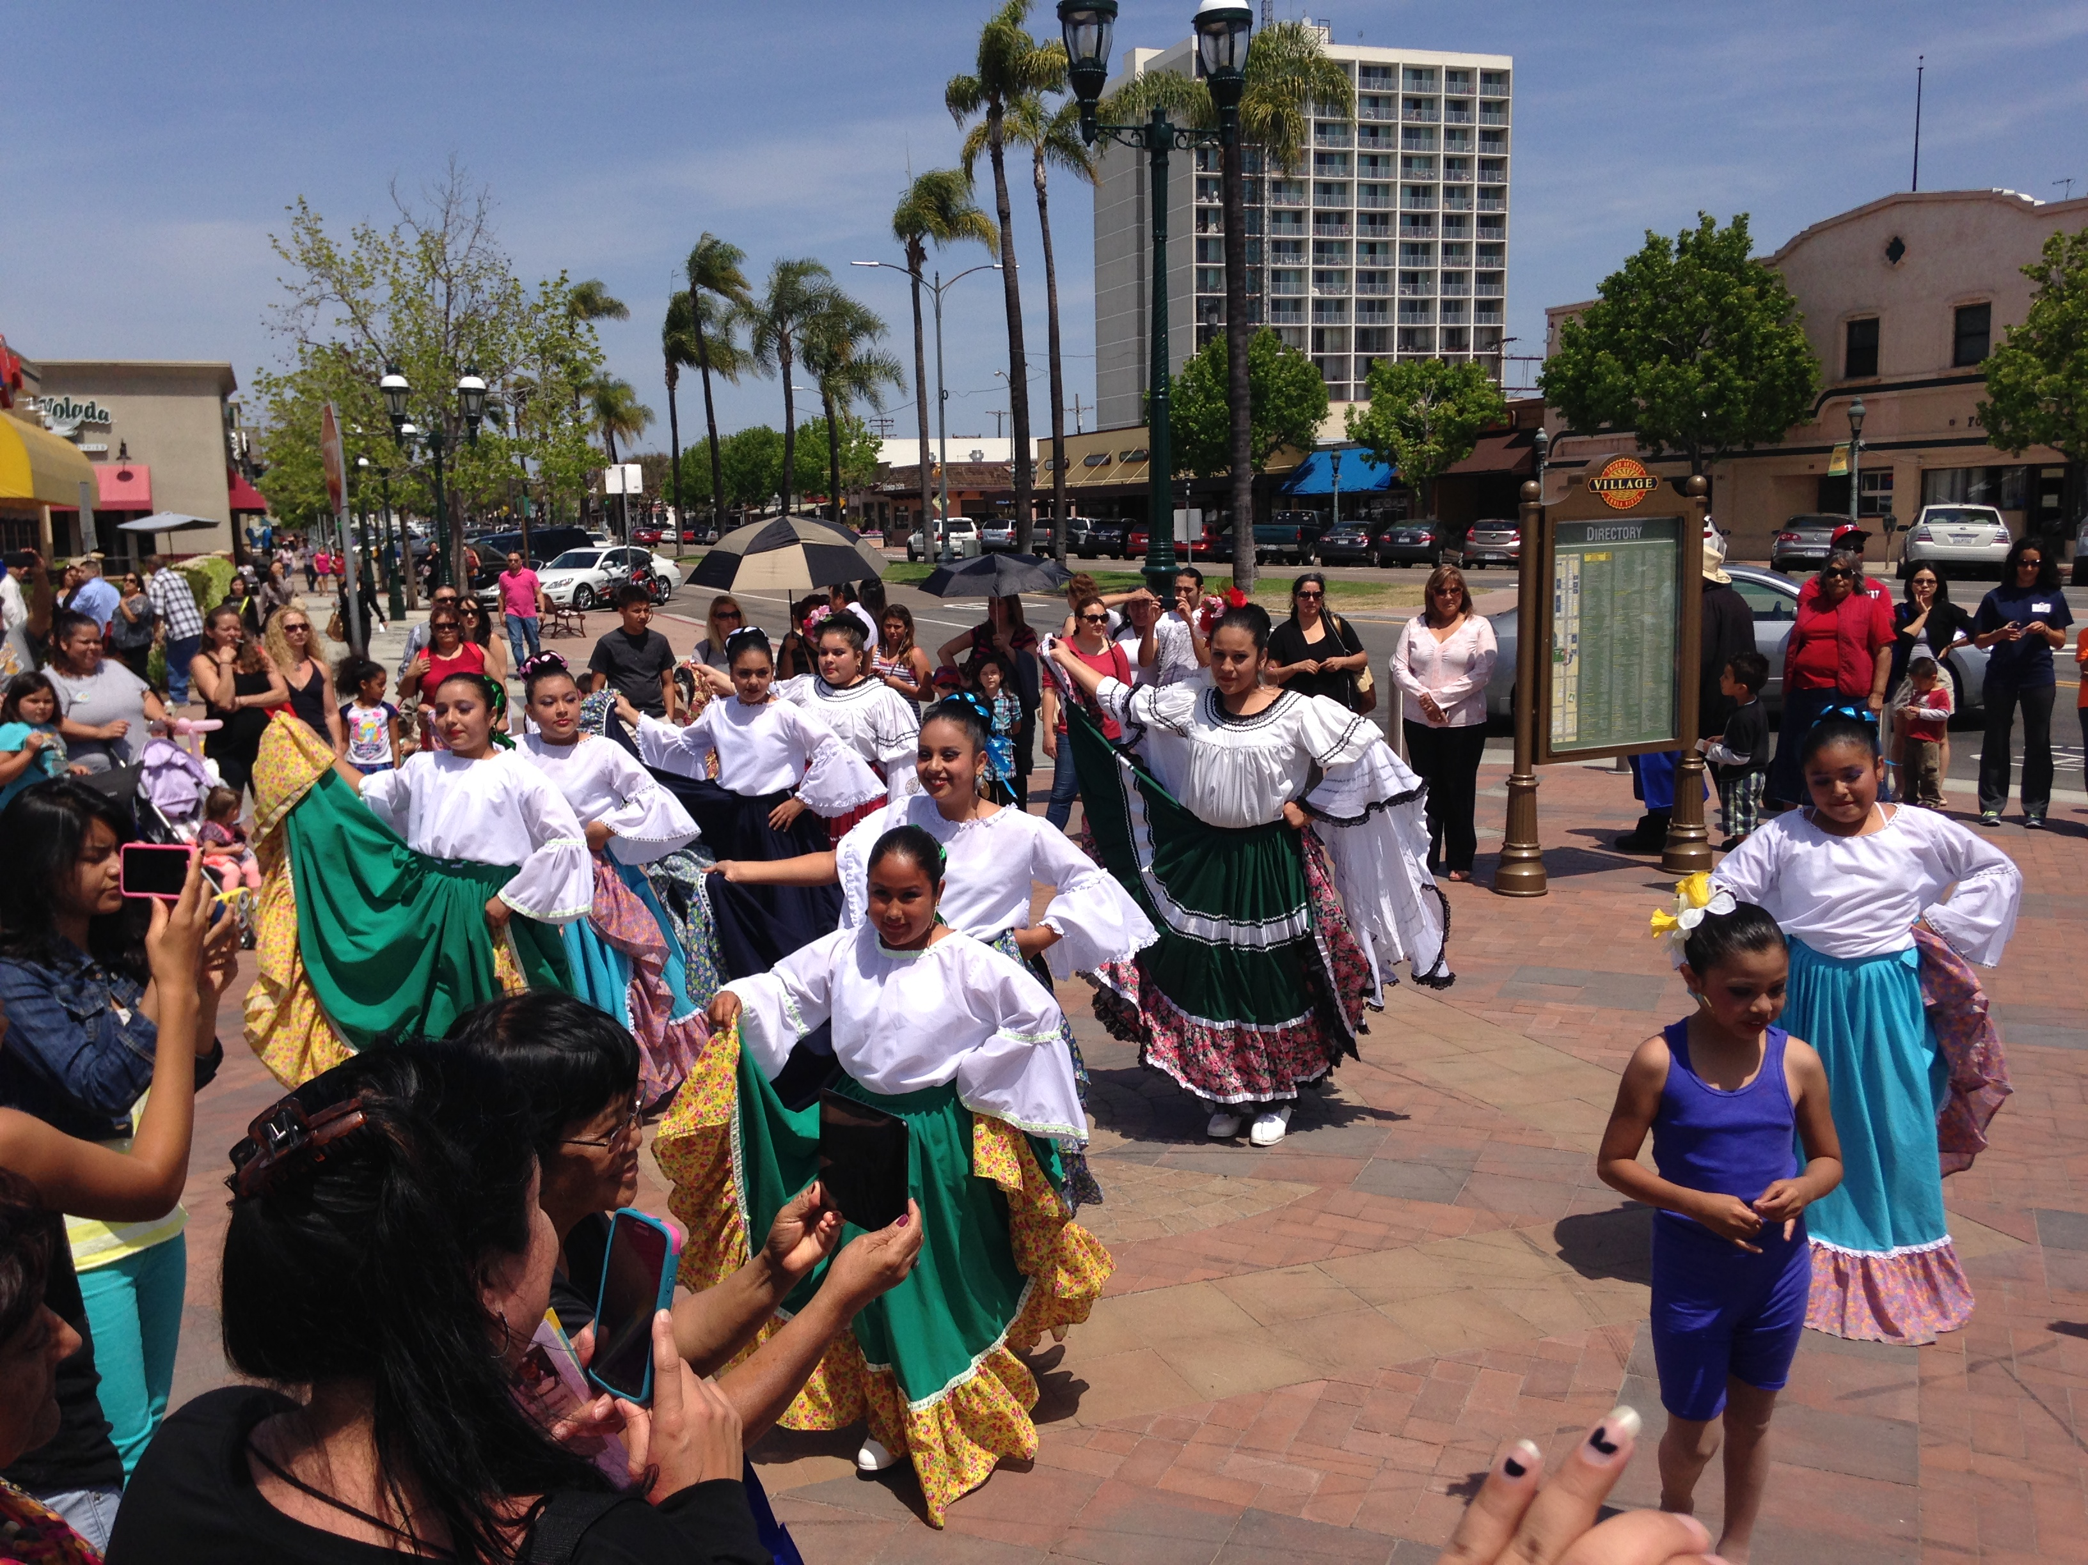
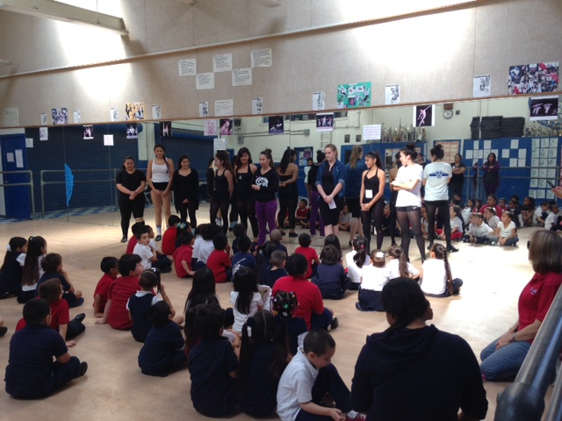
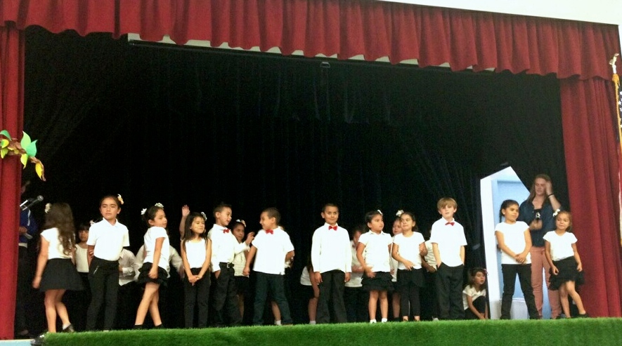
VAPA ACADEMY
Jazz Dance-
Aladdin
Folklorico
HIP HOP
Dance
KINDER
TAP

Slide 19
VAPA ACADEMY
BAND & Choir
VAPA MUSIC
Band:
Brass, Wind, & Percussion
**Collaboration with Feaster CHEER Squad and San Diego Youth Symphony
Choir
Musical Collaboration with Theater
JAZZ BAND:
Students work with Young Audiences as an ensemble
SD Opera Club- La Boheme Performance

Slide 20
VAPA ACADEMY
After School Clubs
HIP HOP
BAND
ART
CHOIR
FOLKLORICO
Jazz Band
Cheer

Slide 21
SOCIAL EMOTIONAL LEARNING
Quarterly Character Strengths:
Strengths will be taught and weaved into curriculum and all staff will recognize
Peace Path:
Students will utilize the Peace Path to solve problems in and out of all classes & recess
Classroom Community Meeting:
All classes will hold a 5-15 minute community meeting to connect and check in with students
Each quarter, 2 students from each class will be recognized at the quarterly awards assemblies

Slide 22
School focuses
STEM Integration
Arts Integration
Integration:
demands creativity, problem solving, perseverance, and collaboration from the students
Integration:
is a rare yet seemingly “magical” approach that has the capacity to turn learning into meaningful practice
Professional Development-
Provided by outside experts and from specialty teachers within to support staff created integration goals
Integration:
requires collaboration, research, intentional alignments and practical application on behalf of the teachers who take the challenge
Instructional Focuses
-Writers Workshop
-Focus Lessons (Gradual Release of Responsibility)
-Accountable Talk

Slide 23
School focuses…cont’d
ELD Support
SLD (Dual immersion.)
IMAGINE LEARNING:
**Unlimited Licenses
*For all CELDT 1, 2, 3 students, All Kinder & 1st Grade Student, Spanish Learners & Parents
GLAD:
45/50 classroom teachers trained,
3 strategies selected as non-negotiable school-wide: CCD, Pictorials, Chants
Content & Language Objectives &
Language frames are non-negotiable practices
Familiarization of all staff toward new ELD standards
”New Comer” groups for students “New to country” during school and as an after school club.

