Slide 1

School Health Advisory Committee
Montgomery County Schools

Slide 2
What is SHAC?
School Health Advisory Council is an advisory group composed of individuals selected primarily from the health and education segments of the community. The group acts collectively in providing advice to the school system on aspects of the school health programs. The members of the council are appointed by the school system to advise the school system.

Slide 3
What do SHAC’s do?
SHAC’s provide an efficient, effective structure for creating and implementing an age-appropriate, sequential health education program, and early intervention and prevention strategies that can easily be supported by families and community stakeholders. SHAC’s address all elements of the school’s health program including but not limited to: health instruction, school environment, health services, physical education, school counseling, food services, and health of staff and students.

Slide 4
SHAC Responsibilities
Program Planning
Promotion and Advocacy
Fiscal Impact
District and Stage Agency Interaction
District School Board Interaction
Evaluation, Accountability, and Quality Control
Direct Intervention

Slide 5
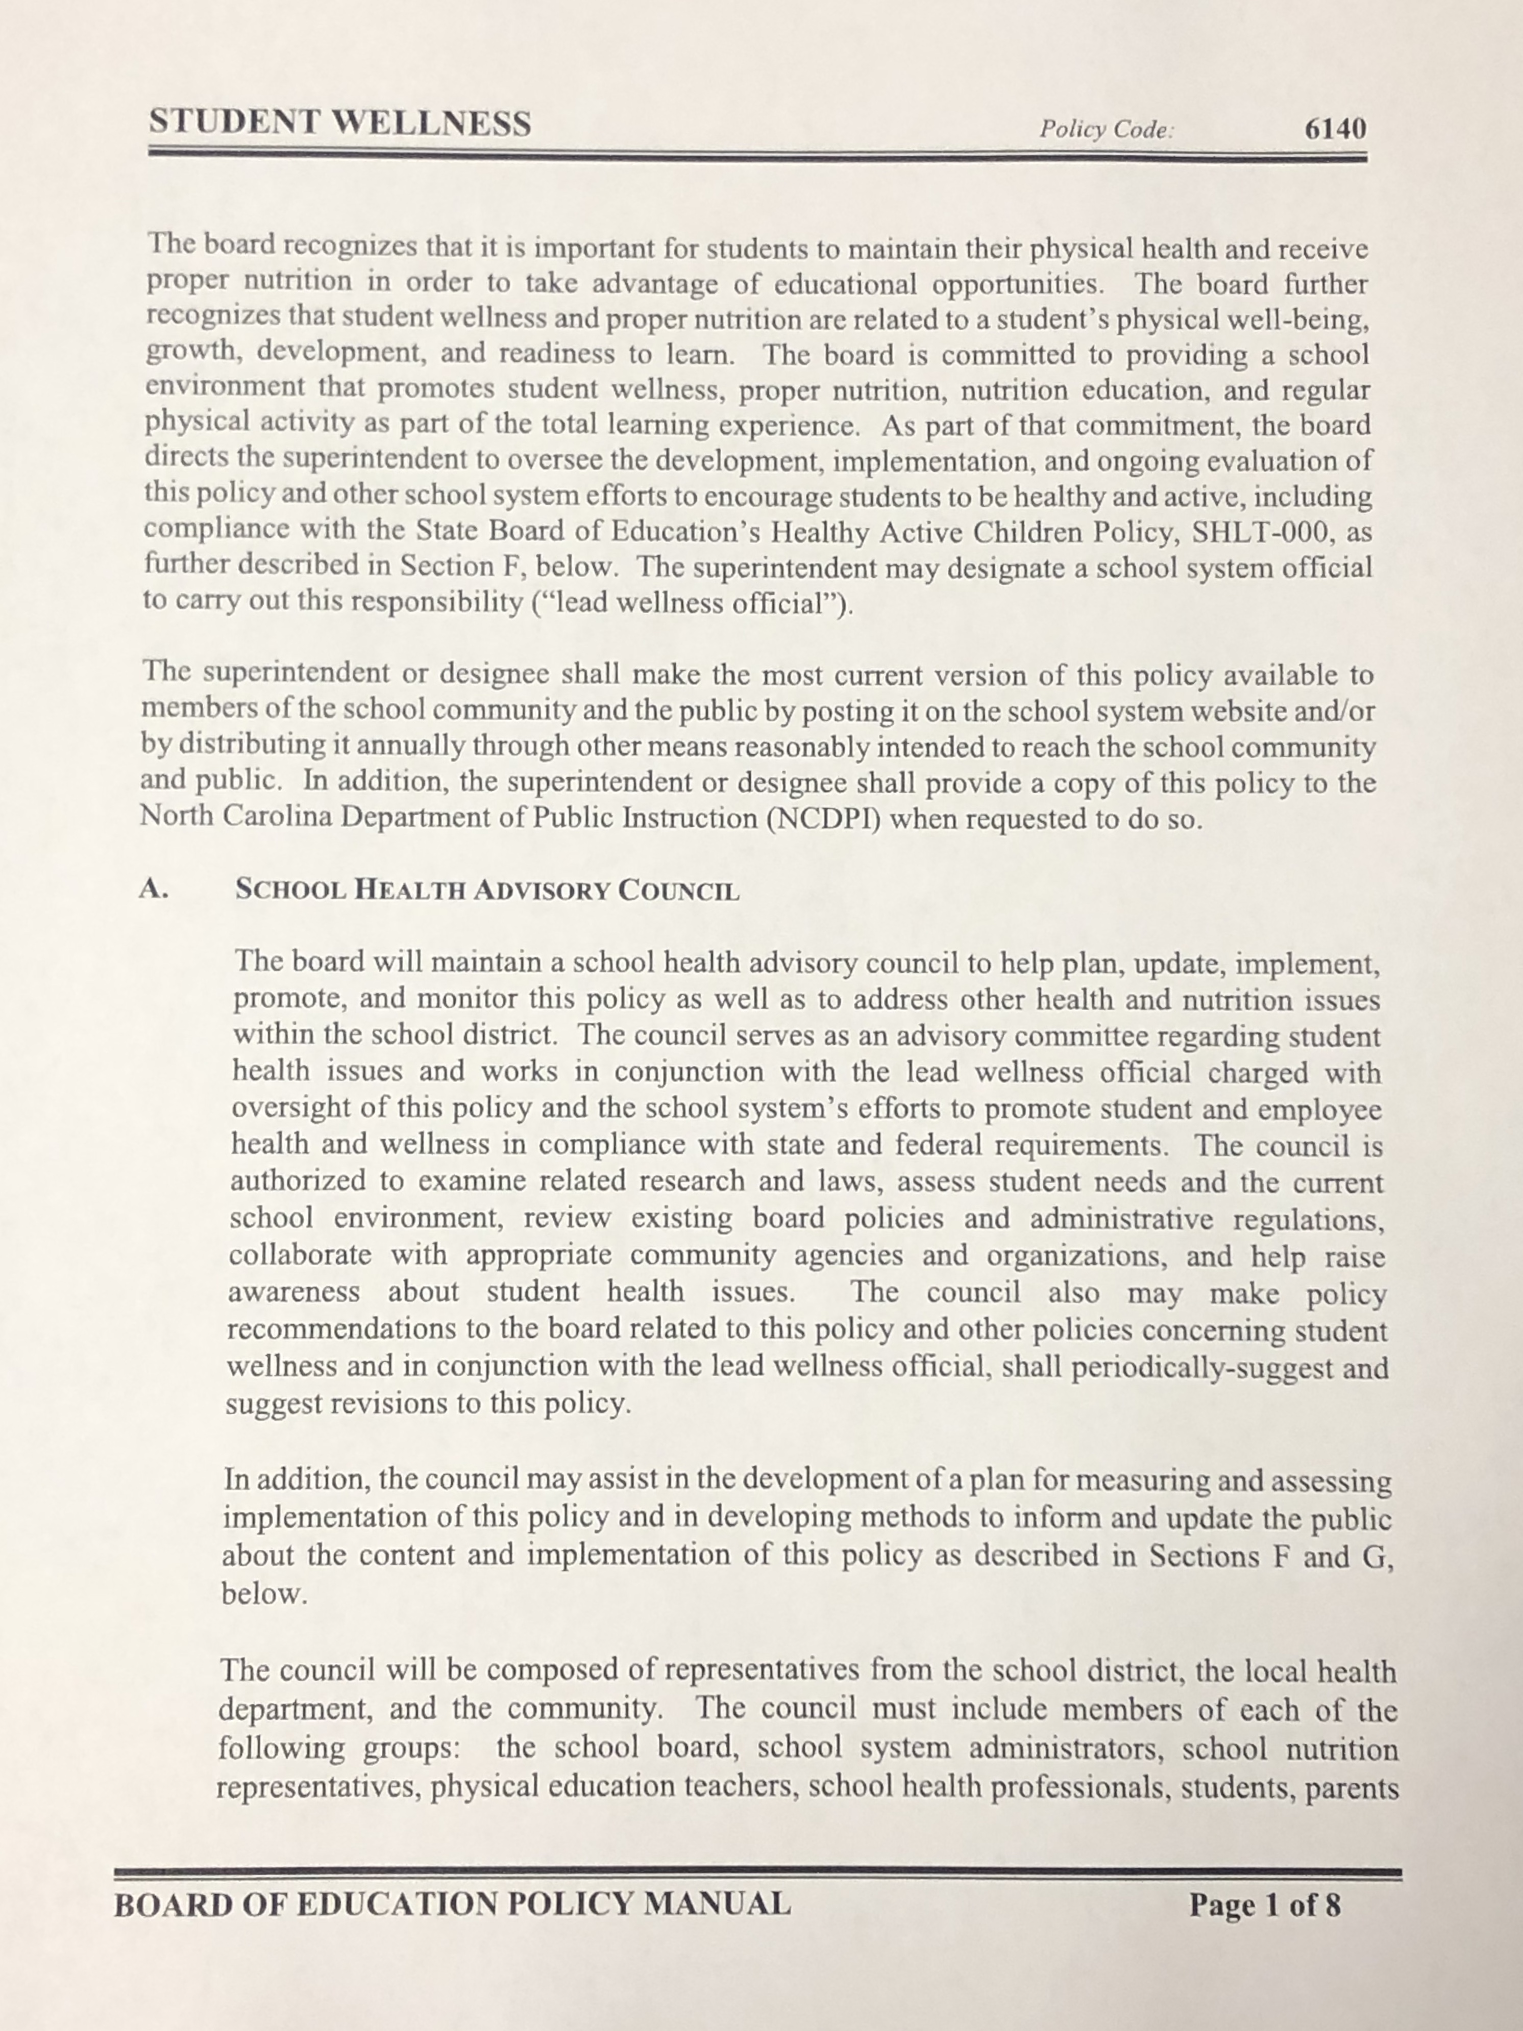
Board Policy on Student Wellness
Policy Code 6140

Slide 6
SHAC Message
Influencing students to lead healthy and productive lives is likely to be most effective when schools, the community, and parents work together. Each has unique resources, each can access students in ways the other can not, and each has different means of influencing the behaviors of young people.

Slide 7
Committee Meetings
Meetings are held on Wednesday’s at 12:00pm.
All meetings are open to the public.
Visit the Montgomery County Schools website for specific meeting dates.

Slide 8
Committee Members
MCS Staff, School based health center Staff, firsthealth, Montgomery county social services and health department, town government officials, cooperative extension service, couseling services, parents, and
mcs students

Slide 9
School Health Advisory Council
We appreciate your support.
Any Questions?

Slide 10
For more information or to join our committee:
Vance Thomas
Director of Early Childhood Education Programs
SHAC Chairperson
Montgomery County Schools

