Slide 1

Amazon Business Buyer Training

Slide 2
Table of Contents
Registration and Accessing the Amazon Business Account
Account Navigation & Shopping Experience
Placing an Order
Things to Know
Additional Resources
Notes:
Topics Discussed, Contents, Table of Contents, Areas of Focus

Slide 3



Amazon Business Benefits
There are a variety of discounts available on Amazon Business that your organization can take advantage of to unlock savings.
Business Pricing
Cheaper pricing available only for registered Amazon Business customers.
Business-Only Selection
Business-only selection refers to items and offers that are only available for purchase by Amazon Business customers.
Quantity Discounts and Limited Time Deals/Coupons
Volume-tiered discounts
Amazon Business Analytics
Use Amazon Business Analytics to view data about your orders, create and filter reports based on your business needs, and view both charts and tables. Click to learn more.

Slide 4


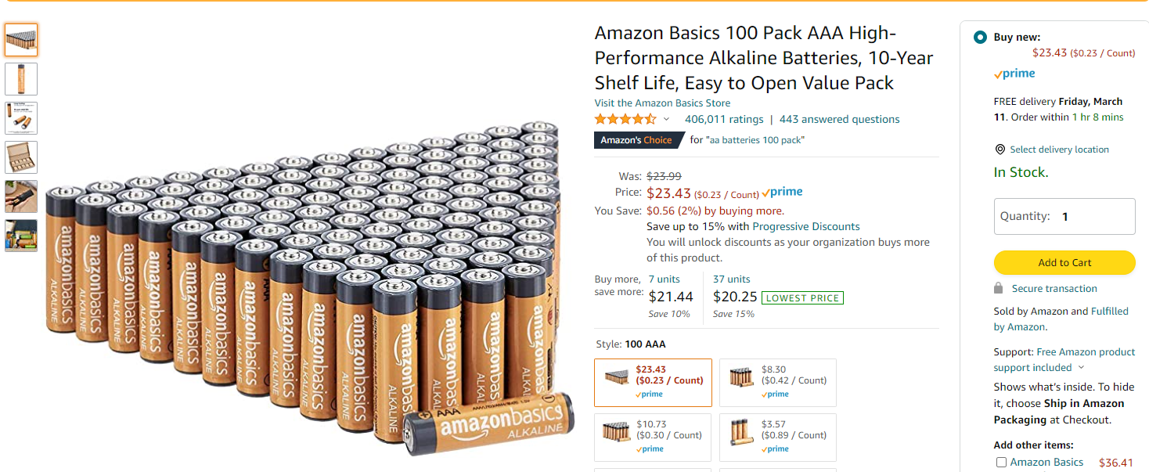

DELETE: IF BP IS NOT IN SCOPE
Take Advantage of Amazon of Business Prime Shipping
Once Business Prime Shipping has been purchased, it provides Free Two-Day Shipping on eligible items for all users in the business account. There are multiple pricing tiers to meet the needs of businesses of all sizes. Click to learn more.
Prime Eligibility – Fulfilled by Amazon
Prime eligible items are fulfilled by Amazon. We recommend searching for prime eligible items to ensure that your products arrive on time and as expected. All products clearly mark who the seller is on the product detail page.
What’s not Included?
Business Prime Shipping does not include additional Prime benefits such as Amazon Fresh, Pantry, Video, or Music.

Slide 5
Business Account Access and Navigation
Registration & Accessing the Amazon Business Account

Slide 6
Amazon Business Registration Scenarios
Depending on how you have used your work email on Amazon in the past, you will be prompted through a corresponding registration flow
Persona | Objective
New User | Has never used email domain on any Amazon account
Existing Amazon.com account used for Business Purchases | Amazon User has email linked to Amazon. Since they have only made business purchases in the past, their order history and account information (payment methods, addresses, etc.) should be converted/migrated to the centralized Business account.
Existing Amazon.com account used for Personal Purchases | Amazon User has email linked to Amazon. Since they may have made personal purchases, they would like to transfer all previous order history and account information to a personal email, and start a clear profile in the new centralized Business account.
Existing Amazon Business | Amazon Business User email is linked to a separate AB account) who needs to either 1) merge the current account into the central Business account from an email invitation or 2) deregister the account (convert to a .com account) before joining the central account.

Slide 7
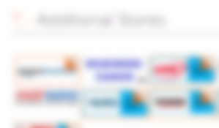
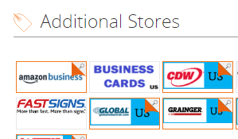
Accessing Amazon Business
Accessing the Amazon Business account is simple when Amazon is integrated with your organization
How do you sign in?
[For SSO] All registration flows when you click the link provided to access the centralized Amazon Business account. This will automatically log you into the appropriate account.
For those who have not used their work email in the past, they will be immediately authenticated into the central account.
For those who do need to take action to separate out their existing account, this is a one time process that they will be guided through. They will be authenticated automatically each subsequent time.
Link to Join through:
<inert link>
or Screenshot

Slide 8
Account Navigation

Slide 9


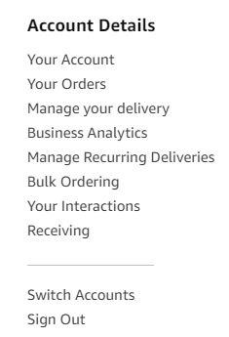
Account Navigation
Hover over your name in the top right hand corner to access additional tools in your account
Page | Functionality
Your Account | Standard Amazon account information including name, email address & password
Your Orders | View and track your orders. Administrations can view orders others have placed on behalf of the organization
Bulk Ordering | Create a new bulk order, continue saved bulk orders, or track your requests for quotes and quantity discounts
Business Analytics | Create and filter custom reports based on your business needs to view your organization’s orders
Switch Accounts | Allows you to easily toggle between your different Amazon accounts

Slide 10
Start Your Shopping Experience
DO & DELETE: COVER BP LOGO IF NOT A BP MEMBER
Utilize the Search bar, your Lists, or Your Catalog to search for specific items
Click here to shop by department and/or category
Click here to create and manage lists. You can also
access lists shared with you.
Access your Shopping Cart Here
LINKS TO EXPLORE:
Workplace Essentials: 4+ star rated work supplies, including top searched and purchased
PPE Workplace Essentials
Featured programs and storefronts
Best Sellers: Shop best-selling items across all departments, updated hourly
Today’s Deals: Discover all current deals, including coupons
Wholesale: Save by purchasing items in bulk, case packs, and large packs
Private Brands: Discover Amazon Business brands, including Amazon Commercial, Amazon Basics and more

Slide 11
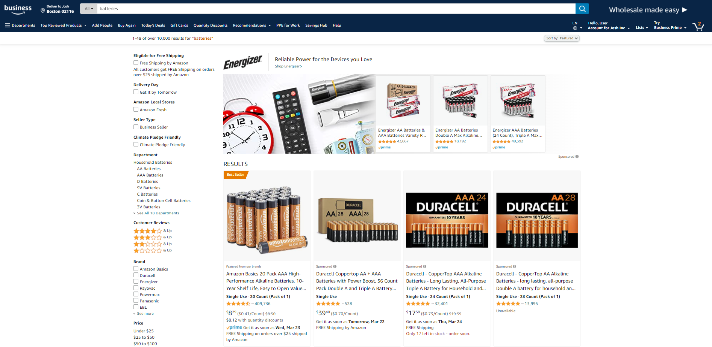
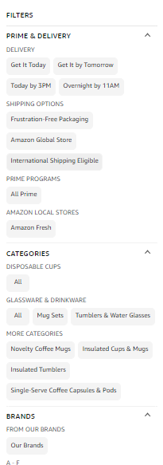


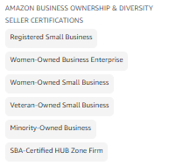
Traditional Marketplace Search
Search for and filter results to identify items you are looking for.
Enter item or key word(s) in the search bar. Search All Departments & try using generic descriptors instead of brand names
Consider refining search results with filters available of left side of your screen, such as Prime or Business Seller or Climate Pledge Friendly
Sort results by options listed on the top left of your screen, such as Price: Low to High

Slide 12
Placing an Order

Slide 13
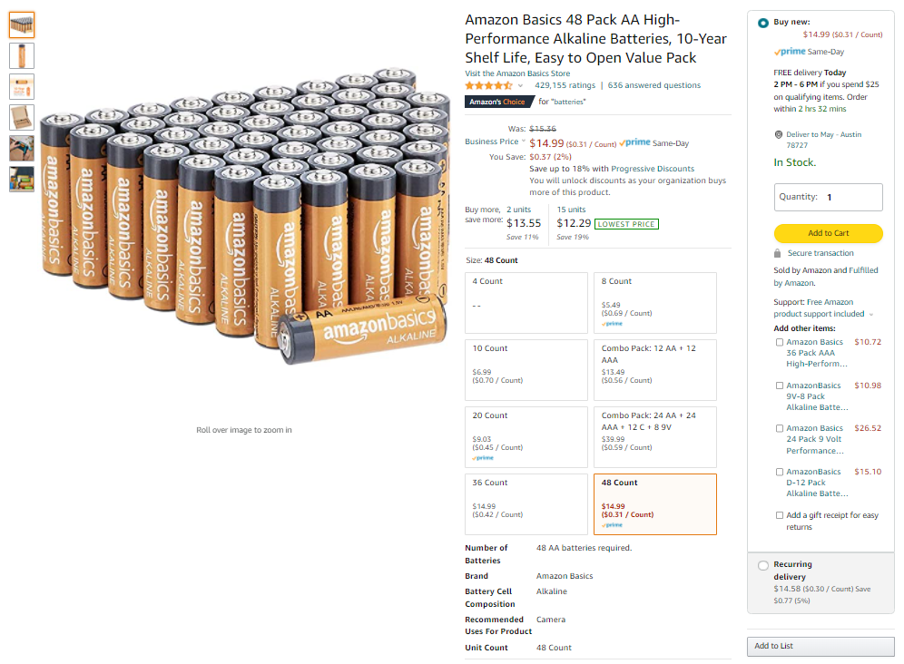

Adding Items to Your Shopping Cart
Product considerations
Prime eligibility
Expected delivery time
Quantity
Seller and fulfillment

Slide 14
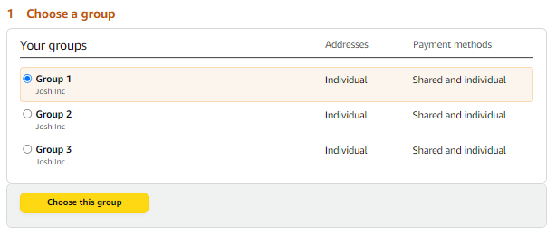
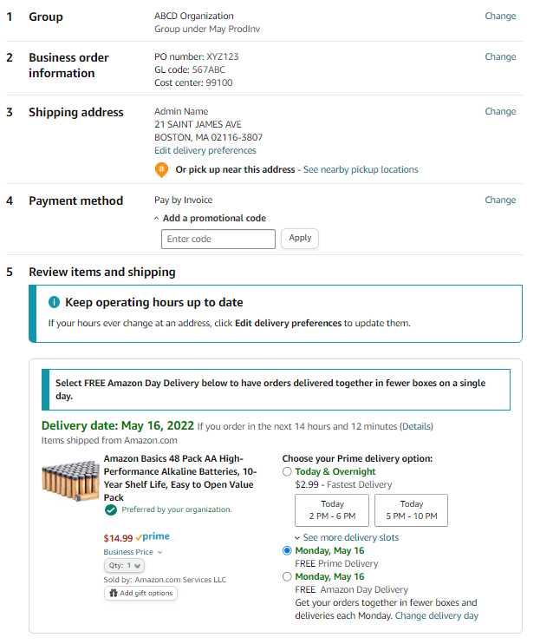
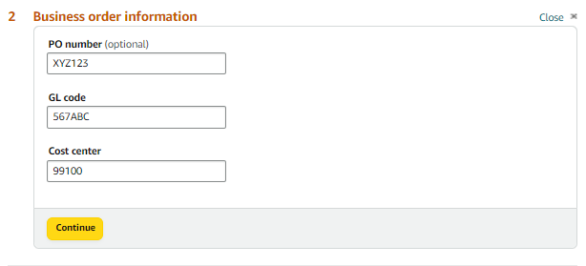
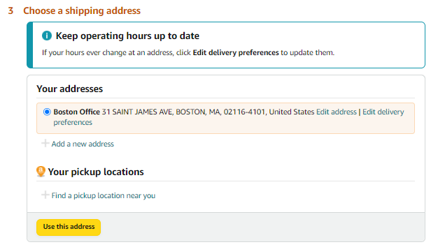

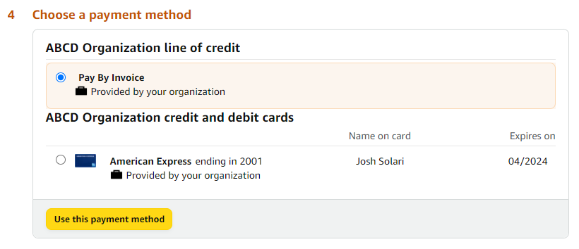
Checkout
Select group for which you are purchasing
Enter Business Order Information
Select Shipping Address
Select Payment Method
Review items and Select Shipping Speed and Place your order

Slide 15
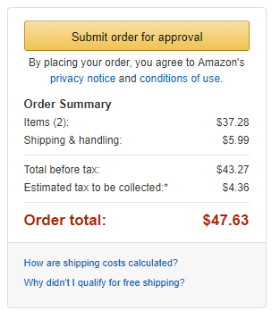
Checkout – Approvals
Some orders or all orders placed on the account may be subject to approval before being fulfilled
How do I order with Approvals configured?
Depending on your role, some or all of your orders may require approval.
There are no additional steps to take to submit your order for approval. Check out as you normally would and you will see the option at checkout.
Your order will not be processed until it is approved by the appropriate approver. Keep this in mind for shipping timelines.
You will be notified over email once your order is submitted and then again once your order has been approved and processed. Just as with a normal order on Amazon, you will also receive relevant shipping updates.
If your order is not approved within 7 days, the order will automatically be canceled; however, the items in your order will not be deleted. If your order is canceled, you will need to submit the order again for approval.

Slide 16
Things to Know

Slide 17
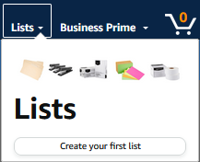
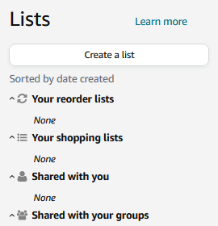
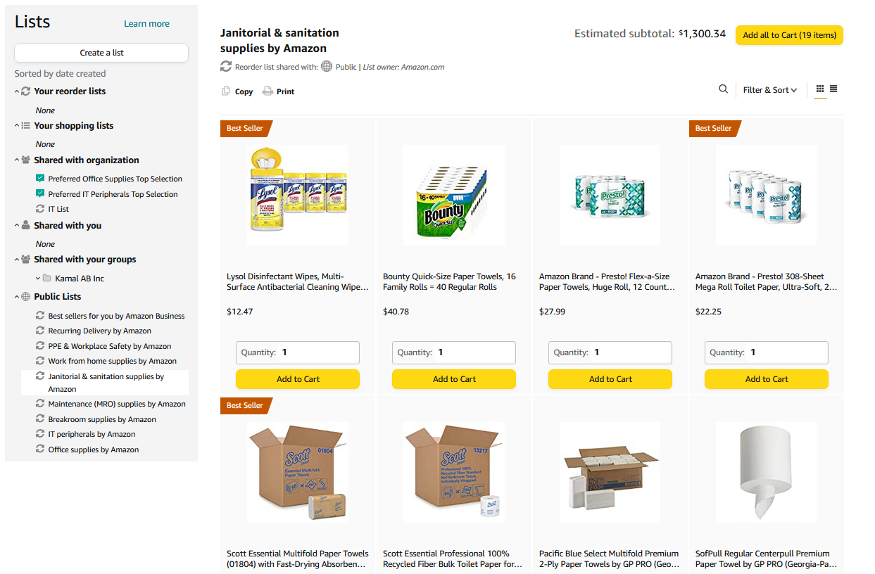
Reorder & Shopping Lists
How do Lists work on Amazon Business?
Lists make it easy to keep track of the things you need, and are easy to share with others. Choose between multiple list types depending on whether or not you want the items to remain on a list after they are ordered.
Create a List - Any User on Amazon Business can create a shopping list
Share a List - Create a public list and share with your desired audience
Review a Shared Shopping List - When a list is shared with you, you can save it to your own account or make a copy to edit yourself

Slide 18
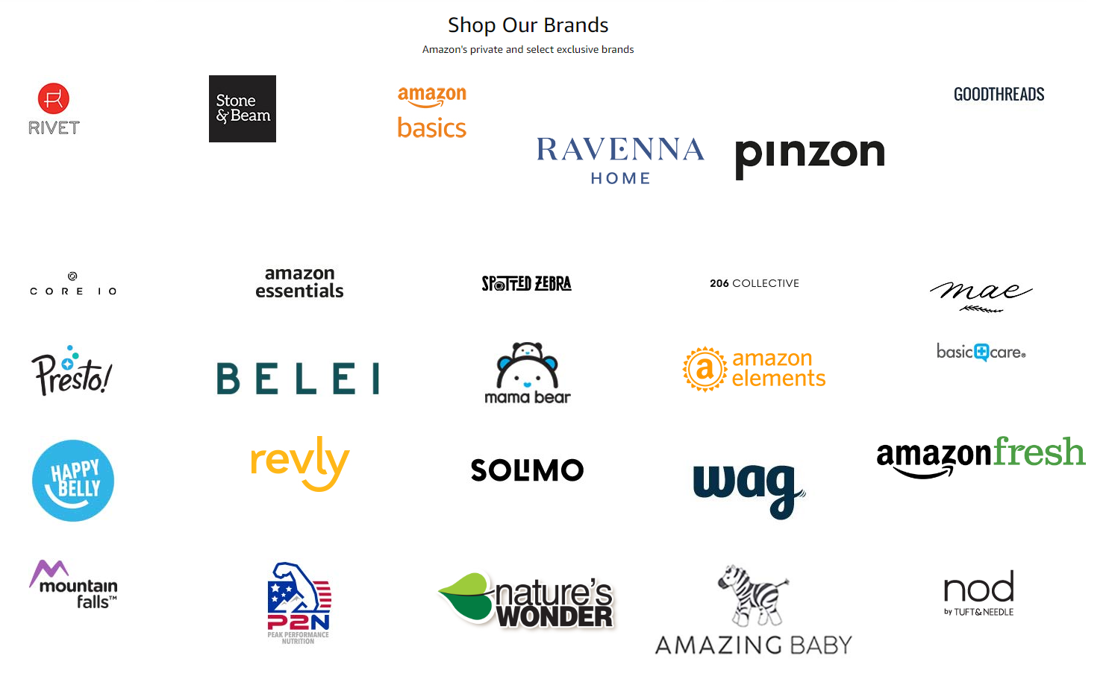

Amazon’s Private Brands
Private Brands
High-quality and durable products, Average Rating 4.2+ stars
Over 48,000 products in 352 categories and growing
Cost-effective options, including quantity discounts and lower-priced alternatives to national brands
Quantities needed to get the job done, including large pack sizes and case packs
End-to-end purchasing solutions for work, from everyday essentials to professional-grade selection
Learn more in this video

Slide 19
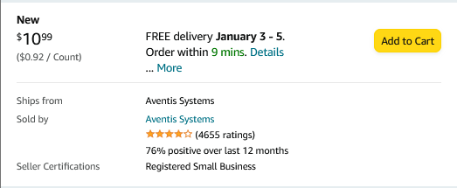
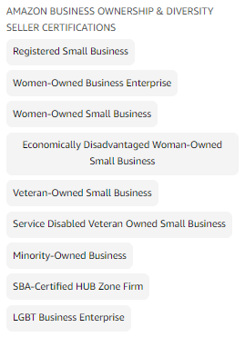


Socially Responsible Storefronts
Socially Responsible Purchasing
Climate Pledge Friendly
Women-Owned Businesses
Black-Owned Businesses
Veteran-Owned Businesses
Small & Local Businesses

Slide 20
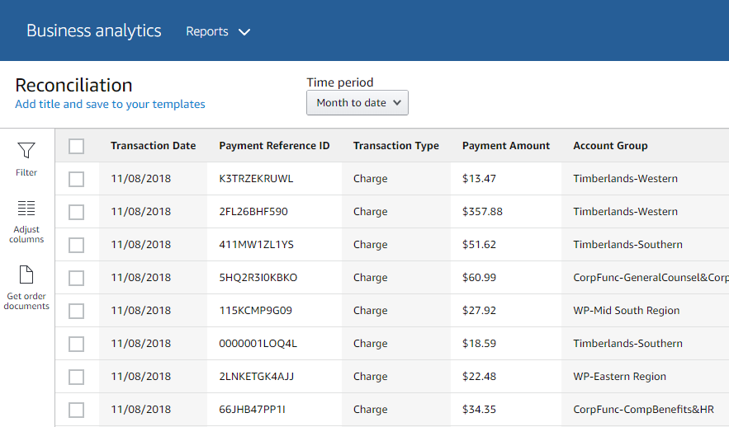
Reporting & Reconciliation
Use the Reconciliation Report to view data including transaction info, customer info, and order info.
Simplify the reconciliation process by matching corporate credit card charges to each item in a shipment.
Match the Payment Reference ID in the Reconciliation Report against your credit card statement
Customize report columns and filters at the left to find required information

Slide 21
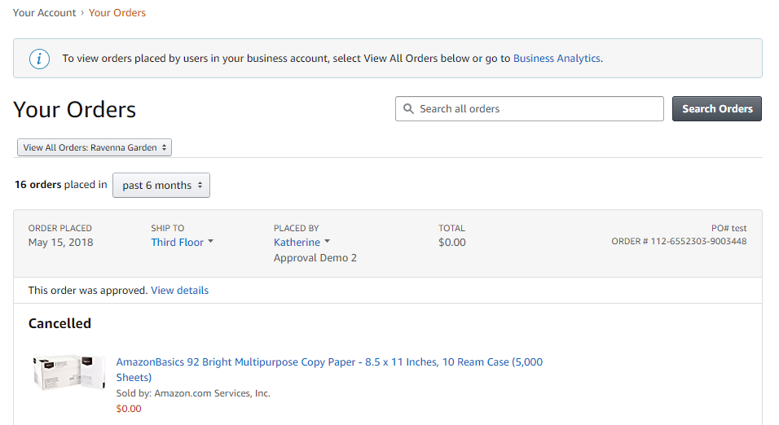
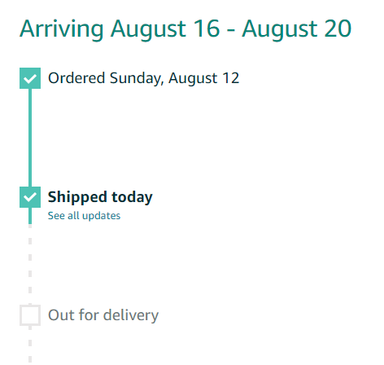
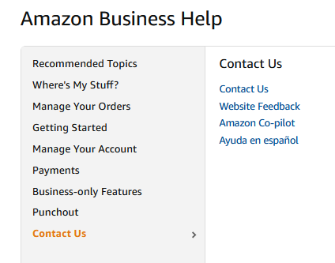
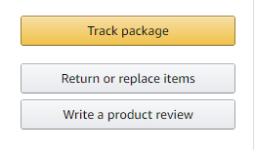
Your Orders
This section of the account provides additional detail regarding the status of all orders you have placed within the Business Account.
Take a variety of actions on Your Orders:
Track Packages
Initiate a Return
Use Contact Us or our Chat feature for assistance with Returns

Slide 22
Additional Resources

Slide 23
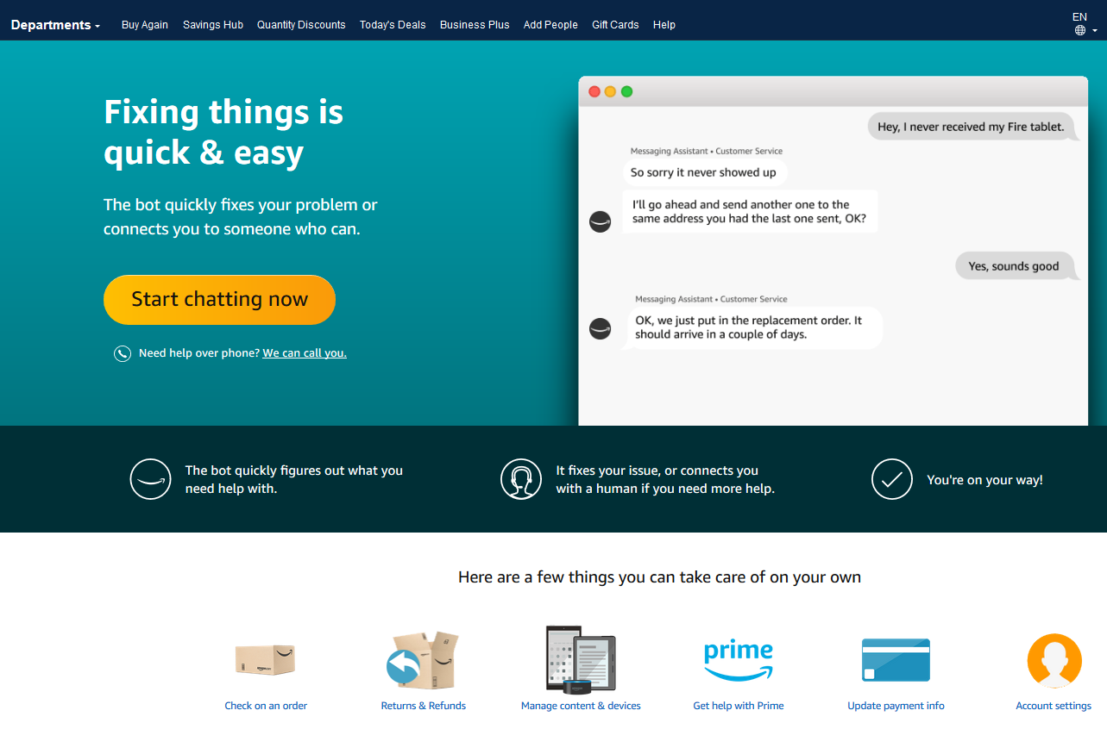
Amazon Business Customer Support
Dedicated U.S. based Business Customer Support can be reached a number of ways including email, chat and phone. Not sure what you’re looking for? Learn more about the features and benefits on Amazon Business HERE.

Slide 24

Common Amazon Business Support Questions
Quick resolutions to frequently asked questions and contact information for a variety of support resources
Contact Business Customer Support: CLICK HERE
  Provides end users the option to call, email, or live chat. Please use this method of contact for anything relating to an order, transaction, charge, or shipment
Cancel an Individual Prime Membership:
  Your Account > Manage My Prime Membership > End Membership
  The end user must follow the steps to receive a pro-rated refund
Request a Tax Exemption Refund:
  Your Orders > Locate Order > Contact Seller > Request refund through email
  Additional tax queries can be emailed to tax-exempt@amazon.com

Slide 25
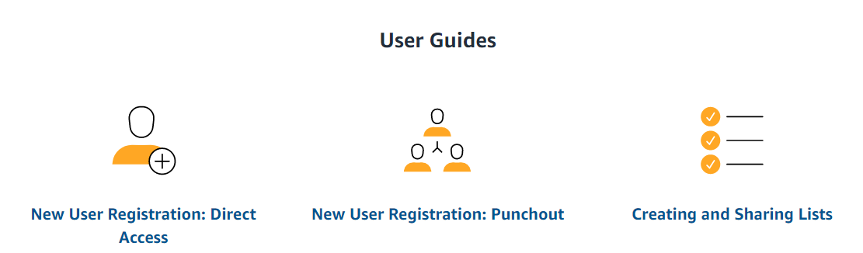
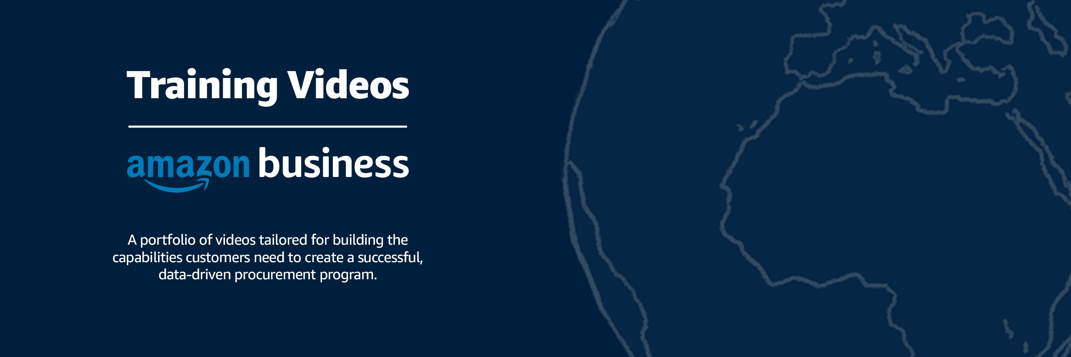
How To Guides and Helpful Videos
Self Service Resources
Training Videos

Slide 26
Thank You

