Slide 1



Jamestown Public Schools
DISTRICT-WIDE SURVEY
PUBLIC MEETING – MAY 12TH

Slide 2
AGENDA
Introductions
Process to Date
Survey
Questions
Notes:
Josh

Slide 3
INTRODUCTIONS
Rob Lech: District Superintendent
School Board Member:
ICON Architectural Group: Kyle Kvamme and Travis Jordan
Notes:
Josh

Slide 4
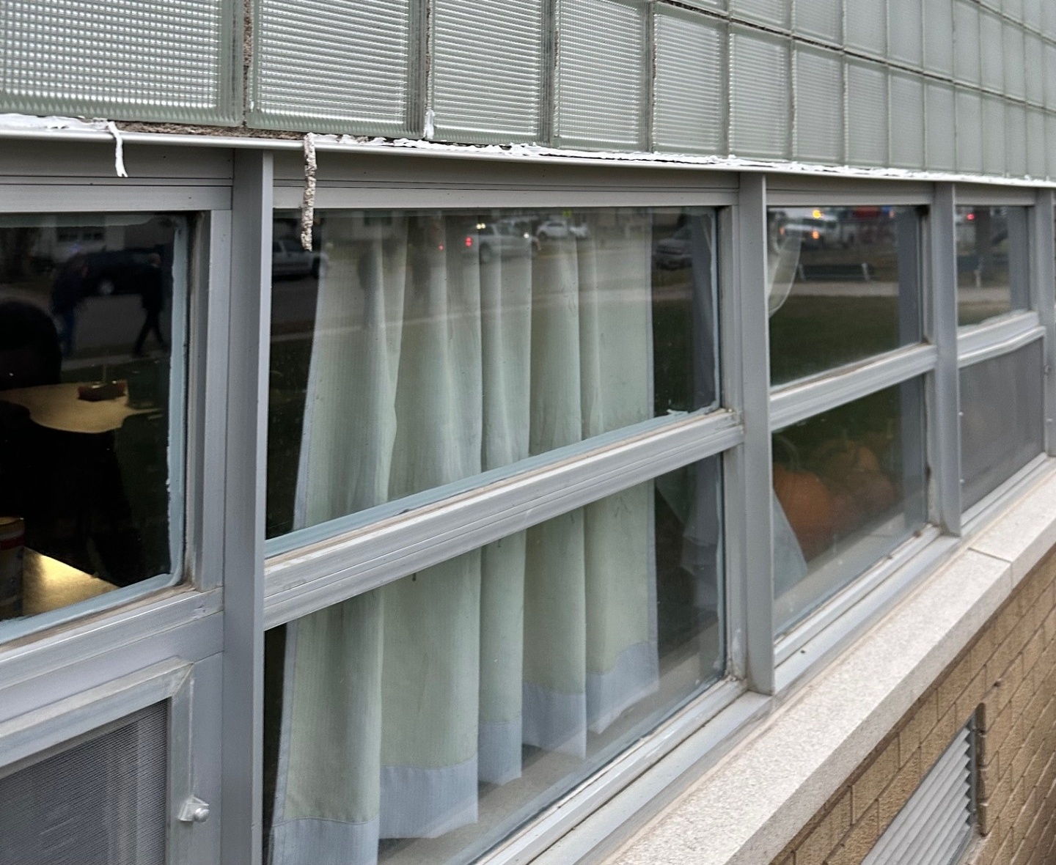
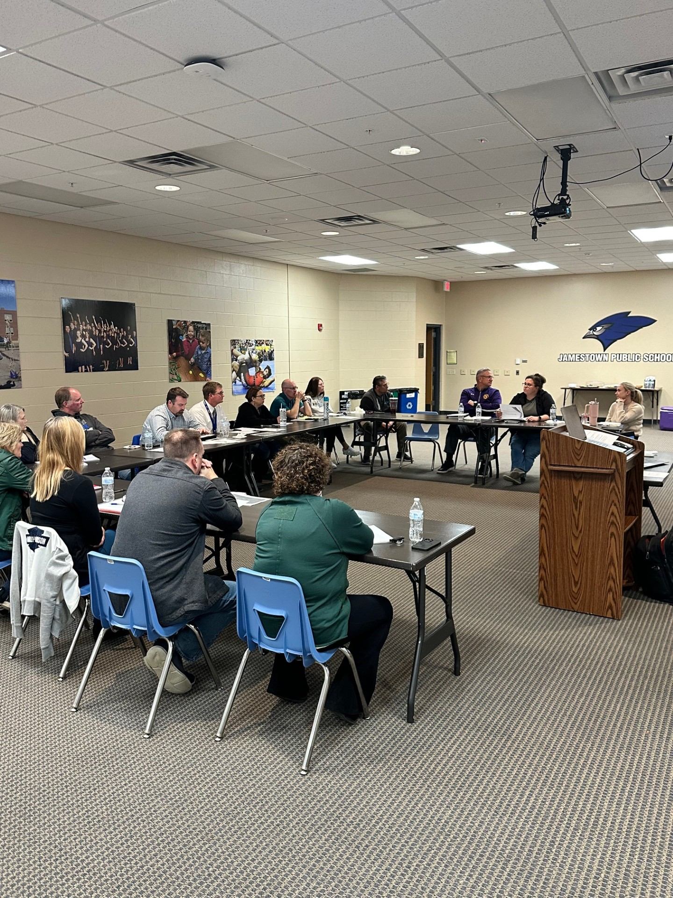
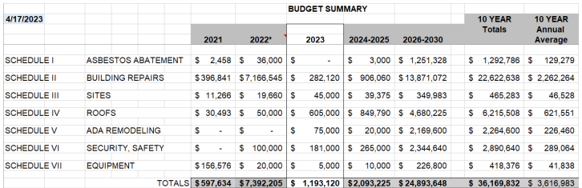
PROCESS TO DATE
Enrollment and Community Task Force meetings between November 2022 and May 2023.
10 Year Facility and Enrollment Analysis
Hired ICON Architectural Group
2nd Community Task Force Formed
Bringing Solutions to the Public via Survey to Determine Next Steps

Slide 5

THE SURVEY
Notes:
Josh

Slide 6
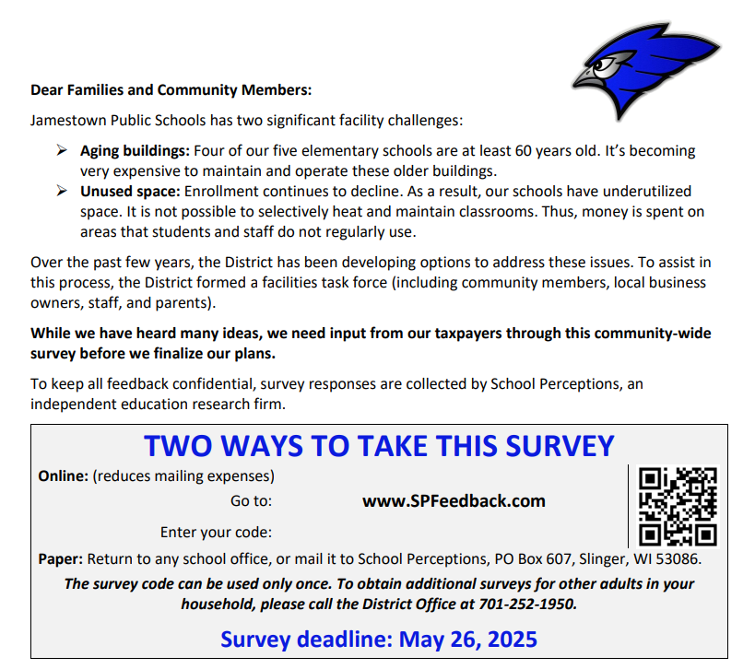
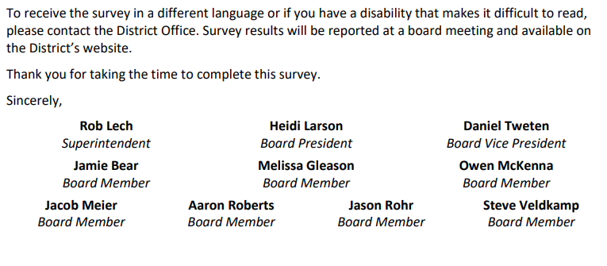

Slide 7
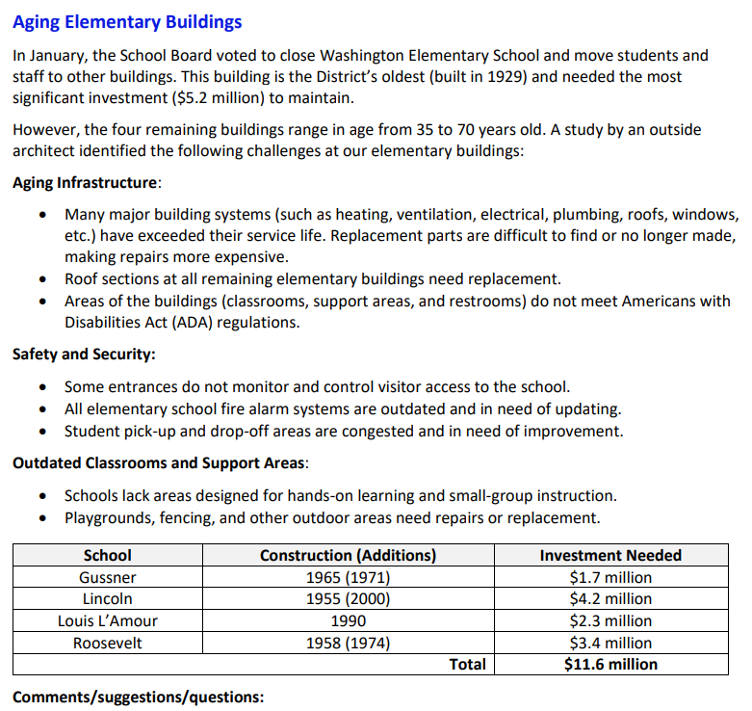

Slide 8
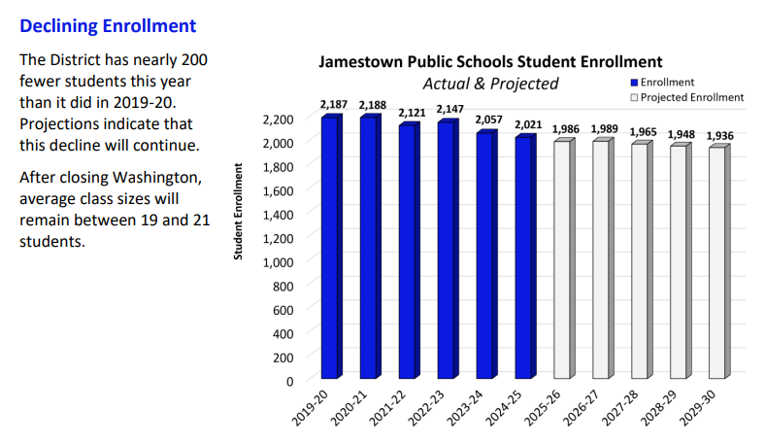

Slide 9
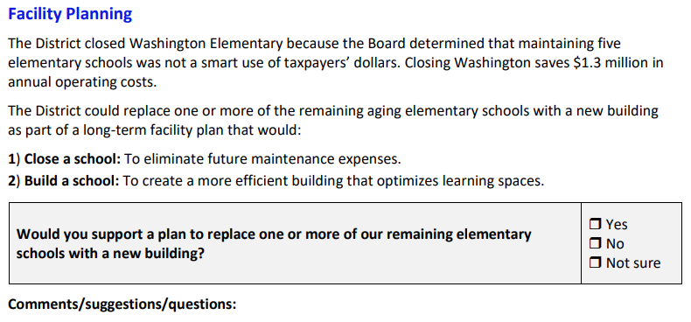

Slide 10
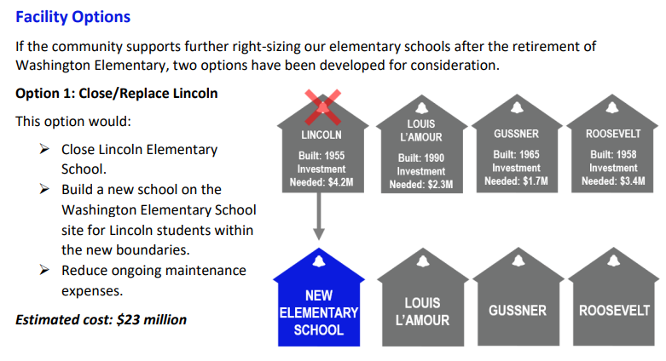

Slide 11
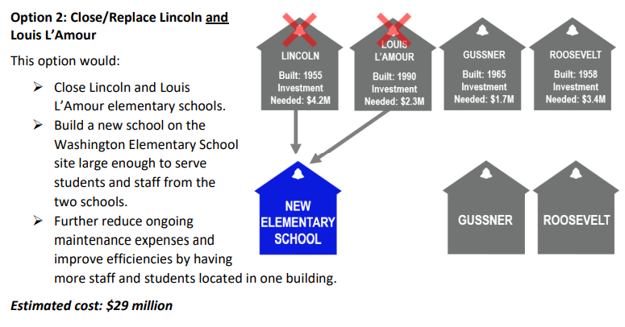

Slide 12
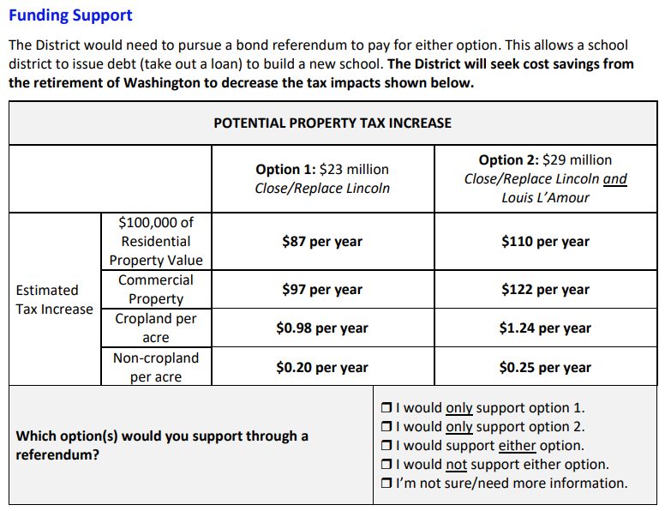
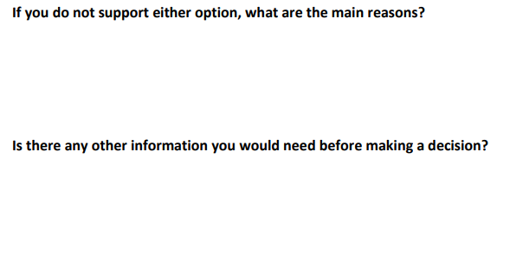

Slide 13
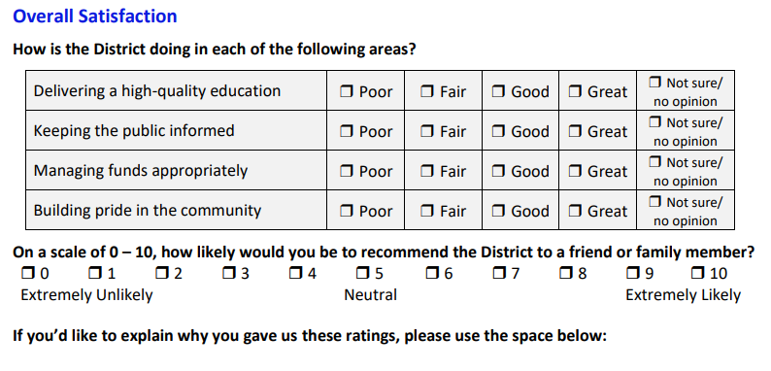

Slide 14
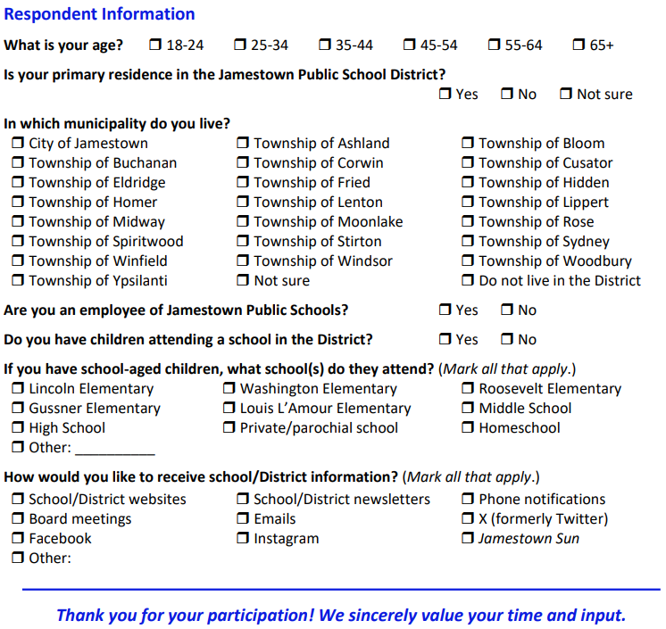

Slide 15


Slide 16
Jamestown Public Schools
THANK YOU FOR LISTENING.

Slide 17
QUESTIONS & NEXT STEPS
Bullet 01
Bullet 02
Bullet 03
PHOTO HERE
Notes:
Kyle

Slide 18
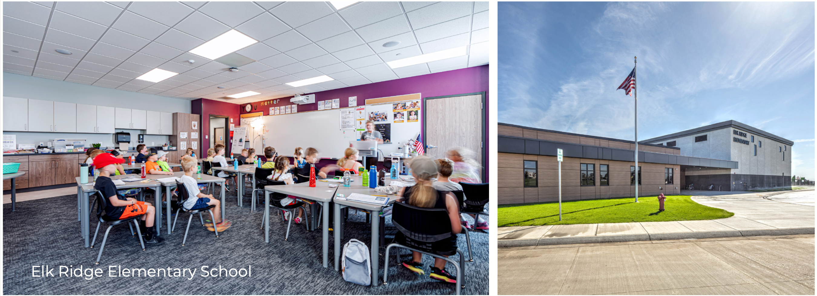
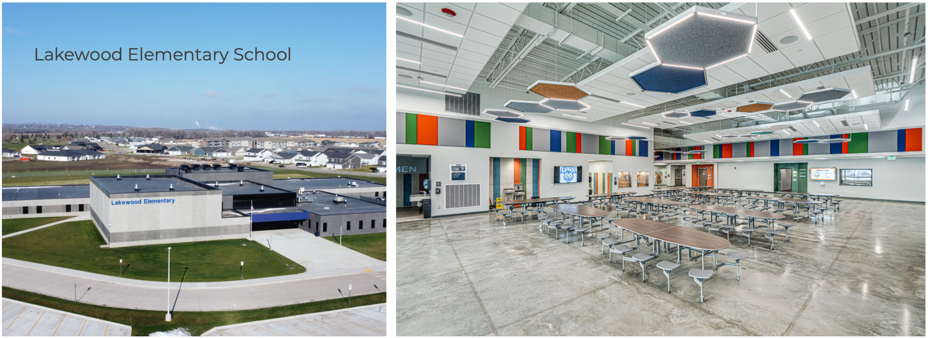
MODERN EDUCATIONAL SPACES
School Safety and Security
ADA Accessibility
Modern Classrooms
21st Century Learning Spaces

