Slide 1
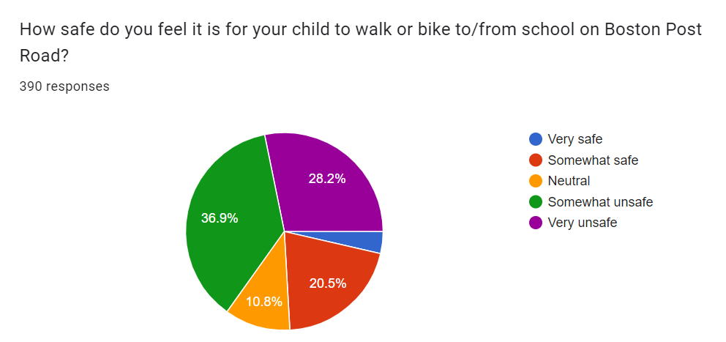
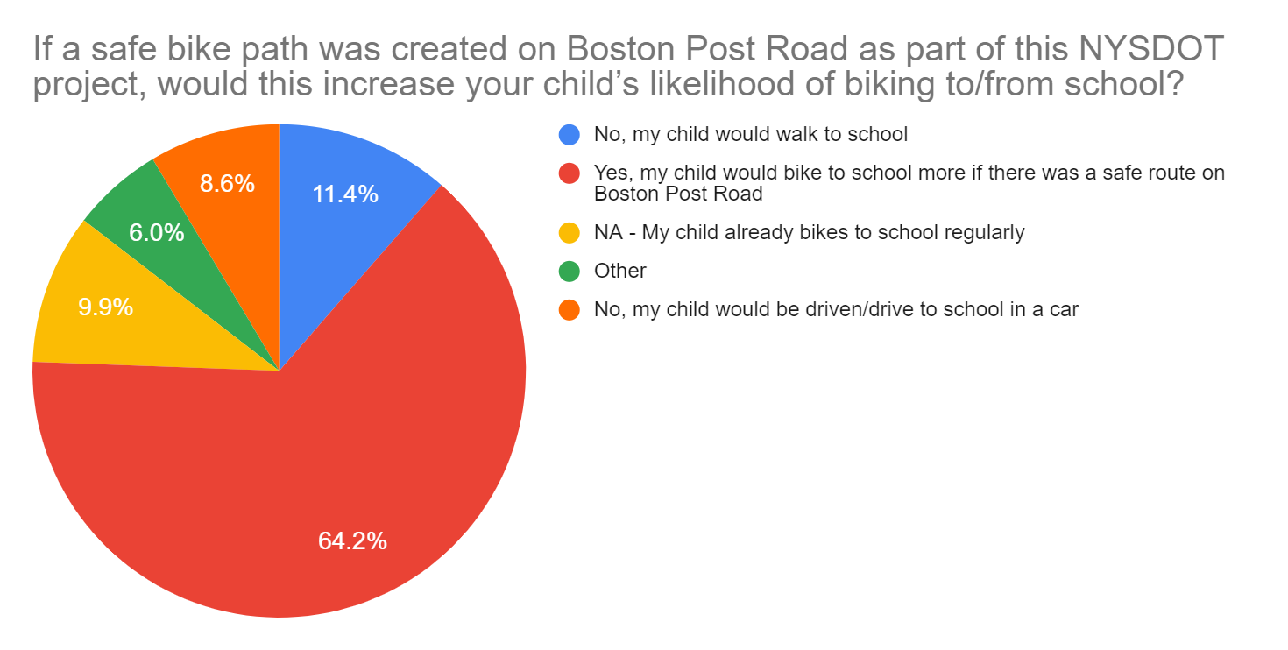
Rye Neck SRTS survey results – Rte. 1
390 responses from the Rye Neck school district community during the period of July 3-23, 2024 (20%: Daniel Warren Elementary; 24.1%: F.E. Bellows Elementary; 33.8%: RN Middle School; 22.1%: RN High School)
65.1% of respondents feel it is unsafe (either somewhat or very unsafe) to walk or bike to/from school on Boston Post Road.
64.2% of respondents said that, if a safe bike path was created on Boston Post Road, this would increase their child’s likelihood of biking to/from school.

Slide 2
Rye Neck SRTS survey results – Rte. 1
Suggestions to improve safety for pedestrians/bikers in the Rye Neck school district included:
The creation of a safe bike path (from approximately Carroll Ave. to Hornidge Rd.) would help fix the current problem of people biking on the sidewalks.
The bike path should be a protected bike lane, separating the bike lanes and the cars physically (not just with paint, etc.).
            Eliminating some parking on Boston Post Road (since most businesses have parking in the back) would create room for a designated bike lane.
            Decreasing the number of lanes on Boston Post Road from 4 to 2 (or 3) would create room for a designated bike lane.
A school zone with slower speed limits should be established by RN Middle/High School, as well as by F.E Bellows/Carroll Ave.
There need to be more safe crosswalks across Rte. 1 (e.g., by Carroll Ave., Stuart Ave.)and possibly traffic lights, as there are long stretches of Boston Post Road between Mamaroneck Ave and Hornidge Road without crosswalks.
Additional crosswalks are needed on adjacent roads (e.g., Taylor’s Lane) that have dangerous intersections with Rte. 1.

Slide 3
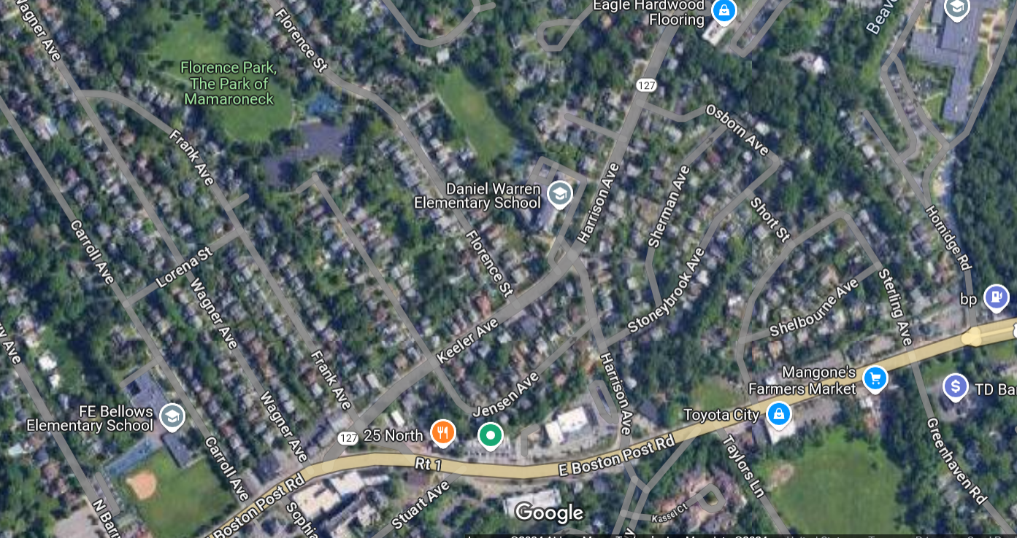




*Please see the attached spreadsheet for detailed comments from survey participants.

