Slide 1


Slide 2

2025-26
Budget Hearing
May 7, 2025

Slide 3
Budget Development Process & Timeline
Board of Education:
Budget Work Session #1
February 12, 2025
Budget Work Session #2
Budget Work Session #3
March 19, 2025
Budget Proposals from each
Department / Building
Superintendent’s final evaluation and review with Cabinet
Initial trend analysis / Review of need and back-up documentation
Culminates in final budget drafts to BOE for consideration
Departments / Buildings Principals meet with Superintendent and Asst. Supt./Business
Ongoing analysis of major cost drivers, contractual obligations, strategic planning
3

Slide 4

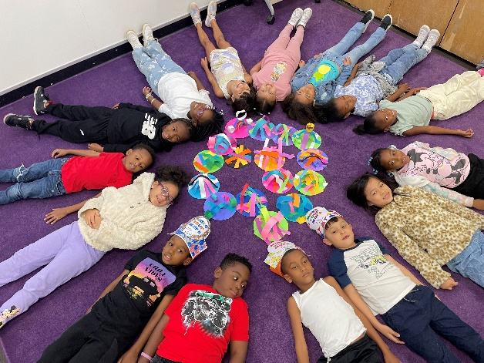
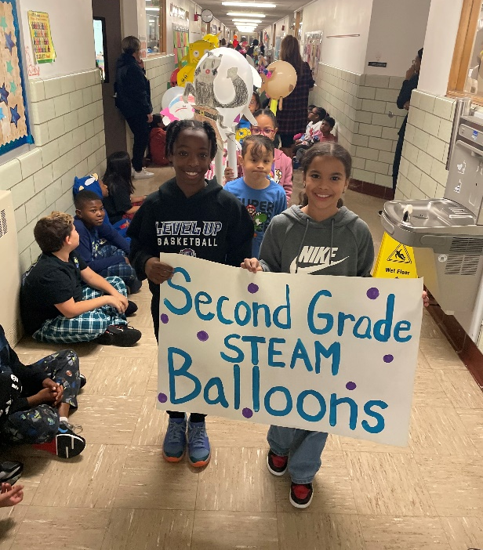
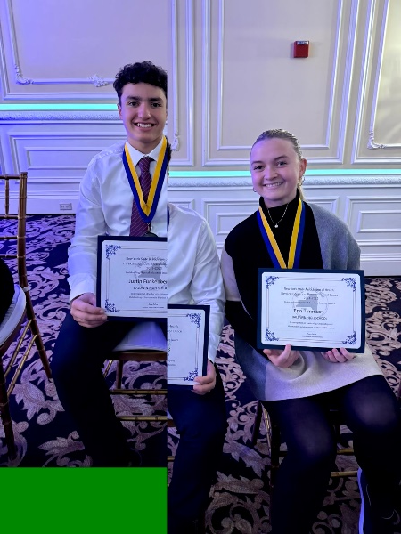
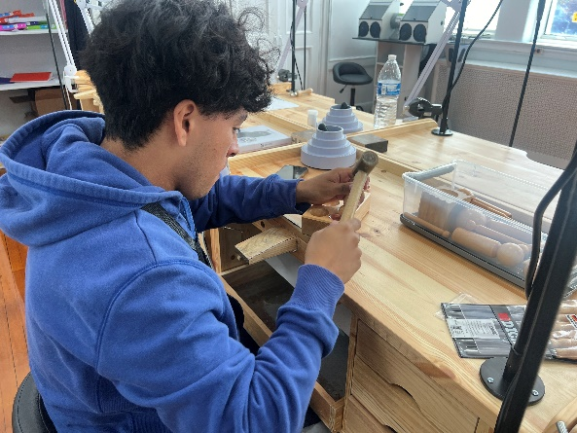
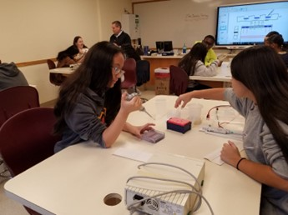
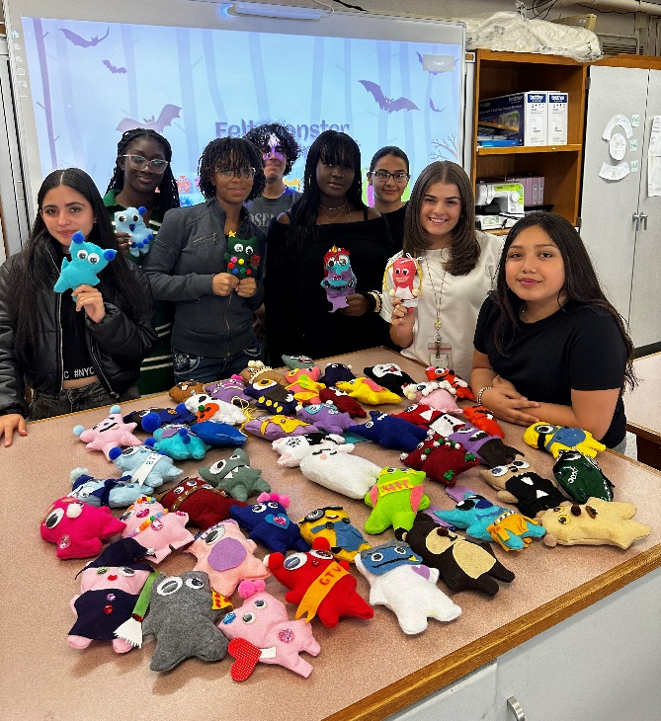
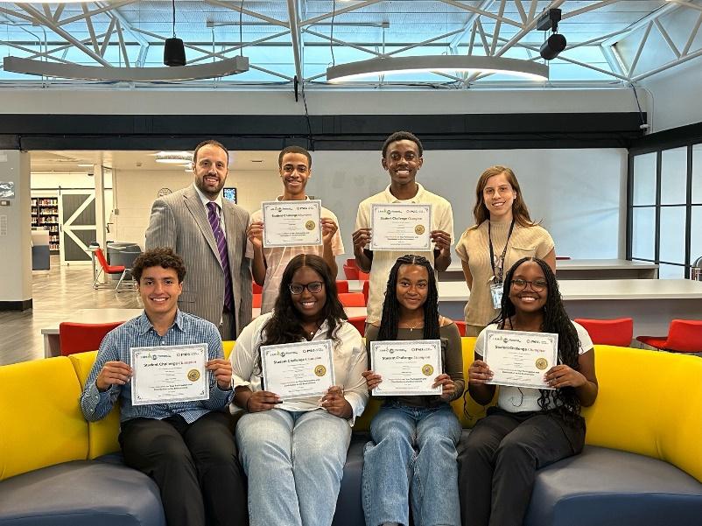
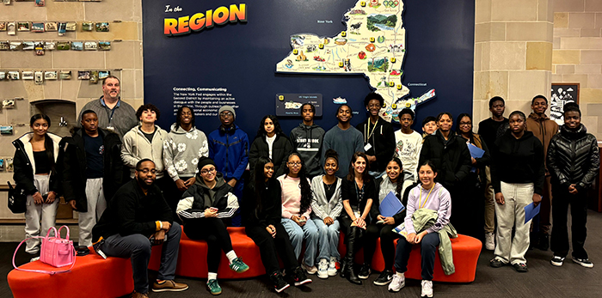
What is the Purpose of a School Budget?
4

Slide 5






Recent
Accomplishments
5

Slide 6


Recent
Accomplishments
Bethpage Best of LI winners for 2025
Best Principal –
  Dr. Erica Taylor
Best School Psychologist –
  Meghan Kargman
NYSSBA Champion of Change Awards
Two Awards in 2024: Brookside Shark Tank and Wellness Center
Four Awards Total for Baldwin UFSD
6

Slide 7
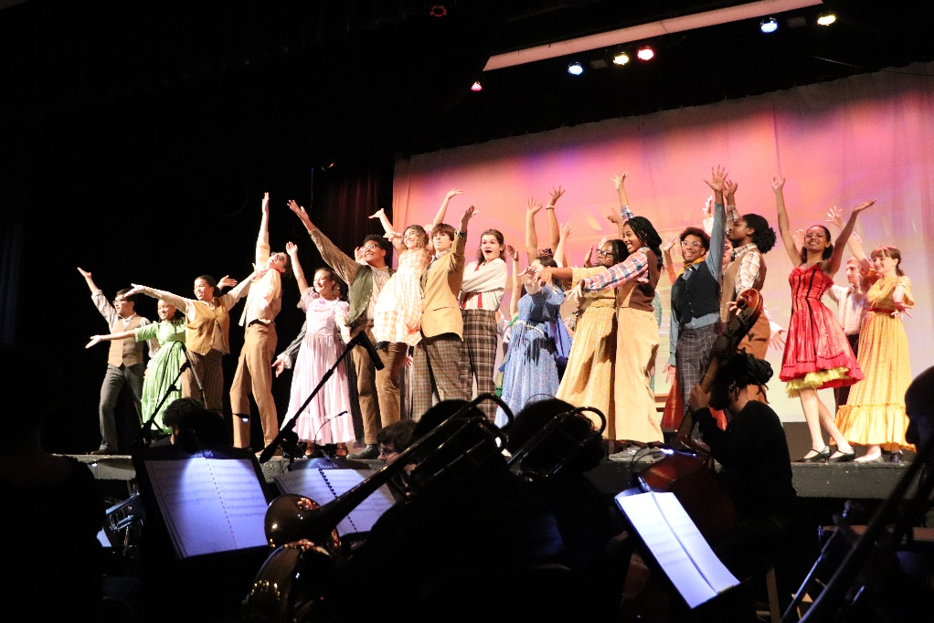
Recent
Accomplishments
Molly Brown Grant
Only New York school district to win $10,000 award for
Fine & Performing Arts program
7

Slide 8

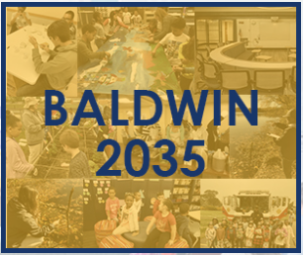
Recent
Accomplishments
Ongoing/New Major Initiatives:
School2Career Efforts
Senior Experience Course
Baldwin High School Academic Academies
Pre-Academies
Career & Technical Education (CTE) at Baldwin High School@Shubert
Mentoring Program at Baldwin High School and Baldwin Middle School
Continued Expansion of Advanced and Innovative Coursework
  More than 30 dual enrollment (college-level) courses and 29 AP courses
  NCCC Partnership allows students to earn up to 36 credits before graduating
  AP Capstone Diploma program celebrated 22 Baldwin High School graduates last year
  Nearly 50% of high school students take college-credit bearing courses
  Baldwin Schools embedding essential “news and media literacy” skills into curriculum
  College credit bearing course with Stony Brook University
Wellness Centers
Mindfulness
Thought Leaders & Baldwin 2035
8

Slide 9
Recent
Accomplishments
Ongoing/New Major Initiatives:
Continued Expansion of College-Level Coursework
District often featured as an “expert” in media based on the topic of news literacy and the impact of the digital world on students and families
9

Slide 10
Recent
Accomplishments
Ongoing/New Major Initiatives:
Thought Leaders & Baldwin 2035 – On-going district/community discussions to work towards thoughtful learning in Baldwin where students are producers
Mindfulness – Successfully integrated mindfulness in elementary physical education and as part of YALE program, and a mindfulness elective at Baldwin High School
Wellness Centers – Secured funding to construct Wellness Centers
  Middle school complete and fully operational
  High school under construction with a planned launch, Spring 2025
10

Slide 11
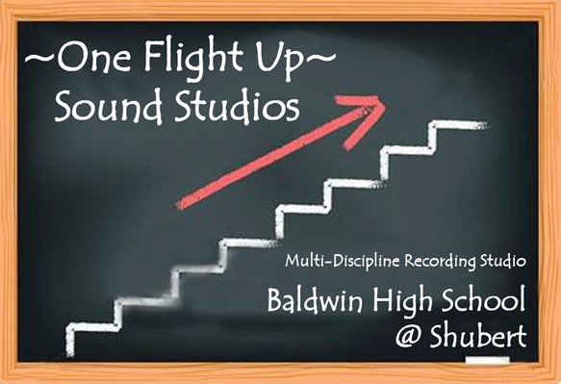

Recent
Accomplishments
Major Initiatives for Students:
Recording Studio and Jewelry Academy
aimed at nurturing the talents and aspirations
of our students
We look forward to seeing the incredible projects and creative endeavors that have and will continue to emerge in the years to come
11

Slide 12
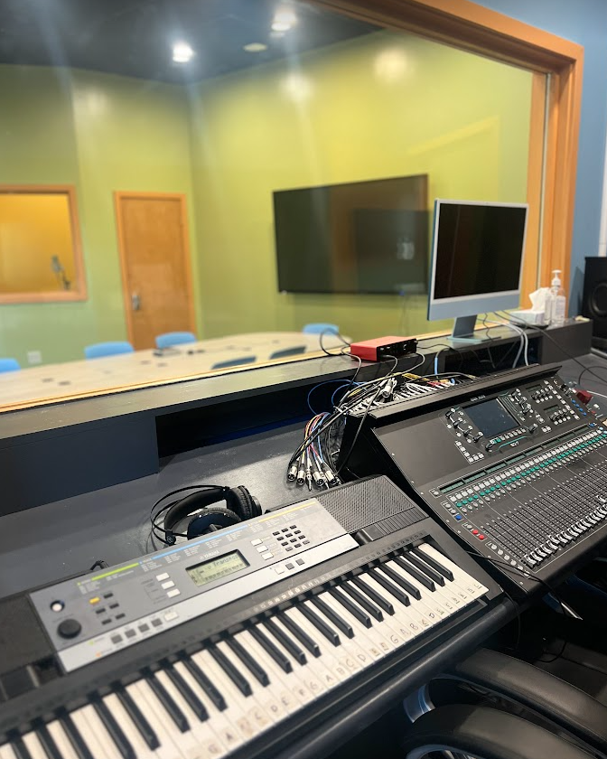
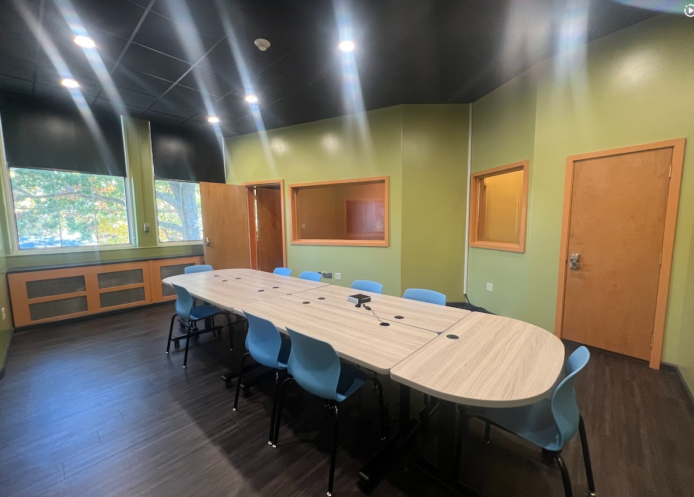
Other District Capital Initiatives
“One Flight Up” Recording Studio
District Initiatives
12
Notes:
Multi-Discipline Pod-Casting and Recording/Engineering

Slide 13
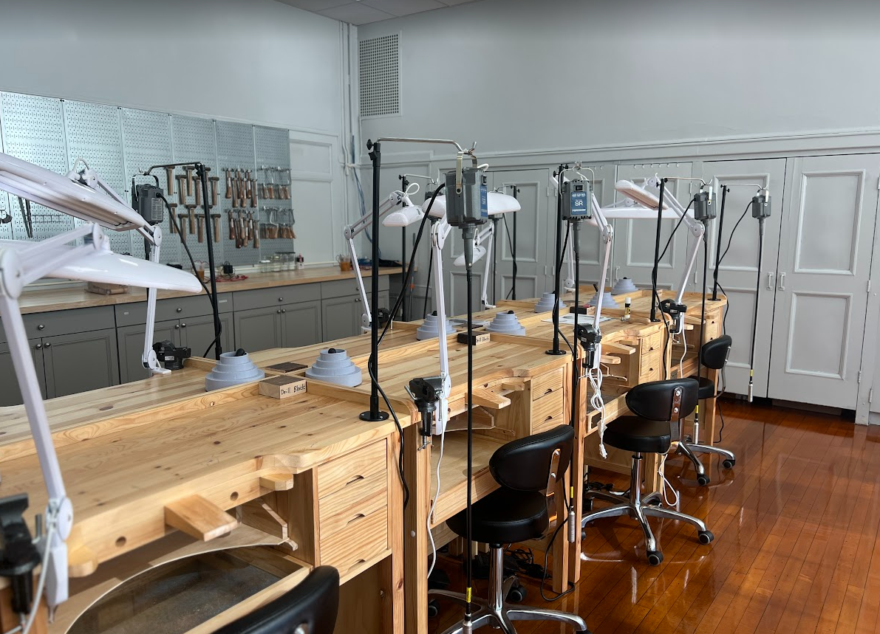
Other District Capital Initiatives
Future Jewelers Academy
District Initiatives
13

Slide 14
Recent
Accomplishments
Major Initiatives for Staff and Students:
Baldwin 2035
Focused on developing the 6 C’s
  Creativity
  Critical-thinking
  Communication
  Collaboration
  Character
  Civics
14

Slide 15
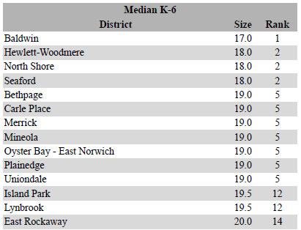
Baldwin Class Size
Class Size Analysis – K-6:
15
Source: Nassau BOCES 2024-25 Elementary Class Size Study, December, 2024

Slide 16
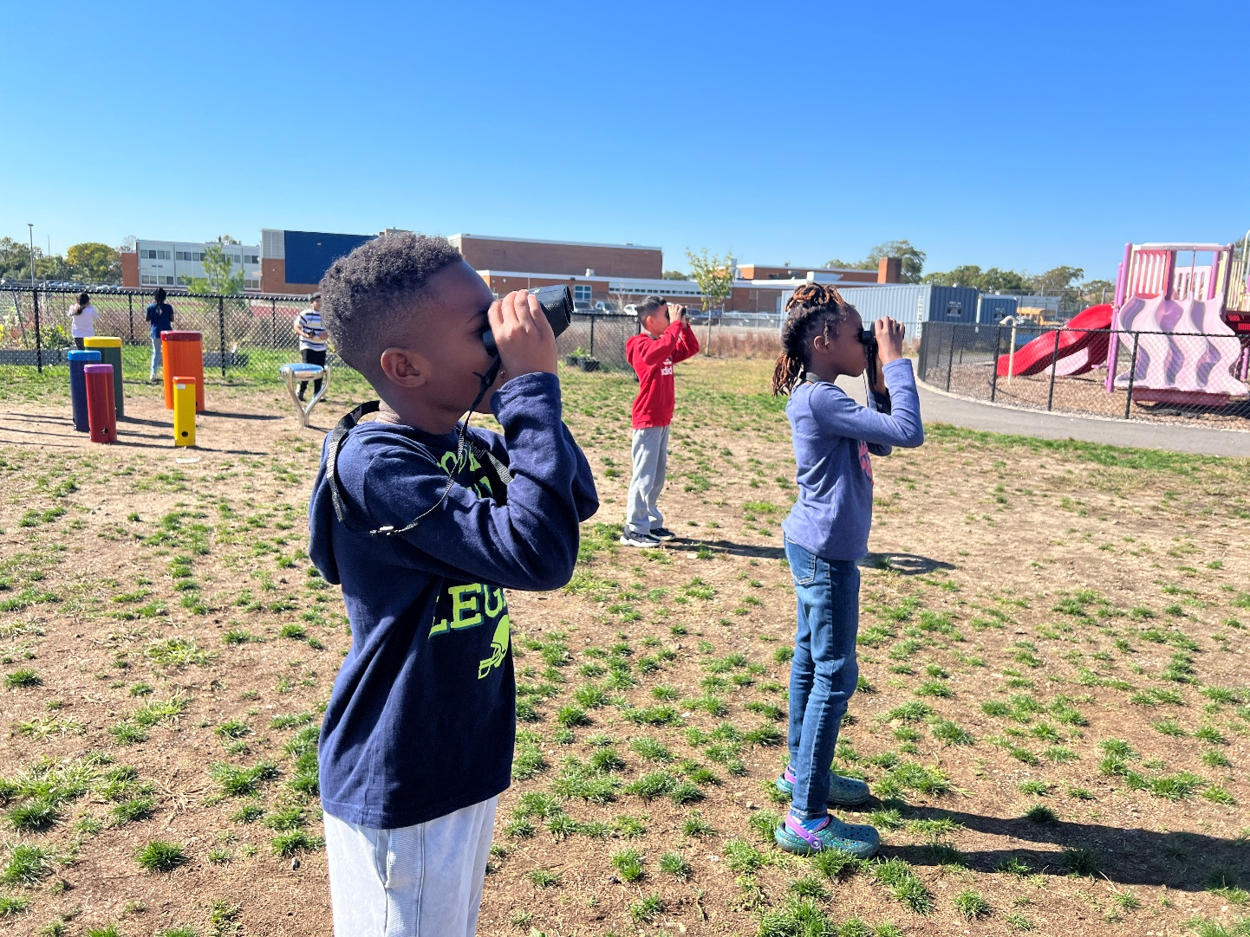
Planning for the Future
16
Notes:
We all look to the future – but we need to navigate and have a plan and strategy to get there…

Slide 17

This Year’s Focus:
Uncertainty AND Sustainability
Unpredictability
17
Notes:
Despite all of the UNPREDICTABILITY – The district continues to focus on stability and sustainability….

Slide 18
This Year’s Focus:
Uncertainty AND Sustainability
Unpredictability
Funding
  New York State
  Federal (Grants and other aid)
  US Department of Education
Major Cost Drivers (Mandated and Unpredictable)
  Transportation
  Special Education
  BOCES
18

Slide 19
This Year’s Focus:
Uncertainty AND Sustainability
Unpredictability
Major Cost Drivers (Mandated and Unpredictable)
  Transportation
  Special Education
  BOCES
19

Slide 20
This Year’s Focus:
Uncertainty AND Sustainability
Stability
District Objectives
  Financial / Operational
  Sustainability
  Preserving student programs and initiatives
20

Slide 21
Financial / Operational
Sustainability
New York State Comptroller’s Office – Fiscal Stress Analysis Report
2024
Fiscal Stress Score - Point Range (Out of 100 total pts)
Significant Fiscal Stress 65 - 100
Moderate Fiscal Stress 45 - 64.9
Susceptible Fiscal Stress 25 - 44.9
No Designation 0 - 24.9
6.7
Environmental Stress Score - Point Range (Out of 100 total pts)
Significant Environmental Stress 60 - 100
Moderate Environmental Stress 45 - 59.9 Susceptible Environmental Stress 30 - 44.9
No Designation 0 - 29.9
20.0
21
Notes:
District to monitor - will have a direct impact on longer range financial stability.
FISCAL STRESS SCORE: Is a product of - the district’s “CASH” position.
Defined as “CASH RATIO” and “CASH as a percentage of monthly expenditures”
Contributors: - Unrestricted fund balance from
- Cash flow
ENVIRONMENTAL STRESS SCORE: (SES & Demographics)
(Largely Socio-Economic and Demographic components)
Demographic Shifts
This is 100% assessed by New York State measurements
Baldwin School district score is a product of - the % change in Property value of the community, % of ELL’s

Slide 22
Financial / Operational
Sustainability
New York State Comptroller’s Office – Fiscal Stress Analysis Report
2024
Fiscal Stress Score - Point Range (Out of 100 total pts)
Significant Fiscal Stress 65 - 100
Moderate Fiscal Stress 45 - 64.9
Susceptible Fiscal Stress 25 - 44.9
No Designation 0 - 24.9
6.7
Baldwin Schools
Environmental Stress Score - Point Range (Out of 100 total pts)
Significant Environmental Stress 60 - 100
Moderate Environmental Stress 45 - 59.9 Susceptible Environmental Stress 30 - 44.9
No Designation 0 - 29.9
20.0
Baldwin Schools
22
Notes:
District to monitor - will have a direct impact on longer range financial stability.
FISCAL STRESS SCORE: Is a product of - the district’s “CASH” position.
Defined as “CASH RATIO” and “CASH as a percentage of monthly expenditures”
Contributors: - Unrestricted fund balance from
- Cash flow
ENVIRONMENTAL STRESS SCORE: (SES & Demographics)

Slide 23
2025 – 2026 Budget
Expense
3 Parts:
Administrative
Capital
Program
23

Slide 24
2025 – 2026 Budget
3 Part Expense Components
24

Slide 25
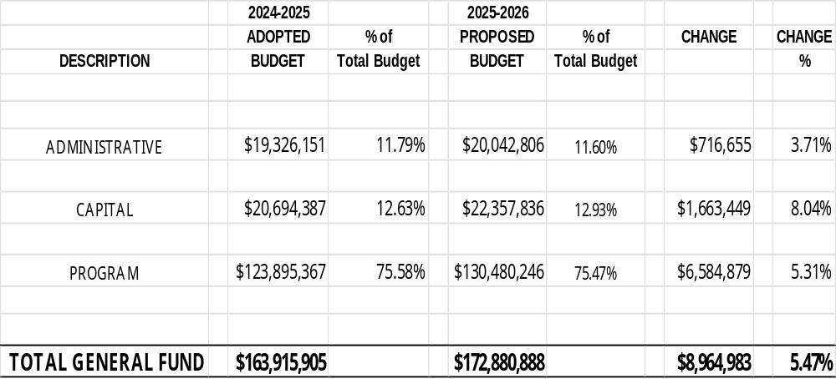
2025-2026
Proposed Budget Expenditures
*
* New Baldwin Public Library debt is factored
budget to budget increase
(Budget to Budget would be 4.86% without Library Debt)
*Pending NYS Legislative Budget adoption in April
25
Notes:
IMPORTANT NOTES:
If you recall, at the February Budget Workshop, we indicated we had a current deficit and that reductions would be needed
Capital Component WOULD BE 3.19% increase WITHOUT Library Debt (which resides in the Capital Component).

Slide 26
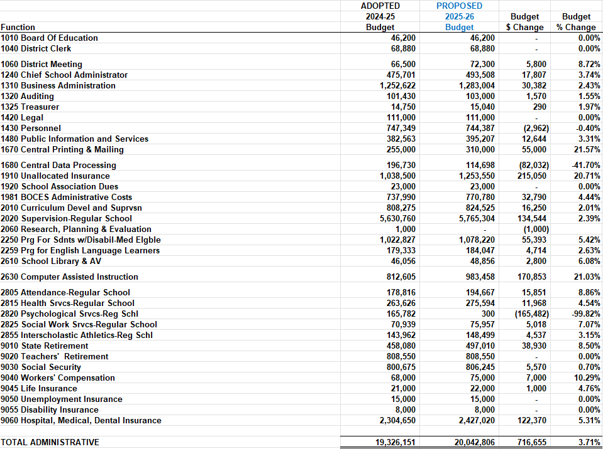
2025-2026
Analysis by Function – Administrative
26
Notes:
Highlights:
1060 District Meeting 8.72% BOLD Election Mgmt system upgrade to 3.0 and Board Doc's full year
1430 Personnel -0.40% Contractual decrease Timeclocks purchased PY
1670 Central Printing & Mailing 21.57% New Copier Leases - prior year was on maintenance contracts
1680 Central Data Processing -41.70% BOCES IT Support moved to 2630 from 1680 Central Data Processing
1910 Unallocated Insurance 20.71% NYSIR Rates
2630 Computer Assisted Instruction 21.03% BOCES IT Support moved to 2630 from 1680 Central Data Processing
2805 Attendance-Regular School 8.86% Residency investigations - increase based on PY Actuals, salary increase for attendance coordinators
2820 Psychological Srvcs-Reg Schl -99.82% R. Murray (Admin) retired, was replaced by Psychologist
9010 State Retirement 8.50% Increase in published ERS rate from 15.2% to 16.5%
9060 Hospital, Medical, Dental Insurance 5.31% Anticipated rate increases in January 2026

Slide 27
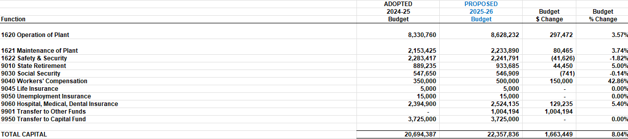
2025-2026
Analysis by Function - Capital
27
Notes:
Highlights:
1620 Operation of Plant 3.57% Increase in MS Electric due to new RTU, National Grid 9.4% rate increase, Triennial AHERA
1622 Safety & Security -1.82% Attrition
9010 State Retirement 5.00% Increase in published ERS rate from 15.2% to 16.5%
9040 Workers' Compensation 42.86% PY actual expenditures were higher
9060 Hospital, Medical, Dental Insurance 5.40% Anticipated rate increases in January 2026
9901 Transfer to Other Funds -------- $1,004,194 Library Debt Service

Slide 28
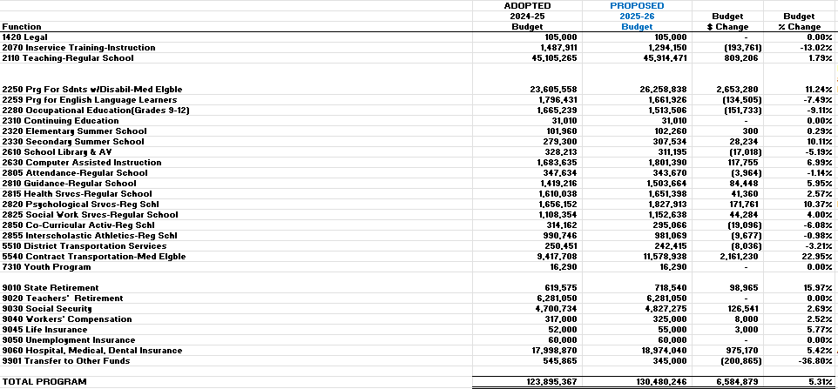
2025-2026
Analysis by Function - Program
28
Notes:
Highlights:
2070 Inservice Training-Instruction -13.02% Move ERP teachers to Teaching (2110)
2250 Prg For Sdnts w/Disabil-Med Elgble 11.24% Increase Out-of-District ($883K) and BOCES tuition ($713K) rates and enrollment; net salary increase primarily due to Teacher Aides FTE increase ($562K); OT/PT ($240K)
2259 Prg for English Language Learners -7.49% 2 retirees replaced
2280 Occupational Education(Grades 9-12) -9.11% Eliminated Barbering CTE Program
2330 Secondary Summer School 10.11% Homebound/Hospital instruction increase
2610 School Library & AV -5.19% Open Library position at MS (lower salary)
2630 Computer Assisted Instruction 6.99% BOCES IT Support
2805 Attendance-Regular School -1.14% Typist Clerk retired and replaced at lower salary
Psychological Srvcs-Reg Schl 10.37% R. Murray (Admin) retired, was replaced by Psychologist (Admin to Program)
2850 Co-Curricular Activ-Reg Schl -6.08% Moved Academy Dues and Supplies to Teaching code (2110)
2855 Interscholastic Athletics-Reg Schl -0.98% Decrease in equipment budgeted
5510 District Transportation Services -3.21% New transportation manager salary lower
5540 Contract Transportation-Med Elgble 22.95% Increase in rate and # of out-of-district students
9010 State Retirement 15.97% Increase in published ERS rate from 15.2% to 16.5%, plus increase in Teacher Aides
9060 Hospital, Medical, Dental Insurance 5.42% Anticipated rate increases in January 2026
9901 Transfer to Other Funds -36.80% No transfer next year for Cafeteria Fund

Slide 29
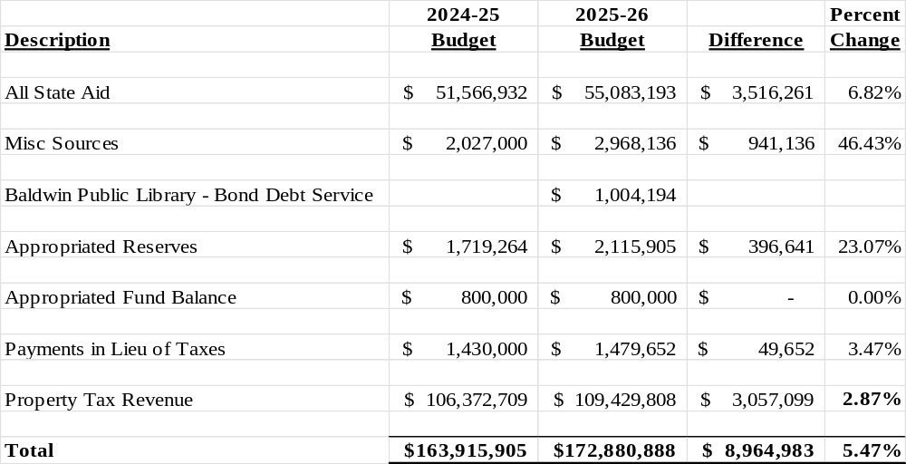
2025-2026
Revenue Budget
*
* New Baldwin Public Library debt is factored
budget to budget increase
(Budget to Budget would be 4.86% without Library Debt)
29
Notes:
NOTES:
Appropriated Reserves:
Analysis of current reserves and how to apply to gaps in budget
(MUST take long term view of use of reserves and ability to fund them over multiple years)
Includes: TRS, ERS, Workers Comp, Unemployment, EBALR (Employee Benefits Accrued Liability Reserve)
Appropriated Fund Balance:
Available funding unspent in 24-25 school year, used to apply to the subsequent (25-26) school year
NEW THIS YEAR – Library Debt Service:
Included as a “Revenue” as the District MUST carry the debt of the library bond, but receives the payment FROM the library, thus
COST NEUTRAL for the District.

Slide 30
Property Tax Cap
Baldwin UFSD’s Property Tax Cap for the 2025-2026 School Year will be 2.87%.
Baldwin Schools will keep expenses within the tax cap limit
30

Slide 31
2025-2026
Budget Development Summary
Governor’s Executive Budget & Long-term Strategic Planning
Budget Expenses
Budget Revenue
=
$172,880,888
$172,880,888
Awaiting legislative approval of the NYS budget!
31
Notes:
Anticipated NYS approval by April 1st

Slide 32

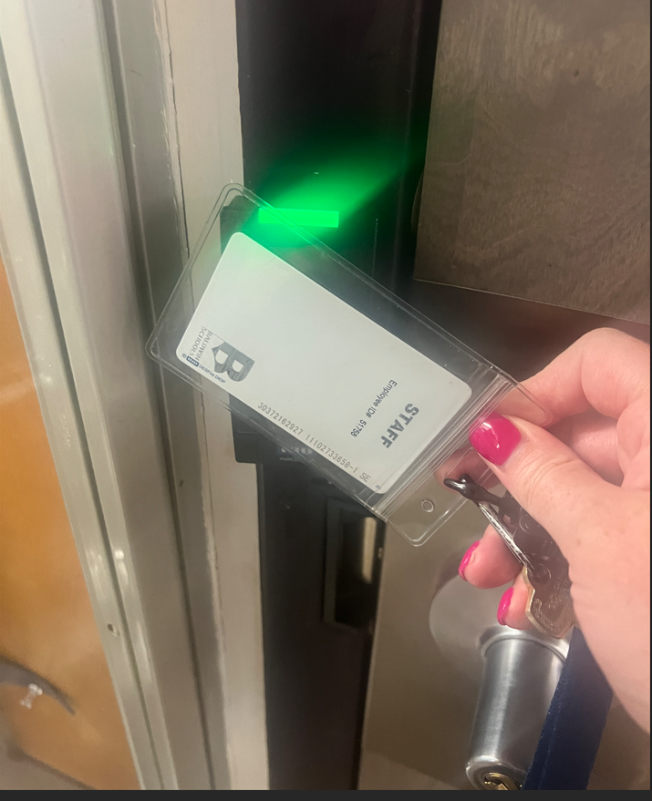
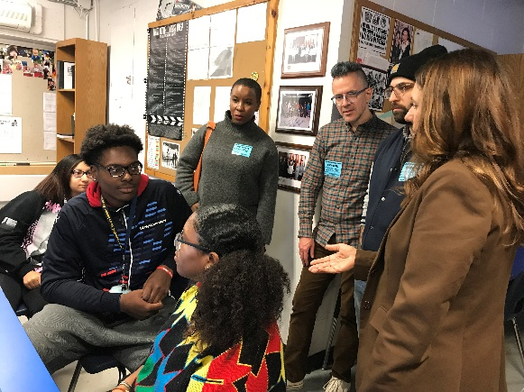
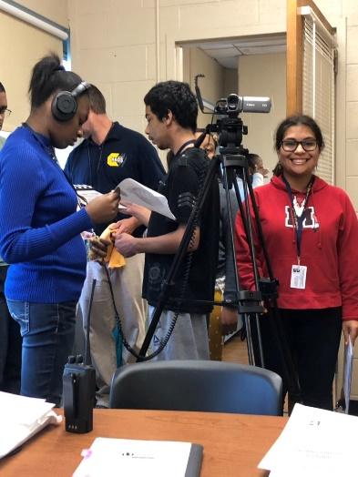
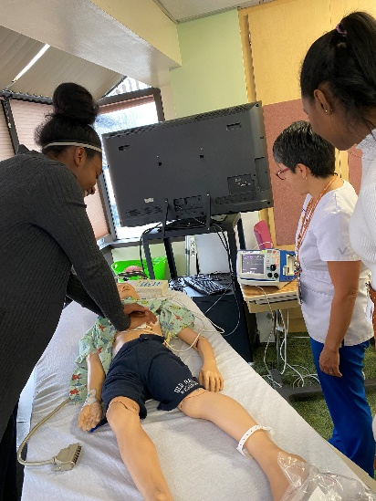
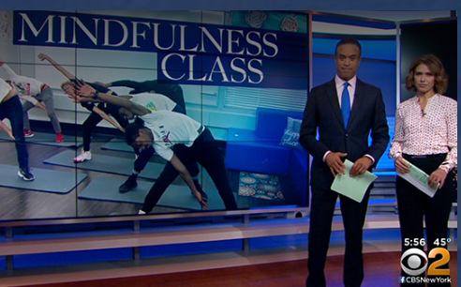
Supporting the Momentum
Long Range Capital Planning
Innovation is important…especially in Baldwin!

Slide 33

Multi-Year – Multi Funded Capital Initiatives
Transfer to Capital (General Fund Appropriations)
Capital Reserve (Ability to Fund and Use)
Capital Bond Proposal (Impact on long range planning)
Smart Schools Bond
Others (Local, State, Federal)
33
Notes:
Grant funding are likely to become more UNCERTAIN in the foreseeable future….

Slide 34
Previous
Use of Transfer to Capital
Projects Complete
Plaza Elevator √
Steele Elevator √
High School Tennis Courts √
High School Locker replacement √
Plaza Window replacements √
HS/MS HVAC-Mechanical projects √
Middle School Auditorium √
Shubert Soffit replacement (Pending) √
34

Slide 35
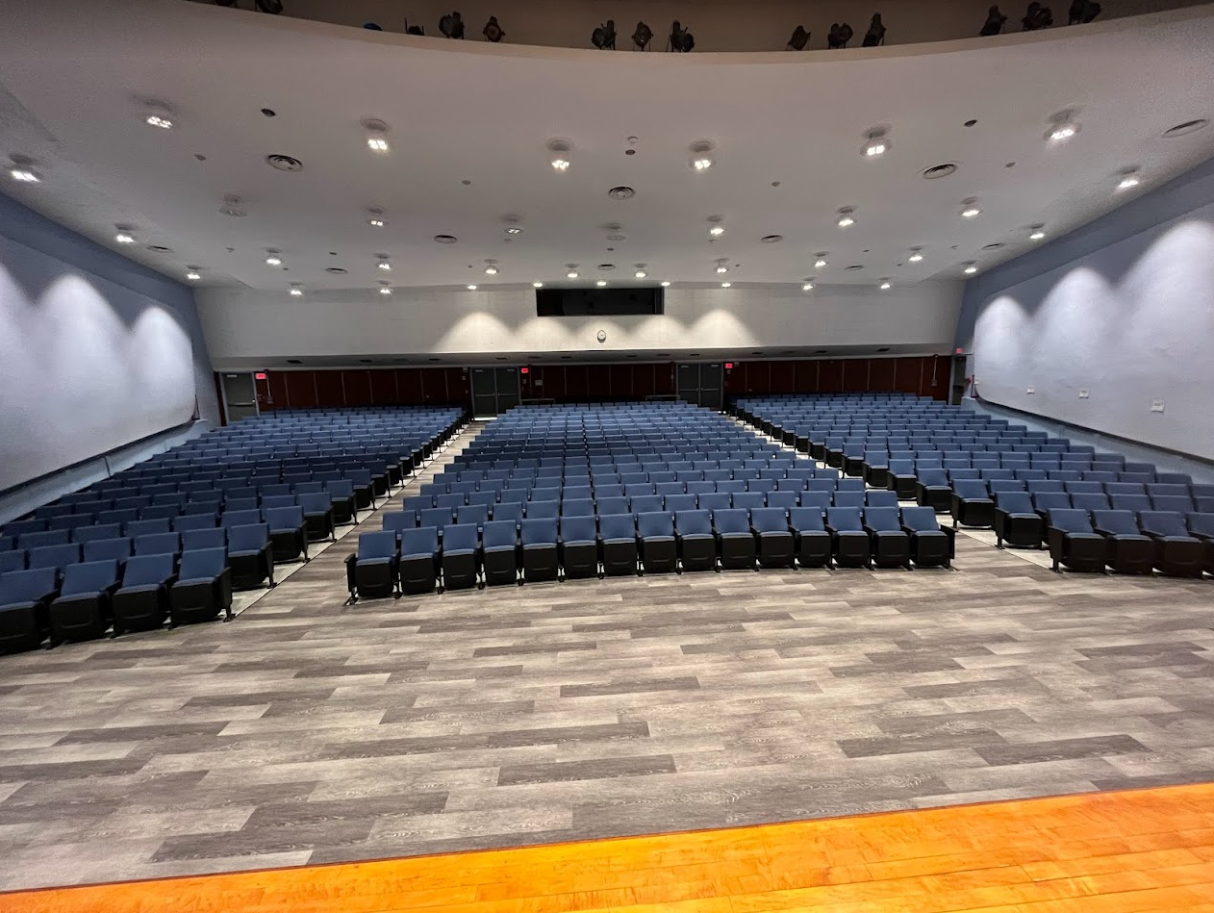
Multi-Year – Multi Funded Capital Initiatives
Xfer to Capital
Middle School Auditorium
35

Slide 36
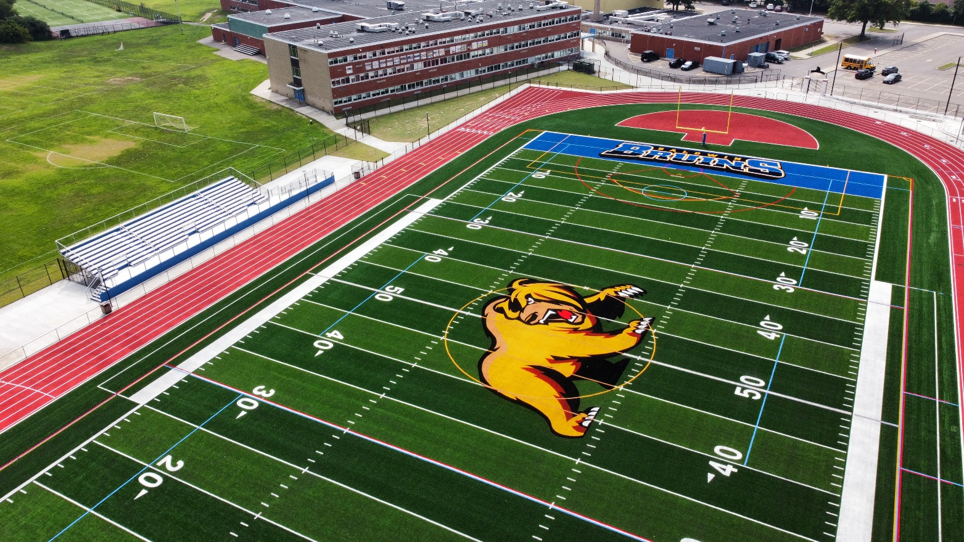
Multi-Year – Multi Funded Capital Initiatives
Capital Reserves
HS Athletic Complex
36

Slide 37
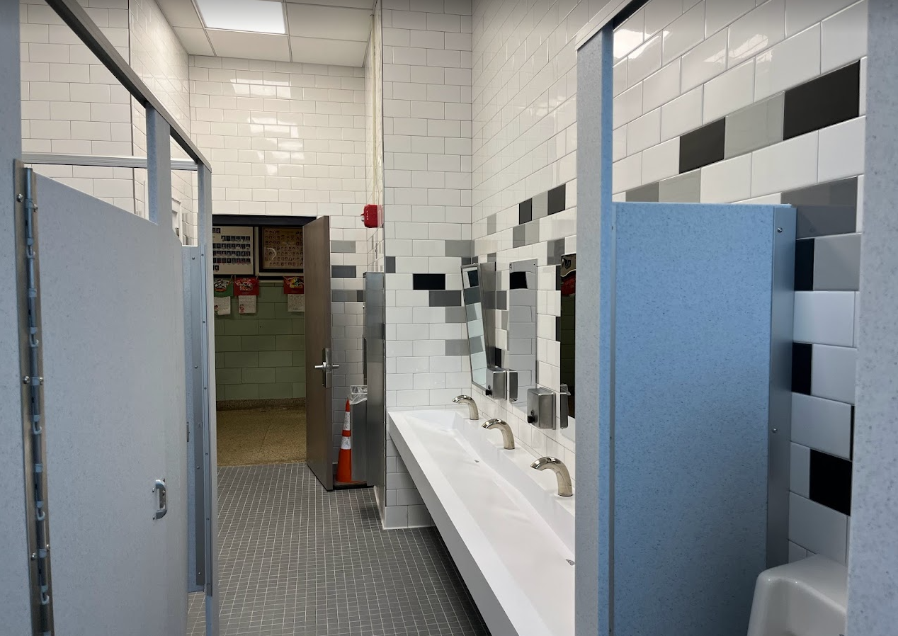
Multi-Year – Multi Funded Capital Initiatives
Capital Reserves
Bathroom Renovations
37

Slide 38
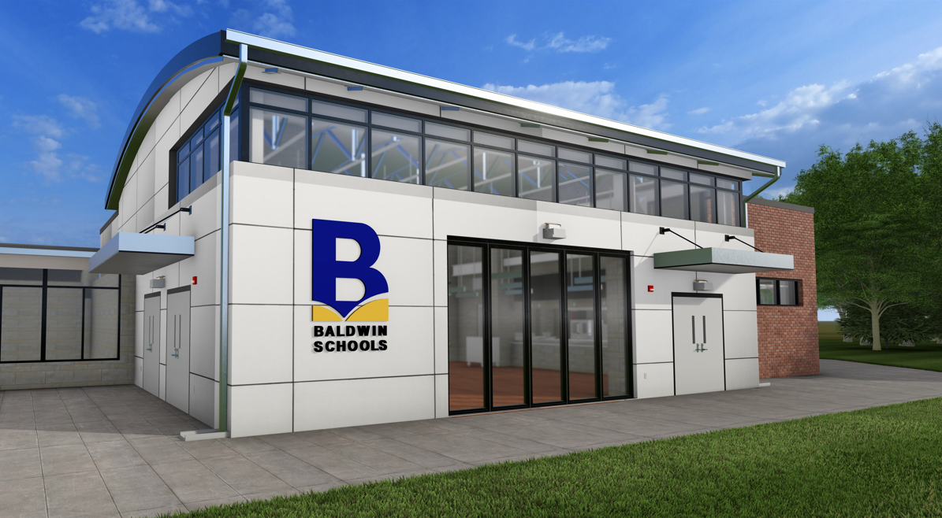
Multi-Year – Multi Funded Capital Initiatives
Elementary
Kitchens & Café
Brookside
Lenox
Meadow
Plaza
Steele
38

Slide 39
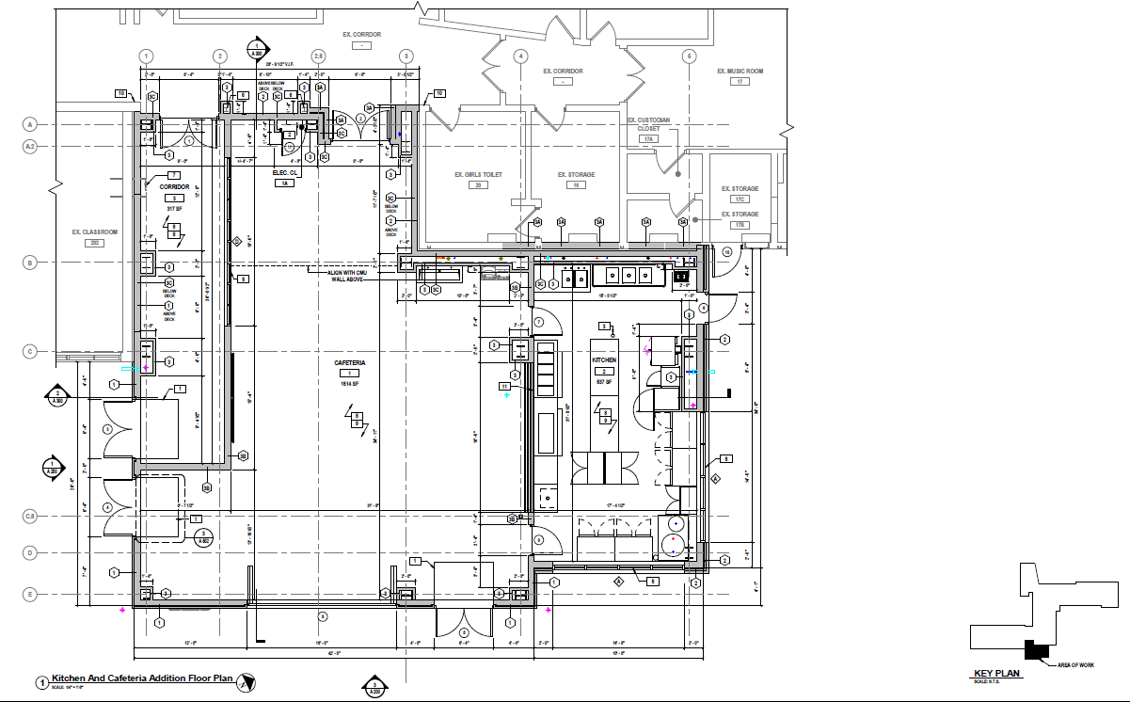
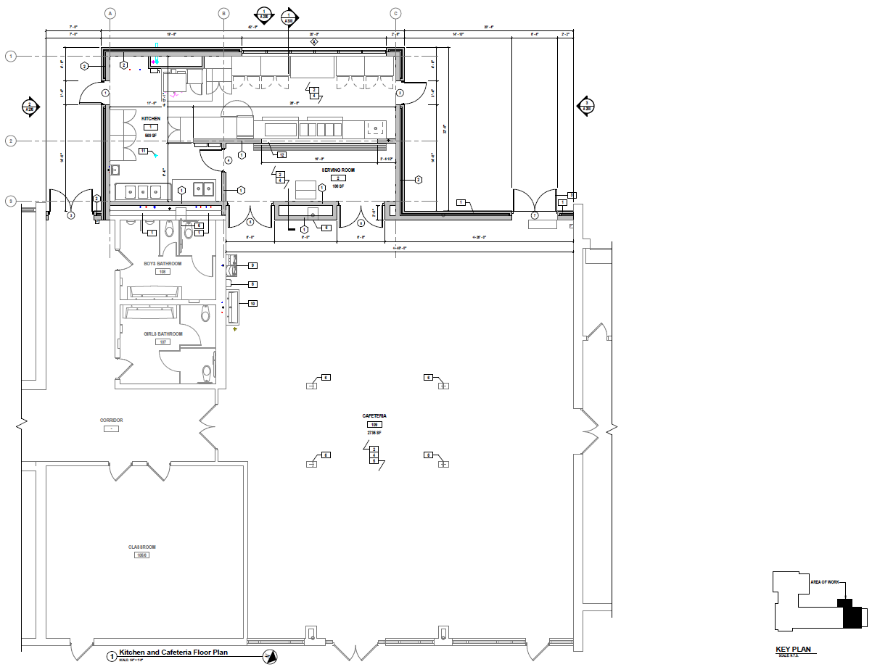
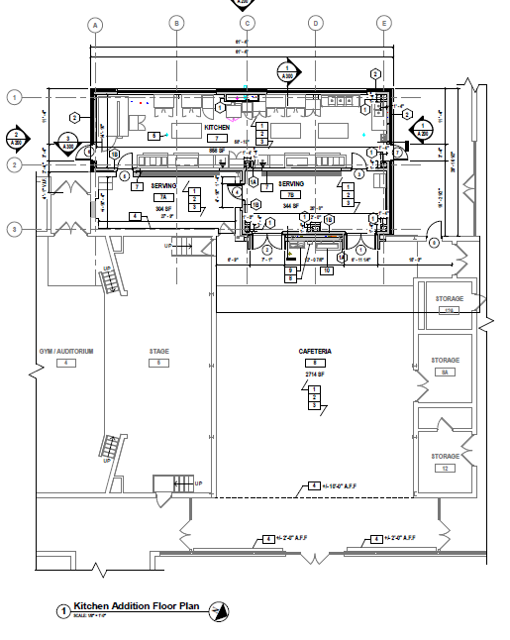
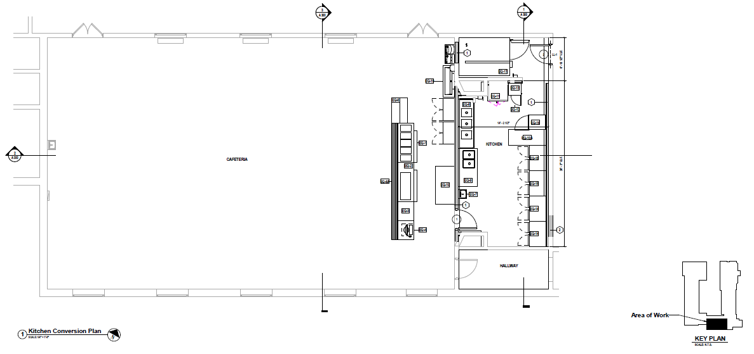
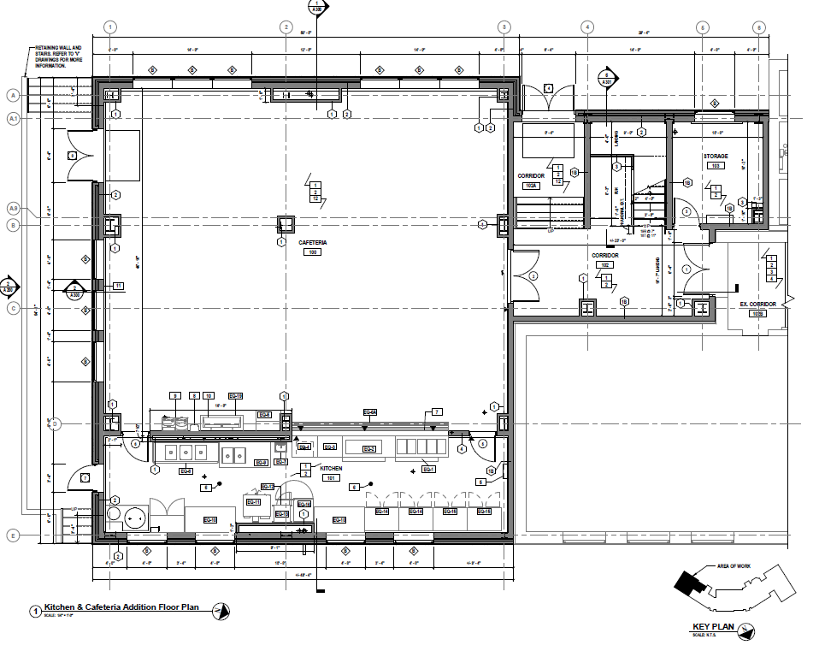
Multi-Year – Multi Funded Capital Initiatives
Capital Reserves
Elementary Kitchens & Cafe
Brookside ● Lenox ● Meadow ● Plaza ● Steele
Design/Engineering finalized
All buildings have been submitted for NYSED Facilities Planning Review
Approval anticipated by May/June, 2025
39

Slide 40
Multi-Year – Multi Funded Capital Initiatives
VOTER APPROVED BOND
HS Athletic Center (Gymnasium) √
HS 600 Wing - PERFORMANCE BASED LEARNING CENTER √
HS Performing Arts Center - PERFORMING ARTS/CAREER TECH ED CENTER √
HS Parking/Site Renovations √
HS Cafeteria Renovations √
Electrical upgrades/Improvements √
Reconstruction of 300 Wing – APPRENTICESHIP / LIFE SKILLS / WORK BASED LEARNING √
Courtyard and Corridor Improvements/Additions √
$134.8MM
40

Slide 41
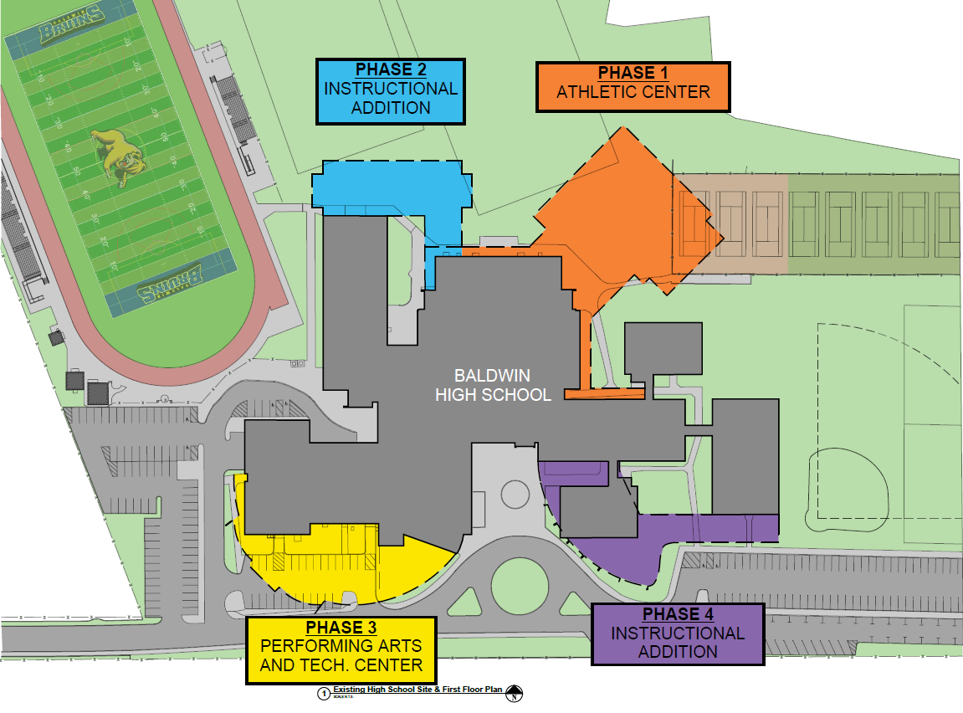
Multi-Year – Multi Funded Capital Initiatives
Approved Capital Bond – Implemented in 4 Phases
PHASE 2
PERFORMANCE BASED
LEARNING CENTER
PHASE 3
PERFORMING ARTS/
CAREER TECH ED CENTER
PHASE 4
APPRENTICESHIP /
LIFE SKILLS / WORK BASED LEARNING
41

Slide 42
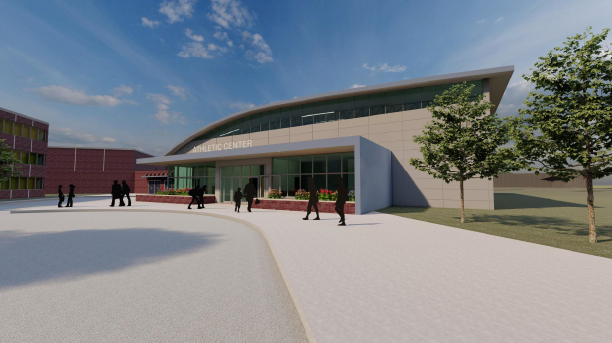
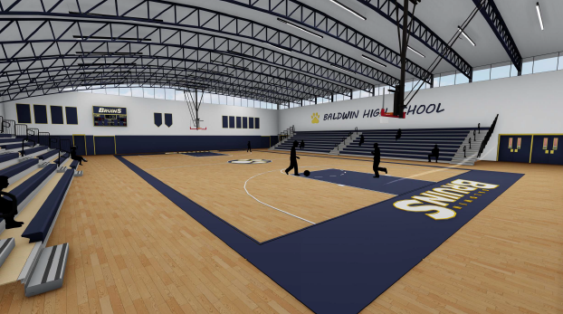
Multi-Year – Multi Funded Capital Initiatives
Bond Projects In-Development
Athletic Center
Phase 1
42

Slide 43
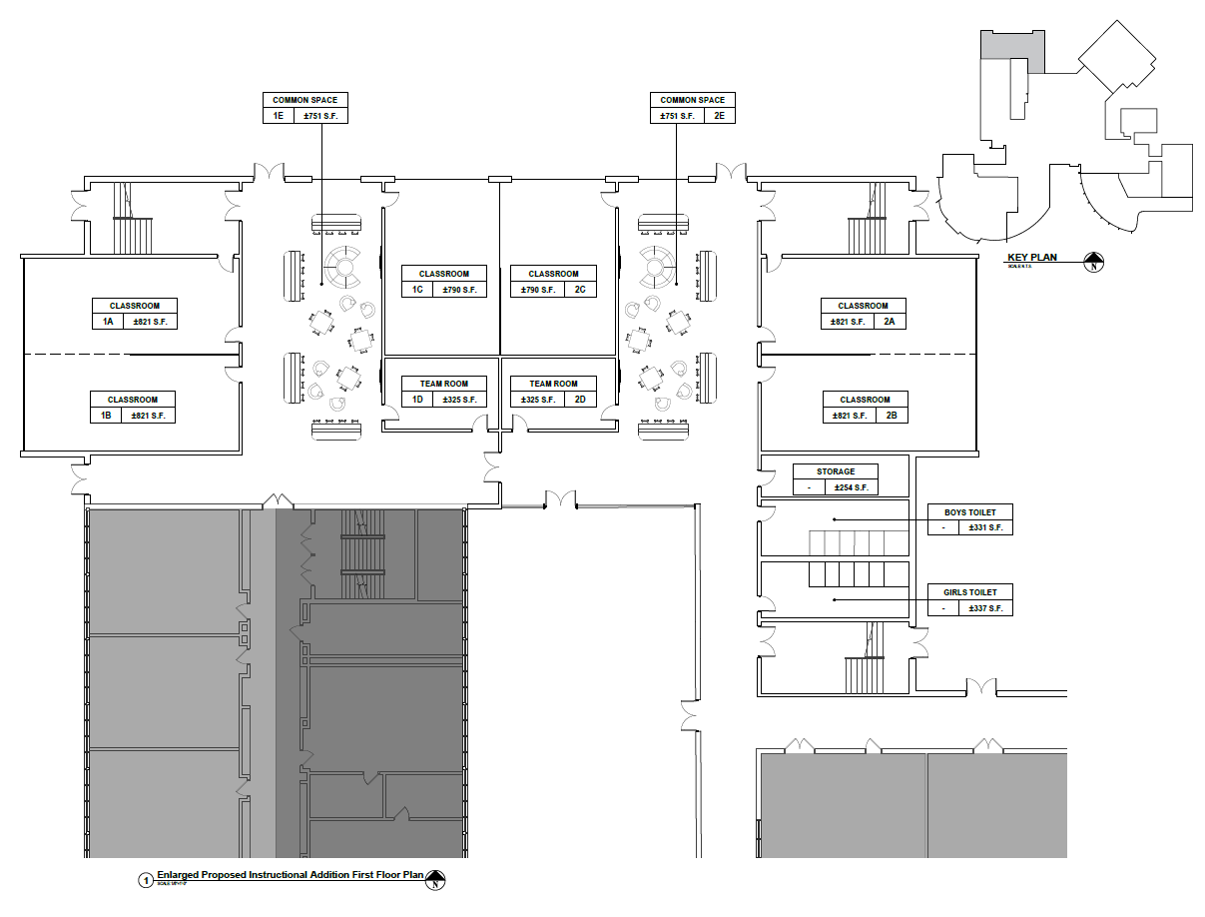
Multi-Year – Multi Funded Capital Initiatives
Bond Projects In-Development
Phase 2
Design work and renderings being developed
Performance Based Learning Center
43

Slide 44
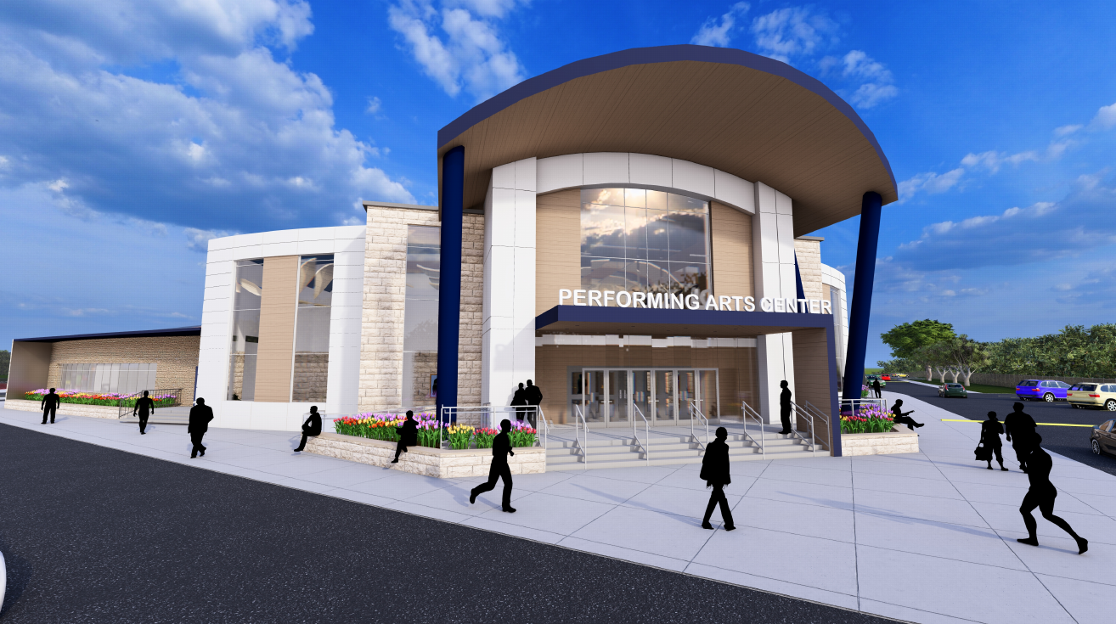
Multi-Year – Multi Funded Capital Initiatives
Bond Projects In-Development
Phase 3
Performing Arts and CTE Center
44

Slide 45
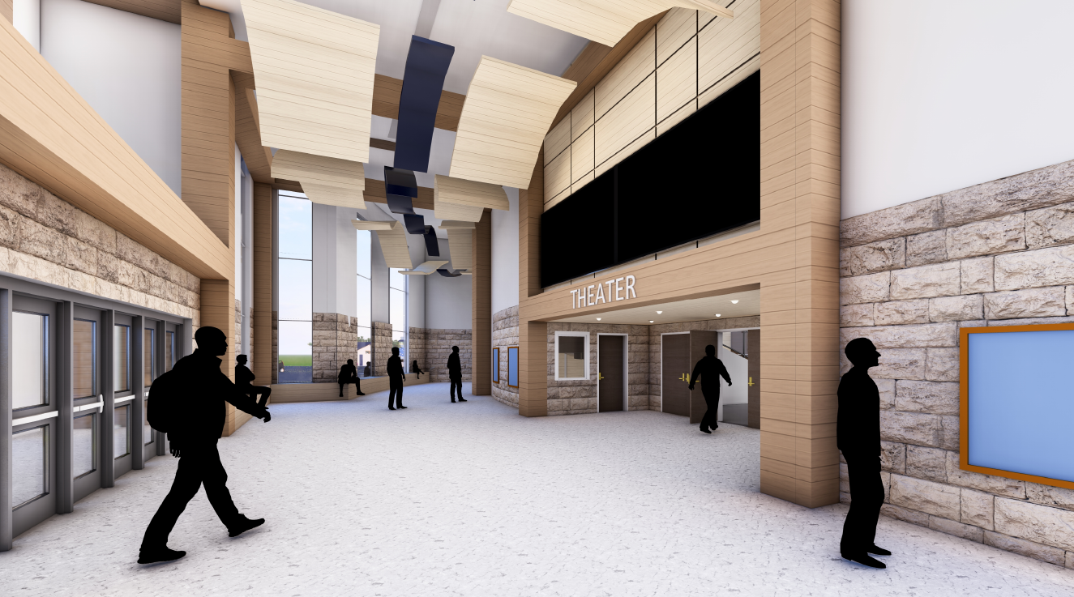
Multi-Year – Multi Funded Capital Initiatives
Bond Projects In-Development
Phase 3
Performing Arts and CTE Center
45

Slide 46
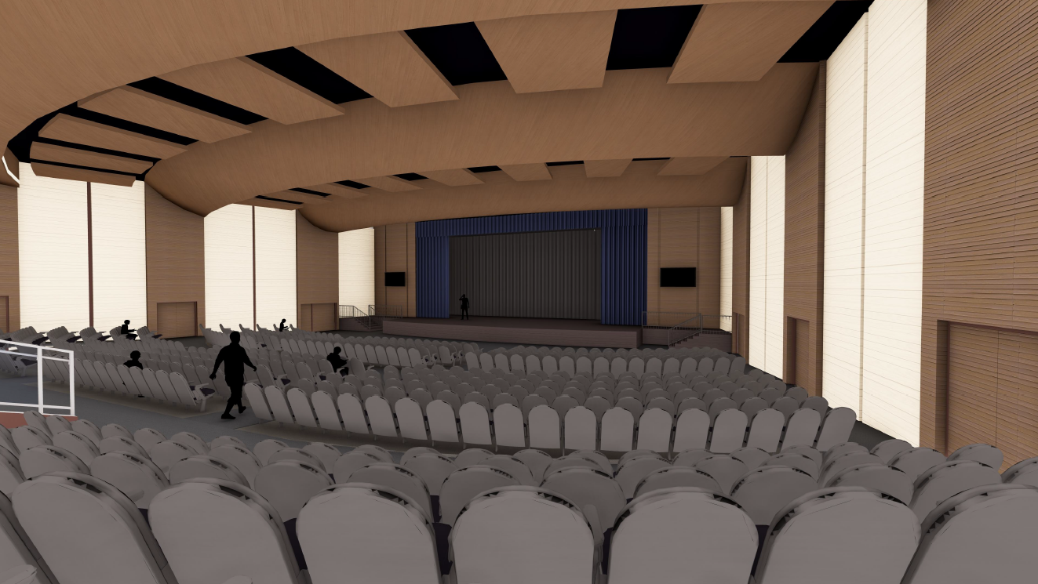
Multi-Year – Multi Funded Capital Initiatives
Bond Projects In-Development
Phase 3
Performing Arts and CTE Center
46

Slide 47
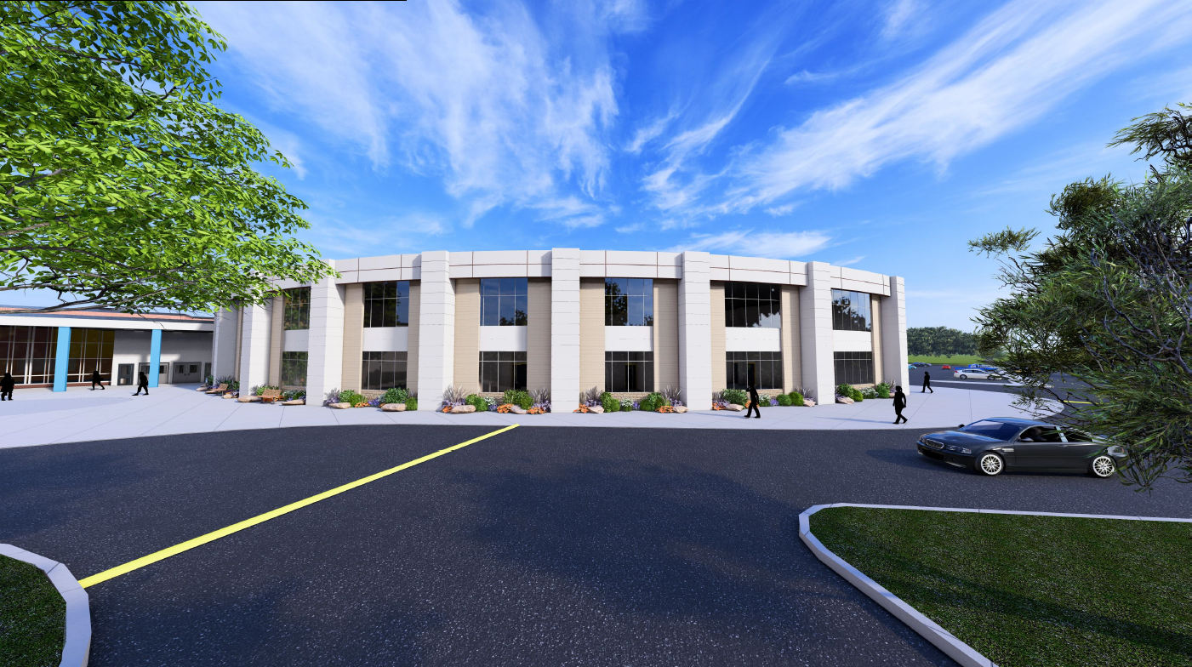
Multi-Year – Multi Funded Capital Initiatives
Bond Projects In-Development
Phase 4
Apprenticeship / Life Skills / Work Based Learning Center
47

Slide 48
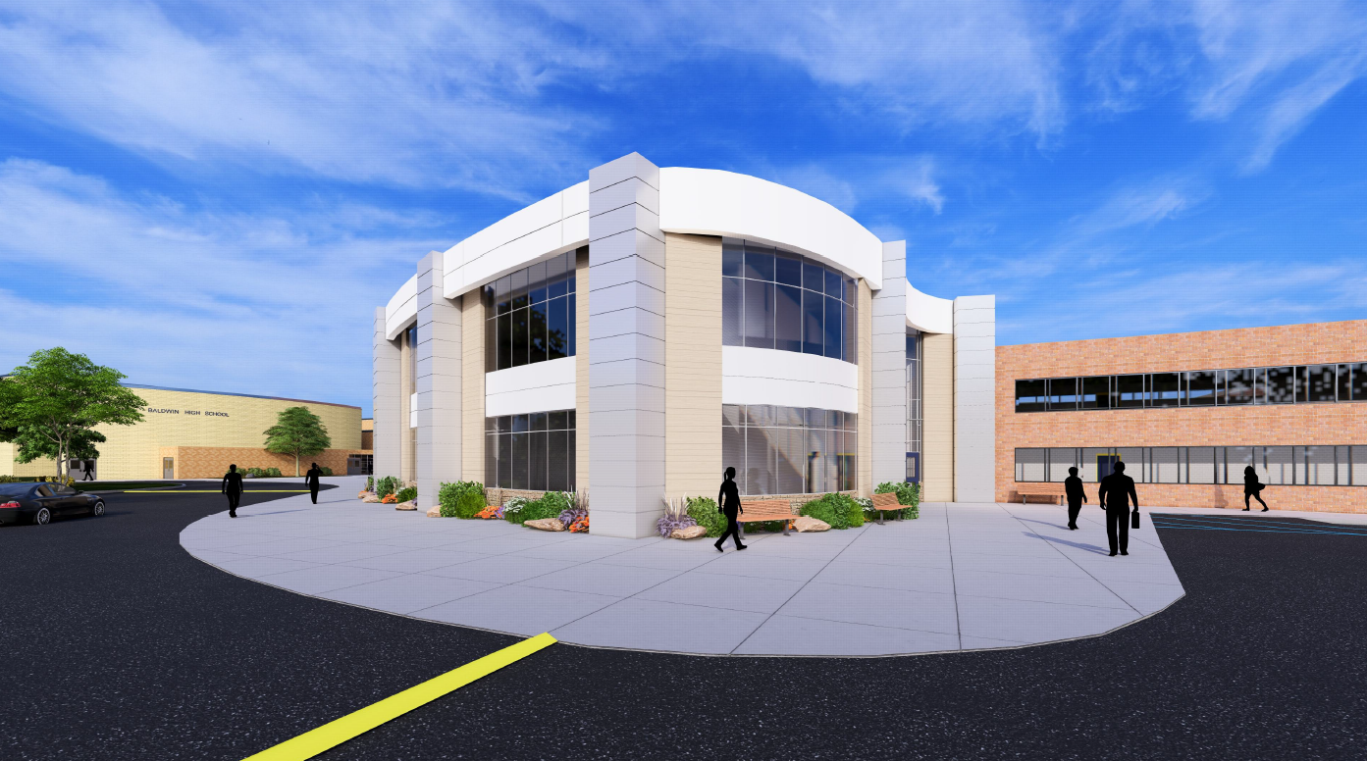
Multi-Year – Multi Funded Capital Initiatives
Bond Projects In-Development
Phase 4
Apprenticeship / Life Skills / Work Based Learning Center
48

Slide 49
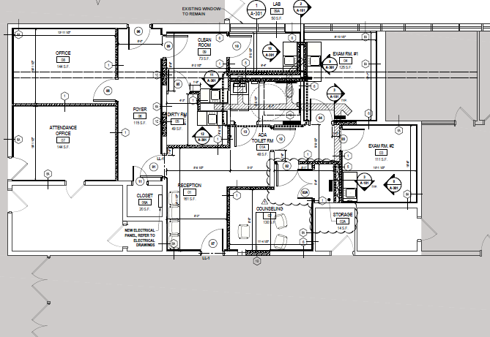
Multi-Year – Multi Funded Capital Initiatives
District Initiatives
HS Wellness Center coming…. SPRING, 2025!!!
HS Wellness Center construction
HAS BEGUN!
49
Notes:
Other Initiatives:
Needed to complete the new Nursing Center Suite to make way for the High School Wellness Center Initiative!

Slide 50
Transfer to Capital
2024-2025
Roof Replacement (Brookside)
Roof Replacement (Plaza)
Roof Replacement (Steele)
Roof Replacement (Meadow)
Sidewalk Repairs/Replacement (D/W)
Additional Classroom Redesigns/Renovations (D/W)
2025-2026 Anticipated Cost
Roof Replacement (High School) $ 1,668,186
Roof Replacement (Middle School) $ 2,056,814
$ 3,725,000
50

Slide 51
2025-26
Transfer to Capital
Proposed Capital Projects Anticipated Cost
Roof Replacement (High School) $ 1,668,186
Roof Replacement (Middle School) $ 2,056,814
$ 3,725,000
51

Slide 52
2025-2026
Proposed Use of Capital Reserve
Proposition for USE of the Capital Reserve: $ 18,100,000
HS Career Tech Ed Center Addition (CTE) $ 5,157,750
HS Existing Auditorium Renovations $ 5,115,695
MS – New Turf Soccer Field (West of Track) $ 3,636,875
Lenox – A/C Electrical Upgrades $ 2,174,190
Meadow – A/C Electrical Upgrades $ 2,015,490
    $ 18,100,000
Based on multi-year plan & SED project submission packaging
These funds are already set aside in the district Capital Reserve Fund –
Thus, there is no additional impact on the tax levy
52

Slide 53
2025-2026
Create New Capital Reserve Concerns…
Creation of a NEW Capital Reserve Fund: ~ Proposition ~
SHALL the Board of Education, pursuant to Education Law section 3651, be authorized to establish a Capital Reserve Fund known as the “Capital - 2025” for the purpose of performing District-Wide capital improvements
$25 million Total Fund
5 Year Term >>> Annual limit not to exceed $10 million beginning
with the 2024-25 School year.
This proposition is ONLY to “establish” this reserve
Funding this reserve would come from end-of-year fund balance
Any expense/usage from this reserve must be voter authorized
No additional impact on the tax levy
53

Slide 54
2025-2026
Proposition for Use of Technology Reserve
Proposition for USE of existing Technology Reserve: $ 450,000
New Chromebooks for 3rd grade students $ 215,000
Stylus Pens for 3rd grade students $ 20,000
Hard Cases for Chromebooks $ 10,000
Bags for Chromebooks $ 10,000
MedVision (medical mannequins) $ 195,000
Total: $ 450,000
These funds are already set aside in the district Technology Reserve Fund –
Thus, there is no additional impact on the tax levy
54
Notes:
Addressed a growing replacement cycle….

Slide 55
Components to
Long Range Capital Planning
Innovation is important…especially in Baldwin!
Navigating the challenges ahead:
Strategic, on-going use of Capital Reserves
  - The ability to fund them
Long Range Financial Planning
Project planning / timing / effective sequencing of projects
Minimizing disruptions to learning spaces
NYSED Facilities Planning submission and approval process
Responsive bidding

Slide 56

Planning for the Future
56

Slide 57
Planning for the Future
57

Slide 58
Property Tax Cap
Baldwin UFSD’s Property Tax Cap for the 2025-2026 School Year will be 2.87%.
Baldwin Schools will keep expenses within the tax cap limit
58

Slide 59
Rules for
Contingency Budget
If the budget is defeated twice, pursuant to NYS Tax Cap legislation, there can be no increase in the tax levy – 0%.
Regulations for a Contingency Budget:
Tax levy must be ZERO increase
All capital work removed from budget
No new equipment
Other operational restrictions
59

Slide 60
IMPORTANT INFORMATION:
Ballot Summary
5 Propositions
Proposition #1: School Budget
Proposition #2: Baldwin Public Library Budget
Proposition #3: Use of Technology Reserve
Proposition #4: Use of Capital Reserve
Proposition #5: Authorization to create a new Capital Reserve Account
60

Slide 61
IMPORTANT INFORMATION:
Early Mail and Absentee Ballots
Early Mail and Absentee Ballots – Due to District Clerk on or before May 20, 2025
BEFORE 5:00 pm
For more information, contact Jacqueline Torres, District Clerk, at 516.434.6011 or districtclerk@baldwinschools.org
Early Mail or Absentee Ballot Request must be received by the District Clerk:
No later than May 13, 2025, by 4:00 PM if the ballot is to be mailed to the voter
The day before the election Monday, May 19, 2025, by 4:30 PM if the application is to be dropped off and the ballot is to be picked up in person by the voter
61

Slide 62
IMPORTANT INFORMATION:
Budget Vote & Election
Budget Vote: Tuesday, May 20, 2025
7 a.m. – 9 p.m.
Baldwin High School
841 Ethel T. Kloberg Drive
*Note change of time*
62

Slide 63
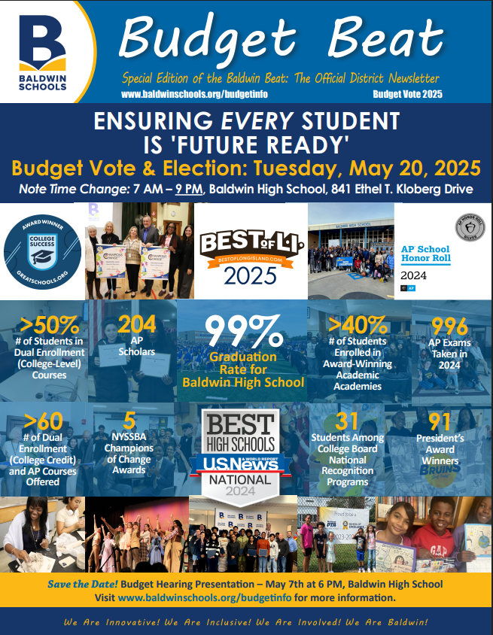


Spread the Word
Make an informed vote
and tell others to:
Read
Attend
Ask
63

Slide 64
Questions on the Budget?
Questions?

Slide 65
We want you to be informed!
Dr. Shari L. Camhi
Superintendent of Schools
516-434-6010
Dr. James P. Robinson
Assistant Superintendent for Business
516-434-6040
Jennifer Walsh
Assistant Business Manager
516-434-6040

Slide 66
All budget details can be found on our website:
www.baldwinschools.org

