Slide 1











Bronson HelpNet
Employee Assistance Program
Presented By:
Maureen Jenkins
1-800-969-6162
www.Bronsonhelpnet.com

Slide 2

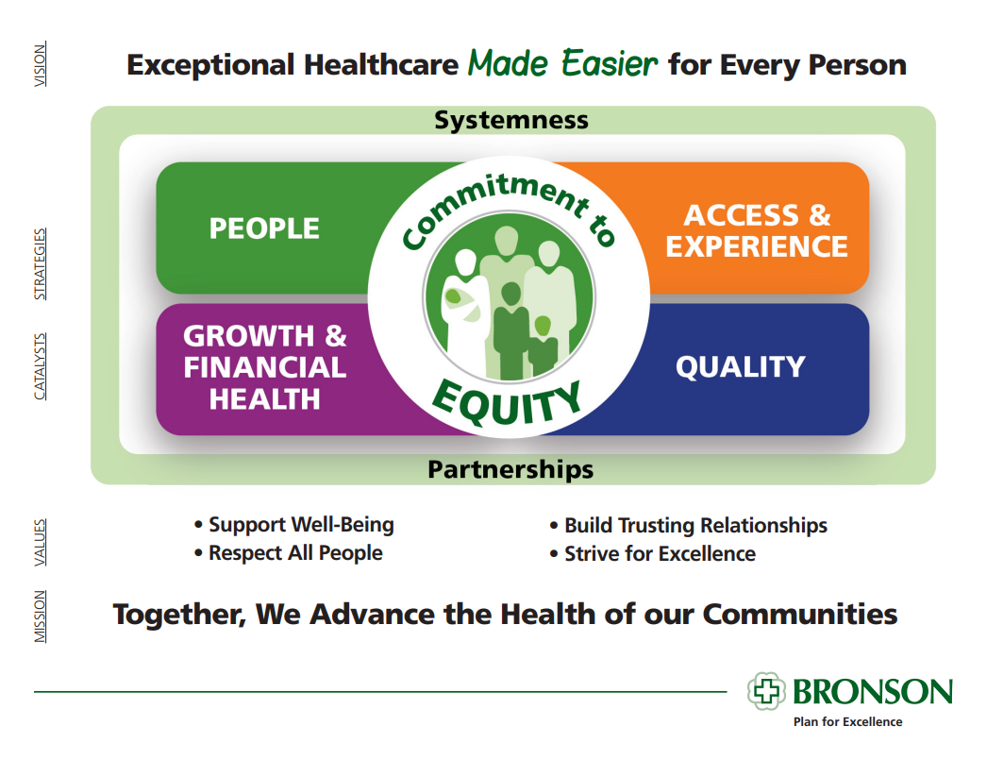
Introduction
We are Mission-Driven and Value-Centered
  Inception in 1989
  HQ in Battle Creek, MI; Office in Kalamazoo, MI
  Bronson Healthcare Group, nonprofit hospital
  Over 195,000 lives in diverse organizational sectors
  Industry-leading, exclusively EAP services
  97% contract retention

Slide 3





OVERVIEW
AWARDS
HelpNet is a member of Bronson Healthcare Group. Bronson Healthcare (www.bronsonhealth.com) is a not-for-profit, community-governed health system. Always mindful of its responsibility to the communities in which it serves, Bronson provides more than $138 million in community benefits annually through outreach and charitable care for the un- and under-insured. Our healthcare system also has a track record of clinical and workplace excellence as evidenced by numerous national achievements.
We have a strong and rich history in healthcare, with a mission to advance the health of our communities by elevating mental health as foundational to the health of the organizations we serve, and a vision to create an exceptional experiences for every member, every time.
All of our customers are served in a personalized, customer-centric approach and establish close working partnerships. We are an employee resource to provide access to equitable mental health solutions for any type of problem at work or home, and an organizational resource that provider leaders services to alleviate the burden of handling employee personal problems alone. We believe in collaboration and service integration with our customers, to ensure EAP benefits align with industry needs and focus.
Awards
Bronson Healthcare was named a 15 Top Health System by PINC AI
(2023)
Forbes as one of America’s
Best-In-State Employers
(2022-2024)
National Association for Business Resources as one of the 101 Best and Brightest Companies to Work For (2023 & 2024)
Newsweek as one of America’s Greatest Workplaces for Women (2023)
1-800-969-6162

Slide 4










4 SERVICE CATEGORIES
WHAT WE OFFER
Promotion
Solutions to stimulate a supportive and healthy workplace environment, increase understanding of health determinants, and empowering and engaging people to protect and promote their mental wellbeing.
Bronson HelpNet offers supportive EAP services across the continuum of organizational health.
Prevention
Solutions to encourage health promoting behavior change to deter and prevent disease, reduce risk factors, and build resilience.
Eligibility: Employees and anyone that lives in their household. This includes students who are away for the school year.
Intervention
Solutions to relieve emotional distress and reduce workplace disruption.
Management Services
Support and development for organizational leaders to enhance recruitment, retention, and engagement.
Accessibility: Employees can access our services in the way that suits them best, whether it’s by phone, online, or in person.

Slide 5

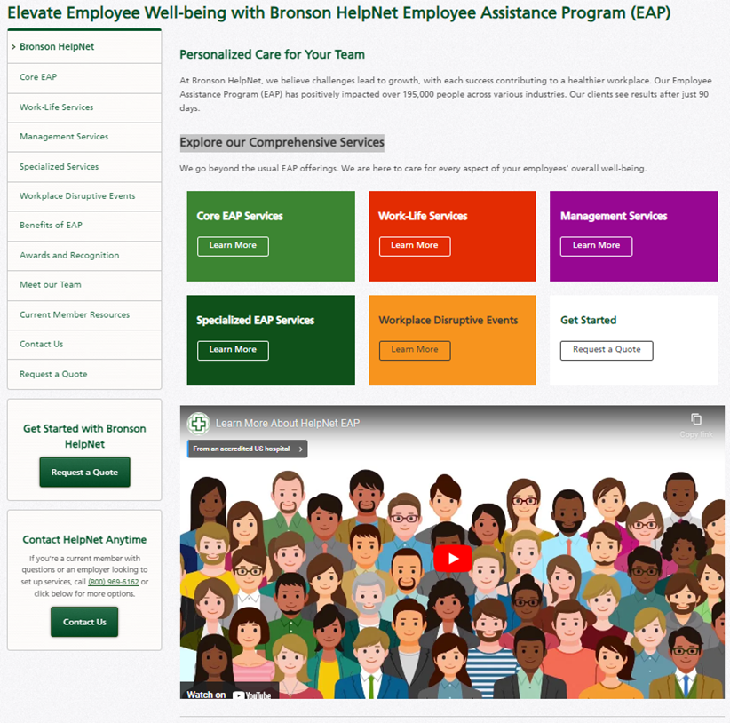


Slide 6


What We Offer
All offerings can be broken into 4 service categories:
Promotion
Prevention
Intervention
Management Services
Notes:
5 core services that can all be broken into 4 service categories.
Promotion
Prevention
Intervention
and Management Services

Slide 7




Counseling
1-5
Session Model
When you want to talk
Free, confidential, counseling for employees, spouse/partner, dependents and household members.
We provide support related to stress, anxiety, depression, addiction, grief, relationships, and much more.
We are available 24 hours a day, 7 days a week, 365 days a year; including holidays.
In-person and virtual appointments are available.
Call 800-969-6162 to set up an appointment or request a non-urgent appointment online.
All matters discussed in counseling are completely confidential unless the client reports severe harm to themselves or others. All clinicians are mandated reporters by state and federal regulations.

Slide 8


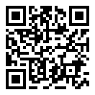
Work Life Member Portal
When you want resources
The work life member portal has hundreds of articles, tip sheets, calculators, monthly webinars and more on topics like growth, development, depression, mental health and wellness. Best of all, it is personalized based on the content the user enjoys.
OurRelationship; A Couples Online Program
Discount Market Place
Resource Locator: We provide employees an easy way to find childcare, elder care
and education resources in their area.
Visit www.BronsonHelpNet.com then click on Work Life Login on the left side.
Enter your Company Code: RCS123
Notes:
Live demo of the website or use the images at the end.

Slide 9
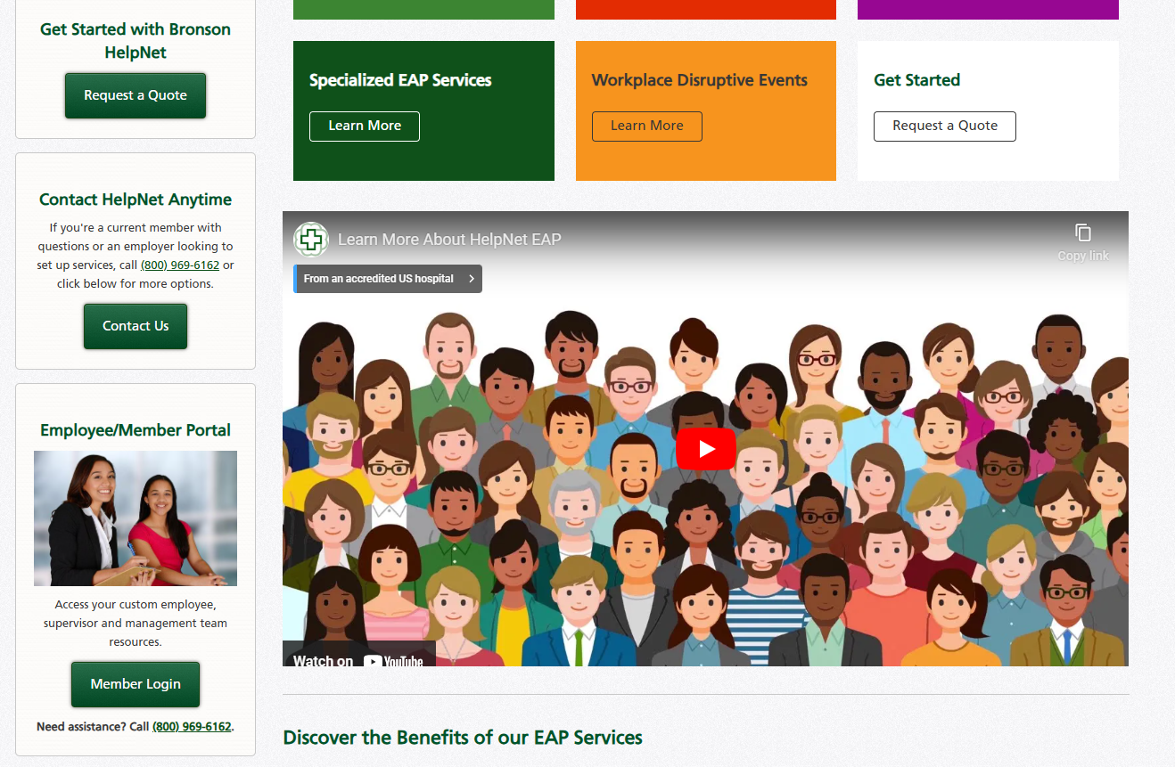


Slide 10
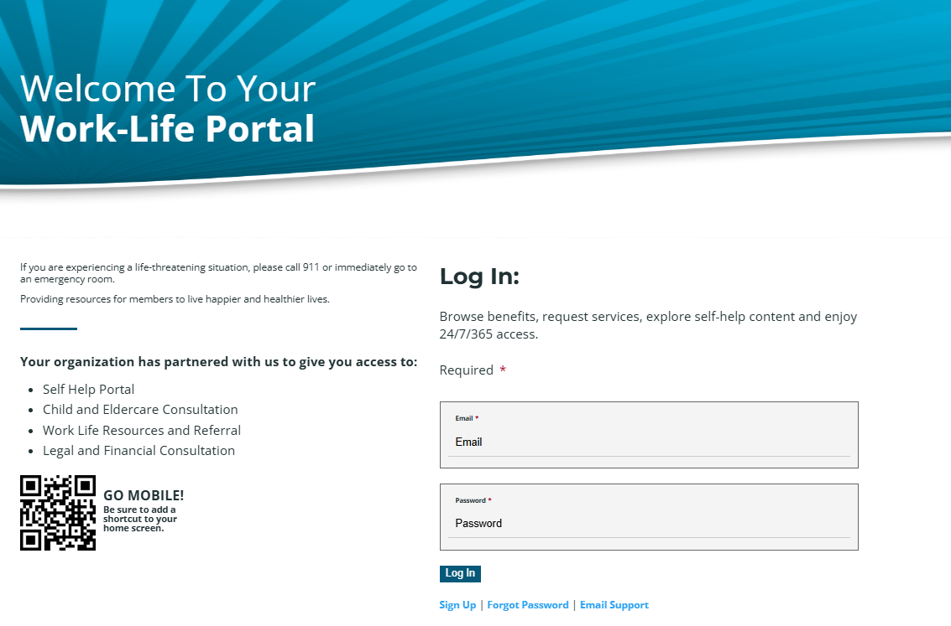


Slide 11
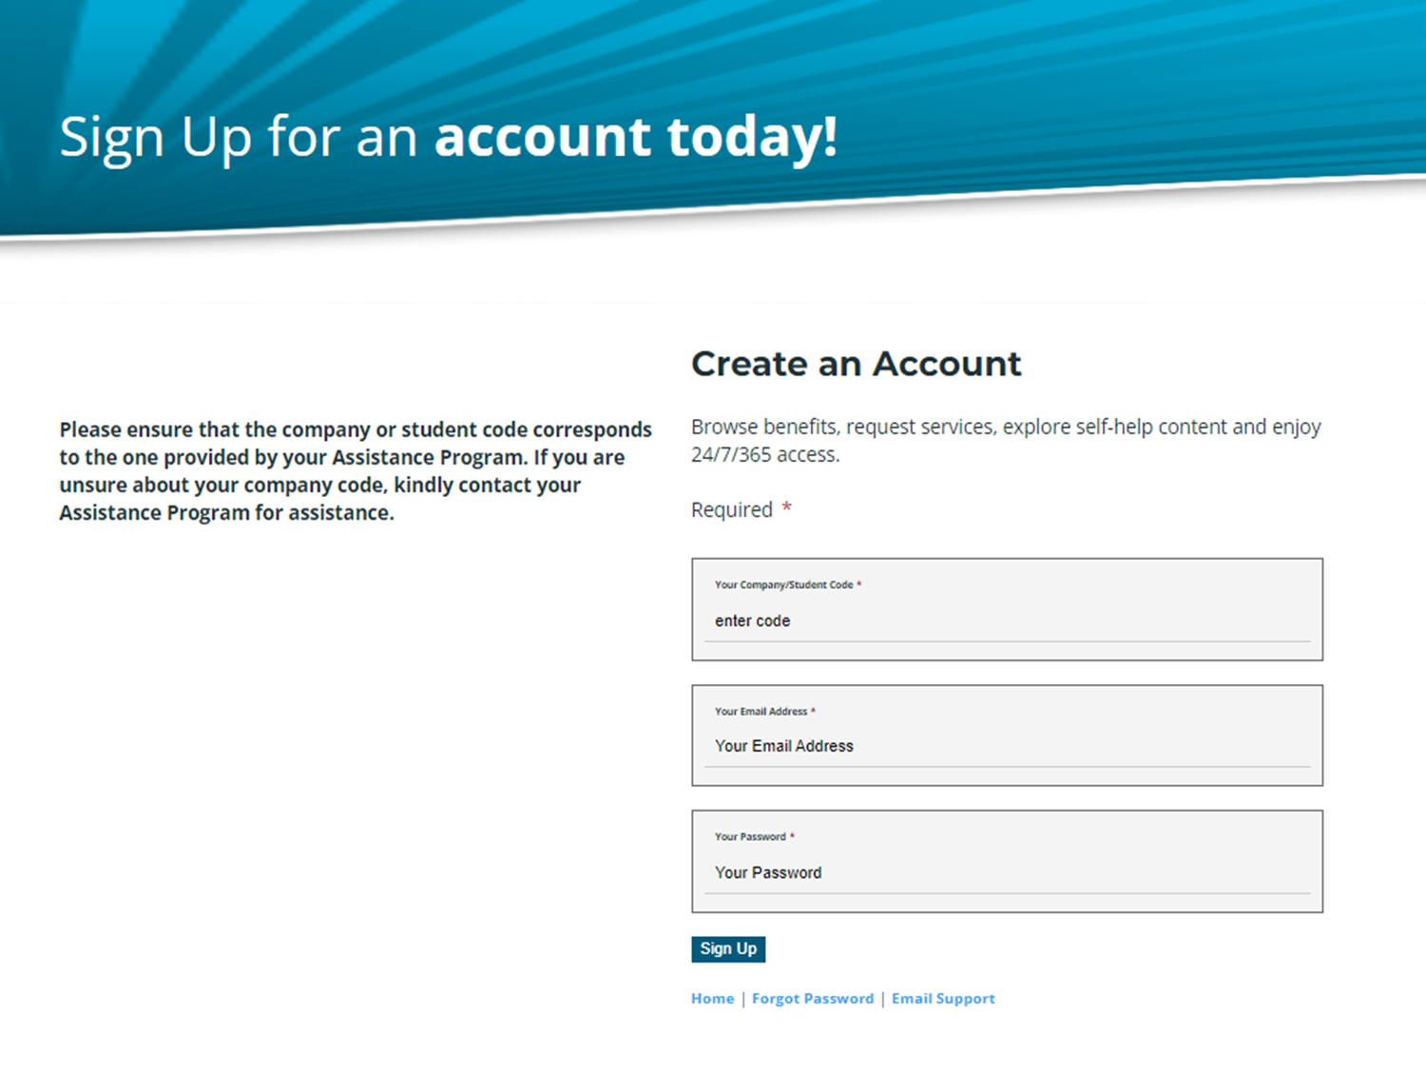

Slide 13
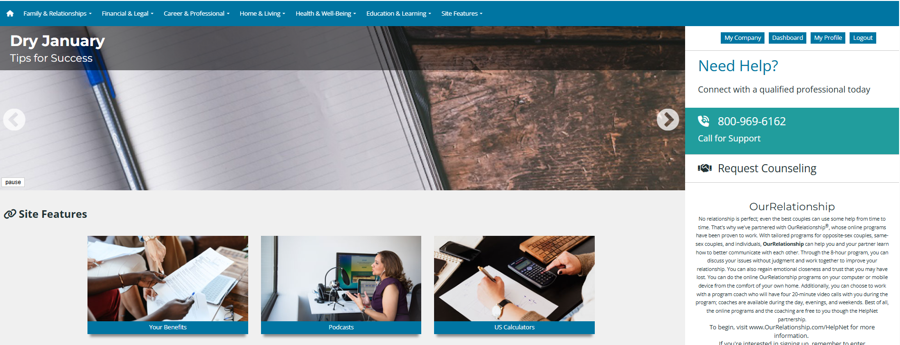

Slide 14

Topics on the Member Portal
Family & Relationships
Home & Living
10+
Lifestyle Assessments
  Senior
  Children
  Parents
  Relationships
  Holidays
  Pets
  Family
  Home
  Tech
  Abroad
  Outdoors
  Disaster
  Safety
  Weather
  Living
  Observances
100+
Soft Skills
Courses
Financial & Legal
  Auto
  Financial
  Legal
  Forms
Health & Well-Being
41+
Calculators
  Nutrition
  Health
  Addiction
  Fitness
  Mental Health
  Podcasts
Career & Professional
  Military
  Careers
  Management
  First Responders
64+
Recorded
Webinars
Education & Learning
  Student
  Higher Education
  Education

Slide 15


Legal Assistance
When you need advice
Free 30-minute consultation with an attorney or mediator to assist with legal issues and questions. Then if you require counsel, you receive a 25% discount.
This engagement can be in-person or virtual.
Topics include will building, estate planning, divorce, custody, and more.
Excluded topics include employer-related issues, wrongful termination, malpractice, disability, worker’s compensation, etc.
Call our office or chat on the work life member portal to access.

Slide 16


Financial Consultation
When you want to ask
All our Coaches are Certified in their area of expertise and deliver top-notch financial counseling designed to help restore financial balance to people’s lives.
Comprehensive Financial coaching that addresses many facets of a client situation. This counseling model is not scripted, and places focus on problem resolution, goal setting, and behavioral and financial awareness to financially empower individuals.
Areas of service & coaching include budgeting, debt management, tax questions, retirement planning advice, identity theft, savings coaching, credit review/improvement, consumer advocacy and more.
These advisors do not provide money or tell the clients how to invest.
Call our office or chat on the work life member portal to access.

Slide 17


Managment Support
When you want guidance
Free confidential consultations to assist with workplace challenges.
Assessments and help for areas of improvement and development.
Training and Coaching sessions are available.
Precise steps for the Mandatory Management Referral.
Comprehensive Resources and Tools.
Insights for leading of your team toward your goal and growth.
Call our office or contact your account manager to access.
Notes:
MR forms are located on the WLW

Slide 18
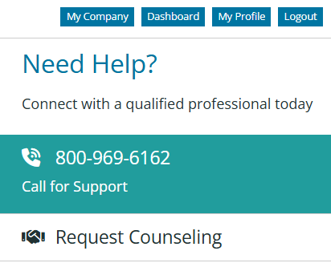
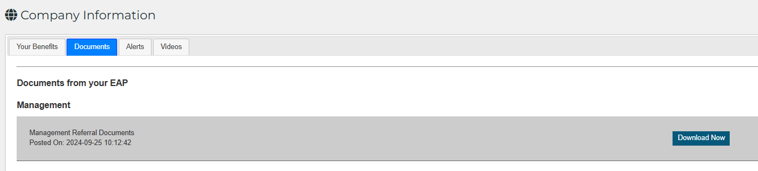
Management Referral Forms are on the Member Portal
Click on “My Company” and then on “Documents”

Slide 19



Let us be your First Resource,
not a Last Resort.
1-800-969-6162
helpnet@bronsonhg.org
www.bronsonhelpnet.org

