Slide 1
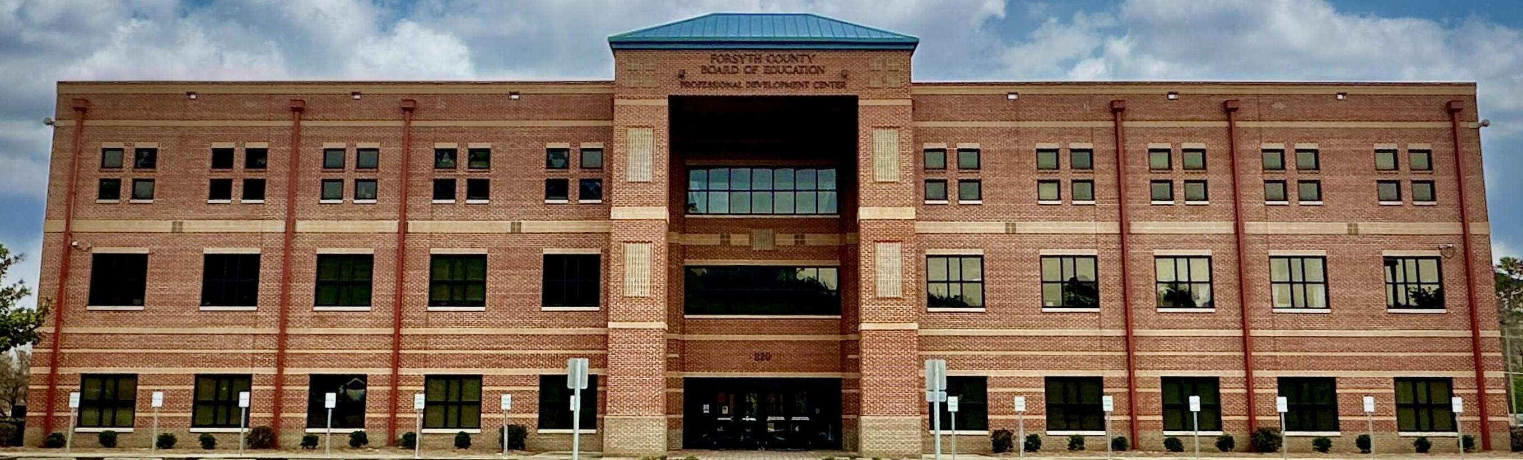

FY25 Initial Budget
Presentation
May 14, 2024
Notes:
MITCH

Slide 2

FY25 Budget Proposal
Five Major Objectives
Strategic Vision
Balanced Budget
Safety and Security
Academic Achievement
and Growth
Recruitment and Retention
Large System Feeling Small
Operational Excellence
Social and Emotional Health
The Learner Experience
Staff Recruitment and
Development
- Culture, Climate, and
Community
AP: 9,916
FVA: 3,054
Dual Enrollment: 1,659
G AVS: 1,355
APEX: 452
AP: 9,916
FVA: 3,054
Dual Enrollment: 1,659
GAVS: 1,355
APEX: 452

Slide 3
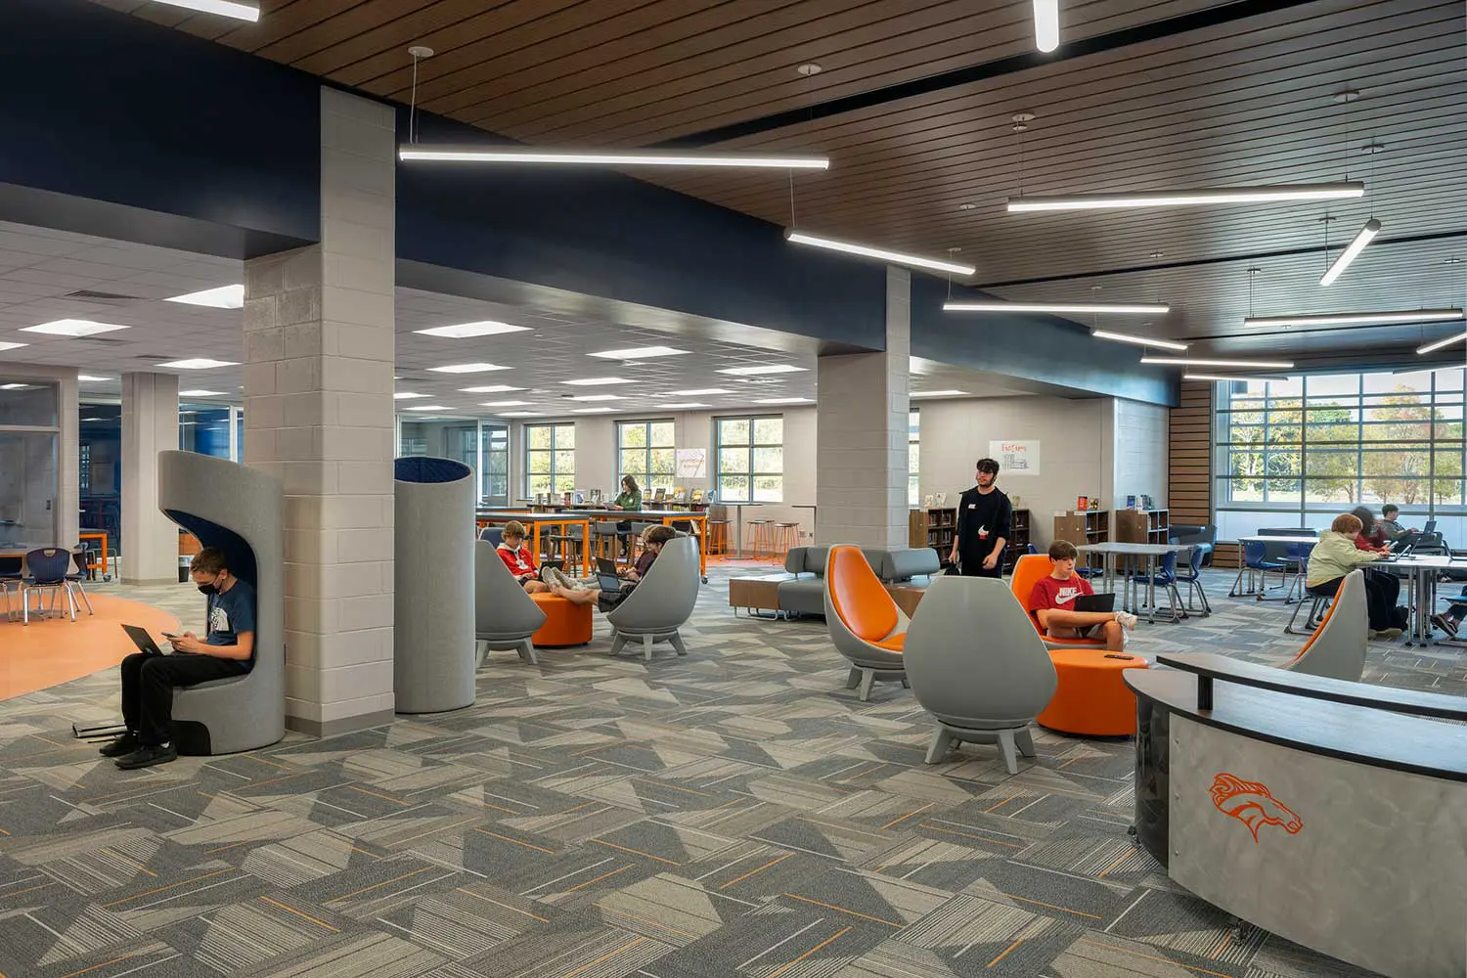
Challenges We Continue to Face
Continued Student Growth
Increases in Students with Disabilities and English Language Learners
State-Mandated Insurance and Retirement Increases
Recruiting and Retaining High Quality Educators and Staff – Classified and Certified
Inflation Across the Board

Slide 4
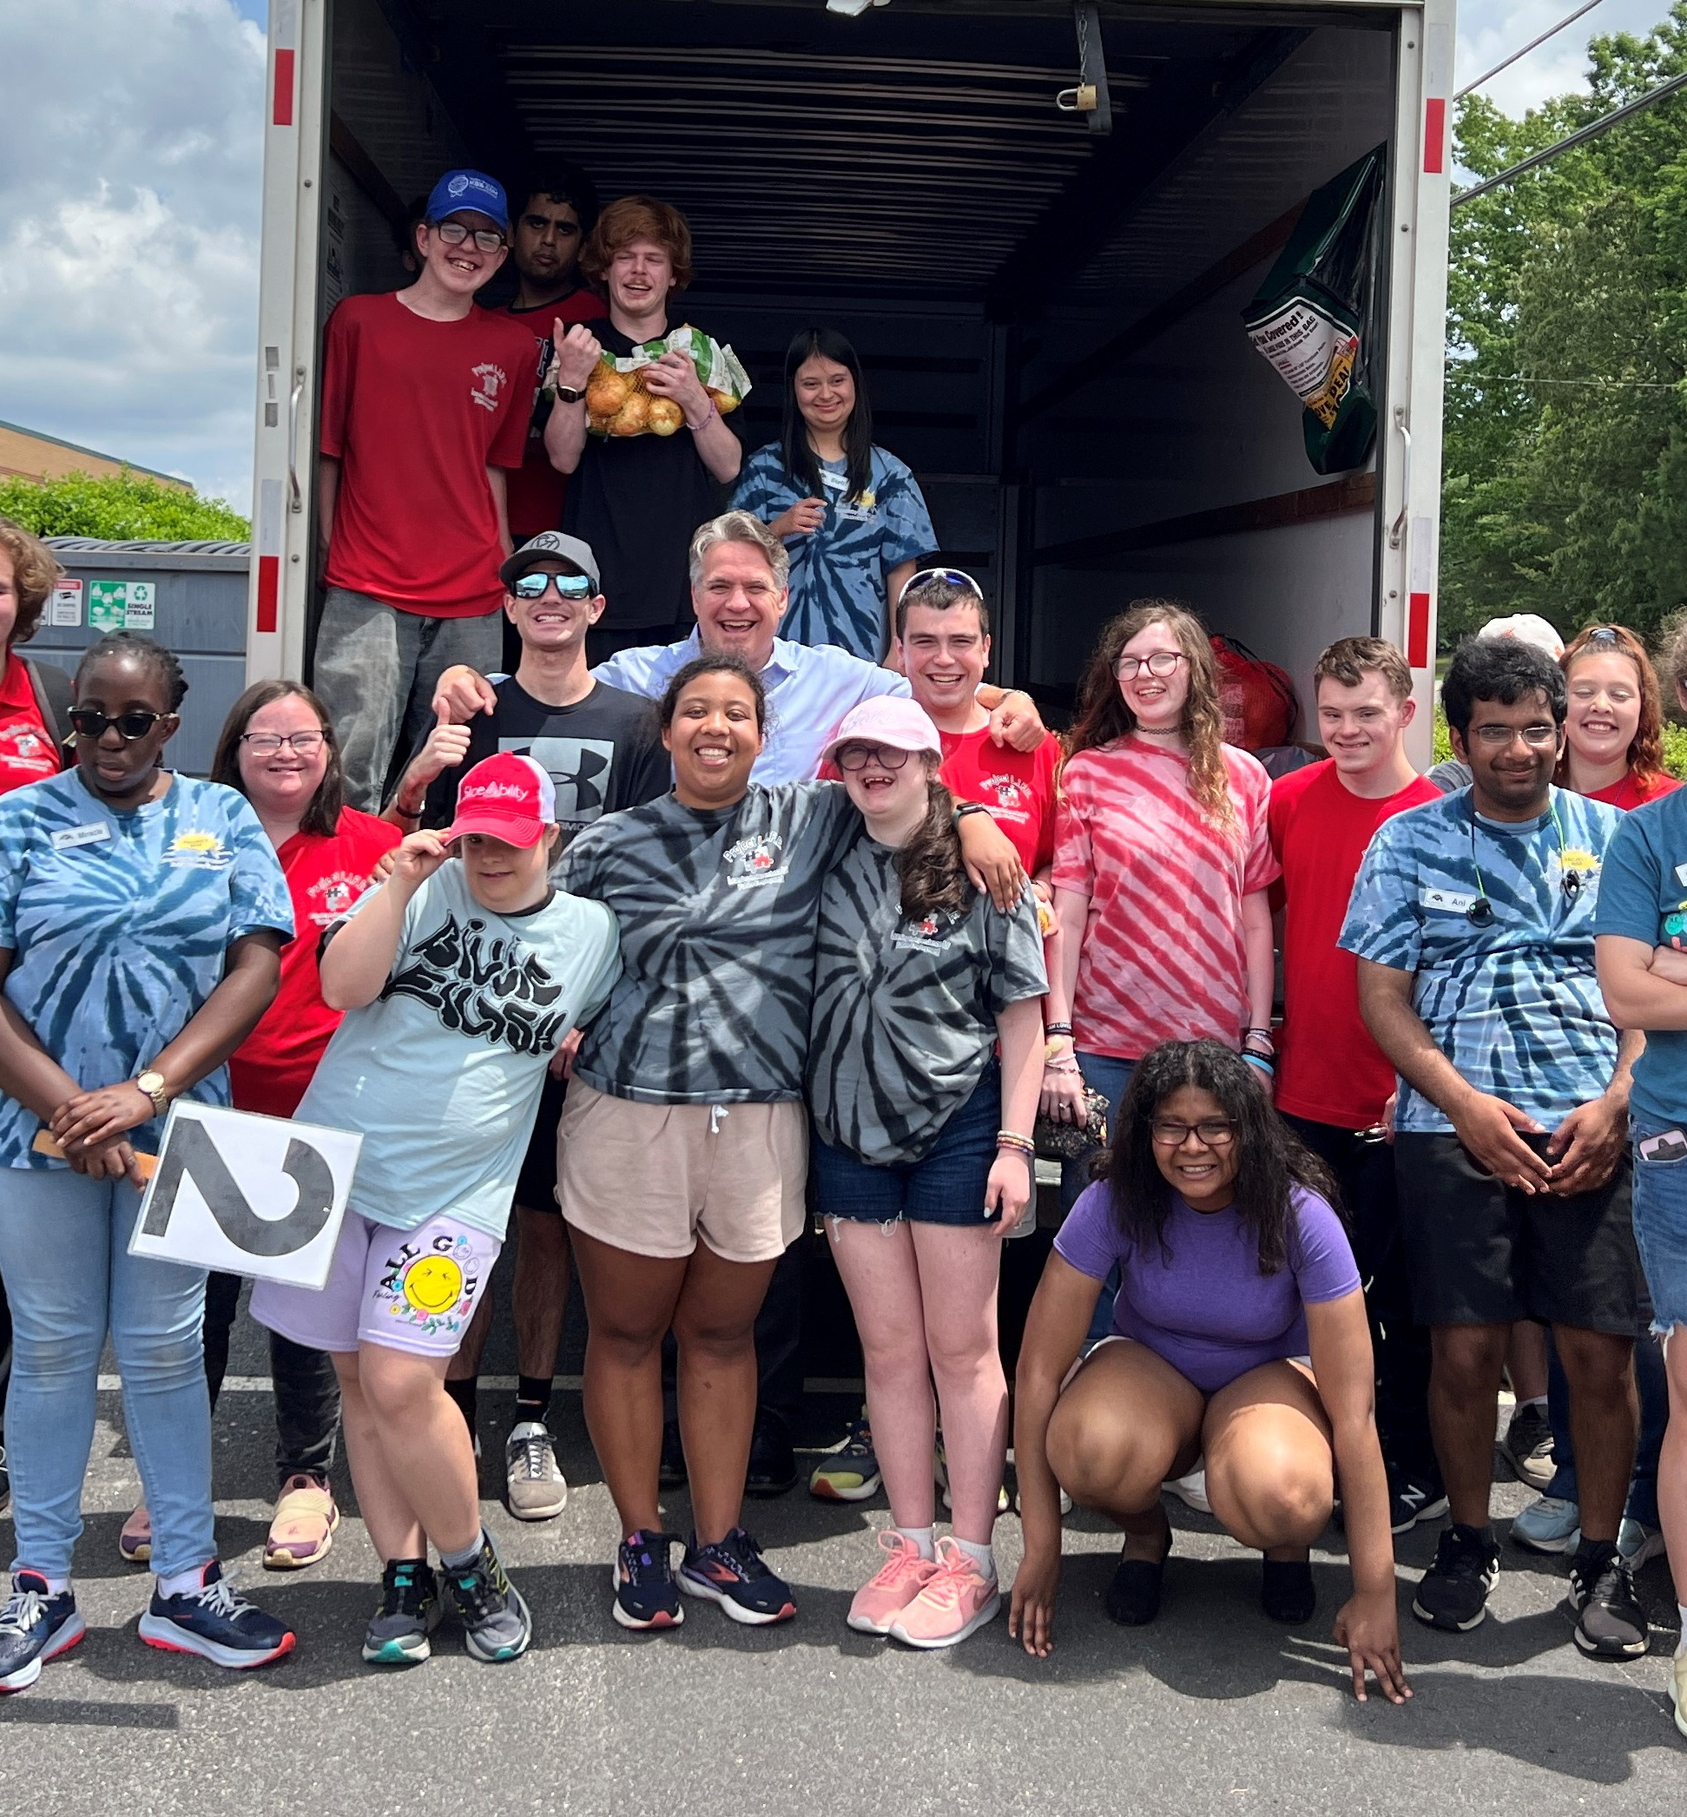
FY25 Budget Highlights
Revenues
47.13% State and Federal
No Austerity Cuts
$2,500 Teacher Raises
Increase in Funding for Safety and Transportation
Fully Funded QBE
52.87% Local
Inflation and Low Housing Inventory Result in a *6.89% Increase in County Digest
Budget Built Maintaining the Current 15.30 M&O Millage Rate
* Based on projected Forsyth
County property assessments –
subject to change
Notes:
LARRY

Slide 5

FY25 Budget Highlights
Expenses
State Increases – *6.44%
Health Insurance Increases
Retirement Increases (TRS)
$2,500 Teacher Raises
* Mandated Increases
Local Increases – 4.32%
Mashburn ES Expansion
Safety Expansion and Relocation
Special Education and Futures Center
5% Increase - Classified Pay
1% Cost of Living Adjustment (COLA) - Additional Step
$2,500 Raises Not Covered by the State
Notes:
LARRY

Slide 6
FY25 Budget Proposal
Five Major Objectives
Local Increases
Balanced Budget
Safety and Security
Academic Achievement
And Growth
Recruitment and Retention
Large System Feeling Small
- Balanced Budget with No Proposed Millage Rate Hike
- Safety Center Expansion
- Staff Increases in Special Education, English Language Learners, and Gifted; Special Education and Futures Center
- Pay Adjustments for All Staff
- Mashburn ES Expansion; Additional Support Positions
AP: 9,916
FVA: 3,054
Dual Enrollment: 1,659
G AVS: 1,355
APEX: 452
AP: 9,916
FVA: 3,054
Dual Enrollment: 1,659
GAVS: 1,355
APEX: 452

Slide 7
Student Enrollment Growth
Since the 1990s, FCS has experienced incredible, nationally recognized, growth
FY14: 4,200 full-time employees operating under a $297 million budget
FY24: 6,233 employees operating under a $645 million budget
9
14,462
New Schools
Including
ACE
New Students
Similar to adding a new
school the size of SFMS annually

Slide 8

The Learner Experience
Increase Student
Achievement and Growth
Increase Student
Engagement
AP: 9,916
FVA: 3,054
Dual Enrollment: 1,659
GAVS: 1,355
APEX: 452
Students Enrolled in 23-24 Courses:
AP: 9,916
FVA: 3,054
Dual Enrollment: 1,659
GAVS: 1,355
APEX: 452
Highest Grad Rate in FCS History: 96%
Highest SAT in GA
- 3 FCS HS in Top 10 in GA
Highest Grad Rate and ACT Score Among Metro-Atlanta and Large Districts
CTAE Pathways: 13,862
Pathway Completers:
3,638
Internship Participants:
937

Slide 9

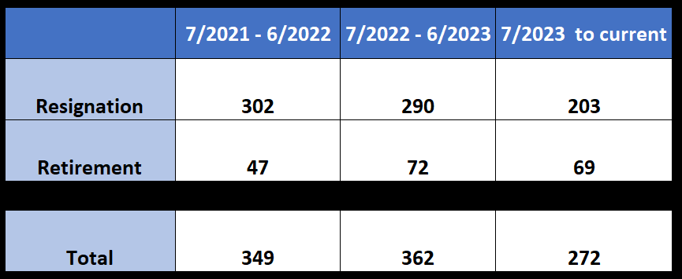
Staff Recruitment and Development
Acquire and Retain
Excellent Staff
Forsyth County Schools is the Largest Employer in Forsyth County

Slide 10




Operational Excellence
Manage Financial Resources
Plan and Allocate Resources
Plan and Adapt for Growth
FY23 Lowered Bond 1 MILL
- 2.418 to 1.418
- Back to FY10 Rate
FY24 Lowered M&O 2 MILLS
- 17.30 to 15.30
Lower than FY08 Rate
Only District in GA with an 8 year 5 Star Financial Rating
Among 12 Largest GA Districts:
- Lowest Per Pupil Cost
- Lowest for School Admin
- 2nd Lowest for Total Admin
- 4th Lowest for General Admin
        View Details Here
One of a Few Districts in GA with Over 65 School Tax Exemption
Impact Fees for Schools
and Fixed Homestead Exemption
SPLOST vs Bonds
View 2000-24 Rates

Slide 11
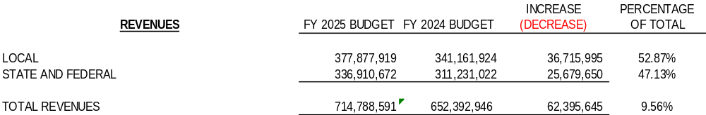

Slide 12
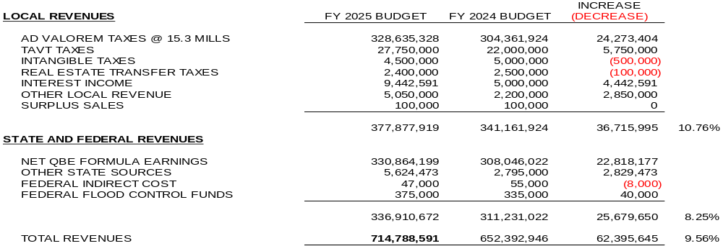

Slide 13
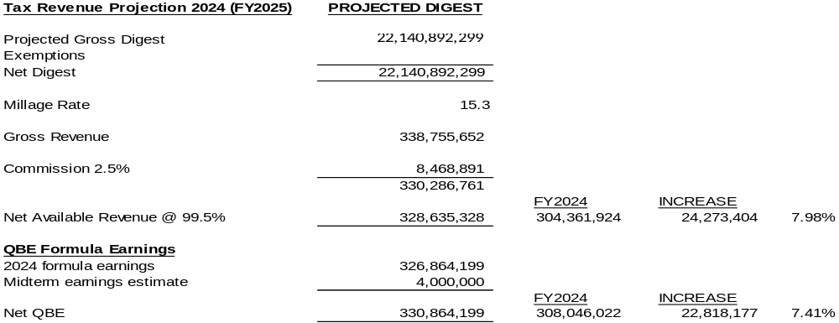

Slide 14
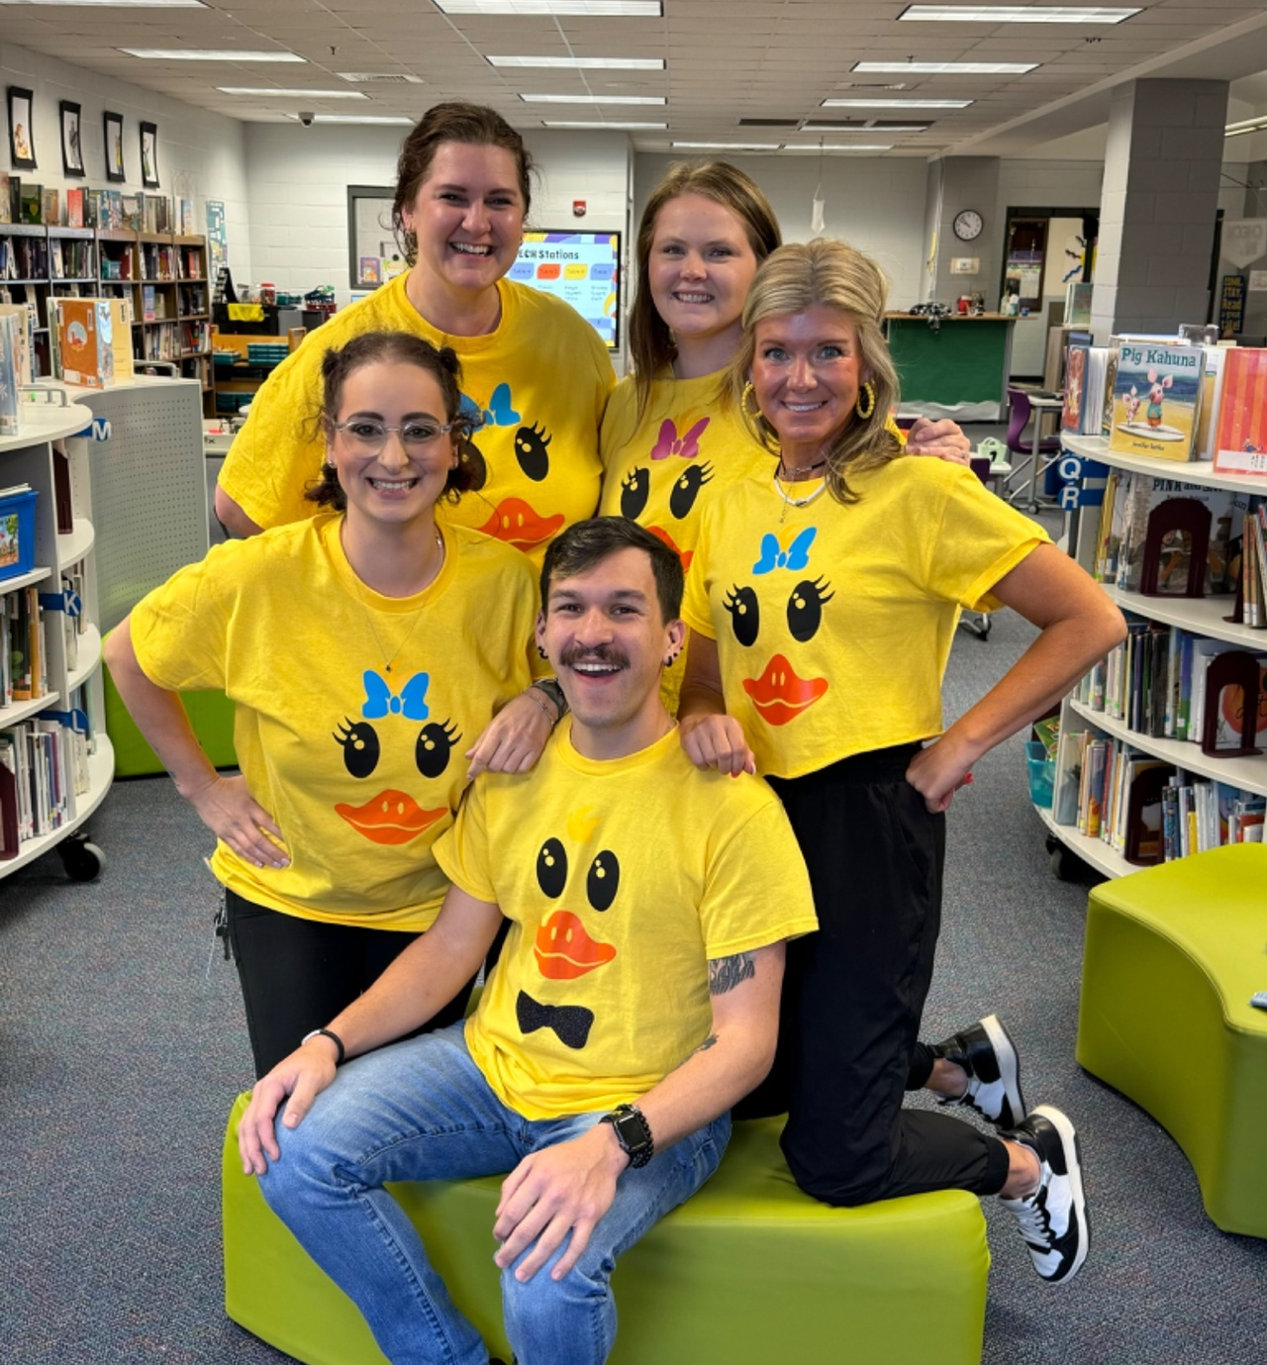
FY25 Budget Highlights
Expenses
Supporting Employees
Supporting Student Growth
131.48 New School-Based Positions
8.5 New Support Positions
Step Increase for Eligible Employees
Addition of New Step to the End of all Employee Salary Schedules Except Paraprofessionals
  Expand Paraprofessional Salary Schedule
5% COLA for Classified Staff
1% COLA for Certified Staff and $2,500 Increase
Notes:
Note: Derrick will follow Larry’s portion of the presentation to provide more details from HR on areas we are supporting employees in the budget.

Slide 15
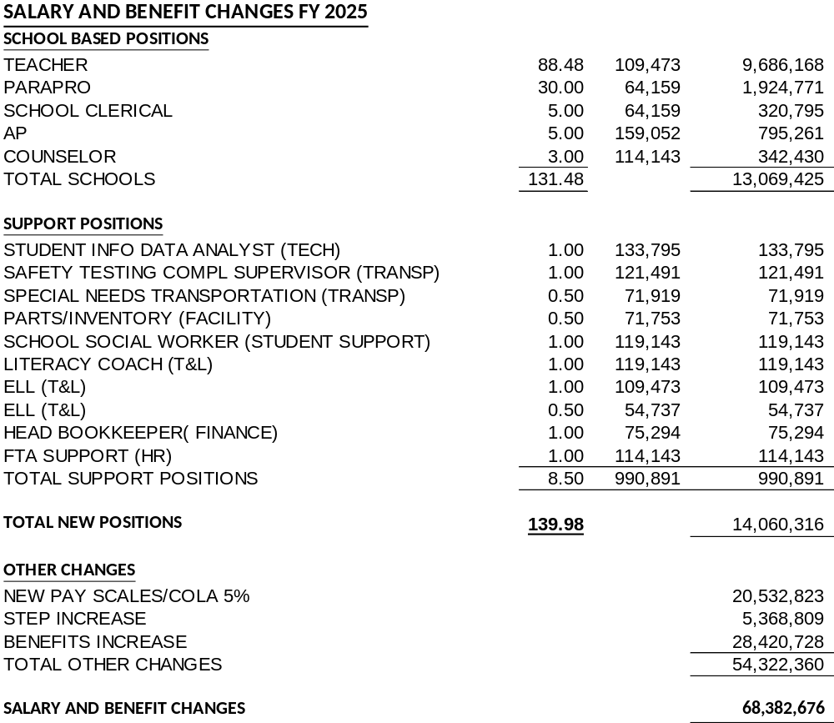

Slide 16
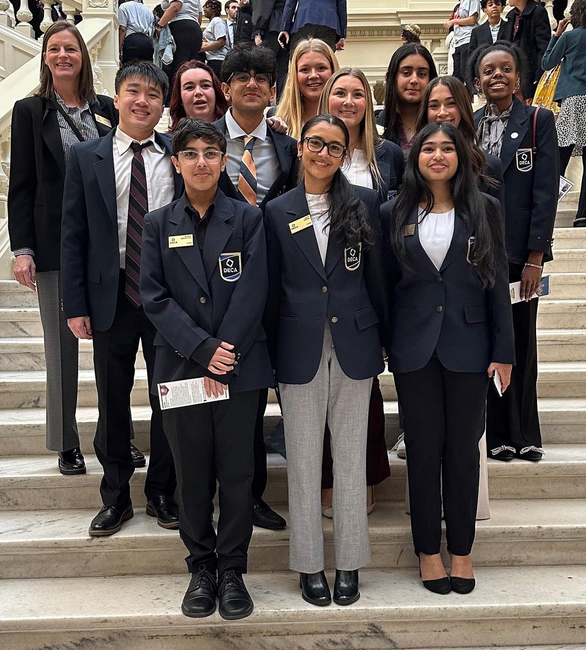
FY25 Budget Highlights
Expenses
6.44% Increase
15% Fund Balance
$2 Million for Security Relocation
$8.375 Million for Mashburn ES Expansion
2nd Year of State Mandated Changes in Salary, Health Care, and TRS Costs
4.32% Increase
- Step and Salary Increases for Employees

Slide 17
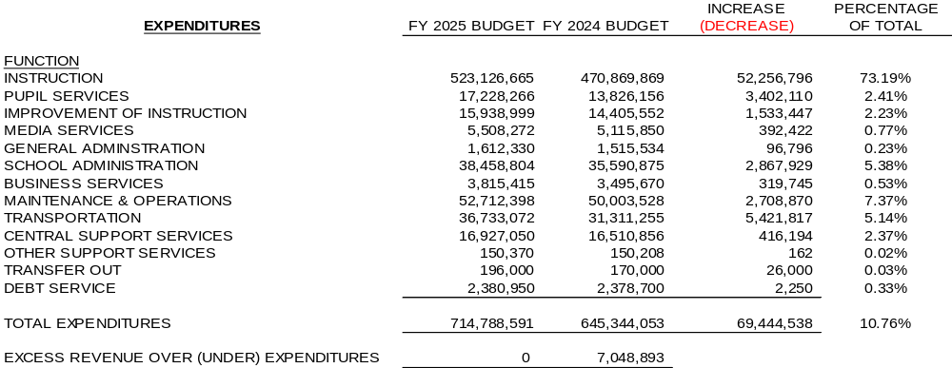

Slide 18
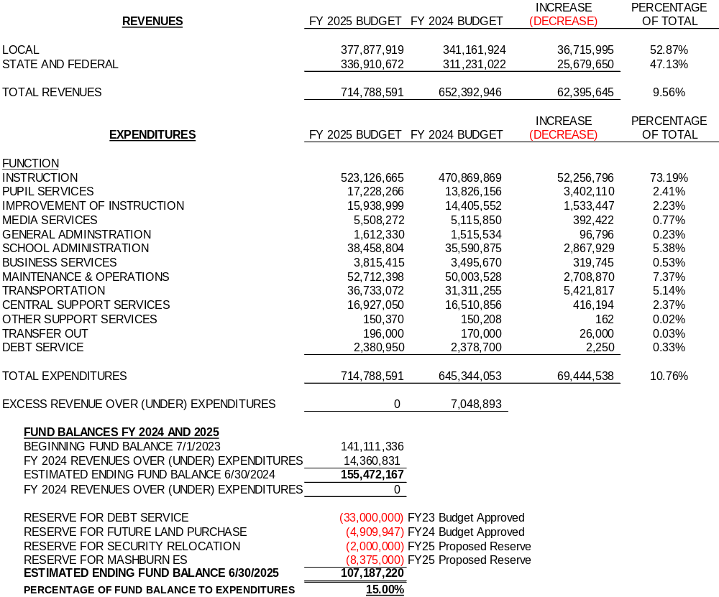

Slide 19
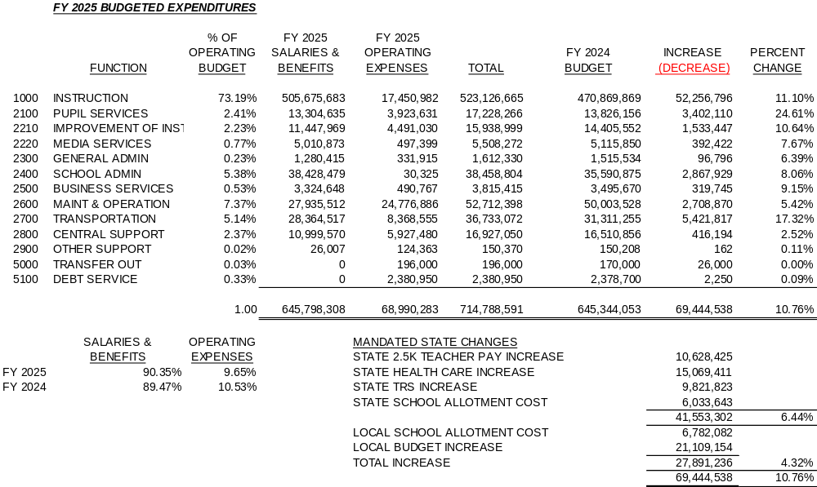

Slide 20
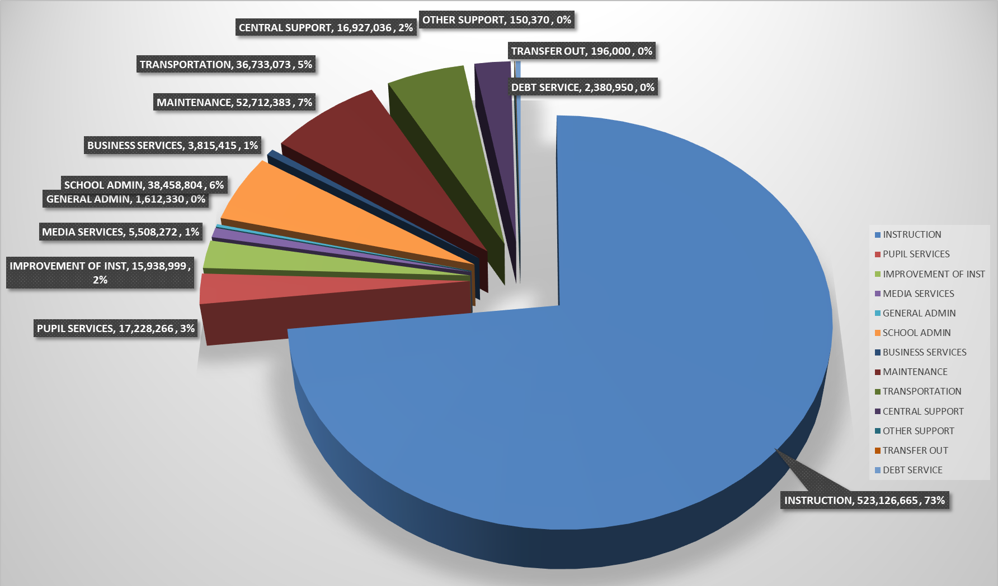
Expenditure Comparison

Slide 21
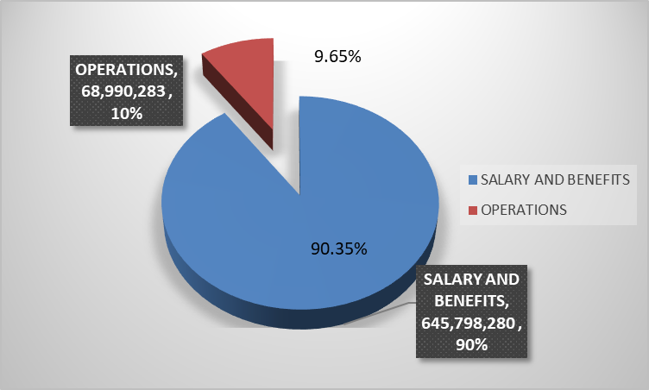
Salary Compared to Operations

Slide 22
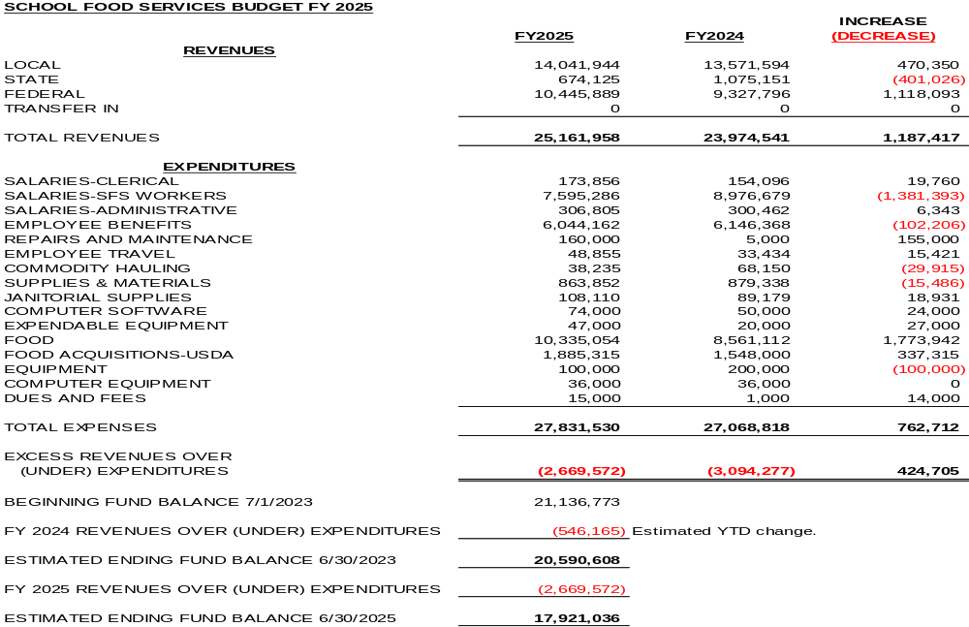
Food and Nutrition
No increase on student meal prices for FY24

Slide 23
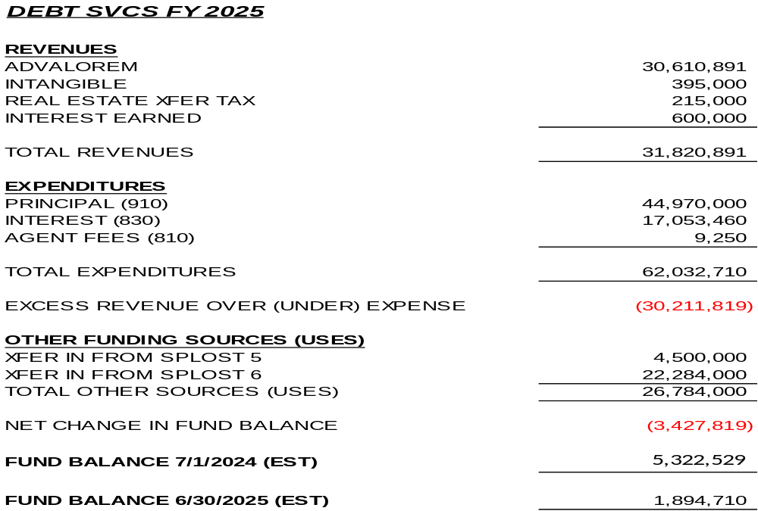
Debt Services

Slide 24
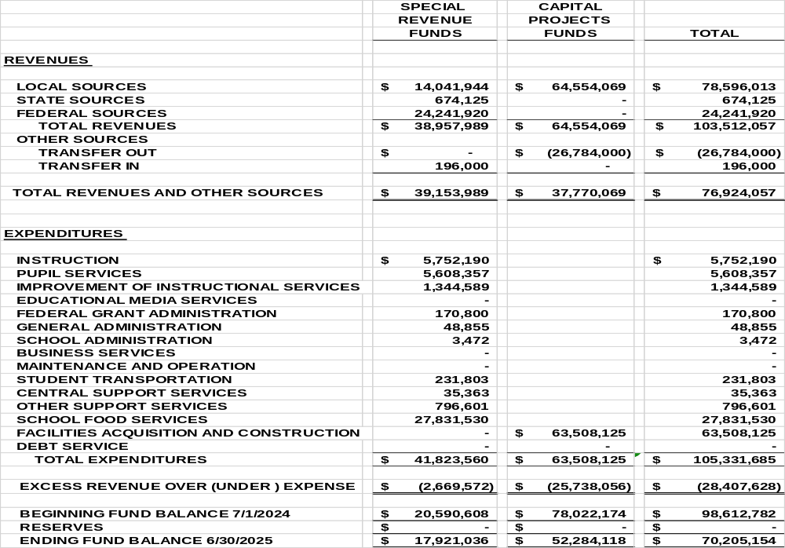
Other Budgets

Slide 25
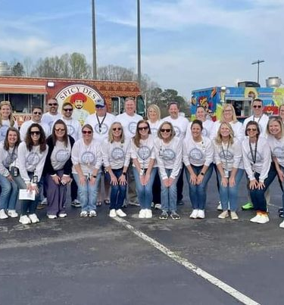
FY25 HR Highlights
Eligible Certified Staff
Step Increase for Eligible Employees
Addition of New Step to the End of all Employee Salary Schedules
  Adding a 26th Step Impacts 510+ Teachers
1% COLA and $2,500 Increase
  Each Step Includes a Minimum $3,000 Increase with an Average $3,250 Increase Across all Pay Bands*
T4 Teachers will make $60,000 by their 5th Year in FCS
$1,500 Annual Supplement for Specialized Instruction Teachers in January
*Includes $2,500 increase from the State
Notes:
DERRICK

Slide 26
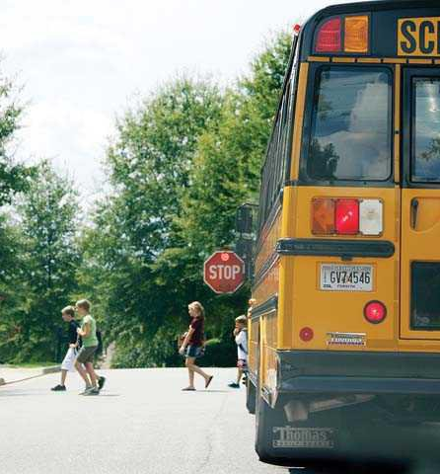
FY25 HR Highlights
Eligible Classified Staff
Step Increase for Eligible Employees
Expand Paraprofessional Salary Schedule to Eliminate Static Steps
Addition of New Step to the End of all Employee Salary Schedules Except Paraprofessionals
5% COLA Increase for Classified Staff
Bus Driver Starting Hourly Rate: $21.02
$1,000 Annual Supplement for Specialized Instruction Parapros in January

Slide 27
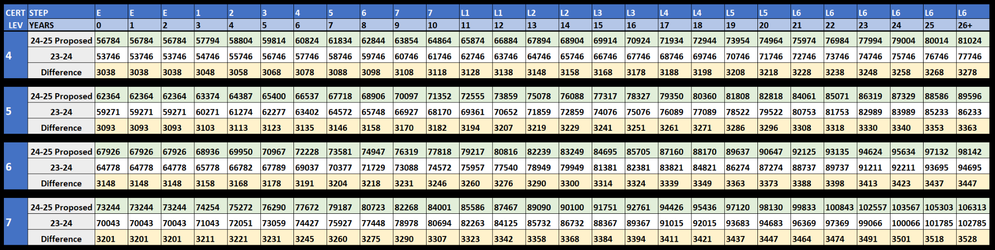
24-25 Proposed Teacher Salary Schedule
Pending BOE Approval, All Employee Salary Schedules will be Released Online on June 18, 2024

Slide 28
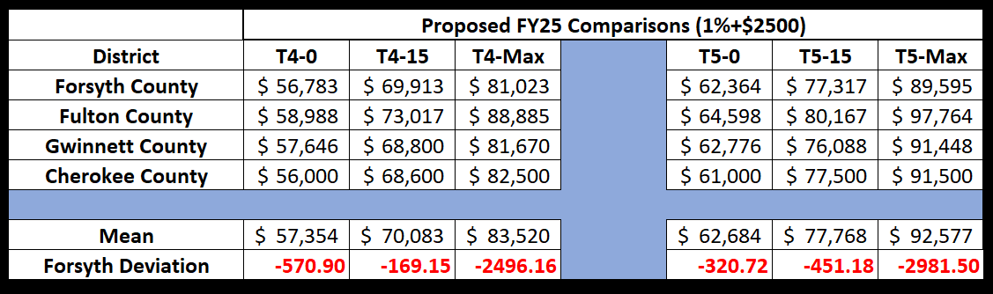
Teacher Salary Comparison
*2024-2025 projections based on a minimum increase of $2,500 for other districts from State funds

Slide 29
Safe.
Connected. Thriving.
Forsyth County Schools
Notes:
MITCH

