Slide 1

Holland Central
School District
2025-2026 BUDGET HEARING
Cathy Fabiatos
Interim Superintendent of Schools
Brittany Carey
School Business Administrator
May 6, 2025

Slide 2
District Goals
PRESENTATION OVERVIEW
We are unwavering in our commitment to meeting the needs and interests of our students.
We are committed to exercising care and good judgement in managing the resources with which we are entrusted by our community.
We are committed to conducting our business in an objective, professional, and transparent manner.

Slide 3
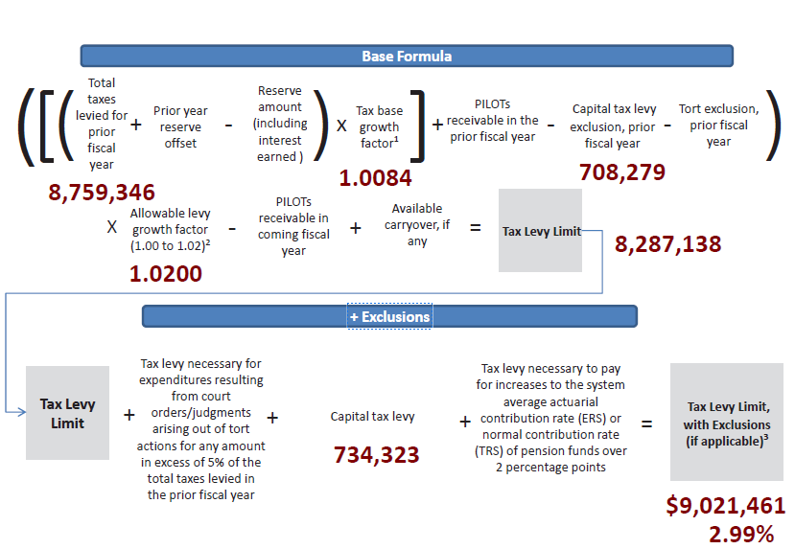
Tax Levy 2025-26
PRESENTATION OVERVIEW
Tax Levy: $9,021,461
Increase % from 24-25: 2.99%
Increase $ from 24-25: $262,115
Does NOT require supermajority vote

Slide 4
Ten-Year Tax Levy History
2016-17 | 0.00%
2017-18 | 0.00%
2018-19 | 1.98%
2019-20 | 2.73%
2020-21 | 3.33%
2021-22 | 1.90%
2022-23 | 2.99%
2023-24 | 3.08%
2024-25 | 3.98%
2025-26 | 2.99%
All within formula allowed tax cap limit

Slide 5

25-26 Tax Levy: 2.99%
PRESENTATION OVERVIEW
Does not exceed NYS Tax Cap or require a supermajority vote
Tax Levy: $9,021,461
Increase from 24-25: $262,115
 | Rate in 2024-2025 | *Rate in 2025-2026 | Increase Per $100,000
Aurora | $39.44 | $40.62 | $117.93
Colden | $36.27 | $37.35 | $108.44
Concord | $30.22 | $31.12 | $90.37
Holland | $18.13 | $18.67 | $54.22
Sardinia | $25.90 | $26.67 | $77.47
Wales | $34.87 | $35.91 | $104.27
Java | $11.89 | $12.25 | $35.55
Sheldon | $10.35 | $10.66 | $30.95
* Rates are estimates based on assessment values, equalization rates, and exemptions from 24-25

Slide 6
10 Year K-12 Enrollment Data
PRESENTATION OVERVIEW
 | 14-15 | 15-16 | 16-17 | 17-18 | 18-19 | 19-20 | 20-21 | 21-22 | 22-23 | 23-24
Enrollment | 893 | 885 | 870 | 881 | 864 | 829 | 758 | 727 | 732 | 684
 |  | -8 | -15 | 11 | -17 | -35 | -71 | -31 | 5 | -48
data.nysed.com
Notes:
Data counts are as of BEDS (basic education data system) Day which is the first Wednesday in October

Slide 7
2025-2026 Revenues Snapshot
PRESENTATION OVERVIEW

Slide 8
Tripartite Budget
PRESENTATION OVERVIEW
 | 2024-2025 | 2025-2026 | Change | % Change
Administration | $1,516,994 | $1,532,469 | $15,475 | 1.02
Capital | $4,257,317 | $4,483,100 | $225,783 | 5.30
Program | $16,878,136 | $17,049,770 | $171,634 | 1.02
Total | $22,652,447 | $23,065,339 | $412,892 | 1.82

Slide 9
Component Budget
PRESENTATION OVERVIEW

Slide 10
Vehicle Proposition - $363,043
PRESENTATION OVERVIEW
Diesel Type C, 64 Pupil Front-Engine Bus $181,521.27
Diesel Type C, 64 Pupil Front-Engine Bus $181,521.27
Total Vehicle Proposition $363,043

Slide 11
Contingency Budget - $22,564,798
PRESENTATION OVERVIEW
Would require an approximate reduction of $500,541 from the proposed budget
  Levies a tax no greater than current fiscal year of $8,759,346 ($262,115), would require additional staffing reductions
  Student Supplies and Materials ($53,926)
  Non-Essential Capital Work ($100,000 aided at 81%)
  Equipment Purchases ($74,500)
  Expenses Attributed to Public Use of School Buildings & Grounds ($10,000)

Slide 12
Board of Education Seats
PRESENTATION OVERVIEW
An election for members of the Board shall be held to fill one (1) at-large position on the Board resulting from the expiration, on June 30, 202, of the term of Gerald Vella. The candidate receiving the highest vote total will be elected to a five (5) year term commencing July 1, 2025 and ending on June 30, 2030.
Candidates:
Tom Olszewski
Martin Wilke

Slide 13
2025-2026 Proposed Budget
PRESENTATION OVERVIEW
$23,065,339
Overall Increase: $412,892 or 1.8%
Budget Vote
May 20, 2025
7am – 8pm
Holland Community Center
3 Legion Drive, Holland NY

