Slide 1

Teacher Stories
EdTech Webinar Series
April 23, 2025

Slide 2
Welcome & Norms
Chat
Mute
Mute mic when not speaking
Use the Chat area to ask questions or get help
Say Hello in our Chat Now:
  What's your go to EdTech Tool or Application?
Engage in the content and prompts

Slide 3

Session is being Recorded
Recording in Progress

Slide 4
Who is Fresno EdTech?
Matthew Schwartz
Brian Dvorak

Slide 5
Fresno EdTech Website (go.fresnou.org/edtech)
Sign up for our Weekly Blog Posts
Try our new Chat Bot
Discover Classroom Apps
Webinar Resources
Student Digital Literacy – Updated Tech Scope and Sequence
Digital Citizenship Resources
EdTech Conference
And more…
Notes:
Educational Technology - Fresno Unified School District

Slide 6
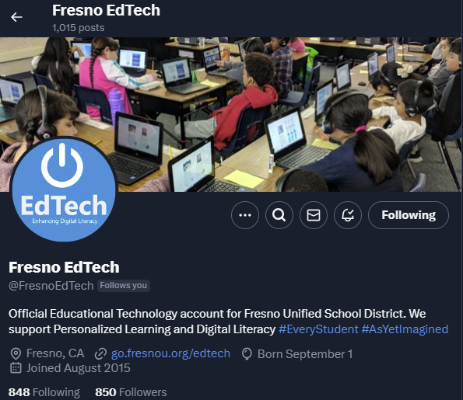

Follow Fresno EdTech on Social Media
Fresno EdTech

Slide 7

Student
Tech
Scope and
Sequence
Updated skills
TK-12 Grades
Linked Resources
Organized by Grade Bands

Slide 8
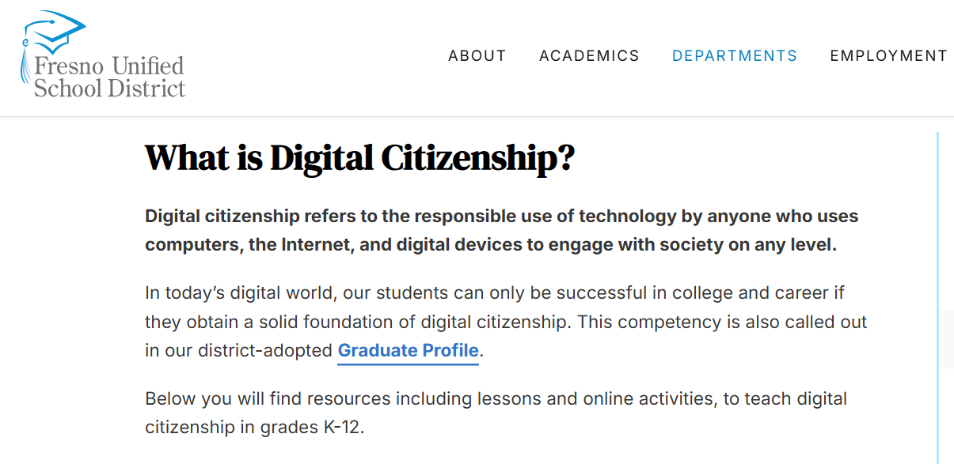
Digital Citizenship
Digital Citizenship - Fresno Unified School District
Notes:
Digital Citizenship - Fresno Unified School District

Slide 9
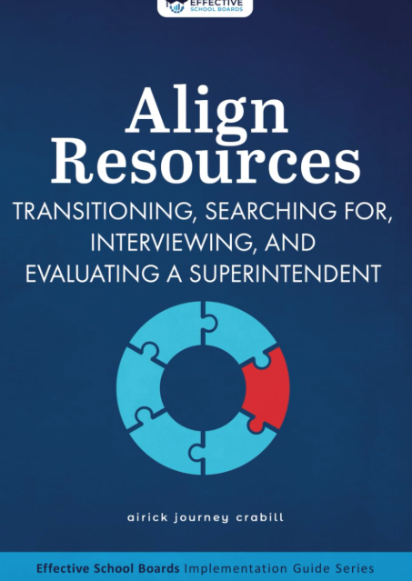
Board Adopted Goals
Early Literacy: The percentage of 1st graders who are proficient in literacy based on iReady results will increase from 48% in June 2024 to 80% June 2030.
Literacy Intervention: The percentage of 3rd-8th grade students who are more than one year behind as measured by Smarter Balanced (SBAC) English Language Arts (ELA) who make more than one year’s growth will increase from X% in June 2024 to Y% by June 2030.
College & Career Readiness: The percentage of students graduating from high school who are college and career ready based on CCI will increase from 43% in June 2024 to 64% by June 2030.
Life Skills: The percentage of 6th, 8th, and 12th grade students who demonstrate benchmarked competencies in the skills listed in the Portrait of a Learner using age-appropriate assessments will increase by X% in June 2027 to Y% by June 2030.

Slide 10
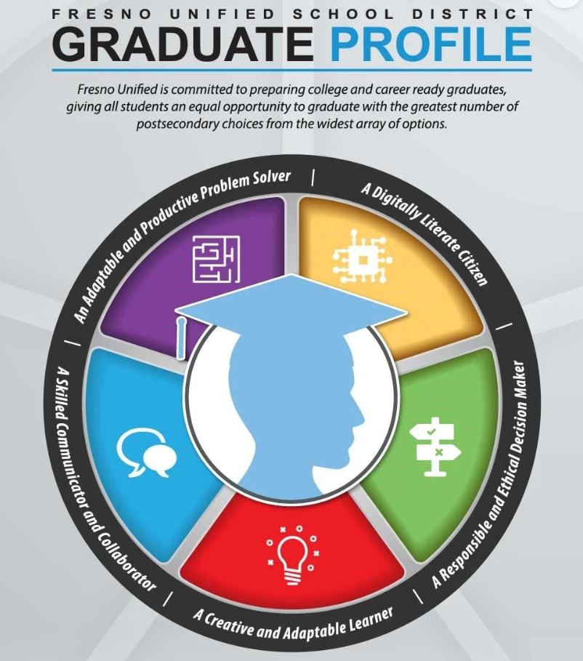
Graduate Profile
Graduate-Profile-Poster-2018

Slide 11

Agenda
Relax and have an informative webinar
Share and Discuss Examples of Implementation
  Learning Accelerators, AI Teacher Assistants, Minecraft, Multimedia, Presentations
Reflect on what was shared

Slide 12
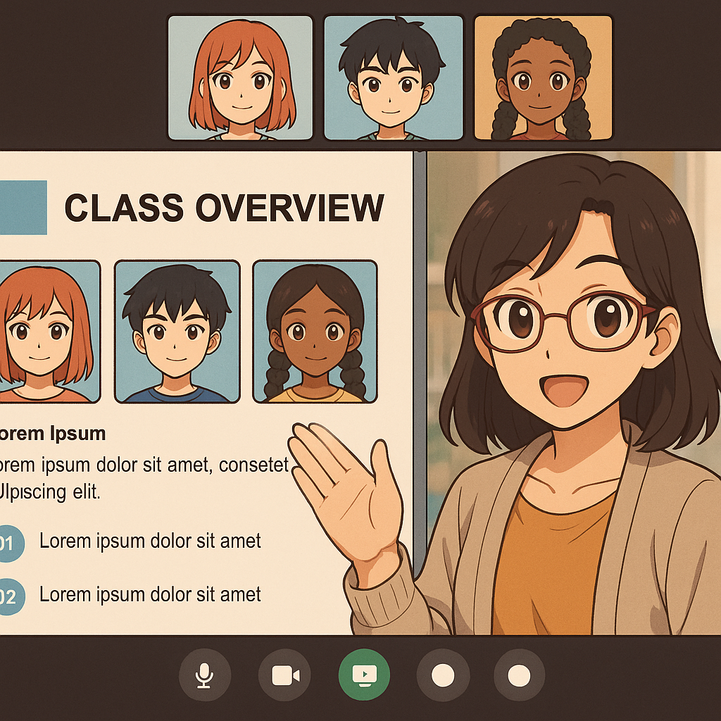
Process
5 minutes of sharing
5 minutes to ask and clarify
Repeat steps 1 and 2 as needed (Open Mic)
Digital activity for all to reflect
Closing survey

Slide 13
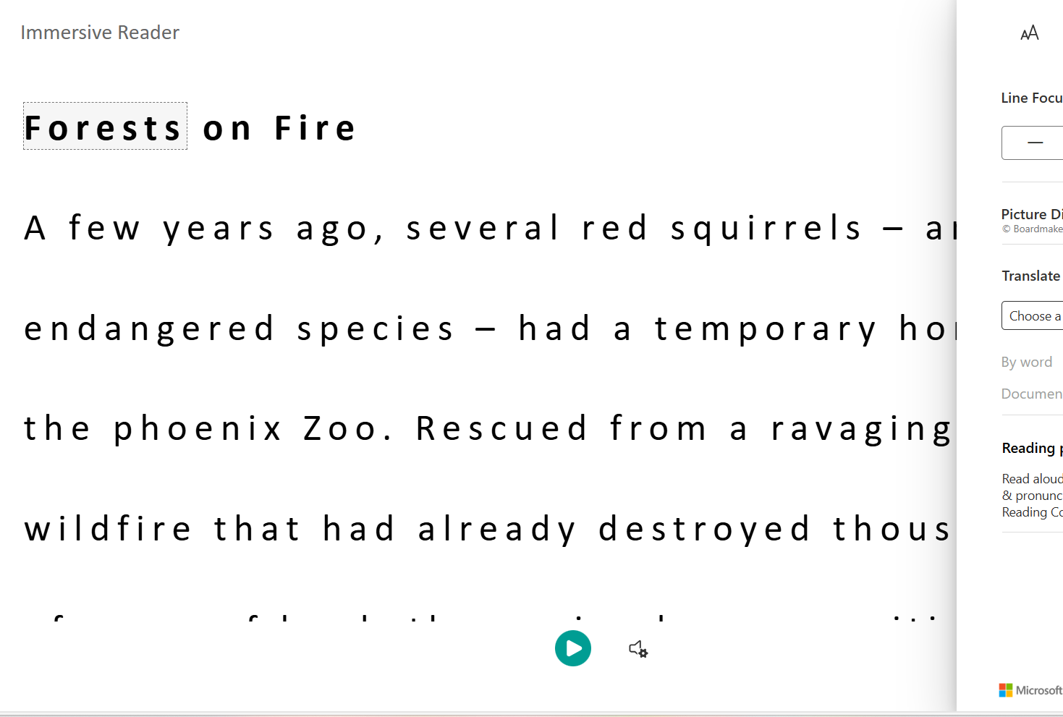
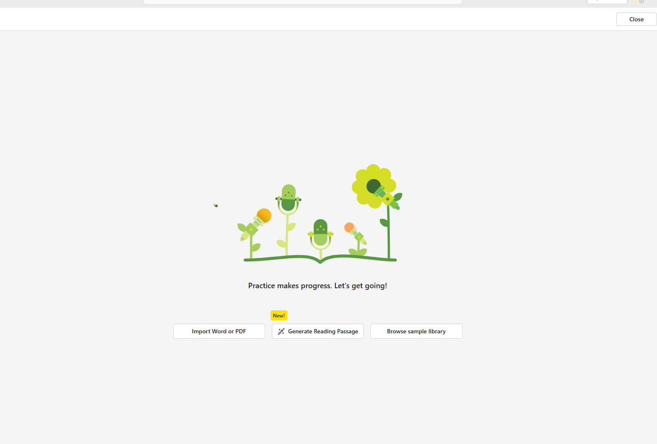
Learning Accelerators, Immersive Reader
November Webinar

Slide 14


AI Teacher Assistants – October Webinar
Have you used your AI Teacher Assistants?

Slide 15


Recent Khan Academy Webinar for Teachers

Slide 16
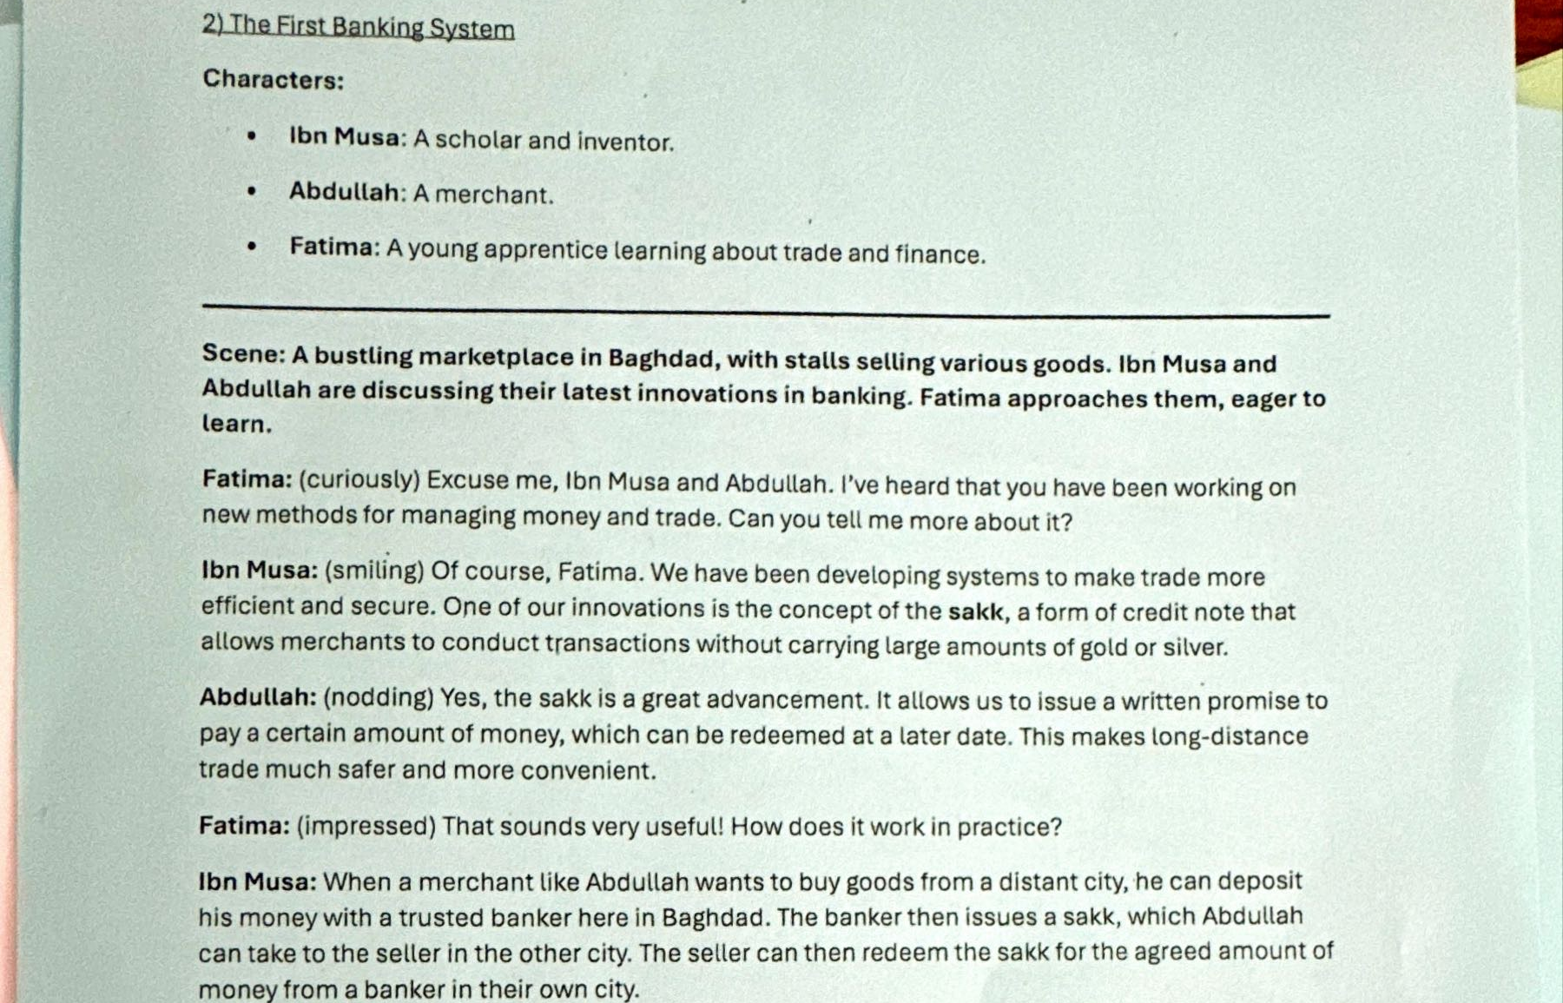
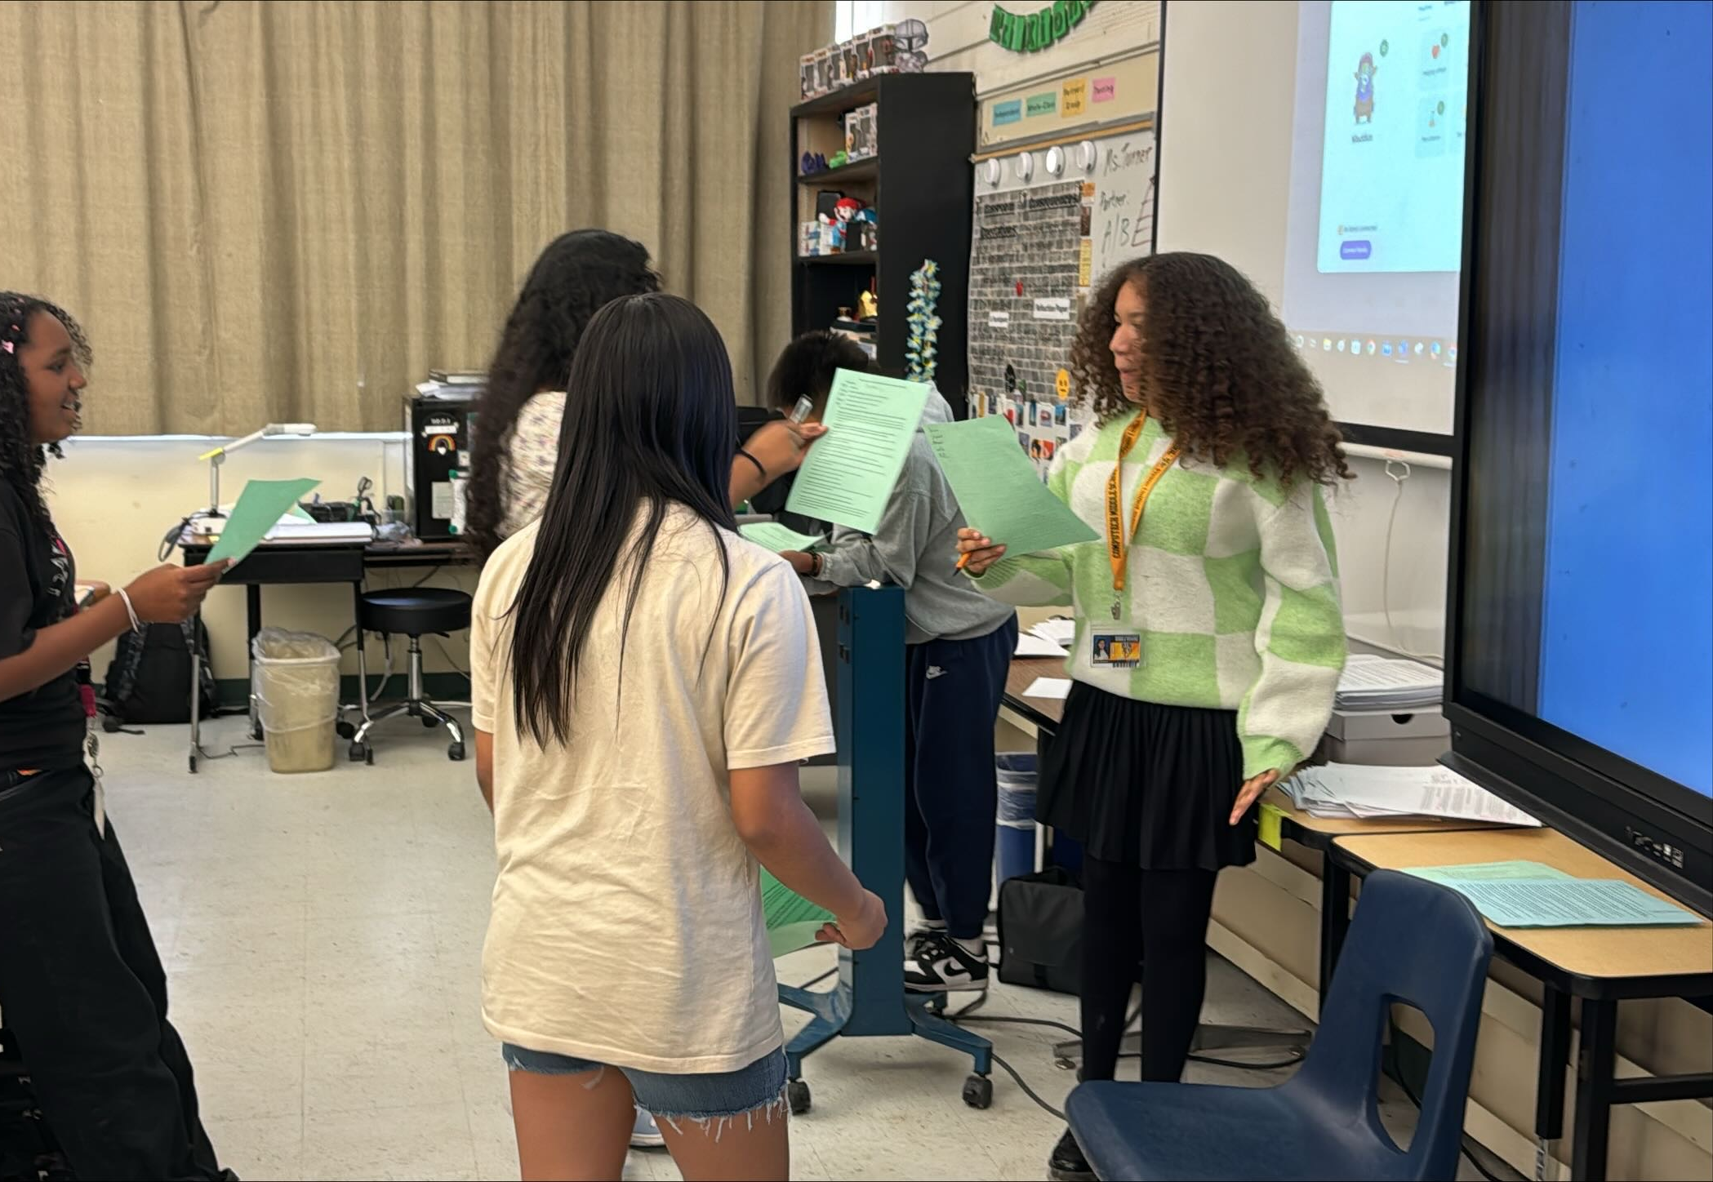
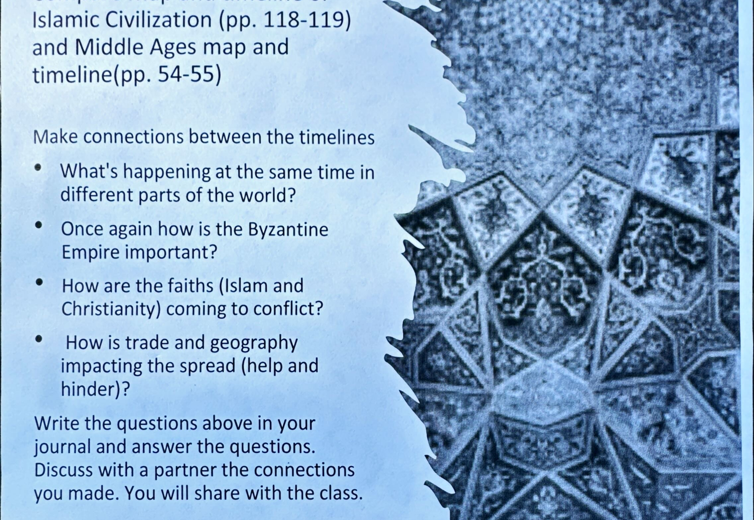
Creating Historical Simulations – CoPilot Created Scripts

Slide 17

Minecraft Edu
March Webinar

Slide 18
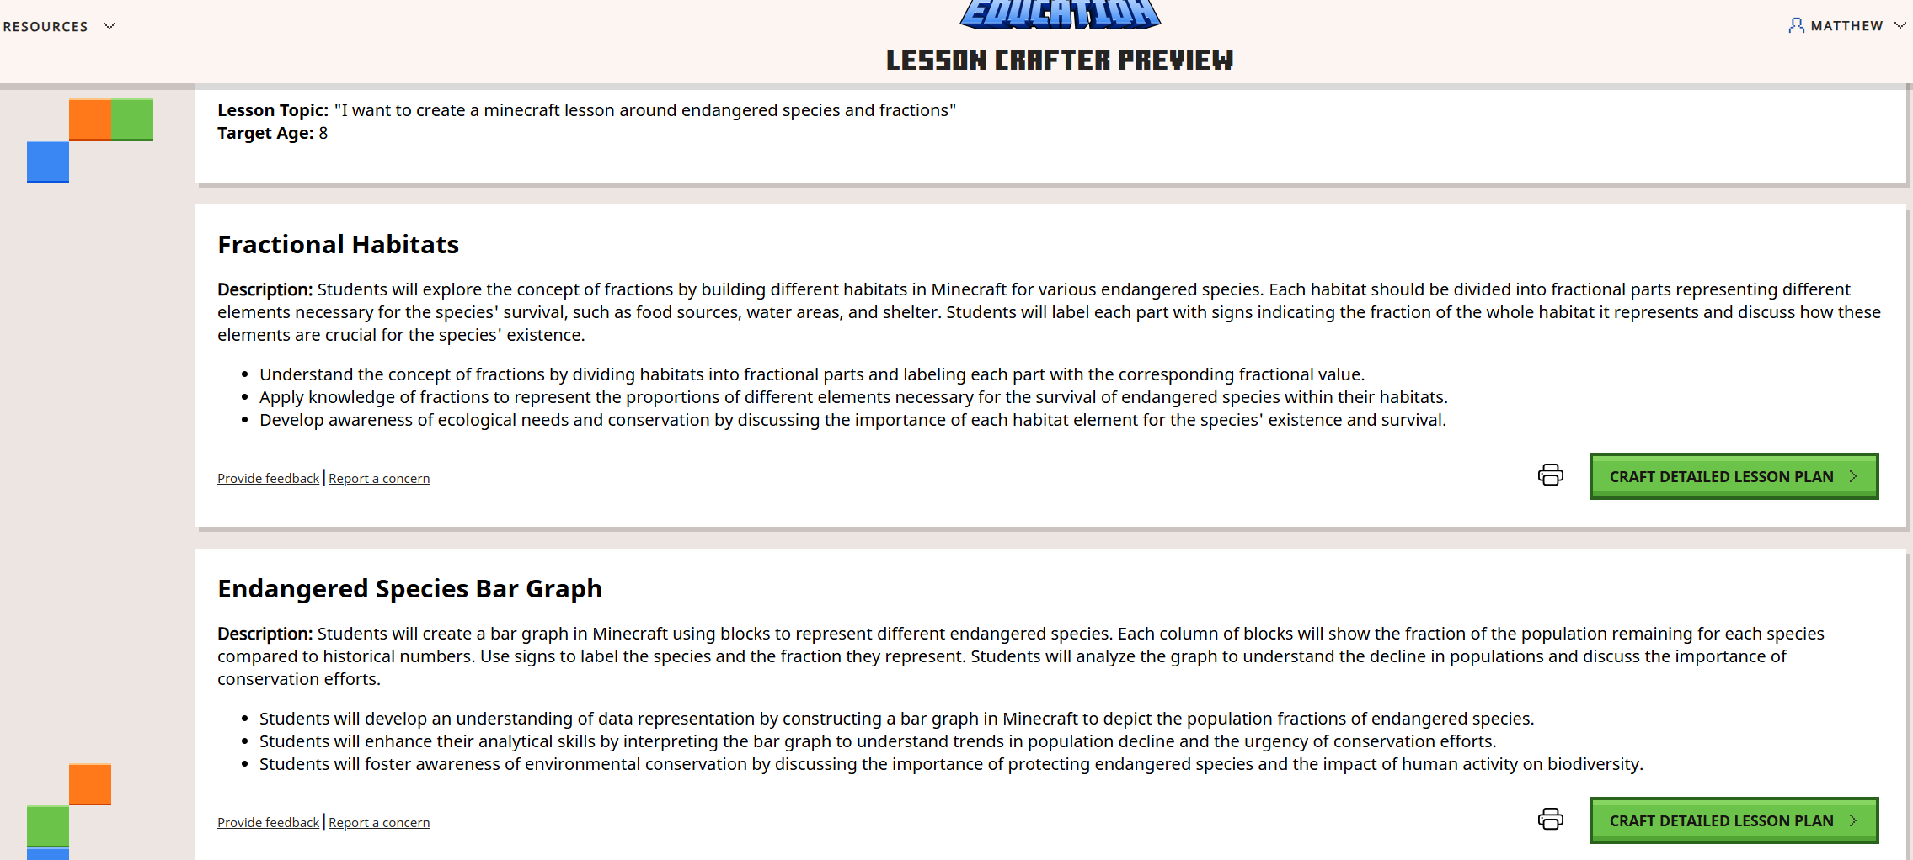
Minecraft EDU Lesson Crafter
Minecraft Education Lesson Crafter Preview
Notes:
https://teachertools.web.minecrafteduservices.com/lessons

Slide 19
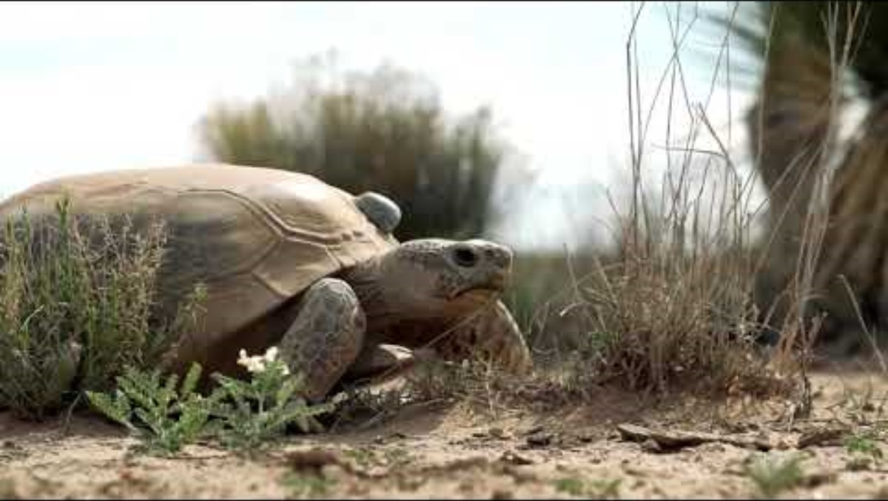
Real World Connection – Ted Turner Conservancy

Slide 20
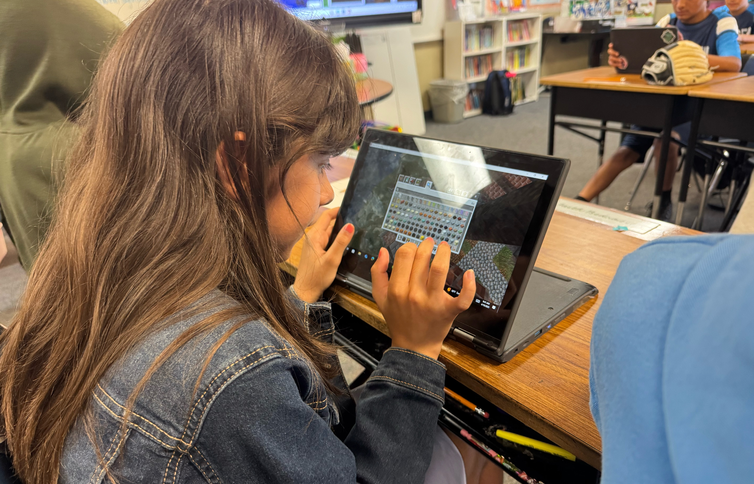
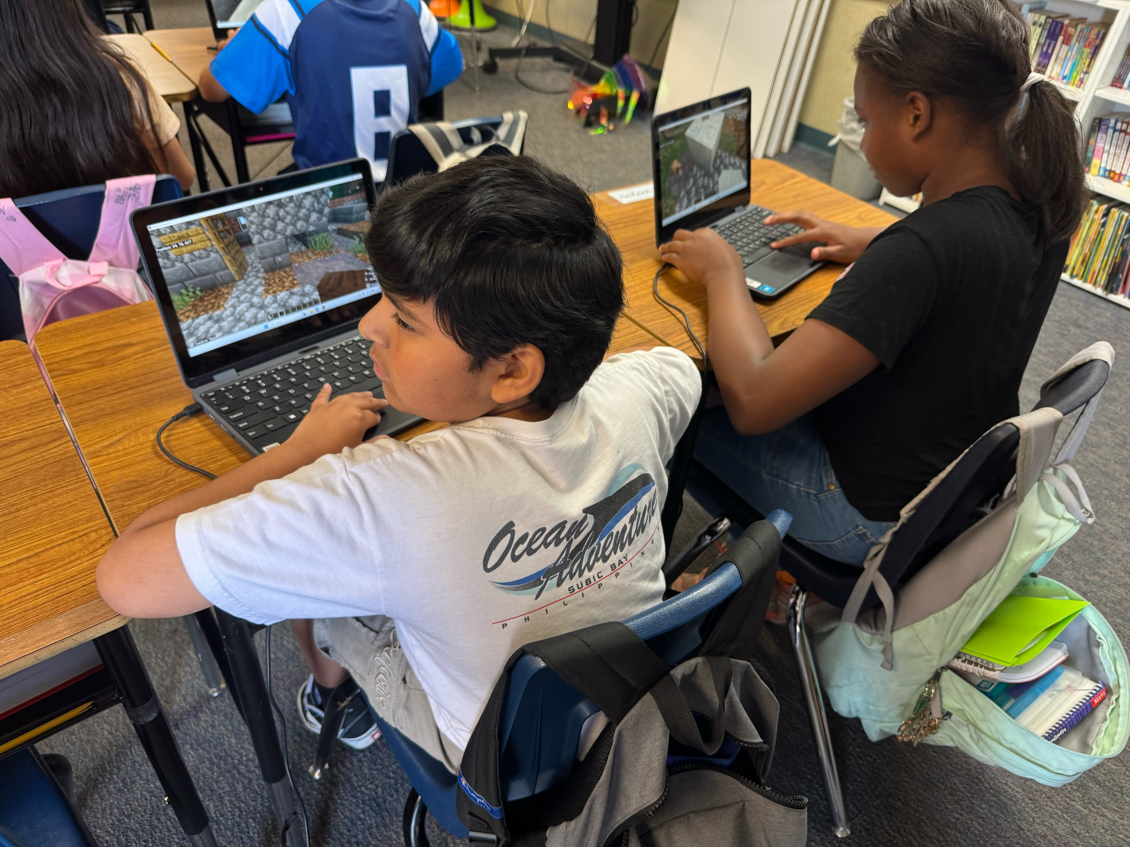
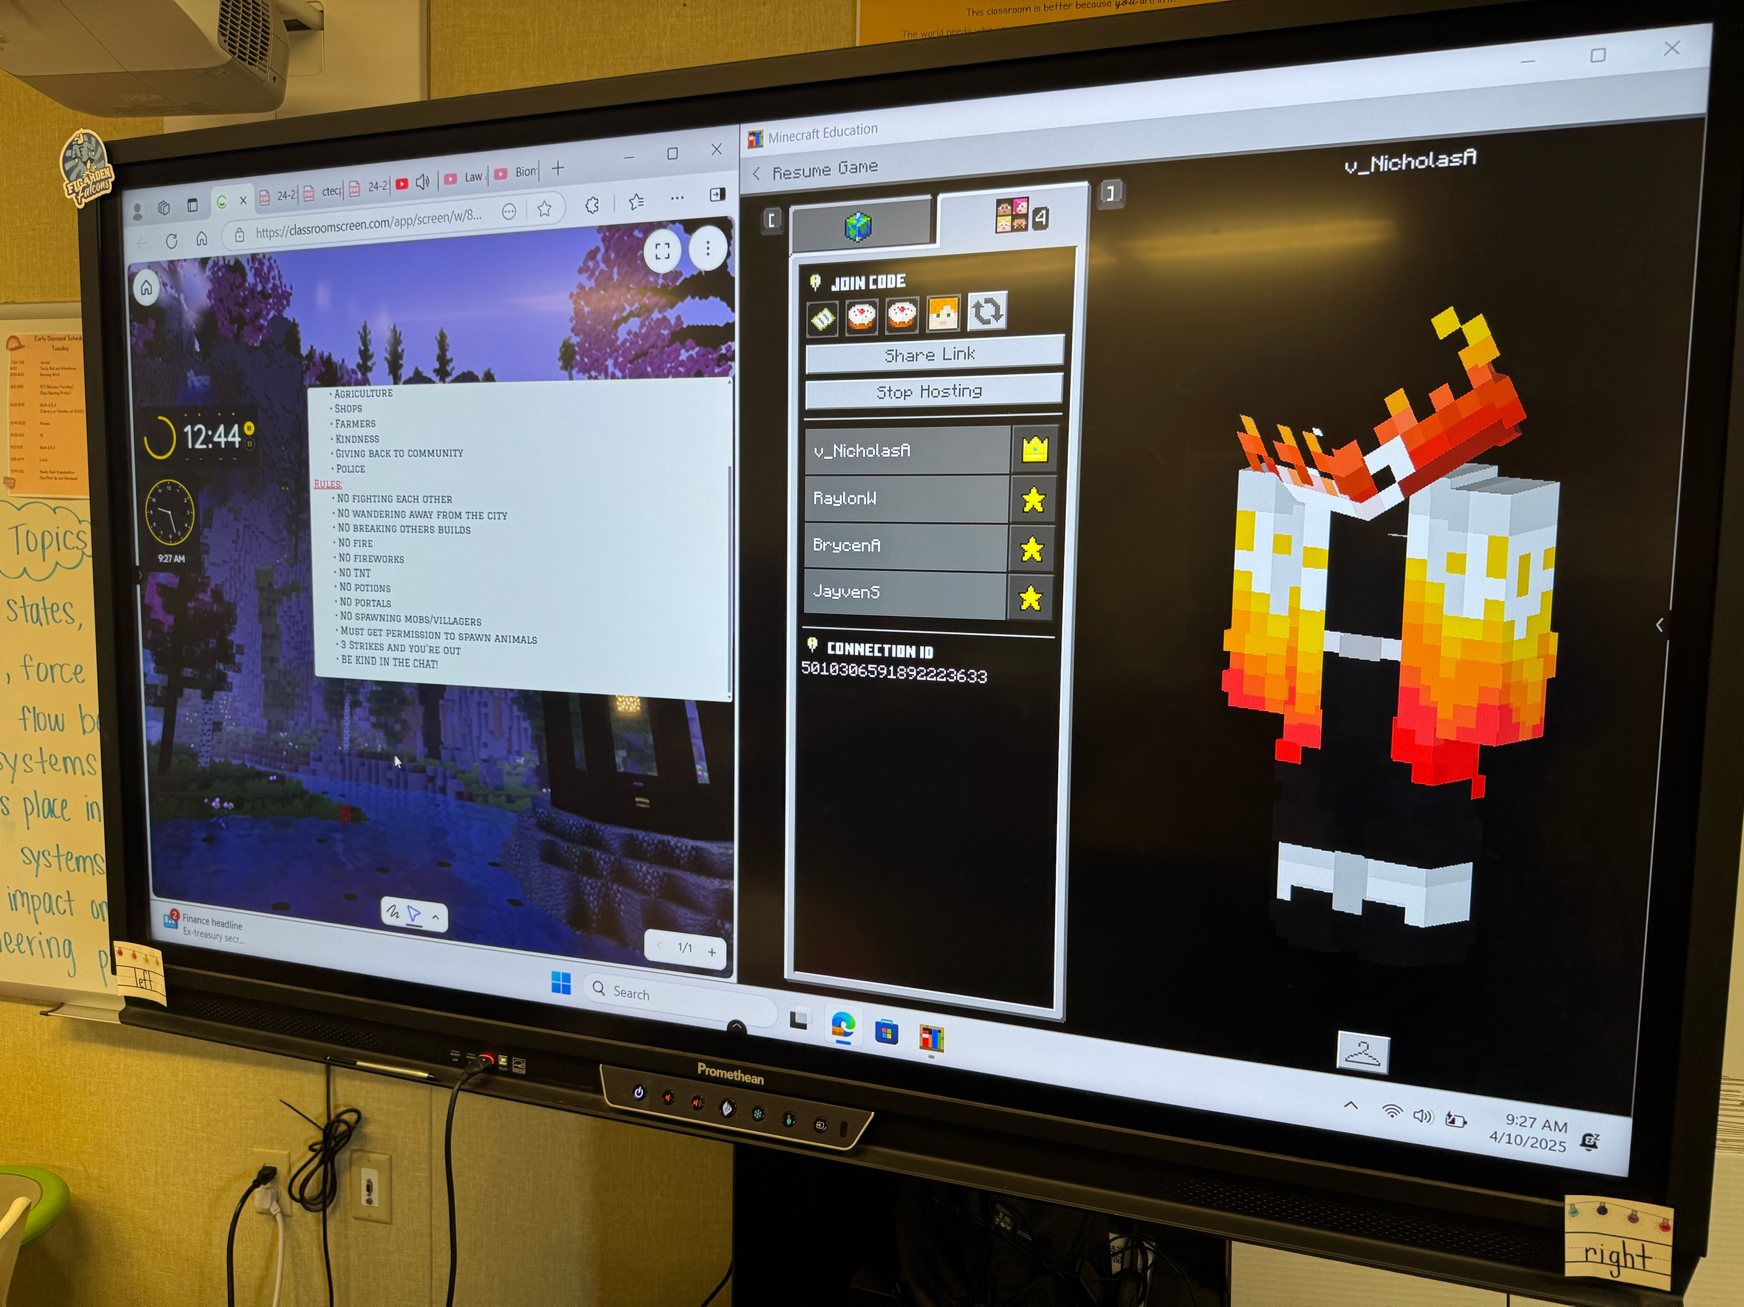
Exploring CTE Pathways in Minecraft

Slide 21
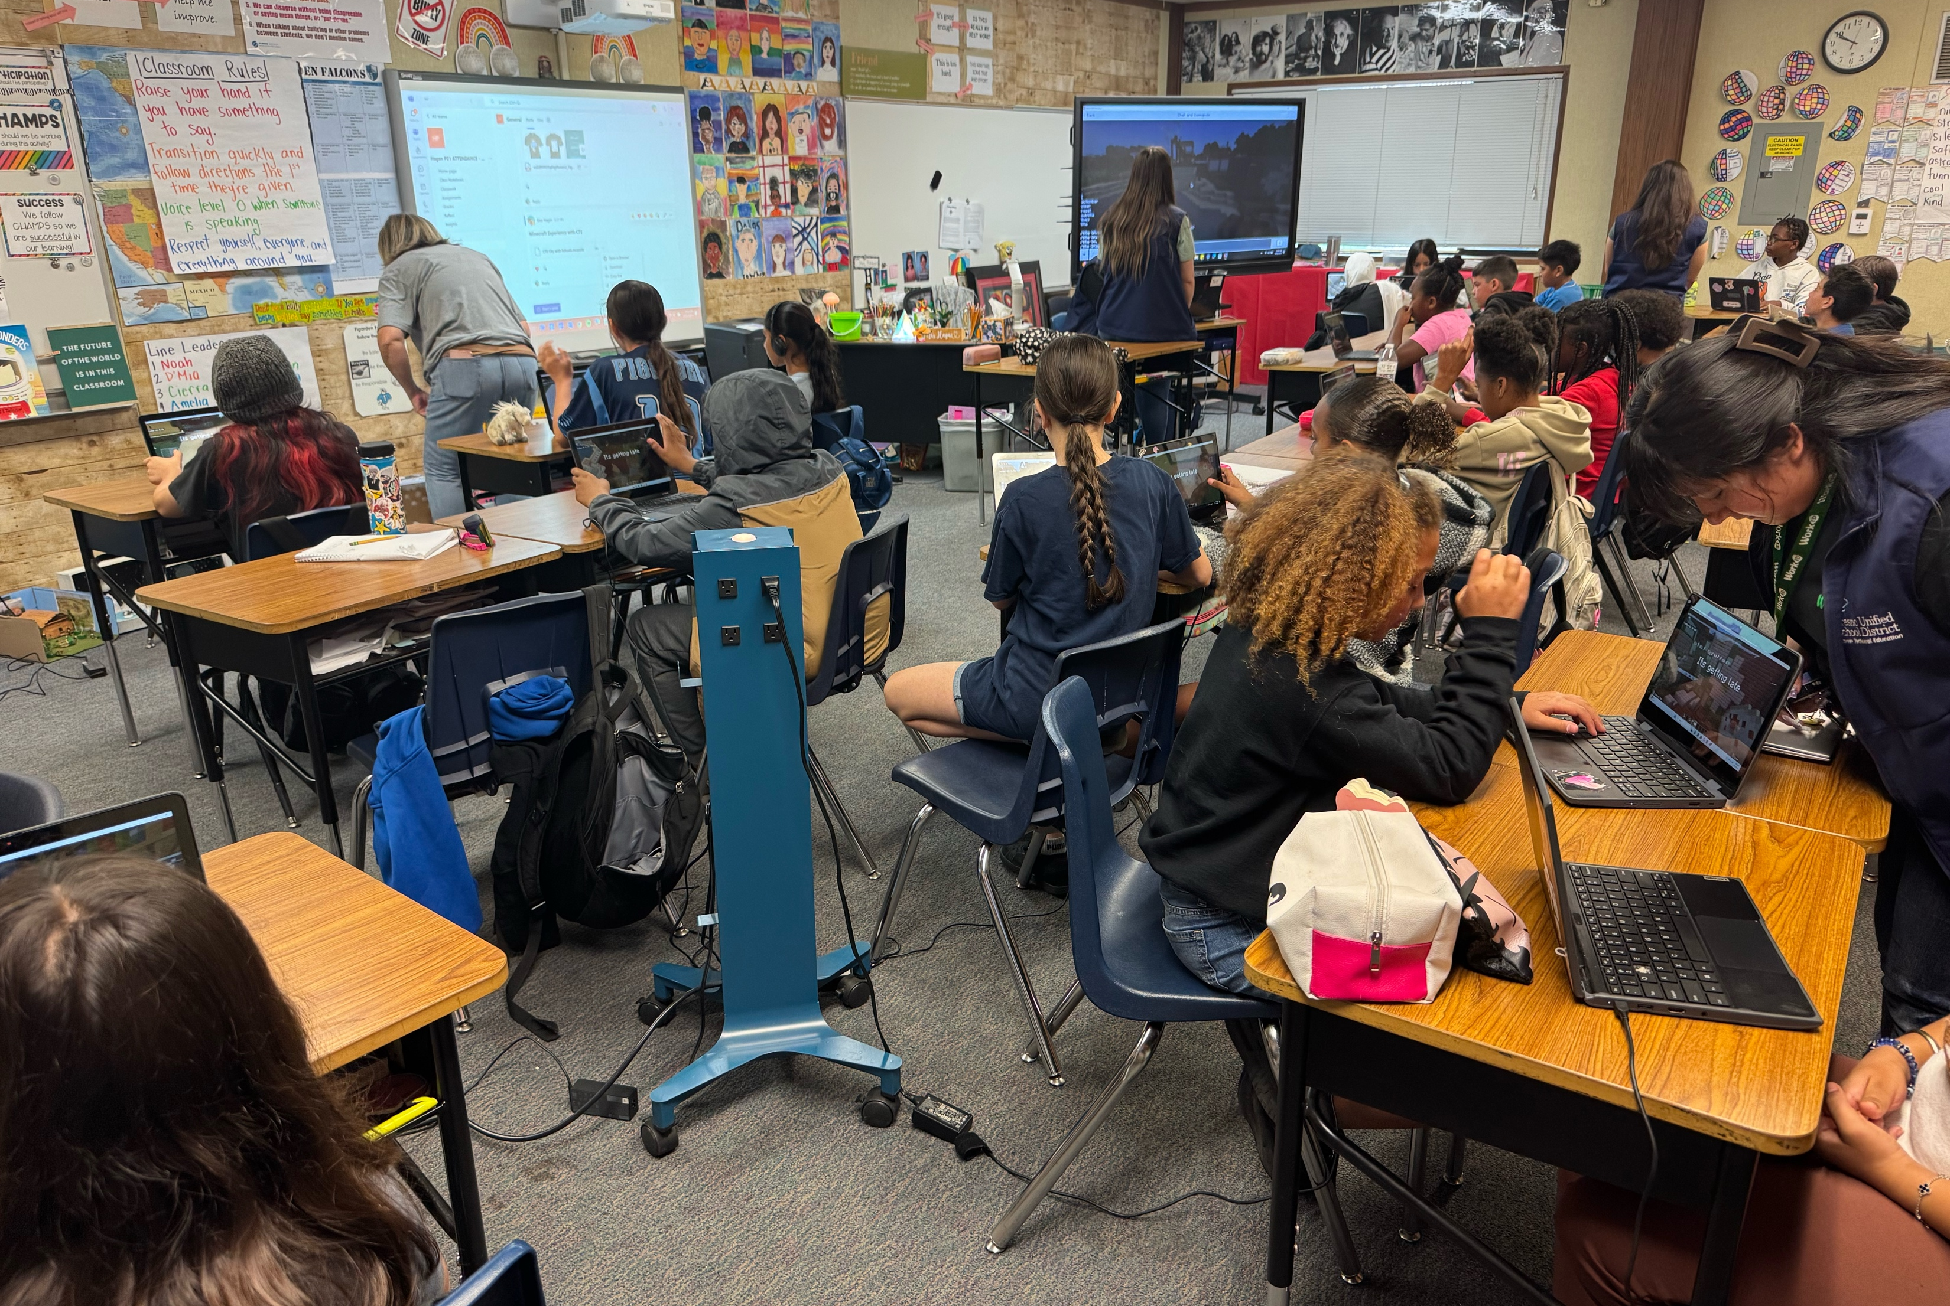
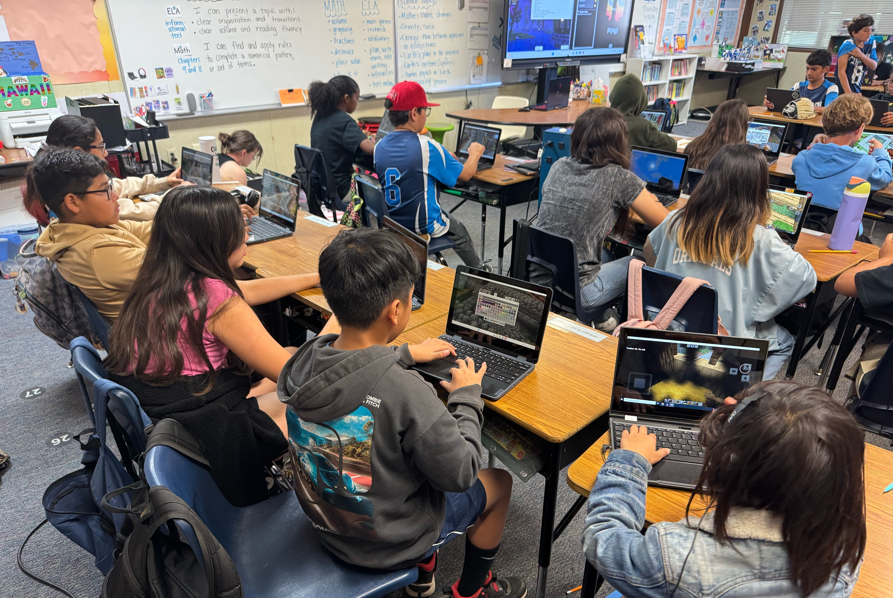
Rebuilding a Community

Slide 22
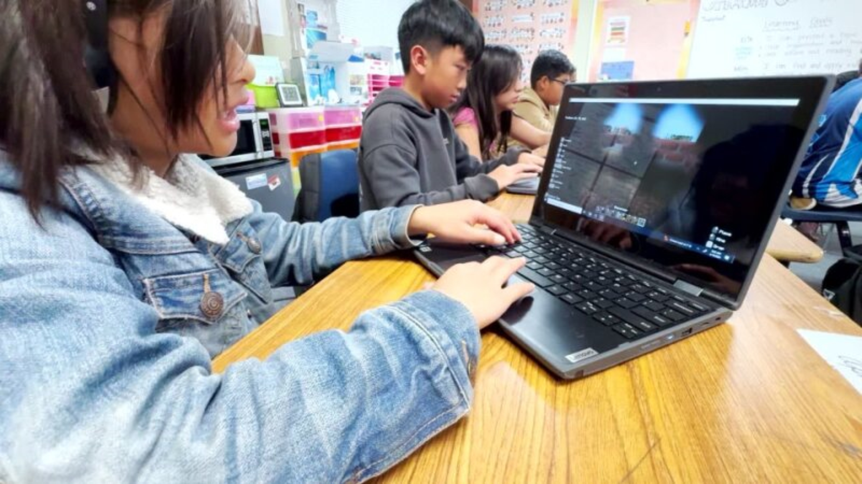
Creating a Community Food Pantry

Slide 23
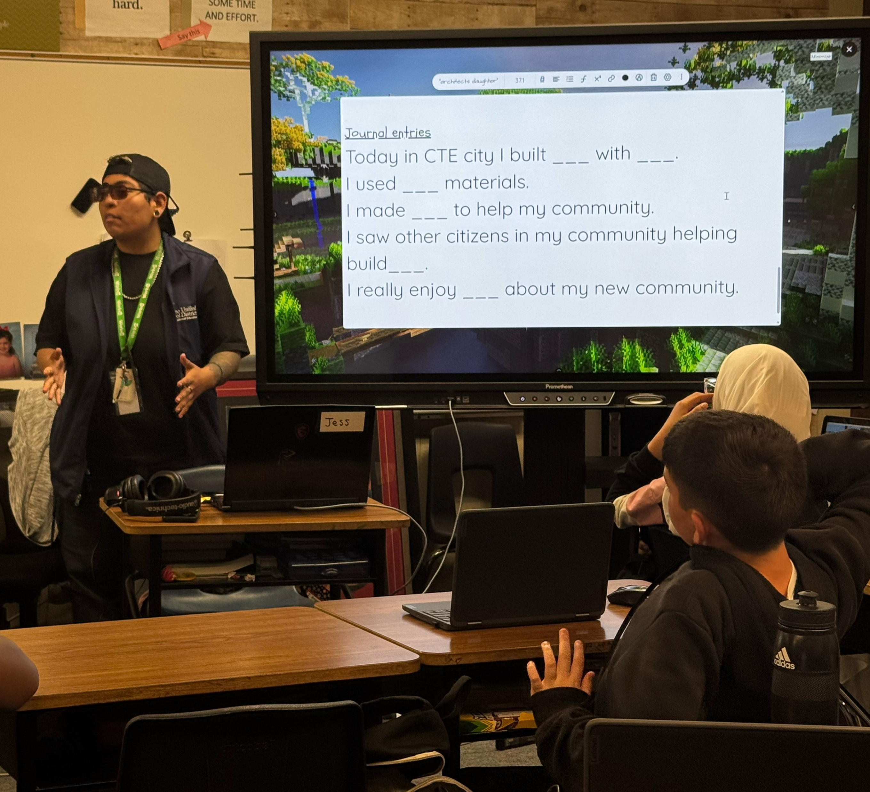
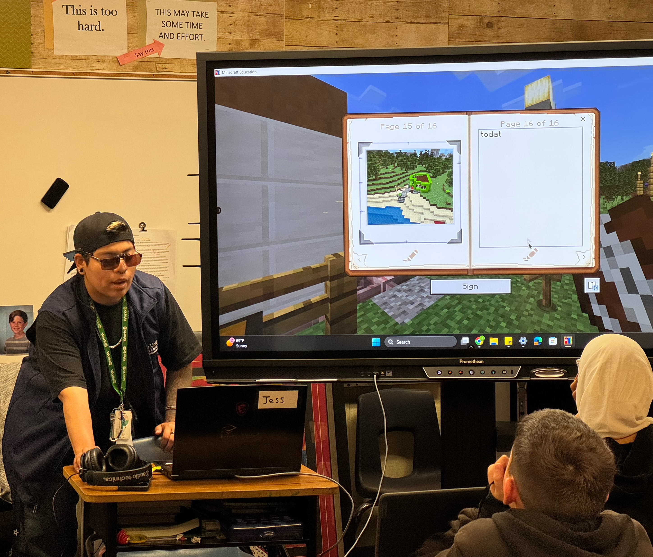
Meaningful Reflections

Slide 24
Examples of Canva and PowerPoint
Brian Shares

Slide 25
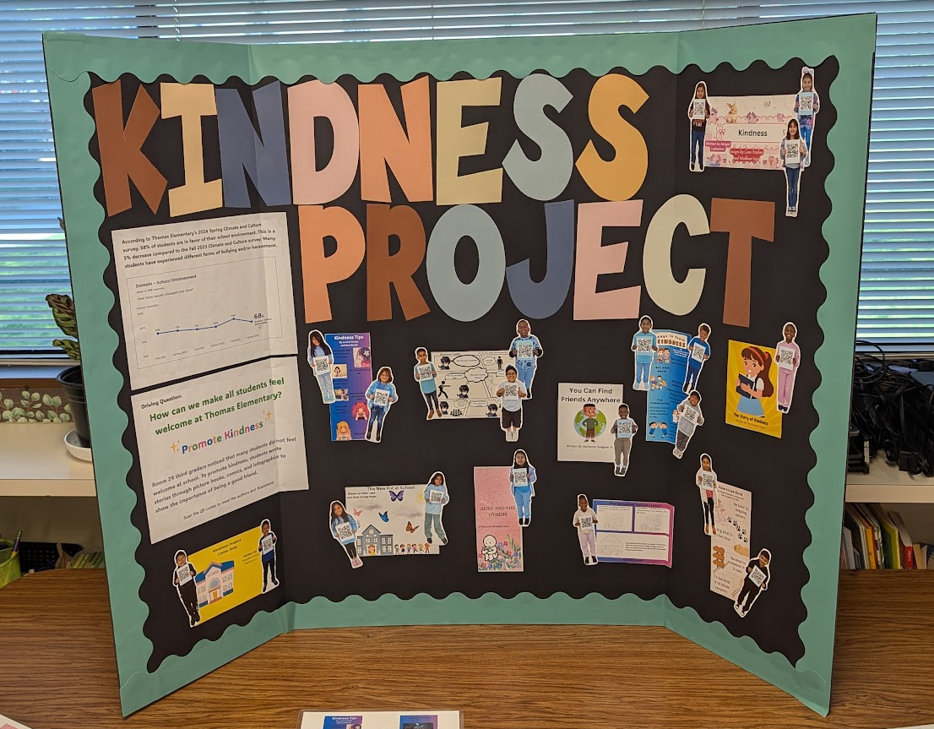
3rd Grade
SEL
Canva

Slide 26
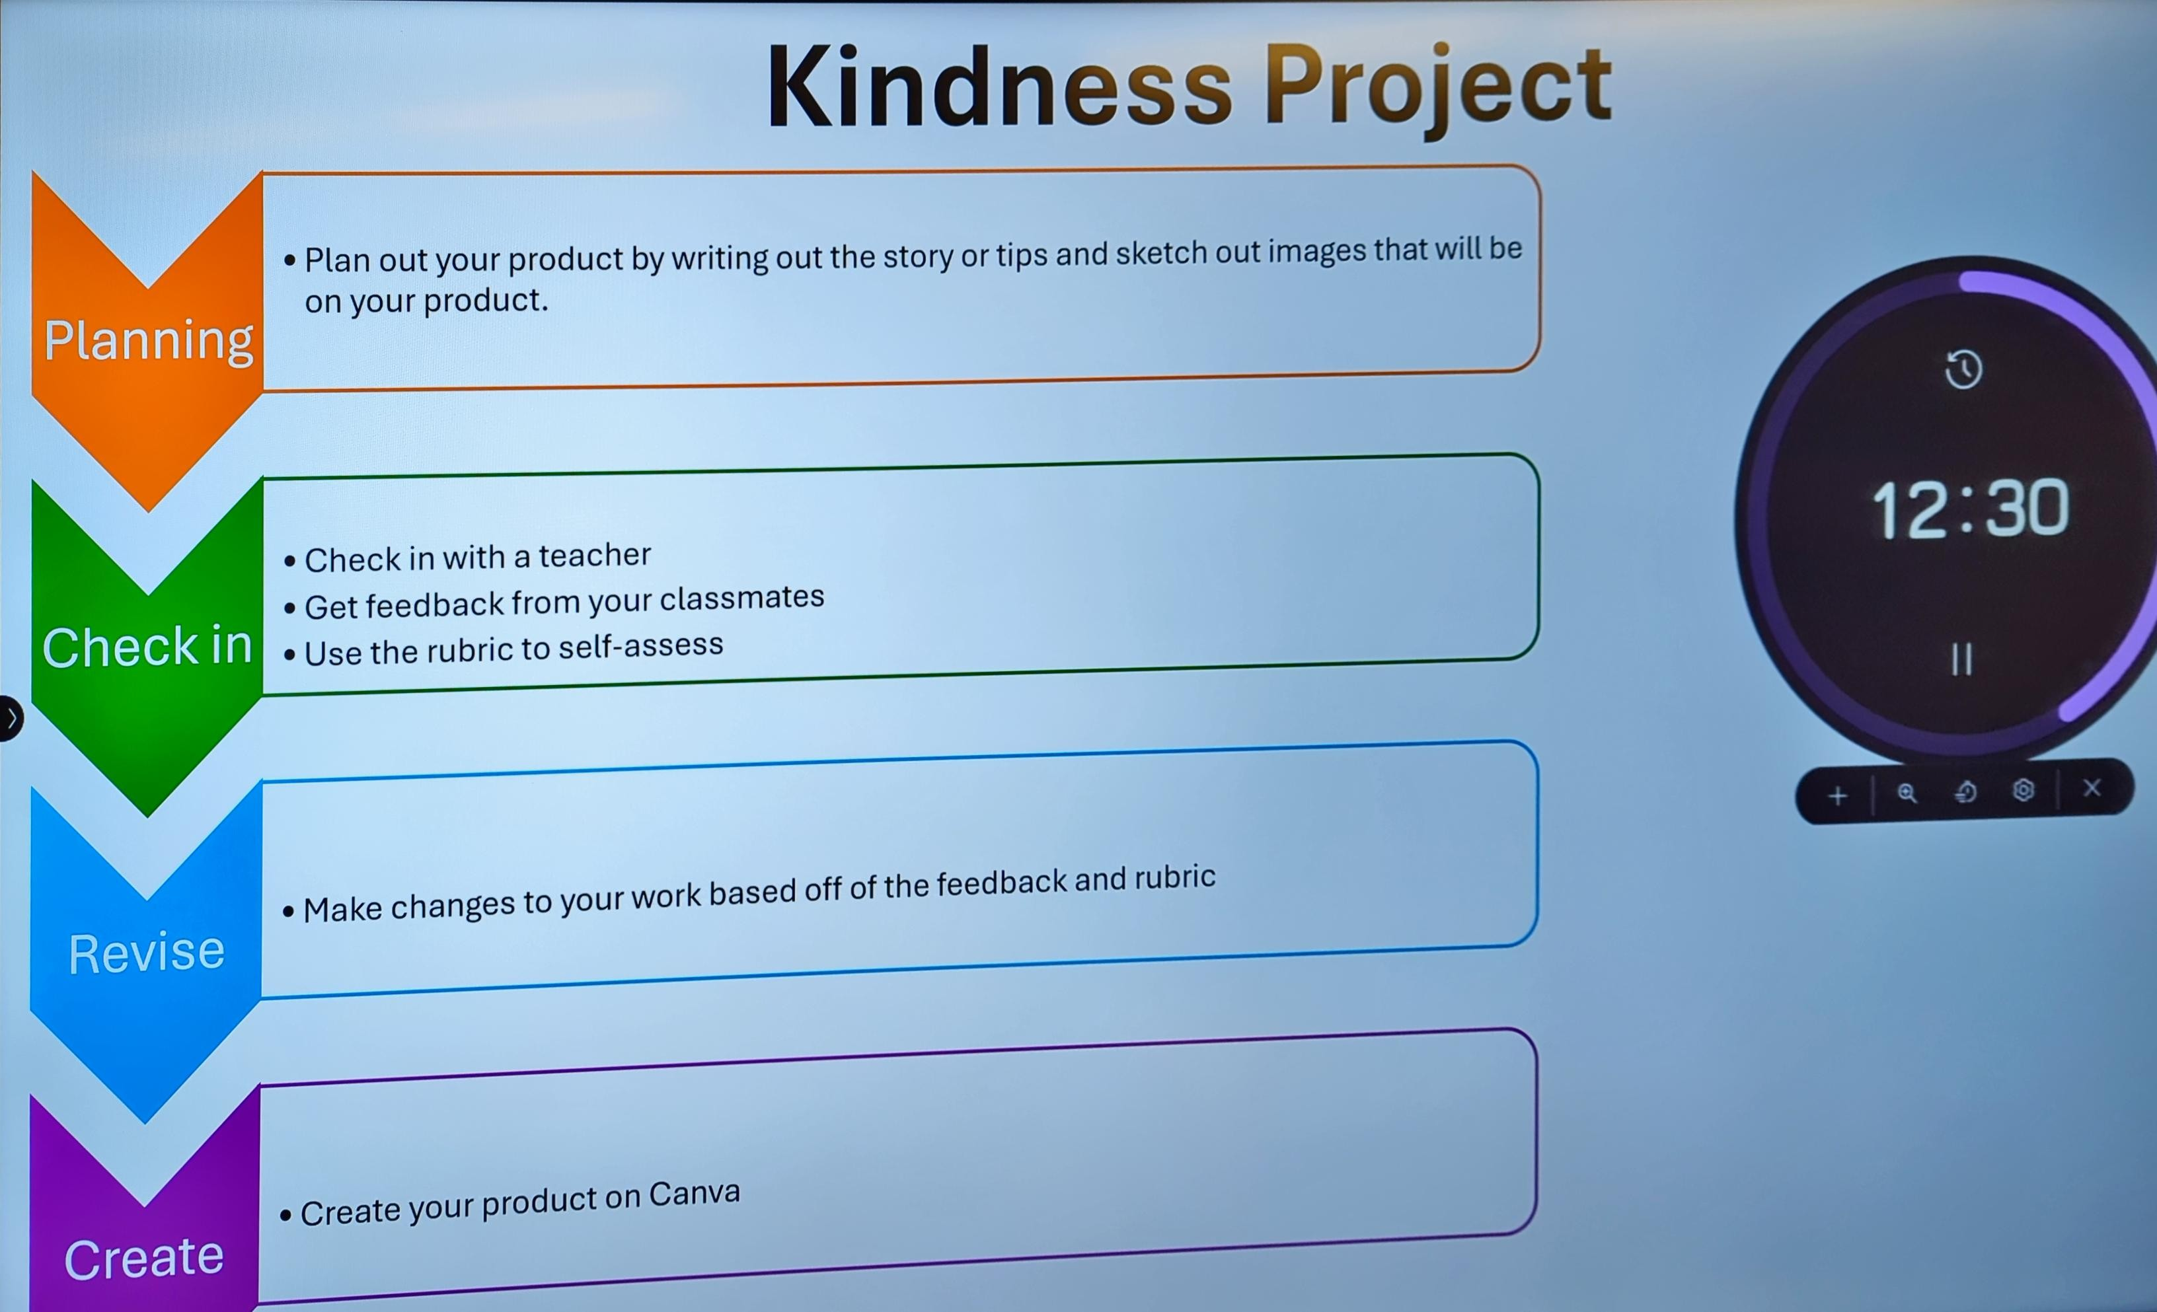

Slide 27
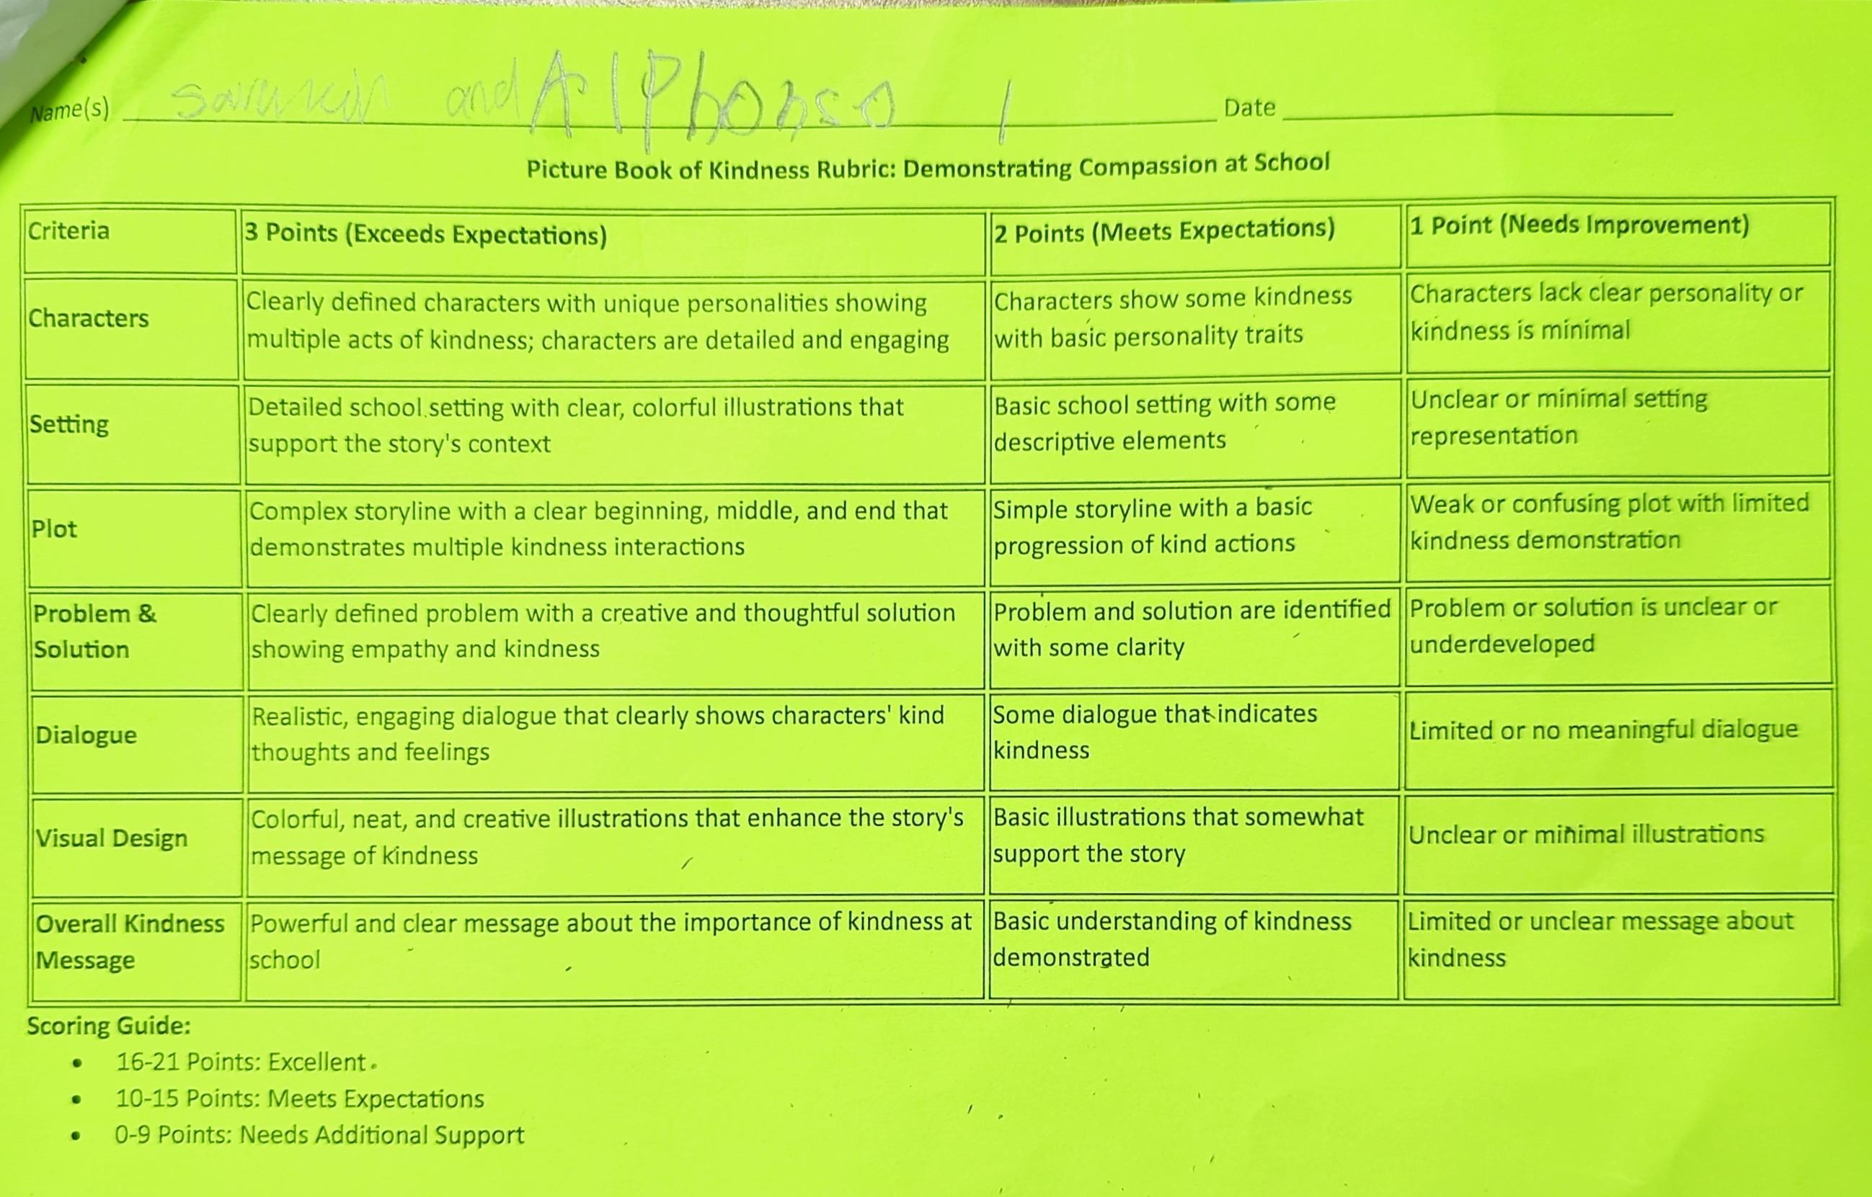
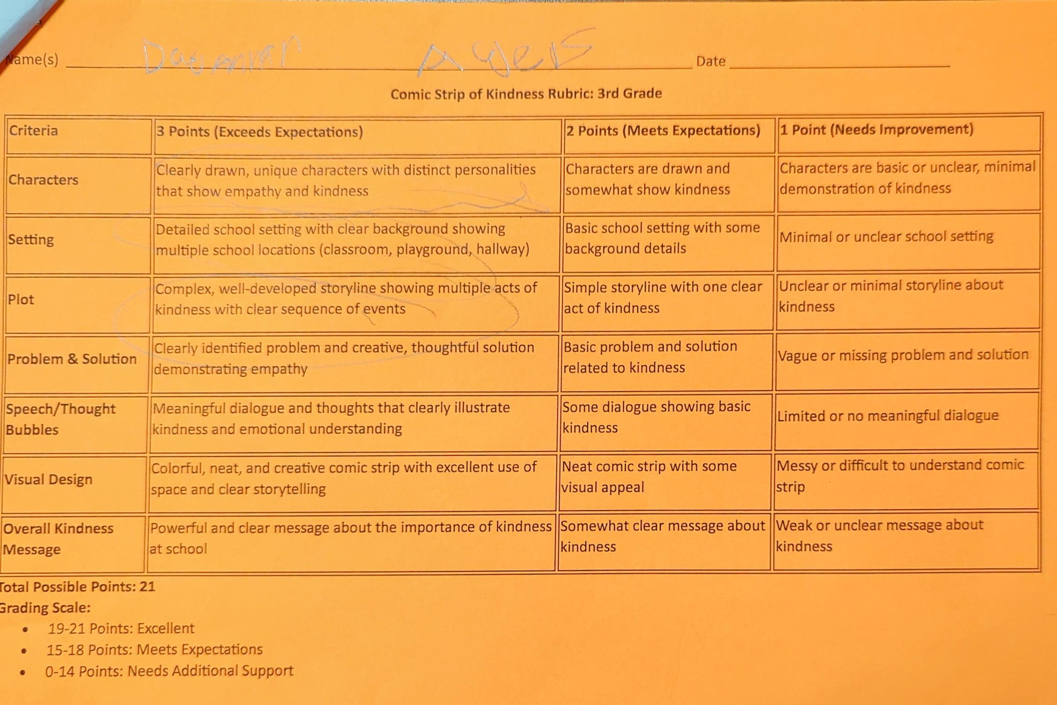
Rubrics

Slide 28
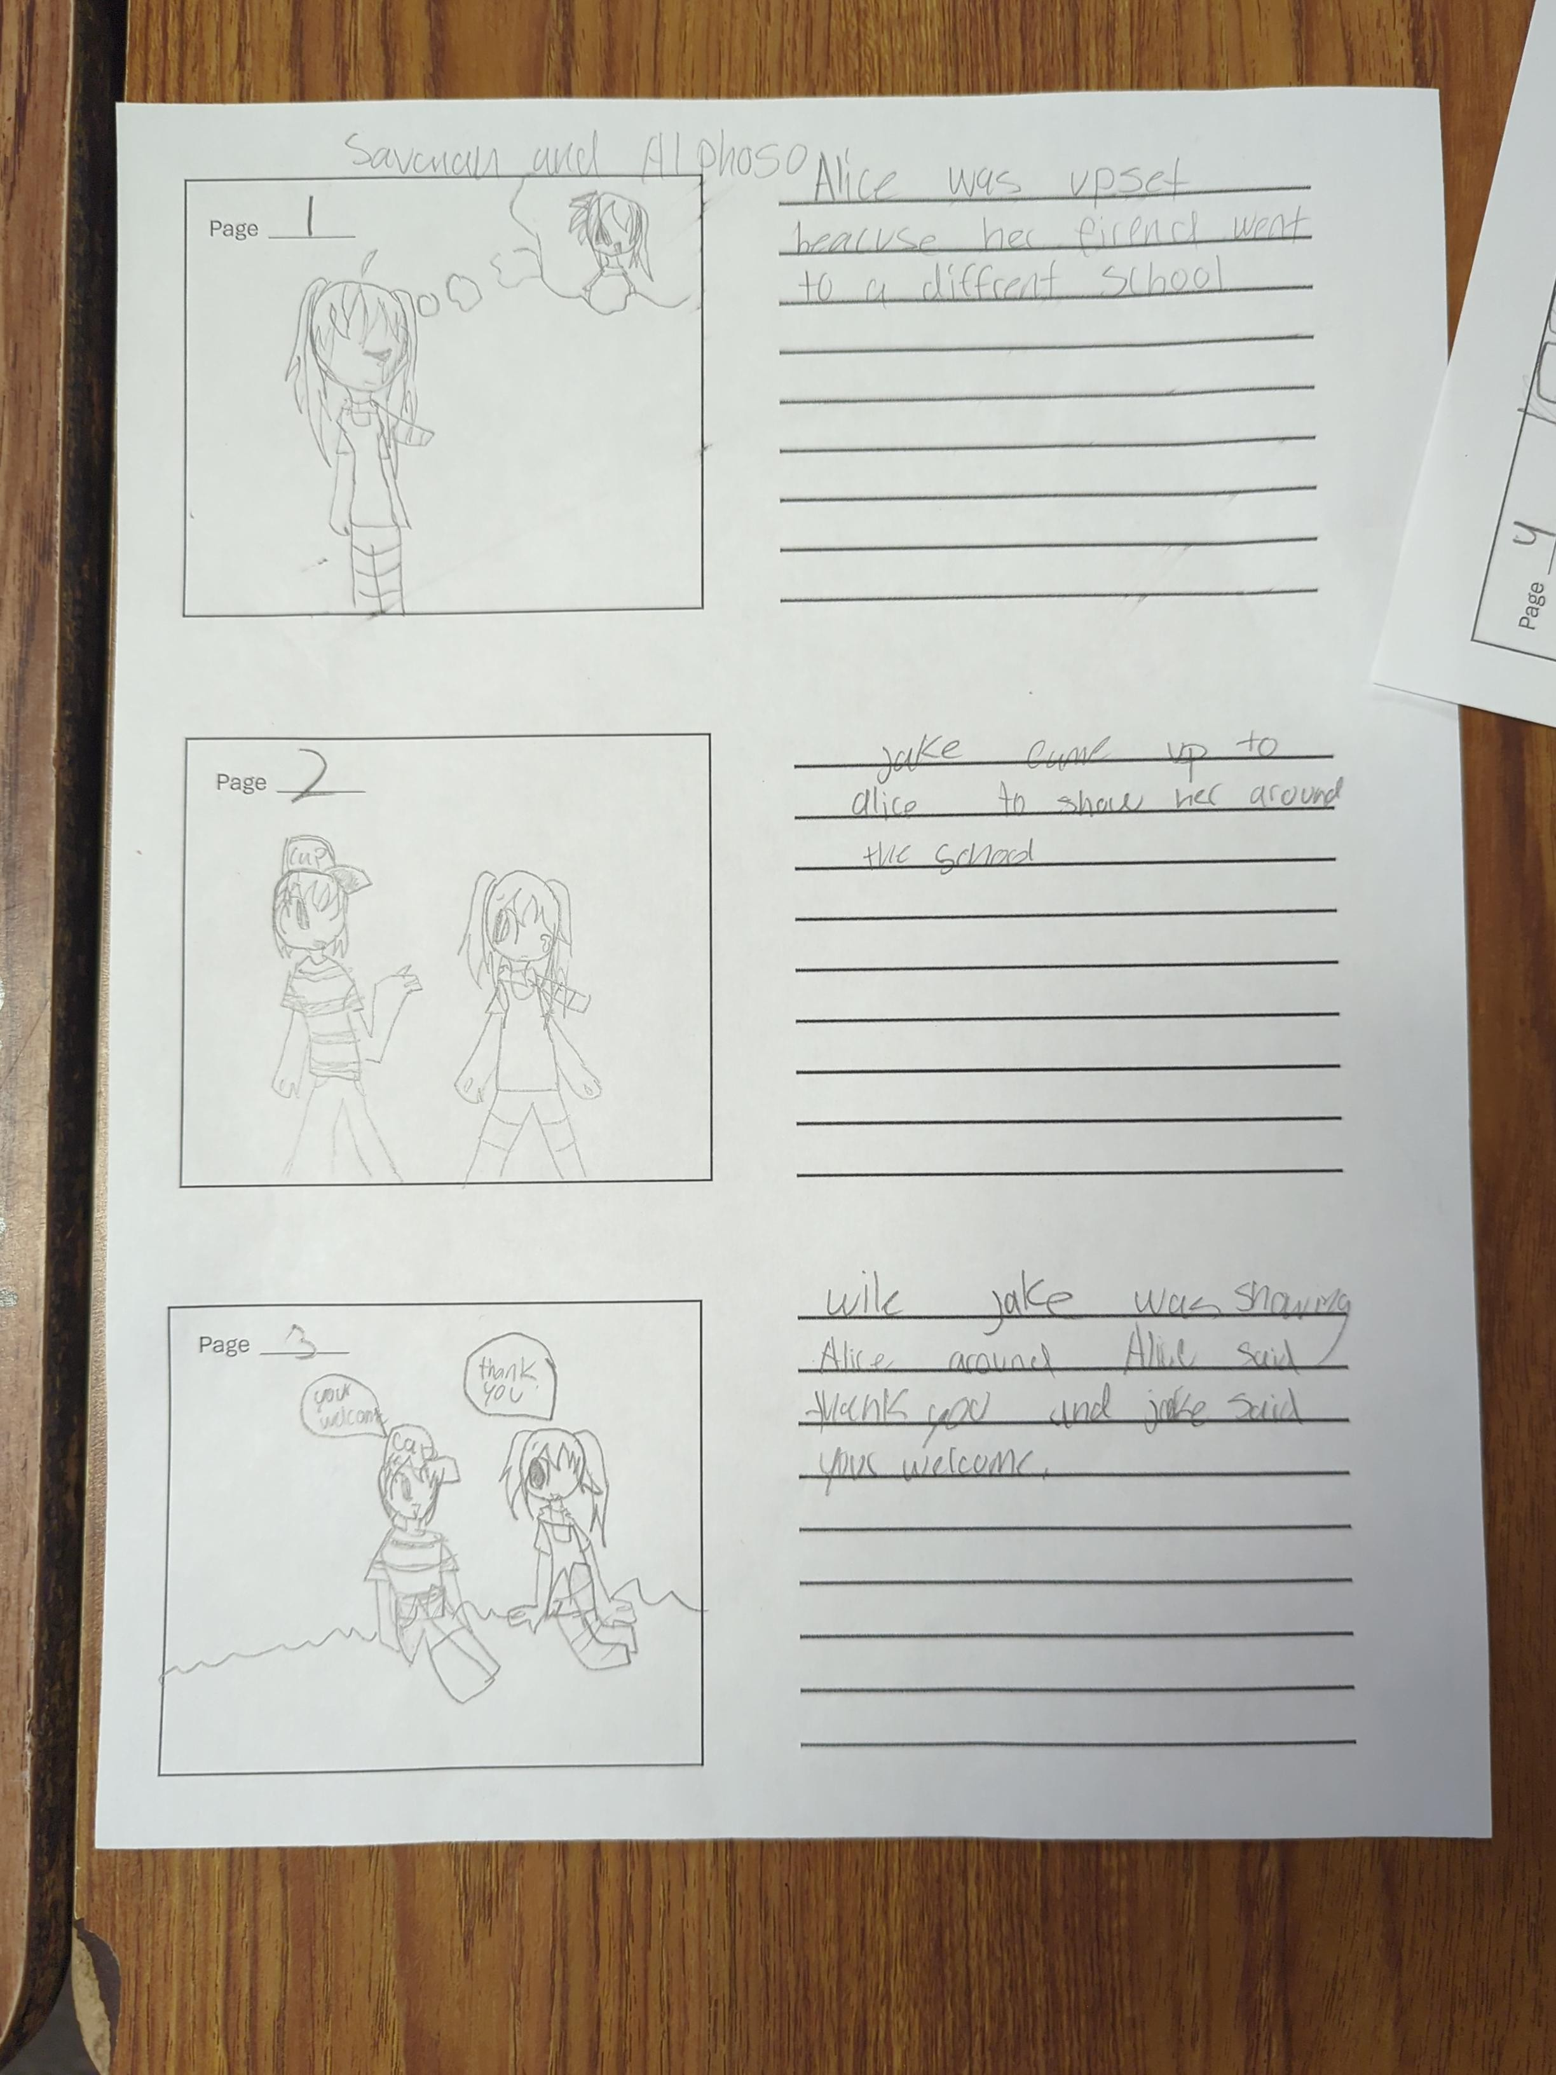
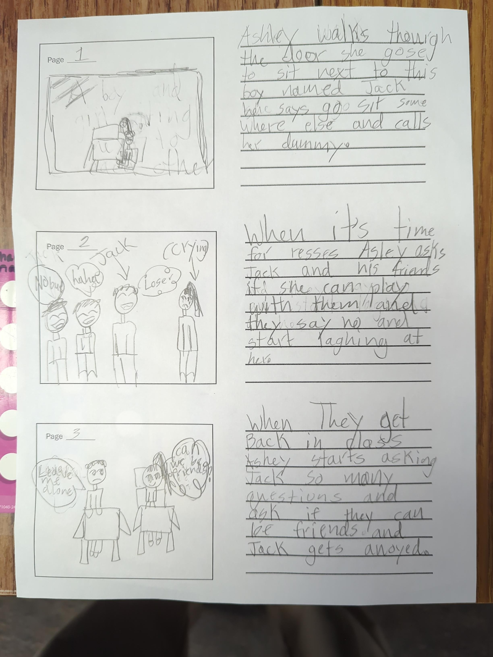
Writing Stage

Slide 29
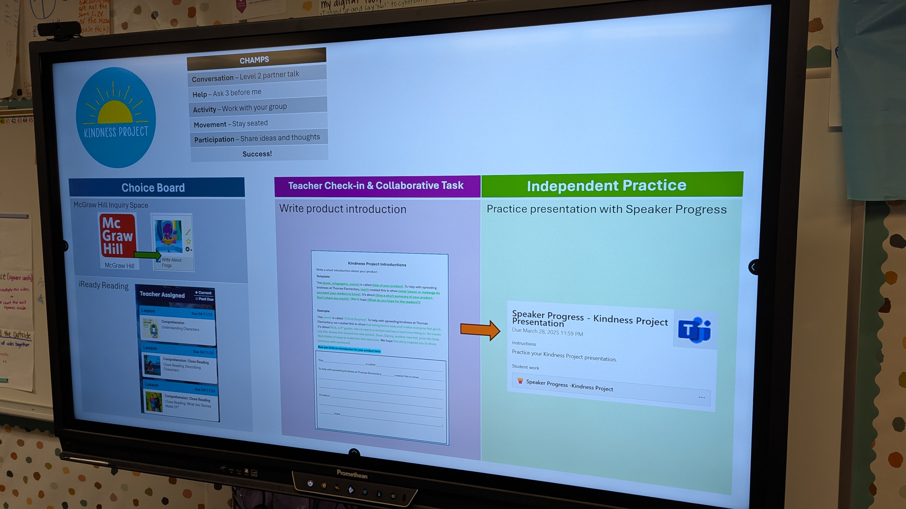

Slide 30
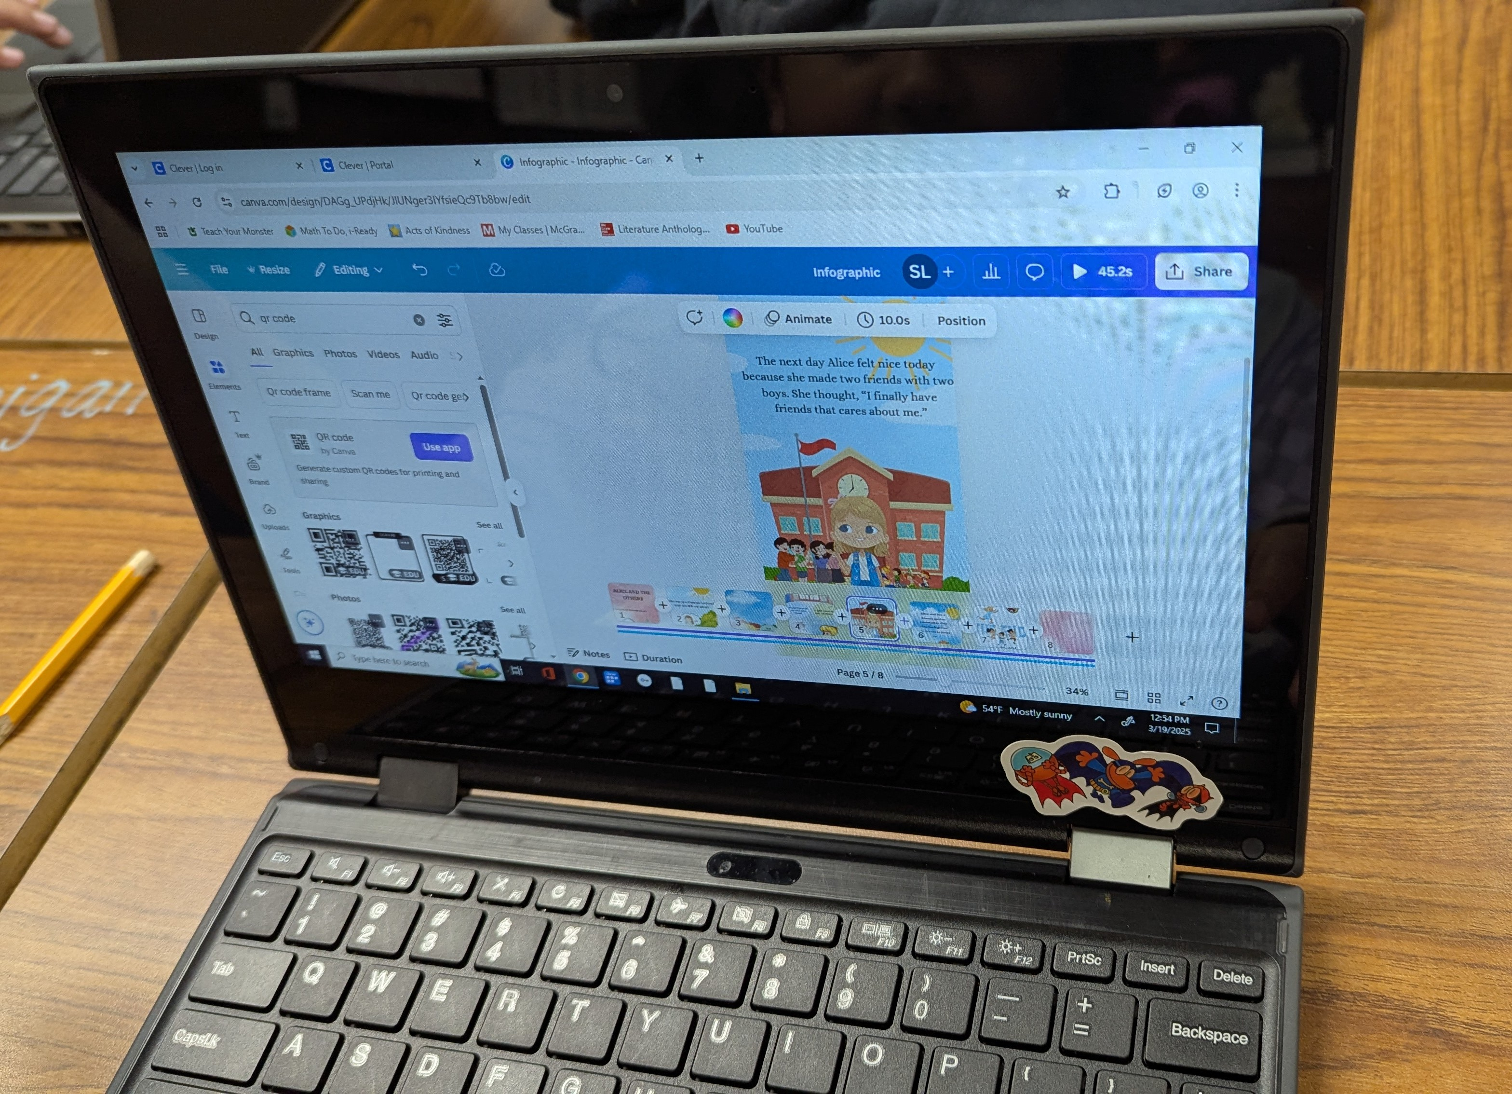
Canva

Slide 31
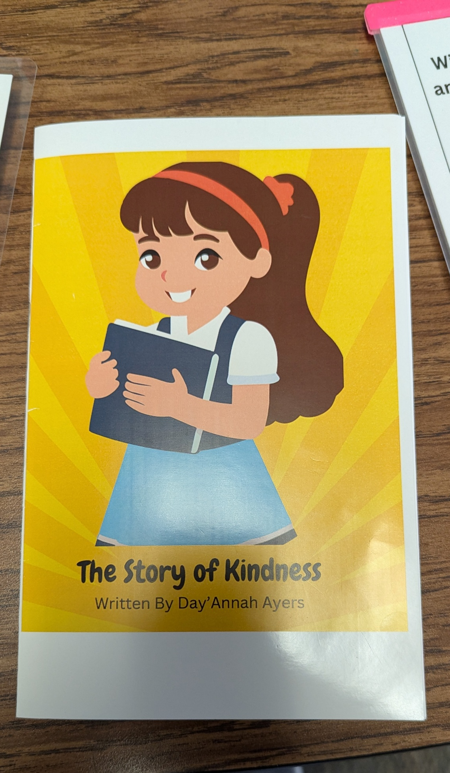
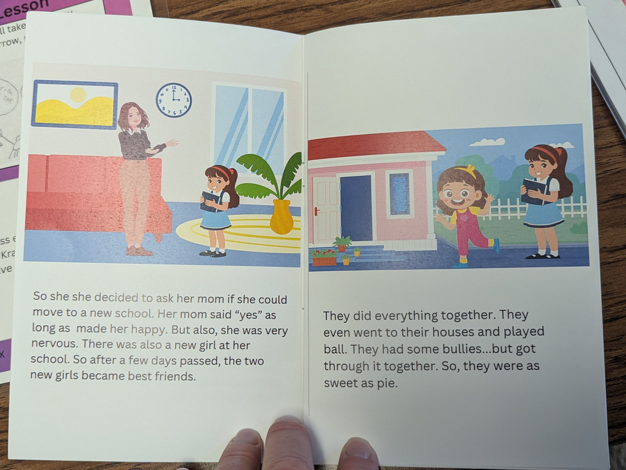
Printed Product

Slide 32
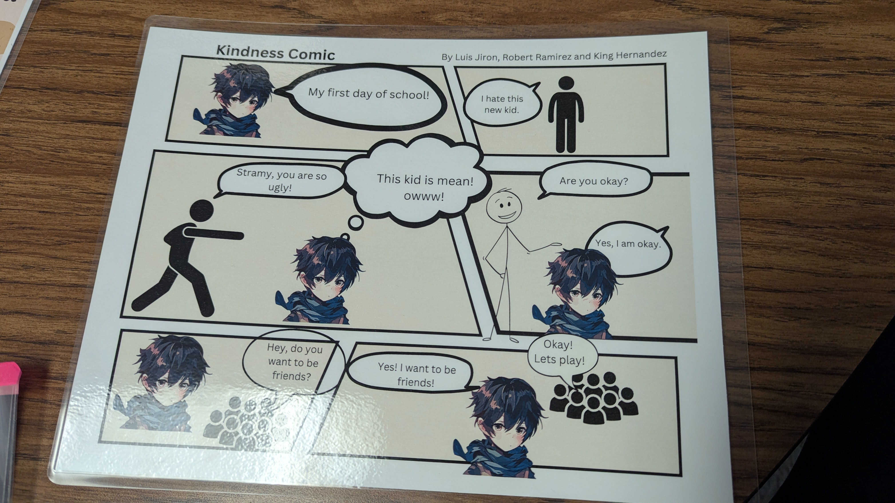

Slide 33
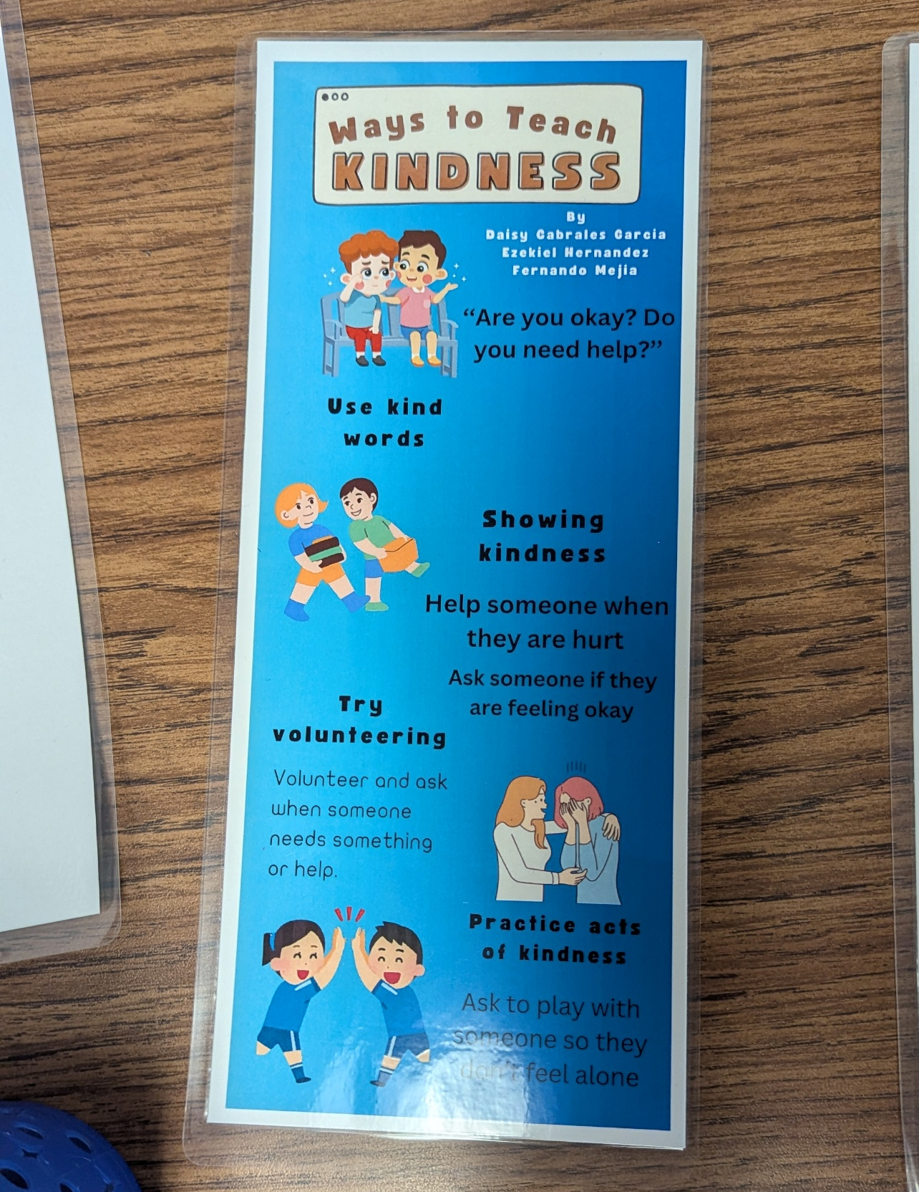
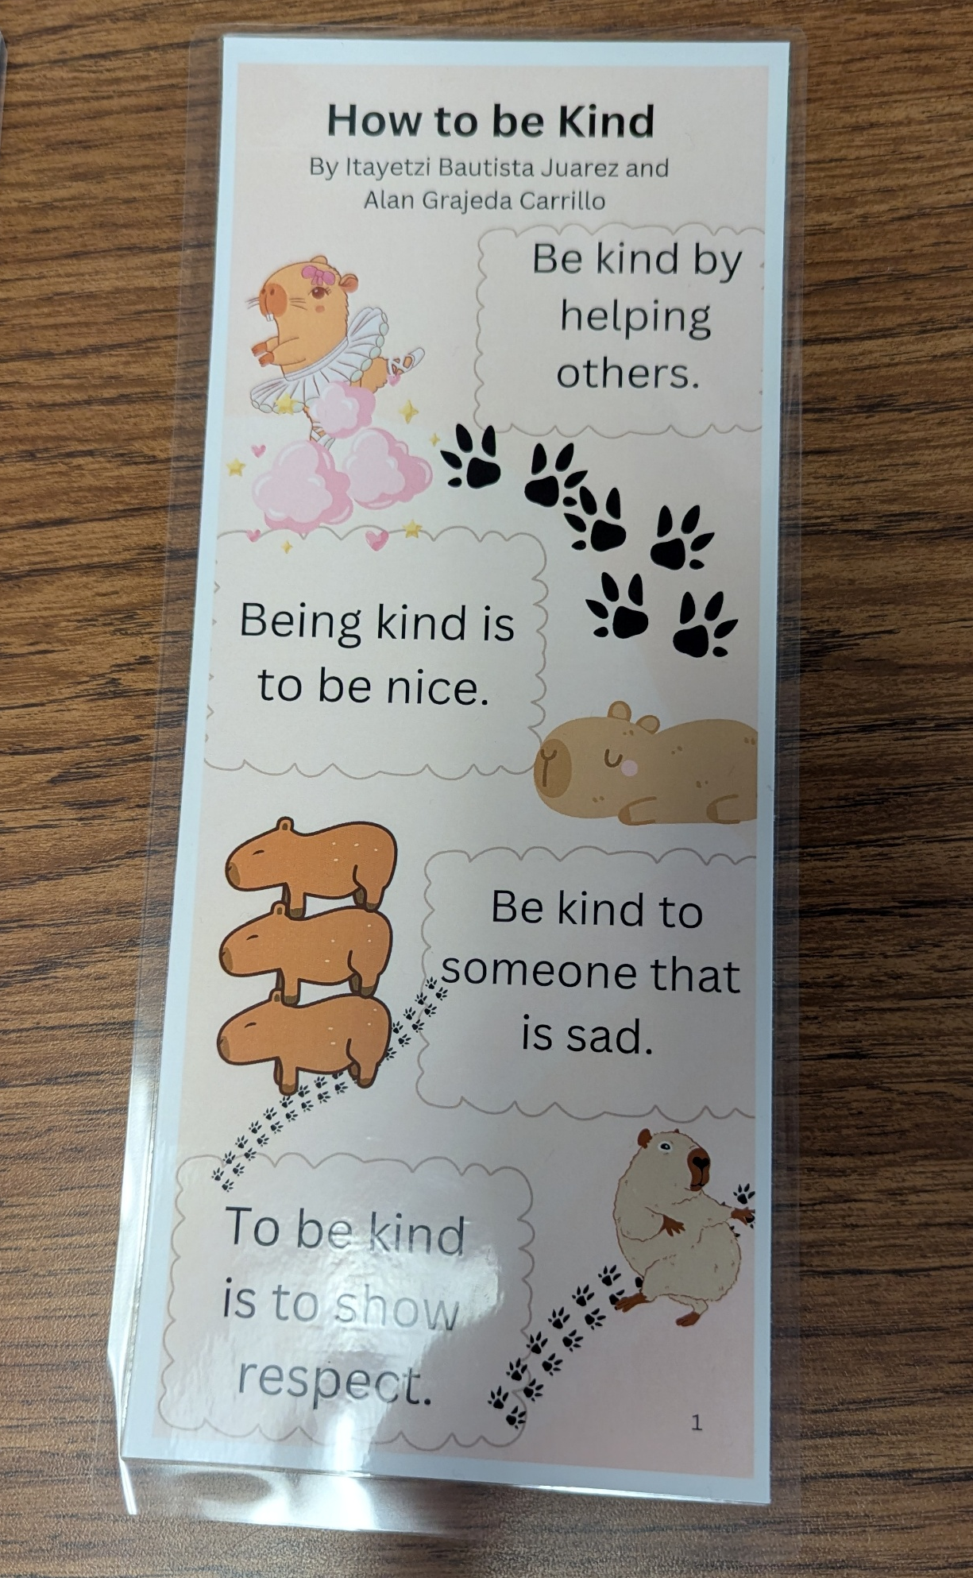
Infographics

Slide 34
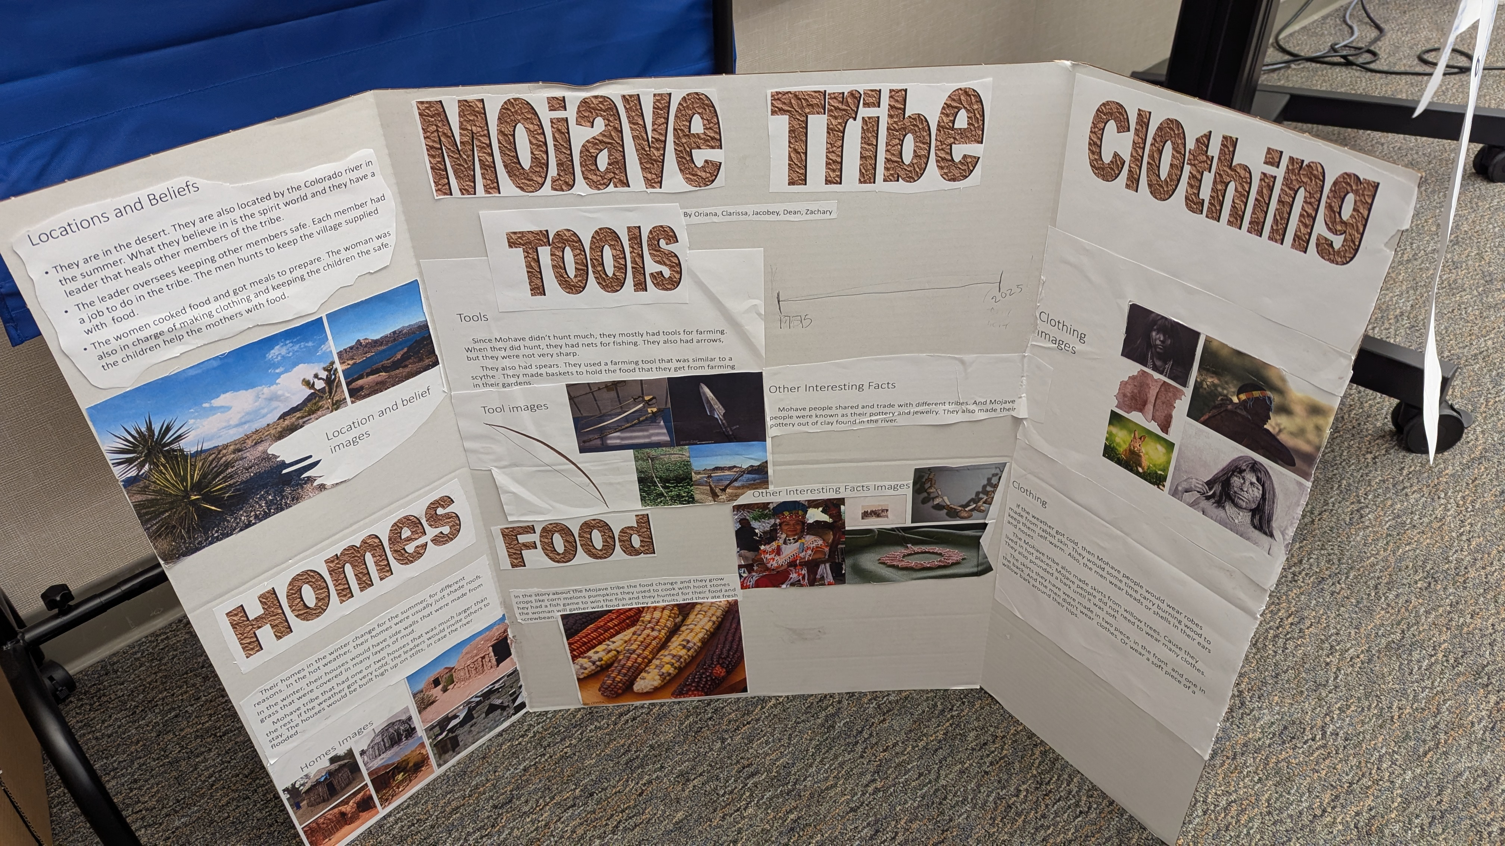
4th Grade | Social Studies | Word/PowerPoint

Slide 35
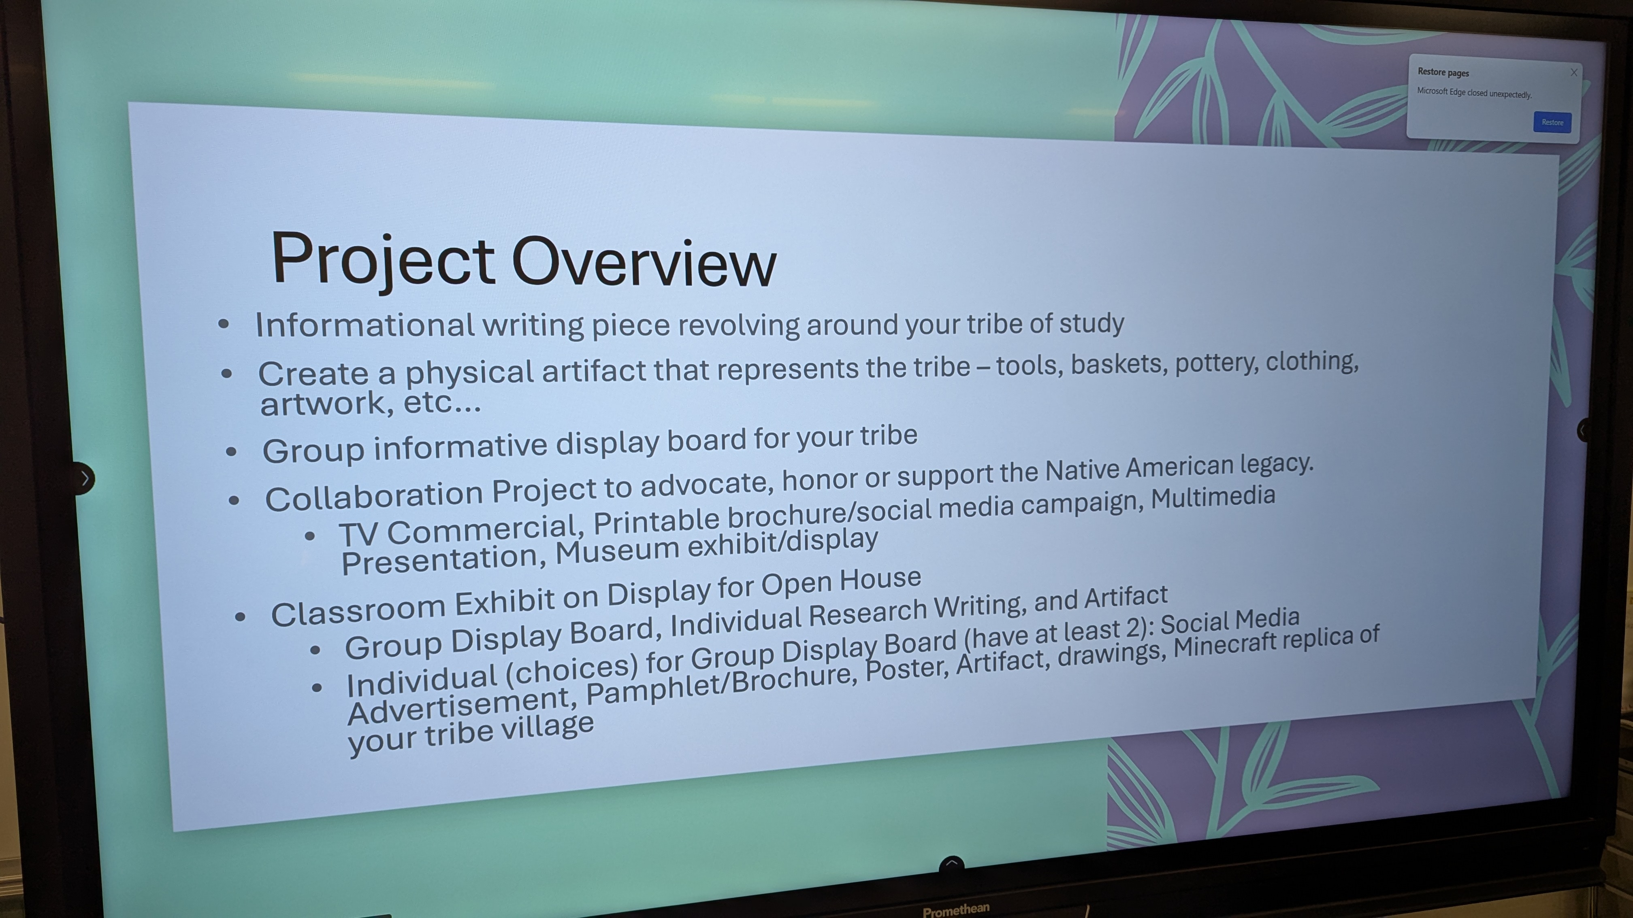

Slide 36
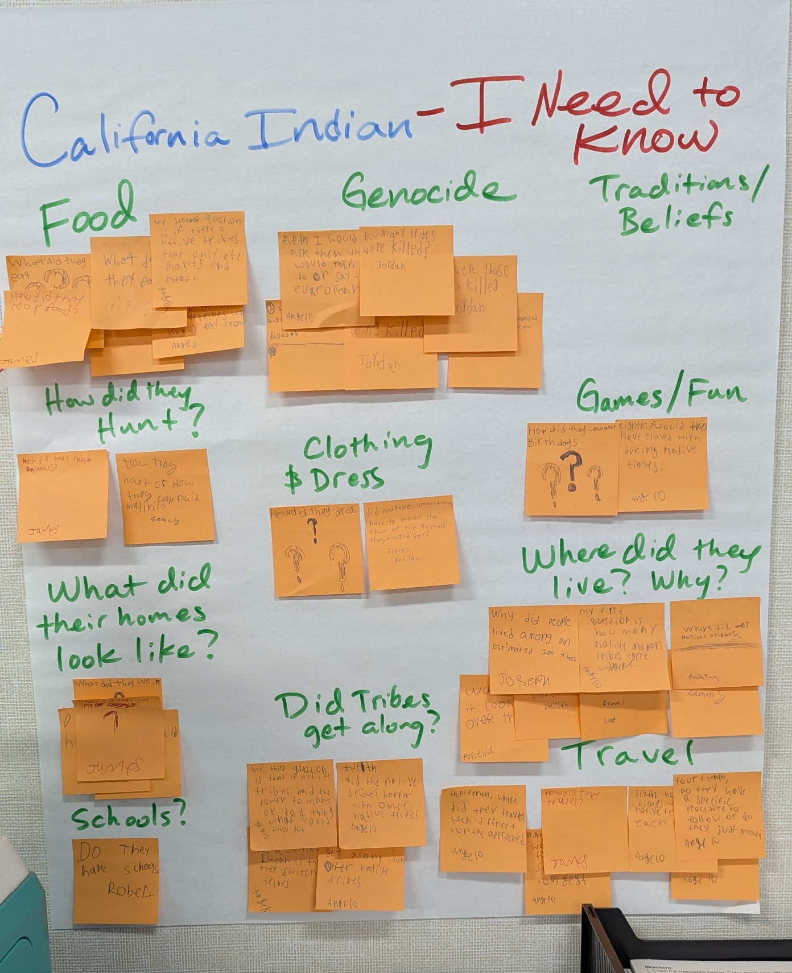
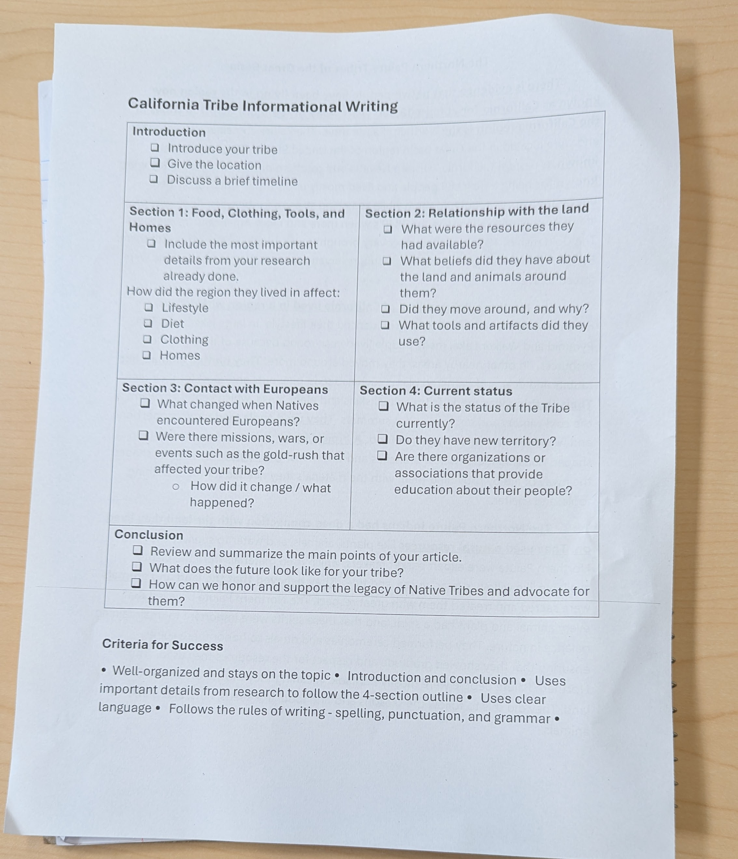

Slide 37
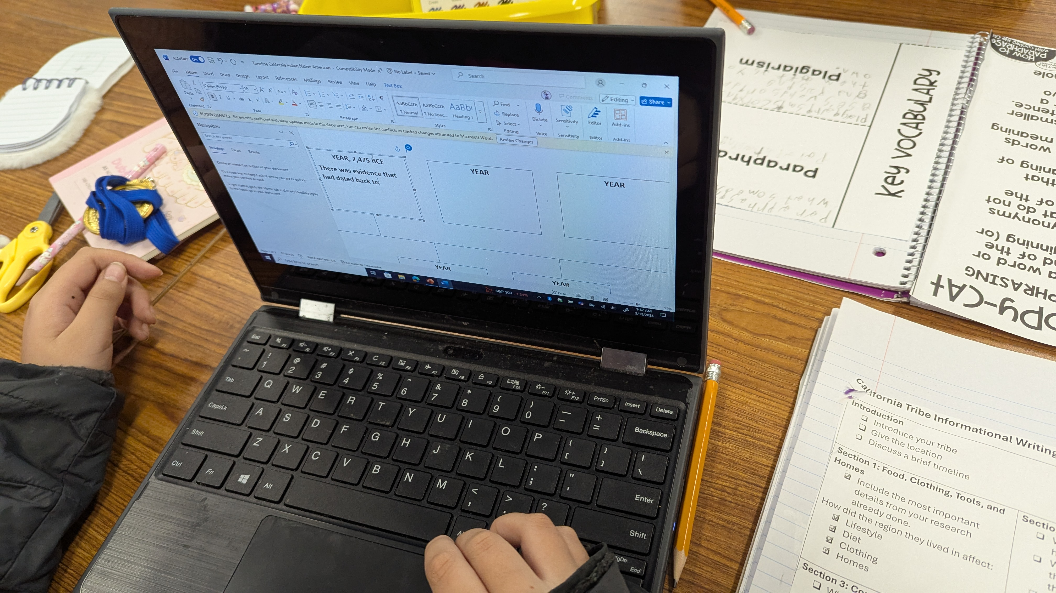

Slide 38
Group
Work
Contract

Slide 40

Open Microphone
Please share one of your Teacher Stories

Slide 41
Reflection in Canva
Find a flyer template to show your learning today.
What resonated with you?
What are you excited to try in your classroom?

Slide 42
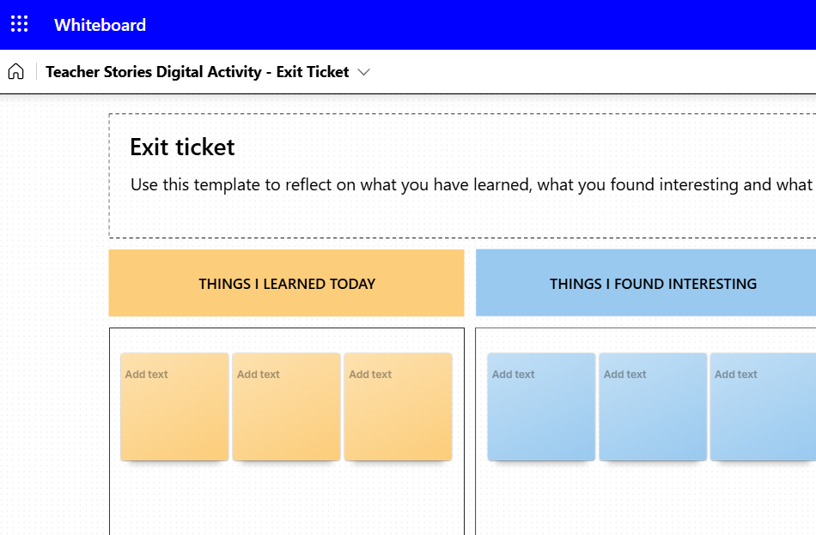
Digital Activity – Whiteboard Exit Ticket
Teacher Stories Digital Activity - Whiteboard Exit Ticket
Notes:
https://fusd-my.sharepoint.com/:wb:/g/personal/matthew_schwartz_fresnounified_org/EfwlehVbSANGrVAINt31xcgB9ps8pDSJ9F5P6xR4guEFAw?e=luqAps

Slide 43
Please Complete the Feedback Form
Your feedback informs what types of trainings we may offer
Your feedback can help us improve our training
We will send a follow-up form
We would love to visit your classroom and see how you're using AI

Slide 44
Thank you for attending our EdTech Webinar!

