Slide 1

Bellflower Unified School District
Report to the Board for August 8, 2024
Presented By:
WESTBERG WHITE ARCHITECTURE

Slide 2
Bellflower Unified School District
Report to the Board for August 8, 2024
Mayfair High School – Athletic Fields
District provided direction to move forward with the project in October 2023.
A meeting with Stakeholders to review additional program requirements was convened on December 6, 2023.
Direction to proceed with the additional scope requirements was provided by District on March 8, 2024.
The March 13, 2024 Registration for a new project with added scope was revised with DSA on April 15, 2024.
Acceptance of Application and Submittal for the new project was completed with DSA on May 28, 2024.
The current Fire Flow Report was provided by District on June 13, 2024 and uploaded to DSA Box.
Conceptual plan approval from LA County Flood Control for Channel Improvements received on June 13, 2024.
An Estimated Construction Cost of $ 9,250,00.00 was provided to DSA, a ROM cost of $15 M reported to the Board in April 2023 should include the additional scope for the new project.

Slide 3
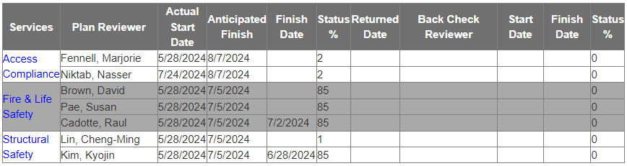
Bellflower Unified School District
Report to the Board for August 8, 2024
Mayfair High School – Athletic Fields (continued)
DSA review was anticipated to finish on July 5, 2024, but as of 7/22/24 Access Compliance review has not started, projected finish date is now at August 7, 2024.
Anticipating 4 weeks to respond to DSA comments and obtain approval, bidding of the project should commence in late September with a November construction start date.
According to a LA County Flood Control District moratorium, the window for construction in the Flood Control channel is between April and October, making this work the first priority for a construction milestone.
To meet the 2025 Football Season, the Stadium and practice fields portion of the project will be scheduled to completed in August, providing an ten month construction duration, with final completion in November.

Slide 4
Bellflower Unified School District
Report to the Board for August 8, 2024
Thomas Jefferson Elementary School – Parking Lot
District provided direction to move forward with the project in October 2023.
At that time, the application and drawings prepared for DSA submittal on June 23, 2021 had been canceled by DSA as the project did not move forward with over 12 months of inactivity.
DSA review comments as of 6/25/2021 required Local Fire Authority review for the Fire Access site plan and definition of the Path of Travel elements including accessible restrooms and drinking fountains to be included.
Revisions to the drawings were completed per the earlier DSA comments and submittal to the Local Fire Authority was made on May 13, 2024.
Project was re-registered on June 20, 2024, a new application number will be issued and the re-submittal back to DSA will occur on August 1, 2024.

Slide 5
Bellflower Unified School District
Report to the Board for August 8, 2024
Thomas Jefferson Elementary School – (Continued)
Allowing 6 to 8 weeks for DSA review and response to comments should achieve DSA approval by the end of September 2024
Advertising and Bidding of the project should commence in October 2024 with award of contract and start of construction scheduled for December 2024.
The Estimated Construction Costs reported on the DSA application was $600,000.00

Slide 6
Westberg White Architecture appreciates the opportunity to be of service to the Staff and Board of Bellflower Unified School District, and would welcome the consideration to be involved in any and all future projects for the District.
QUESTIONS ?

