Slide 1

Mercer Island School District
Highlights from the 2023 Healthy Youth Survey
(February 15, 2024)

Slide 2
Student Participation
Mercer Island School District
  311 (95%) of Grade 6 students
  291 (95%) of Grade 8 students
  210 (59%) of Grade 10 students
  251 (63%) of Grade 12 students

Slide 3
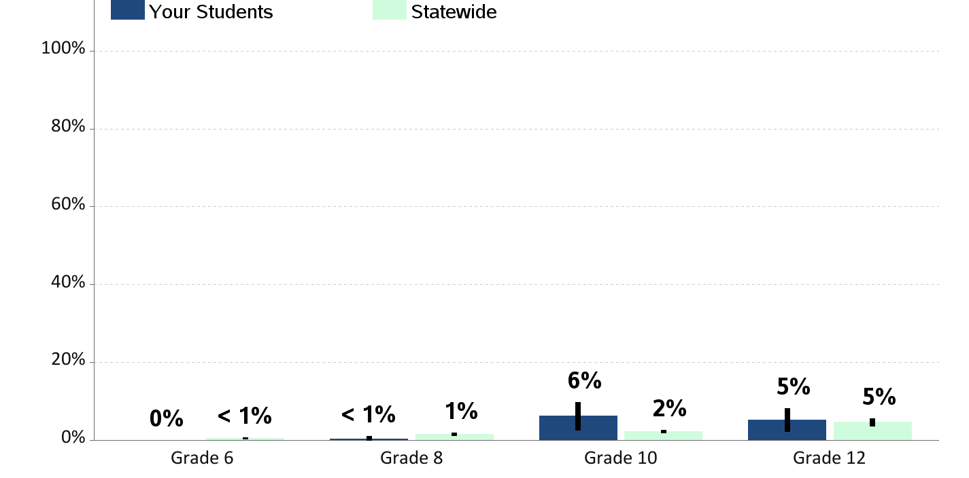
Current Cigarette Smoking
Percent of students who report smoking cigarettes in the past 30 days

Slide 4
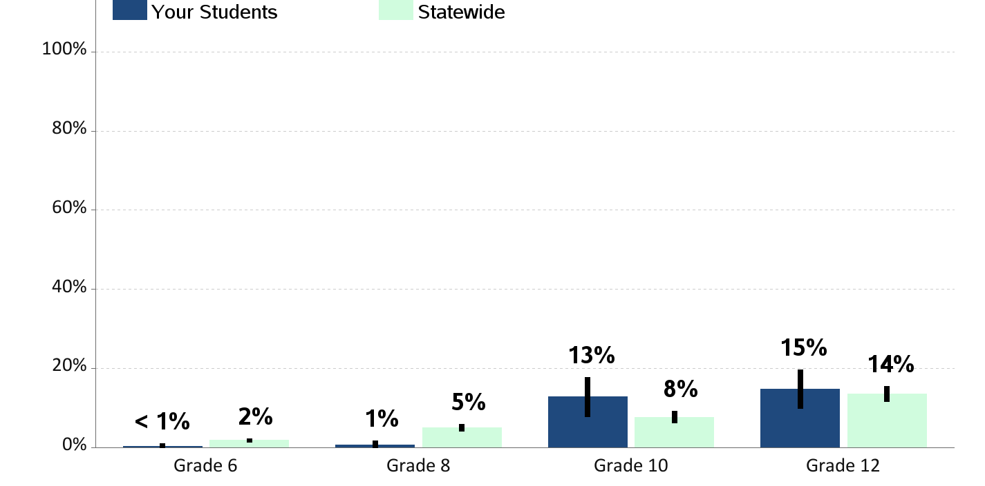
Current E-Cigarette Smoking or Vaping
Percent of students who report using an electronic cigarette, e-cig, JUUL, or vape pen in the past 30 days

Slide 5
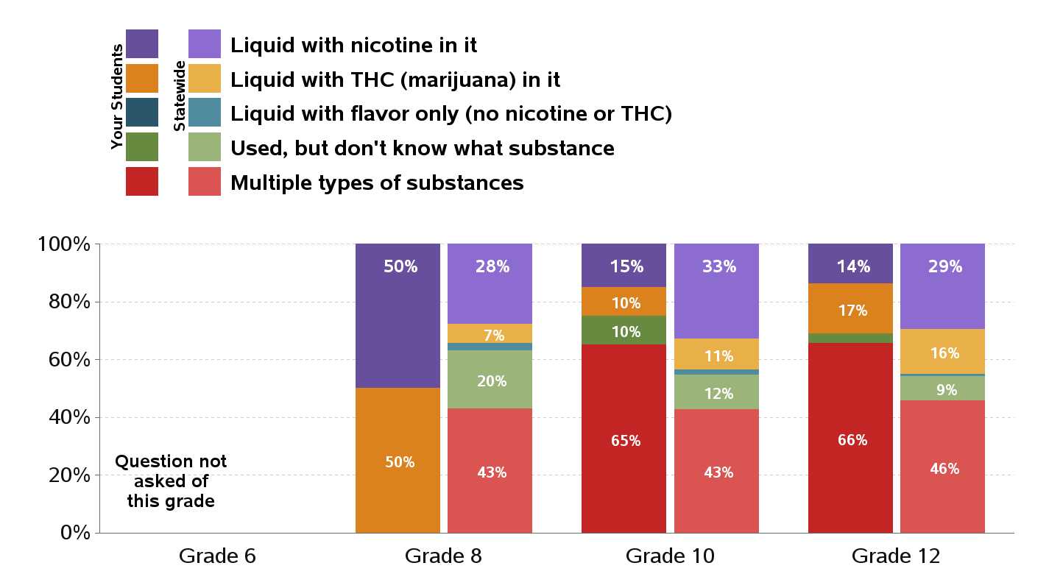
Type of Substance Used in E-Cigarette or Vaped in Past 30 Days
Percentages are of students who used e-cigarettes in the past 30 days

Slide 6
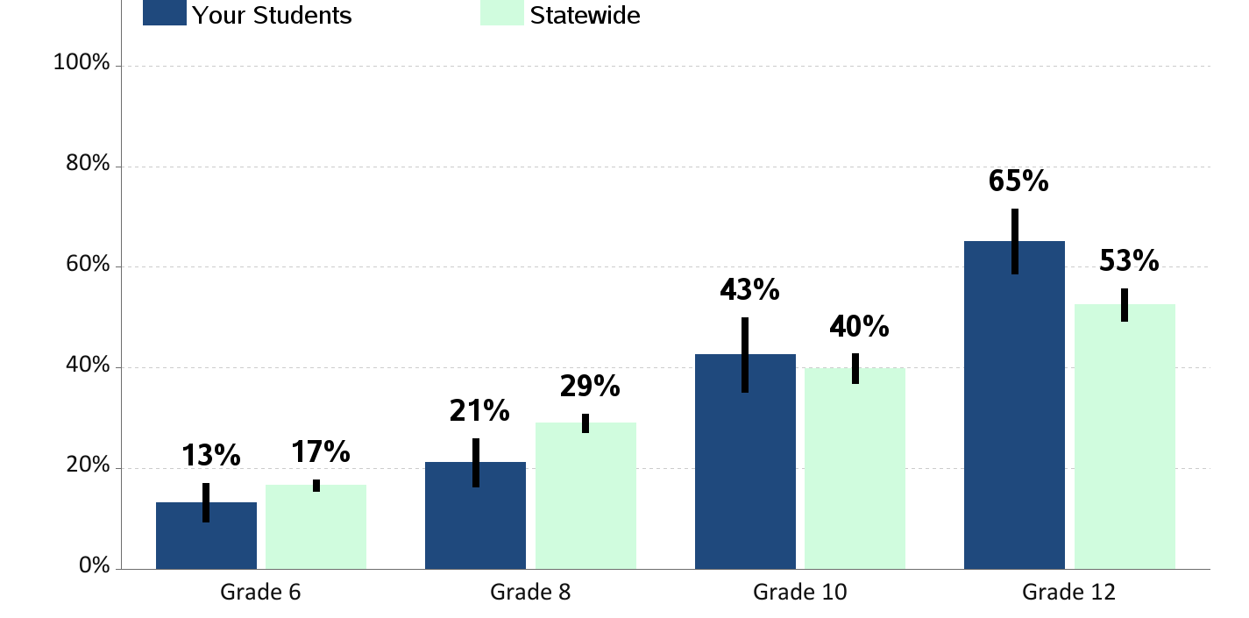
Lifetime Alcohol Use
Percent of students who report having ever drunk more than a sip of alcohol

Slide 7
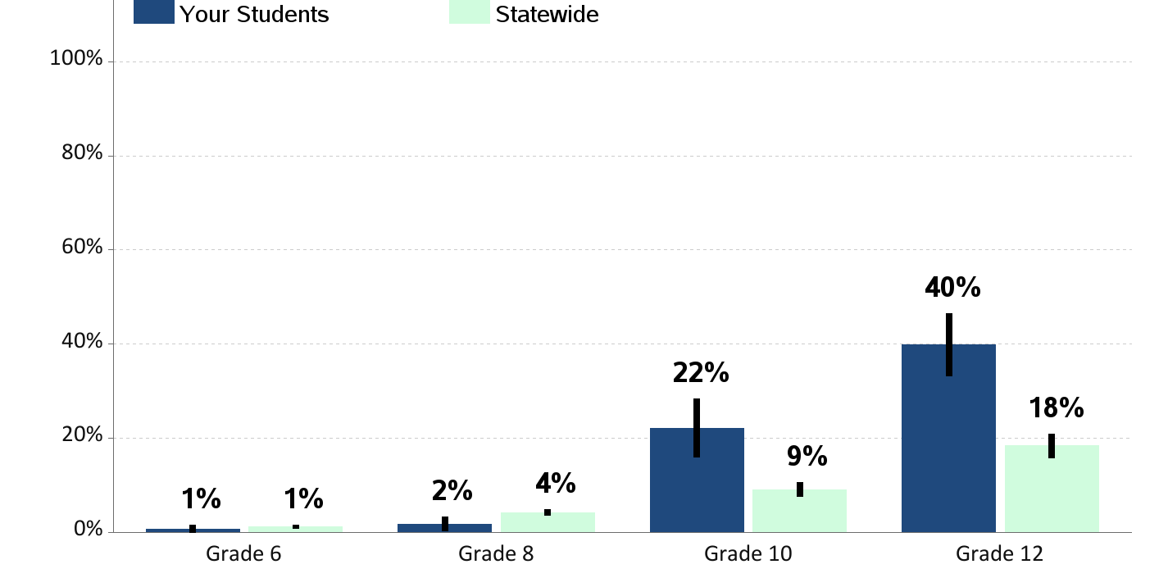
Current Alcohol Use
Percent of students who report having drunk a glass, can or bottle of alcohol in the past 30 days

Slide 8
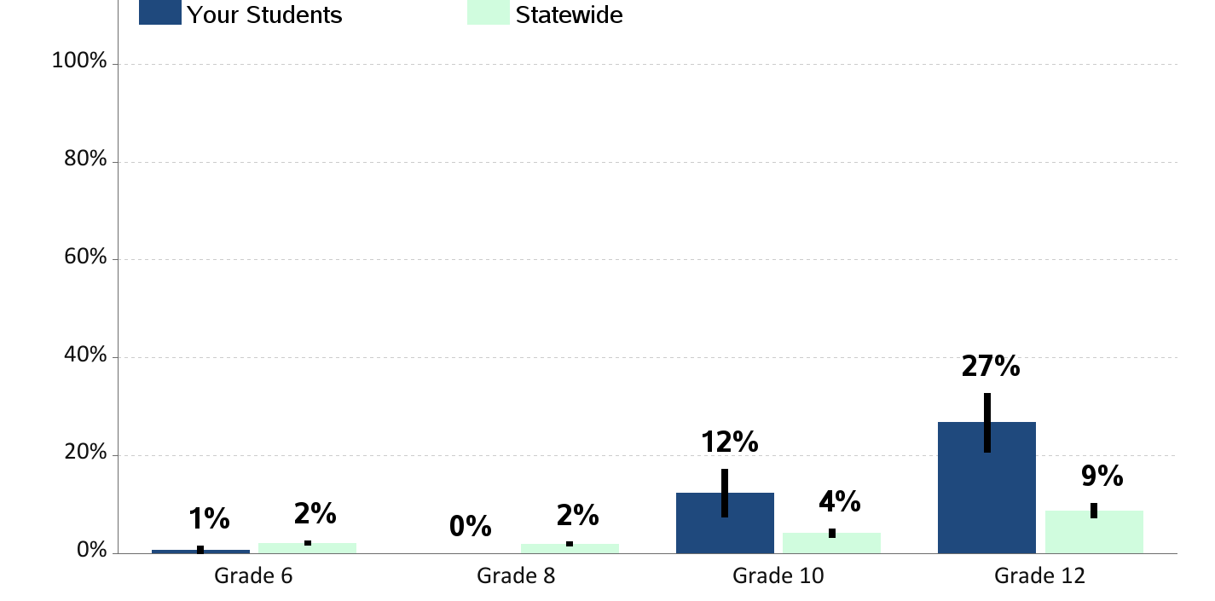
Current Binge Drinking
Percent of students who report having drunk 5 or more drinks in a row in the past 2 weeks

Slide 9
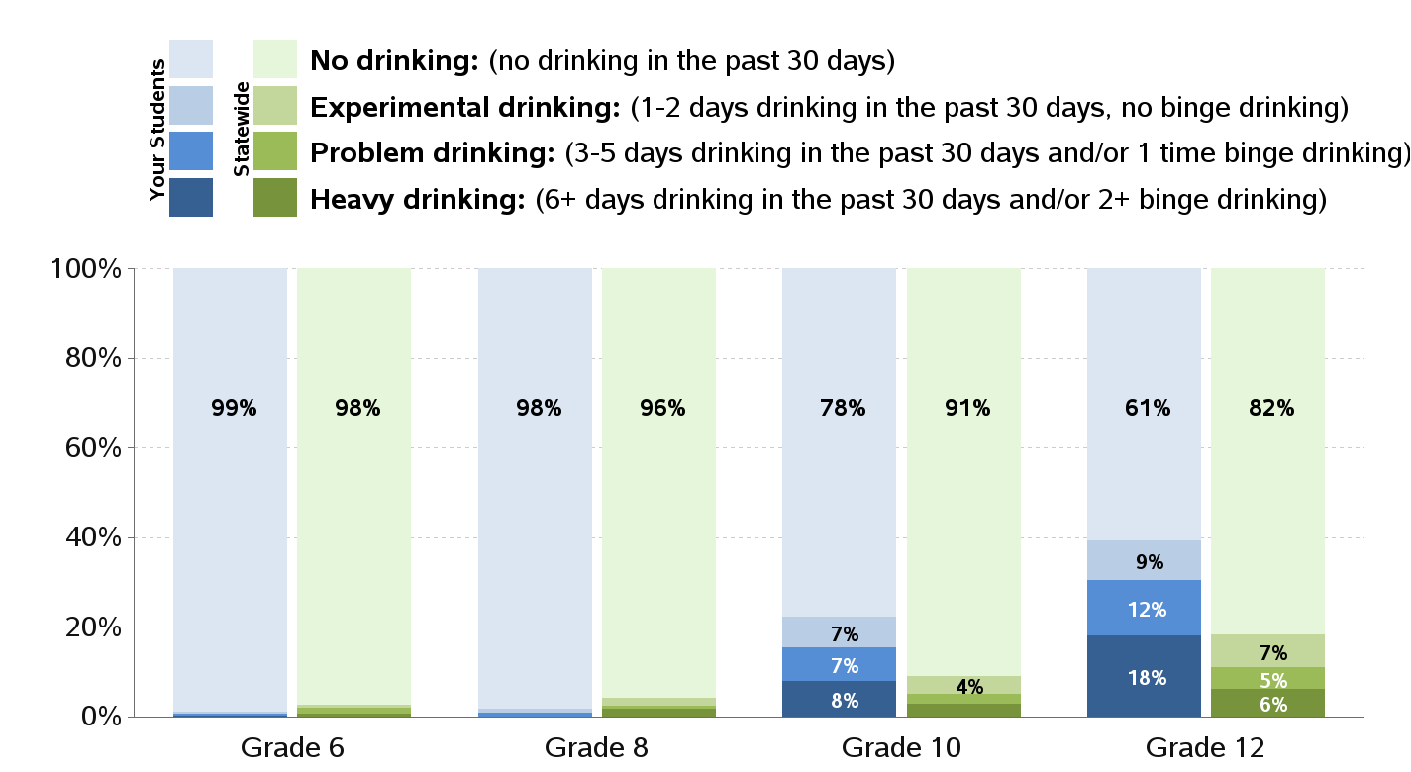
Levels of Alcohol Use

Slide 10
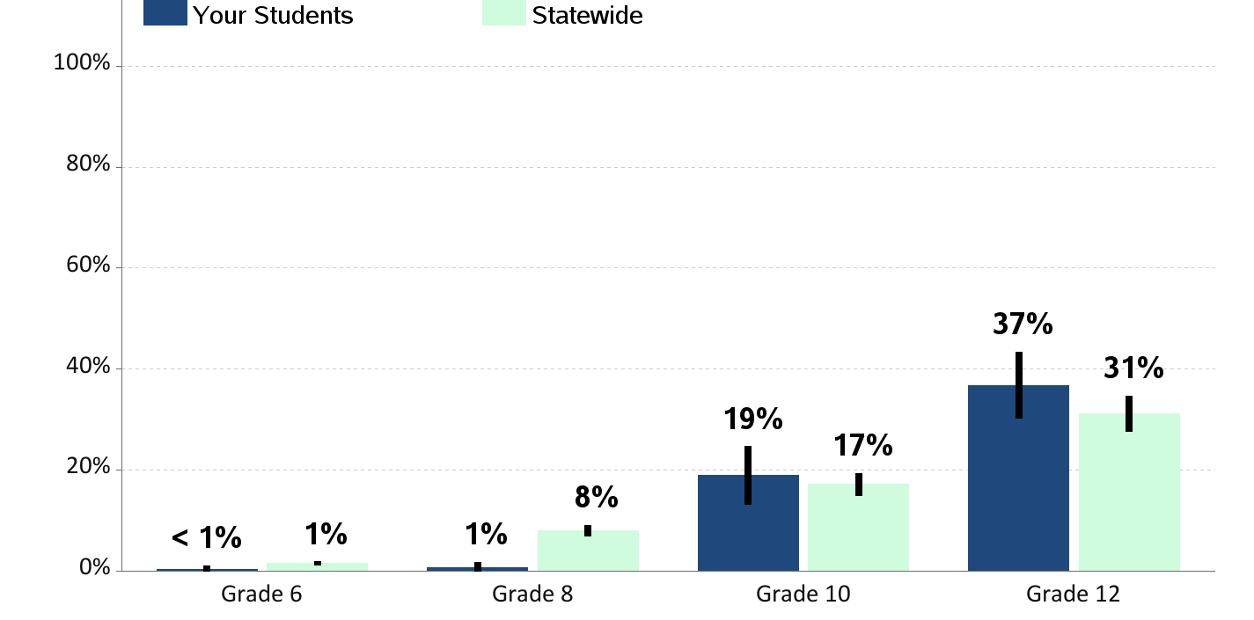
Lifetime Marijuana Use
Percent of students who report having ever used marijuana

Slide 11

Current Marijuana Use
Percent of students who report using marijuana in the past 30 days

Slide 12
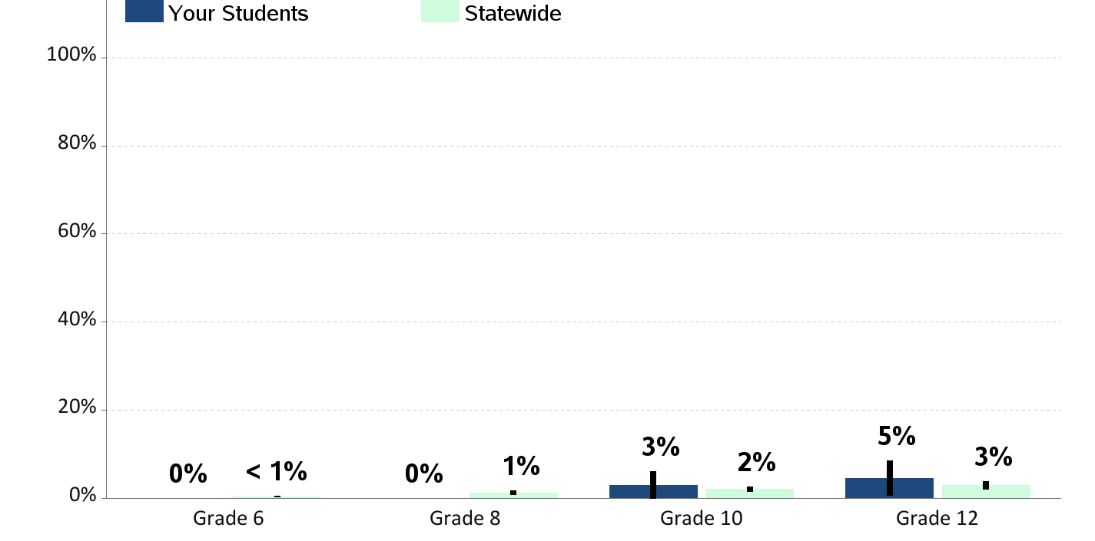
Current Illegal Drug Use
Percent of students who report using illegal drugs in the past 30 days (not including alcohol, tobacco or marijuana)

Slide 13
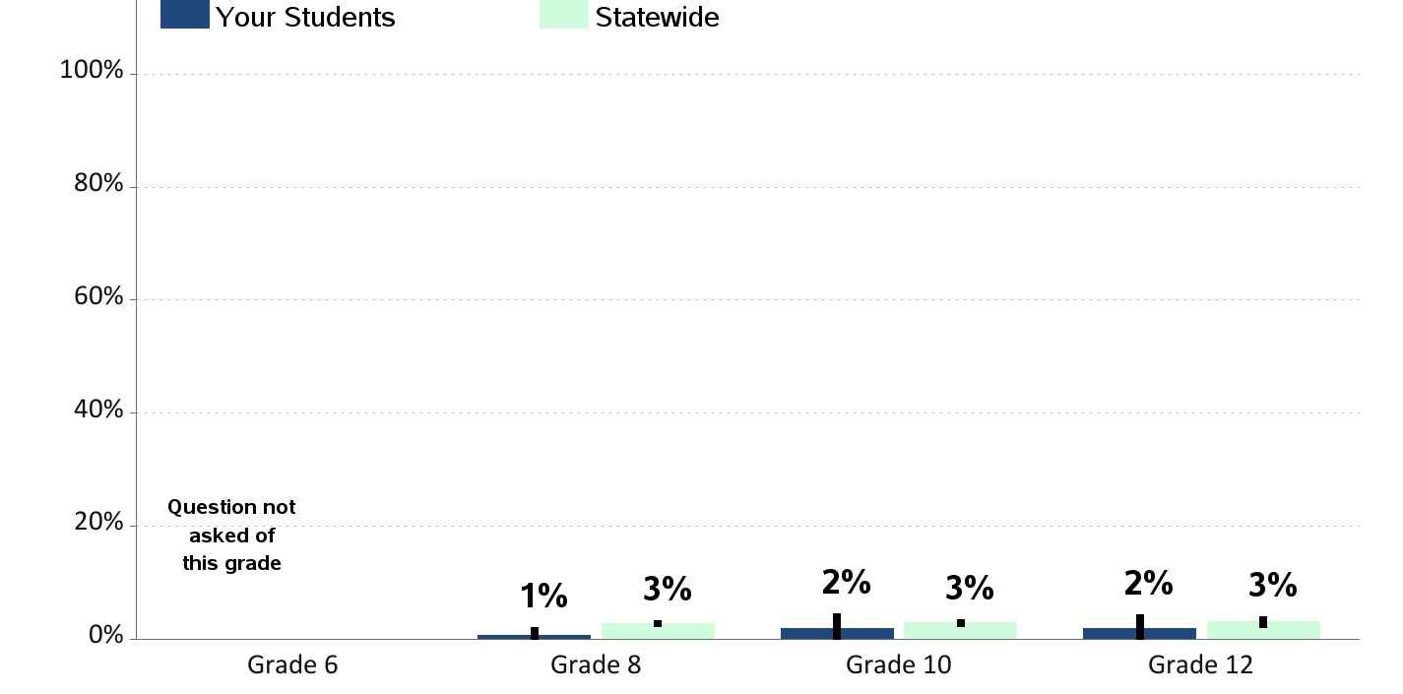
Current Prescription Drug Use
Percent of students who report using prescription drugs not prescribed to them in the past 30 days

Slide 14
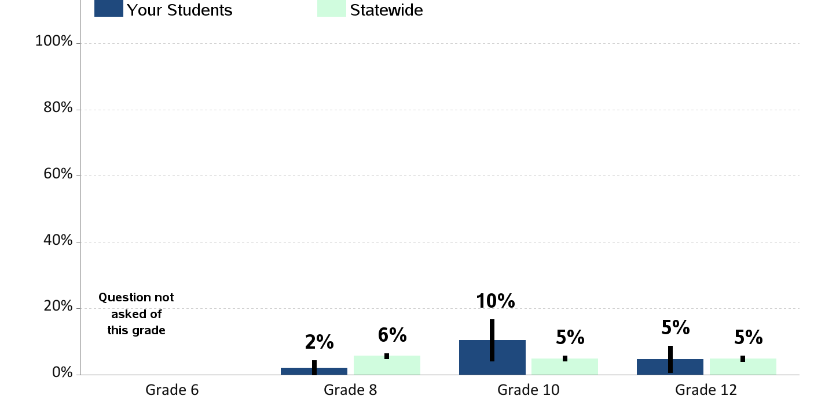
Current Over-the-Counter Drug Use
Percent of students who report using over-the-counter drugs, like cough syrup or cold medicine for non-medical purposes in the past 30 days

Slide 15
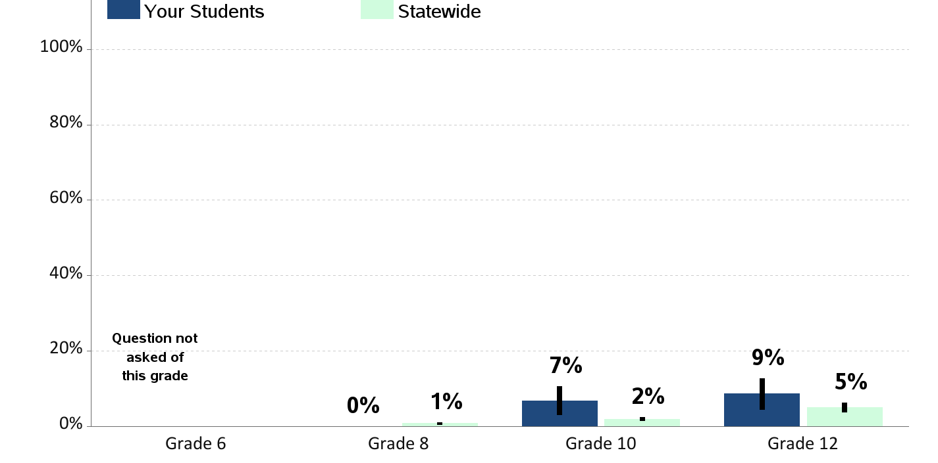
Alcohol Drinking while Using Marijuana
Percent of students who report drinking alcohol at the same time they were using marijuana in the past 30 days

Slide 16
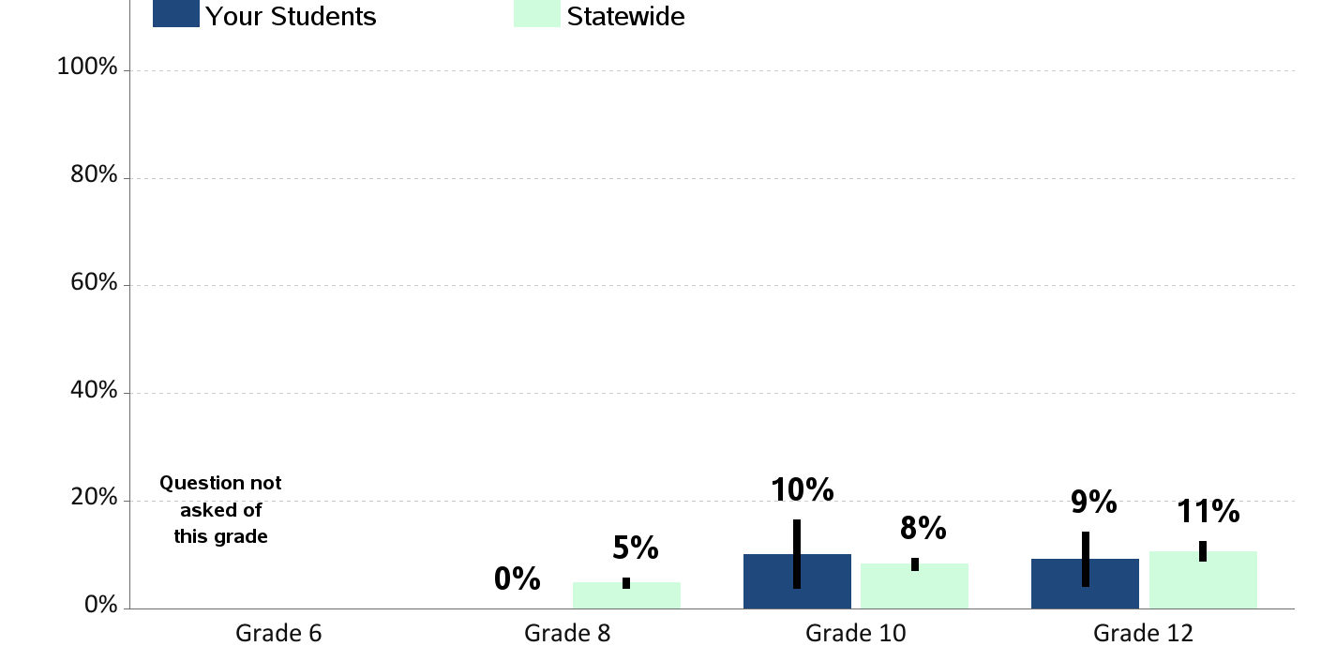
Substance Use at School
Percent of students who report being drunk or high while participating in school in the past year

Slide 17
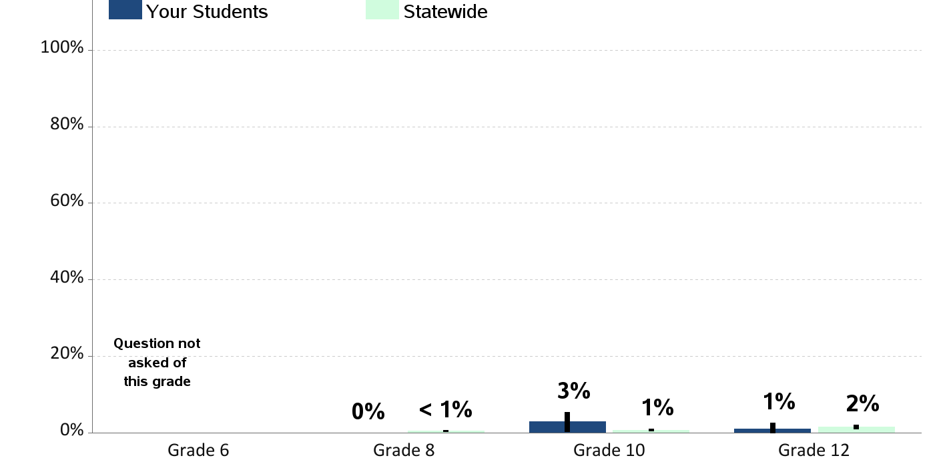
Tobacco Use on School Property
Percent of students who report using cigarettes, cigars, or chew/dip on school property in the past 30 days
(among those on school property in the past 30 days)

Slide 18
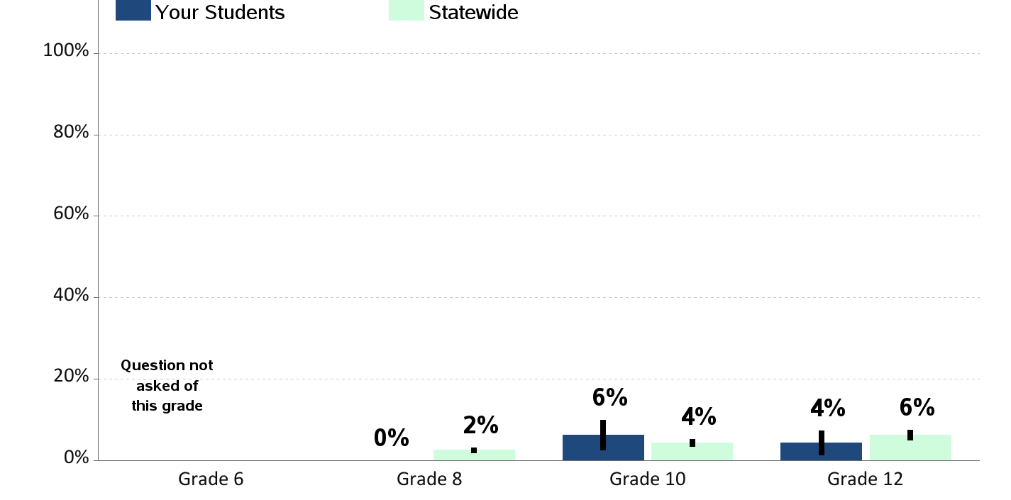
E-Cigarette Use on School Property
Percent of students who report using an electronic cigarette, e-cig, JUUL, or vape pen on school property in the past 30 days
(among those on school property in the past 30 days)

Slide 19
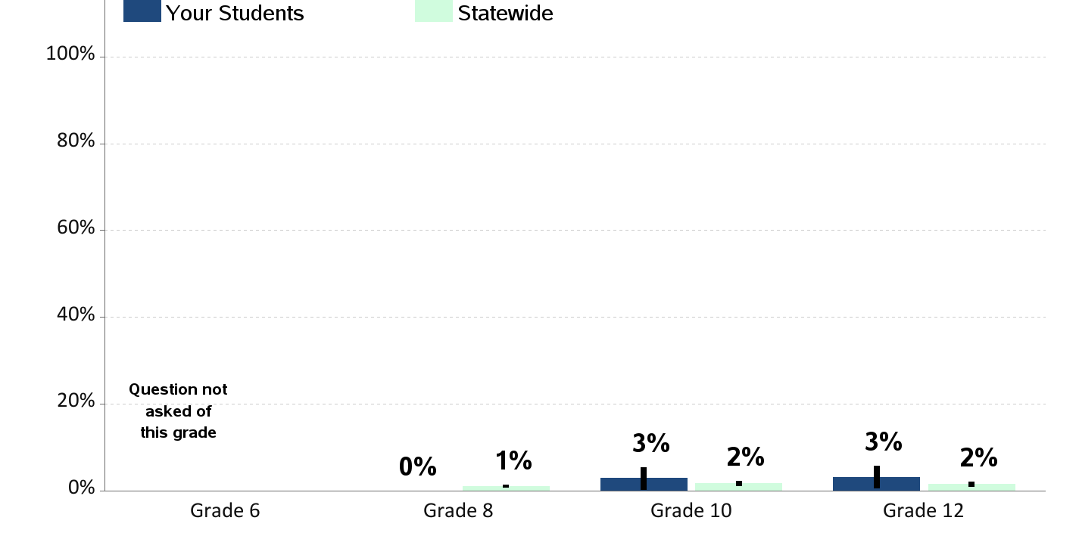
Alcohol Use on School Property
Percent of students who report having at least one drink of alcohol on school property in the past 30 days
(among those on school property in the past 30 days)

Slide 20
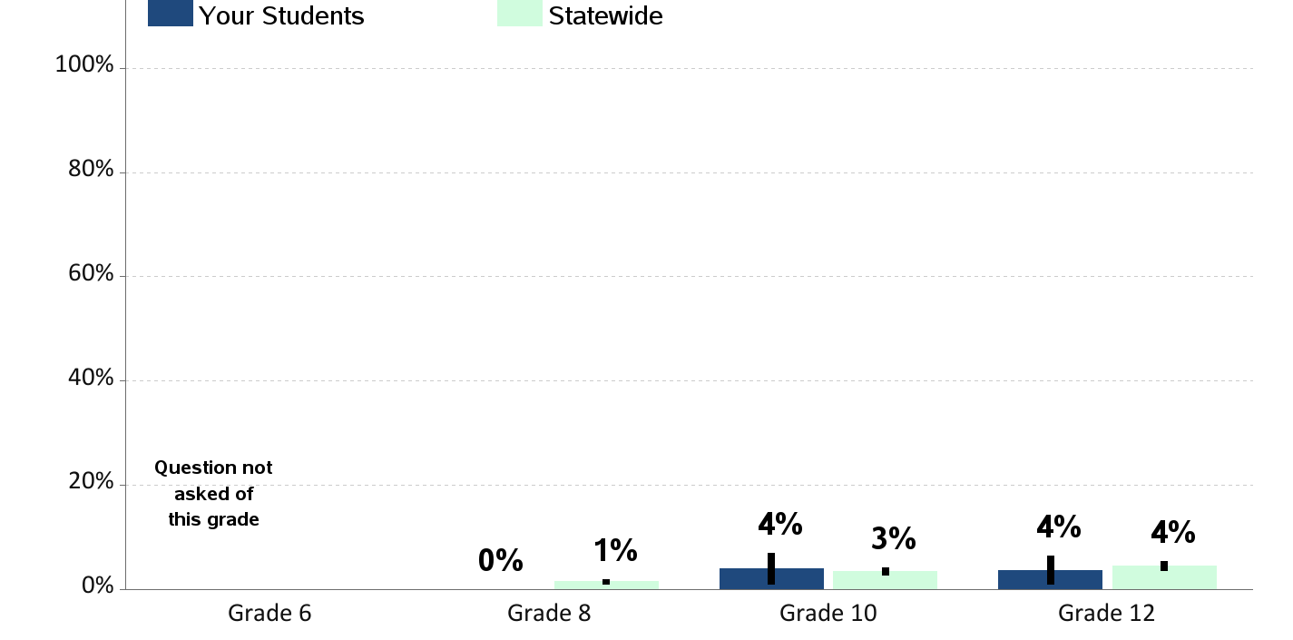
Marijuana Use on School Property
Percent of students who report using marijuana on school property in the past 30 days
(among those on school property in the past 30 days)

Slide 21
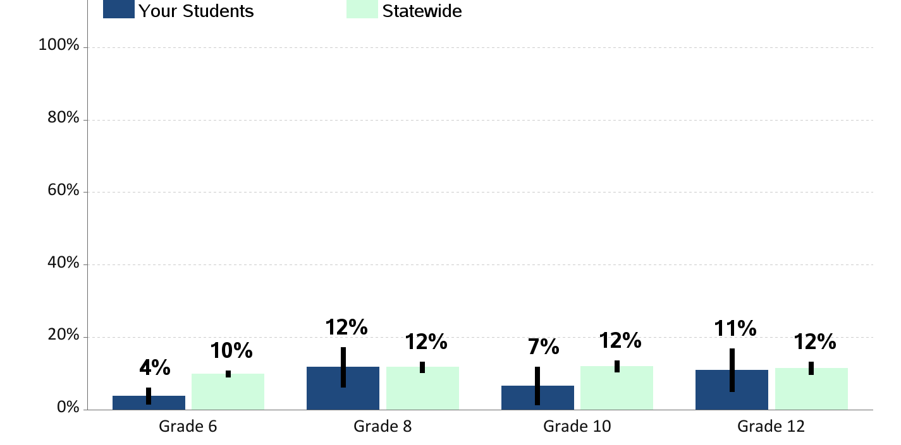
Riding with a Drinking Driver
Percent of students who report having ridden in the past 30 days with a driver who had been drinking alcohol

Slide 22
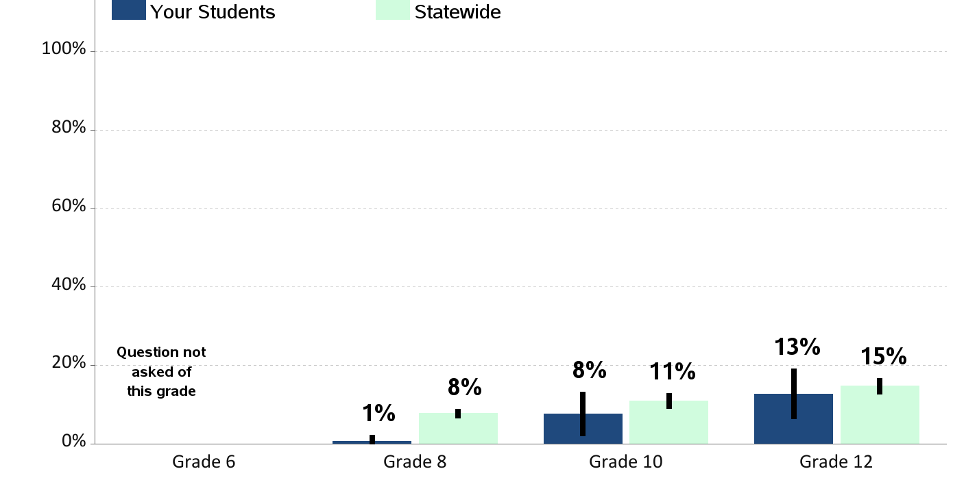
Riding With a Recent Marijuana User
Percent of students who report having ridden in the past 30 days with a driver who had been using marijuana

Slide 23
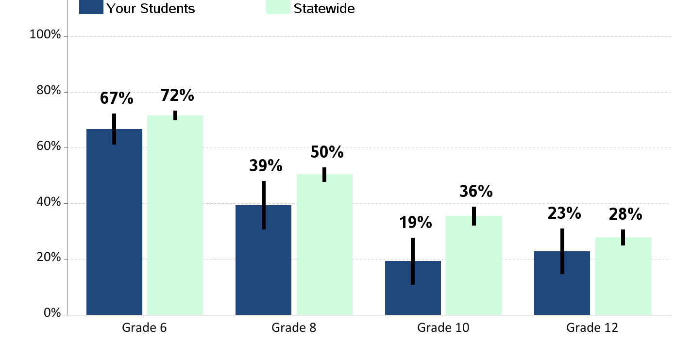
Perceived Availability of Alcohol
Percent of students who report alcohol would be "very hard" to get

Slide 24
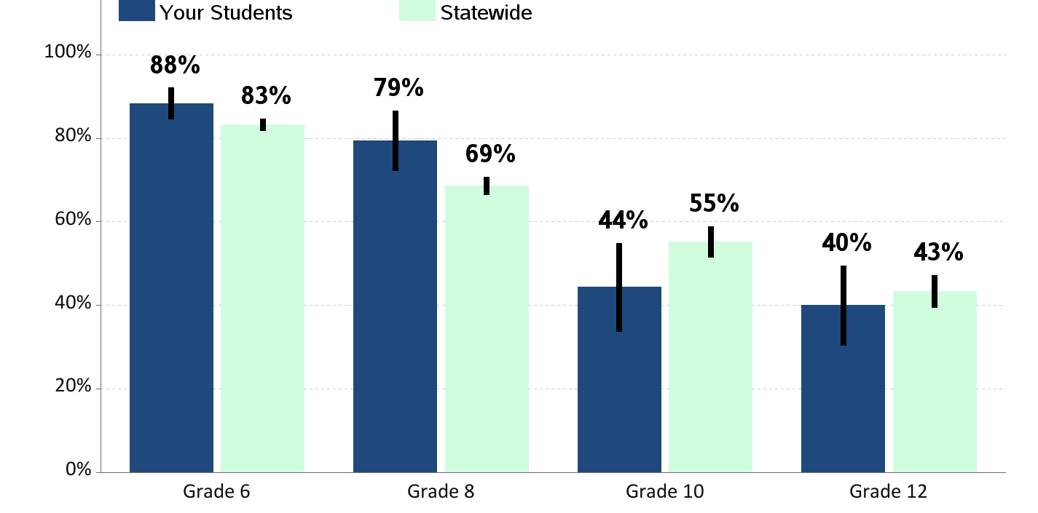
Perceived Availability of Cigarettes
Percent of students who report cigarettes would be "very hard" to get

Slide 25
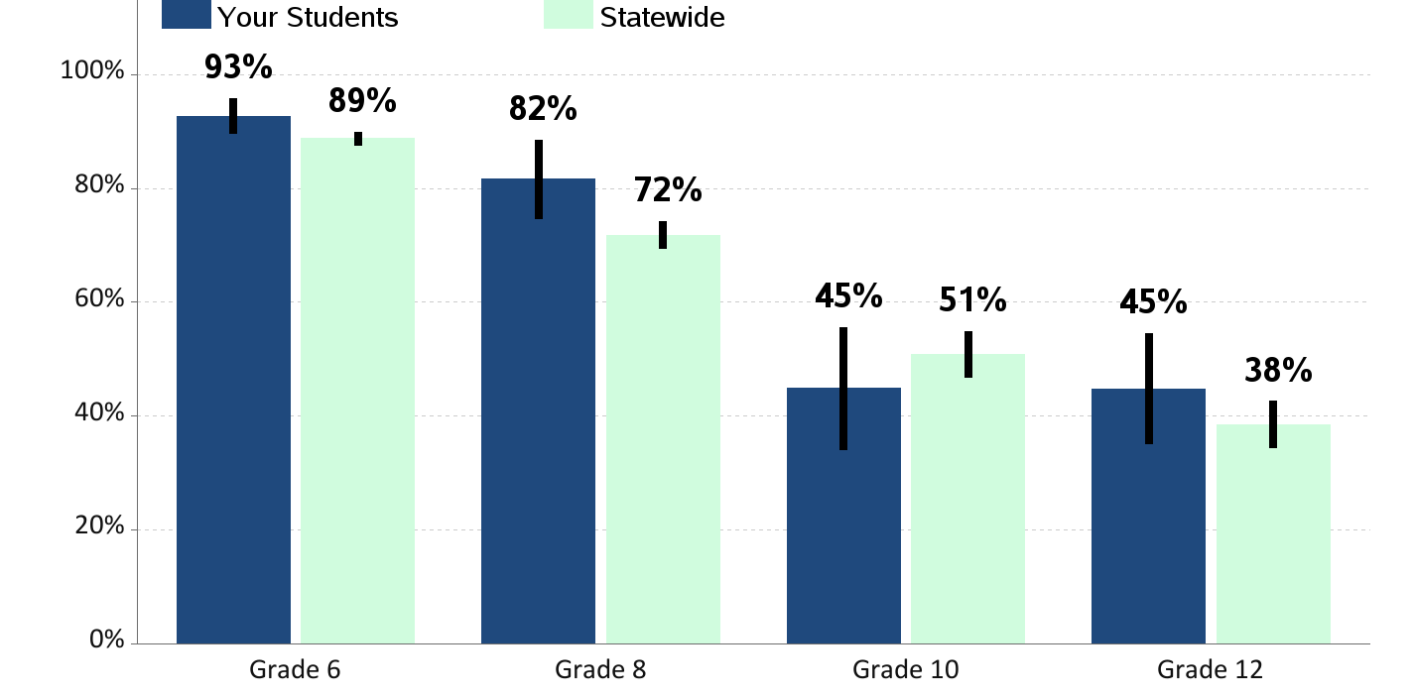
Perceived Availability of Marijuana
Percent of students who report marijuana would be "very hard" to get

Slide 26
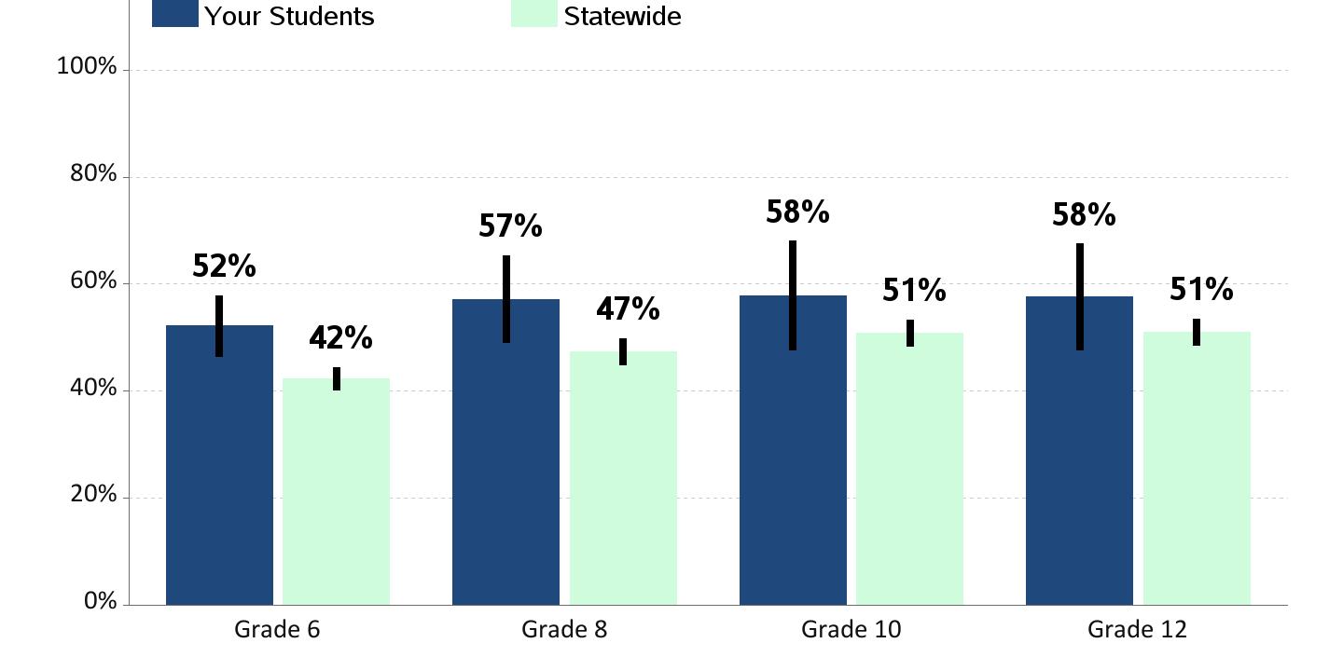
Perceived Risk of Regular Alcohol Use
Percent of students who report "great risk" of harm from drinking alcohol daily

Slide 27
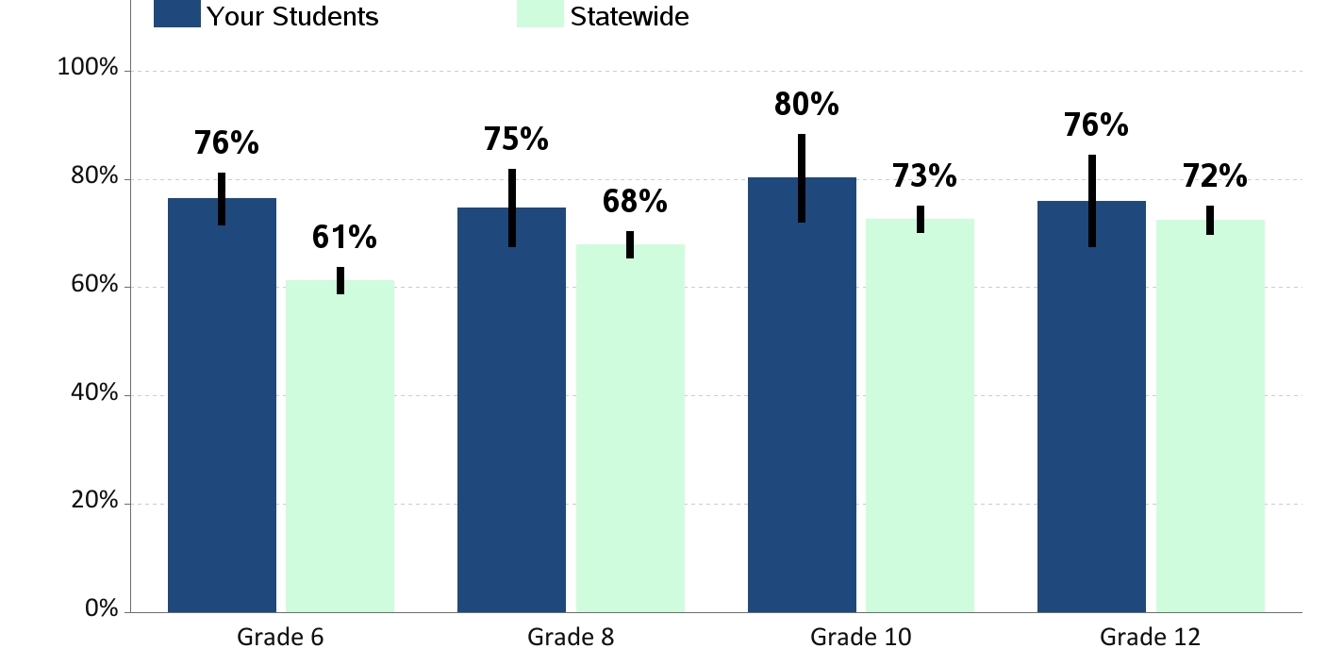
Perceived Risk of Regular Cigarette Smoking
Percent of students who report "great risk" of harm from smoking a pack or more a day

Slide 28
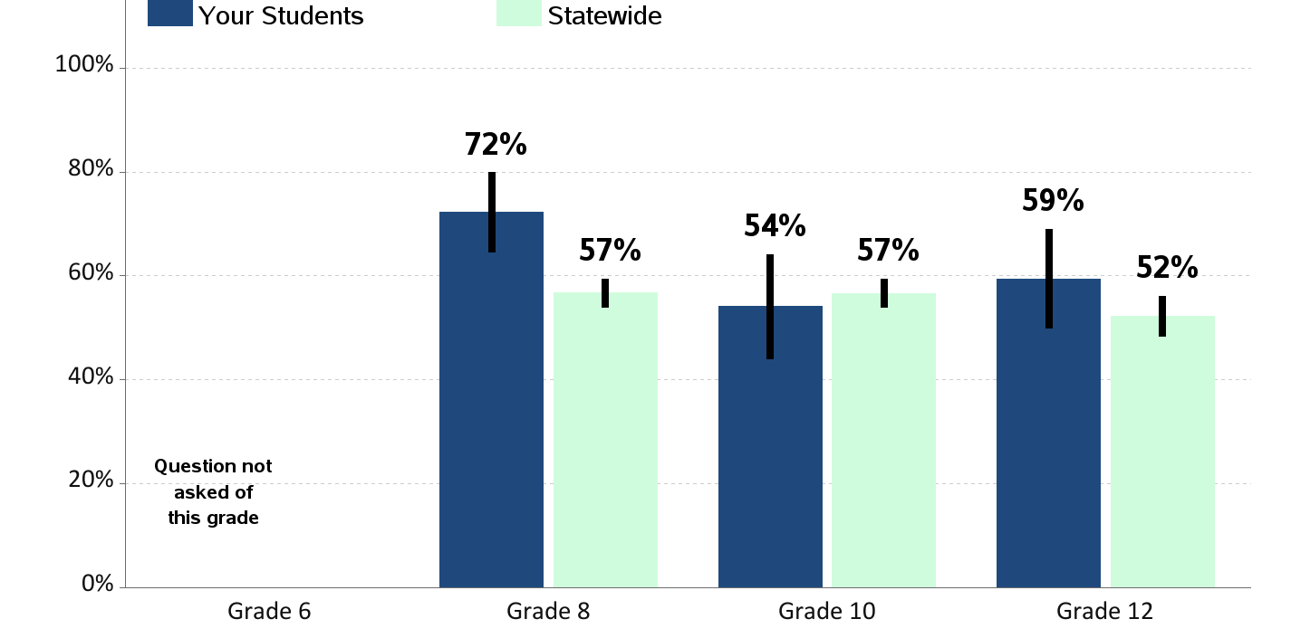
Perceived Risk of E-Cigarette Smoking or Vaping
Percent of students who report "great risk" of harm from using e-cigarette, JUUL, or vape pen regularly (almost daily)

Slide 29
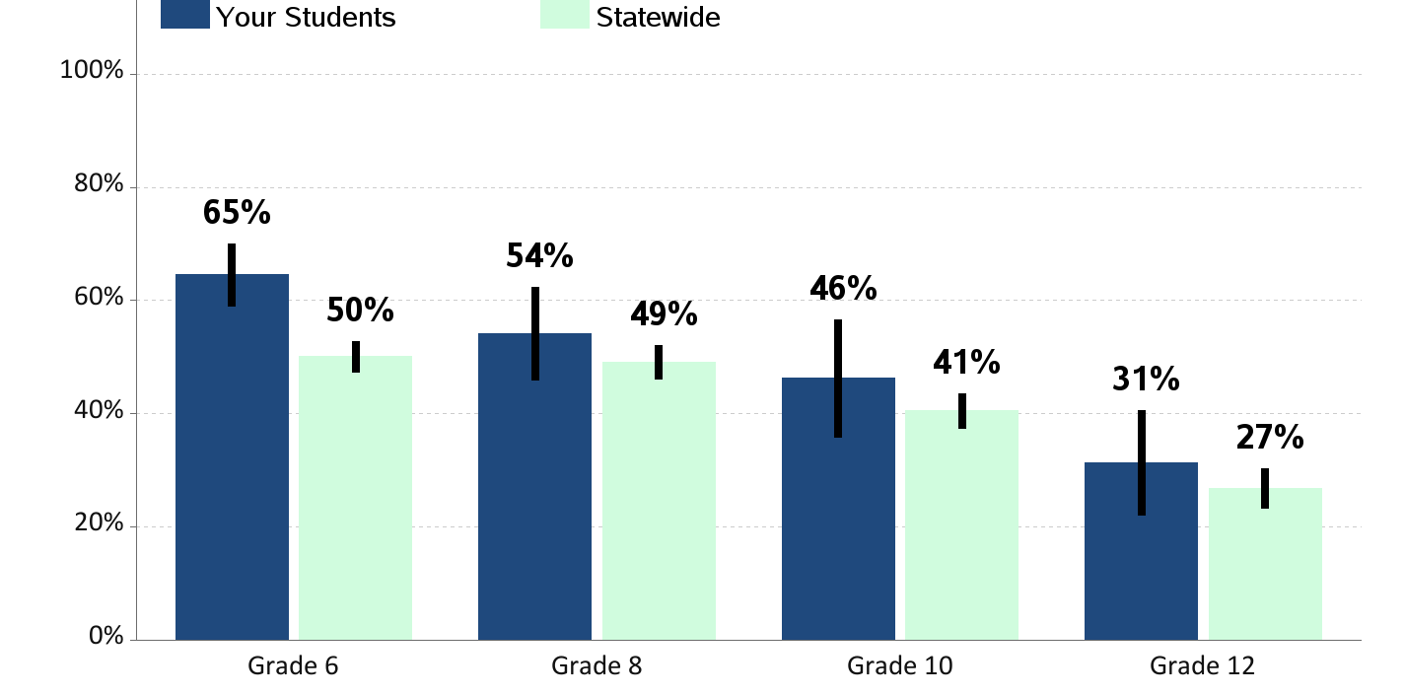
Perceived Risk of Regular Marijuana Use
Percent of students who report "great risk" of harm from using marijuana at least once or twice a week

Slide 30
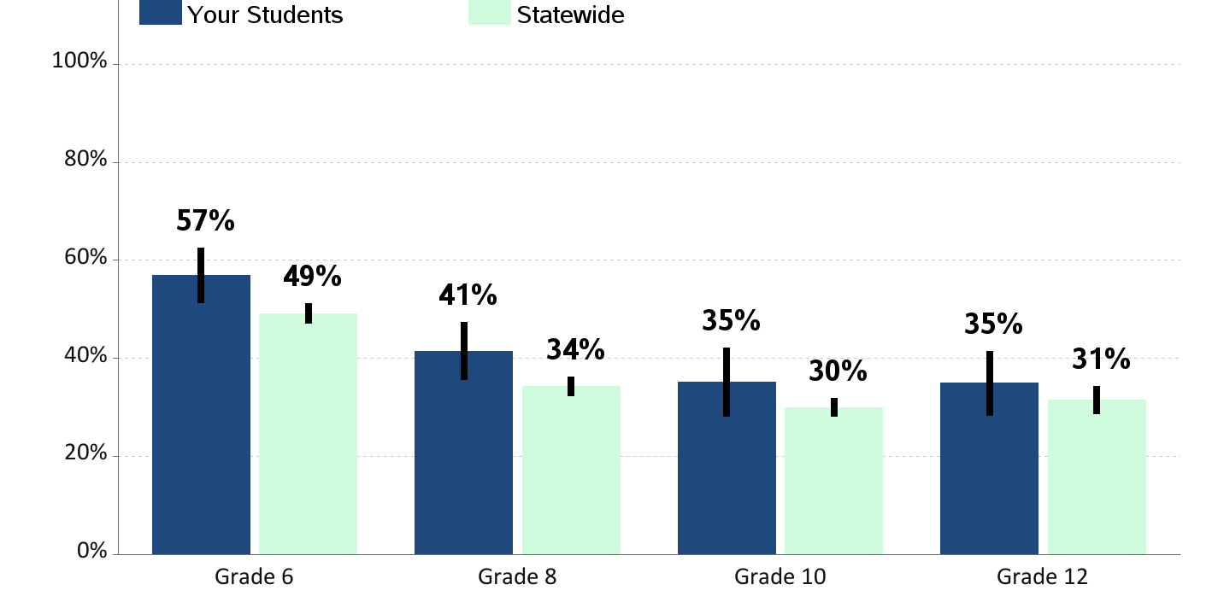
Enjoyment of School
Percent of students who report "often" or "almost always" enjoying school in the past year

Slide 31
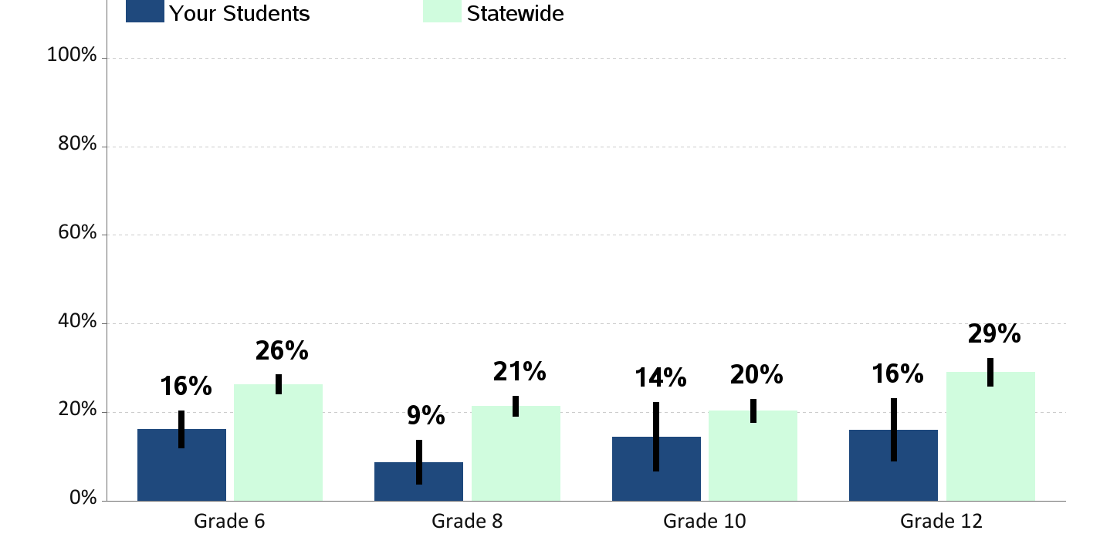
Skipping School
Percent of students who report skipping
1 or more whole days of school in the past 4 weeks

Slide 32
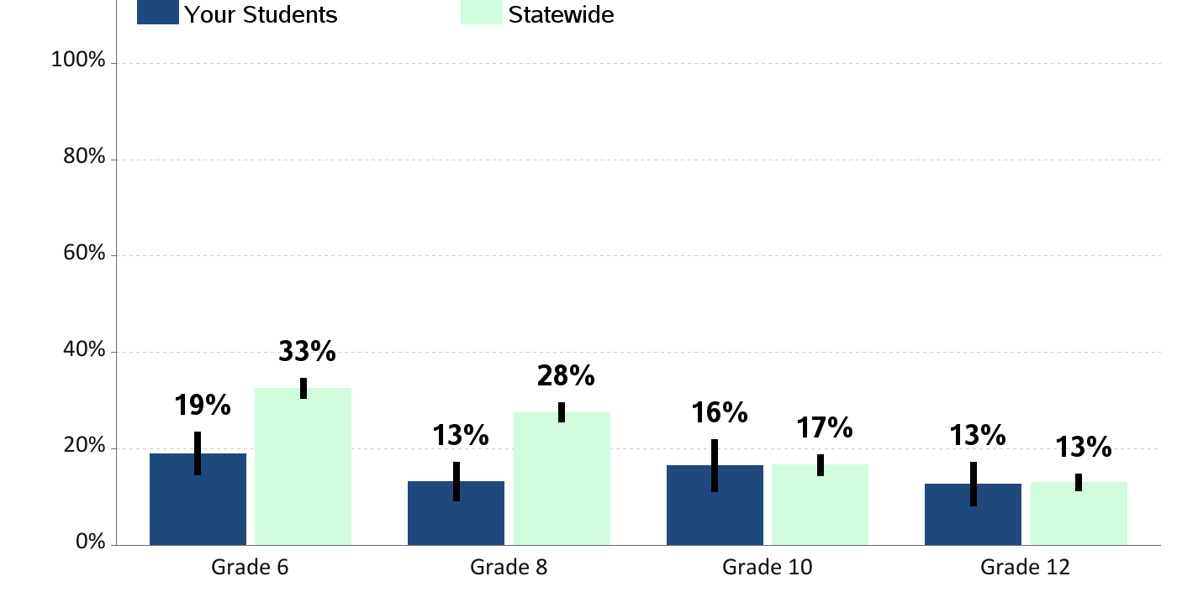
Bullying
Percent of students who report being bullied in the past 30 days
Bullying is when one or more students threaten, spread rumors about, hit, shove, or otherwise hurt another student over and over again.

Slide 33
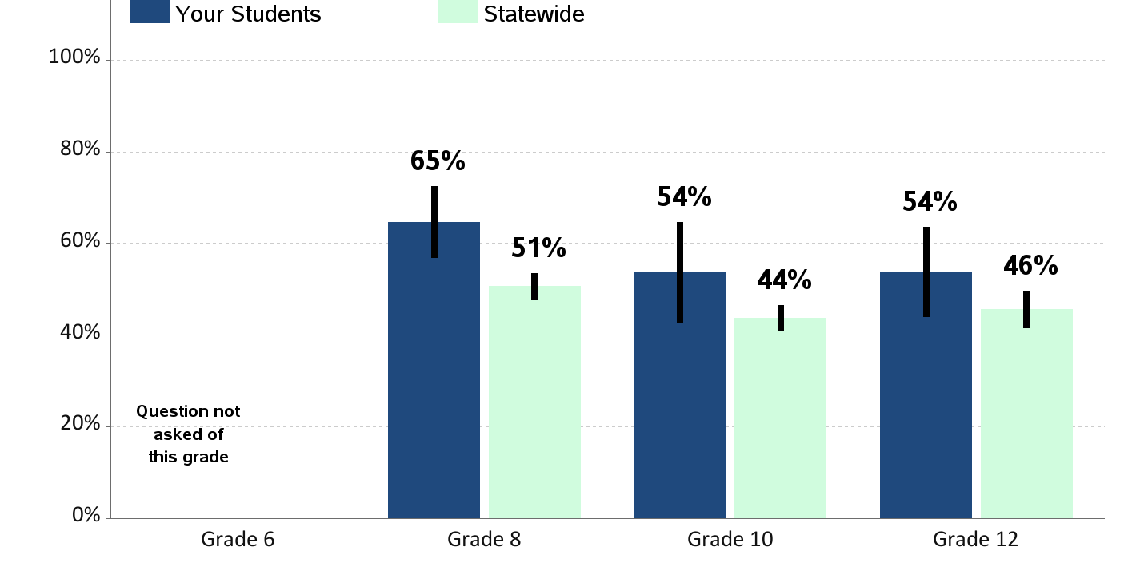
School Tries to Stop Bullying
Percent of students who report teachers or other adults from school
"almost always" or "often" try to stop bullying

Slide 34
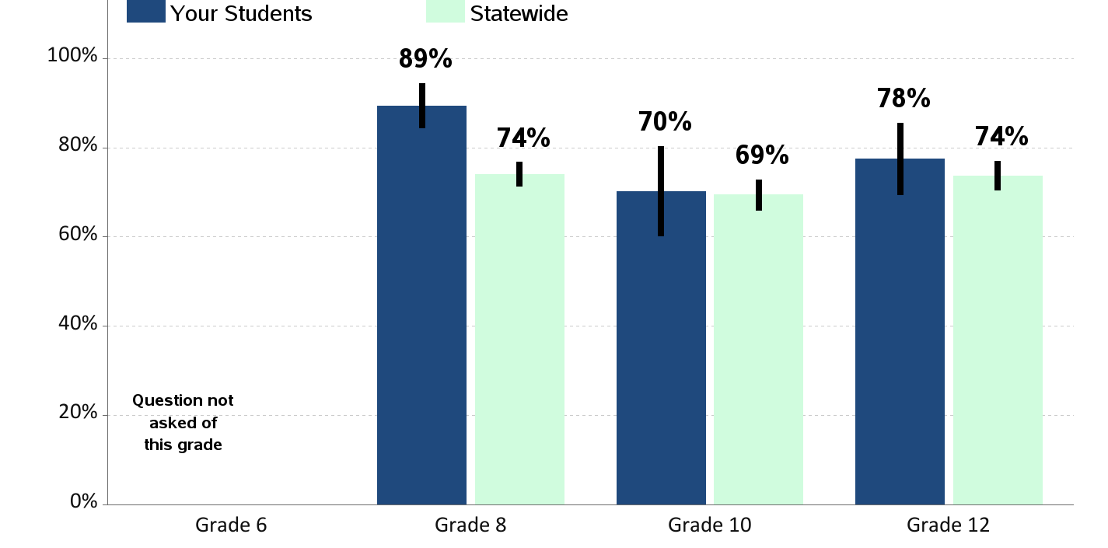
Students Know How to Report Bullying
Percent of students who report they know how to report bullying during school

Slide 35
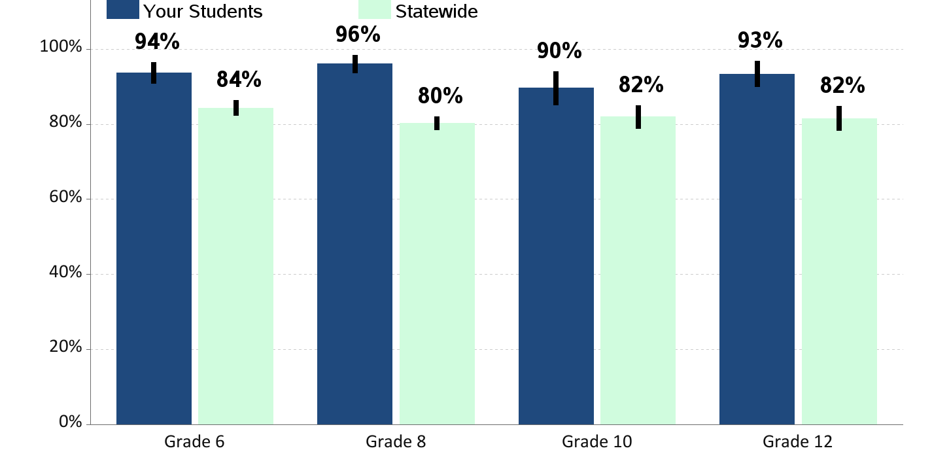
Feeling Safe During School
Percent of students who report that they feel safe during school

Slide 36
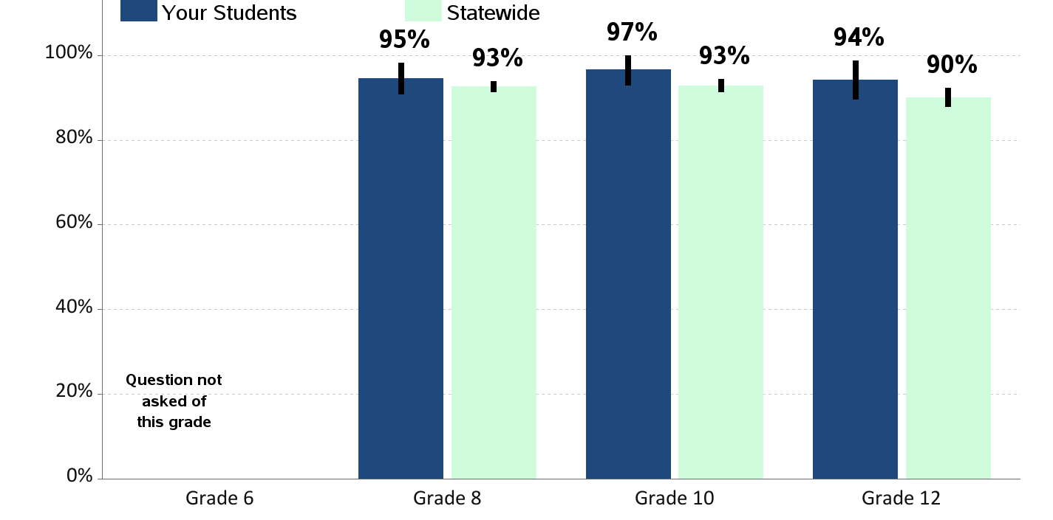
Opportunities for School Involvement
Percent of students who report that they have lots of chances for involvement in school activities

Slide 37
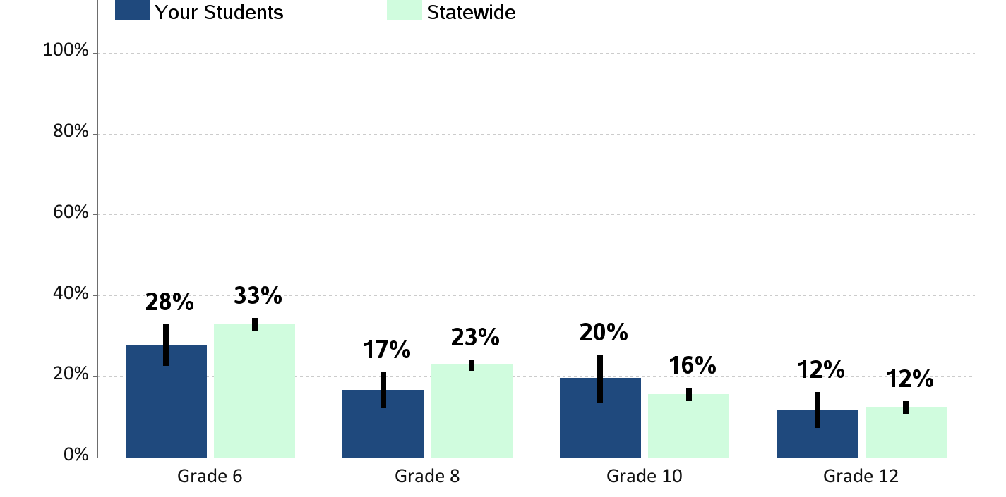
Physical Fighting
Percent of students who report being in a physical fight in the past year

Slide 38
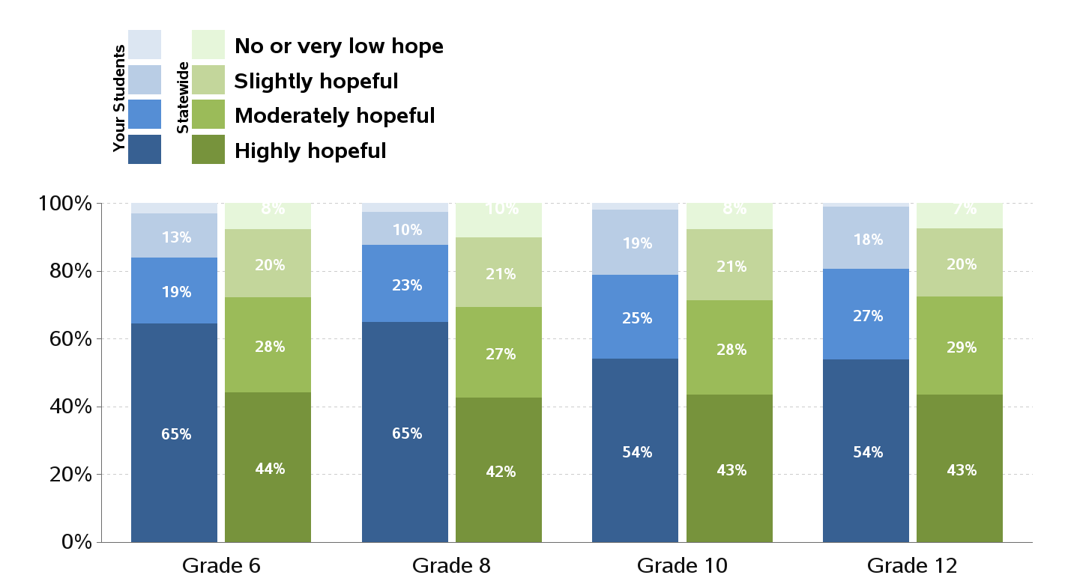
Children's Hope Scale
Hope reflects a future orientated mindset and motivational process toward attaining a desirable goal.
Research has linked hope with overall physical, psychological, and social well-being.

Slide 39
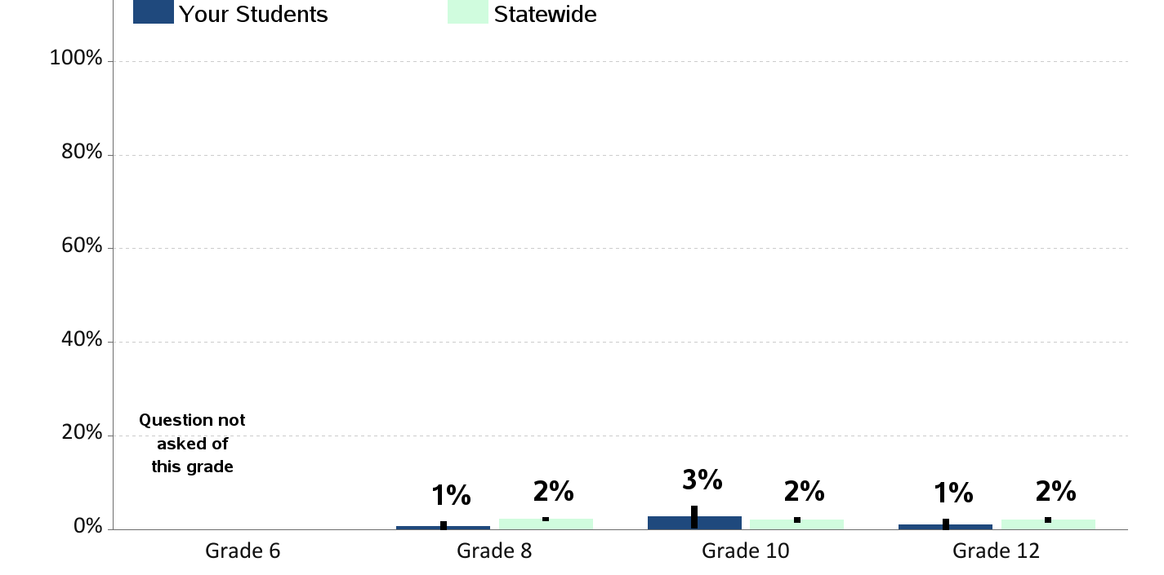
Gang Membership
Percent of students who report being members of a gang in the past year

Slide 40
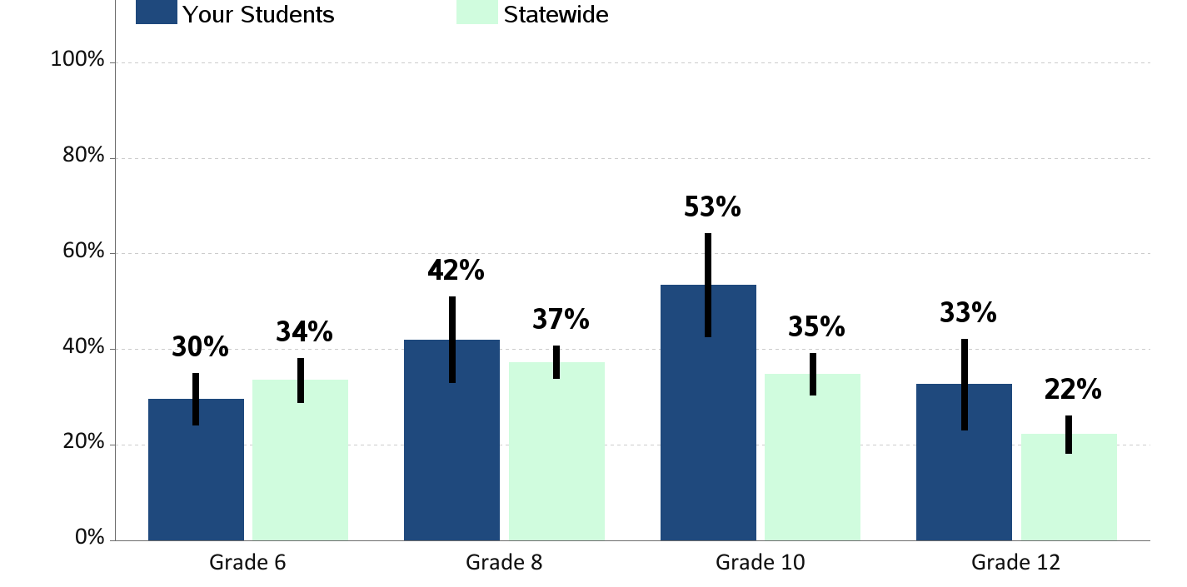
Walking/Biking To or From School
Percent of students who report walking or riding a bicycle to or from school during an average week
(among those who normally travel to school)

Slide 41
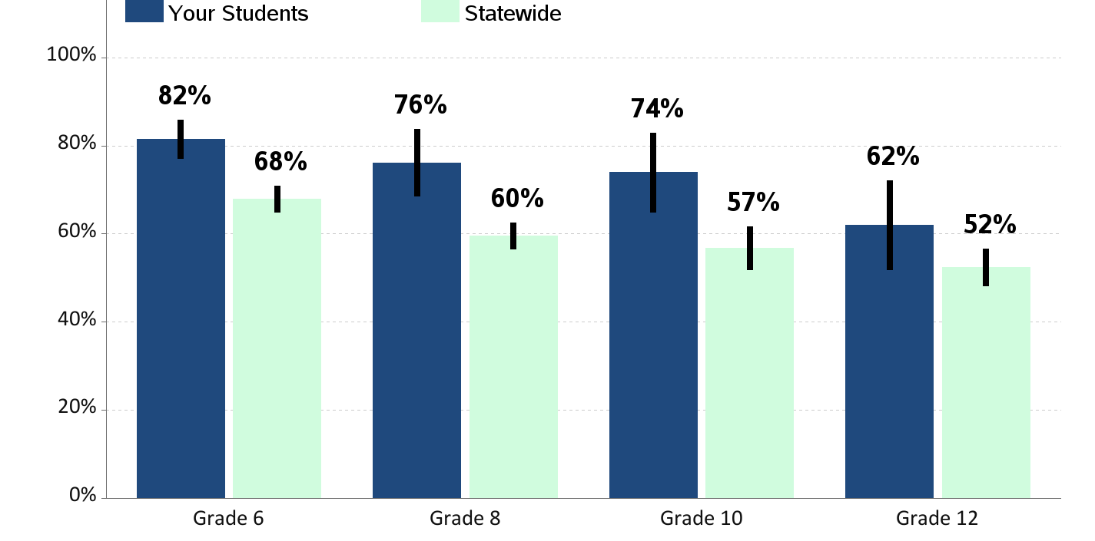
Eating Breakfast
Percent of students who report eating breakfast

Slide 42
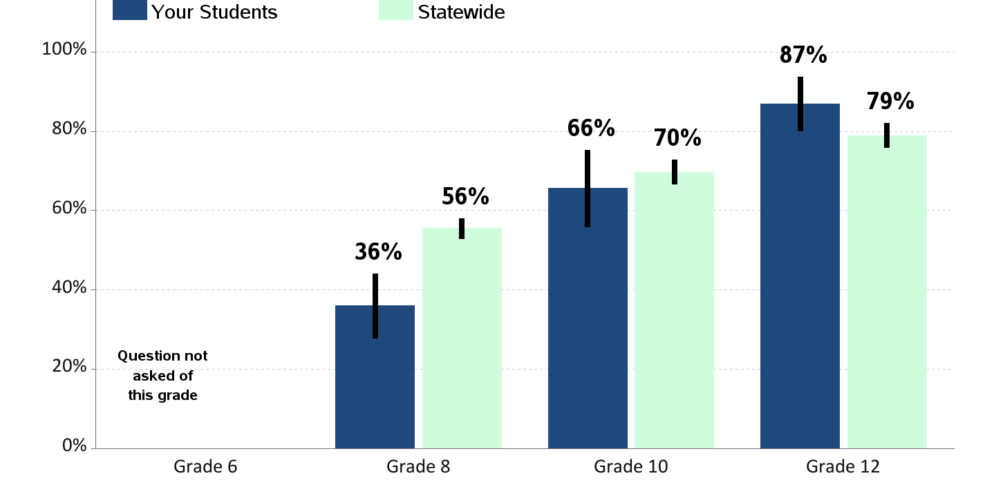
Sleep on a School Night
Percent of students who report sleeping less than 8 hours on an average school night

Slide 43
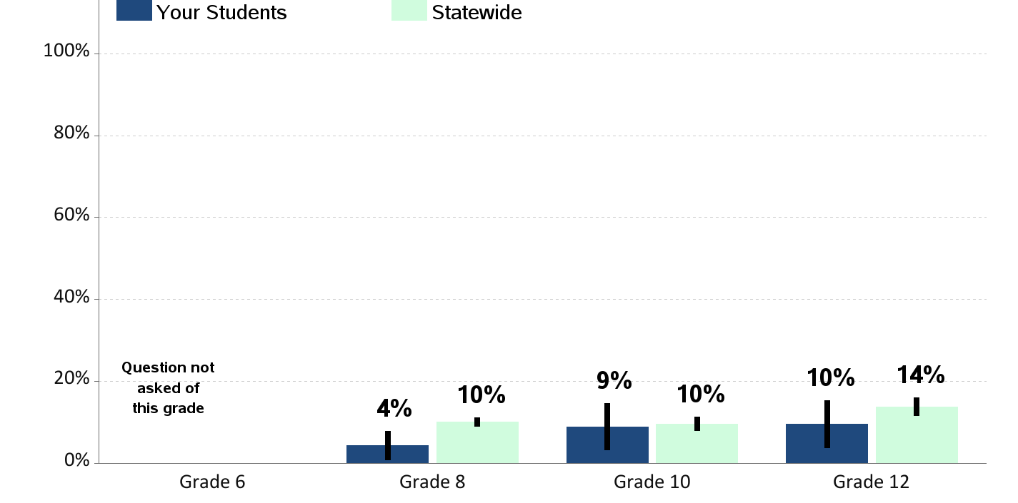
Sugar Sweetened Beverages Consumption
Percent of students who report drinking sugar sweetened drinks
(not including diet, sugar-free or drinks with artificial sweeteners)
2 or more times a day

Slide 44
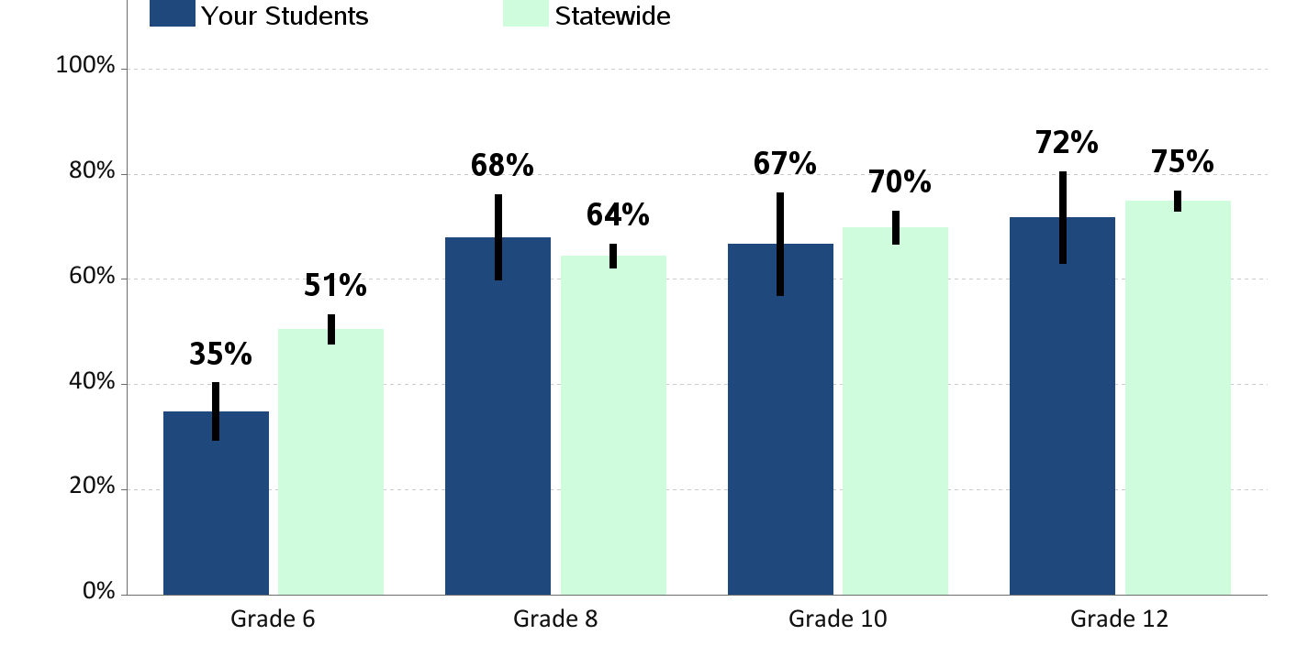
Excessive Screen Time
Percent of students who report 3 or more hours of screen time on an average school day
(time spent in front of a TV, computer, smart phone, or other electronic device watching shows or videos, playing games, accessing the Internet, or using social media)

Slide 45
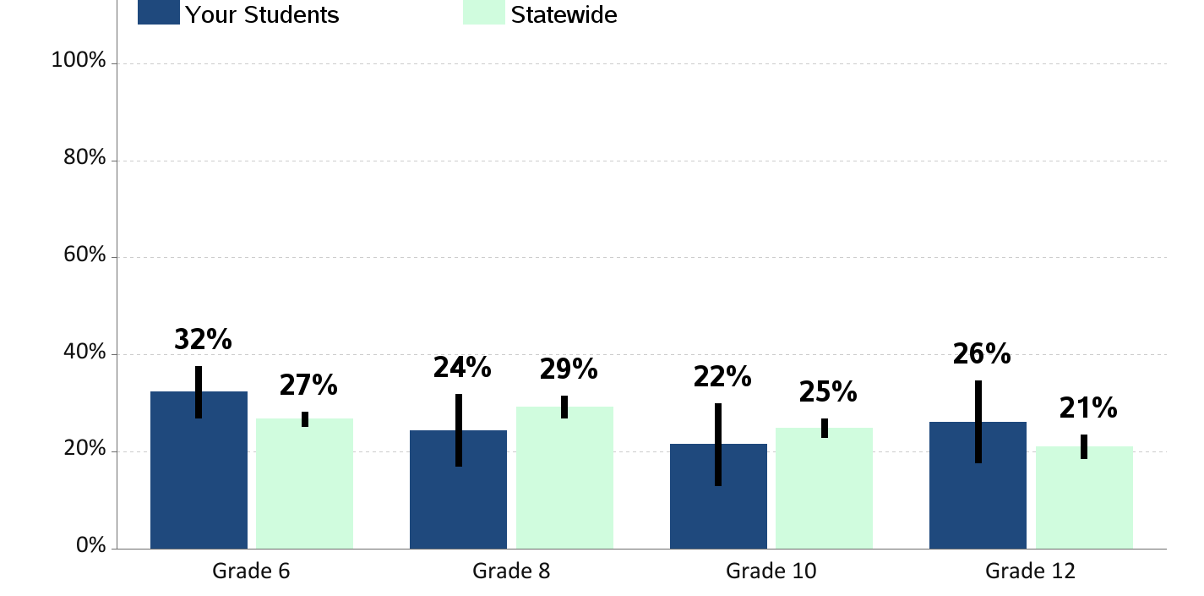
60 Minutes of Physical Activity per Day
Percent of students who report being physically active
60 minutes per day, 7 days a week

Slide 46
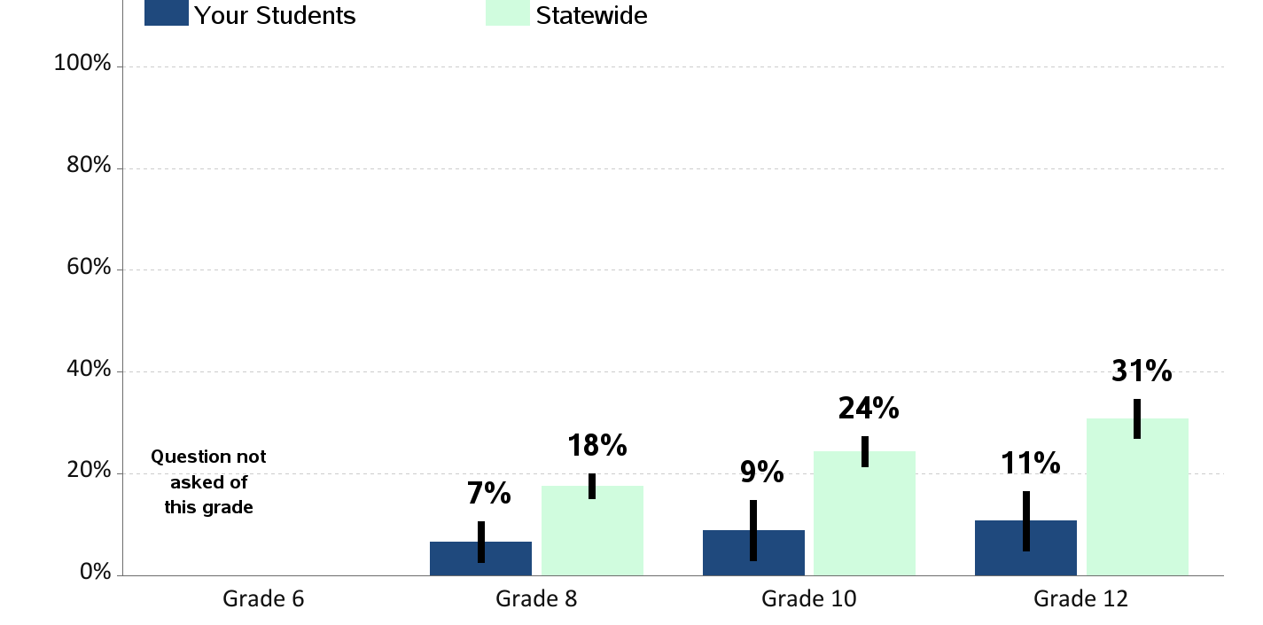
Body Mass Index (BMI) Over 25.0
Percent of students who report a BMI over 25.0
(according to reported height and weight)

Slide 47
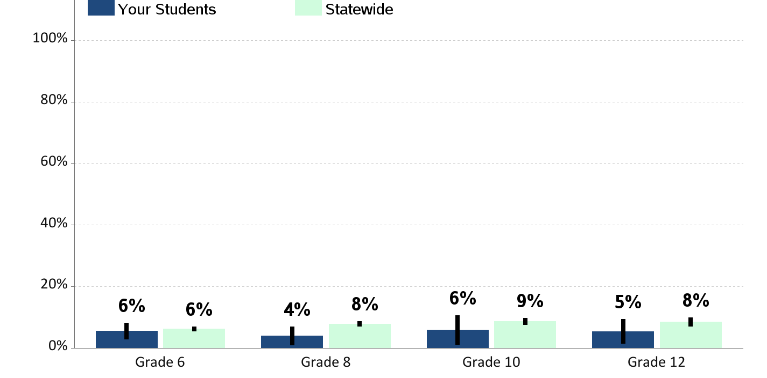
Current Asthma
Percent of students who currently have asthma

Slide 48
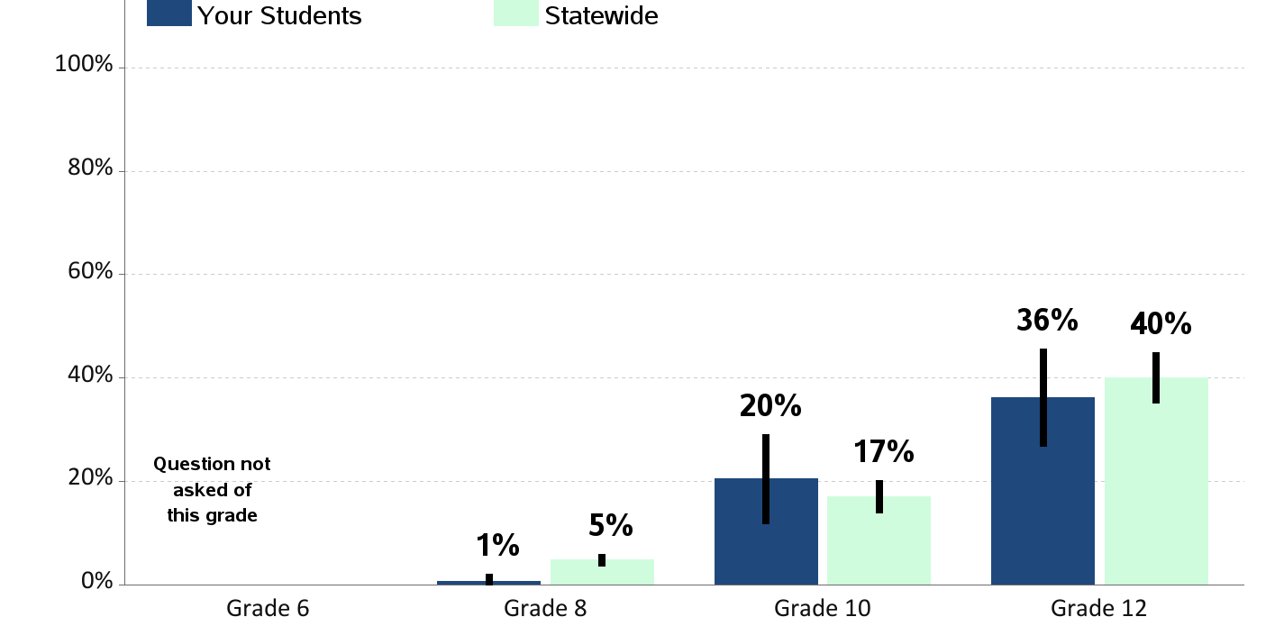
Lifetime Sex
Percent of students who report ever having sex in their lifetime

Slide 49
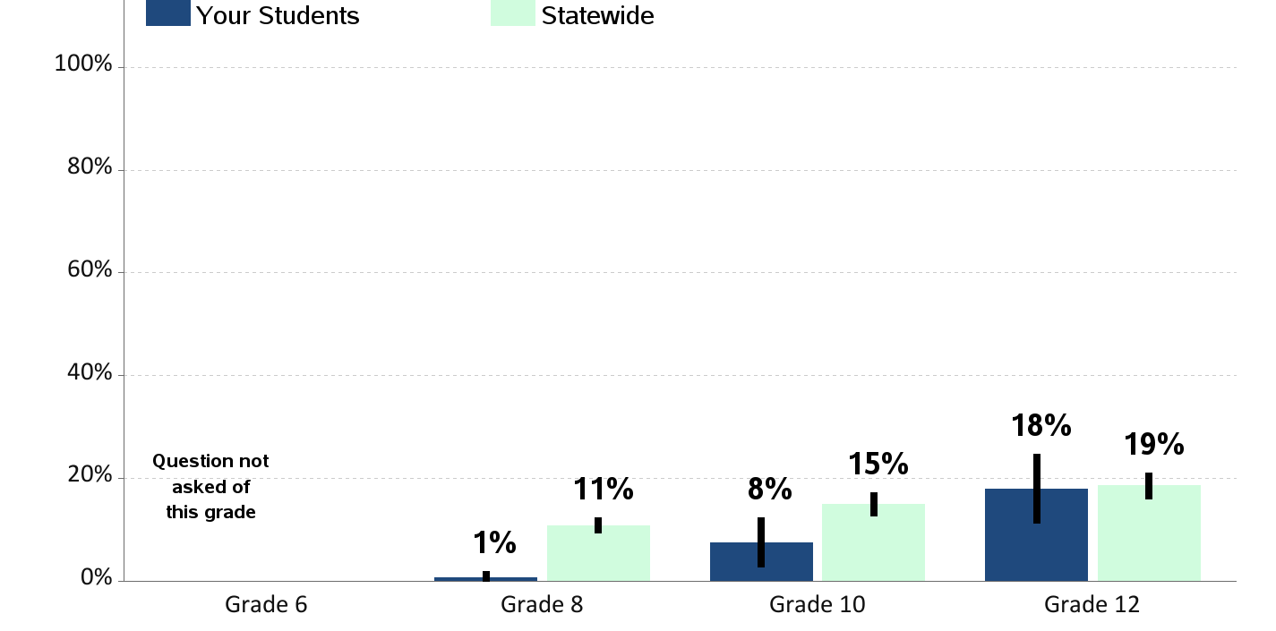
Lifetime Sexual Abuse
Percent of students who report having ever been in a in a situation where someone made them engage in kissing, sexual touch or sexual intercourse when they did not want to

Slide 50
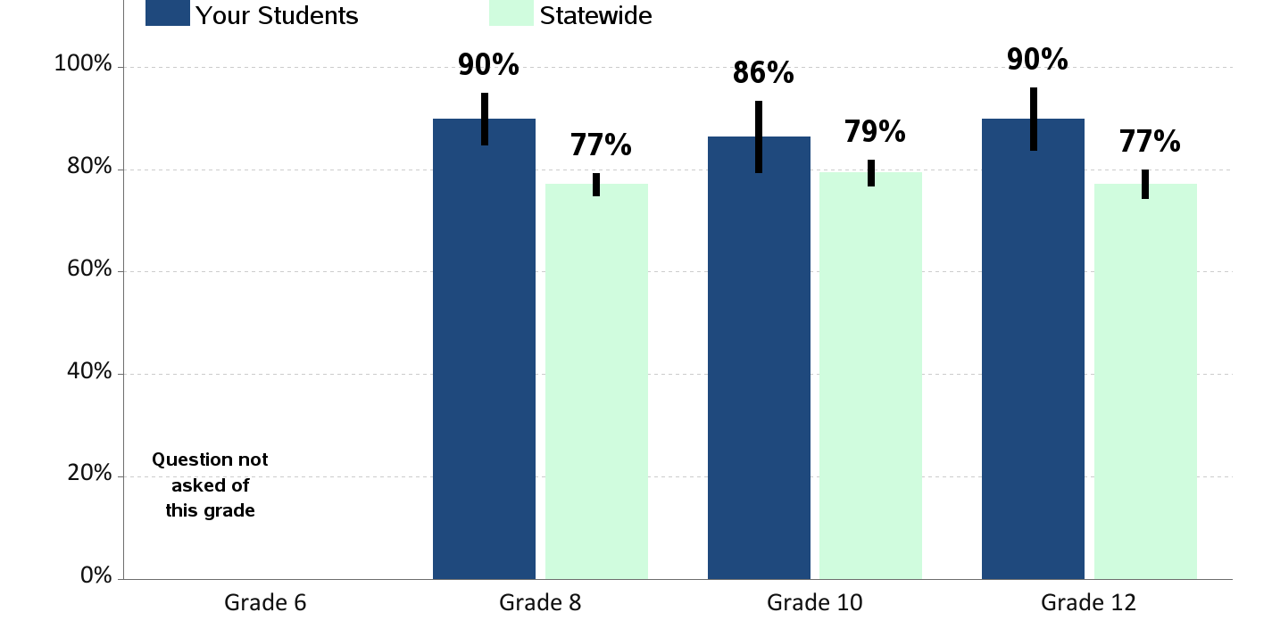
Access to Dental Care
Percent of students who report visiting a dentist for a routine checkup in the past year

Slide 51
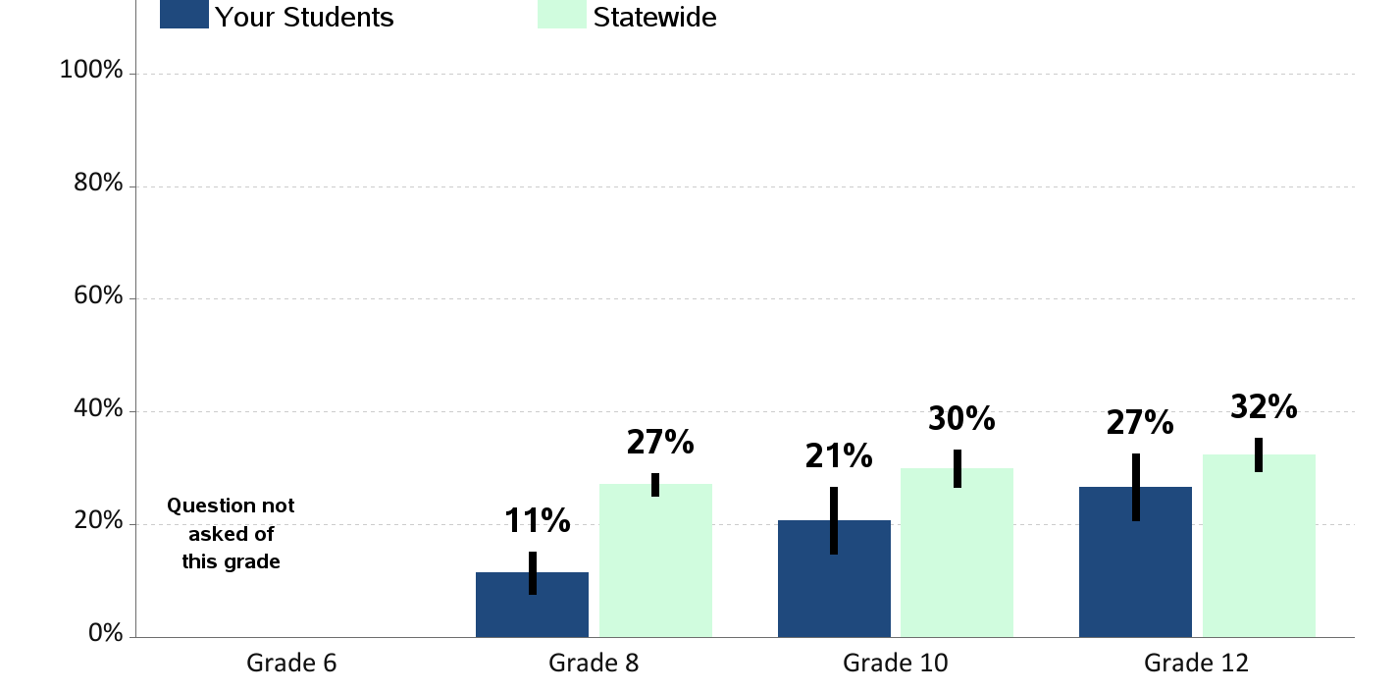
Depression
Percent of students who report feeling so sad or hopeless almost every day for two weeks or more in a row that they stopped doing some usual activities in the past year.

Slide 52
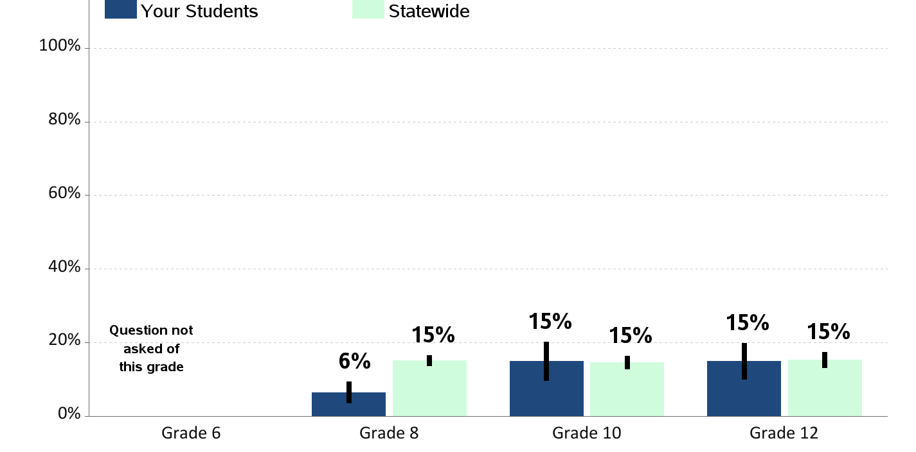
Contemplation of Suicide
Percent of students who report having seriously considered suicide in the past year

Slide 53
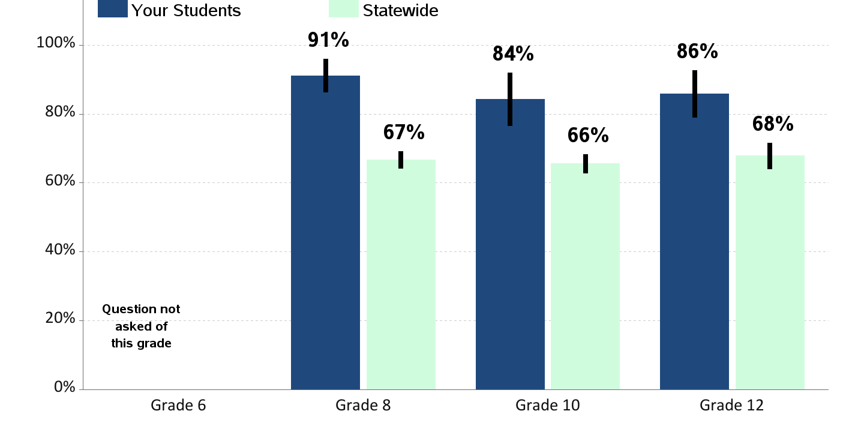
Someone in Community to Talk To
Percent of students who report having an adult in their neighborhood or community they can talk to about something important

