Slide 1


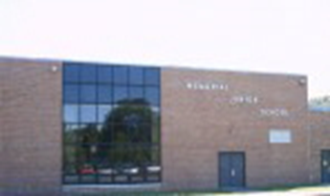
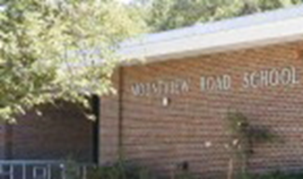
Hanover Township
Public Schools
2025-2026
Budget Presentation
April 29, 2025

Slide 2
Hanover Township
Board of Education
Lisa Bomengo, President
Marc Amoresano, Vice President, Finance Committee Chair
Karin Coffey
Christine Egbert
Gina Johnston
Bill McCabe
Christopher Mattessich, Finance Committee Member
Gregory Skiff, Finance Committee Member
Michelle Stricchiola

Slide 3
Five Year District Enrollment Trends
School | 2021-22 | 2022-23 | 2023-24 | 2024-25 | 2025-26
BMS | 303 | 319 | 323 | 298 | 307
MTV | 256 | 250 | 265 | 274 | 285
SDS | 232 | 233 | 238 | 246 | 256
MJS | 473 | 465 | 425 | 419 | 430
TOTAL | 1,264 | 1,267 | 1,251 | 1,237 | 1,278
 |  |  |  |  | *Projected Enrollments

Slide 4
Enrollment Summary
Projected Enrollment 2025 - 2026:
Grade Level | Pupils
K-5 | 848
MJS | 430
Total K-8 | 1,278
Notes:
Enrollment Summary:
Elementary Level:
826 to 825
Down .1% (-1 student)
Middle School Level:
425 to 413
Down 3.3% (-12 students)
Overall District Enrollment:
Down 1% (-13 students)
1,251 to 1,238 students
Total does not include Out-of-District Placements…….10-12 Students
Graduation 8th Grade 152
Incoming 6th grade 135
Incoming Kindergarten 116
Negative Kindergarten Replacement (-36)

Slide 5
Cost Saving Measures
RIF (Reduction in Force) 3 teaching positions
  Auditor recommended eliminating 10 positions
Postpone the addition of 2 new positions
  Instructional Coach & District Registrar
Special Education Programming
  Starting a full day PSD class @ BMS and an LLD class @ MJS
National School Lunch Program
  Working with Dept. of Agriculture to finalize participation
  Reimbursed for free and reduced-lunch meals
  Must be profitable by code which will in turn bring money into the district in the years to come
Additional Revenue
  Partnering with local organizations for facilities usage rentals
  Charging for field usage by private groups (not sponsored by HT Recreation)
Shared Services
  Working with Hanover Township to identify areas within DPW that can be shared i.e. paving, potholes

Slide 6
Budget Summary: Revenues
REVENUES | 2024-25 | 2025-26 | Differ | % Differ
Fund Bal 24-25 Withdraw From Cap Res Excess Cost Cap Projects 25-26 | 773,121 | 652,230 | 652,230
Capital Reserve Interest | 210 | 75,000 | 74,790 | 35614.29%
State Aid | 1,798,785 | 1,888,845 | 90,060 | 1.05%
Extraordinary Aid | 400,000 | 400,000 | 0 | 0
Miscellaneous Revenue | 100,210 | 199,011 | 99,011 | 99.01%
Tuition Preschool & McKinney Vento | 60,000 | 379,200 | 319,200 | 532.00%
Taxes Operating | 29,781,939 | 31,295,502 | 1,513,563 | 5.08%
Total Revenues: | 32,914,265 | 34,889,788 | 1,975,523 | 6.0%

Slide 7
Expenditures

Slide 8
Capital Projects & Investments
MJS Roof Replacement (7th Grade Wing)
  ROD Grant eligible
MJS Viking Gym Air Condition
  ROD Grant eligible
2 New School Buses
  Entered 5-year lease agreements
Food Service Equipment
  Kitchens @ BMS & MJS, Serving Stations @ MTV & SDS

Slide 9
Tax Levy Cap
Title | 25/ Budget
Prebudget Year Tax Levy | 29,781,939
2% of Prebudget Year Levy | 595,639
Adjustment for Healthcare Costs | 713,924
Use of Banked Cap | 200,000
Tax Levy | 31,295,502

Slide 10
Tax Implications
 | 2024 | 2025 | Difference
Ratables | 3,897,397,292 | 3,853,540,492 | -43,856,800
Tax Levy | 29,332,990 | 31,295,502 | 1,962,512
Tax Rate | 0.753 | 0.812 | 0.059
SUMMARY
5.9 cent increase
0.07 increase
The 2025 K-8 school tax on a home assessed as $428,300 is $3,478

