Slide 1

Probability
Lesson 4.7
The Multiplication Counting
Principle and Permutations
Statistics and Probability with Applications, 3rd Edition
Starnes & Tabor
Bedford Freeman Worth Publishers

Slide 2
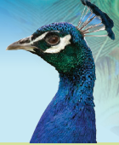
The Multiplication Counting Principle and Permutations
Learning Targets
After this lesson, you should be able to:
Use the multiplication counting principle to determine the number of ways to complete a process involving several steps.
Use factorials to count the number of permutations of a group of individuals.
Compute the number of permutations of n individuals taken k at a time.

Slide 3
The Multiplication Counting Principle and Permutations
Finding the probability of an event often involves counting the number of possible outcomes of some chance process.
The Agricola Restaurant offers a three-course dinner menu. Customers who order from this menu must choose one appetizer, one main dish, and one dessert. Here are the options for each course.
Appetizer | Main dish | Dessert
Butternut squash soup | Grilled pork chop | Chocolate cake
Green salad | Ribeye steak | Apple and cranberry tart
Caesar salad | Roasted chicken breast
 | Poached salmon
How many different meals can be ordered from this menu?

Slide 4
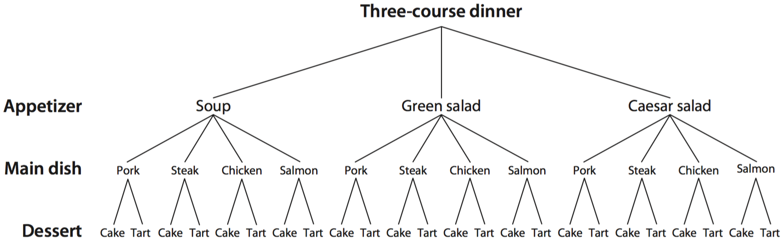
The Multiplication Counting Principle and Permutations
How many different meals can be ordered from this menu? We could try to list all possible orders:
Soup—Pork—Cake, Soup—Pork—Tart, Soup—Steak—Cake, . . .
It might be easier to display all of the options in a diagram:

Slide 5
The Multiplication Counting Principle and Permutations
From the diagram, we can see that for each of the three choices of appetizer, there are four choices of main dish, and for each of those main dish choices, there are two dessert choices. So there are
3 • 4 • 2 =24
different meals that can be ordered from the three-course dinner menu. This is an example of the multiplication counting principle.
Multiplication Counting Principle
For a process involving multiple (k) steps, suppose that there are n₁ ways to do Step 1, n₂ ways to do Step 2, ..., and n_{k} ways to do Step k. The total number of different ways to complete the process is
n₁ • n₂ • … • n_{k}
This result is called the multiplication counting principle.

Slide 6

Example: Fundamental Counting Principle
You are purchasing a new car. The possible manufacturers, car sizes, and colors are listed.
  Manufacturer: Ford, GM, Honda
  Car size: compact, midsize
  Color: white (W), red (R), black (B), green (G)
How many different ways can you select one manufacturer, one car size, and one color?
Larson/Farber 4th ed
6

Slide 7
The Multiplication Counting Principle
How many five-character passwords?
Online passwords help protect confidential information. One Web site allows users to choose a password that can consist of capital letters, lowercase letters, digits, or any of 4 special symbols (#, !, %, or $). The only other requirement is that the first character of the password must be a letter.
How many different five-character passwords can be created?

Slide 8
The Multiplication Counting Principle and Permutations
The multiplication counting principle can also help us determine how many ways there are to arrange a group of people, animals, or things.
We call arrangements where the order matters permutations.
Permutation
A permutation is a distinct arrangement of some group of individuals.
Suppose you have 5 framed photographs of different family members that you want to arrange in a line on top of your dresser. In how many ways can you do this?
Let’s count the options moving from left to right across the dresser. There are 5 options for the first photo, 4 options for the next photo, and so on.
By the multiplication counting principle, there are 5 •4 •3 •2 •1 =120
different photo arrangements.

Slide 9
The Multiplication Counting Principle and Permutations
Expressions like 5 • 4 • 3 • 2 • 1 occur often enough in counting problems that mathematicians invented a special name and notation for them. We write 5 • 4 • 3 • 2 • 1 = 5!, read as “5 factorial.”
Factorial
For any positive integer n, we define n! (read “n factorial”) as
n! = n(n−1)(n−2) … • 3 • 2 • 1
That is, n factorial is the product of the numbers starting with n and going down to 1.

Slide 10
PERMUTATION
An ordered arrangement of objects
The number of different permutations of n distinct objects is n! (n factorial)
  n! = n∙(n – 1)∙(n – 2)∙(n – 3)∙ ∙ ∙3∙2 ∙1
  0! = 1
  Examples:
    6! = 6∙5∙4∙3∙2∙1 = 720
    4! = 4∙3∙2∙1 = 24

Slide 11
Permutations and factorials
How many finishes?
At a track meet, 8 different hurdlers compete in the 400 meter hurdles. How many different ways are there for these runners to finish?

Slide 12

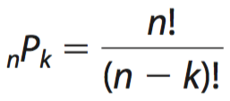
The Multiplication Counting Principle and Permutations
So far, we have shown how to count the number of distinct arrangements of all the individuals in a group of people, animals, or things. Sometimes, we want to determine how many ways there are to select and arrange only some of the individuals in a group.
Denoting Permutations: _{n}P_{k}
If there are n individuals, the notation _{n}P_{k} represents the number of different permutations of k individuals selected from the entire group of n.
You can calculate the number of permutations of n individuals taken k at a time (where k ≤ n) using the multiplication counting principle or with the formula
By definition, 0! = 1.

Slide 13

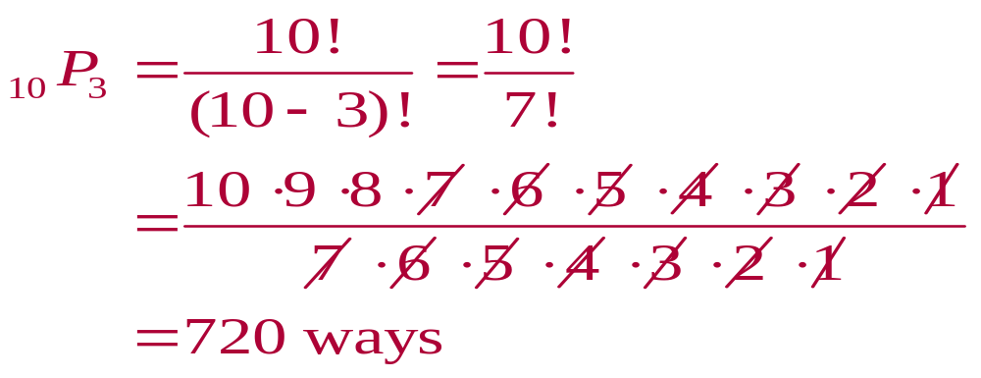
Example: Finding nPr
Find the number of ways of forming three-digit codes in which no digit is repeated.
Solution:
You need to select 3 digits from a group of 10
n = 10, r = 3

Slide 14

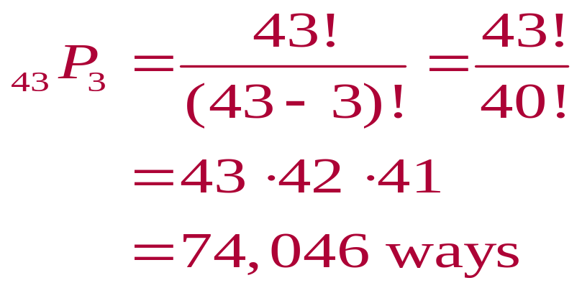
Example: Finding nPr
Forty-three race cars started the 2007 Daytona 500. How many ways can the cars finish first, second, and third?
Solution:
You need to select 3 cars from a group of 43
n = 43, r = 3

Slide 15
Finding the number of permutations
What’s for lunch?
Your school cafeteria has purchased enough food for 12 different lunches over the next few weeks. Due to a holiday on Monday, there are only 4 school days this week. How many different ways are there for the cafeteria to select and arrange 4 of these lunches to serve?

Slide 16
LESSON APP 4.7
Do you scream for ice cream?
The local ice cream shop in Dontrelle’s town is called 21 Choices. Why? Because they offer 21 different flavors of ice cream. Dontrelle likes all but three of the flavors that 21 Choices offers: bubble gum, butter pecan, and pistachio.
A 21 Choices “basic sundae” comes in three sizes— small, medium, or large—and includes one flavor of ice cream and one of 12 toppings. Dontrelle has enough money for a small or medium basic sundae. How many different sundaes could Dontrelle order that include only flavors that he likes?
Dontrelle could order a cone with three scoops of ice cream instead of a sundae. He prefers to have three different flavors (for variety) and he considers the order of the flavors on his cone to be important. How many three-scoop cones with three different flavors that Dontrelle likes are possible at 21 Choices? Give your answer as a number and using _{n}P_{k} notation.

Slide 17
Distinguishable Permutations
Consider:
In how many ways can you arrange the letters in the word
EAT to create a new “word” ?
In how many ways can you arrange the letters in the word
MOM to create a new “word”?

Slide 18
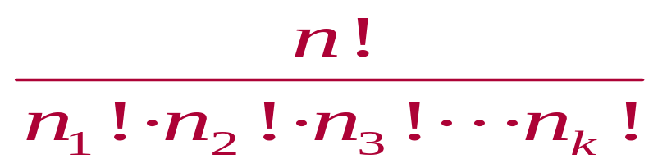
Distinguishable Permutations
Distinguishable Permutations
The number of distinguishable permutations of n objects where n₁ are of one type, n₂ are of another type, and so on
where n₁ + n₂ + n₃ +∙∙∙+ n_{k} = n
■
Use this new rule to find the number of ways to
arrange the letters in the word
MISSISSIPPI

Slide 19

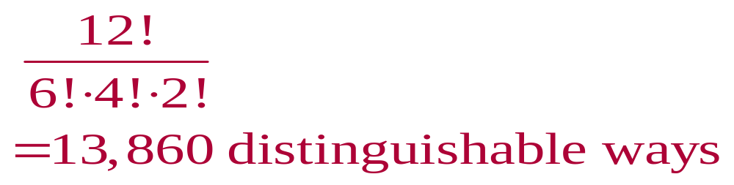
Example: Distinguishable Permutations
A building contractor is planning to develop a subdivision that consists of 6 one-story houses, 4 two-story houses, and 2 split-level houses. In how many distinguishable ways can the houses be arranged?
Solution:
There are 12 houses in the subdivision
n = 12, n₁ = 6, n₂ = 4, n₃ = 2

Slide 20
The Multiplication Counting Principle and Permutations
Learning Targets
After this lesson, you should be able to:
Use the multiplication counting principle to determine the number of ways to complete a process involving several steps.
Use factorials to count the number of permutations of a group of individuals.
Compute the number of permutations of n individuals taken k at a time.

