Slide 1

Sampling Distributions
Lesson 6.6
The Central Limit Theorem
Statistics and Probability with Applications, 3rd Edition
Starnes & Tabor
Bedford Freeman Worth Publishers

Slide 2


The Central Limit Theorem
Learning Targets
After this lesson, you should be able to:
is approximately normal when sampling from a non-normal population.
Determine if the sampling distribution of
If appropriate, use a normal distribution to calculate probabilities involving .

Slide 3
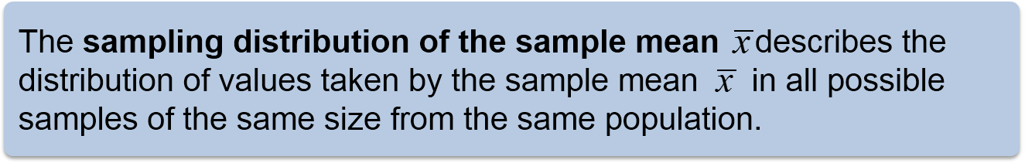
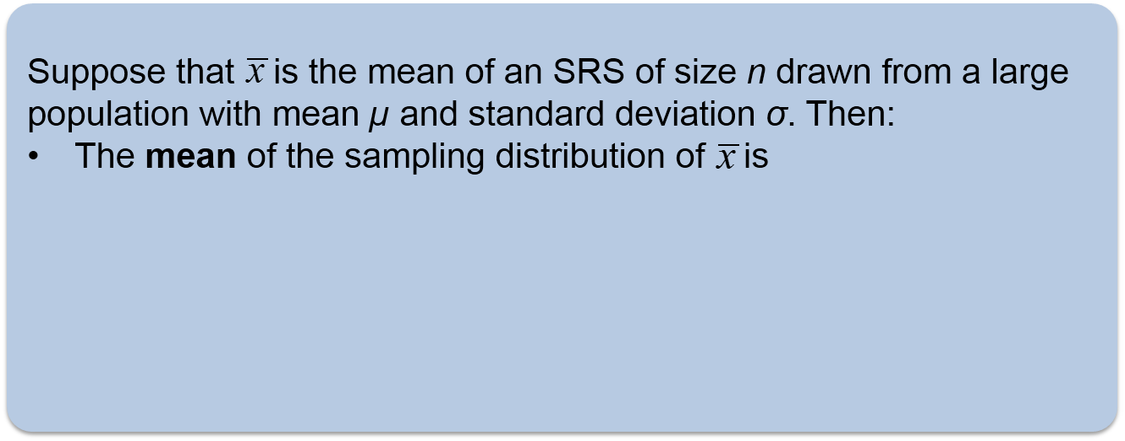

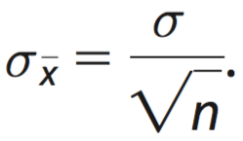
The Sampling Distribution of a Sample Mean
When sample data are categorical, we often use the count or proportion of successes in the sample to make an inference about a population. When sample data are quantitative, we often use the sample mean
to estimate the mean µ of a population.
Sampling Distribution of the Sample Mean

Slide 4
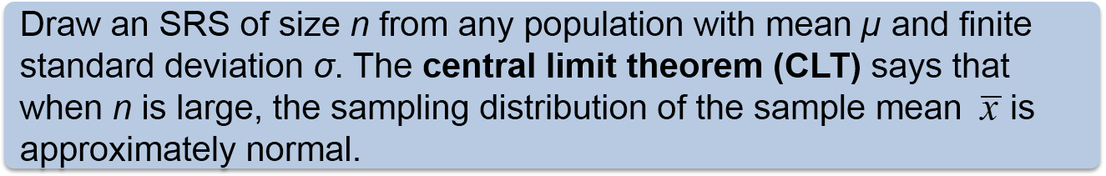
The Central Limit Theorem
Most population distributions are not Normal. What is the shape of the sampling distribution of sample means when the population distribution isn’t Normal?
It is a remarkable fact that as the sample size increases, the distribution of sample means changes its shape: it looks less like that of the population and more like a Normal distribution!
When the sample is large enough, the distribution of sample means is very close to Normal, no matter what shape the population distribution has, as long as the population has a finite standard deviation.
Central Limit Theorem (CLT)

Slide 5
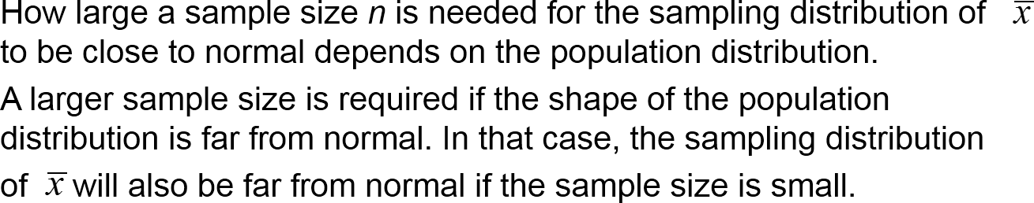
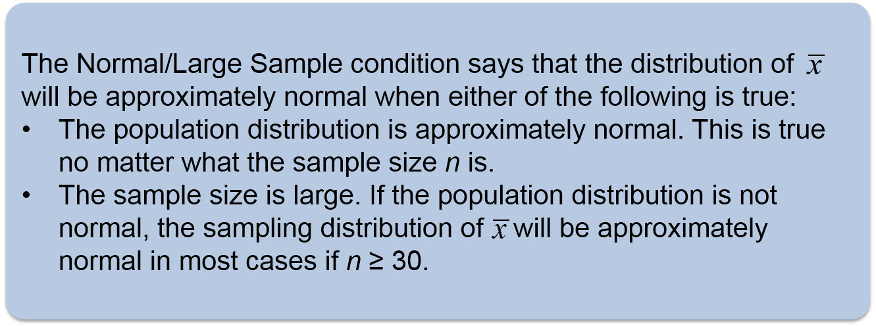
The Central Limit Theorem
Normal/Large Sample Condition

Slide 6
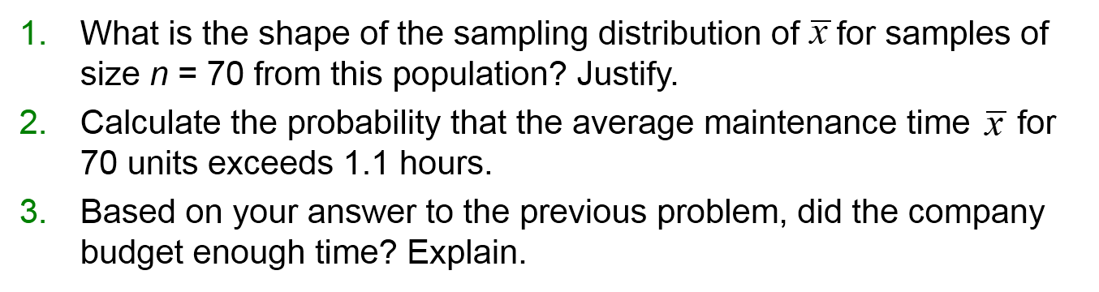
LESSON APP 6.6
Keeping things cool with statistics?
Your company has a contract to perform preventive maintenance on thousands of air-conditioning units in a large city. Based on service records from the past year, the time (in hours) that a technician requires to complete the work follows a strongly right-skewed distribution with µ = 1 hour and σ = 1.5 hours.
As a promotion, your company will provide service to a random sample of 70 air-conditioning units free of charge. You plan to budget an average of 1.1 hours per unit for a technician to complete the work. Will this be enough time?

Slide 7
The Central Limit Theorem
Learning Targets
After this lesson, you should be able to:
is approximately normal when sampling from a non-normal population.
Determine if the sampling distribution of
If appropriate, use a normal distribution to calculate probabilities involving .

