Slide 1

Probability
Lesson 4.8
Combinations and Probability
Statistics and Probability with Applications, 3rd Edition
Starnes & Tabor
Bedford Freeman Worth Publishers

Slide 2

Combinations and Probability
Learning Targets
After this lesson, you should be able to:
Compute the number of combinations of n individuals taken k at a time.
Use combinations to calculate probabilities.
Use the multiplication counting principle and combinations to calculate probabilities.

Slide 3
NEXT CONSIDER:
IN HOW MANY WAYS CAN YOU CHOOSE THREE PEOPLE FROM THIS CLASS TO FORM A COMMITTEE?
ASK YOURSELF: IS ORDER IMPORTANT?????

Slide 4
Combinations and Probability
Recall that a permutation is a distinct arrangement of some group of individuals. With permutations, order matters. Sometimes, we’re just interested in finding how many ways there are to choose some number of individuals from a group, but we don’t care about the order in which the individuals are selected.
_{n}C_{k}
Combinations,
A combination is a selection of individuals from some group in which the order of selection doesn’t matter. If there are n individuals, then the notation _{n}C_{k} represents the number of different combinations of k individuals chosen from the entire group of n.

Slide 5
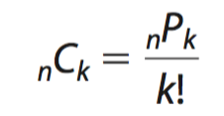
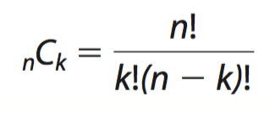
Combinations and Probability
How to Compute Combinations
You can calculate the number of combinations of n individuals taken k at a time (where k ≤ n) using the multiplication counting principle, with the formula
or with the formula

Slide 6

Example: Combinations
A state’s department of transportation plans to develop a new section of interstate highway and receives 16 bids for the project. The state plans to hire four of the bidding companies. How many different combinations of four companies can be selected from the 16 bidding companies?
Solution:
You need to select 4 companies from a group of 16
n = 16, r = 4
Order is not important

Slide 7
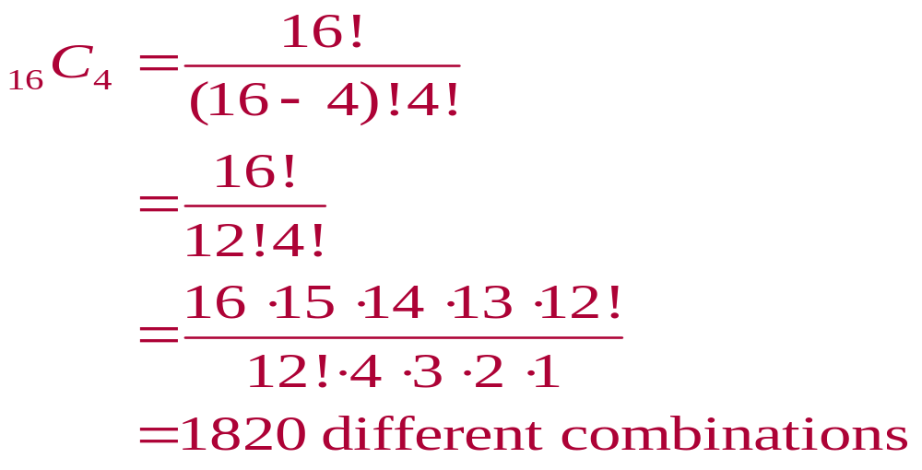
Solution: Combinations

Slide 8
Combinations
Who screams for ice cream?
Mr. Starnes loves ice cream. The local ice-cream stand offers a triple-scoop dish of ice cream. The stand has 15 different ice-cream flavors, and Mr. Starnes always chooses three different flavors for his dish. How many different sets of three flavors can Mr. Starnes choose for his dish?

Slide 9
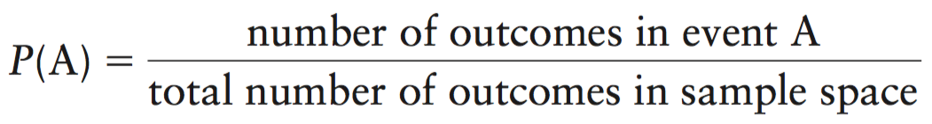
Combinations and Probability
The focus of this chapter is probability. Recall that when a chance process results in equally likely outcomes, the probability that event A occurs is
You can use the multiplication counting principle and what you have learned about permutations and combinations to help count the number of outcomes.

Slide 10

Probability Using the Fundamental Counting Principle
Your college identification number consists of 8 digits. Each digit can be 0 through 9 and each digit can be repeated. What is the probability of getting your college identification number when randomly generating eight digits?

Slide 11
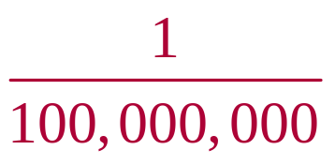
Probability Using the Fundamental Counting Principle
SOLUTION:
Each digit can be repeated
There are 10 choices for each of the 8 digits
Using the Fundamental Counting Principle, there are
  10 ∙ 10 ∙ 10 ∙ 10 ∙ 10 ∙ 10 ∙ 10 ∙ 10
  = 10⁸ = 100,000,000 possible identification numbers
Only one of those numbers corresponds to your ID number
P(your ID number) =

Slide 12
From counting to probability
What else is there for lunch?
Your school cafeteria has purchased enough food for 12 different lunches over the next few weeks, 5 of which include some sort of pasta. Due to a holiday on Monday, there are only 4 school days this week. The cafeteria workers plan to randomly select 4 different lunches from the 12 lunches to serve this week. What is the probability that all 4 meals this week will include pasta?

Slide 13
LESSON APP 4.8
How many ways can you set up an iPod playlist?
Janine wants to set up a play list with 8 songs on her iPod. She has 50 songs to choose from, including 15 songs by One Direction. Janine’s iPod won’t allow any song to appear more than once in a play list.
How many different sets of 8 songs are possible for Janine’s play list? Assume that the order of the songs doesn’t matter.
2. How many 8-song play lists contain no songs by One Direction?
Suppose Janine decides to let her iPod select an 8-song play list at random.
What’s the probability that none of the 8 songs is by One Direction?
4. Find the probability that exactly 2 of the 8 songs on the play list are by One Direction.

Slide 14

Example: Finding Probabilities
A food manufacturer is analyzing a sample of 400 corn kernels for the presence of a toxin. In this sample, three kernels have dangerously high levels of the toxin. If four kernels are randomly selected from the sample, what is the probability that exactly one kernel contains a dangerously high level of the toxin?

Slide 15
Solution: Finding Probabilities
The possible number of ways of choosing one toxic kernel out of three toxic kernels is
₃C₁ = 3
The possible number of ways of choosing three nontoxic kernels from 397 nontoxic kernels is
    ₃₉₇C₃ = 10,349,790
Using the Multiplication Rule, the number of ways of choosing one toxic kernel and three nontoxic kernels is
  ₃C₁ ∙ ₃₉₇C₃ = 3 ∙ 10,349,790 3 = 31,049,370

Slide 16
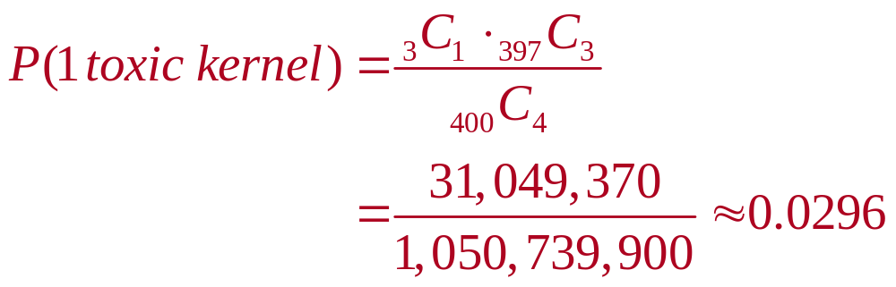
Solution: Finding Probabilities
The number of possible ways of choosing 4 kernels from 400 kernels is
₄₀₀C₄ = 1,050,739,900
The probability of selecting exactly 1 toxic kernel is

Slide 17
Finding probabilities with combination
Were there selection shenanigans?
The student council at a local high school consists of 10 juniors and 30 seniors who are advised by a teacher. The state Association of Student Councils is holding a conference and the school has enough funds to send only 6 students.
The student council advisor decided that 6 students will be selected at random to go to the conference. The advisor conducted a drawing one night after school and announced the results the next day: 4 juniors and 2 seniors would go. The seniors were concerned that the advisor may not have used random chance to decide because so few seniors were chosen.
(a) Find the number of ways in which a randomly chosen group of six student council members could result in 4 juniors and 2 seniors being selected.
(b) Find the probability that random selection would result in 4 juniors and 2 seniors being chosen for the conference.
(c) Based on your answer to (b), is there convincing evidence that the selection process wasn’t carried out by random chance? Explain.

Slide 18
Combinations and Probability
Learning Targets
After this lesson, you should be able to:
Compute the number of combinations of n individuals taken k at a time.
Use combinations to calculate probabilities.
Use the multiplication counting principle and combinations to calculate probabilities.

