Slide 1
AP French
White Station High School
Stephanie Altman

Slide 2
AP French
Prerequisites
Benefits
French III at a minimum
French IV preferred
Potential to earn college credit for French classes
Increased proficiency for use on Seal of Biliteracy test
Increased performance ability for college placement tests

Slide 3
Purpose
To enhance students’ knowledge of the French language in all four communicative domains: reading, writing, listening, and speaking
To expand cultural knowledge and understanding of the French-speaking world
To make connections and draw comparisons between Francophone cultures and one’s own
To use the French language in real-life settings (and simulations of them)

Slide 4
Course Elements
The course is conducted almost exclusively in French.
Students will listen to authentic recordings of French speakers, the teacher, and classmates in French and respond appropriately.
Students will read authentic materials on the course themes, answer questions about them, and have class discussions about the materials.
Students will speak in class discussions and for various assignments, including conversations and presentations.
Students will write in French to answer questions, compose essays, and complete research.
Students will study various French-speaking cultures and compare and contrast it to either American culture or their culture of origin.

Slide 5
Course Themes
  Families in Different Societies
  The influence of Language and Culture on Identity
  Influences of Beauty and Art
  How Science and Technology Affect Our Lives
  Factors that Impact the Quality of Life
  Environmental, Political, and Societal Changes

Slide 6
The AP Exam
MCQ (multiple choice questions)
FRQ (free response questions)
E-mail reply
  15 minutes, 12.5% of score
Argumentative essay
  55 minutes, 12.5% of score
Simulated conversation
  5 exchanges @ 20 seconds each, 12.5% of score
Cultural comparison
  2 minutes, 12.5% of score
Text based
  30 questions in 40 minutes
  23% of score
Text and audio based
  35 questions in 55 minutes
  27% of score

Slide 7
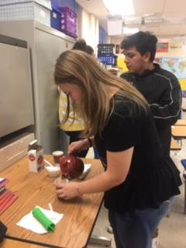
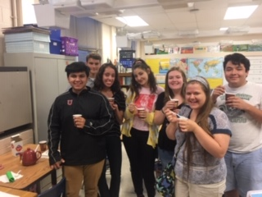
Moroccan Tea Ceremony

Slide 8
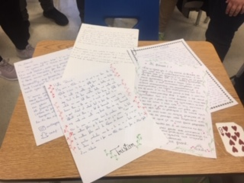
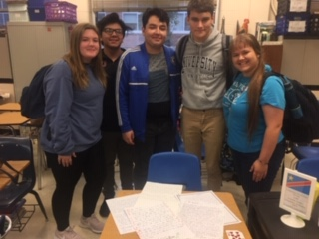
Pen Pals in Antibes

Slide 9
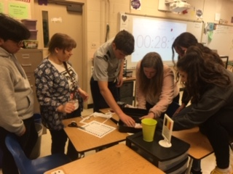
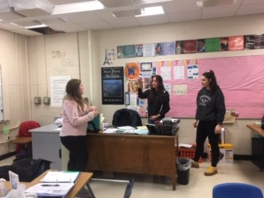
Breakout Edu

Slide 10
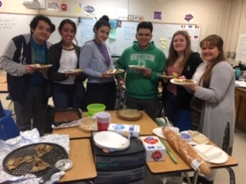
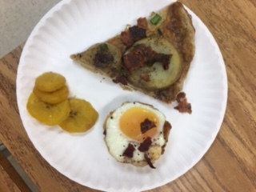
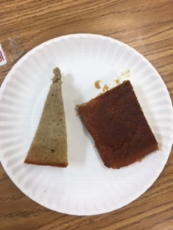
Francophone Potluck

Slide 11
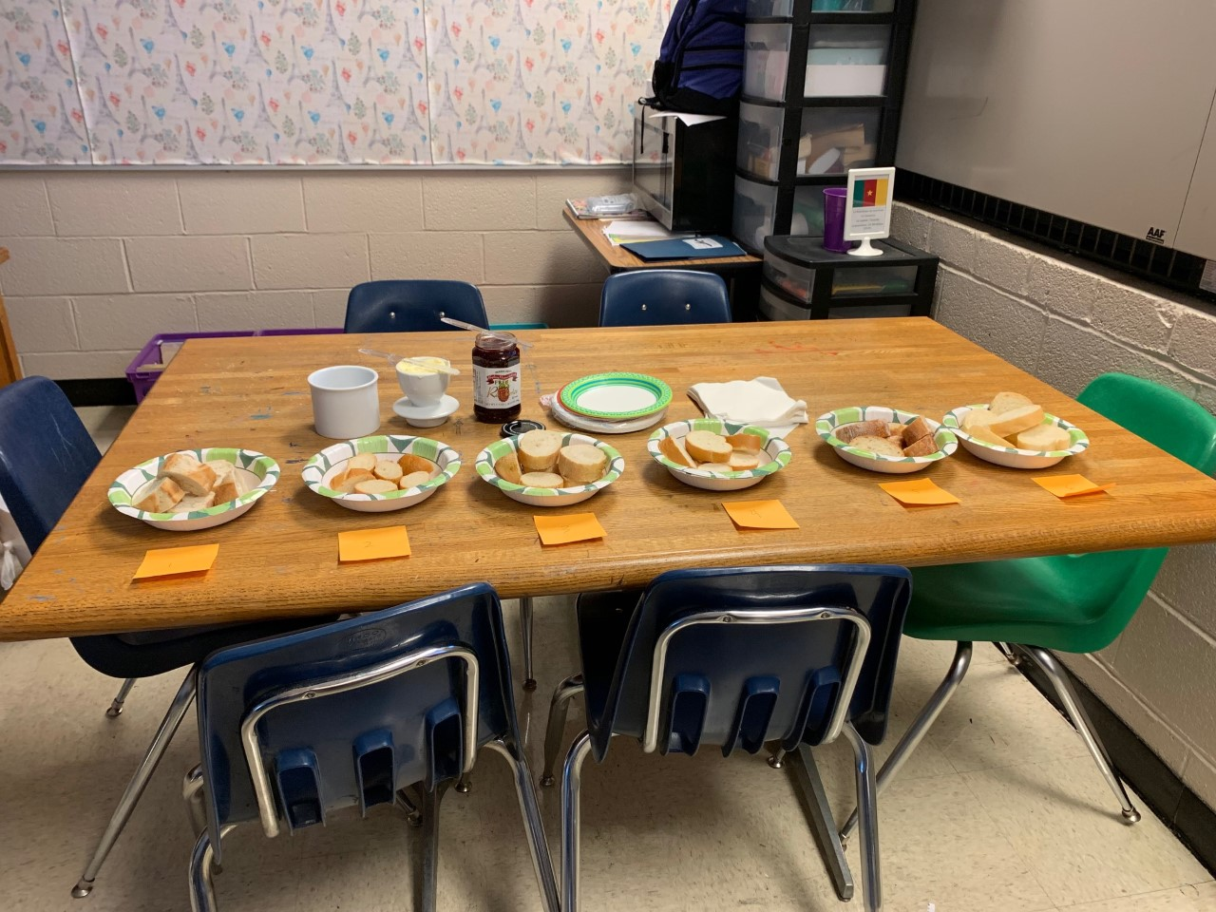
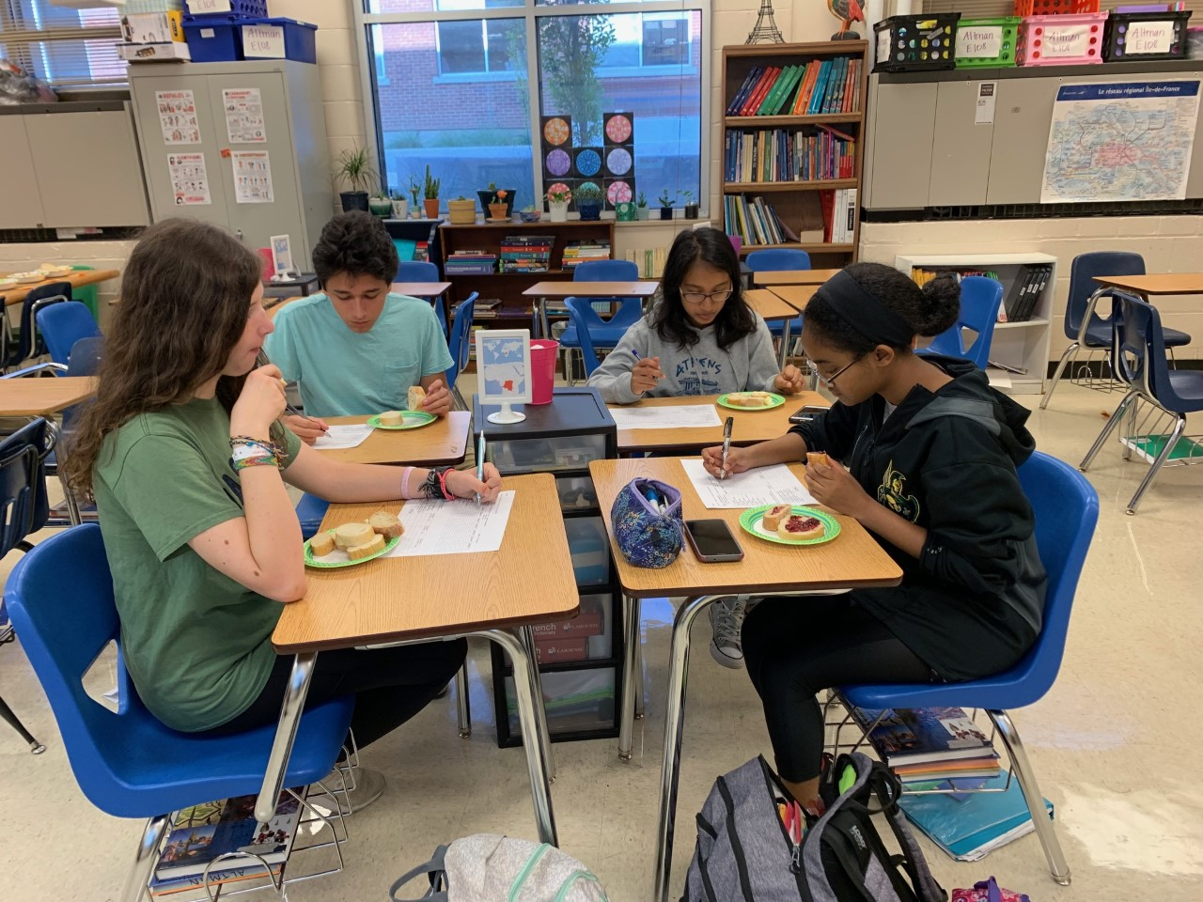
Baguette Judging

Slide 12
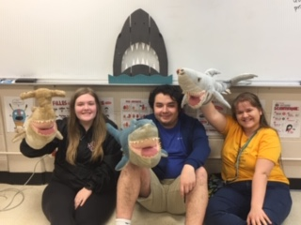
U of M Foreign Language Fair
https://www.youtube.com/watch?v=txGPjNj1798

Slide 13
Resources
College Board: About the AP French Course
College Board: About the AP French Exam
Is AP French Hard?
2021 AP French Exam Guide
AP French Study Guide
The Ultimate List of AP French Language Tips
How to Study for AP French Language

