Slide 1
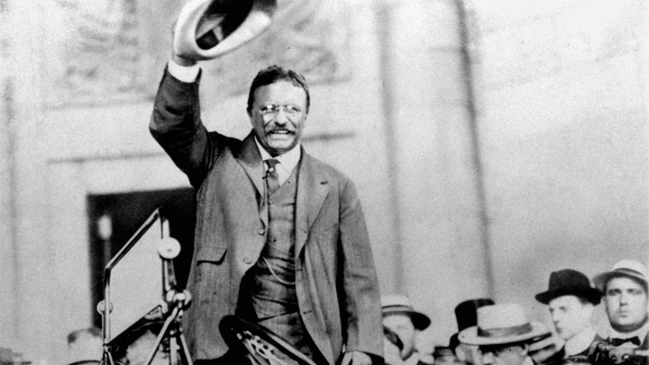
Welcome to Open House
Mike Stephenson AP European History and AP US History
stephensonmr@scsk12.org

Slide 2
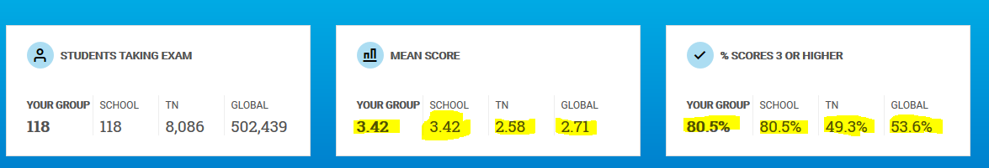
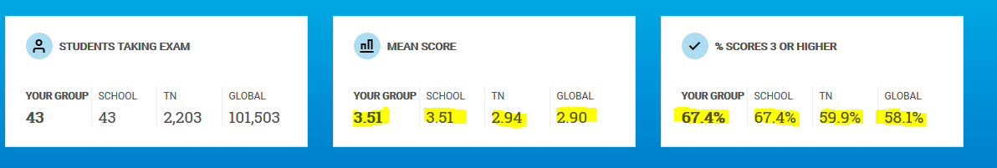
AP US History Results 2018-2019
This was the last year for the full exam score
AP European History Results 2018-2019

Slide 3
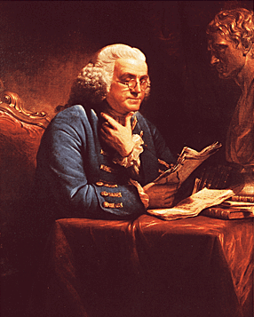
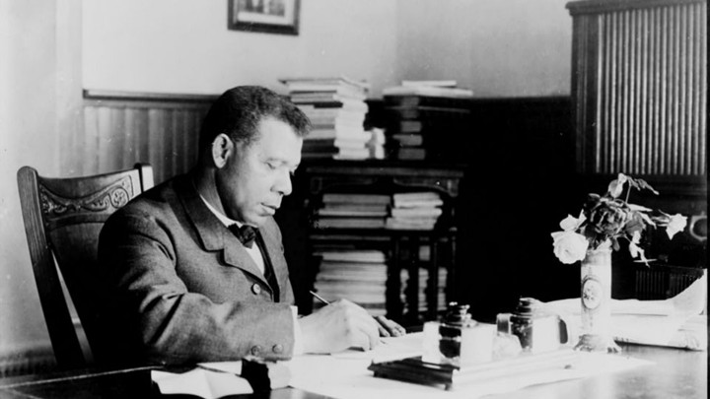

Be Prepared for a lot of document and text reading and a good bit of writing
Formal essays about every 10-14 days
Other Written responses every 2-3 days
Unit test Document-based Multiple Choice questions (like the ACT/SAT)

Slide 4
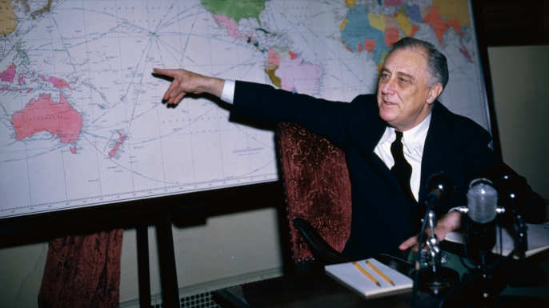
Staying Organized
Objective Boards
And our class website

Slide 5
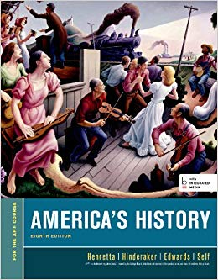
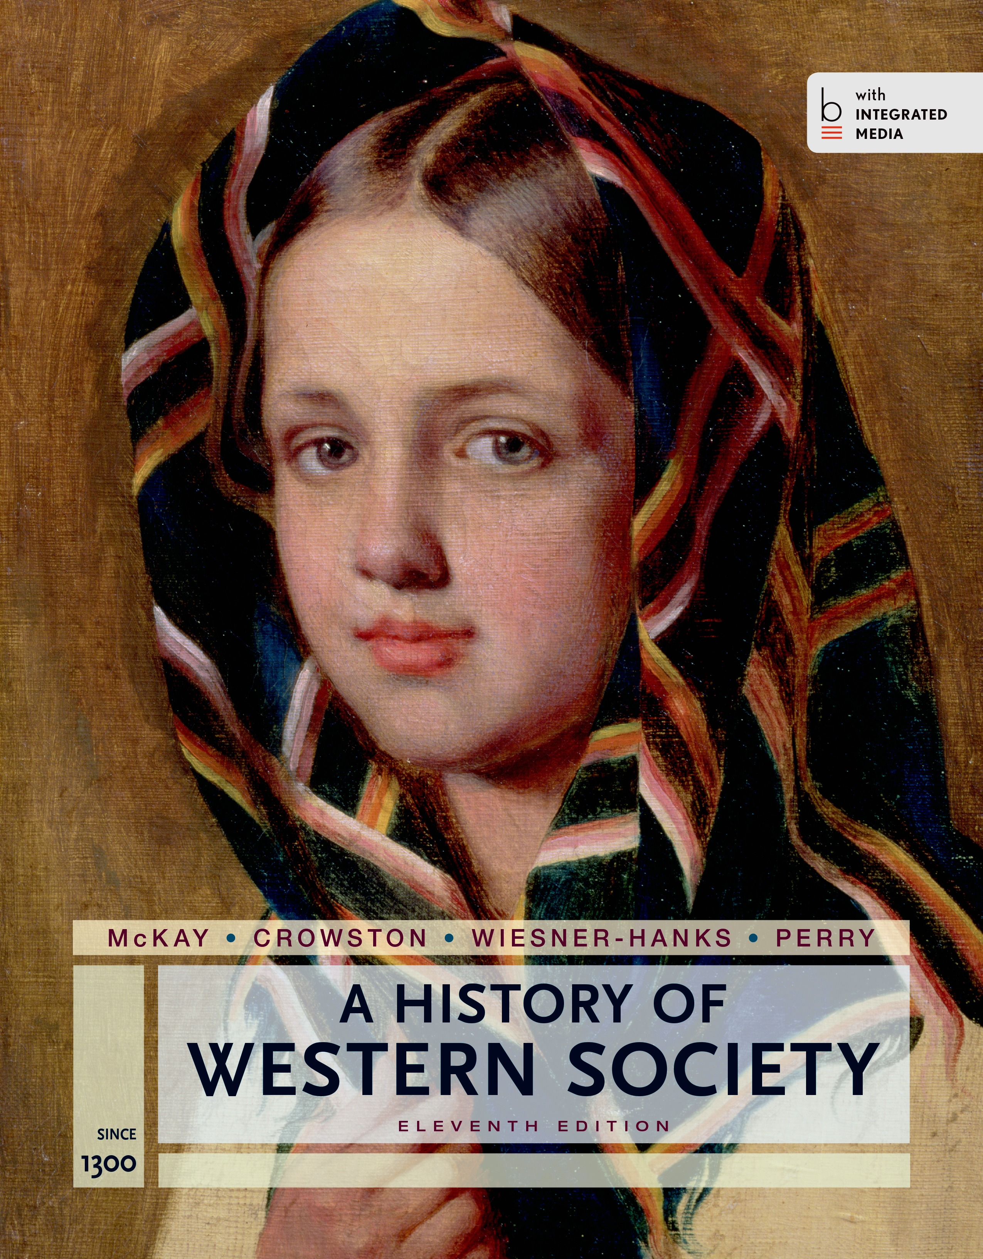
Class Text Books

Slide 6

The “New and Improved” Grade Scale
Assessments (40%)
Unit Tests (MCQ) and Written Assignments (LEQ, DBQ, SQA formats)
Quizzes (In-class SQA format and Online Quia website)
“Soooooo many quizzes…………”

Slide 7

The “New and Improved” Grade Scale
Class work (35%)
Analysis of primary and secondary sources
text-based assignments,
timed essay writing assignments
Class Participation (5%)
Bell work
Short partner assignments
Socratic questioning

Slide 8

The “New and Improved” Grade Scale
Homework (10%)
Text based reading sources
Review activities
Reading assignments (with guided-questions)
Projects (10%)
Partner writing assignments
Guided reading based on themes and topics.
Video and podcast reviews

