Slide 1
AP Environmental Science
Alicia McGee

Slide 2
About the AP Environmental Science Course
The AP Environmental Science Course is designed to be the equivalent of a one-semester, introductory college course in environmental science.
Students should have completed two years of high school laboratory science – one year of life science and one year of physical science (e.g., a year of biology and a year of chemistry). Due to the quantitative analysis required in the course, it is also required that the students have taken at least one year of algebra.
It is required that students have the opportunity to spend a minimum of 25% of instructional time engaged in hands-on, inquiry-based laboratory and/or fieldwork investigations.

Slide 3
AP Environmental Science Practices
Students will learn and use the following Science Practices as we study the Big Ideas covered in AP Environmental Science
Concept Explanation
Visual Representations
Text and Data Analysis
Scientific Experiments
Mathematical Routines
Environmental Solutions
Big Ideas Covered in APES
Interactions between Earth Systems
Interactions between Different Species and the Environment
Sustainability
Energy Transfer

Slide 4
You are literally learning how to save the world!
It is the most interesting class you will ever take!

Slide 5
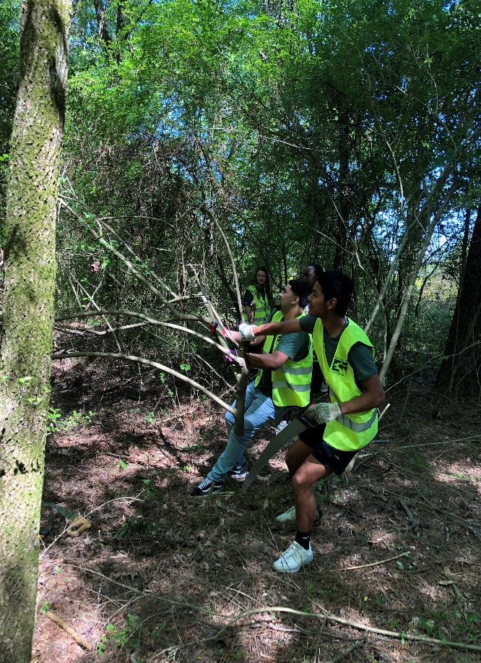
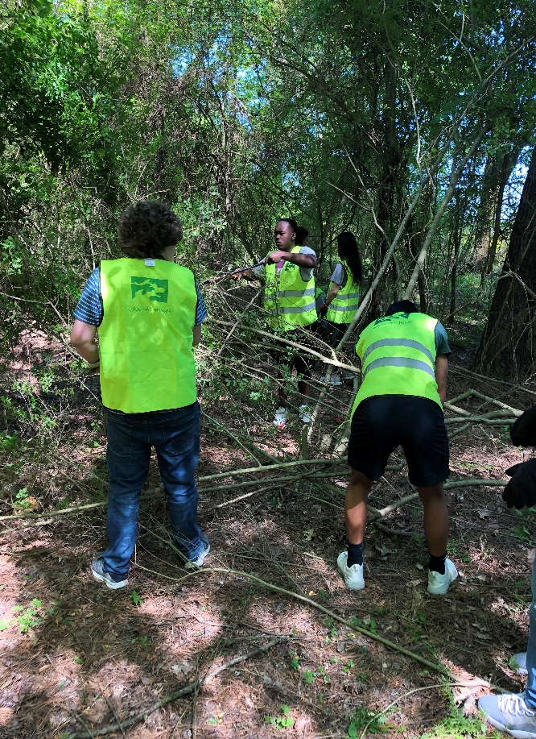
Even though this year has been different:
In APES, you will get the opportunity to:
Students volunteering on Earth Day 2019
Become part of the solution to environmental issues
Go on field trips to learn about the local environment
Participate in webinars and meetings that will affect our local environment.
Participate in outdoor field activities and interesting labs
Participate in volunteer activities

Slide 6
QUESTIONS?

Slide 7
It’s your opportunity to save the World!
I look forward to seeing you next year. – Alicia McGee

