Slide 1
WELCOME
to
AP ENGLISH LANGUAGE
Mrs. Adrien Alsobrook

Slide 2
AP English Language and Composition
What’s it all about?

Slide 3
AP English Language and Composition
Course Goals:
Develop critical literacy
Facilitate an informed citizenry

Slide 4
course goals:
Develop critical literacy
Inquiry | Deliberation
Argument | Analysis
Reading | Writing
Synthesis | Listening
Speaking | Critical Thinking

Slide 5
Course goals
Facilitate an informed citizenry –
Prepare students to meet the literacy challenges of college-level study and
Cultivate the critical literacy students need for life-long learning.

Slide 6
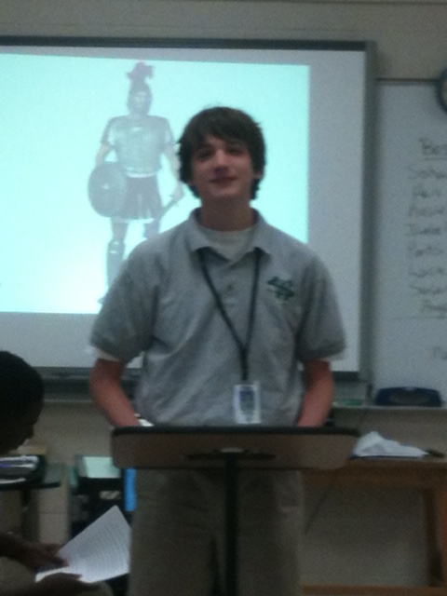

Debates

Slide 7
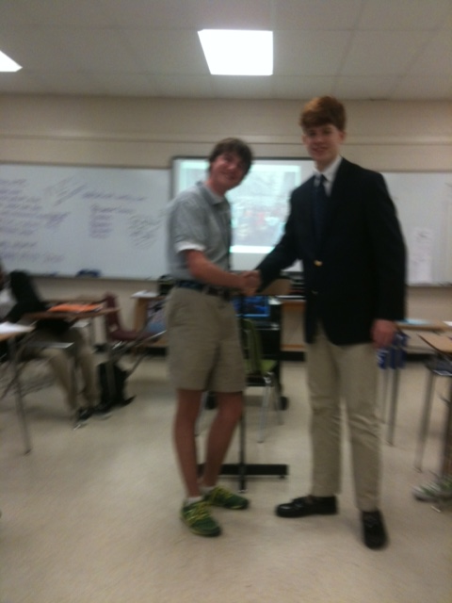
Debates

Slide 8
ACTIVITIES
TO
FACILITATE
OUR
GOALS

Slide 9
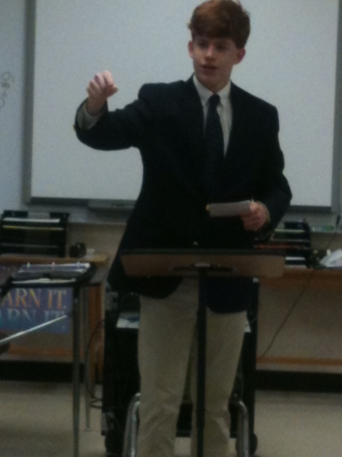
Debates

Slide 10
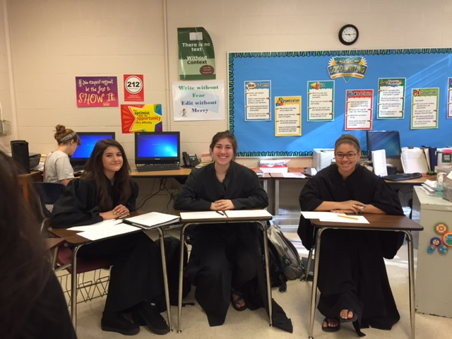
debates

Slide 11
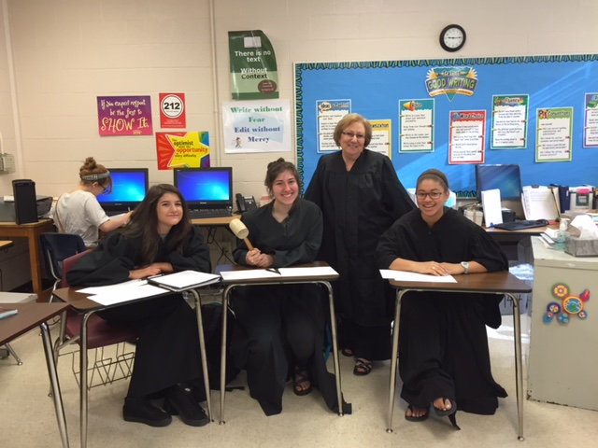
debates

Slide 12
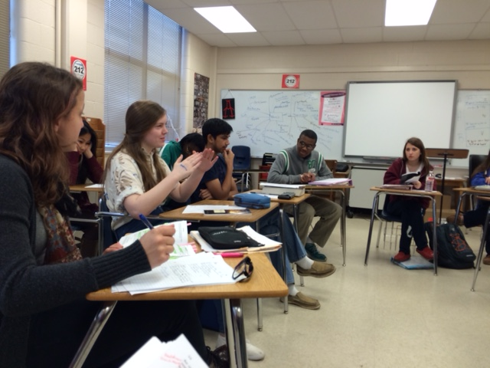
Socratic Seminars

Slide 13
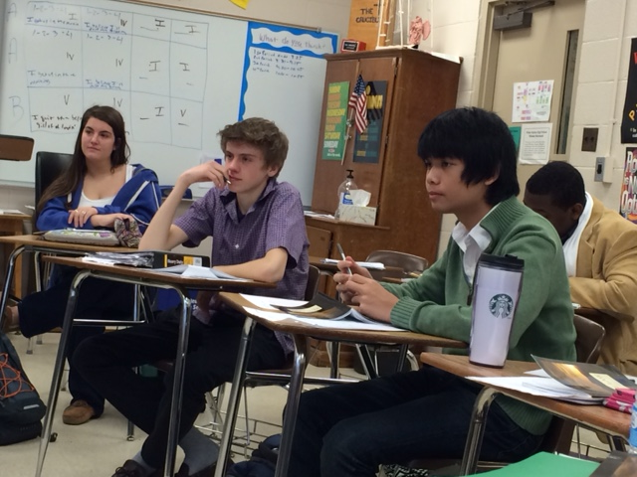
Socratic Seminars

Slide 14
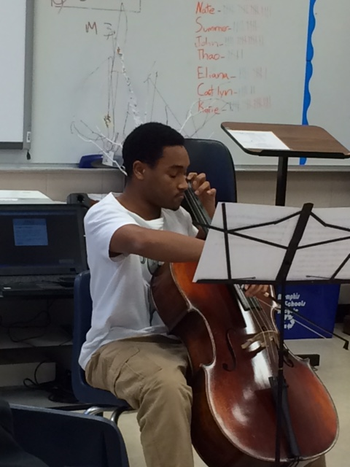
Alternative assessments

Slide 15
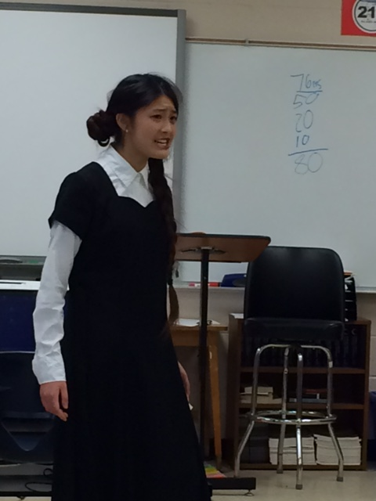
Alternative assessments

Slide 16
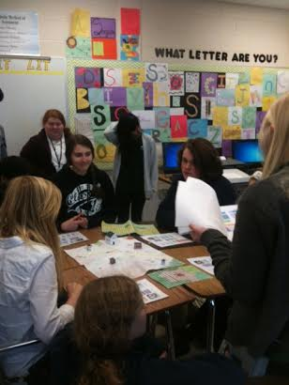
Alternative assessments

Slide 17
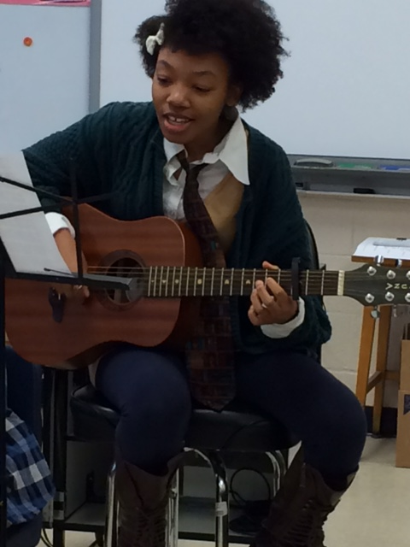
Alternative assessments

Slide 18
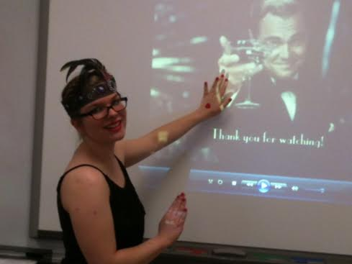
Alternative assessments

Slide 19
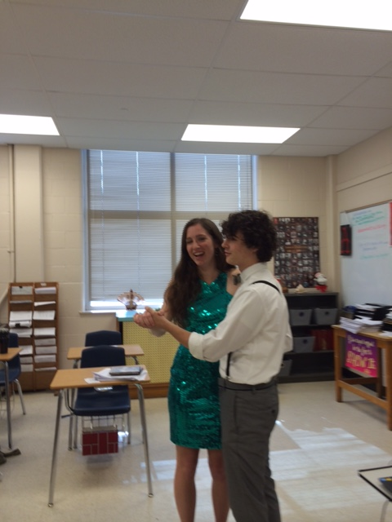
Alternative assessments

Slide 20
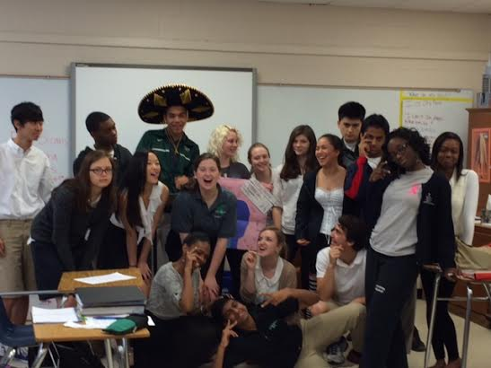
Alternative assessments

Slide 21
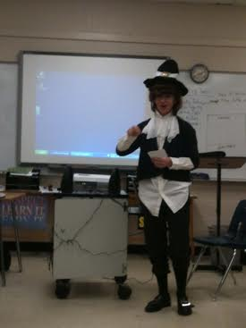
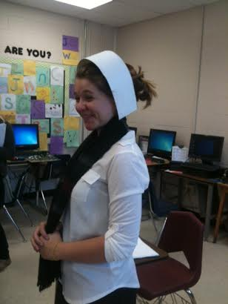
Alternative assessment

Slide 22
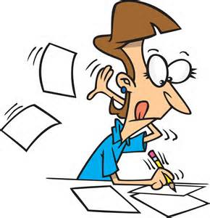
Research Papers and Projects

Slide 23
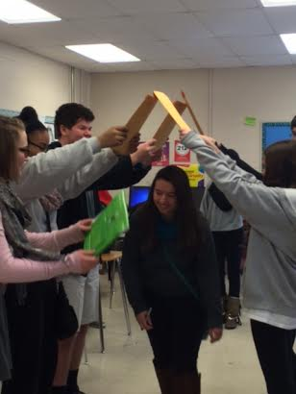
Research Papers and Projects

Slide 24
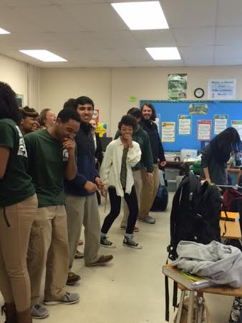
Research papers and projects

Slide 25
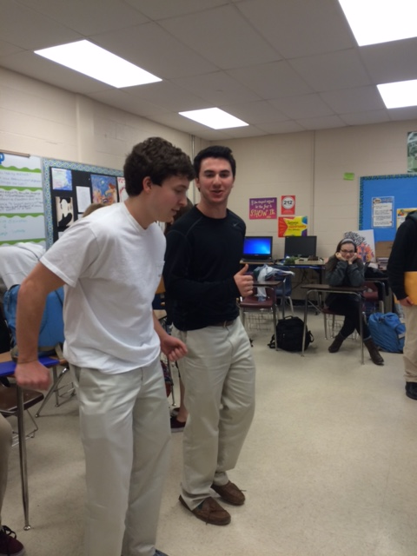
Research papers and projects

Slide 26
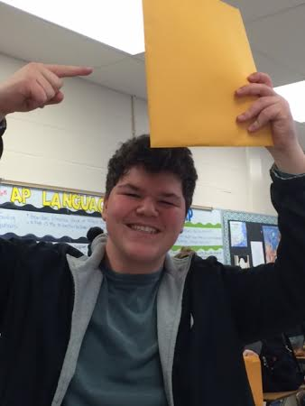
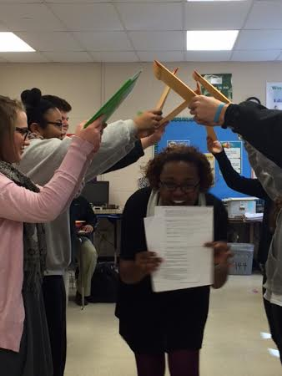
Research Papers and Projects

Slide 27
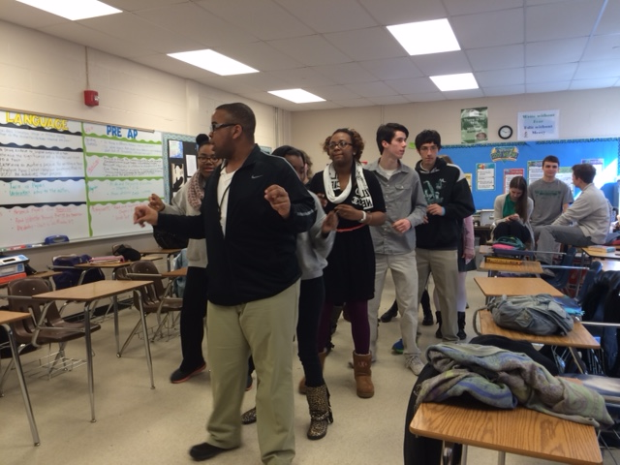
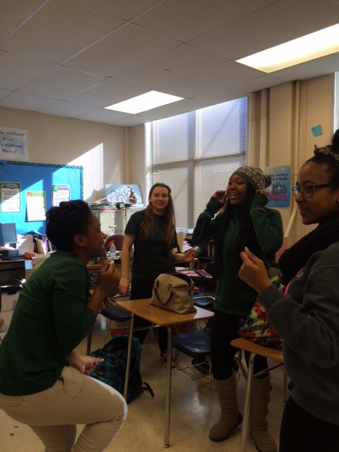
Research Papers and Projects

Slide 28
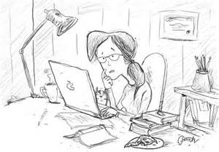
Writing and Winning

Slide 29
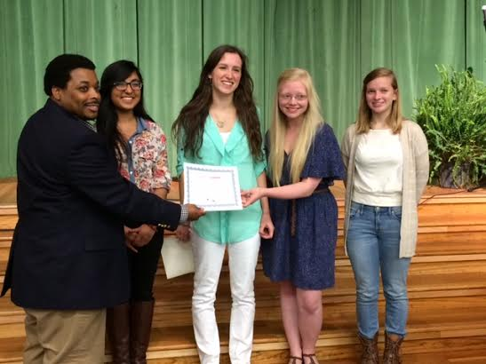
Writing & Winning – Letters about Literature

Slide 30
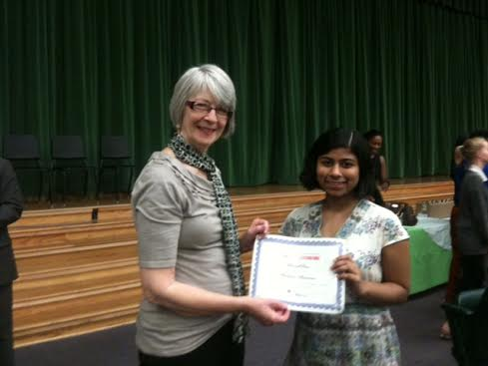
Writing & winning – Letters about Literature

