Slide 1

Inver Grove Heights Community Schools
Public Hearing for
Taxes Payable in 2013

Slide 2
Welcome
December 17, 2012
Presented by:
Bruce Rimstad
Business Manager

Slide 3
Tax Hearing Presentation
State law requires that we present information on the current year budget and actual revenue and expenses for the prior year
State law also requires that we present information on the proposed property tax levy, including:
  The percentage increase over the prior year
  Specific purposes and reasons for which taxes are being increased
District cannot increase proposed levy unless an increase was approved by voters or the levy limitation calculations updated by the Commissioner of Education
District must also allow for public comments

Slide 4
Agenda for Hearing
Background on School Funding, Property Tax Levies, and Budgets
Information on District Budget
Information on the District’s Proposed Tax Levy for Taxes Payable in 2013
Public Comments and Questions

Slide 5
Public Education is Strong in Minnesota…
In Minnesota, the most commonly taken standardized college entrance exam is the ACT. Seventy-four percent of Minnesota high school graduates in 2012 took the assessment.
Minnesota’s average composite score of 22.8 was the highest in the nation among the 28 states in which more than half the college-bound students took the test in 2012. Minnesota has led the nation in average composite ACT scores for seven consecutive years. The national composite score was 21.1.

Slide 6
Public Schools Established by Minnesota Constitution
“ARTICLE XIII
MISCELLANEOUS SUBJECTS
Section 1. UNIFORM SYSTEM OF PUBLIC SCHOOLS. The stability of a republican form of government depending mainly upon the intelligence of the people, it is the duty of the legislature to establish a general and uniform system of public schools. The legislature shall make such provisions by taxation or otherwise as will secure a thorough and efficient system of public schools throughout the state.”

Slide 7
As a result…
School funding is highly regulated by the state
State sets formulas which determine revenue; most revenue is based on specified amounts per pupil
State sets tax policy for local schools
State sets maximum authorized property tax levy (districts can levy less but not more than amount authorized by state, unless approved by the voters)
State authorizes school board to submit referendums for operating and capital needs to voters for approval

Slide 8
State Funding for Schools Has Not Kept Pace with Inflation
Increases in basic general education revenue per pupil have been less than inflation
  Per-pupil revenue for fiscal year 2013-14 without increase is $401 below the 2004-05 inflation adjusted amount
Basic per-pupil funding for FY 2014 and 2015 will be set by the 2011 legislature.
Most districts’ expenses will likely increase, without budget cuts, by at least 2-3% annually.

Slide 9
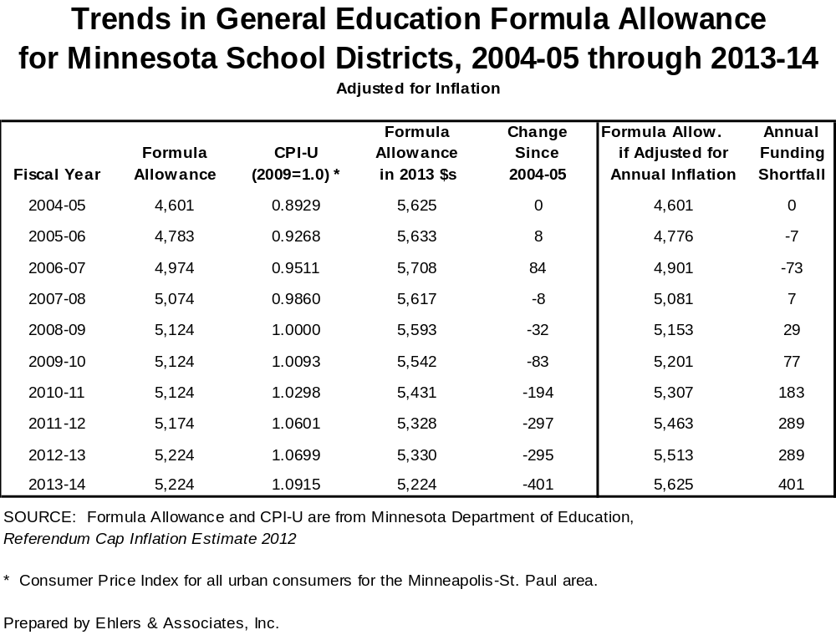

Slide 10
Impact is budget cuts and operating referendums…
With minimal or no increase in state funding or a voter approved referendum, many districts are facing projected budget shortfalls for FY 2014 and FY 2015, and anticipate the need for budget cuts.
To meet local school budget shortfalls voters in 297 districts, or 88% of all Minnesota districts, have approved an operating referendum levy.
The state average amount is $899 per pupil.

Slide 11
Change in Tax Levy Does not Determine Change in Budget
Tax levy is based on many state-determined formulas
Some increases in tax levies are revenue neutral, offset by reductions in state aid
Expenditure budget is limited by state-set revenue formulas, voter-approved levies, and fund balance, not just by tax levies

Slide 12
Contrast of City/County to School District Levy Cycle
City/County - Budget Year is same as calendar year. The 2013 tax levy provides revenue for the calendar year 2013 budget
Schools - Budget year begins July 1st and coincides with school year. The 2013 tax levy provides revenue for the 2013-2014 school fiscal year. Budget will be adopted in June 2013.

Slide 13
Budget Information
Because approval of the budget lags certification of the tax levy by six months, the state requires only current year budget information and prior year actual financial results to be presented at this hearing

Slide 14
Budget Information
All school districts’ budgets are divided into separate funds, based on purposes of revenue, as required by law
For our district, 9 funds:
  General
  Food Service
  Community Service
  Building Construction
  Debt Service
  Trust
  Internal Service
  OPEB Revocable Trust
  OPEB Debt Service

Slide 15
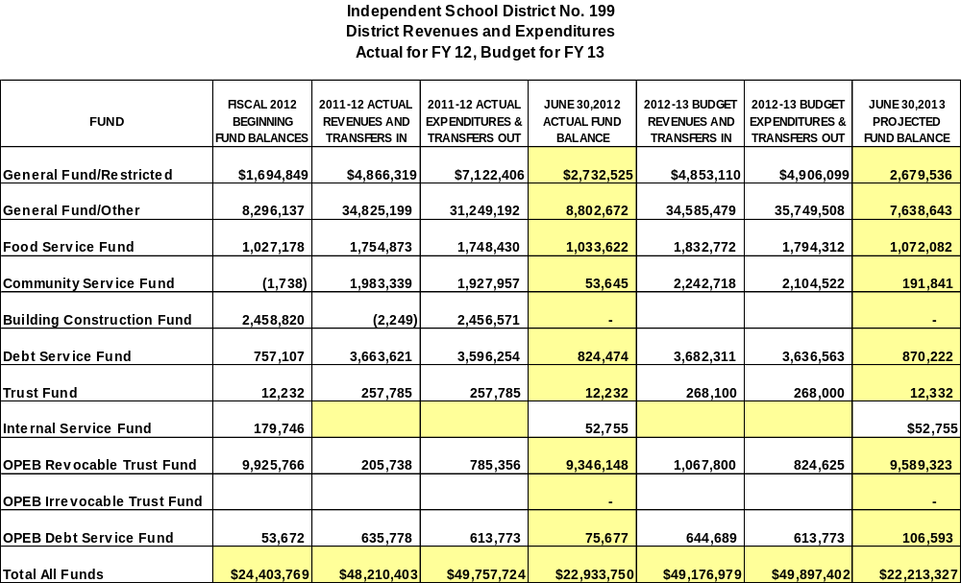

Slide 18
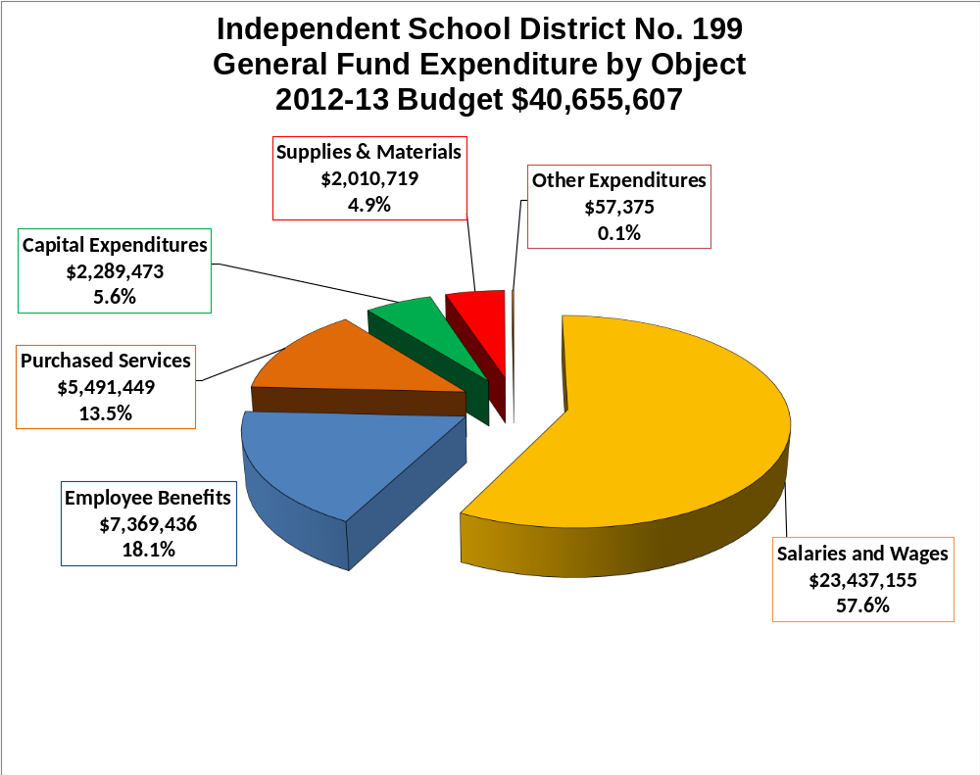

Slide 20
Proposed 2013 Property
Tax Levy
Determination of levy
“Homestead Credit Shift” (elimination of homestead credit and replacement with homestead market value exclusion)
Comparison 2012 to 2013 levies
Specific reasons for changes in tax levy
Impact on taxpayers

Slide 21
Property Tax Background
Every owner of taxable property pays property taxes for the various “taxing jurisdictions” (county, city or township, school district, special districts) in which the property is located
Each taxing jurisdiction sets its own tax levy, often based on limits in state law
County sends out bills, collects taxes from property owners, and distributes funds back to other taxing jurisdictions

Slide 22
School District Property Taxes
Each school district may levy taxes in up to 30 different categories
“Levy limits” (maximum levy amounts) for each category are set either by:
  State law, or
  Voter approval
Minnesota Department of Education (MDE) calculates detailed levy limits for each district

Slide 23
The Homestead Credit Shift
The 2011 legislature repealed the Homestead Market Value Credit
In its place, the Legislature implemented a Homestead Market Value Exclusion
This caused some significant shifts in tax burdens in some communities between 2011 and 2012
2013 is the second year of this change; it will not cause significant shifts in the tax burdens from 2012 to 2013

Slide 24
Property Tax Background
School District Property Taxes
  Key steps in the process are summarized on the next slide
  Any of these steps may affect the taxes on a parcel of property, but the district has control over only 1 of the 7 steps

Slide 25
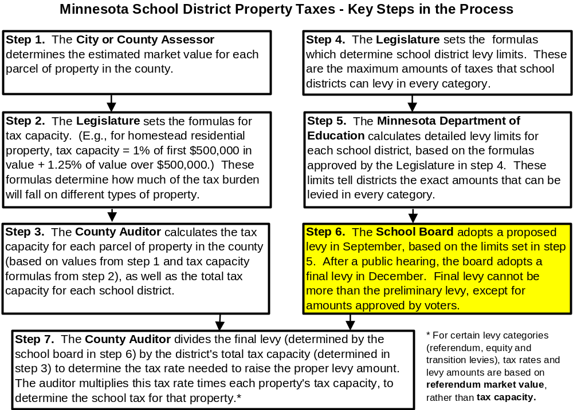

Slide 26
Proposed Levy
Payable in 2013
Schedule of events in approval of district’s 2012 (Payable 2013) tax levy
  Mid-September: Dept. of Education prepared and distributed first draft of levy limit worksheets setting maximum authorized levy
  September 24: School board approved proposed levy amounts
  Mid-November: County mailed “Proposed Property Tax Statements” to all property owners
  December 17: Public hearing on proposed levy at regular meeting
  Following hearing school board will certify final levy amounts

Slide 27
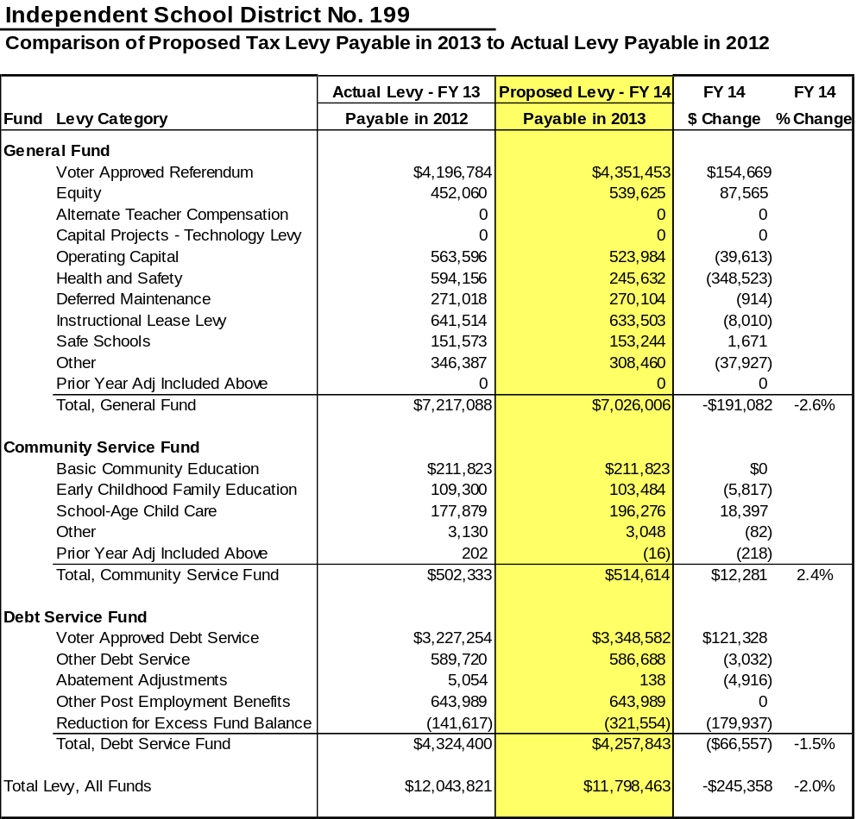

Slide 28
Overview of Proposed Levy
Payable in 2013
The total 2013 proposed property tax levy will decrease from 2012, by 2.0% or $245,358. State law requires that we explain the reasons for the major increases in the levy
We will explain some of the changes in specific levies

Slide 29
Explanation of Levy Changes
Category: General Fund
Change: -$191,082
Use of funds: general operating expenses
Reason for decrease:
  Levy for health and safety costs decreased by $348,523 – current levy decreased by $210,256 coupled with a 2013 negative prior year adjustment of $138,267
    Increase in enrollment resulted in an increase in referendum, equity, and operating capital levies off-setting in part the decrease noted above.

Slide 30
Explanation of Levy Changes
Category: Community Services
Change: $12,281
Use of funds: Provide after school programs for youth and adults of the community and early childhood family education services
Reason for increase:
  A $18,397 increase in the levy for school age care offset by an small decrease in ECFE levies.
  Increase in school age levy triggered by change in prior year adjustments

Slide 31
Explanation of Levy Changes
Category: Debt Service
Change: -$66,557
Use of funds: Annual required payment of principal and interest on bonds
Reason for decrease:
  Dollars available in fund balance (levy reduction for excess fund balance) were used to reduce the required debt service levy

Slide 32
Impact on Taxpayers
Examples for property in the City of Inver Grove Heights
  school taxes in other parts of the district may be slightly higher or lower, due to variations in the impact of the state homestead and agricultural credits and the Fiscal Disparities Program
Figures for 2013 are preliminary estimates, based on the best data available now – final figures could change slightly
Estimates were prepared by Ehlers, the district’s financial advisors

Slide 33
Impact on Taxpayers
Following are a table and graphs showing examples of changes in the school district portion of property taxes from 2010 to 2013
  Examples include school district taxes only
  All examples are based on a 13.2% decrease in property value over this period
    Actual increases in value may be more or less than this for any parcel of property
    These figures are intended to provide a fair representation of what has happened to school district property taxes over this period for typical properties

Slide 34
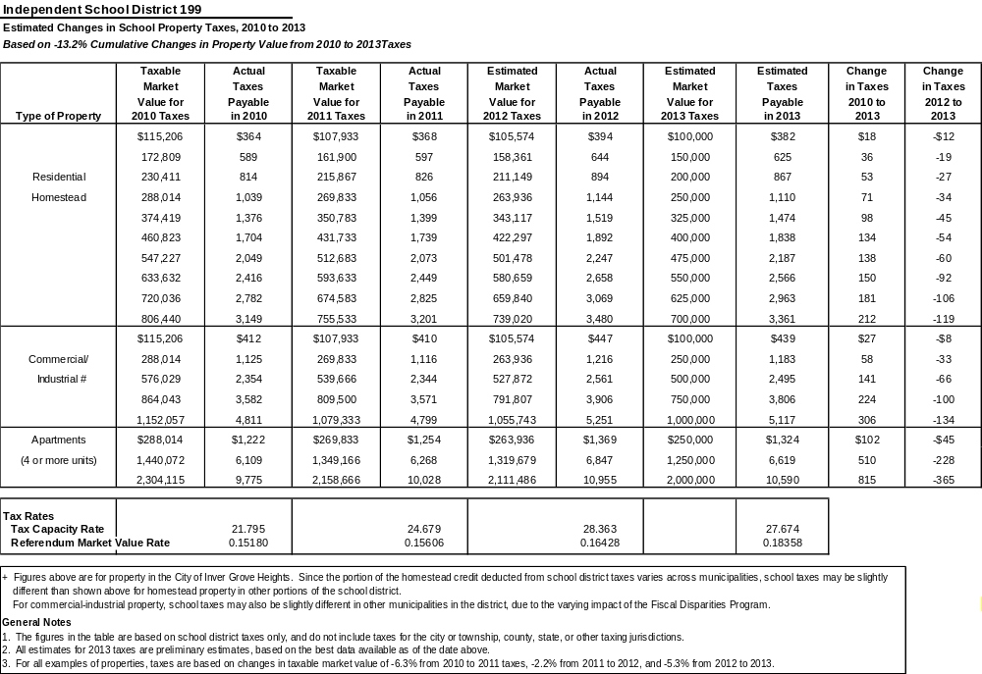

Slide 35
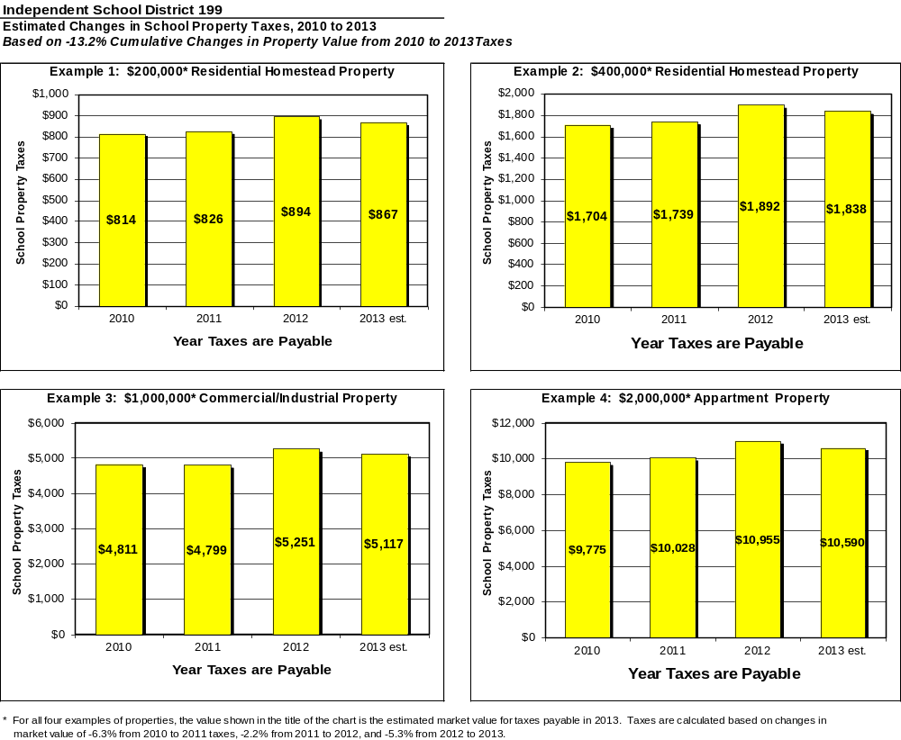

Slide 36
Factors Causing Changes from 2012 to 2013
Many factors can cause the tax bill for an individual property to increase or decrease from year to year:
  Changes in the total value of all property in the district
  Changes in value of the individual property
  Increases or decreases in levy amounts caused by changes in state funding formulas, local needs and costs, voter-approved referendums, and other factors

Slide 37
State Property Tax Refunds
State of Minnesota has two tax refund programs and one tax deferral program available for owners of homestead property
These programs may reduce the net tax burden for local taxpayers, but only if you take time to complete and send in the forms
For help with the forms and instructions:
  Consult your tax professional, or
  Visit the Department of Revenue web site at www.taxes.state.mn.us

Slide 38
State Property Tax Refunds
Minnesota Property Tax Refund (aka “Circuit Breaker” Refund)
  Has existed since 1970s
  Available to all owners of homestead property
  Annual income must be approx. $100,780 or less (income limit is higher if you have dependents)
  Refund is a sliding scale, based on total property taxes and income
  Maximum refund is $2,460
  Especially helpful to those with lower incomes
  Fill out state tax form M-1PR

Slide 39
State Property Tax Refunds
Special Property Tax Refund
  Available for all homestead properties with a gross tax increase of at least 12% and $100 over the prior year
  Refund is 60% of the amount by which the tax increase exceeds the greater of 12% or $100, up to a maximum of $1,000
  No income limits
  Fill out state tax form M-1PR

Slide 40
Senior Citizen
Property Tax Deferral
Allows people 65 years of age or older with a household income of $60,000 or less to defer a portion of the property taxes on their home
Taxes paid in any year limited to 3% of household income for year before entering deferral program; this amount does not change in future years
Additional taxes are deferred, but not forgiven
State charges interest up to 5% per year on deferred taxes and attaches a lien to the property
The deferred property taxes plus accrued interest must be paid when the home is sold or the homeowner(s) dies

Slide 41
Next Steps
Board will accept public comments and questions on proposed levy
Board action to certify the 2013 school tax levy

Slide 42
Public Comments and Questions

