Slide 1

Inver Grove Heights Community Schools
Public Hearing for
Taxes Payable in 2014
December 16, 2013
Jason Mutzenberger
Director of Business Services

Slide 2
Tax Hearing Presentation
State law requires that we present:
  Current year budget
  Proposed property tax levy including:
    The percentage change over the prior year
    Specific purposes and reasons for which taxes are being increased
District must also allow for public comments

Slide 3
Public Schools Established by Minnesota Constitution
“ARTICLE XIII
MISCELLANEOUS SUBJECTS
Section 1. UNIFORM SYSTEM OF PUBLIC SCHOOLS. The stability of a republican form of government depending mainly upon the intelligence of the people, it is the duty of the legislature to establish a general and uniform system of public schools. The legislature shall make such provisions by taxation or otherwise as will secure a thorough and efficient system of public schools throughout the state.”

Slide 4
As a result…
School funding is highly regulated by the state
State sets formulas which determine revenue
State sets tax policy for local schools
State sets maximum authorized property tax levy
State authorizes school board to submit referendums for operating and capital needs to voters for approval

Slide 5
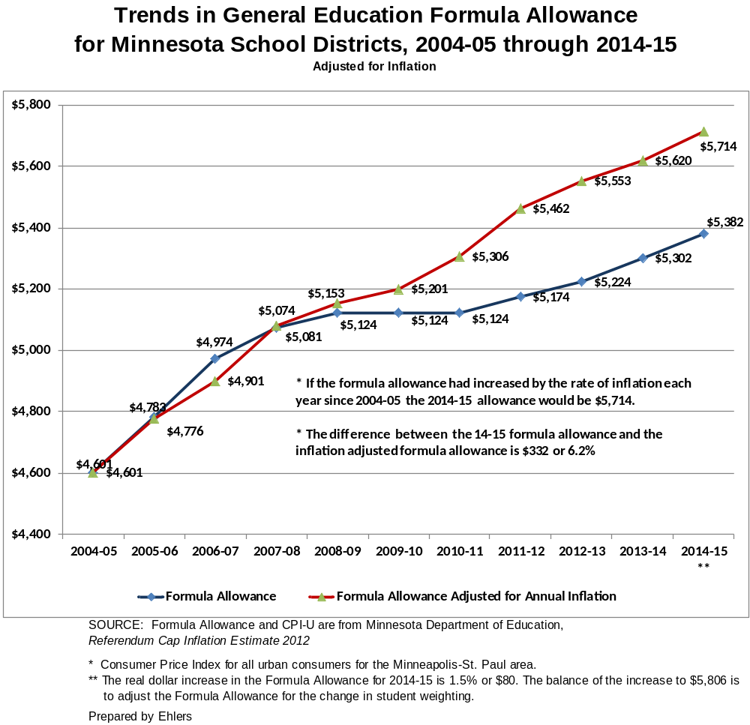

Slide 6
Impact is budget cuts and operating referendums…
With minimal increases in state funding, 44.2%* of districts are facing projected budget shortfalls for FY 2014 and FY 2015, and anticipate the need for budget cuts
To meet local school budget shortfalls voters in 300 districts, or 89.3% of all Minnesota districts, have approved an operating referendum levy
The state average amount for the current year is $920 per pupil unit , IGH receives $844
* Survey by Minnesota Association of School Business Officials (MASBO)

Slide 7
Budget Information
All school districts’ budgets are divided into separate funds, based on purposes of revenue, as required by law
For our district, 8 funds:
  General
  Food Service
  Community Service
  Debt Service
  Trust
  Internal Service
  OPEB Revocable Trust Fund
  OPEB Debt Service

Slide 10
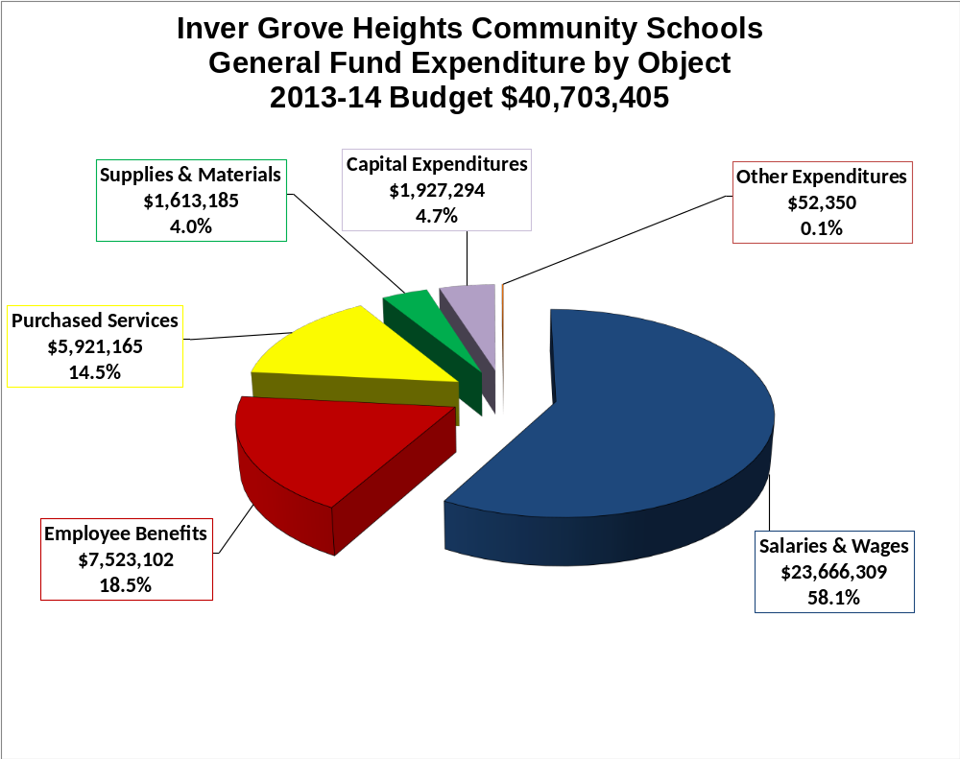

Slide 11
Proposed 2014 Property
Tax Levy
Determination of levy
Comparison of 2013 to 2014 levies
Specific reasons for changes in tax levy
Impact on taxpayers

Slide 12
Property Tax Background
Every owner of taxable property pays property taxes for the various “taxing jurisdictions” (county, city or township, school district, special districts) in which the property is located
Each taxing jurisdiction sets its own tax levy, often based on limits in state law
County sends out bills, collects taxes from property owners, and distributes funds back to other taxing jurisdictions

Slide 13
School District Property Taxes
Each school district may levy taxes in up to 30 different categories
“Levy limits” (maximum levy amounts) for each category are set either by:
  State law, or
  Voter approval
Minnesota Department of Education (MDE) calculates detailed levy limits for each district

Slide 14
Proposed Levy
Payable in 2014
Schedule of events:
  Summer: Submission of data to Dept. of Education
  September 23: School board approved proposed levy amts
  Mid-November: County mailed “Proposed Property Tax Statements” to all property owners
  December 16: Public hearing on proposed levy at regular meeting, school board will certify final levy amounts
  March – Final tax statements mailed to property owners

Slide 15
Total Levy By Fund
Fund | Proposed 2014 Levy | Payable 2013 Levy | Dollar Change | Percent Change
General | $ 6,678,536 | $ 7,026,005 | $ (347,469) | (4.95%)
Community Service | $ 441,422 | $ 514,614 | $ (73,192) | (14.22%)
Debt Service | $ 5,565,890 | $ 4,257,843 | $ 1,308,047 | 30.72%
Total | $ 12,685,848 | $ 11,798,462 | $ 887,385 | 7.52%

Slide 16
General Fund Levy Components
 | Proposed 2014 Levy | Payable 2013 Levy | Dollar Change | Percent Change
Equity | $ 534,622 | $ 539,625 | $ (5,002) | (0.93) %
Operating Capital | 385,389 | 523,984 | (138,594) | (26.45) %
Deferred Maintenance | 261,713 | 270,104 | (8,391) | (3.11) %
Student Achievement | 86,203 | - | 86,203 | 100.00 %
Location Equity | 1,758,811 | - | 1,758,811 | 100.00 %
Achievement & Integration | 168,276 | 115,298 | 52,975 | 45.95 %
Referendum | 2,055,355 | 4,351,453 | (2,296,098) | (52.77) %
Safe Schools | 167,149 | 153,244 | 13,905 | 9.07 %
Health & Safety | 418,036 | 245,632 | 172,404 | 70.19 %
Building/Lease | 701,657 | 633,503 | 68,154 | 10.76 %
Re-Employment | 50,138 | 121,039 | (70,901) | (58.58) %
Career Technical | 47,475 | 72,433 | (24,958) | (34.46) %
Abatement Adjustment | 43,714 | (311) | 44,025 | 100.00 %
Total | $ 6,678,536 | $ 7,026,005 | $ (347,469) | (4.95) %

Slide 17
General Fund Levy Changes
Explanation of Changes:
Category: Voter Approved Operating Referendum Levy
Change: -$2,296,098
Reason for decrease:
  The voter approved levy was further reduced due to the new Location Equity Revenue ($424 per adj. pupil unit)
  Building Bond on November 5th is not included here
  The state increased equalization aid for referendum levies,
  causing a reduction in the tax levy

Slide 18
General Fund Levy Changes
Explanation of Changes:
Category: Location Equity Levy
Change: +$1,758,811
Reason for increase:
  This is a new category of revenue created through state legislation; districts with property in the 7 county metro area are authorized $424 per adjusted pupil
  The district’s existing referendum revenue was reduced by the amount of this revenue, resulting in no net change in revenue
  Location equity revenue recognizes higher cost of operations in metro area and non-metro centers of population

Slide 19
General Fund Levy Changes
Explanation of Changes:
Category: Student Achievement Levy
Change: +$86,203
Reason for increase:
  New levy for 2014
  Levy used to fund basic revenue allowance
  Balance of basic allowance funded by state aid
  Does not increase revenue, only replaces basic allowance state aid

Slide 20
General Fund Levy Changes
Explanation of Changes:
Category: Operating Capital
Change: -$138,594
Reason for decrease:
  Funding for this program is provided through a combination of state aid and local tax levies
  Legislature opted to reduce the operating capital levy by providing additional state aid
  Change does not reduce revenue. State aid will increase by a similar amount, so there will be little net change in revenue

Slide 21
General Fund Levy Changes
Explanation of Changes
Category: Health and Safety Levy
Change: +$172,404
Reason for increase:
  The amount of this levy is based on the estimated cost of qualifying state-approved projects
  The levy will be used to address health and safety deficiencies in district facilities

Slide 22
General Fund Levy Changes
Explanation of Changes:
Category: Lease Levy
Change: +$68,154
Reason for increase:
  Required to meet lease payment obligations incurred to fund classroom additions
  The replacement of the Family Connections lease with Buckley Way and the addition to Hilltop Elementary caused an increase in this levy

Slide 23
Community Service Levy Components
 | Proposed 2014 Levy | Payable 2013 Levy | Dollar Change | Percent Change
Basic Levy | $ 211,823 | $ 211,823 | $ - | - %
Early Childhood | 100,183 | 103,484 | (3,301) | (3.18) %
Home Visitation | 3,032 | 3,048 | (16) | (0.52) %
School Age Care | 124,115 | 196,296 | (72,161) | (36.76) %
Abatements | 2,269 | (16) | 2,285 | 100.00 %
Total | $ 441,422 | $ 514,635 | $ (73,213) | (14.22) %

Slide 24
Community Service Levy Changes
Explanation of Changes:
Category: School Age Child Care
Change: -$72,161
Reason for decrease:
  Prior year adjustment for School Age Child Care declined by approximately $75,000

Slide 25
Debt Service Levy Components
 | Proposed 2014 Levy | Payable 2013 Levy | Dollar Change | Percent Change
Debt Levy | $ 4,370,163 | $ 3,348,582 | $ 1,021,581 | 30.50 %
Debt Excess | (201,791) | (321,554) | 119,763 | 53.33 %
Alternative Bond | 587,895 | 586,688 | 1,207 | 0.20 %
OPEB Bond | 780,489 | 643,989 | 136,500 | 21.19 %
Abatements | 29,134 | 138 | 28,996 | 100.00 %
Total | $ 5,565,890 | $ 4,257,843 | $ 1,308,047 | 30.72 %

Slide 26
Debt Service Levy Changes
Explanation of Changes:
Category: Debt Service
Change: +$1,308,047
Reasons for increase:
  The voter approved bond referendum on November 5 increased the levy by $1,021,581
  The levy for principal and interest on OPEB bonds increased by $136,500
  Adjustment for excess fund balance was down $119,763

Slide 27
Impact on Taxpayers
Many factors can cause the tax bill for an individual property to change:
  Changes in value of individual property
      6.40% decrease between 2011-2014
  Changes in total value of all property in the district
  Changes in levy amounts caused by legislative changes
  Changes in voter-approved referendums

Slide 28
Impact on Taxpayers
Residential
Taxable Market Value | Estimated Annual Taxes | Estimated Change from 2013
$100,000 | $396 | + $20
$200,000 | $917 | + $61
$325,000 | $1,568 | + $114
$475,000 | $2,330 | + $171

Slide 29
Impact on Taxpayers
Commercial
Taxable Market Value | Estimated Annual Taxes | Estimated Change from 2013
$250,000 | $1,278 | + $111
$500,000 | $2,711 | + $249
$750,000 | $4,146 | + $390
$1,000,000 | $5,579 | + $528

Slide 30
State Property Tax Refunds
State of Minnesota has two tax refund programs and one tax deferral program available for owners of homestead property
These programs may reduce the net tax burden for local taxpayers, but only if you take time to complete and send in the forms
For help with the forms and instructions:
  Consult your tax professional, or
  Visit the Department of Revenue web site at www.taxes.state.mn.us

Slide 31
State Property Tax Refunds
Minnesota Property Tax Refund (aka “Circuit Breaker” Refund)
  Has existed since 1970s
  Available to all owners of homestead property
  Annual income must be approx. $105,500 or less (income limit is higher if you have dependents)
  Refund is a sliding scale, based on total property taxes and income
  Maximum refund is $2,580
  Especially helpful to those with lower incomes
  Fill out state tax form M-1PR

Slide 32
State Property Tax Refunds
Special Property Tax Refund
  Available for all homestead properties with a gross tax increase of at least 12% and $100 over the prior year
  Refund is 60% of the amount by which the tax increase exceeds the greater of 12% or $100, up to a maximum of $1,000
  No income limits
  Fill out state tax form M-1PR

Slide 33
Senior Citizen Property Tax Deferral
Allows people 65 years of age or older with a household income of $60,000 or less to defer a portion of the property taxes on their home
Taxes paid in any year limited to 3% of household income for year before entering deferral program; this amount does not change in future years
Additional taxes are deferred, but not forgiven
State charges interest up to 5% per year on deferred taxes and attaches a lien to the property
The deferred property taxes plus accrued interest must be paid when the home is sold or the homeowner(s) dies

Slide 34
Public Comments and Questions

