Slide 1

Inver Grove Heights Schools, ISD 199
Public Hearing for Taxes Payable in 2021
December 14, 2020
Presented By:
Heather aune, director of business services

Slide 2
Minnesota State Law Requires:
A Public Meeting…
  Between November 25th & December 28th
  At 6:00 PM or later
  May be part of regularly scheduled meeting
  Must allow for public comments
  May adopt final levy at same meeting
…and Presentation of:
  Current year budget
  Proposed property tax levy

Slide 3
Hearing
Agenda
__________
  Background Information on School Funding
  District’s Budget
  District’s Proposed Tax Levy for Taxes Payable in 2021
  Public Comments

Slide 4
MN Legislature Must Set Funding for Minnesota Public Schools
Minnesota Constitution ARTICLE XIII
MISCELLANEOUS SUBJECTS
Section 1
“UNIFORM SYSTEM OF PUBLIC SCHOOLS. The stability of a republican form of government depending mainly upon the intelligence of the people, it is the duty of the legislature to establish a general and uniform system of public schools. The legislature shall make such provisions by taxation or otherwise as will secure a thorough and efficient system of public schools throughout the state.”

Slide 5
Funding is Highly Regulated
As a result…
  State Sets:
  Formulas which determine revenue; most revenue based on specified amounts per pupil
  Tax policy for local schools
  Maximum authorized property tax levy (districts can levy less but not more than amount authorized by state, unless approved by voters in November)
  State also authorizes school board to submit referendums for operating and capital needs to voters for approval

Slide 6
Challenge: State Set Basic General Education Formula Lags Inflation
  Since 2002-03, state General Education Revenue formula has not kept pace with inflation
  For Fiscal Year 2020-21, an increase of 2% or $129 over previous year was approved
  No additional changes to formula have been approved by legislature
Per-pupil allowance for Fiscal Year 2020-21 of $6,567 would need to increase by another $503 (7.7%) to have kept pace with inflation since 2002-03

Slide 7
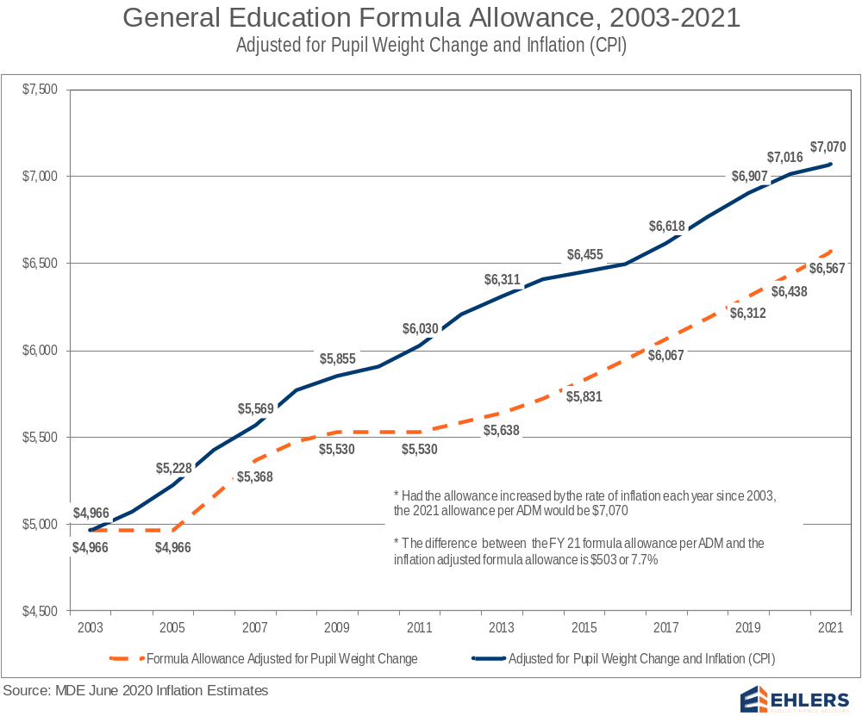
Notes:
Basic General Education Formula Lags Inflation

Slide 8
Underfunding of Special Education
__________
MDE reports FY 2018 cost of providing special education programs was underfunded by $822 million, or an average of 40% underfunded
Translating into a statewide average funding shortfall of $5,705 per special education student
Underfunding of special education costs requires a transfer from regular program resources to support an underfunded program mandated by state and federal law
Primary options to bridge special education funding gap are to cut regular program budgets or increase referendum revenue, most districts have done both

Slide 9
Result: Growing Dependence on Referendum Revenue
  In 1992-93, 65% of districts had operating referendum revenue averaging $332 per pupil
  For 2020-21, all Minnesota districts have referendum revenue and/or local optional revenue levy authority averaging $1,570 per pupil
      Of this amount, $846 is a voter approved operating referendum, and $724 is Local Optional Revenue (LOR)
      Statewide, referendum revenue including Local Optional Revenue (LOR) provides 14.3% of General Fund operating revenue

Slide 10
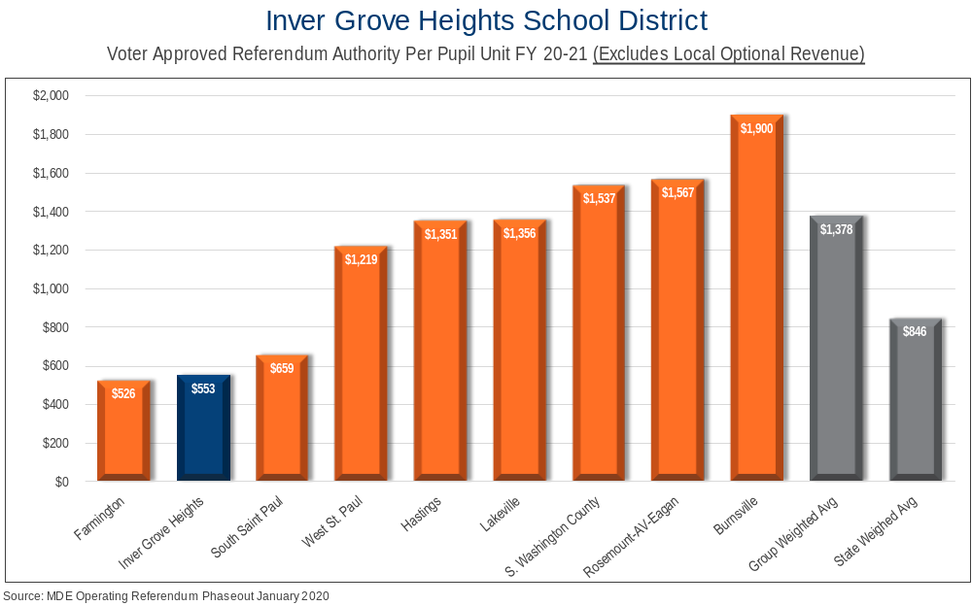

Slide 11
Change in Tax Levy does not Determine Change in Budget
Tax levy is based on many state-determined formulas plus voter approved referendums
1
Some increases in tax levies are revenue neutral, offset by reductions in state aid
2
Expenditure budget is limited by state-set revenue formulas, voter-approved levies, and fund balance
3
An increase in school taxes does not always correlate to an equal increase in budget
4

Slide 12
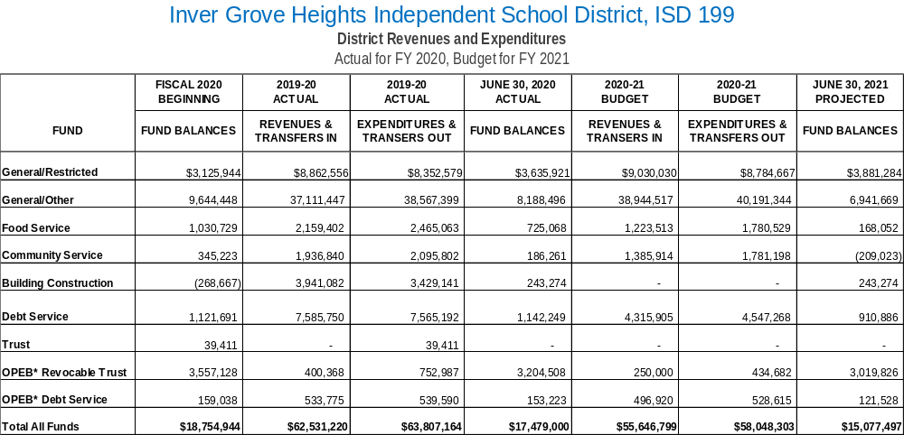

Slide 13
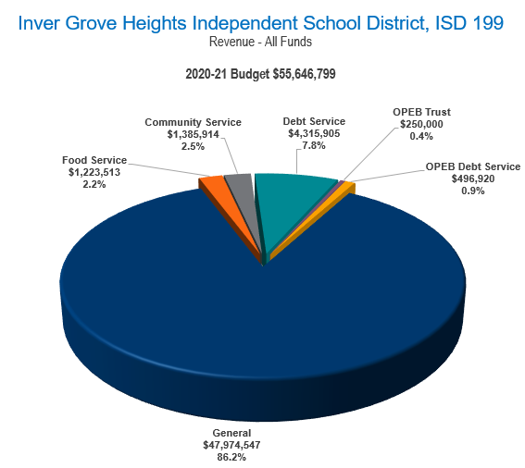

Slide 14
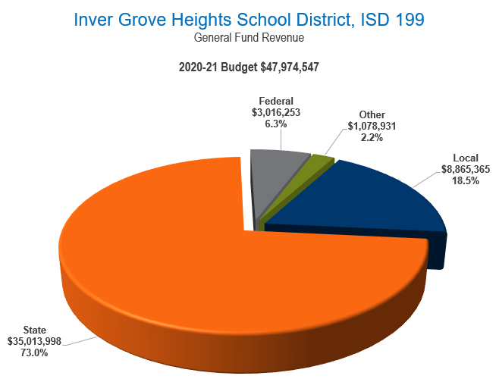

Slide 15
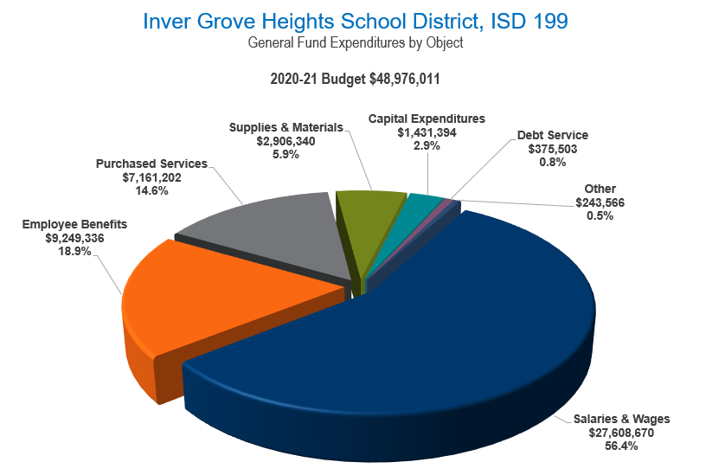

Slide 16
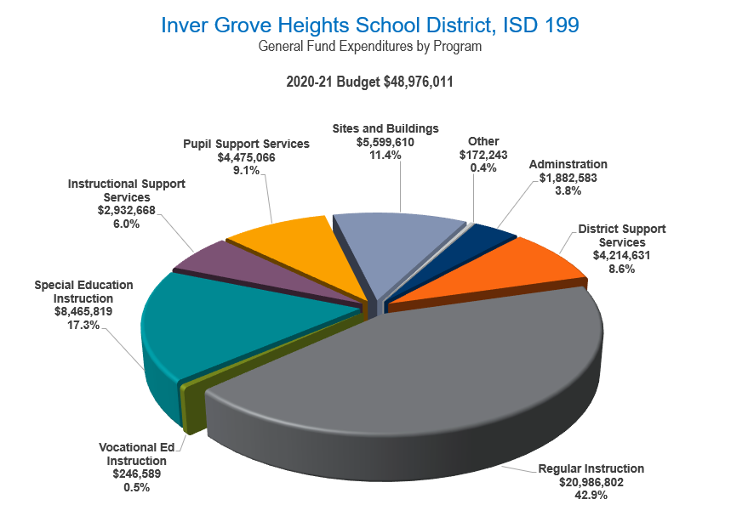

Slide 17
Payable 2021 Property Tax Levy
__________
Determination of levy
Comparison of 2020 to 2021 levies
Reasons for changes in tax levy
Impact on taxpayers

Slide 18
Property Tax Background
  Every owner of taxable property pays property taxes to various “taxing jurisdictions” (county, city/township, school district, special districts) in which property is located
  Each taxing jurisdiction sets own tax levy, often based on limits in state law
  County sends bills, collects taxes from property owners, and distributes funds back to other taxing jurisdictions

Slide 19
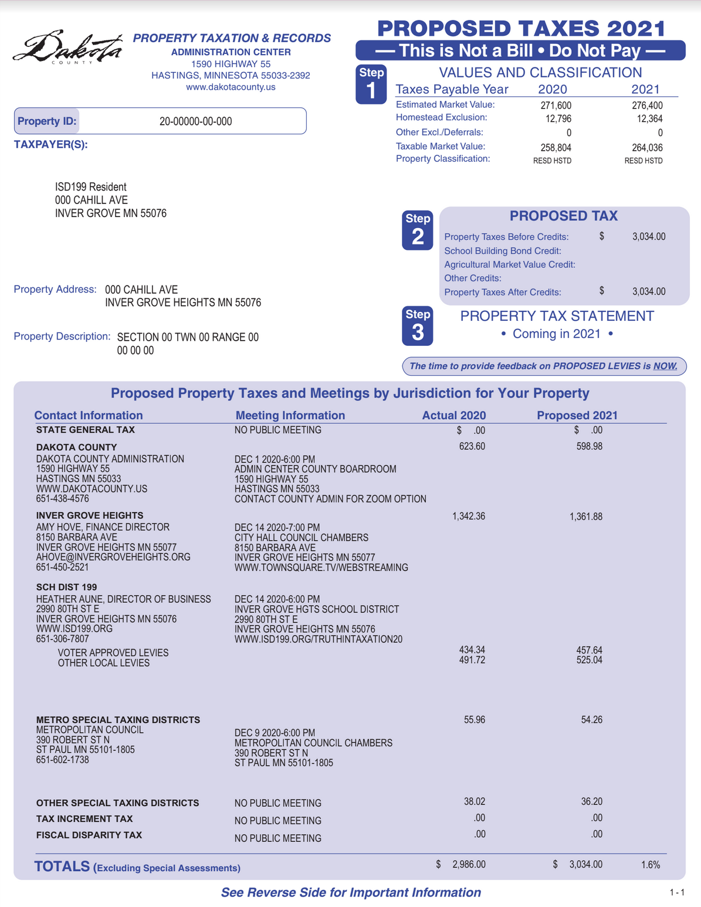
Sample of parcel specific notice mailed to every property owner between November 11 & November 24 with information on impact of Proposed 2021 levy
Contents:
Proposed property taxes compared to last year
By taxing jurisdiction
Contains time and place of public meetings
By voter approved and other for school district

Slide 20
School District Property Taxes
  Each school district may levy taxes in over 40 different categories
  Maximum levy amounts for each category are set by:
      State law
      Voter approval
Minnesota Department of Education (MDE) calculates levy maximums for each district

Slide 21
Overview of Proposed Levy
Payable in 2021
  Proposed property tax levy for 2021 is an increase from 2020 of $1,123,766 or 8.3%
  Reasons for major changes in levy are included on following slides

Slide 22
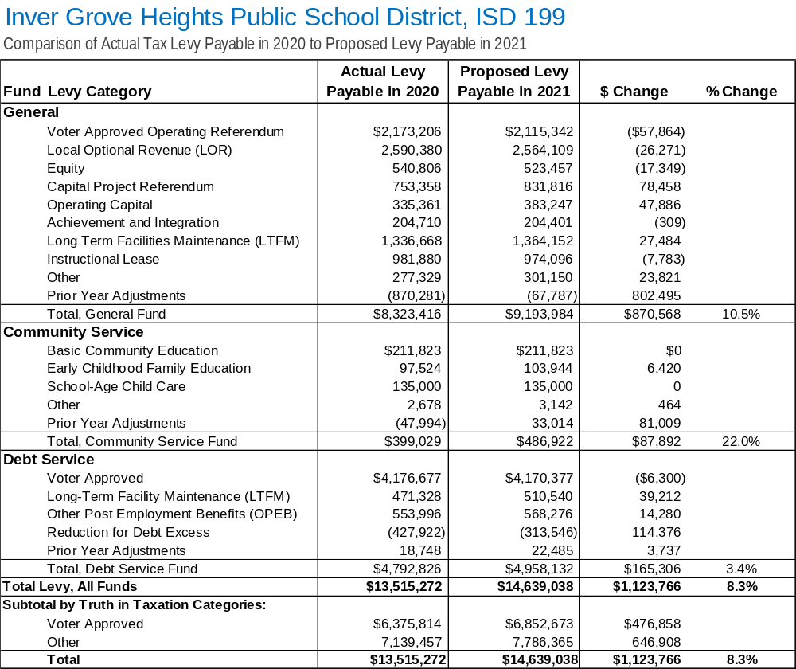

Slide 23
Explanation of Levy Changes
Category: General Fund – Prior Year Adjustments
Change: +$802,495
Use of Funds: General Operating Expenses
Reason for Change:
  Each year, initial levies are based on estimates of enrollment, values, and expenditures for future years
  In later years, estimates are updated, and levies are retroactively adjusted
  Adjustments in several categories for taxes payable in 2020 are larger negative amounts as compared to the adjustments for taxes payable in 2021

Slide 24
Explanation of Levy Changes
Category: Debt Service – Reduction for Debt Excess
Change: +$114,376
Use of Funds: Payments on Bonds
Reason for Change:
  Districts are required to levy at 105% of debt service payment amounts to cover delinquencies in tax collections
  Because delinquencies are generally less than 5%, most districts gradually build up fund balances in debt service funds
  Formulas in state law determine adjustments to tax levy for debt excess balances

Slide 25
Factors Impacting Individual
Taxpayers’ School Taxes
Many factors can cause tax bill for an individual property to increase or decrease from year to year
Changes in value of individual property
Changes in total value of all property in District
Increases or decreases in levy amounts caused by changes in state funding formulas, local needs and costs, voter-approved referendums, and other factors

Slide 26
Four Year School Levy Comparison
  Following slides show examples of changes in school district portion of property taxes from 2018 to 2021
  All examples are based on a 13.0% increase in property value over this four-year period
      Actual changes in value may be more or less than this for any parcel of property
      Intended to provide a fair representation of what happened to school district property taxes over this period for typical properties

Slide 27
Impact on Taxpayers
  For commercial-industrial property, examples are for property in City of Inver Grove Heights; school taxes in other parts of District may be slightly higher or lower due to variations in impact of Fiscal Disparities Program
  Amounts for 2021 are preliminary estimates, based on best available data – final amounts could change slightly
  Estimates prepared by Ehlers, District’s municipal financial advisors
Notes:
Use for out-state districts

Slide 28
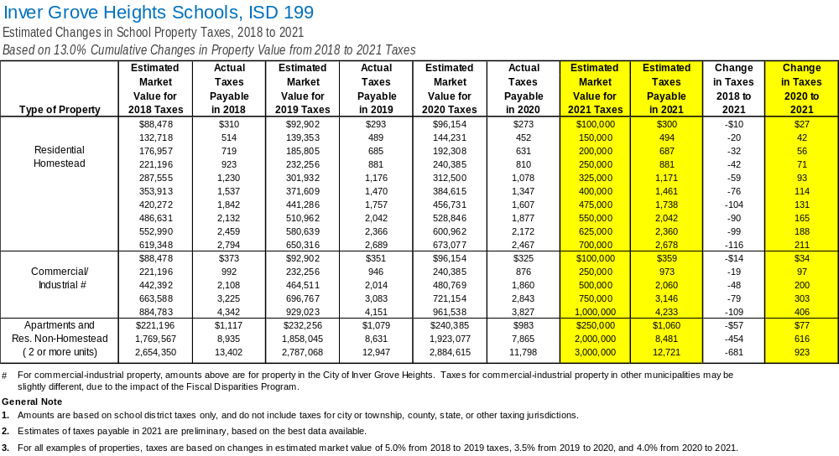

Slide 29
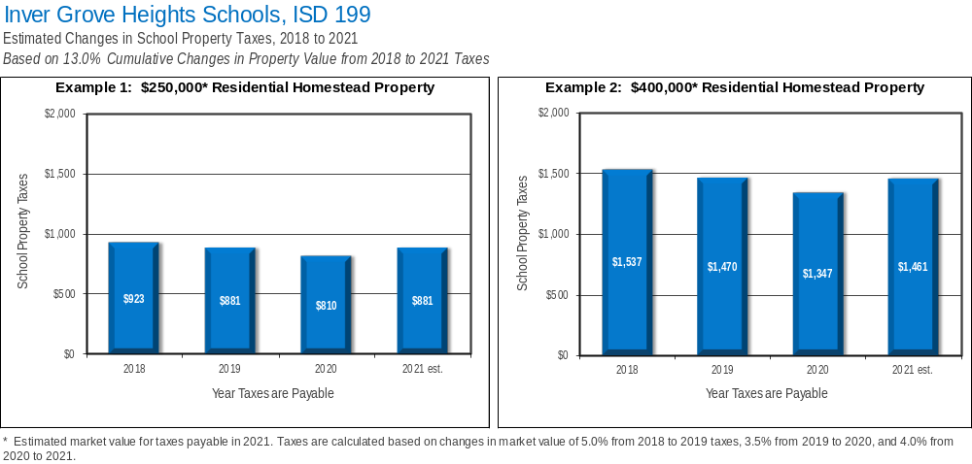

Slide 30
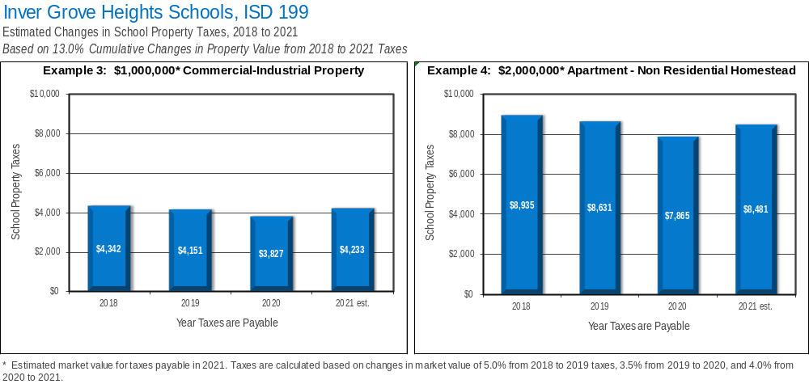

Slide 31
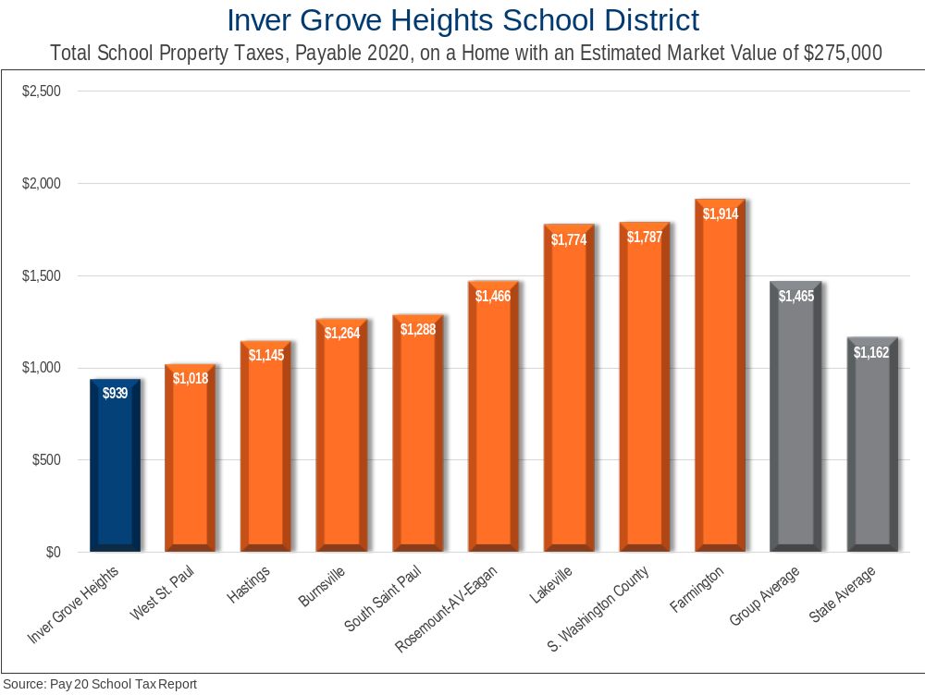

Slide 32
Next Steps
Board will accept public comments on proposed levy
1
Board will certify 2021 property tax levy
2

Slide 33
Public comments

