Slide 1

RESPECT FOR AUTHORITY

Slide 2

Definition:
Seguir las normas y expectativas de las personas a cargo.
Notes:
Districtwide definition

Slide 3
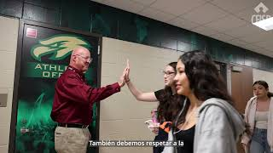
Insert the District Video Here
Notes:
Show district wide presentation

Slide 4

Respect for Authority
Looks Like: Maintaining an open and attentive posture.
Sounds Like: Appropriate volume, tone and pace of words.
Feels Like: A sense of security, stability and trust.
Notes:
Discuss what respect for authority looks like, sounds like, & feels like

Slide 5
Who Are Authority Figures?
  School staff
  Parents and guardians
  Law enforcement officers
  Coaches and mentors
  Employers and supervisors
Notes:
Discuss different authority figures; school staff - secretary, bus driver, custodian, administration, etc.

Slide 6
The Role of Authority Figures
Provide guidance and support
Ensure safety and order
Offer knowledge and resources
Enforce rules and laws
Build relationships
Notes:
Discuss the role of authority figures

Slide 7
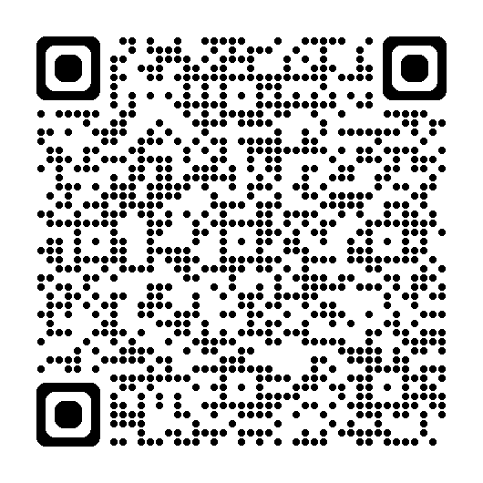
Quiz -
Students will use their phones to click on the QR code to complete the quiz.
Notes:
Teachers will discuss the answers to the quiz with the students.
Answer Key
True
False
True
True
True
False
True
True
False
False
True

Slide 8
Reflection:
Based on the quiz, reflect on how you can practice respectful responses and create/maintain positive relationships with people in authority.
To Go Activity:
Which area(s) are you going to work on?
“One of the most sincere forms of respect is
actually listening to what another has to say.”
Bryant H. McGill

