Slide 1
Pinnacle Card
(PCards)
Expense Reporting
By: Mrs. Quinette Bruno, CSFO
Dallas County School System

Slide 2
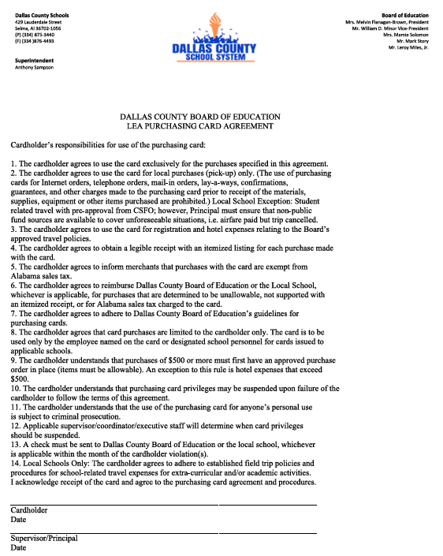

Slide 3
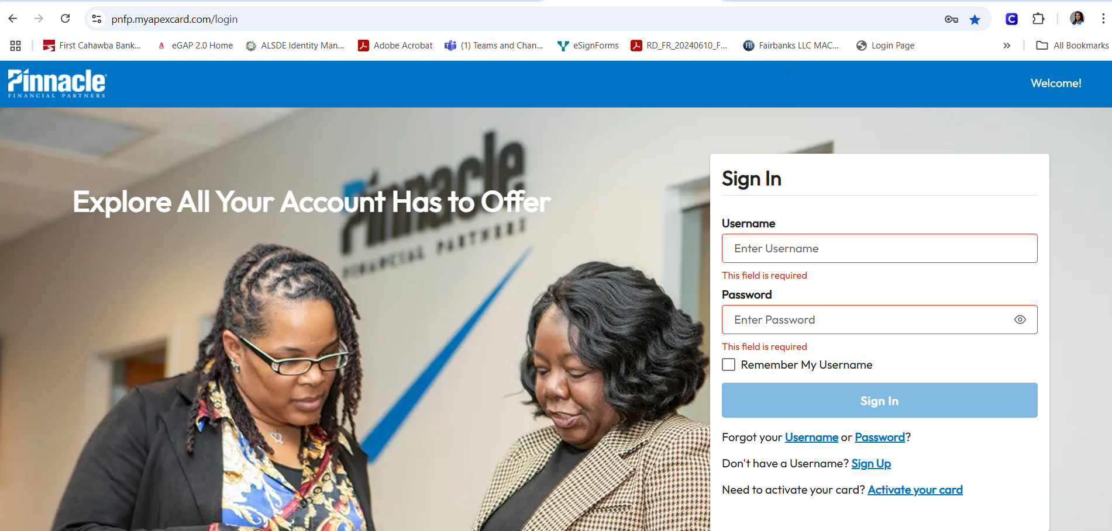

Slide 4
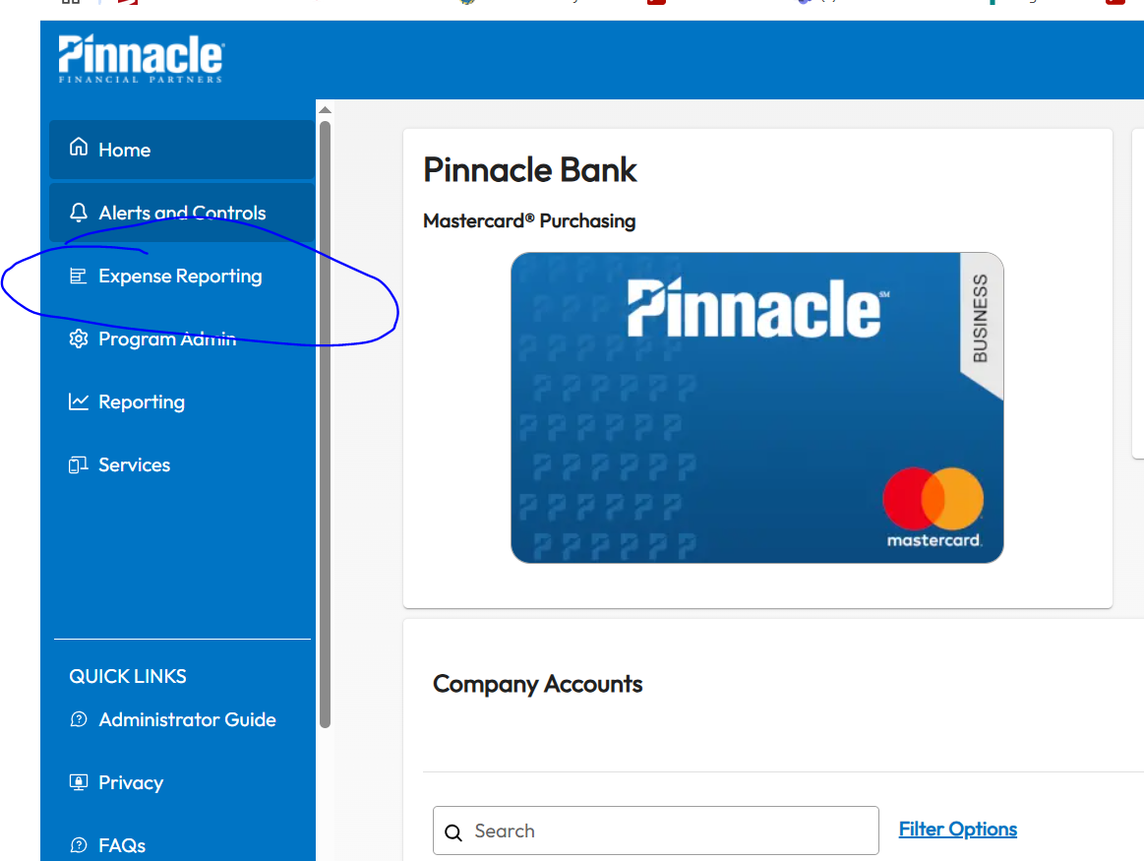
Click on Expense Reporting
Please note this will be available after the expense has taken place.
We are counting on you (Bookkeeper & Secretary) to work with the Principal to make sure this is done in a timely manner.

Slide 5
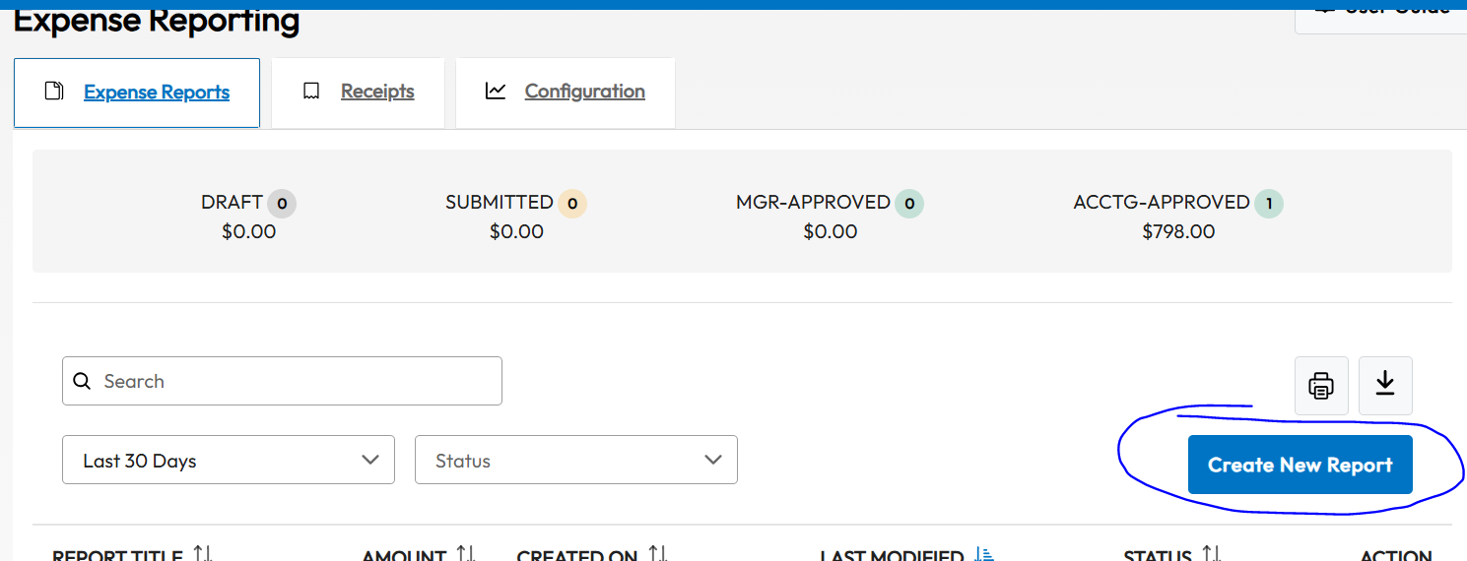
Click on Create New Report
Make sure you have a copy of all itemized detail receipts.
Know the funding source that will be used to pay.

Slide 6
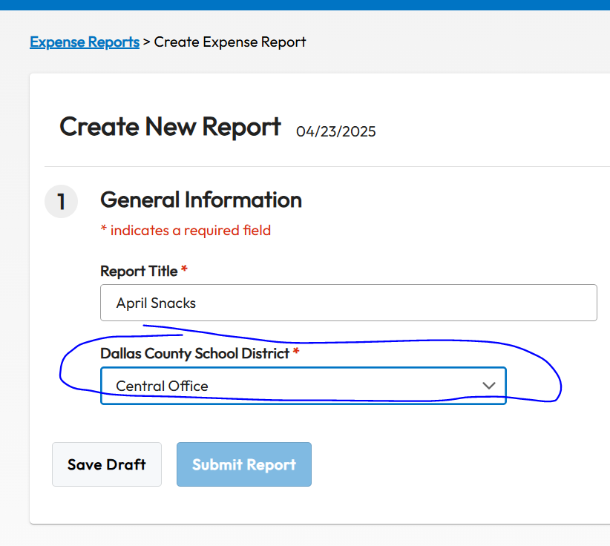
*Indicates a required field.
Report Title
Select your school
Save Draft

Slide 7
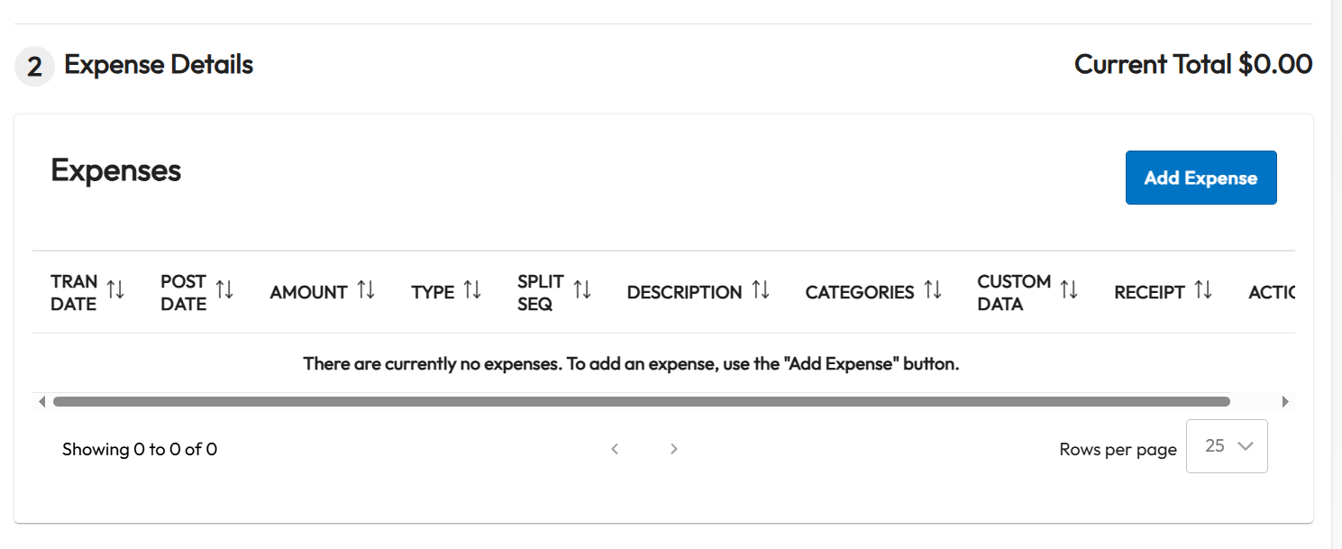
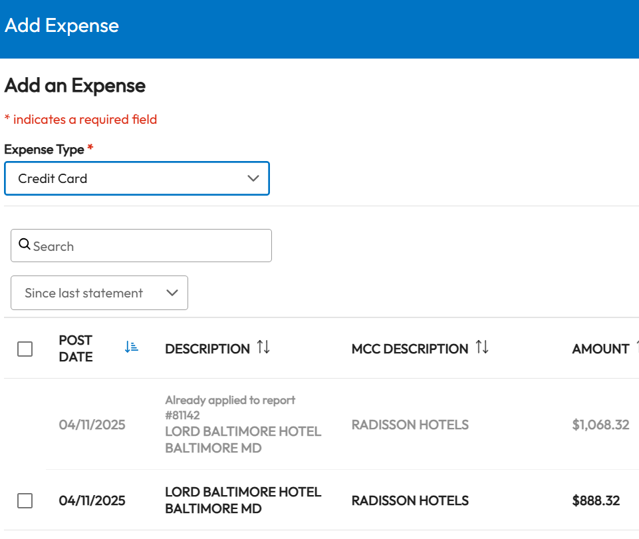
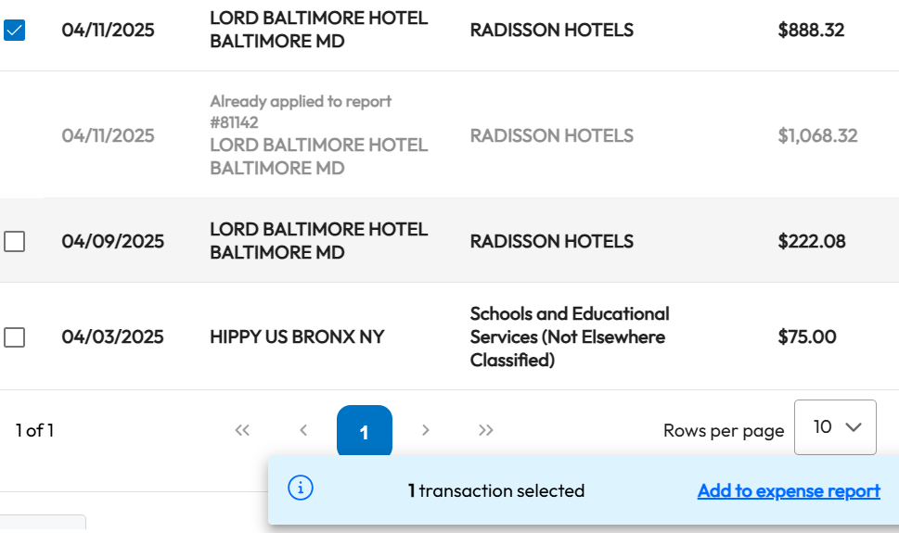
<<<<<<<<Click Add Expense

Slide 8
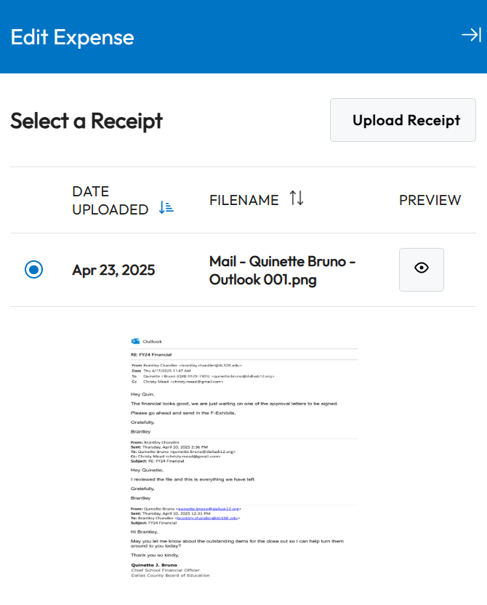
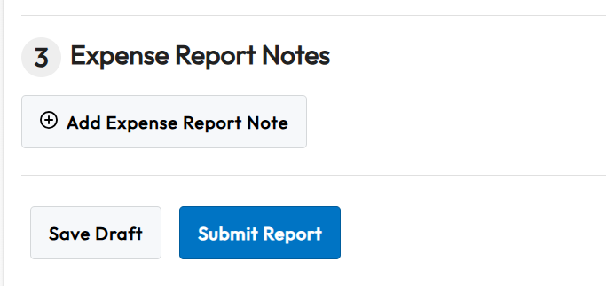
Here is where you can upload copies of receipts and add helpful notes.

Slide 9
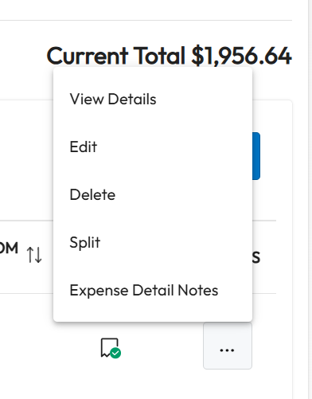
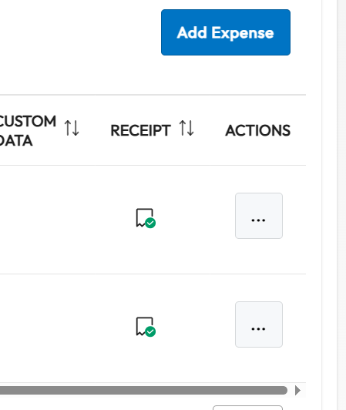
Once you have thoroughly documented the transactions. Scroll over and complete Actions... Click on (Edit)

Slide 10
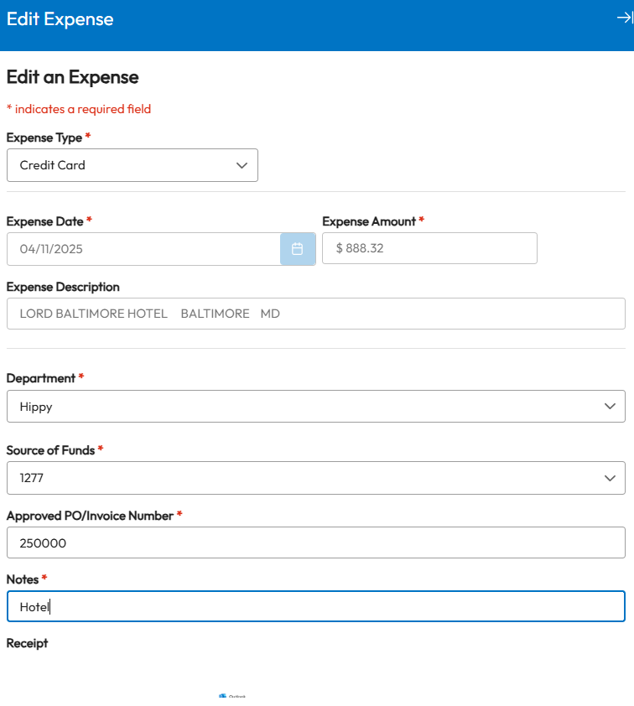
You can do this!!!
Very important to complete this properly for processing on the central office side. Follow policy and procedures before use of card.
Approved purchase order over $500
Use for monthly snacks, hotels, registration etc.
Always ask if your unsure!!!
We can work better if you can tell us how we can help you!

Slide 11

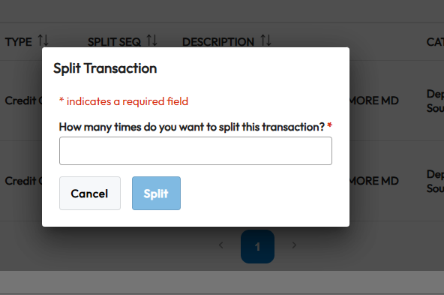
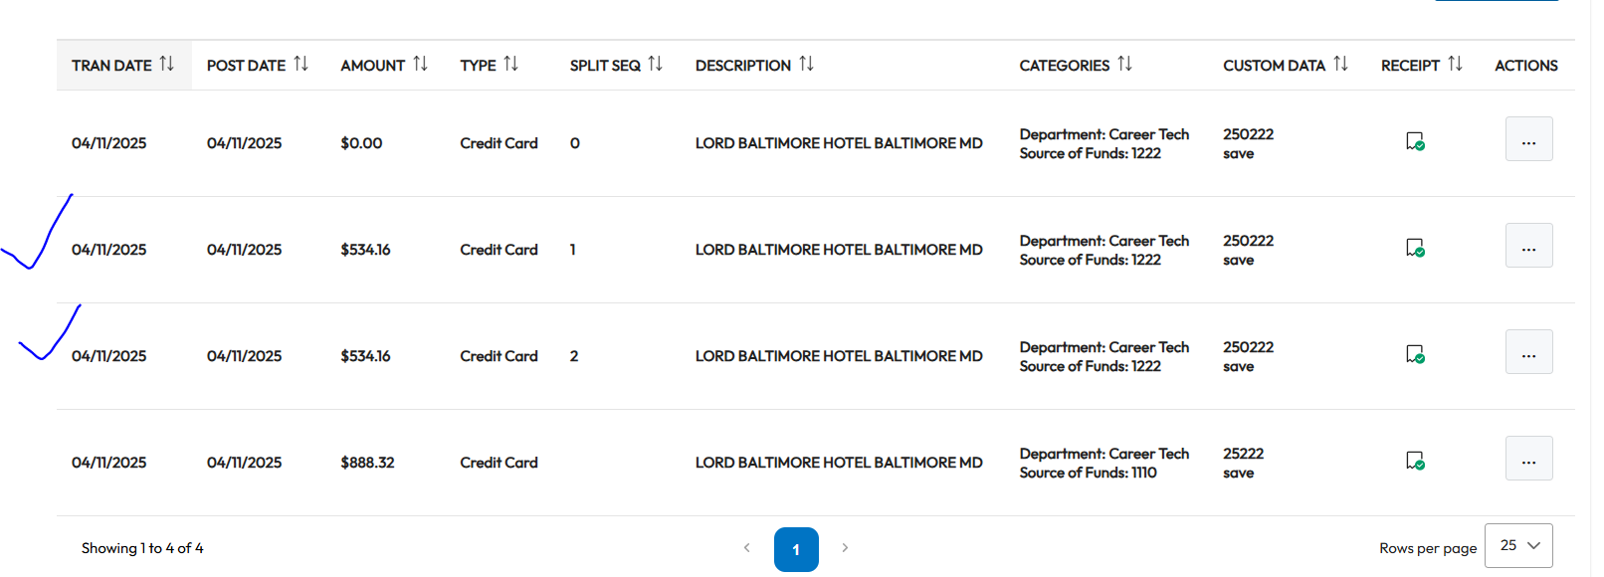
You can split the amount and code separately.

Slide 12
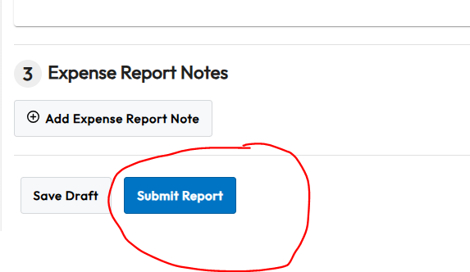
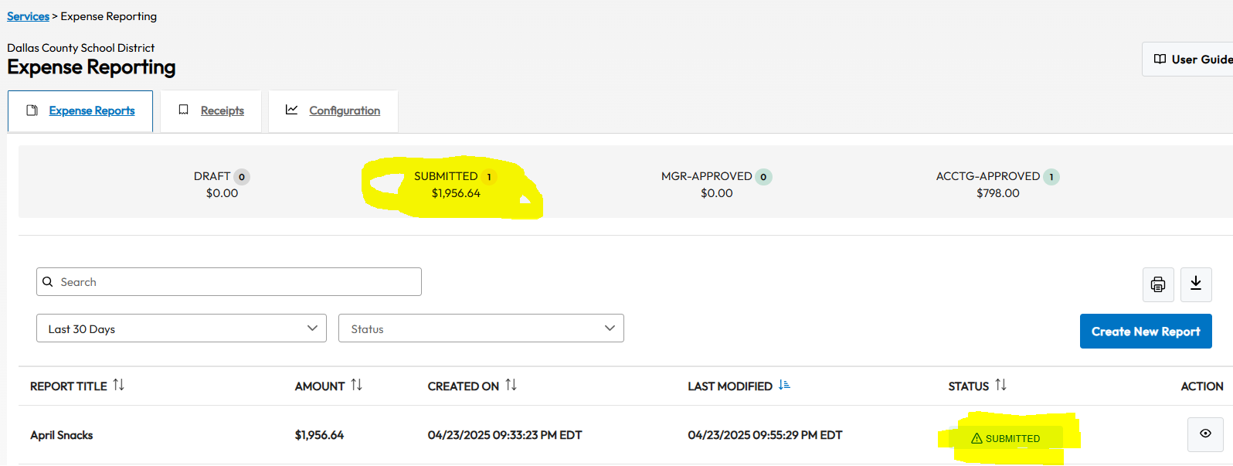
You have successfully completed the expense reporting. Follow your local school policy on issuing payment to the central office no later than the 20th of each month.
☺

Slide 13
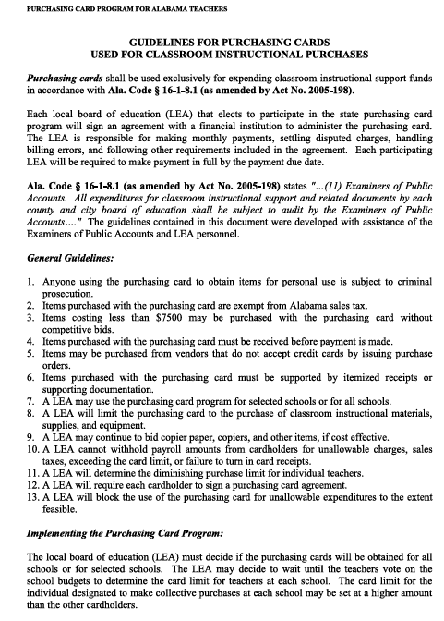
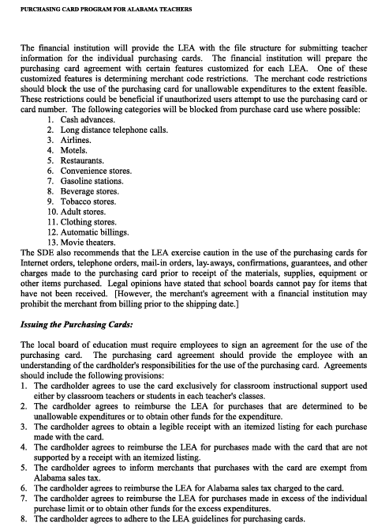
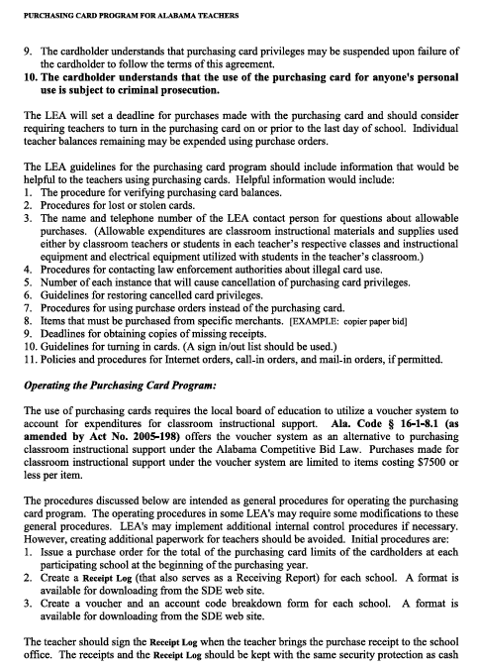
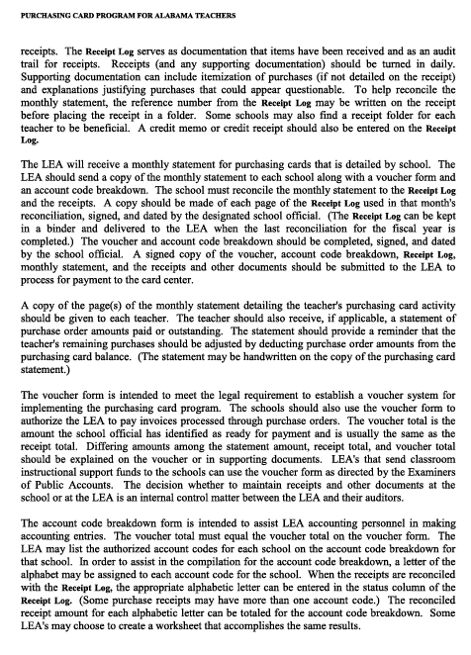
Purchasing Card Guidelines

Slide 14


