Slide 1

2025-2026 ROLLOVER Budget Presentation
APRIL 22, 2025

Slide 2


The budget development process:
Roll over current year budget and expenses
Predict Revenues: State Aid, Property Tax Cap, Fund Balances
Calculate employee salaries and benefit costs
Estimate other fixed costs
Review line-item expenditures (ongoing throughout process)
Evaluate existing programs and prioritizing program enhancements
Look for operational and programmatic efficiencies to create
savings and/or maximize State Aid or reimbursement revenues
Adjust revenue estimates when NY State Budget is passed
Balance expenditures and revenues

Slide 3
OUR CHANGING LANDSCAPE: creating our “new normal”
Foundation Aid Formula changes remain uncertain
    Governor’s Proposal represents a significant decrease in Foundation Aid
Lower reimbursement for “expensed-based” state aid categories
    Increased property values and average income in our district have lowered many of our state aid factors for reimbursement.
    This affects State Aid for areas such as: Transportation, Special Education and BOCES services.
In addition to the cost of inflation, the post-pandemic cost of services such
as Transportation and Special Education have increased significantly over
the past 3 – 4 years.
Although COVID-relief funds have ended, the increase in student needs
remain, requiring resources and strategies for continued support.
K-4 class sizes have decreased, calling for a strategic realignment.

Slide 4
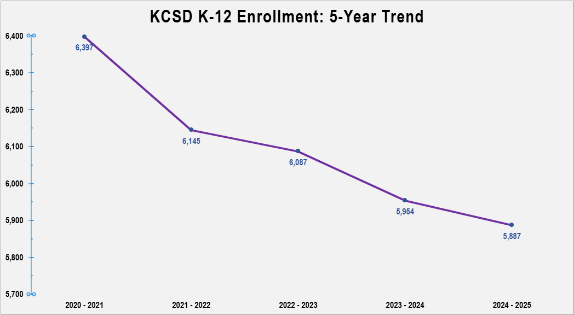
Declining enrollment:
Impacts state aid and class sizes

Slide 5
2025-26 PRELIMINARY revenueS major CHANGES
*STATE AID INCLUDES 2% MINUMUM INCREASE IN FOUNDATION AID
Tax Levy Increase (Not Maximum) $8,200,000
Reduction in PILOT Income ($ 700,000)
TOTAL REVENUE INCREASE $17,960,500
State Aid Increase* $5,314,500
Decrease in Interest & PILOT Income ($1,050,000)
**Allocation of Reserves (Additional) $5,546,000
Additional Medicaid Reimbursements $ 650,000
**Allocation net of smaller revenue decreases.

Slide 6
TAX CAP CALCULATION:
5 KEY FACTORS:
Current Year Tax Levy
Tax Base Growth Factor
CPI (Inflation)
PILOT Payments
Exclusions: Capital & Retirement

Slide 7
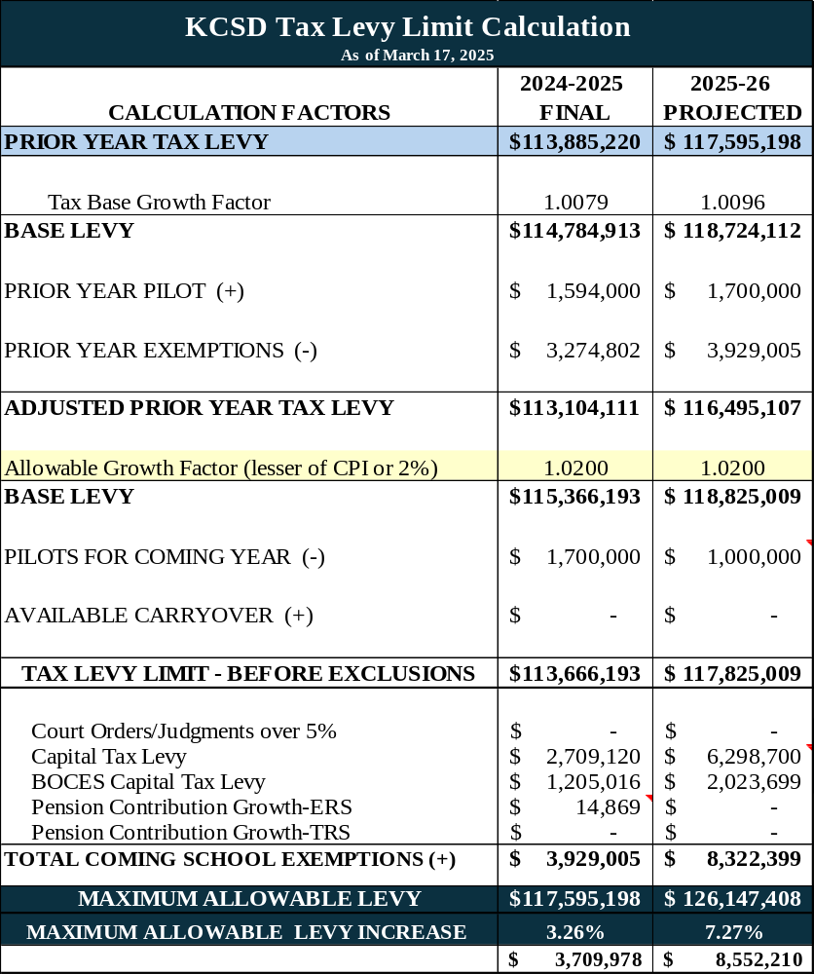
2025-2026
TAX LEVY LIMIT CALCULATION

Slide 8
REDUCTION IN FOUNDATION AID INCREASES: represents over 25% of kcsd revenues

Slide 9
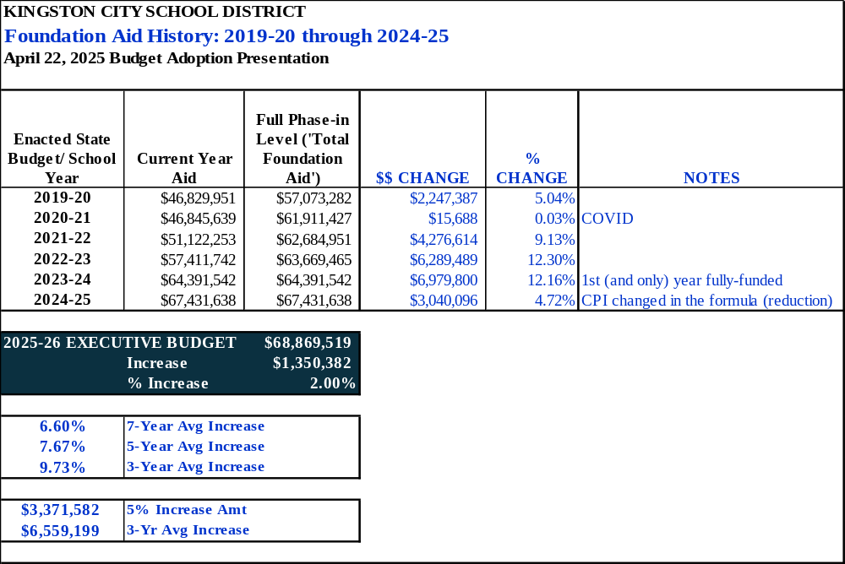

Slide 10
SHIFTING WEALTH MEASUREMENTS:
Impacts state aiD, REIMBURSEMENTS & GRANTS

Slide 11
2025-26 PRELIMINARY EXPENSES major CHANGES
Debt Service $3,191,600
Special Education $1,000,000
TOTAL EXPENSE INCREASE $17,960,500
Salaries & Benefits $6,599,800
Transportation $3,300,000
Other Contractual Expenses $2,069,100
BOCES Leases & Dietz Stadium $1,800,000

Slide 13
SHIFTING WEALTH MEASUREMENTS:
Impacts TO SPECIAL ED & TRANSPORTATION COSTS

Slide 14
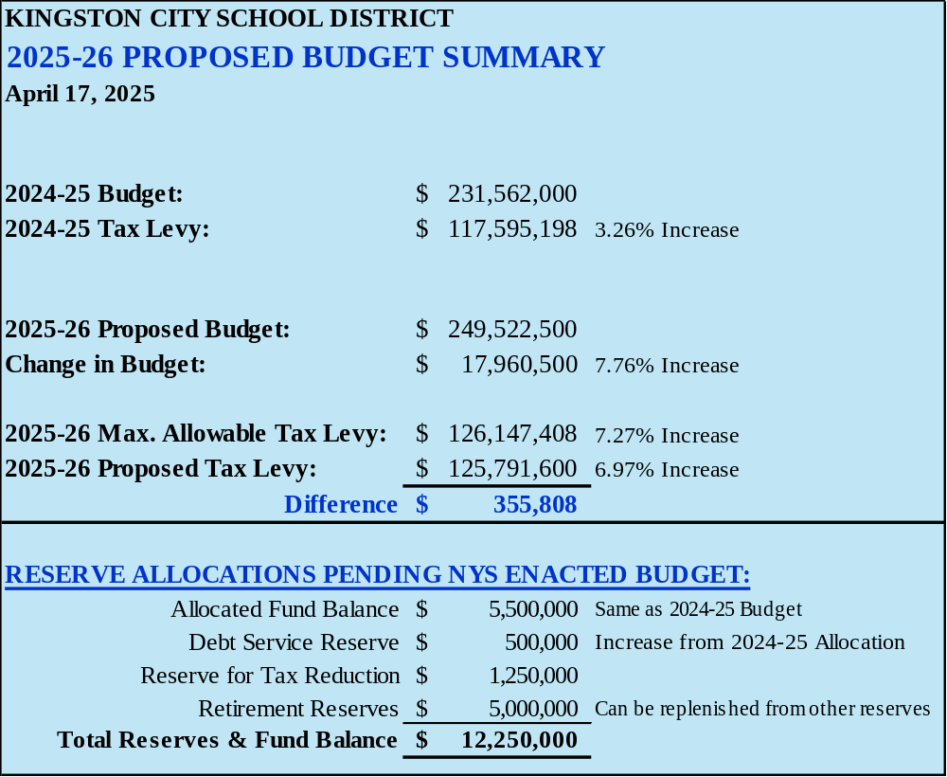
2025-2026 draft BUDGET summary

Slide 15
NEXT STEPS:
Continue to identify opportunities for strategic shifts for the 2025-26 School Year and plan for implementation.
Re-evaluate revenues and reserve allocations when the 2025-26 NYS Budget is passed.
Develop a new long-range financial plan for Kingston City School District, based on the new Foundation Aid Formula that will be enacted in the 2025-26 NYS Budget.
    Restructuring of the NYS Foundation Aid formula was announced immediately after the 2024-25 NYS Budget was passed.
    An effective financial plan for KCSD could not be developed without knowing what the impact of those changes would be.

Slide 16

Thank you!!!

