Slide 1
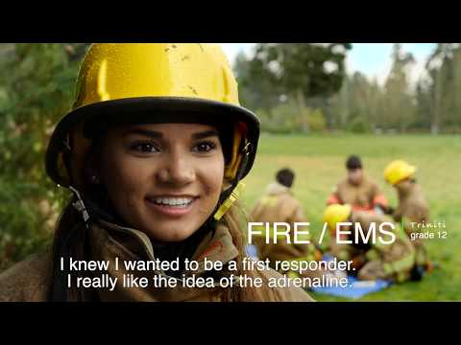
Personal Connections and Student Voices
Notes:
4 minute, 17 second length VIDEO
VIDEO = translation > CLOSE CAPTION > Selected LANGUAGE
Play at BEGINNING of SESSION
As PREVIEW / ‘COMMERCIAL’
Viewed as PARTICIPANTS are ARRIVING into the MEETING
WELCOME everyone as the VIDEO concludes

Slide 2


Washington Network for Innovative Careers
Overview of 2025-26 program opportunities for students in grades 11 and 12
Presentation to Issaquah School District
March 25, 2025
Notes:
WANIC Skill Center=Washington Network for Innovative Careers

Slide 3
AGENDA
PRESENTERS
  Introduction
  Why WANIC?
  Eligibility
  Expectations
  Considerations
  Costs & Financial Assistance
  Support Services
  Programs
  Registration
Jess Hall, ISD CTE Post-High School Pathways Specialist
Lorna Gilmour, ISD Equity & Family Partnership Specialist

Slide 4
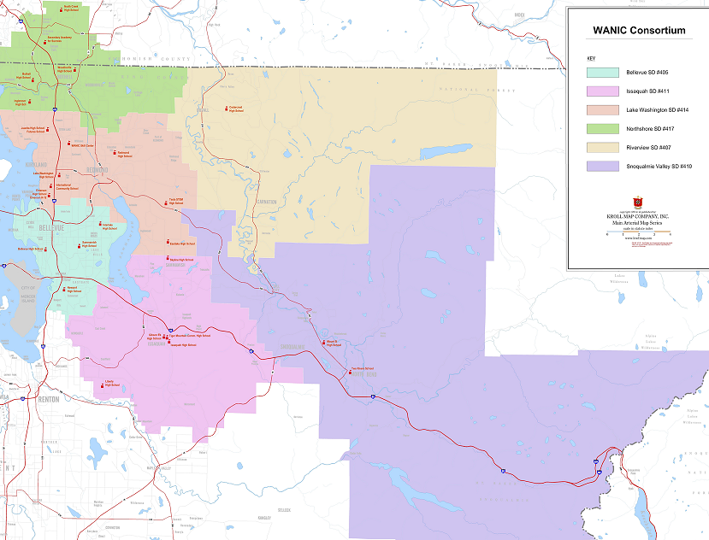
NSD/Woodinville HS
Health Science Careers (Nursing)
Locations of WANIC programs
NSD/Bothell HS
Automotive Technology I and II
Baking & Pastry
Building Industry Tech Core Plus
Academic Year Programs
BSD/Interlake HS
Building Industry Tech Core Plus
Maritime Welding Core Plus
WANIC @ LWTech
Aviation Technology - STEM
Dental Careers
Fire & EMS I and II
Health Science Careers (Nursing)
Medical Careers
NEW
BSD/Bellevue HS
Automotive Technology I and II
BSD/Sammamish HS
Health Science Careers (Nursing)
DigiPen
Art & Animation I and II
Game Design
Music & Sound Design I and II
Video Game Programming I and II
BSD/Newport HS
Cisco Networking I and II
Culinary Arts I and II
ISD/Issaquah HS
Sports Medicine
ISD/Liberty HS
Aerospace Manuf. Core Plus
NOTE: WANIC ≠ LWTech
NEW
Notes:
Kari
21 Academic Year skill center programs are located in 9 locations– these are the 4 ‘Receiving districts and schools’ of the WANIC Consortium.
NORTHSHORE:
We have programs at Woodinville High School and Bothell High School in Northshore School District.
New for 2023-24, we are adding a CorePlus Construction skill center program at Bothell HS.
BELLEVUE:
programs at Interlake, Bellevue, Sammamish, and Newport High Schools.
ISSAQUAH:
one program at Issaquah High School.
LAKE WASHINGTON SCHOOL DISTRICT: we have programs at two sites:
WANIC main campus at Lake Washington Institute of Technology (aka: LWTech) in Kirkland and
WANIC DigiPen campus at DigiPen Institute of Technology in Redmond. ¤
These WANIC and DigiPen programs are the ones we spend most of our time on. We manage and report on the enrollment of ALL the Skill Center programs throughout the consortium, but our day-to-day time and energies are mostly focused on these WANIC-managed programs. We get to know these students very well, and we monitor their attendance and grades and other issues that happen in the classroom.
NEW PROGRAMS for 2023-24
Aviation Technology, a new and exciting STEM program
ISB Systems Medicine program, partnered with Institute of Systems Biology in Seattle
DigiPen Data Analytics -although we offered the class last year, we did not get enough applicants to run it. We hope to run it this year, in this growing field with excellent career prospects.

Slide 5
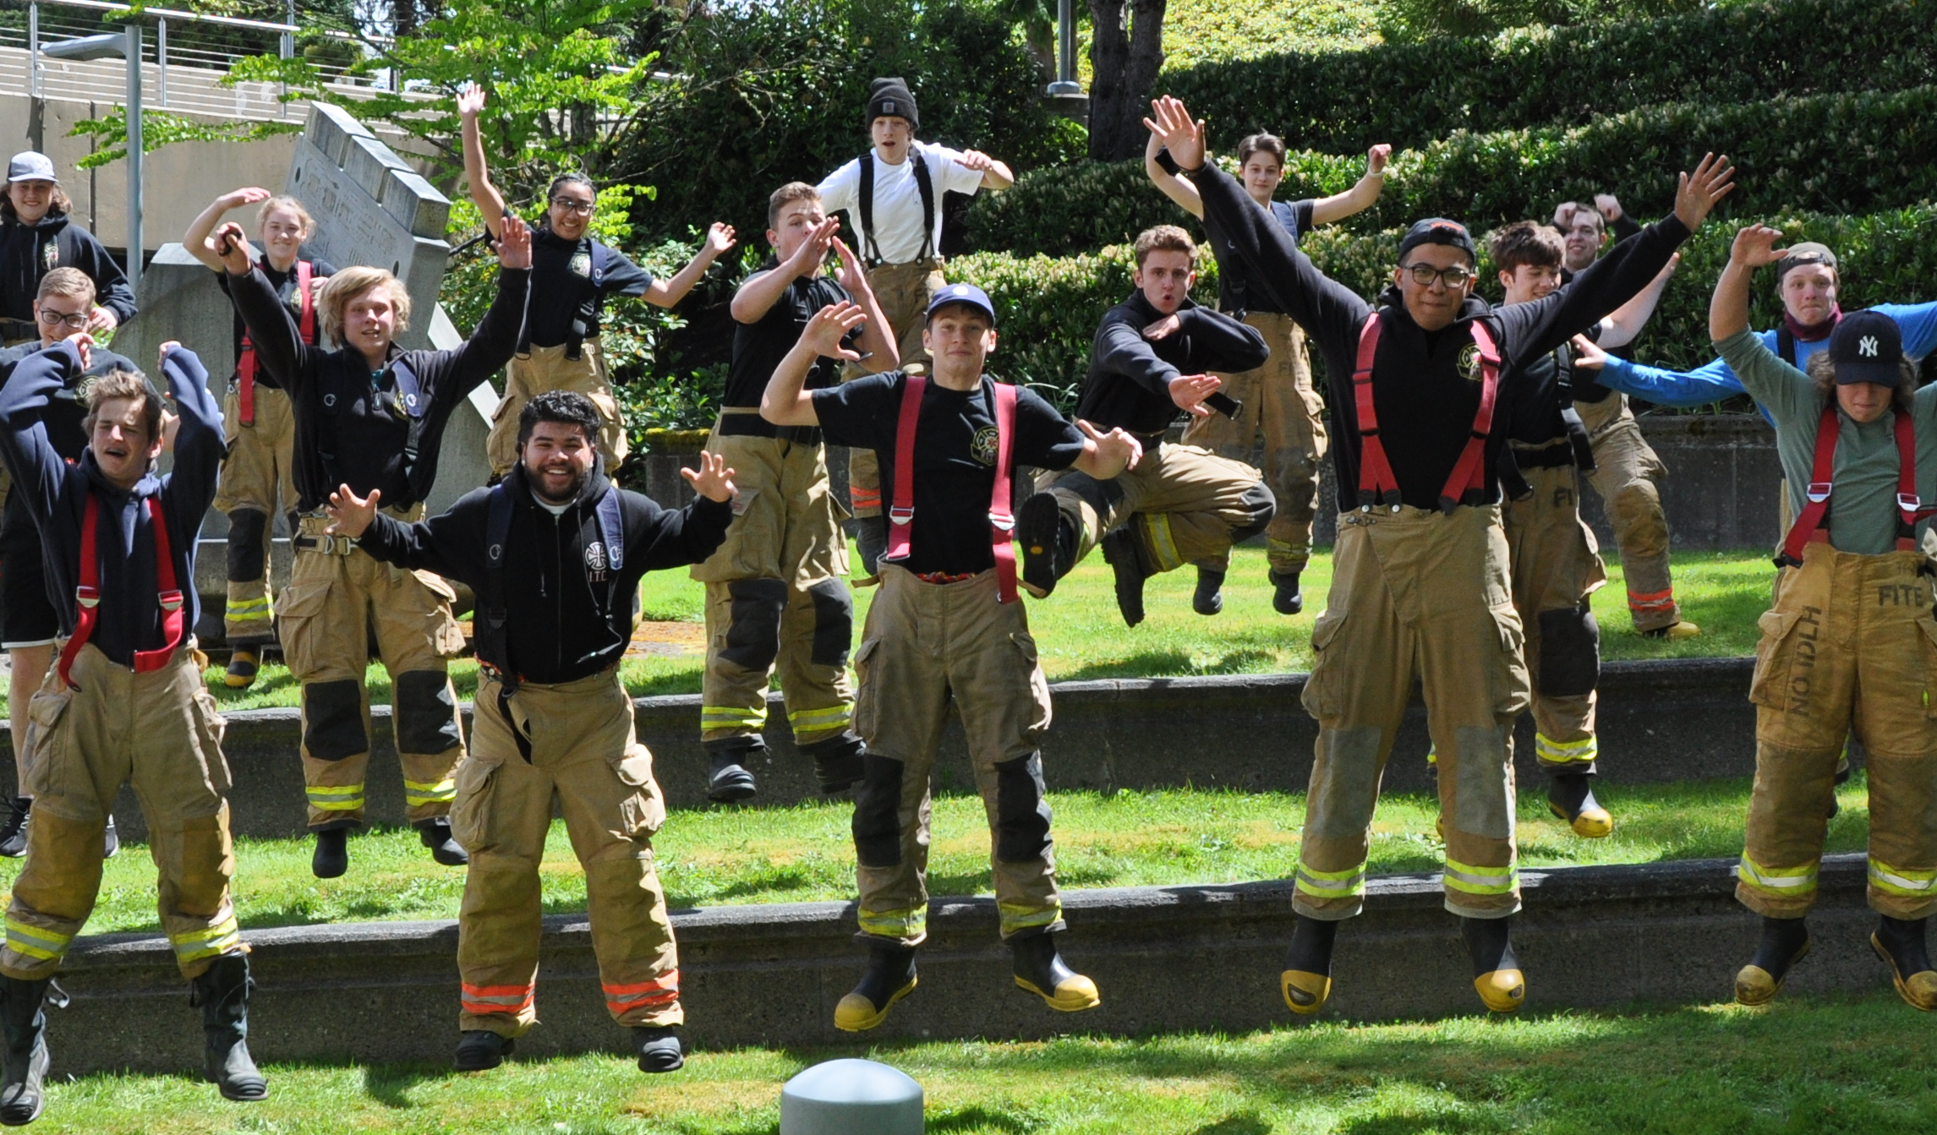
What’s in it for Students?
Career pathway experience
Preparation Employment and College
Advanced skills training
State-of-the-art equipment
CTE graduation pathway fulfilled
Earn college credit and/or industry certifications
Options to continue in 2-year and 4-year colleges
Student leadership opportunities
Experienced instructors
Notes:
Steve
What do students gain by participating in a WANIC Skill Center program?
students have extended learning time each day in the equivalent of 3 class periods (2.5 hours class session )
gaining experience on a career pathway while in high school,
prepare for possible employment in a specialized field of interest and practice advanced, hands-on skills, valuable for preparing them for their post-high school plans.
Our programs have high quality equipment and industry-standard lab and teaching space to support student learning with real-world, hands-on training
In the majority of WANIC programs, students can earn and apply for college credit or industry specific certifications.
Career Pathways allow Students the option to continue toward 2-year and 4-year college programs beyond high school graduation
And finally, many of the WANIC classes offer opportunities to participate in leadership programs
Instructors- experienced in their fields and supported by Advisory Committees with current industry professionals, to ensure student learning is relevant and up-to-date with college and industry demands.
CTE Graduation Pathways: students who take at least 2.0 credits in same pathway (aka: singe 3.0 class) fulfills

Slide 6
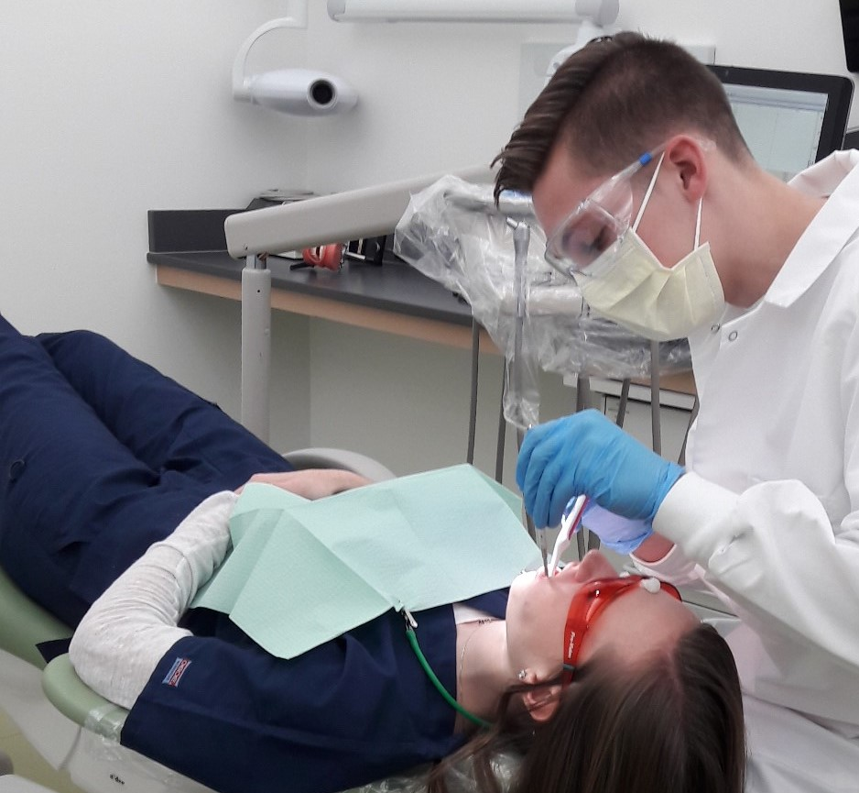
Eligibility Requirements for WANIC applicants
Registered at Gibson Ek, Issaquah HS, Liberty HS, or Skyline HS
Junior or Senior standing *
Approval from Career Specialist
On track to graduate at home high school
Some programs require an information session
Must provide your own, reliable transportation
*10th grade students may be considered for some programs
Notes:
Steve
In order to be eligible for a WANIC Skill Center program students will need to be
registered at one of the high schools in the WANIC consortium, and
entering into 11th or 12th grade next school year.
The sending school Career Specialists have to approve the application and
student must be on track to graduate.
If a student needs to remain at their high school to earn specific credits for graduation, the Career Specialist may have the student hold off their WANIC enrollment for a year. Or they may determine it’s not the best fit for them.
Students who are interested in WANIC are encouraged to speak with their Career Specialists as soon as possible to see if they are well positioned for WANIC.
Some programs require Information Sessions and some have pre-requisites. ( more detailed on individual program slides – in this powerpoint)
Skill Center programs offered in the Northshore, Bellevue and Issaquah school districts have a priority enrollment date of April 15th. If students are interested in any of these programs, they must be sure to apply well before this date to allow their Career Specialist time to approve the application and to give themselves the best chance to get in.
Students are responsible for providing their own reliable means to get to and from the WANIC program.
Note that, although Skill Center programs are designed primarily for upperclassmen, some programs may consider students who are entering 10th grade next school year. We handle those on a case-by-case basis.
Remember, the approval comes from the sending high school.
2/1/23 – Nikki email summary:
Based on input from Receiving Schools/Programs, we have set up SchoolMint so that some programs will not be available on the application if the students is entering 10th grade in Fall 2023.
These programs will not allow a rising-10th grader to apply:
Any Year 2 program
Baking & Pastry at Bothell
Building Tech at Bothell only
Nursing at all locations
ISB Sys Med at WANIC
All other programs will allow a rising-10th grader to apply. That’s not to say they’ll be approved … that will depend on the sending schools.

Slide 7

Course Expectations for success
Complete daily homework/assignments
Turn in all assignments on time
Read and comprehend technical texts
Practice technical writing
Demonstrate hands-on skills
Work independently and in teams
*see Course Expectations Guide
on website (wanic.org)
Notes:
Steve
EXPECTATIONS
We want all our students to be successful. To get the most out of the program, to pass, and to gain the competencies expected of them, students must be able to commit to the following:
Attendance: The single biggest predictor of success is attendance. We expect students to show up. On time. Every day.
Work completion: There will be daily activities and assignments, which they will be expected to turn in on time.
college-level reading and technical writing assignments.
hands-on skills: demonstrate acquired hands-on practice
In all classes, students can expect there to be a mix of independent and group work.
We have created a document – WANIC Course Expectations Guide - to clearly outline expectations in each program. This can be found on our website under FULL YEAR COURSES and Additional Course Info
* Linked in final slide of RESOURCES: https://wanic.lwsd.org/academics/course-catalog/course-expectations

Slide 8
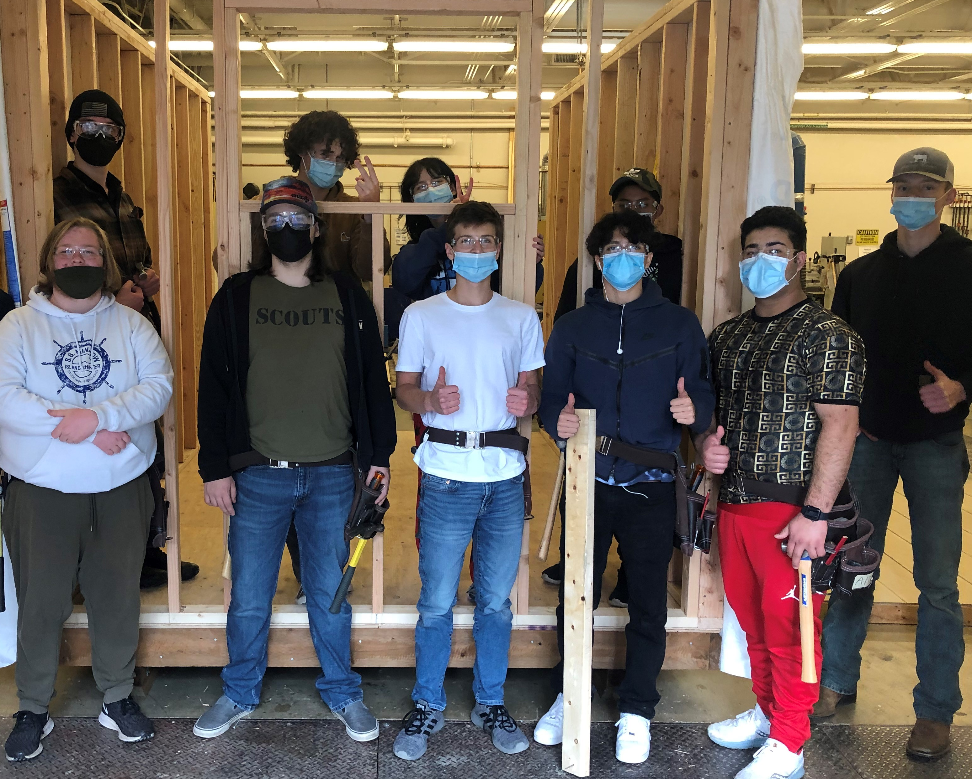
Schedule and Time Considerations
Time needed to get to program.
  Consider: transportation, travel time, after school activities, family commitments, work
Half the school day spent in a different location than home high school
  Consideration to class schedule at the high school
Commitment – full year programs
Follow calendar and schedules of the school the course is in – often different than home high school and Running Start
WANIC is NOT a Running Start program
Notes:
Steve
IMPORTANT CONSIDERATIONS
Student will spend half the school day in a location other than their home high school. For some students, the change of scenery is welcome. For other students, changing locations partway through the day may be unsettling and they may find it difficult to switch gears and shift focus. Students should think about what will fit them best.
daily commute between schools takes planning and maturity to keep up with all classes at two locations
Students need to maintain the commitment to show up to class every day, even if it starts early or ends late.
They should consider all aspects of their busy lives such as how they're going to get to and from the program, how long it takes, and what other activities they have going on.
If they're enrolled in a program that’s not in their school district, they’ll need to be able to navigate two district calendars and two school schedules.
Students are expected to follow the school district calendar reflecting the location of the WANIC class. Some dates, such as Spring Break, could be different than district of student’s home high school.
WANIC is not Running Start. Although the WANIC campus is located on the LWTech campus, we are not directly affiliated with the college. If students enroll in a WANIC program, they become enrolled in the school district of that program – they do not become enrolled in LWTech or DigiPen Institute of Technology
If students are planning to take a WANIC program as well as Running Start classes, they should check their schedules for the whole year and avoid schedule conflicts.

Slide 9

Attendance
Show up to every class - attendance is critical!
Can be a big challenge for many students due to transportation and distance of some programs.
Absences have significant impact!
Just Show Up!
Notes:
Barb
We cannot stress enough, the importance of attendance.
Students who show up for class, on time, every day… are the students who will get the most out of their WANIC program.
If their goal is to get great grades and to get the most practical, transferable skills out of the program, the best way to do this is to JUST SHOW UP.
Missing one day at WANIC is equivalent to missing three days of a regular high school class. Absences add up fast!
It is quite difficult to catch up missed work after an absence, especially hands-on skills. When students join WANIC, they join the commitment to make attendance a priority. Of course, some absences are unavoidable and we’ll work with students if that’s the case. But whenever possible, students should do themselves a favor and JUST SHOW UP.
REMINDER: Have a Transportation ‘Plan A’ and ‘Plan B’…even ‘Plan C’ to get to class daily!

Slide 10
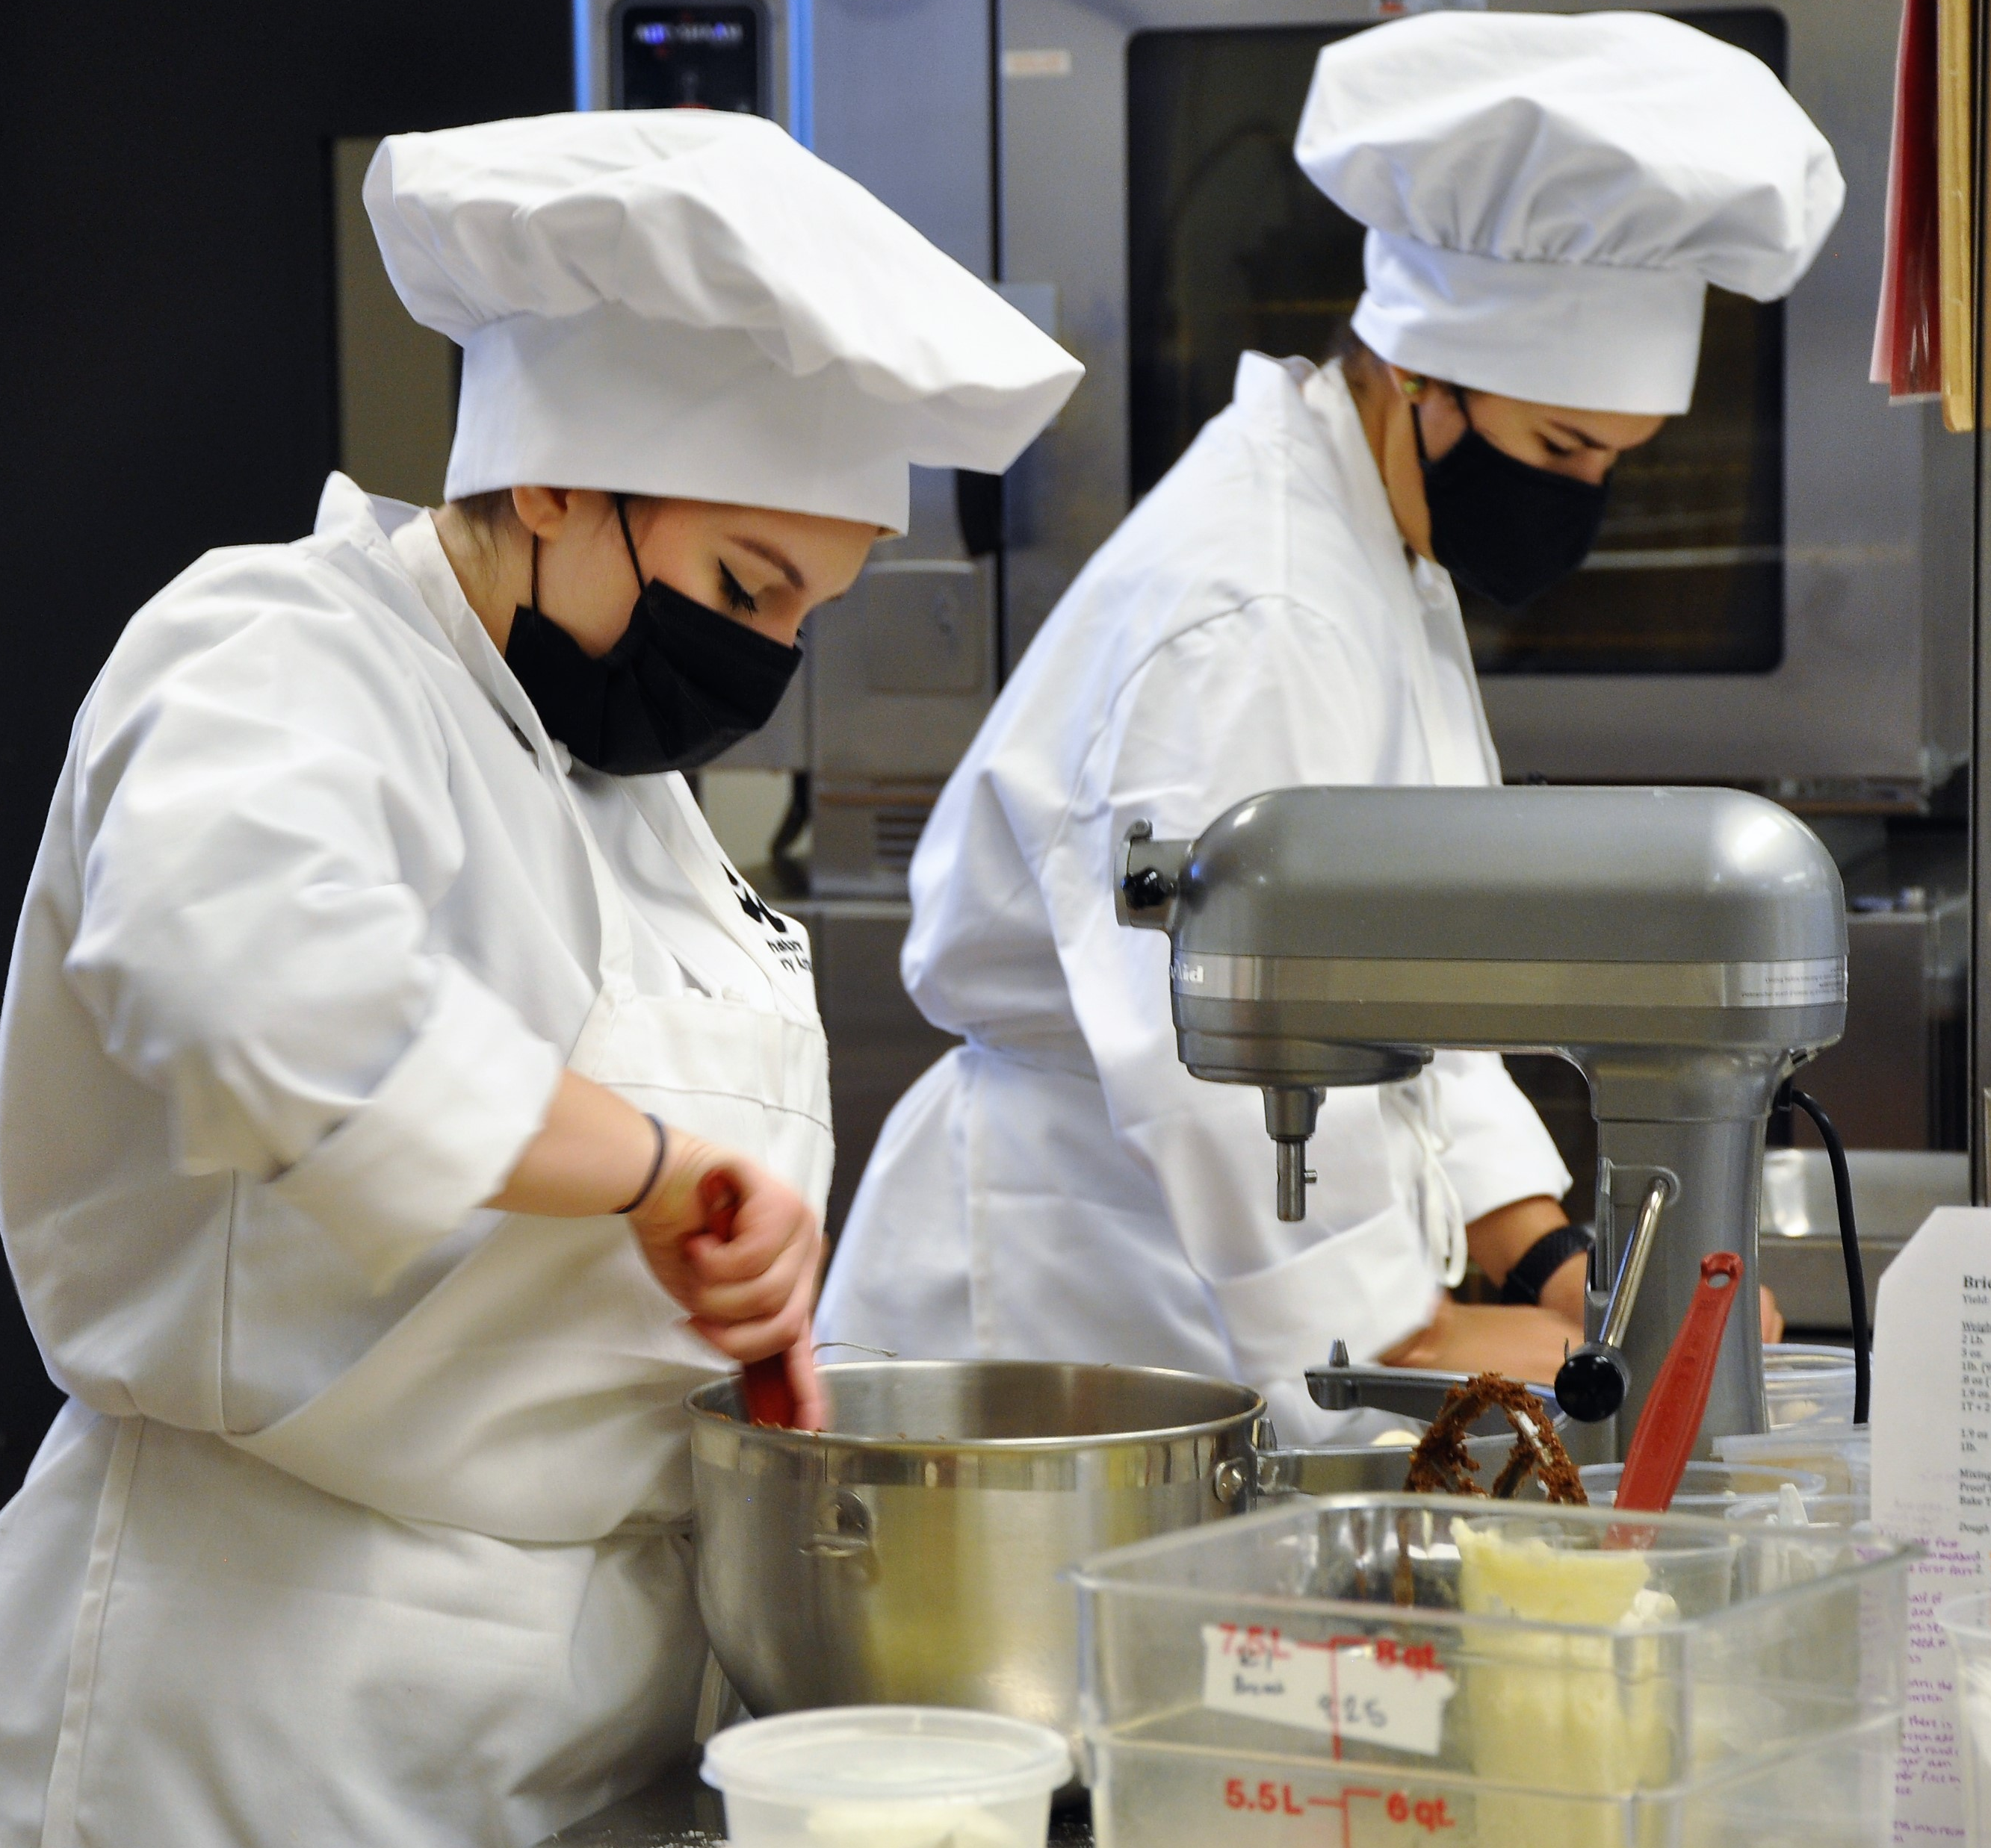

WANIC Cost
Courses are FREE!
Some courses/programs may have supplies/materials fees
Any student in any Skill Center program may qualify for assistance if one or more of these apply:
  Student receives Free/Reduced lunch at sending school
  Family qualifies for another state-funded program
  School Counselor confirms family has financial need
Notes:
Barb
WANIC Skill Center is publicly funded so tuition is free.
Some programs may have a class fee to cover materials or supplies.
If a family has a financial need, we do have what we call “Barrier Reduction Funds” to help cover the cost of class fees and/or transportation.
Eligibility for Barrier Reduction Fund assistance:
Student receives Free and/or Reduced Lunch at the sending school
Family qualifies for other state-funded program
School Counselor can confirm family has financial need

Slide 11


Financial Assistance
If eligible for financial assistance, ‘Barrier Reduction Funds’ can cover costs such as:
  Class fees if applicable (BR funds do not cover optional supplies)
  Required uniform costs
  Gas card or ORCA bus pass (ORCA free if under 18 years)
  Other items may be fully/partially covered
Notes:
Barb
Fees and Financial Assistance continued:
If a family has a financial need, we do have what we call “Barrier Reduction Funds” to help cover the cost of class fees and/or transportation

Slide 12
Support Services at WANIC
WANIC partners with the student’s support team from the sending high school to ensure a good fit and the program expectations are clear prior to enrollment.
  IEP (Individual Education Plan) Special Education
  504 Accommodation Plans
  MLL/ELL=Multilingual Learner/English Language Learner
Parents/Families: Connect with your school's support team (IEP case managers and counselors) if interested in WANIC programs.
Notes:
Barb Beck, Special Services Program Coordinator
If your student has IEP or 504 supports, you’ll want to connect with student’s Case Manager at the high school to review the WANIC expectations and consider if best fit for student’s Transition Plan.
MLL - Multilingual Learning
If student is significantly challenged to access the Skill Center curriculum and learning, it will be responsibility of the ‘Sending School District/ High School’ to provide any additional MLL supports
If you have any students who have an IEP or 504 accommodations or who will be participating in your district’s Transitional Academy, please reach out to Barb as early as possible – ideally BEFORE students submit applications and certainly before they are being considered for enrollment.
Barb can work with you to determine if WANIC is the best fit for your student. It is not always the case.
With early communications with Barb, we can work to have a plan in place for all the necessary and appropriate supports to be available for these students.
An early and ongoing relationship between the student, parent/guardians, counselor, case manager, Barb and the whole support team is so important to set each student up for success.
This year, part of the application approval process will ask Career Specialists to let us know if a student is enrolled in a transitional program. Barb will need to reach out early on in the process to determine eligibility and suitability.
Remember any special accommodations, beyond what can be reasonably be provided by the instructor, must come from the sending school.

Slide 13


Dual Credit high school and college
Students may earn college credit in addition to high school credit
College credit mainly through Bellevue College or LWTech
Must apply for college credit and pay fee by end-of-year deadline
Must earn a B grade or better
PNWCC provides college transcript
WANIC/DigiPen students have opportunity to earn credit toward DigiPen Institute of Technology
DigiPen Student and parent/guardian must declare intent for credit at start-of-year
Notes:
Barb
DUAL CREDIT
Most WANIC programs offer DUAL CREDIT, meaning students may earn college credits in addition to their high school credits.
Articulation agreements between WANIC and COLLEGES allow students to earn college credit if they maintain grade of B or better over course of two semesters
WANIC program agreements exists mainly with Bellevue College and Lake Washington Institute of Technology (LWTech)
Most college credits are managed by Pacific Northwest College Credit (PNWCC),
Starting in December, WANIC instructors assist students to sign up with PNW college credit. Students select which college they would like to get credits with. For example, Bellevue College or Lake Washington Technical Institute (LWTech)
Students eligibility includes earning a B grade or better – this qualifies them for the college credit.
Students must apply for college credits.
The college transcripts become available through PNWCC the following summer after completion of school year program.
For more information visit the PNW college credit website www.pnwcollegecredit.org or email info@pnwcollegecredit.org
*LINKED on our FINAL slide – RESOURCES
DigiPen students have opportunity to earn college credit for DigiPen Institute of Technology. Early in the school year, students are required to sign a declaration of intent. They are then guided through a more advanced curriculum and if they earn a B or better, DigiPen will grant them the college credits, applicable to the DigiPen Institute of Technology. If these students pursue a college degree at DigiPen Institute of Technology, they will be exempt from paying tuition for certain required college classes.
NOTE: DigiPen college credits are not earned through PNW College Credit.
< BRING your individual QUESTIONS to the OPEN HOUSE March 16 >

Slide 14
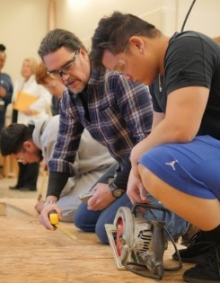

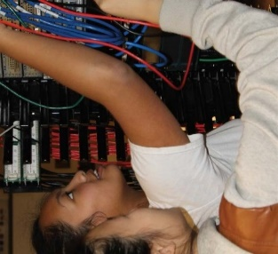
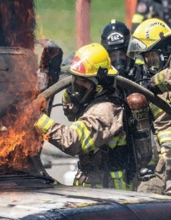
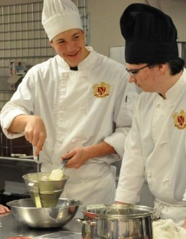
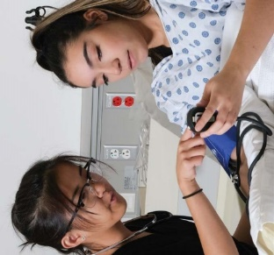
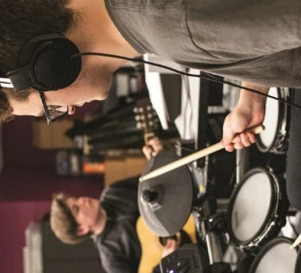
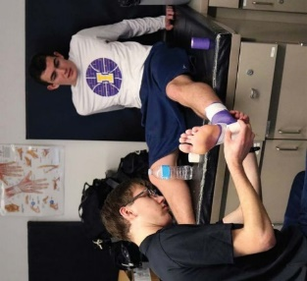
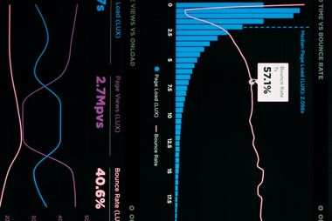
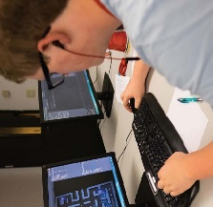
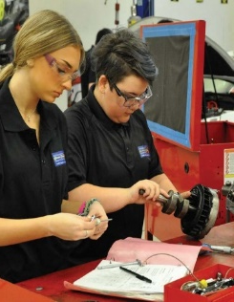

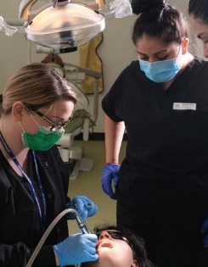
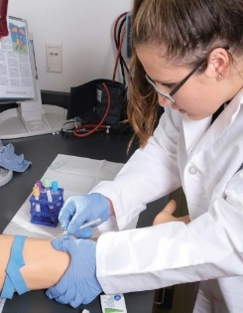
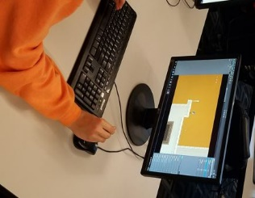
Skill Center Programs
The following slides list the WANIC programs offered next year
For a full listing and descriptions of WANIC programs
offered for 2023-24, visit our website: wanic.org
Notes:
Steve all programs

Slide 15


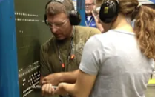
Aerospace Manufacturing Core Plus
New!
NEW
Liberty HS
In this hands-on course you’ll dive into the world of high-tech manufacturing and aviation, exploring how cutting-edge aircraft and components are designed, built, and tested. Learn about materials science, applied physics, electrical systems, hydraulics, sheet metal manufacturing, and much more as you tackle real-world challenges and projects.
Notes:
The DigiPen Data Analytics and Visualization program is a new offering from DigiPen this year!
*The math credit is in the approval process.
computer science-based program examines practical challenges involving complex real world data.
Students learn to extract strategic insights from data, build predictive models to forecast future trends, and efficiently communicate them to inform business strategy.
Algebra 2 is a pre-requisite, requiring successful completion prior to enrollment (as this is math intensive program)

Slide 16
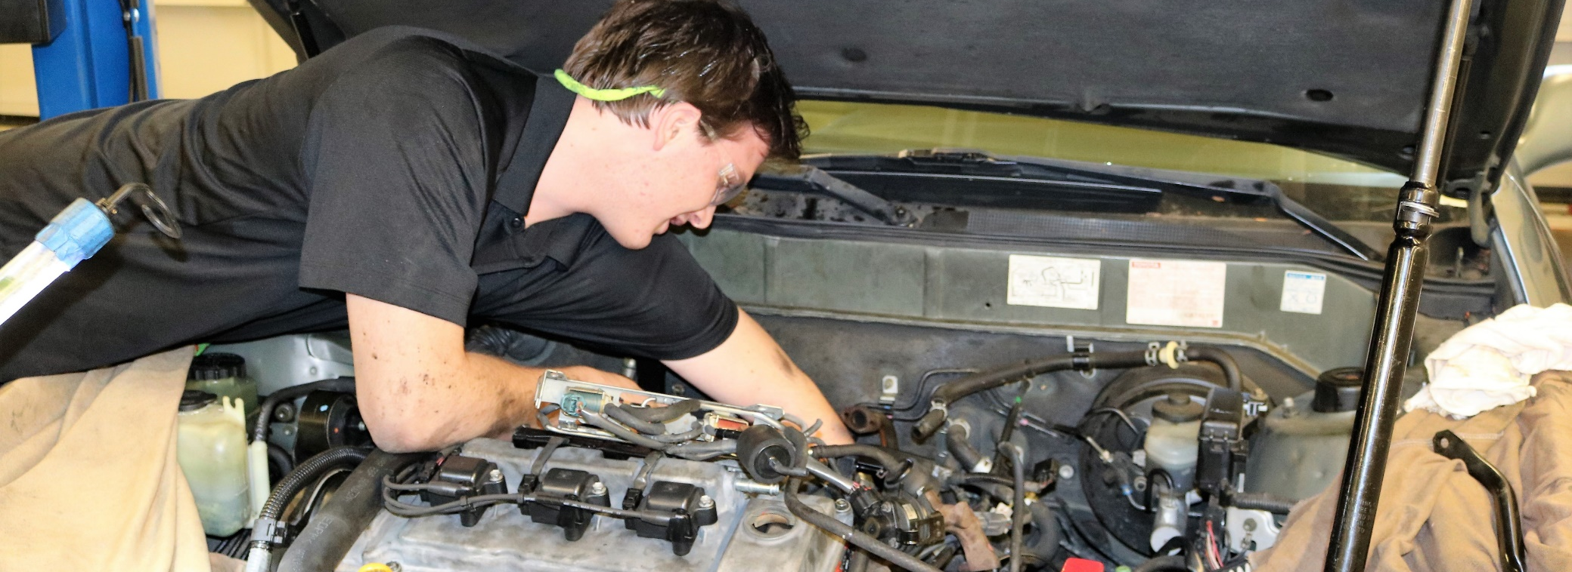
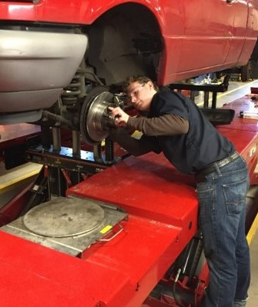
Automotive Technology
Bothell HS, Bellevue HS
Discover the real-world experience of automotive careers.
Industry certification earned: Automotive Service Excellence (ASE)
Notes:
Auto Tech is offered at Bothell HS (Northshore SD) and Bellevue HS (BSD)
Learning includes topics that revolve around the eight nationally recognized Automotive Service Excellence (ASE) areas.
Students work on shop-owned vehicles as well as public and student vehicles.
Leadership skills are learned through SkillsUSA, job shadowing at local shops and dealerships, and class club activities.
At Bothell and Bellevue, students can participate in their 2-year program to get in-depth exposure to the automotive industry.
April 15th is the priority enrollment date for this program so interested students should submit an application well before this date.

Slide 17
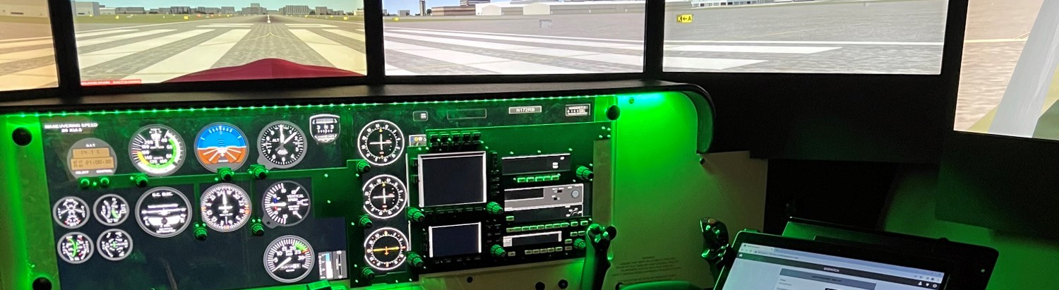
Aviation Technology - STEM
WANIC @ LWTech
This STEM course is an entry point into a multitude of careers in the aviation industry such as an Airline Pilot, Unmanned Aircraft Systems Operator, or Air Traffic Controller. Students will use a simulator and can earn ground school certificates.
Notes:
The Aviation Program will be NEW for Fall 2023 at WANIC main site on LWTech campus
Students will learn VFR -visual flight rules, and IFR -Instrument flight rules, and drone skills
Location will be at the WANIC main campus on LWTech college site
NOTE: successful completion of Geometry is a pre-requisite for this program.

Slide 18
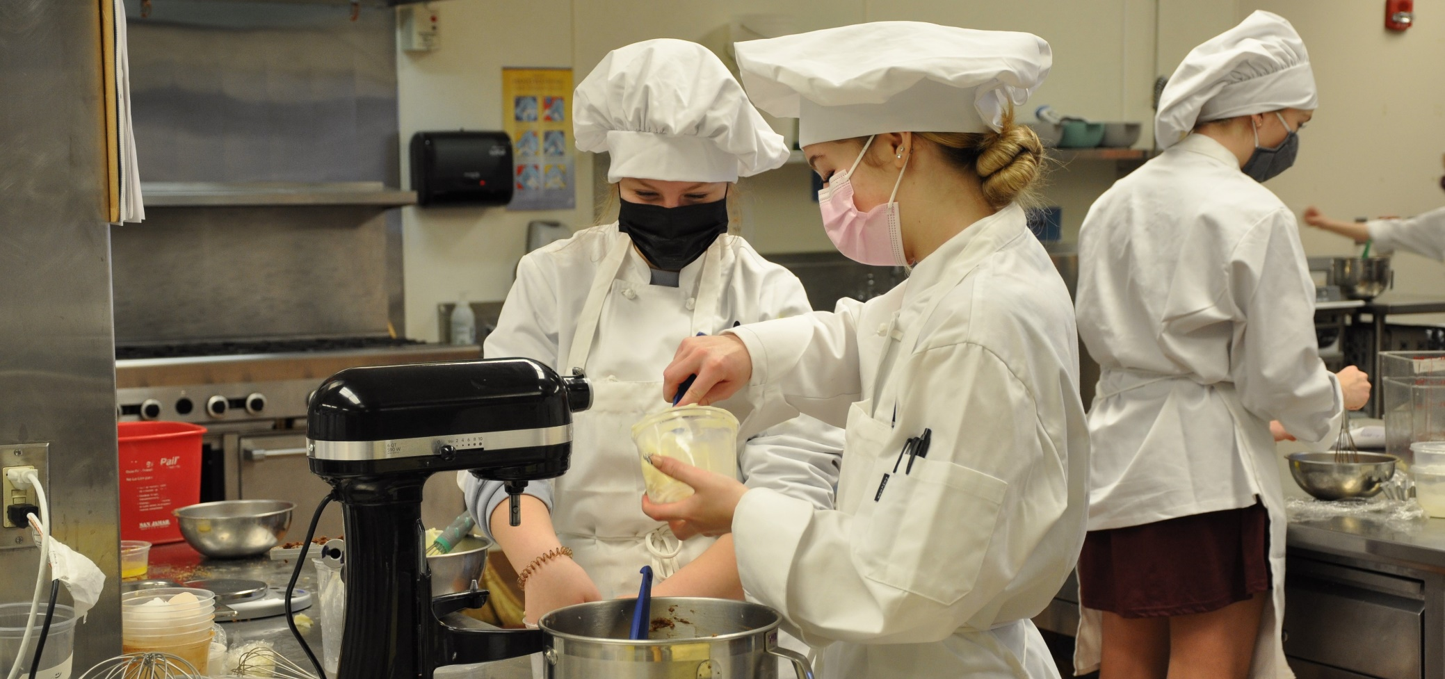
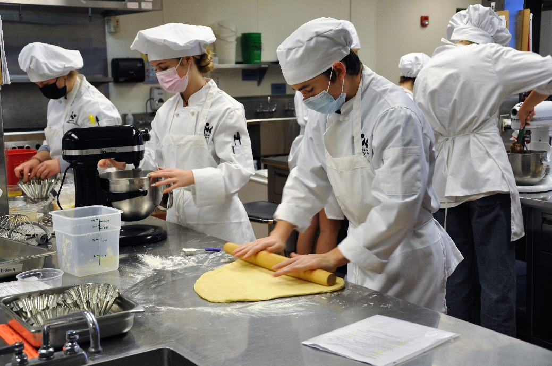

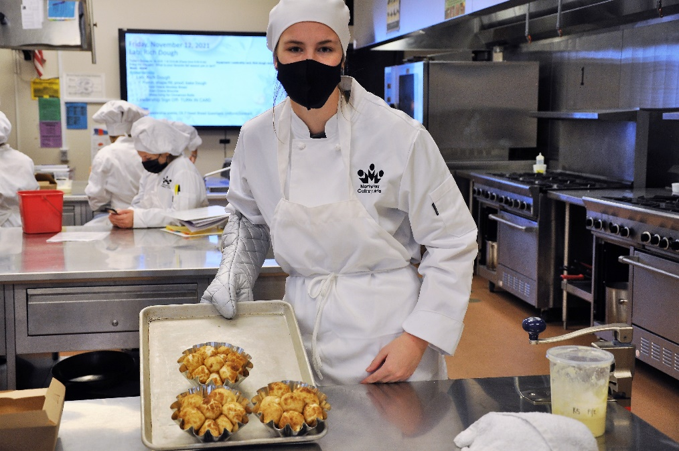
Baking & Pastry
Bothell HS
Learn techniques of mixing, shaping, and folding, while applying the science and math behind baking. Practice decorating techniques like sugar and chocolate garnishing in a well-equipped, industry standard kitchen.
Notes:
The Baking & Pastry program was NEW this year (2022-23) !
It is offered at Bothell High School (in Northshore SD) in a well-equipped, industry standard kitchen.
Students learn techniques of mixing, shaping, folding, and decorating while applying the science and math behind baking.
Right now it is only the morning session for WANIC
April 15th is the priority enrollment date for this program so interested students should submit an application well before this date.

Slide 19
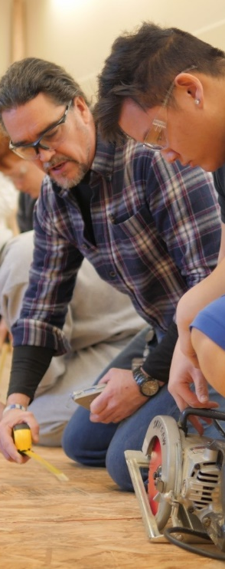
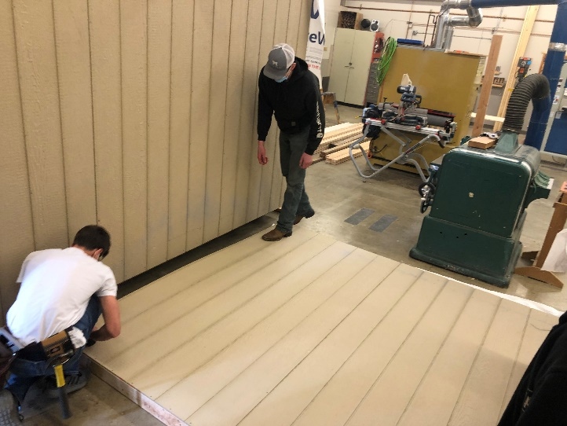
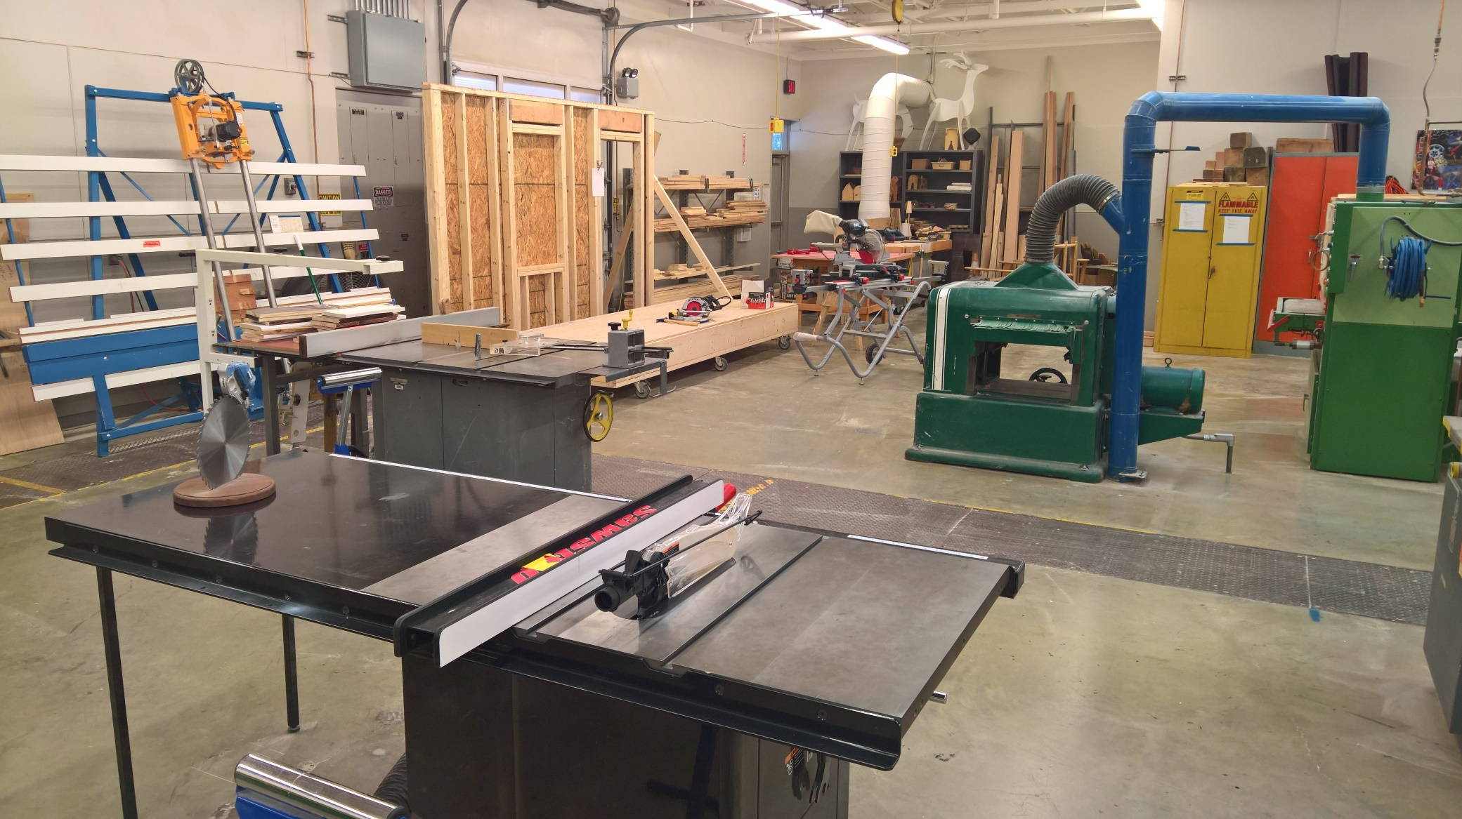
Building Industry Technologies
Core Plus Construction
Interlake HS, Bothell HS
Basic construction skills, use and safety of shop equipment, precision measuring, material science, print reading, extensive record keeping.
Notes:
Building Industry Technologies is a Core-Plus Construction program
at Interlake High school (Bellevue SD) and next year (2023-24) at Bothell High School (Northshore SD)
This program is now a pre-apprenticeship pathway partnered with the Carpenter's Union
WANIC partners with this Washington based program (Core Plus) that offers curriculum, industry expertise, state of the art equipment, and support to encourage young people to explore the real-world, hands-on construction industry.
Students utilize different materials and methods, learn to safely operate various industry tools, and design and implement hands-on skills such as rigging and lifting.
They read and interpret basic plans and engineering drawings, and they apply academic concepts such as mathematics and physics to project design and management.
April 15th is the priority enrollment date for this program so interested students should submit an application well before this date.

Slide 20
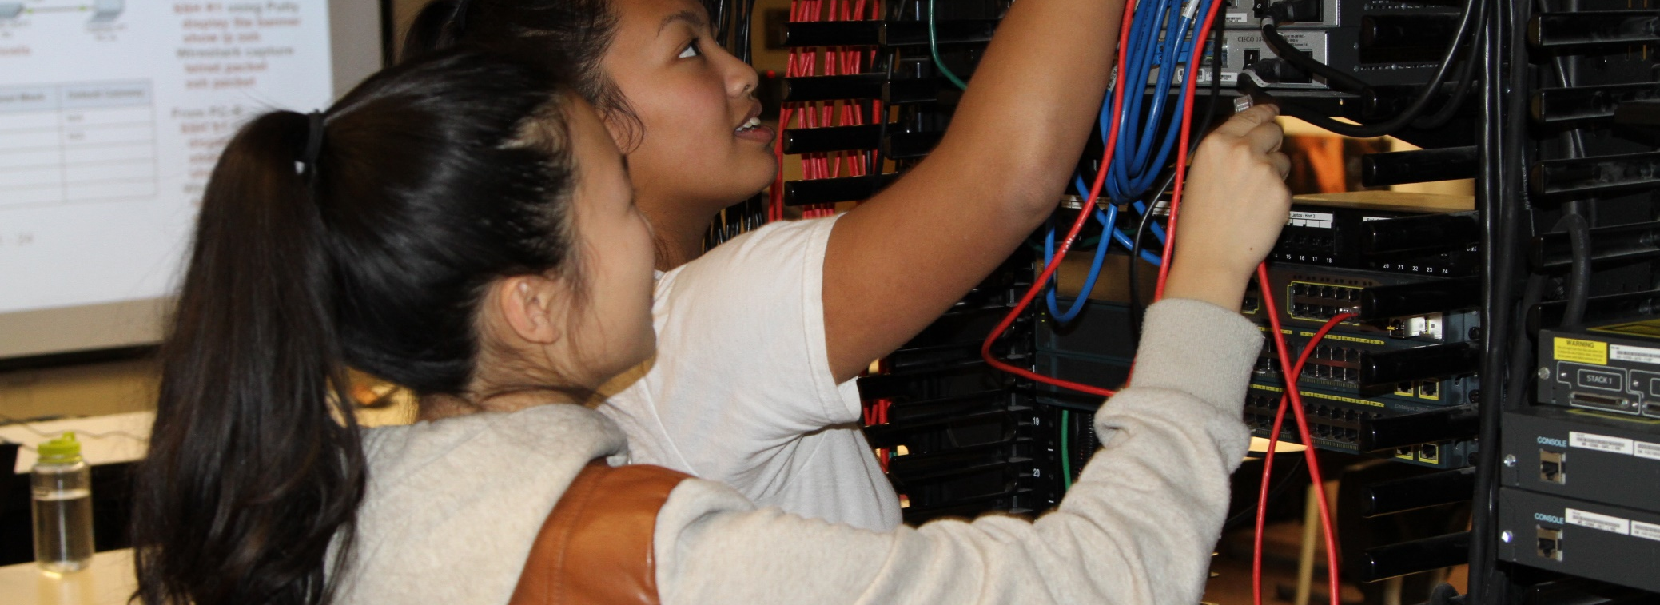
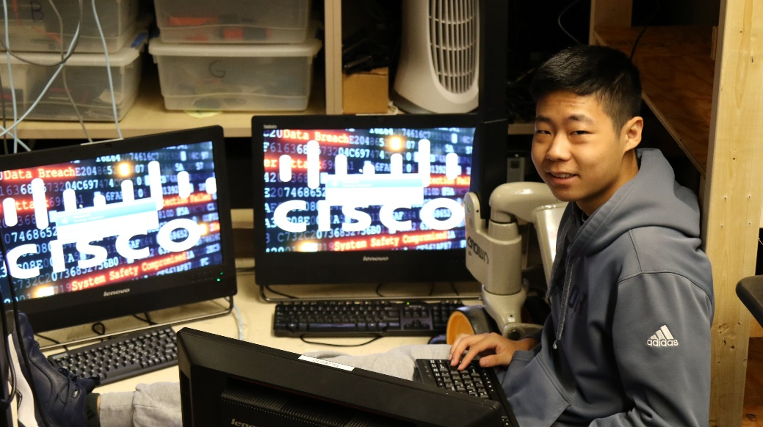
Cisco Networking Academy
Newport HS
State-of-the-art networking lab. Design, build, manage, and troubleshoot networks.
Industry certifications earned: Year 1 – CCNA (Cisco Certified Networking Associate)
Year 2 – CCNP (Cisco Certified Networking Professional)
Notes:
The Cisco Networking program is located at Newport High School (in the Bellevue School District)
students work in a high-end lab to discover how to design, build, manage, and troubleshoot corporate enterprise networks.
At the end of the Year 1, students take the CCNA exam to become a Cisco Certified Networking Associate.
Students who successfully complete Year 1 can choose to apply for the Year 2 program.
At the end of Year 2, students take the CCNP exam to become a Cisco Certified Networking Professional.
April 15th is the priority enrollment date for this program so interested students should submit an application well before this date.

Slide 21

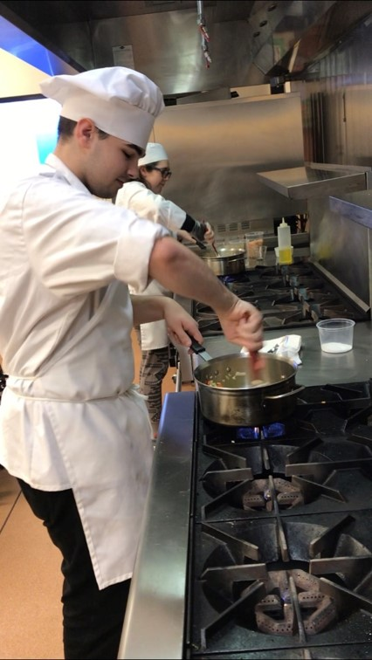

Culinary Arts
Newport HS
Explore careers in a variety of food related industries. Learn professional food production techniques, restaurant management, catering, purchasing, leadership, and more.
Industry certifications earned: Food Handler Permit
Notes:
Culinary Arts is at Newport High School (in the Bellevue School District)
Students explore careers in a variety of food related industries and earn their food handler’s permit.
This is a comprehensive, career-focused introduction to the fundamentals of culinary arts and the professional kitchen.
The classroom is set up as a fully functional commercial kitchen
Students who successfully complete Year 1 may apply for the Year 2 program.

Slide 22
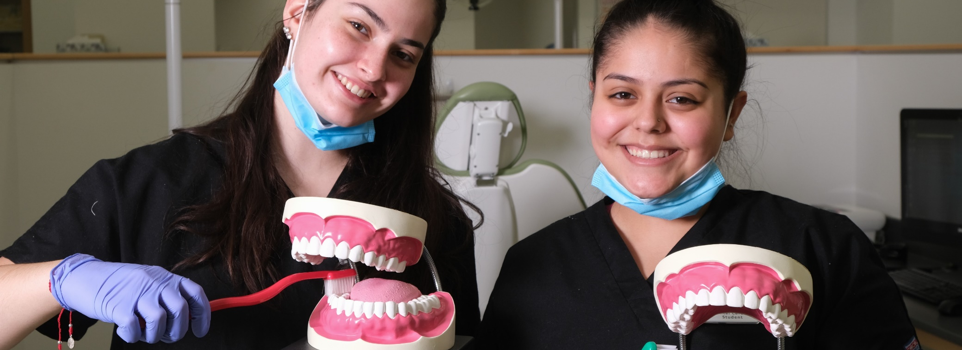
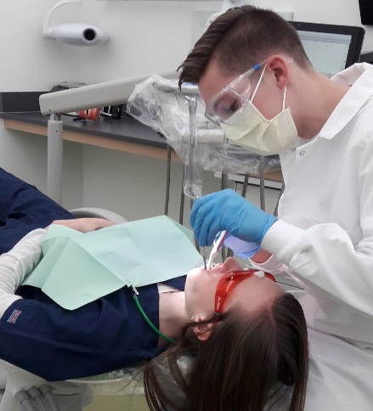
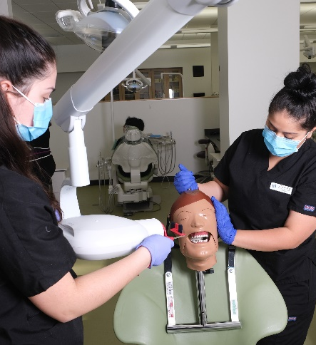
Dental Careers
WANIC @ LWTech
Explore dental careers opportunities. Learn about instruments, procedures, sterilization, radiography, anatomy, infection control, etc. State-of-the-art dental lab and equipment.
Industry certifications earned: First Aid & CPR (additional tests optional)
Notes:
Dental Careers is at WANIC main site on LWTech
This class is a mix of college-level theory, hands-on skills practice in the lab, and clinical internships at dental offices.
students learn about instruments, procedures, sterilization, radiography, anatomy, infection control, and more.
A highlight of the year is when families come in for teeth-cleaning by their students!
Students earn their Basic Life Support First Aid and CPR certificate for professional caregivers.
Plus, they are prepared to test for their Dental Assisting (NELDA) certificate at the end of the school year.
NOTE: This NELDA certification is not needed in Washington State to obtain a job as a dental assistant. However, to work as dental assistant in Washington State, there are mandatory steps to take to get registered with the Department of Health. The instructor goes over these steps in class in the 4th quarter.
Successful completion of Biology is strongly recommended prior to enrolling. ​

Slide 23

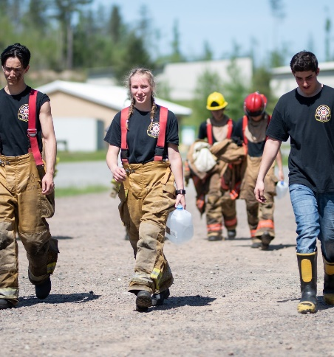
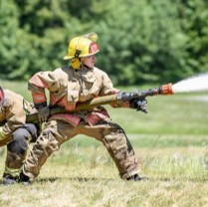
Fire & EMS
WANIC @ LWTech
Part of each week spent at local fire depts. Class is mix of hands-on training & academics.
Industry certification earned: First Aid & CPR
Notes:
The Fire & EMS program is located at WANIC main site on LWTech and is taught by active off-duty firefighters
Fire & EMS prepares students for a career in the fire service and to be an integral part of a community emergency response team.
Students drill at fire stations all over the Eastside in ‘bunker gear’ to get the full experience.
The highlight of the year the ‘live fire’ event at the Washington State Fire Training Academy in North Bend, WA
The program includes college level academics combined with energetic, hands-on skills practice.
students earn their Basic Life Support First Aid and CPR certificate for professional caregivers.
Students who successfully complete Year 1 may apply to continue on with Year 2.

Slide 24
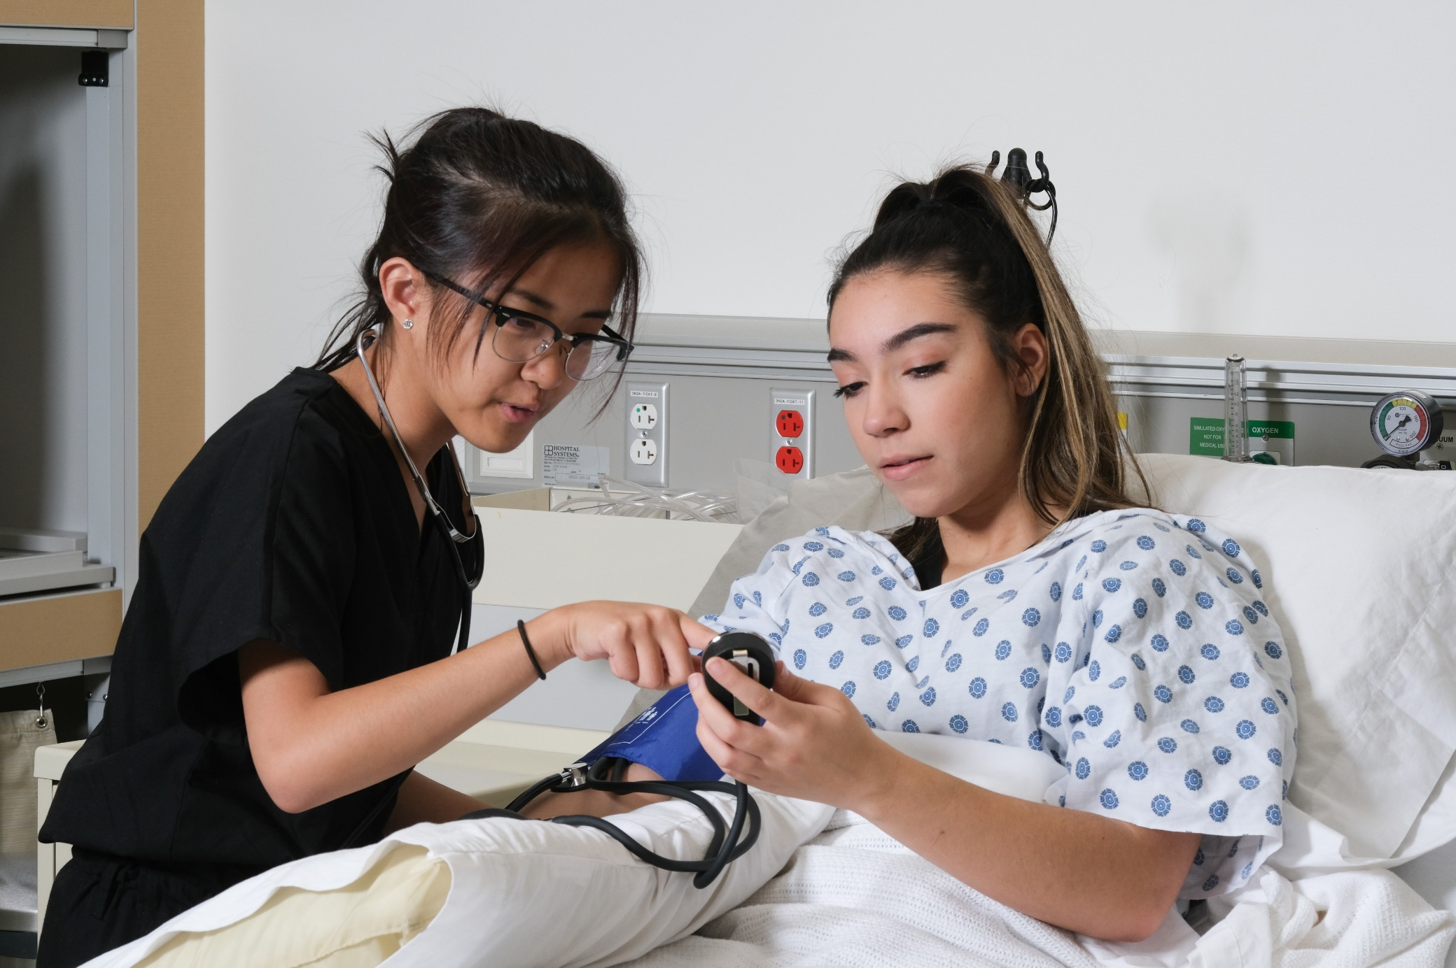
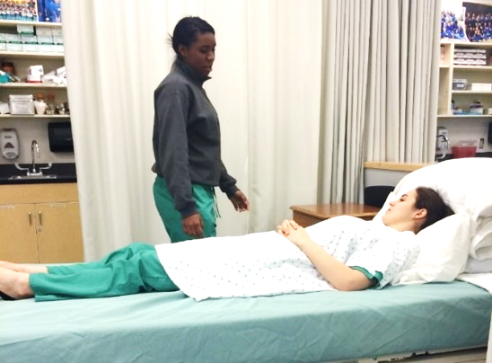
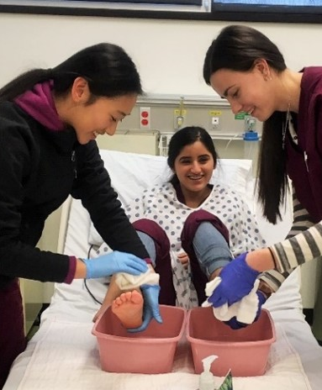
Health Science Careers (Nursing)
WANIC @ LWTech, Sammamish HS, Woodinville HS
Real-life experience at health care clinics.
Industry certification earned: First Aid & CPR (additional tests optional)
Notes:
The Nursing program is offered at three locations:
the WANIC main site on LWTech campus,
Sammamish High School (in the Bellevue School District)
Woodinville High School (in the Northshore School District)
Besides opportunity to pass the Nursing Assistant Certification (NAC), students will also earn their Basic Life Support First Aid and CPR certificate for professional caregivers.
Students practice skills in the Nursing Lab and they spend at least 40 hours at nearby health care clinics in order to meet the Nursing Assistant Certified (NAC) requirements.
In addition to college level academics, there is a robust practical component.
Successful completion of Biology is strongly recommended prior to enrolling.

Slide 25

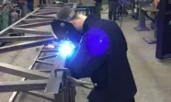
Maritime Welding Core Plus
NEW
Interlake HS
  Dive into the fascinating world of maritime engineering and welding. Students will have a solid foundation to launch a successful career in maritime welding, shipbuilding, or related fields, with a strong emphasis on responsible boating practices.
  Industry certifications: Washington Boater Safety Card
Notes:
WANIC is excited to partner with world-renowned Institute for Systems Biology (ISB) to offer this new course
will be NEW for Fall 2023 at WANIC main site on LWTech campus
Interdisciplinary STEM and healthcare professionals are trained in biology, engineering, physics, computer science, environmental sustainability, health, big data, and technology.
Students actively engage in a series of hands-on laboratory, computer, and community-based units involving medical systems
that aim to be participatory, personalized, predictive, and preventative
Biology is a pre-requisite, requiring successful completion prior to enrollment

Slide 26

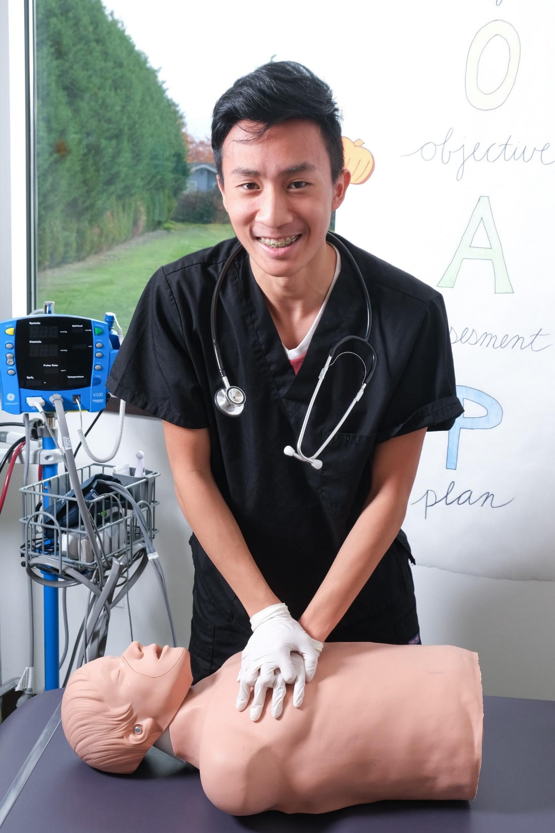
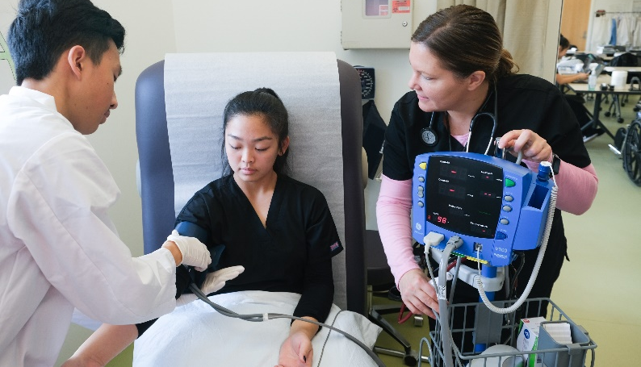
Medical Careers
WANIC @ LWTech
Explore the fields of medicine and medical assisting.
Field trips, job shadows, guest speakers.
Industry certification: First Aid & CPR
Notes:
The Medical Careers program is located at the WANIC main site on the LWTech campus,
Classes meet in a facility that mimics doctors’ examination rooms
students learn treatment room procedures, surgery instrument prep, office practices, vital signs, medical ethics, and more.
This course prepares students for the world of doctors, nurses, and other healthcare professionals.
After completing this program, students interested in pursuing their (Medical Assistant) MA certificate will require 4 more quarters of college.
They also earn their Basic Life Support First Aid and CPR certificate for professional caregivers.
Successful completion of Biology is strongly recommended prior to enrolling.

Slide 27
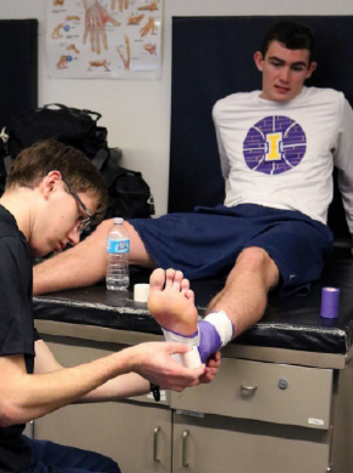
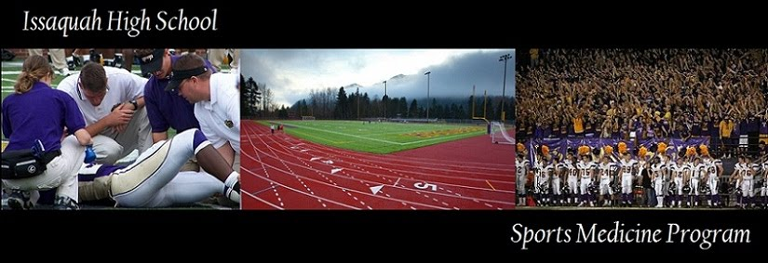
Sports Medicine
Issaquah HS
Learn anatomy, physiology, medical terminology, nutrition, injury prevention, rehabilitation, taping and wrapping, classroom instruction, lab participation, field internships
Industry certification: First Aid & CPR
Notes:
Sports Medicine is offered at Issaquah High School (in the ISD)
This is an advanced and accelerated course where students gain practical skills in the lab as well as assisting at high school sporting events
Students learn anatomy, physiology, medical terminology, First Aid & CPR, nutrition, injury prevention, rehabilitation, and taping and wrapping
All through classroom instruction, lab participation, and field internships.
Successful completion of Biology is strongly recommended prior to enrolling.
April 15th is the priority enrollment date for this program so interested students should submit an application well before this date.

Slide 28


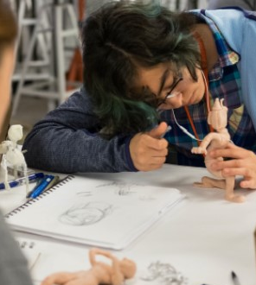
DigiPen Art & Animation
WANIC DigiPen Campus
Learn skills to succeed as an artist, illustrator, or animator.
Notes:
DigiPen Art & Animation provides students with the baseline skills to succeed as an artist, illustrator or animator.
In this program, students study professional production animation from traditional art theory and skills development to composition and storytelling in 2D animation and 3D modeling.
In the second year, students may submit a portfolio and possibly earn Advanced Placement (AP) credit.

Slide 29

DigiPen Game Design
WANIC DigiPen Campus
For creative-minded students who are deeply curious to understand the behavior and psychology behind games, and eager to learn methods for designing fun and engaging interactive experiences.
Notes:
DigiPen Game Design is newer offering (2022-23) and ideal for creative-minded students who are deeply curious to understand the behavior and psychology behind designing games, and eager to learn methods for designing fun and engaging interactive experiences. It incorporates all aspects of the game design process, including computer programming and project management.

Slide 30
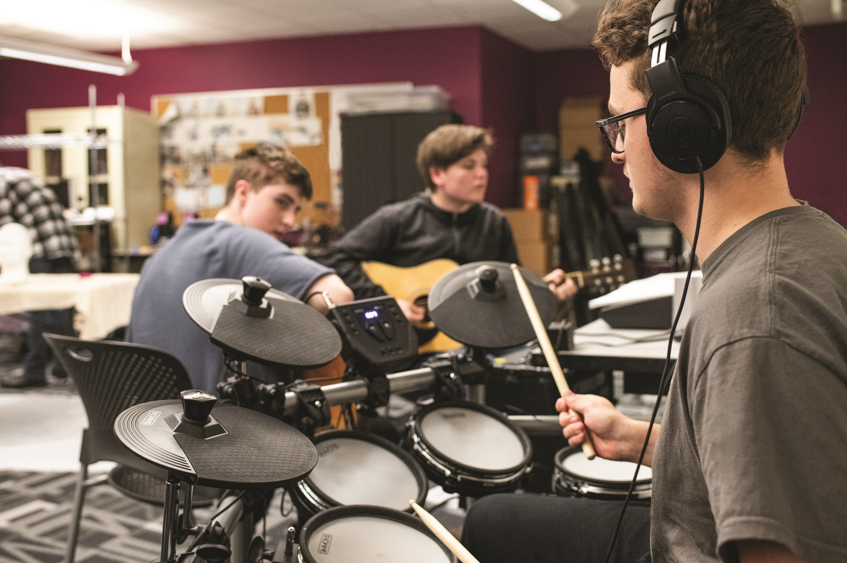
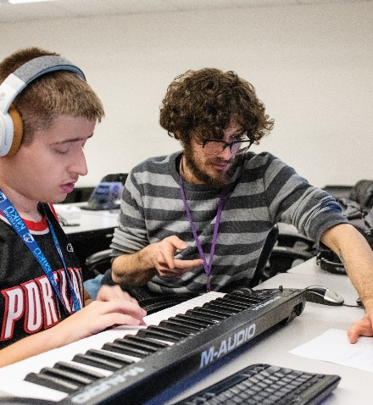
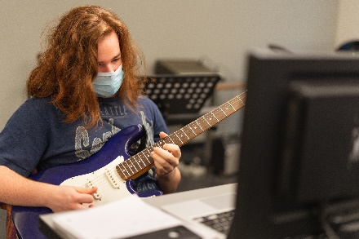
DigiPen Music & Sound Design
WANIC DigiPen Campus
Combine music composition, history, and theory with practical training in studio recording techniques. Work on a team with video game programmers and animators.
Notes:
DigiPen Music & Sound Design focuses on combining music composition, history, and theory with practical training in studio recording techniques.
Students learn to apply fundamentals in computer science, mathematics, and physics to sound design principles.
They work within teams in real-world settings to create interactive audio for video games and engaging soundtracks for film.

Slide 31
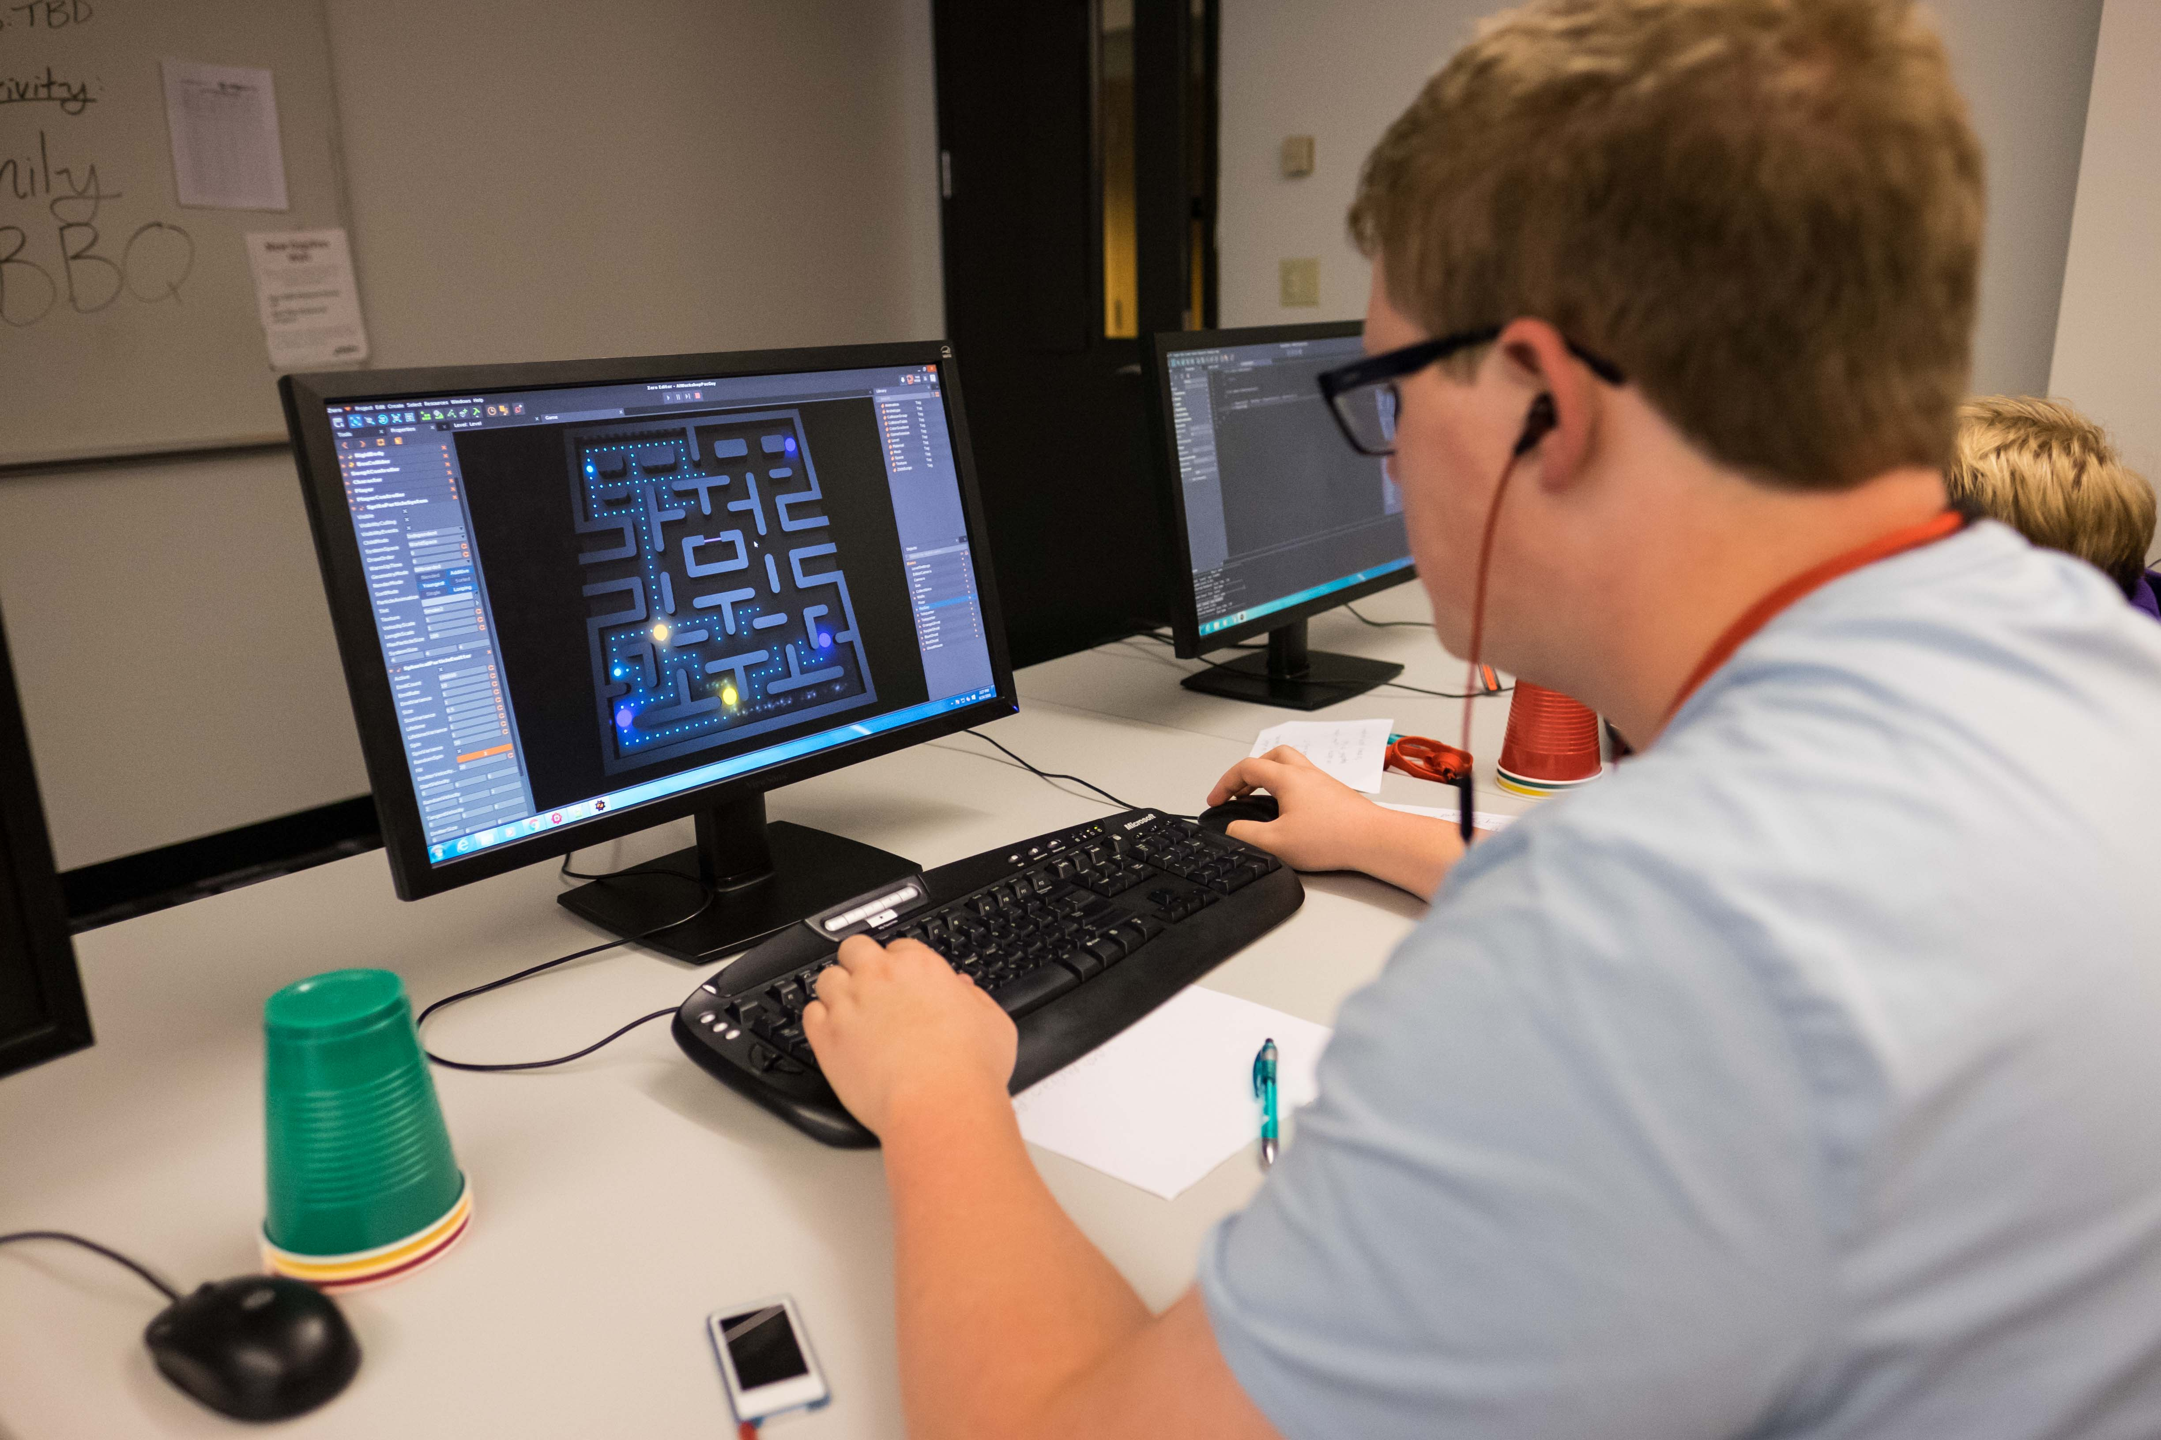

DigiPen Video Game Programming
WANIC DigiPen Campus
Create digital games and interactive experiences.
Notes:
In Video Game Programming students design and develop games using a game engine while learning the basics of programming a variety of languages.
By integrating mathematics and design theory, students immerse themselves in the game production process and explore pathways into video game careers.
Algebra 2 is a pre-requisite, requiring successful completion prior to enrollment (as this is math intensive program)
In the Year 1 program, students are prepared for and may take the AP Computer Science Principles exam to earn Advanced Placement (AP) credit.
Coursework includes the essential mathematical concepts necessary for creating 2D games and simulations using a preexisting game engine. Students code using a variety of languages and learn the logic, algorithms, and process to write programs

Slide 32
Want more information about the programs?
https://wanic.lwsd.org/academics/full-year-courses
High school credits earned
Full description
Possible occupations
Course expectations

Slide 33
REGISTRATION
Applications received before April 15, 2025 receive priority. Students will not be enrolled before this date.
Lotteries will be run and emails regarding enrollment and waitlist status for full-year 2025-26 skill center programs will be sent between April 23 and April 30.
After 3:00PM April 15, applications will only be accepted for programs with space available.
Full year applications close 3:00PM Tuesday July 15.
https://applywanic.schoolmint.com/login

Slide 34


Slide 27
Applying to Skill Center Programs
WANIC
Application
Students Applying
Across Districts
Any Students Applying
to WANIC or DigiPen
Not a WANIC
Application
Students Applying
Within Districts
For Issaquah School District students, the Sports Medicine (IHS) and
Aerospace Manufacturing Core Plus (LHS) programs are not WANIC applications.
Notes:
Kari
Remember, students from any of the high schools in any of the seven school districts within the WANIC consortium are eligible for a Skill Center program.
STUDENTS should work directly with their high school’s CAREER SPECIALIST and SCHOOL COUNSELOR for guidance with the registration process
in general, if a student is applying to a program in a location outside their school district, they must use the WANIC registration system. Otherwise, they must use their own building or district method to apply. There is on exception, and that is LWSD. Any LWSD student applying to ANY WANIC program in ANY location, must use the WANIC reg. system.
Students may apply to a Skill Center program that is NOT in their school district
these types of applications should come through WANIC.
It gets tricky when a student is interested in a WANIC Skill Center program that is offered within their own district:
In such cases, even though the students are applying to a WANIC Skill Center program, because these are WITHIN the student’s OWN districts, the applications do NOT come through WANIC.

Slide 35



WANIC Summer Semester
25+ CTE classes (and Health)
Multiple locations
0.5 HS credits (affects GPA)…not ‘Camp’!
Rising 10th through rising 12th graders
Exploratory, rigorous, fast-paced, 3 weeks
No college credit
Grade reports sent to high school for
official transcription (not optional)
FREE! No fees
Applications open April
Notes:
Kari
SUMMER SEMESTER: IMPORTANT DETAILS
In Summer we may have 25 or more CTE classes plus at least one Health class, which is very popular
The summer classes are offered in multiple locations, depending on which districts participate. In prior years we’ve had classes offered in Northshore, Bellevue, Lake Washington, Riverview, Mercer Island, and Issaquah school districts in addition to WANIC at LWTech.
Each is the equivalent of a high school semester (.05 credit ) packed into three weeks.
All students earn a grade which does affect their GPA. Students and families need to understand that the WANIC Summer program is actual high school – not camp!
Attendance and academic engagement is critical to the students’ success
open to all rising-9th through rising-12th graders. There are a few exceptions which exclude rising 9th graders due to their level of difficulty, for example the Biotech classes offered through our partner, the Institute of Systems Biology.
A LOT of work is covered in the three weeks of summer semester. While it is “exploratory” compared with the Academic Year classes which are ‘preparatory’ in scope, the summer classes are still quite rigorous and fast paced. It’s best if students understand this going in. There’s typically no homework given, but they do have to show up and work hard from 8am until 3pm every day for three weeks.
we do need to verify that each student is registered at the sending school and their other details are accurate. So there is a step that needs to be done by someone at the sending school, usually the Career Specialist.
There is no college credit available for summer semester classes (no ‘dual credit’ for summer)
grade reports are emailed to the sending schools where they are required to be transcribed to the students’ official records. This is not optional. All summer semester classes attempted by students must show up on their high school transcripts, even if the student or parents are not happy with the final grade.
There are no summer class fees
we can only accept students who are registered in a public high school within the WANIC consortium into the WANIC Summer Semester classes. This is part of the verification process. If a student resides with a WANIC Consortium district but is home-schooled or attends private school, they must register at their public high school to be eligible for WANIC.
Summer Semester applications open after spring break in mid to late April.

Slide 36

WANIC Summer Semester
IMPORTANT CONSIDERATIONS
7 hours per day for three weeks
Only one excused absence allowed
  Students with travel plans or school/sports
  commitments should not apply
Challenges
  Students who need extra time
  Students anxious about fast-paced deadlines
Notes:
Kari
Officially, allowed to miss ONLY ONE day.
CANNOT miss DAY 1 or DAY 13
13 days of class

Slide 37
Summer 2025 Calendar
Summer semester 2025 dates: Thursday June 26 - Wednesday July 16. Monday-Friday.
Class time: 8AM-3PM. All classes are in person.
Application window: Tuesday March 25 (9:00 AM) - Thursday April 24 (3:00 PM)
Secondary application window: Tuesday May 6 - Sunday June 1 for classes that have openings or short waitlists; seat allocations are first-come, first-served during this SECONDARY application window.
https://wanic.lwsd.org/academics/summer-courses
Notes:
Kari
Priority enrollment is for ‘Rising’ SENIORS. If more space available then ‘lottery’ will occur to fill classes
NOT a credit retrieval program
HEALTH class in summer allows students to meet required graduation credit (.5 semester)

Slide 38
CONTACT
WANIC Office Location:
Lake Washington Institute of Technology campus
11605 132nd AVE NE (Office #A108)
Kirkland, WA 98034
Email: wanic@lwsd.org
Telephone: (425) 739-8400
Website: wanic.org
Notes:
Barb
Please see detailed information on our website - wanic.org
WANIC office staff welcome your questions and are here to support students.
EMAIL is most effective way to communicate with us directly - wanic@lwsd.org

