Slide 1
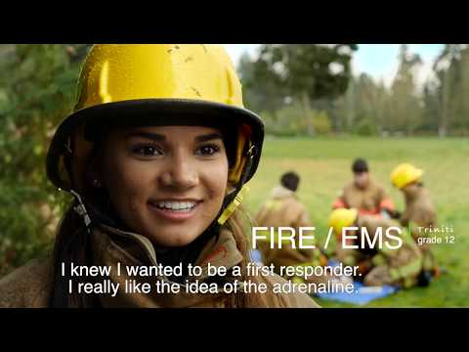
Personal Connections and Student Voices
Notes:
4 minute, 17 second length VIDEO
VIDEO = translation > CLOSE CAPTION > Selected LANGUAGE
Play at BEGINNING of SESSION
As PREVIEW / ‘COMMERCIAL’
Viewed as PARTICIPANTS are ARRIVING into the MEETING
WELCOME everyone as the VIDEO concludes

Slide 2


Washington Network for Innovative Careers
Oportunidades del programa 2025-26 para estudiantes en los grados 11 y 12
Presentación del Distrito Escolar de Issaquah
25 de marzo de 2025
Notes:
WANIC Skill Center=Washington Network for Innovative Careers

Slide 3
AGENDA
  Introducción
  ¿Por qué WANIC?
  Elegibilidad
  Expectativas
  Consideraciones
  Costos y Asistencia Financiera
  Servicios de soporte
  Programas
  Registro

Slide 4
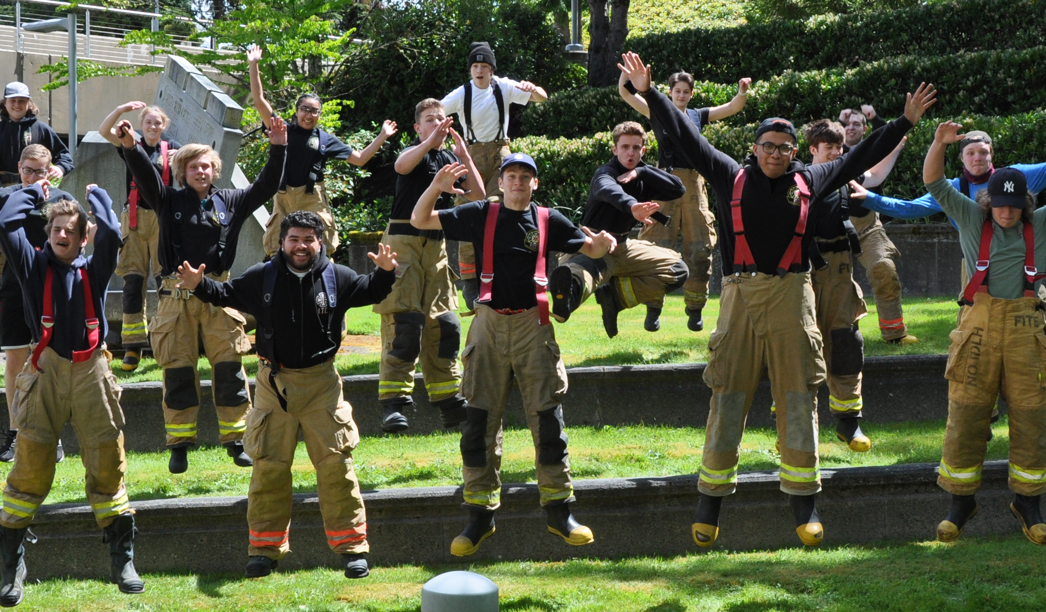
¿Qué es y que ganan los estudiantes?
Clases para obtner experiencia en trayectoria profesional
Preparación: Empleo y Universidad
Formación en habilidades avanzadas
Equipos de última generación
Trayectoria de graduación de CTE cumplida
Obtener créditos universitarios y/o certificaciones de la industria
Opciones para continuar en universidades de 2 y 4 años
Oportunidades de liderazgo estudiantil
Instructores experimentados
Notes:
Steve
What do students gain by participating in a WANIC Skill Center program?
students have extended learning time each day in the equivalent of 3 class periods (2.5 hours class session )
gaining experience on a career pathway while in high school,
prepare for possible employment in a specialized field of interest and practice advanced, hands-on skills, valuable for preparing them for their post-high school plans.
Our programs have high quality equipment and industry-standard lab and teaching space to support student learning with real-world, hands-on training
In the majority of WANIC programs, students can earn and apply for college credit or industry specific certifications.
Career Pathways allow Students the option to continue toward 2-year and 4-year college programs beyond high school graduation
And finally, many of the WANIC classes offer opportunities to participate in leadership programs
Instructors- experienced in their fields and supported by Advisory Committees with current industry professionals, to ensure student learning is relevant and up-to-date with college and industry demands.
CTE Graduation Pathways: students who take at least 2.0 credits in same pathway (aka: singe 3.0 class) fulfills

Slide 5
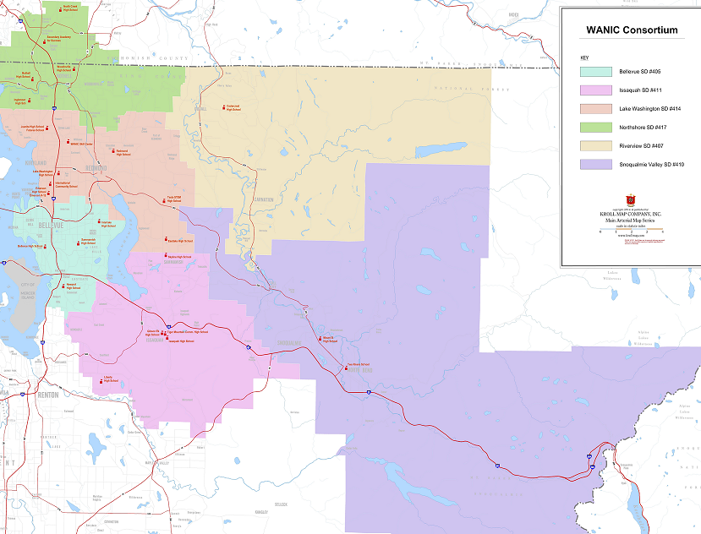
NSD/Woodinville HS
Carreras de Ciencias de la Salud (Enfermería)
Ubicaciones de los programas WANIC
NSD/Bothell HS
Tecnología Automotriz I y II
Panadería y pastelería
Núcleo tecnológico de la industria de la construcción Plus
Programas del Año Académico
BSD/Interlake HS
Núcleo tecnológico de la industria de la construcción Plus
Núcleo de soldadura marítima Plus
WANIC @ LWTech
Aviation Technology - STEM
Dental Careers
Fire & EMS I and II
Health Science Careers (Nursing)
Medical Careers
NEW
BSD/Bellevue HS
Tecnología Automotriz I y II
BSD/Sammamish HS
Carreras de Ciencias de la Salud (Enfermería)
DigiPen
Art & Animation I and II
Game Design
Music & Sound Design I and II
Video Game Programming I and II
BSD/Newport HS
Redes de Cisco I y II
Artes Culinarias I y II
ISD/Issaquah HS
Medicina Deportiva
ISD/Liberty HS
Fabricación aeroespacial Core Plus
NOTE: WANIC ≠ LWTech
NEW
Notes:
Kari
21 Academic Year skill center programs are located in 9 locations– these are the 4 ‘Receiving districts and schools’ of the WANIC Consortium.
NORTHSHORE:
We have programs at Woodinville High School and Bothell High School in Northshore School District.
New for 2023-24, we are adding a CorePlus Construction skill center program at Bothell HS.
BELLEVUE:
programs at Interlake, Bellevue, Sammamish, and Newport High Schools.
ISSAQUAH:
one program at Issaquah High School.
LAKE WASHINGTON SCHOOL DISTRICT: we have programs at two sites:
WANIC main campus at Lake Washington Institute of Technology (aka: LWTech) in Kirkland and
WANIC DigiPen campus at DigiPen Institute of Technology in Redmond. ¤
These WANIC and DigiPen programs are the ones we spend most of our time on. We manage and report on the enrollment of ALL the Skill Center programs throughout the consortium, but our day-to-day time and energies are mostly focused on these WANIC-managed programs. We get to know these students very well, and we monitor their attendance and grades and other issues that happen in the classroom.
NEW PROGRAMS for 2023-24
Aviation Technology, a new and exciting STEM program
ISB Systems Medicine program, partnered with Institute of Systems Biology in Seattle
DigiPen Data Analytics -although we offered the class last year, we did not get enough applicants to run it. We hope to run it this year, in this growing field with excellent career prospects.

Slide 6
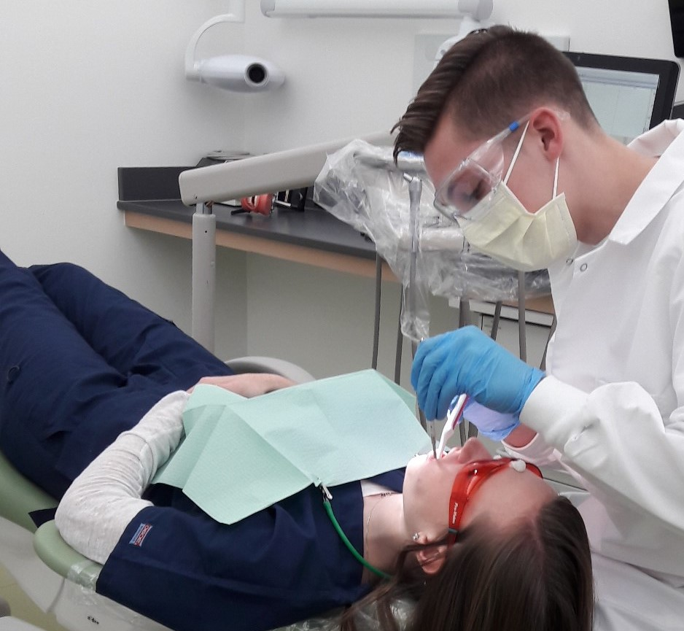
Requisitos de elegibilidad para los solicitantes de WANIC
Registrado en Gibson Ek, Issaquah HS, Liberty HS o Skyline HS
Posición Junior o Senior *
Aprobación del Especialista en Carreras
En camino de graduarse en la escuela secundaria de casa
Algunos programas requieren una sesión informativa
Debe proporcionar su propio transporte confiable
*Los estudiantes de 10º grado pueden ser considerados para algunos programas
Notes:
Steve
In order to be eligible for a WANIC Skill Center program students will need to be
registered at one of the high schools in the WANIC consortium, and
entering into 11th or 12th grade next school year.
The sending school Career Specialists have to approve the application and
student must be on track to graduate.
If a student needs to remain at their high school to earn specific credits for graduation, the Career Specialist may have the student hold off their WANIC enrollment for a year. Or they may determine it’s not the best fit for them.
Students who are interested in WANIC are encouraged to speak with their Career Specialists as soon as possible to see if they are well positioned for WANIC.
Some programs require Information Sessions and some have pre-requisites. ( more detailed on individual program slides – in this powerpoint)
Skill Center programs offered in the Northshore, Bellevue and Issaquah school districts have a priority enrollment date of April 15th. If students are interested in any of these programs, they must be sure to apply well before this date to allow their Career Specialist time to approve the application and to give themselves the best chance to get in.
Students are responsible for providing their own reliable means to get to and from the WANIC program.
Note that, although Skill Center programs are designed primarily for upperclassmen, some programs may consider students who are entering 10th grade next school year. We handle those on a case-by-case basis.
Remember, the approval comes from the sending high school.
2/1/23 – Nikki email summary:
Based on input from Receiving Schools/Programs, we have set up SchoolMint so that some programs will not be available on the application if the students is entering 10th grade in Fall 2023.
These programs will not allow a rising-10th grader to apply:
Any Year 2 program
Baking & Pastry at Bothell
Building Tech at Bothell only
Nursing at all locations
ISB Sys Med at WANIC
All other programs will allow a rising-10th grader to apply. That’s not to say they’ll be approved … that will depend on the sending schools.

Slide 7
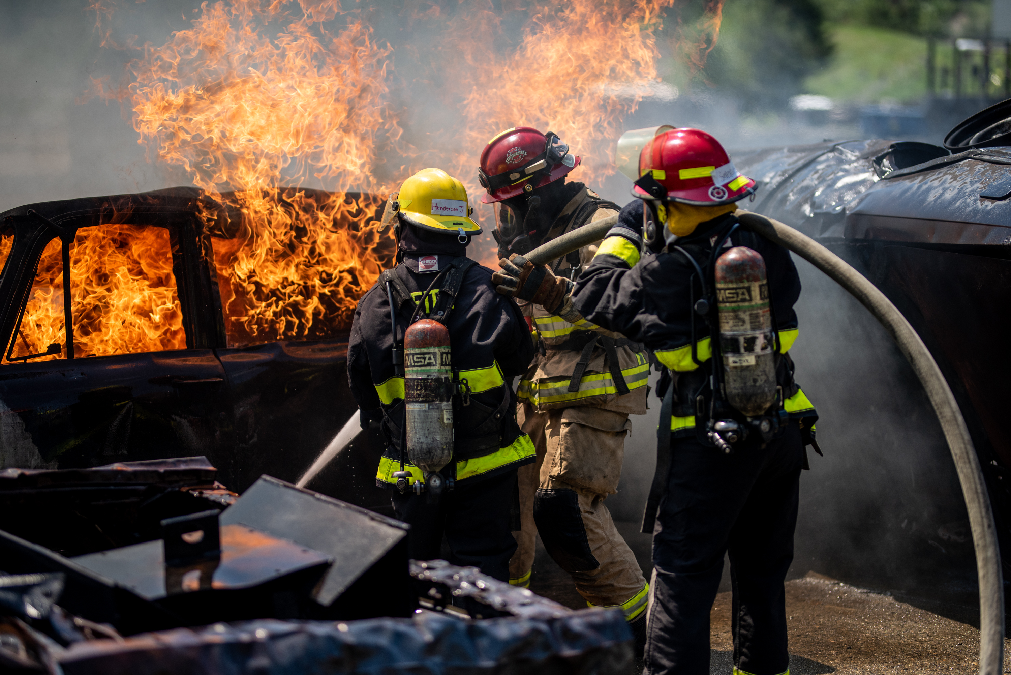
Expectativas de éxito de los cursos
Completar las tareas/tareas diarias
Entregar todas las tareas a tiempo
Leer y comprender textos técnicos
Practicar la redacción técnica
Demostrar habilidades prácticas
Trabajar de forma independiente y en equipo
*ver Guía de Expectativas del Curso
En el sitio web (wanic.org)
Notes:
Steve
EXPECTATIONS
We want all our students to be successful. To get the most out of the program, to pass, and to gain the competencies expected of them, students must be able to commit to the following:
Attendance: The single biggest predictor of success is attendance. We expect students to show up. On time. Every day.
Work completion: There will be daily activities and assignments, which they will be expected to turn in on time.
college-level reading and technical writing assignments.
hands-on skills: demonstrate acquired hands-on practice
In all classes, students can expect there to be a mix of independent and group work.
We have created a document – WANIC Course Expectations Guide - to clearly outline expectations in each program. This can be found on our website under FULL YEAR COURSES and Additional Course Info
* Linked in final slide of RESOURCES: https://wanic.lwsd.org/academics/course-catalog/course-expectations

Slide 8
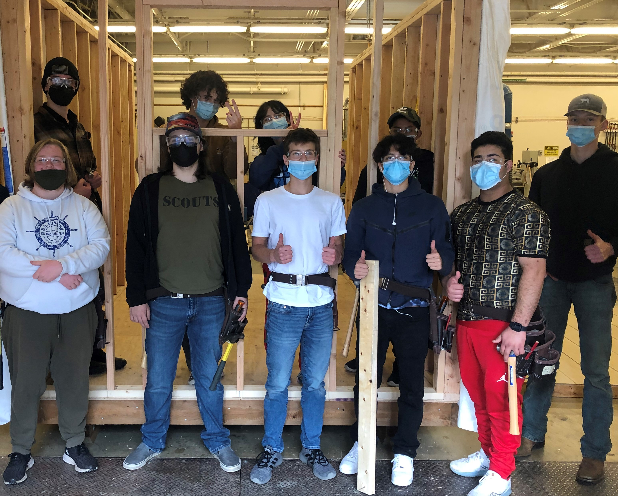
Consideraciones de horario y tiempo
Tiempo necesario para llegar al programa.
  Considere: transporte, tiempo de viaje, actividades después de la escuela, compromisos familiares, trabajo
  La mitad del día escolar se pasa en un lugar diferente al de la escuela secundaria
  Consideración al horario de clases en la escuela secundaria
  Compromiso: programas de año completo
Siga el calendario y los horarios de la escuela en la que se realiza el curso, a menudo diferentes a los de la escuela secundaria en casa y Running Start
WANIC NO es un programa de Running Start
Notes:
Steve
IMPORTANT CONSIDERATIONS
Student will spend half the school day in a location other than their home high school. For some students, the change of scenery is welcome. For other students, changing locations partway through the day may be unsettling and they may find it difficult to switch gears and shift focus. Students should think about what will fit them best.
daily commute between schools takes planning and maturity to keep up with all classes at two locations
Students need to maintain the commitment to show up to class every day, even if it starts early or ends late.
They should consider all aspects of their busy lives such as how they're going to get to and from the program, how long it takes, and what other activities they have going on.
If they're enrolled in a program that’s not in their school district, they’ll need to be able to navigate two district calendars and two school schedules.
Students are expected to follow the school district calendar reflecting the location of the WANIC class. Some dates, such as Spring Break, could be different than district of student’s home high school.
WANIC is not Running Start. Although the WANIC campus is located on the LWTech campus, we are not directly affiliated with the college. If students enroll in a WANIC program, they become enrolled in the school district of that program – they do not become enrolled in LWTech or DigiPen Institute of Technology
If students are planning to take a WANIC program as well as Running Start classes, they should check their schedules for the whole year and avoid schedule conflicts.

Slide 9

Asistencia
Preséntese a todas las clases: ¡la asistencia es fundamental!
Puede ser un gran desafío para muchos estudiantes debido al transporte y la distancia de algunos programas.
¡Las ausencias tienen un impacto significativo!
Just Show Up!
Notes:
Barb
We cannot stress enough, the importance of attendance.
Students who show up for class, on time, every day… are the students who will get the most out of their WANIC program.
If their goal is to get great grades and to get the most practical, transferable skills out of the program, the best way to do this is to JUST SHOW UP.
Missing one day at WANIC is equivalent to missing three days of a regular high school class. Absences add up fast!
It is quite difficult to catch up missed work after an absence, especially hands-on skills. When students join WANIC, they join the commitment to make attendance a priority. Of course, some absences are unavoidable and we’ll work with students if that’s the case. But whenever possible, students should do themselves a favor and JUST SHOW UP.
REMINDER: Have a Transportation ‘Plan A’ and ‘Plan B’…even ‘Plan C’ to get to class daily!

Slide 10
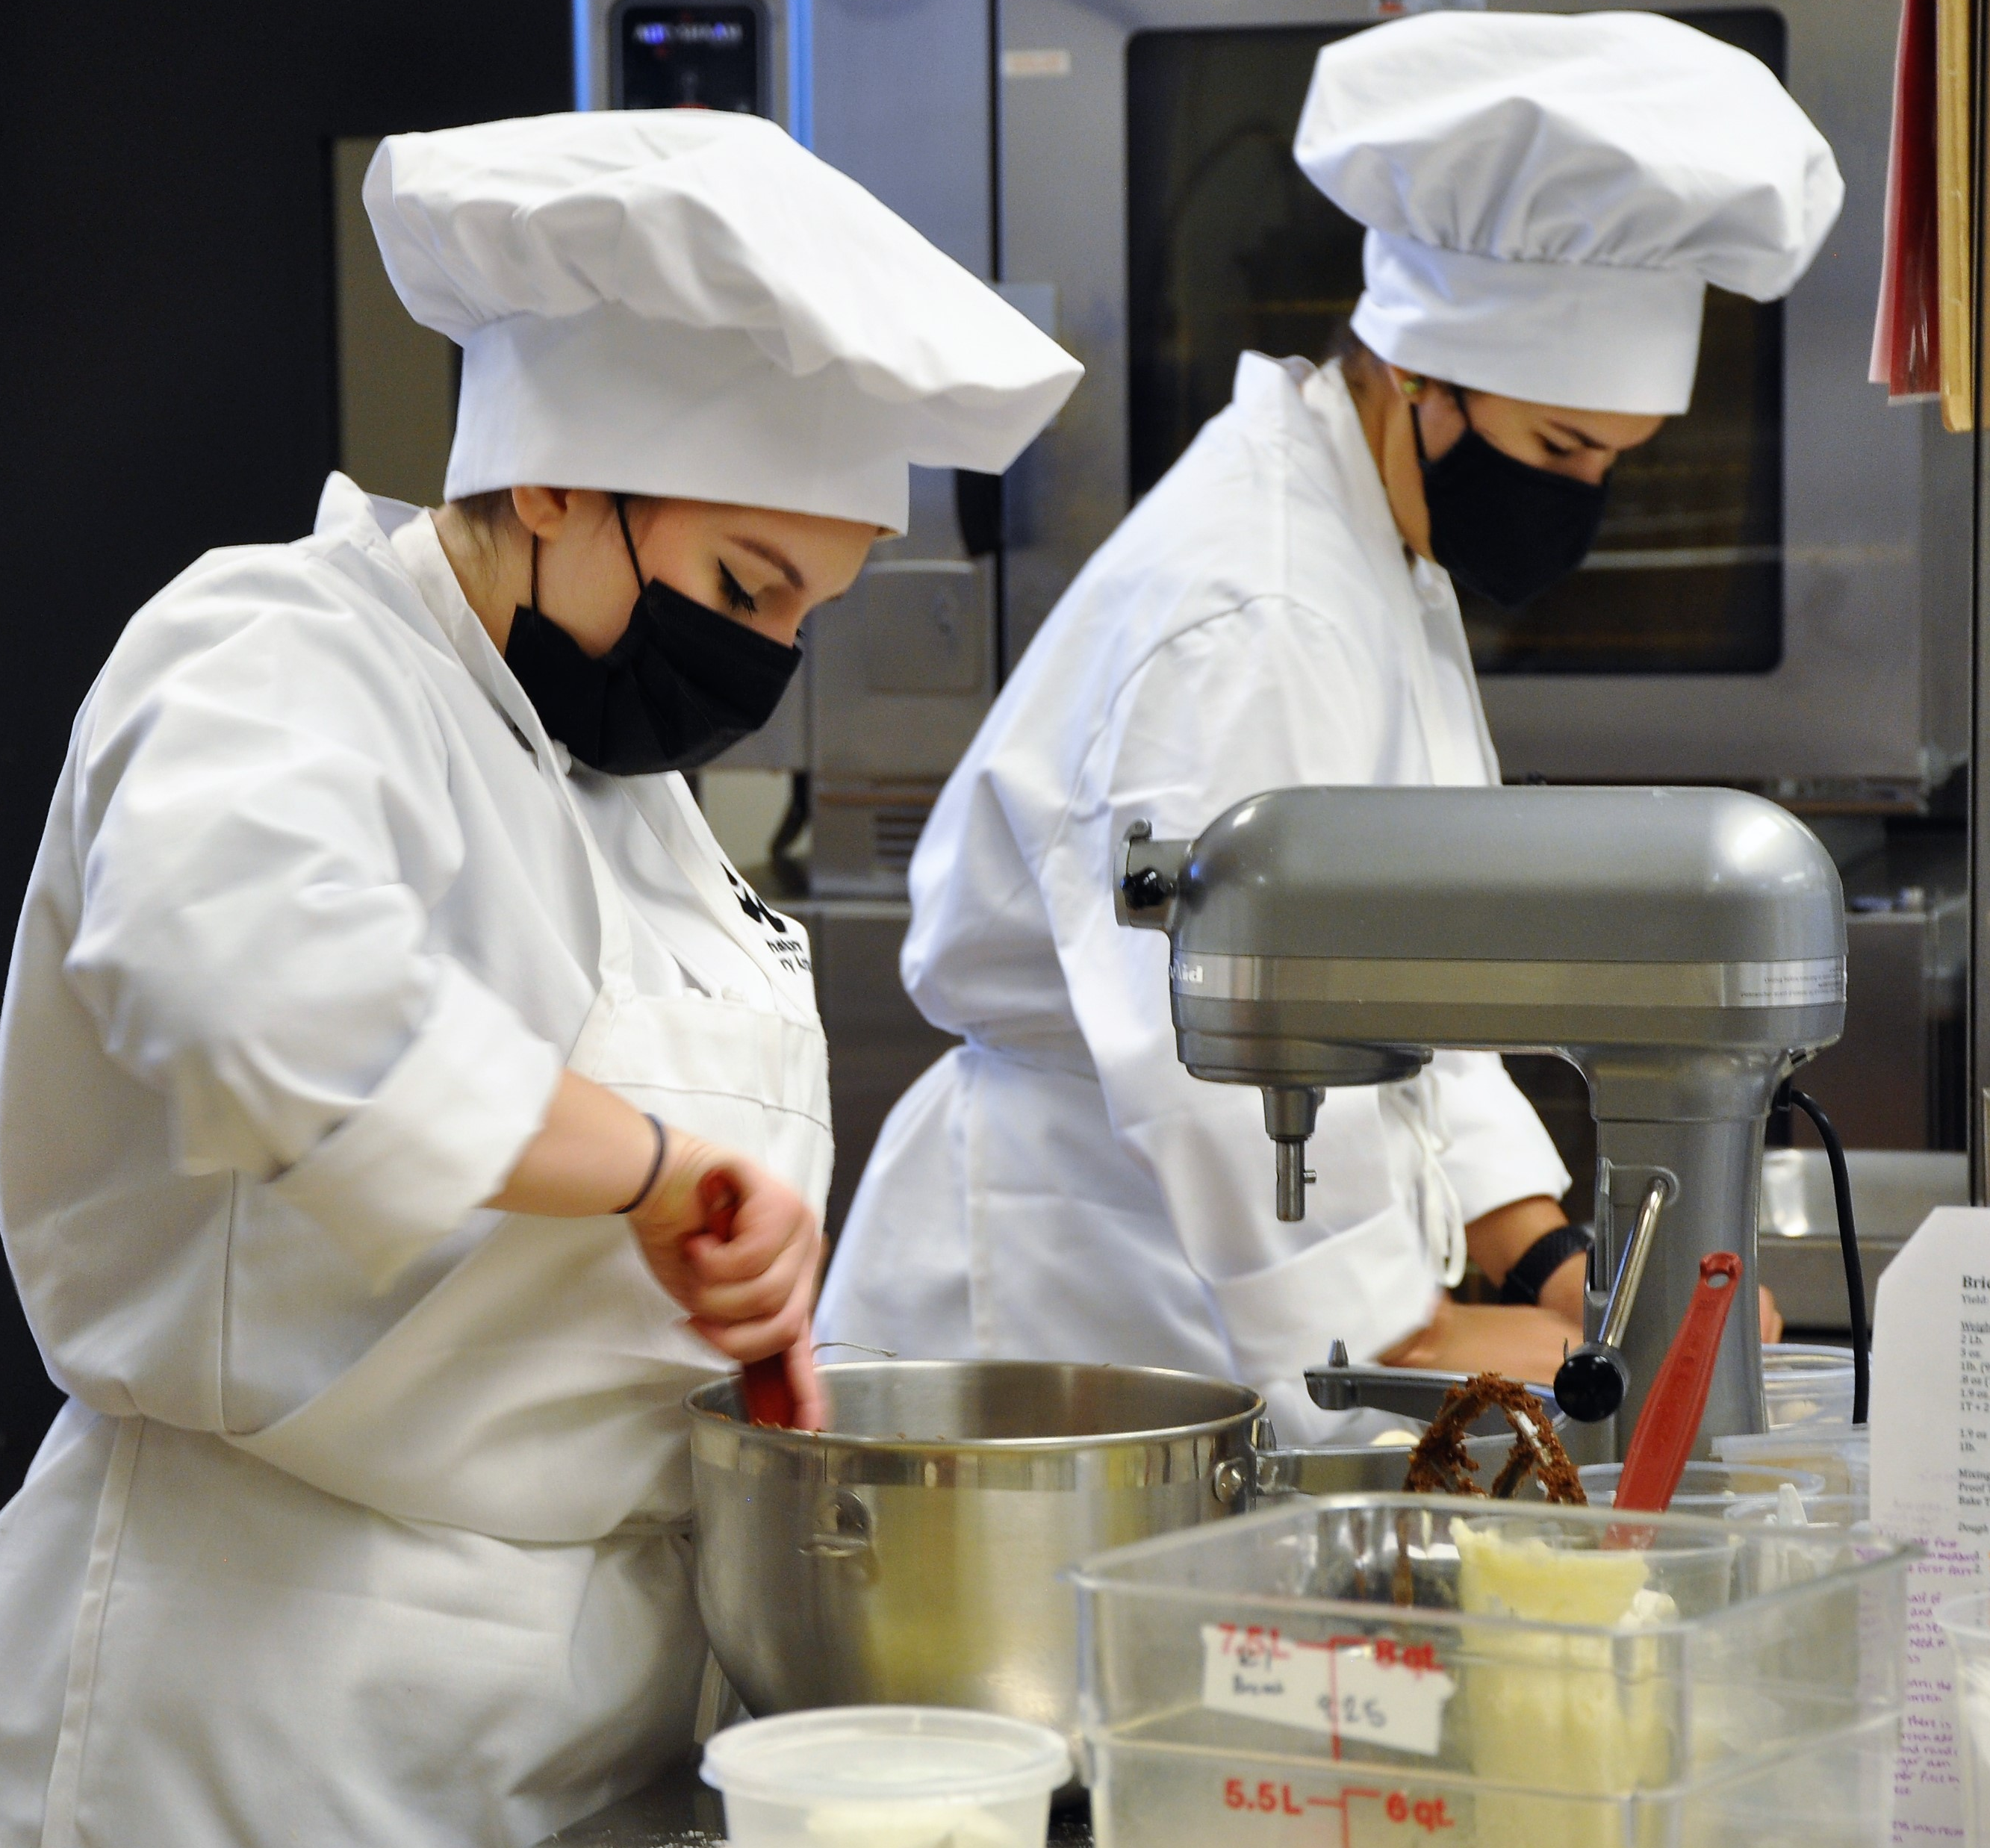
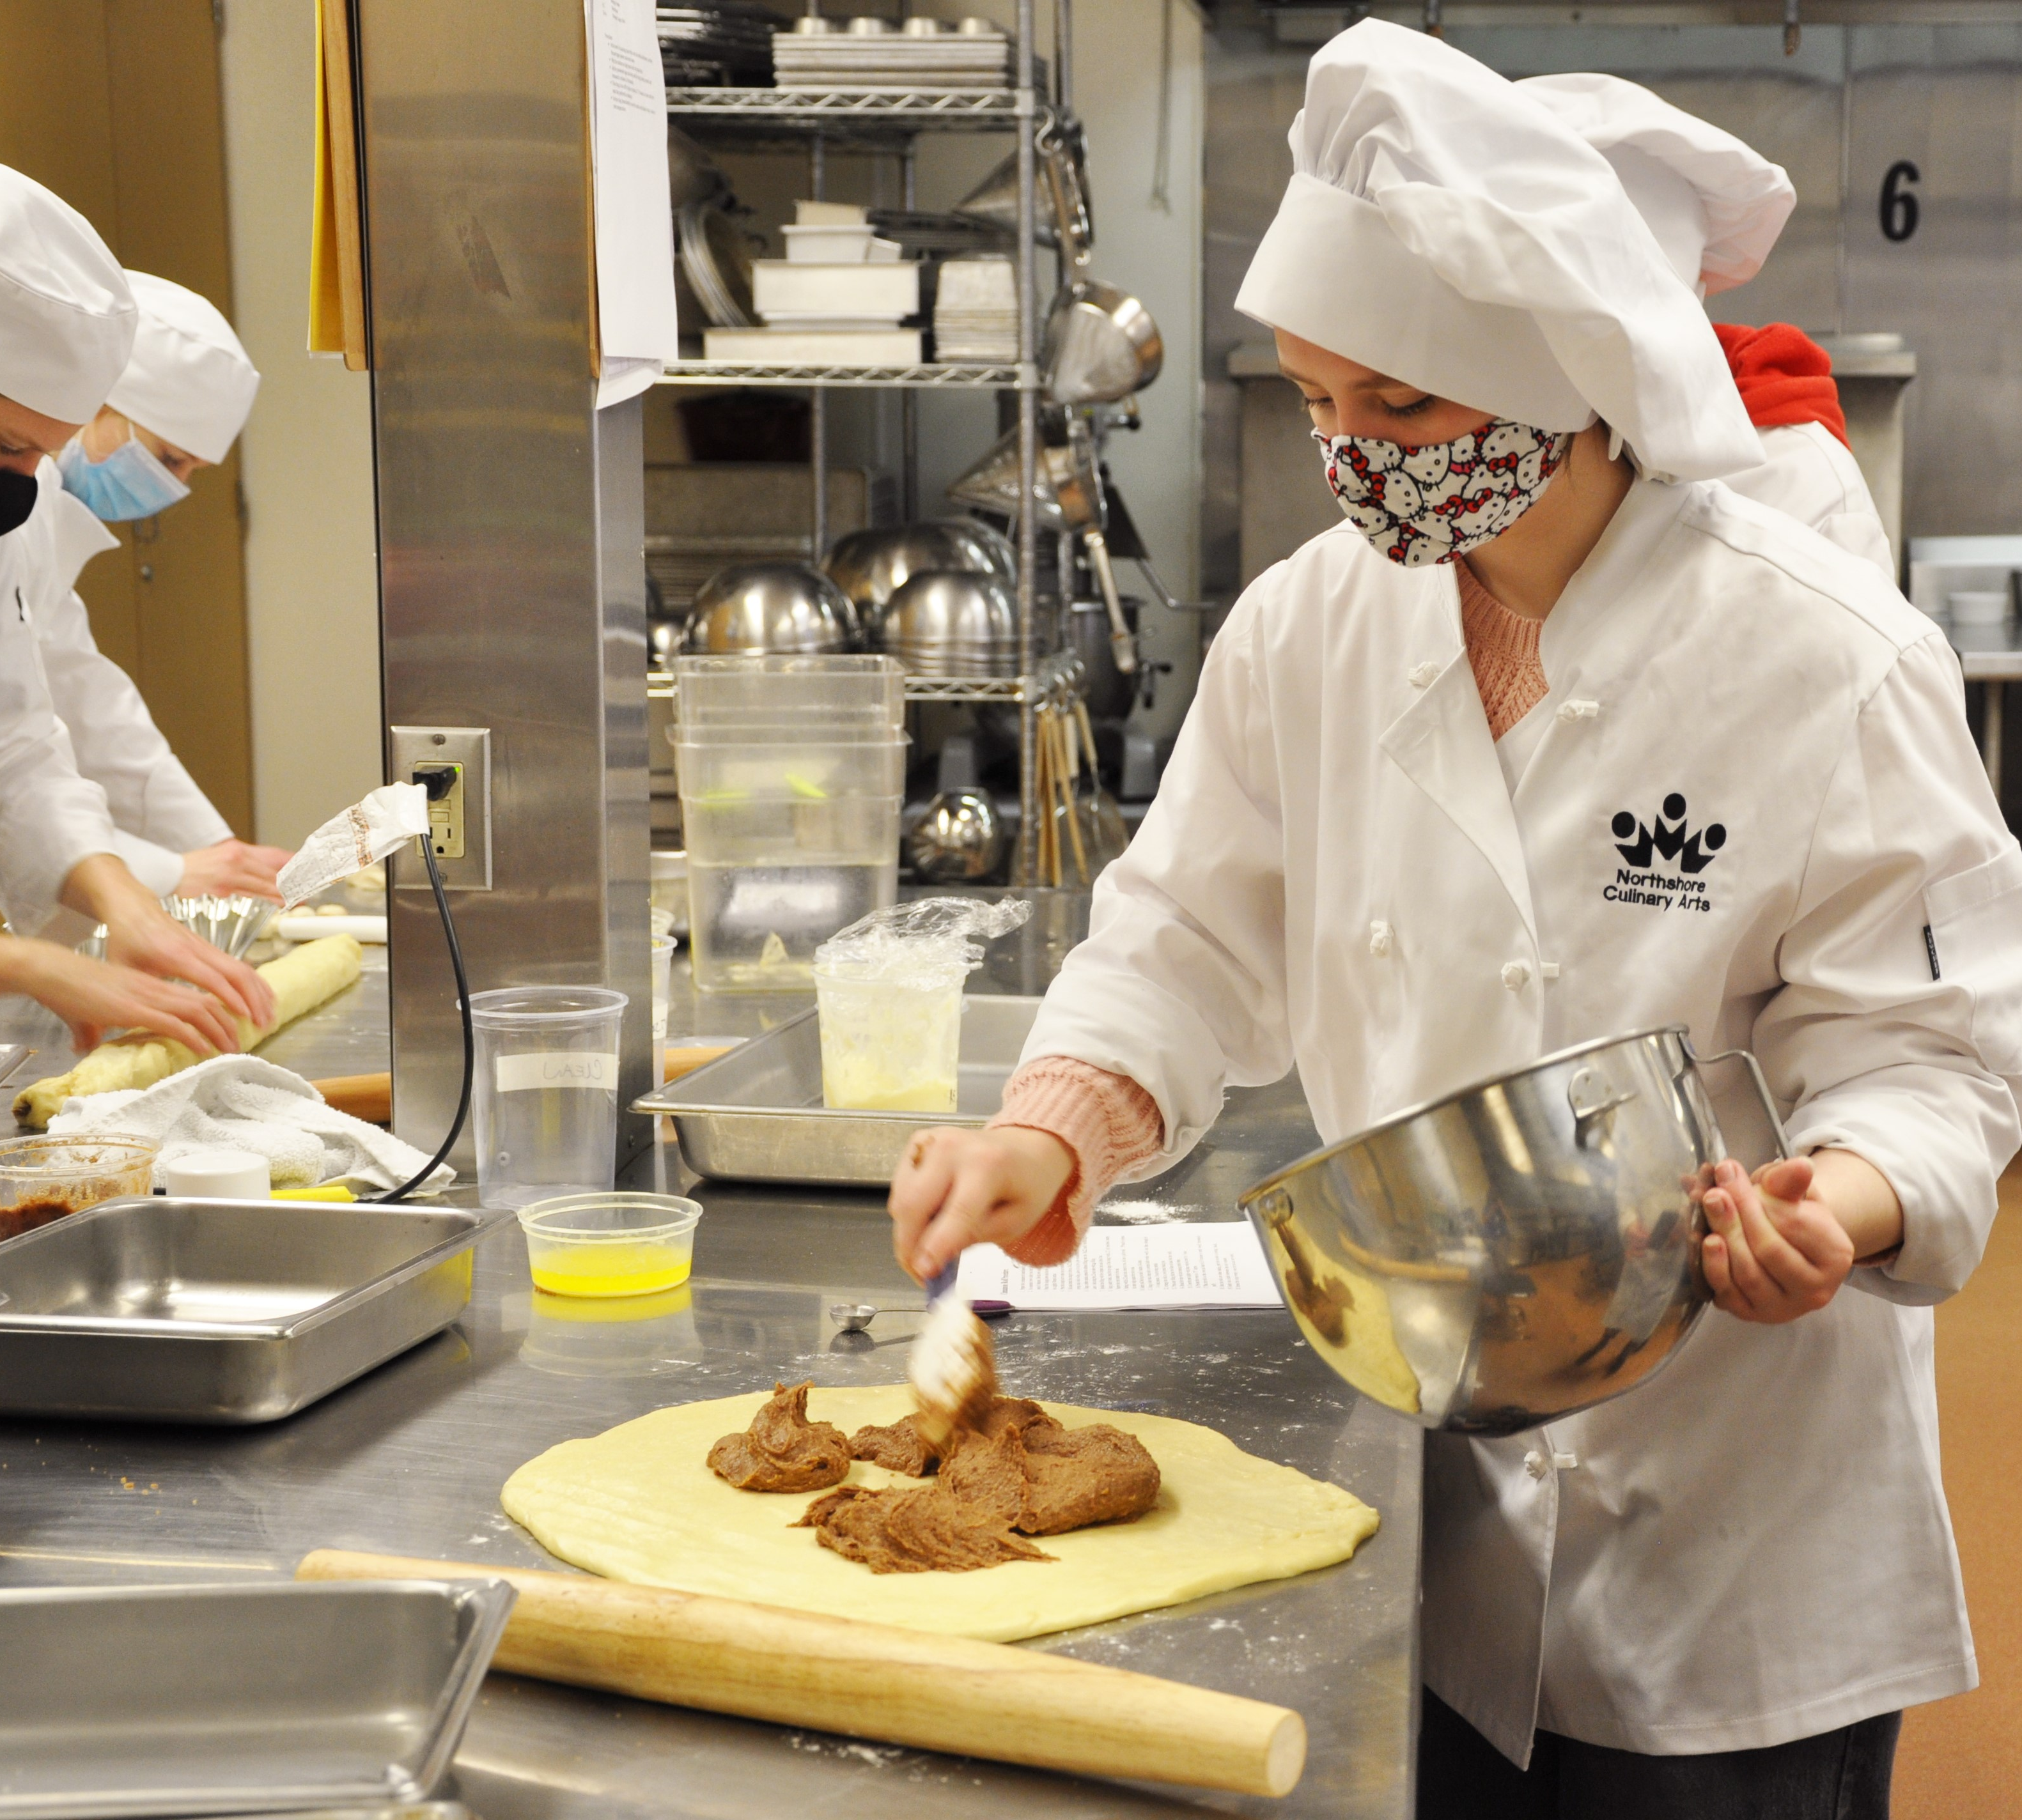
Costo de WANIC
¡Los cursos son GRATIS!
Algunos cursos/programas pueden tener tarifas de suministros/materiales
Cualquier estudiante en cualquier programa del Centro de Habilidades puede calificar para recibir asistencia si se aplica uno o más de los siguientes:
  El estudiante recibe almuerzo gratis/reducido en la escuela de envío
  La familia califica para otro programa financiado por el estado
  El consejero escolar confirma que la familia tiene necesidad financiera
Notes:
Barb
WANIC Skill Center is publicly funded so tuition is free.
Some programs may have a class fee to cover materials or supplies.
If a family has a financial need, we do have what we call “Barrier Reduction Funds” to help cover the cost of class fees and/or transportation.
Eligibility for Barrier Reduction Fund assistance:
Student receives Free and/or Reduced Lunch at the sending school
Family qualifies for other state-funded program
School Counselor can confirm family has financial need

Slide 11


Asistencia financiera
Si son elegibles para recibir asistencia financiera, los "Fondos de Reducción de Barreras" pueden cubrir costos tales como:
  Tarifas de clase, si corresponda (los fondos BR no cubren suministros opcionales)
  Costos de uniforme requeridos
  Tarjeta de gasolina o pase de autobús ORCA (ORCA gratis si es menor de 18 años)
  Otros artículos pueden estar total o parcialmente cubiertos
Notes:
Barb
Fees and Financial Assistance continued:
If a family has a financial need, we do have what we call “Barrier Reduction Funds” to help cover the cost of class fees and/or transportation

Slide 12
Servicios de soporte en WANIC
WANIC se asocia con el equipo de apoyo del estudiante de la escuela secundaria de origen para garantizar un buen ajuste y que las expectativas del programa estén claras antes de la inscripción.
  IEP (Plan de Educación Individual) Educación Especial
  504 Planes de Alojamiento
  MLL/ELL=Aprendiz Multilingüe/Aprendiz del Idioma Inglés
Padres/Familias: Conéctese con el equipo de apoyo de su escuela (administradores de casos y consejeros del IEP) si están interesados en los programas WANIC.
Notes:
Barb Beck, Special Services Program Coordinator
If your student has IEP or 504 supports, you’ll want to connect with student’s Case Manager at the high school to review the WANIC expectations and consider if best fit for student’s Transition Plan.
MLL - Multilingual Learning
If student is significantly challenged to access the Skill Center curriculum and learning, it will be responsibility of the ‘Sending School District/ High School’ to provide any additional MLL supports
If you have any students who have an IEP or 504 accommodations or who will be participating in your district’s Transitional Academy, please reach out to Barb as early as possible – ideally BEFORE students submit applications and certainly before they are being considered for enrollment.
Barb can work with you to determine if WANIC is the best fit for your student. It is not always the case.
With early communications with Barb, we can work to have a plan in place for all the necessary and appropriate supports to be available for these students.
An early and ongoing relationship between the student, parent/guardians, counselor, case manager, Barb and the whole support team is so important to set each student up for success.
This year, part of the application approval process will ask Career Specialists to let us know if a student is enrolled in a transitional program. Barb will need to reach out early on in the process to determine eligibility and suitability.
Remember any special accommodations, beyond what can be reasonably be provided by the instructor, must come from the sending school.

Slide 13


Crédito Dual- Escuela preparatoria y college
Los estudiantes pueden obtener créditos universitarios además de créditos de la escuela preparatoria/High School.
Crédito universitario principalmente a través de Bellevue College o LWTech
Debe solicitar créditos universitarios y pagar la cuota antes de la fecha límite de fin de año
Debe obtener una calificación B o superior
PNWCC proporciona el expediente académico de la universidad
Los estudiantes de WANIC/DigiPen tienen la oportunidad de obtener créditos para el Instituto de Tecnología DigiPen
DigiPen: El estudiante y el padre/tutor deben declarar la intención de obtener crédito al comienzo del año
Notes:
Barb
DUAL CREDIT
Most WANIC programs offer DUAL CREDIT, meaning students may earn college credits in addition to their high school credits.
Articulation agreements between WANIC and COLLEGES allow students to earn college credit if they maintain grade of B or better over course of two semesters
WANIC program agreements exists mainly with Bellevue College and Lake Washington Institute of Technology (LWTech)
Most college credits are managed by Pacific Northwest College Credit (PNWCC),
Starting in December, WANIC instructors assist students to sign up with PNW college credit. Students select which college they would like to get credits with. For example, Bellevue College or Lake Washington Technical Institute (LWTech)
Students eligibility includes earning a B grade or better – this qualifies them for the college credit.
Students must apply for college credits.
The college transcripts become available through PNWCC the following summer after completion of school year program.
For more information visit the PNW college credit website www.pnwcollegecredit.org or email info@pnwcollegecredit.org
*LINKED on our FINAL slide – RESOURCES
DigiPen students have opportunity to earn college credit for DigiPen Institute of Technology. Early in the school year, students are required to sign a declaration of intent. They are then guided through a more advanced curriculum and if they earn a B or better, DigiPen will grant them the college credits, applicable to the DigiPen Institute of Technology. If these students pursue a college degree at DigiPen Institute of Technology, they will be exempt from paying tuition for certain required college classes.
NOTE: DigiPen college credits are not earned through PNW College Credit.
< BRING your individual QUESTIONS to the OPEN HOUSE March 16 >

Slide 14
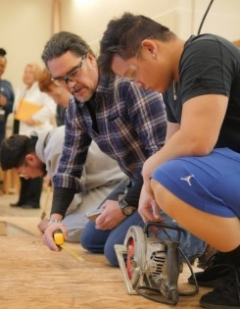

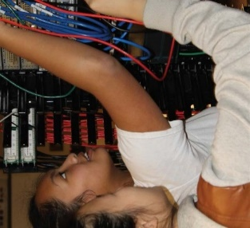
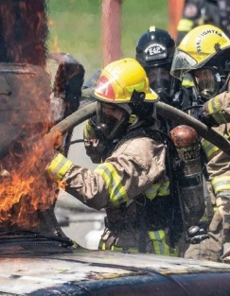
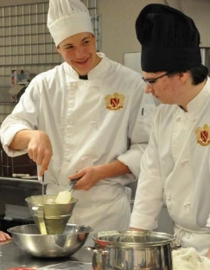
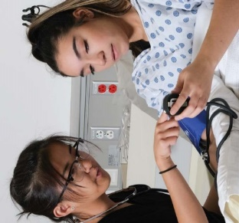
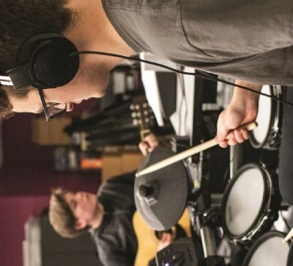
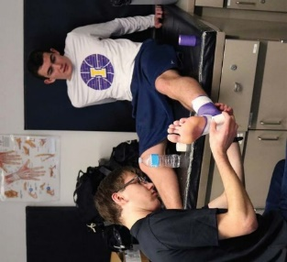
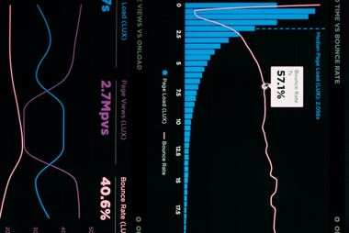
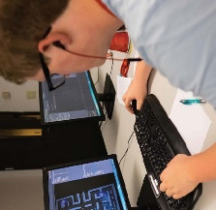
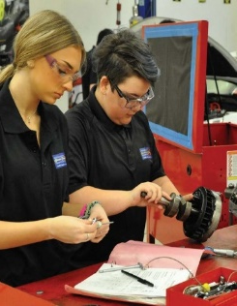

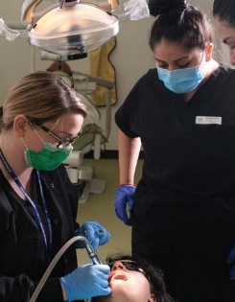
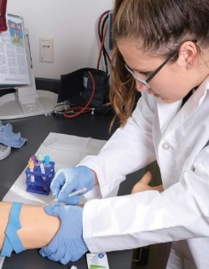
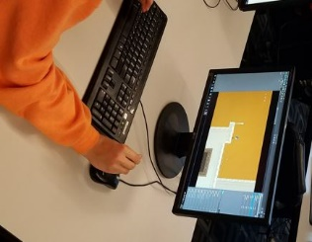
Programas del Centro de Habilidades
The following slides list the WANIC programs offered next year
Para obtener una lista completa y descripciones de los programas WANIC
ofrecida para 2023-24, visite nuestro sitio web: wanic.org
Notes:
Steve all programs

Slide 15


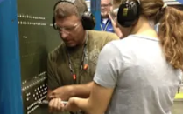
Aerospace Manufacturing Core Plus
New!
NEW
Liberty HS
En este curso práctico, se sumergirá en el mundo de la fabricación y la aviación de alta tecnología, explorando cómo se diseñan, construyen y prueban los aviones y los componentes de vanguardia. Aprenda sobre ciencia de materiales, física aplicada, sistemas eléctricos, hidráulica, fabricación de chapa metálica y mucho más mientras aborda desafíos y proyectos del mundo real.
Notes:
The DigiPen Data Analytics and Visualization program is a new offering from DigiPen this year!
*The math credit is in the approval process.
computer science-based program examines practical challenges involving complex real world data.
Students learn to extract strategic insights from data, build predictive models to forecast future trends, and efficiently communicate them to inform business strategy.
Algebra 2 is a pre-requisite, requiring successful completion prior to enrollment (as this is math intensive program)

Slide 16
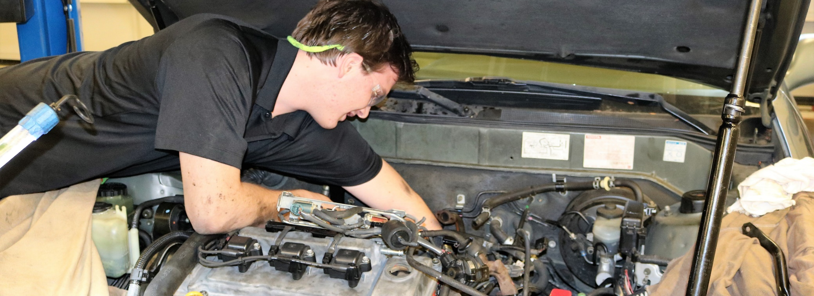
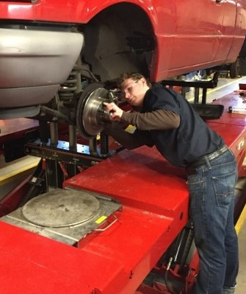
Tecnología automotriz
Bothell HS, Bellevue HS
Descubra la experiencia del mundo real de las carreras automotrices.
Certificación de la industria obtenida: Excelencia en el servicio automotriz (ASE)
Notes:
Auto Tech is offered at Bothell HS (Northshore SD) and Bellevue HS (BSD)
Learning includes topics that revolve around the eight nationally recognized Automotive Service Excellence (ASE) areas.
Students work on shop-owned vehicles as well as public and student vehicles.
Leadership skills are learned through SkillsUSA, job shadowing at local shops and dealerships, and class club activities.
At Bothell and Bellevue, students can participate in their 2-year program to get in-depth exposure to the automotive industry.
April 15th is the priority enrollment date for this program so interested students should submit an application well before this date.

Slide 17
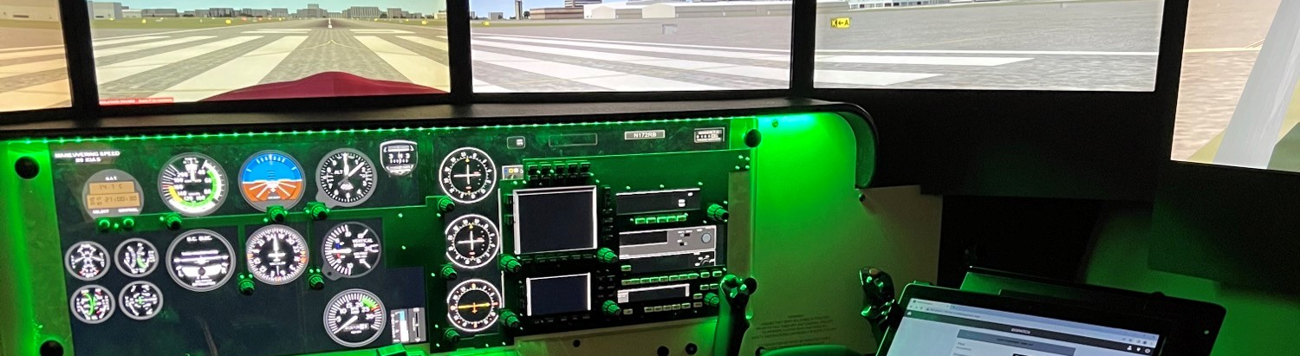
Tecnología de Aviación - STEM
WANIC @ LWTech
Este curso STEM es un punto de entrada a una multitud de carreras en la industria de la aviación, como piloto de aerolínea, operador de sistemas de aeronaves no tripuladas o controlador de tráfico aéreo. Los estudiantes usarán un simulador y pueden obtener certificados de la escuela de tierra.
Notes:
The Aviation Program will be NEW for Fall 2023 at WANIC main site on LWTech campus
Students will learn VFR -visual flight rules, and IFR -Instrument flight rules, and drone skills
Location will be at the WANIC main campus on LWTech college site
NOTE: successful completion of Geometry is a pre-requisite for this program.

Slide 18
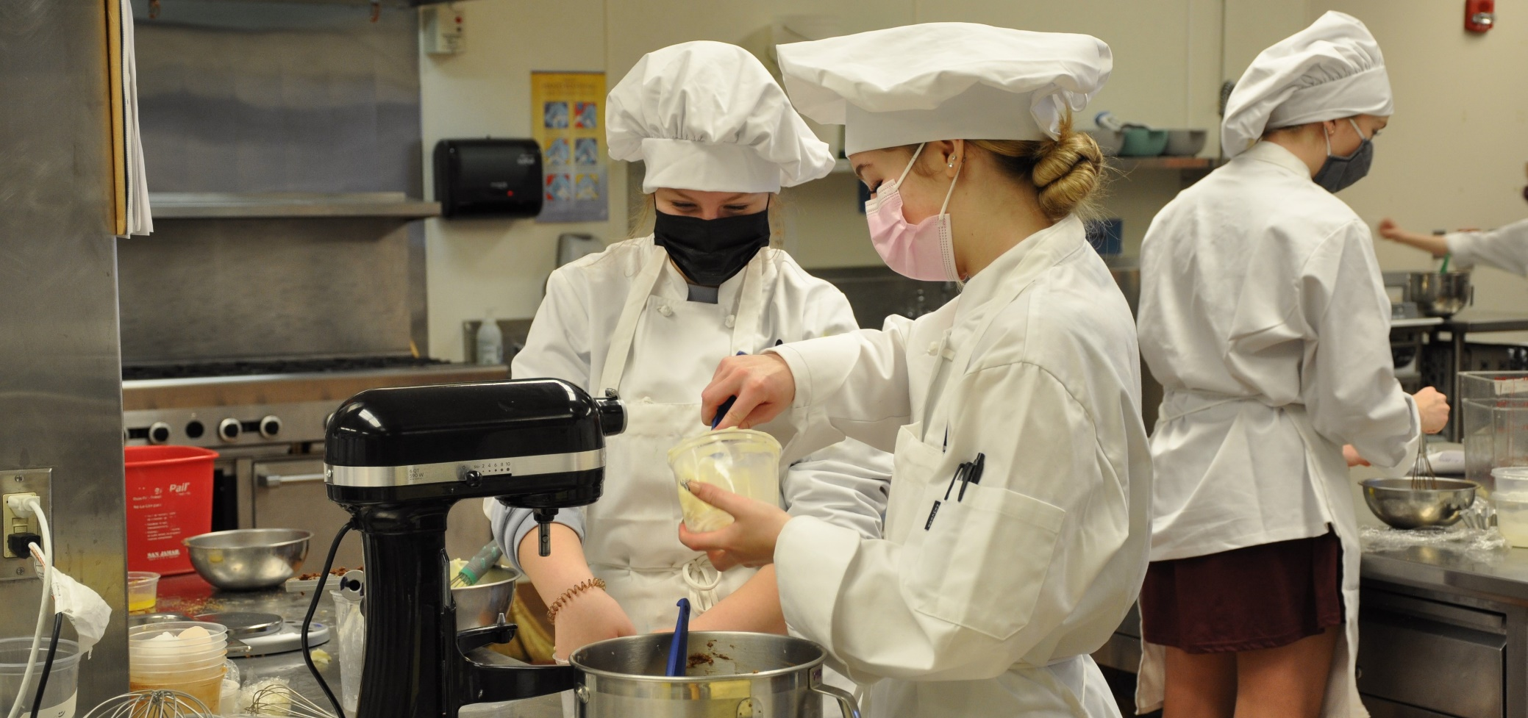
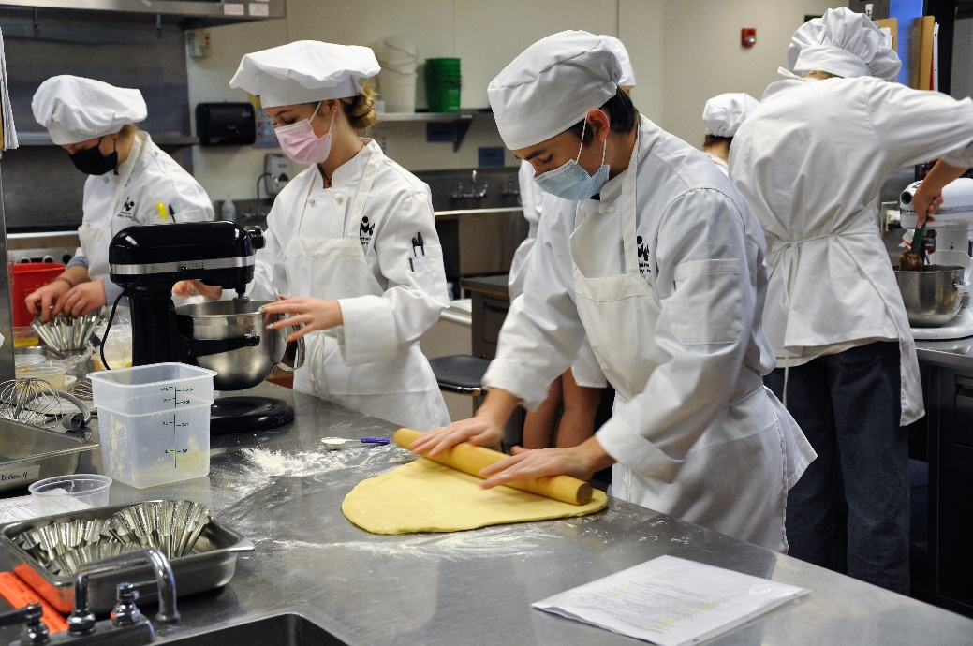
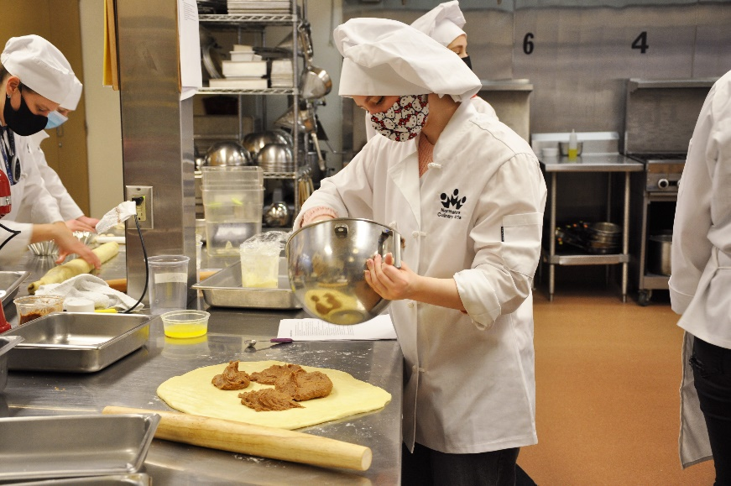
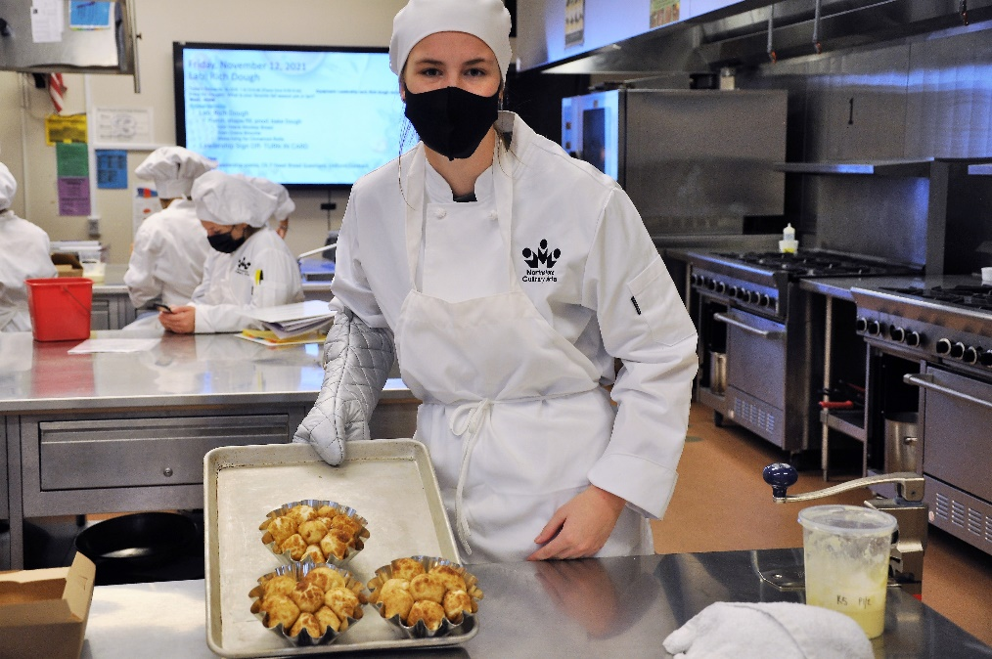
Panadería y pastelería
Bothell HS
Aprenda técnicas de mezclar, dar forma y doblar, mientras aplica la ciencia y las matemáticas detrás de la repostería. Practique técnicas de decoración como la guarnición de azúcar y chocolate en una cocina bien equipada y estándar de la industria.
Notes:
The Baking & Pastry program was NEW this year (2022-23) !
It is offered at Bothell High School (in Northshore SD) in a well-equipped, industry standard kitchen.
Students learn techniques of mixing, shaping, folding, and decorating while applying the science and math behind baking.
Right now it is only the morning session for WANIC
April 15th is the priority enrollment date for this program so interested students should submit an application well before this date.

Slide 19
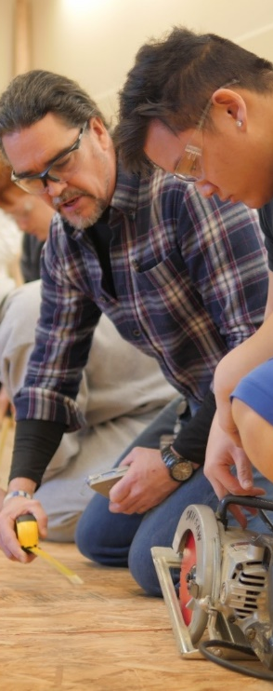
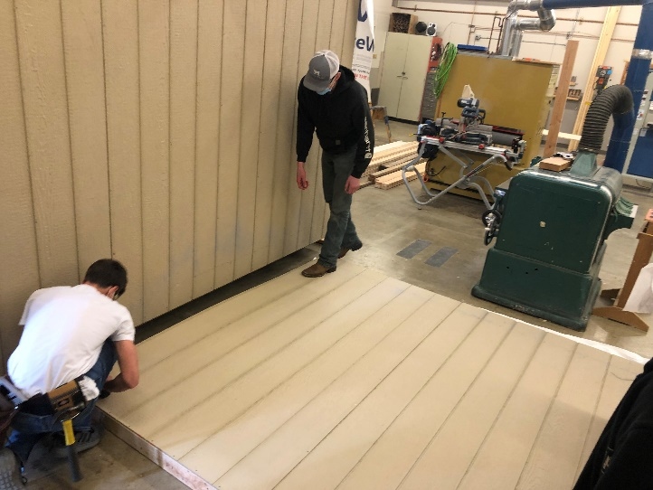
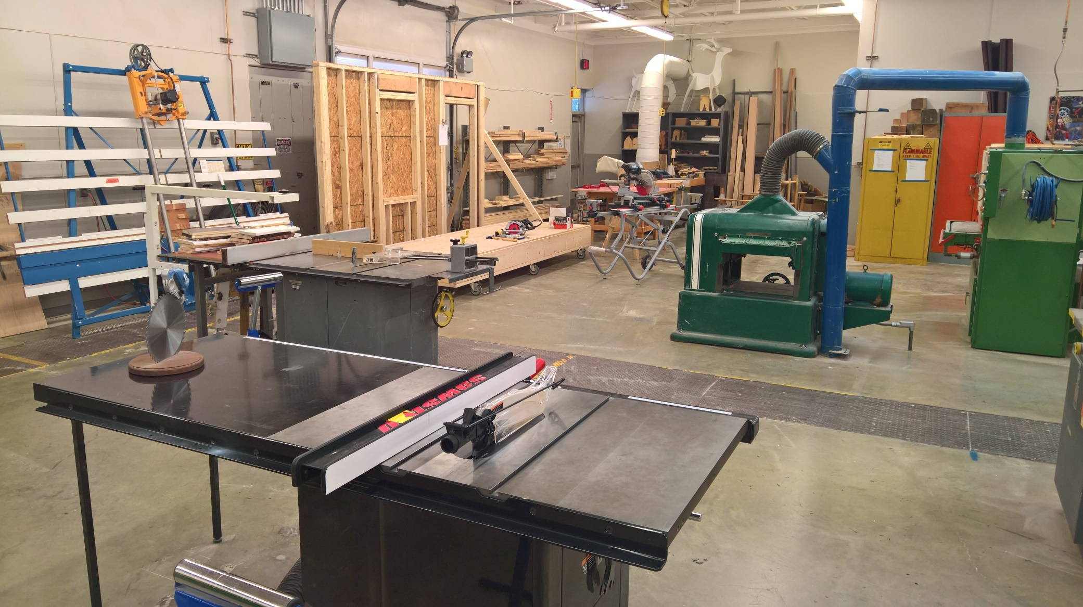
Tecnologías para la industria de la construcción
Construcción Core Plus
I
Interlake HS, Bothell HS
Habilidades básicas de la construcción, uso y seguridad del equipo del taller, medición de precisión, ciencia de los materiales, lectura de la impresión, mantenimiento extenso del registro.
Notes:
Building Industry Technologies is a Core-Plus Construction program
at Interlake High school (Bellevue SD) and next year (2023-24) at Bothell High School (Northshore SD)
This program is now a pre-apprenticeship pathway partnered with the Carpenter's Union
WANIC partners with this Washington based program (Core Plus) that offers curriculum, industry expertise, state of the art equipment, and support to encourage young people to explore the real-world, hands-on construction industry.
Students utilize different materials and methods, learn to safely operate various industry tools, and design and implement hands-on skills such as rigging and lifting.
They read and interpret basic plans and engineering drawings, and they apply academic concepts such as mathematics and physics to project design and management.
April 15th is the priority enrollment date for this program so interested students should submit an application well before this date.

Slide 20
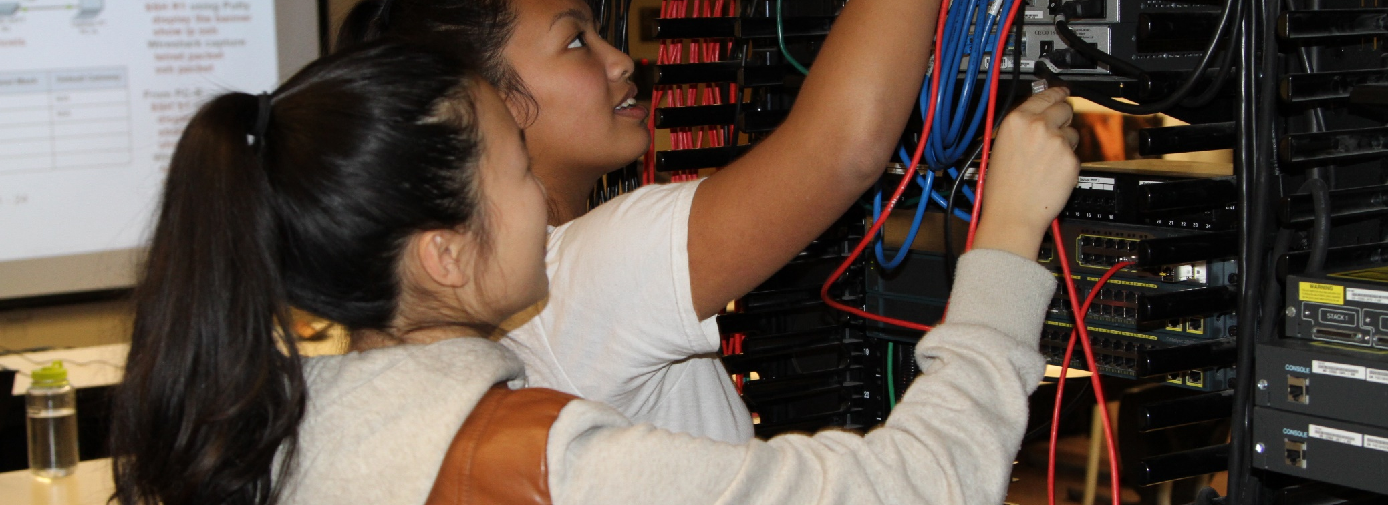
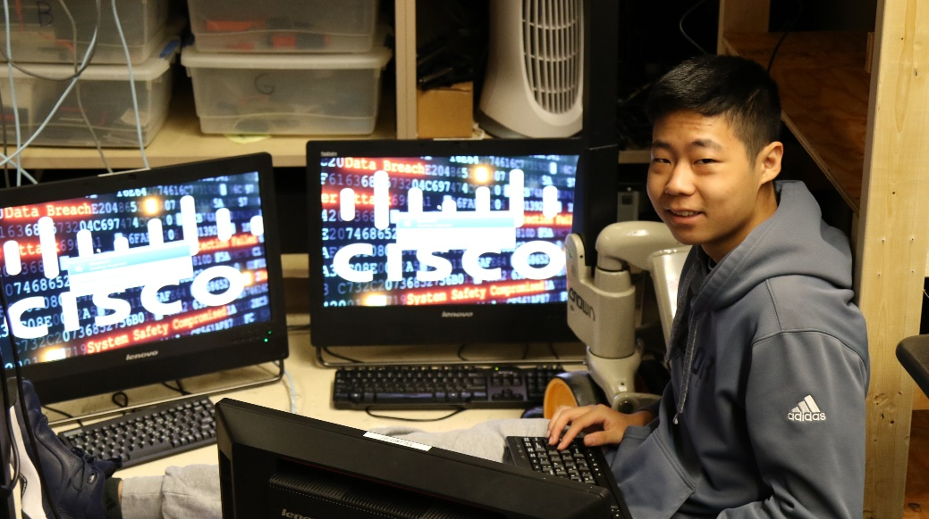
Academia de Redes de Cisco
Newport HS
Laboratorio de redes de última generación. Diseñe, construya, administre y solucione problemas de redes.
Certificaciones de la industria obtenidas: Año 1 – CCNA (Cisco Certified Networking Associate)
Año 2 – CCNP (Profesional de Redes Certificado por Cisco)
Notes:
The Cisco Networking program is located at Newport High School (in the Bellevue School District)
students work in a high-end lab to discover how to design, build, manage, and troubleshoot corporate enterprise networks.
At the end of the Year 1, students take the CCNA exam to become a Cisco Certified Networking Associate.
Students who successfully complete Year 1 can choose to apply for the Year 2 program.
At the end of Year 2, students take the CCNP exam to become a Cisco Certified Networking Professional.
April 15th is the priority enrollment date for this program so interested students should submit an application well before this date.

Slide 21
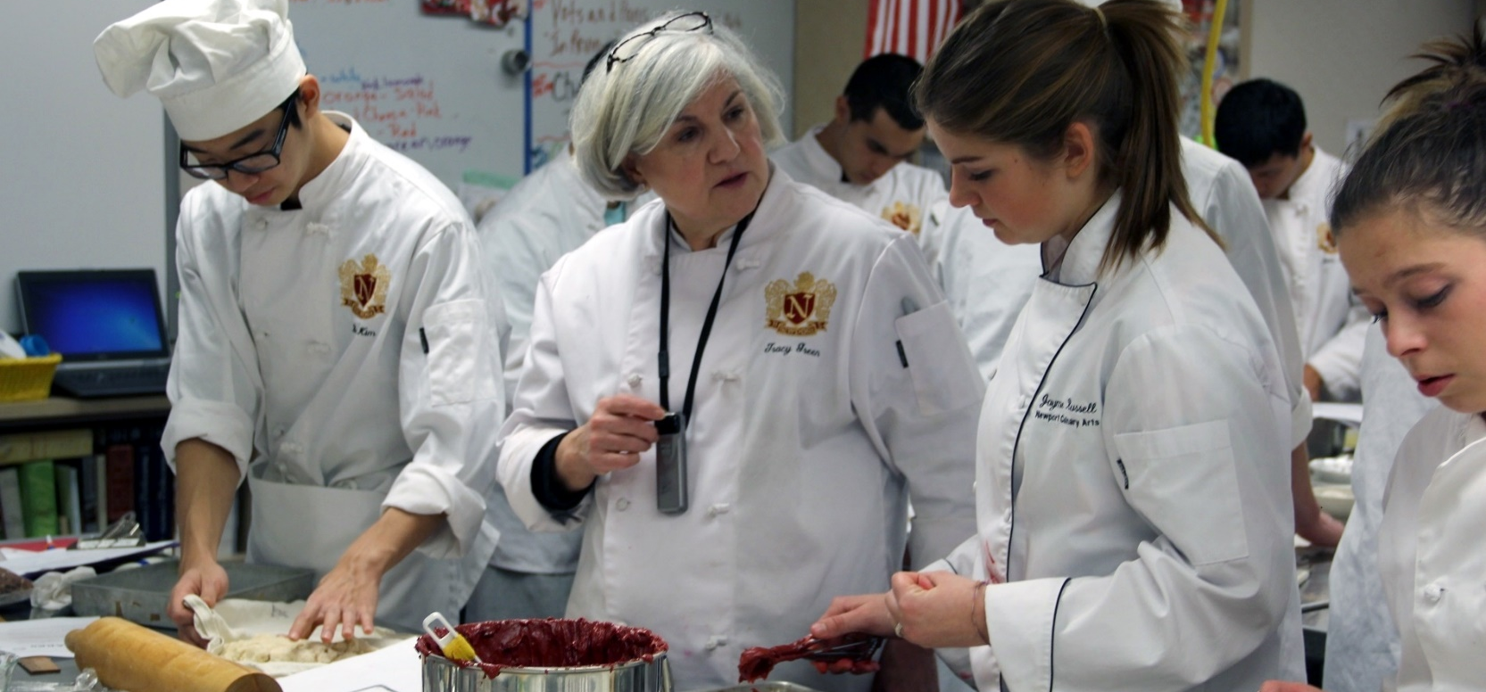
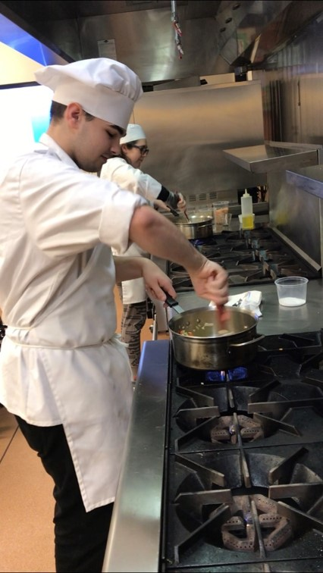
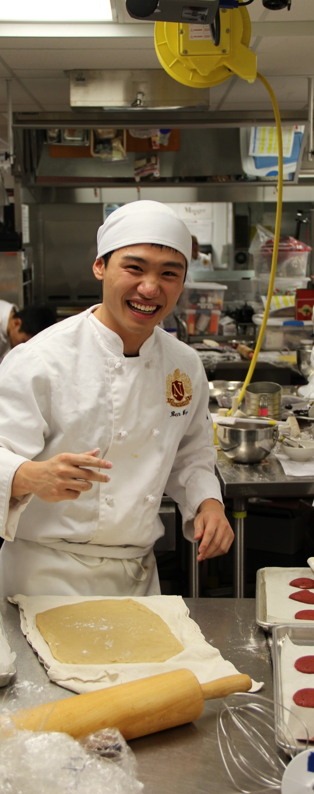
Artes Culinarias
Newport HS
Explore carreras en una variedad de industrias relacionadas con los alimentos. Aprenda técnicas profesionales de producción de alimentos, administración de restaurantes, catering, compras, liderazgo y más.
Certificaciones de la industria obtenidas: Permiso de Manipulador de Alimentos
Notes:
Culinary Arts is at Newport High School (in the Bellevue School District)
Students explore careers in a variety of food related industries and earn their food handler’s permit.
This is a comprehensive, career-focused introduction to the fundamentals of culinary arts and the professional kitchen.
The classroom is set up as a fully functional commercial kitchen
Students who successfully complete Year 1 may apply for the Year 2 program.

Slide 22
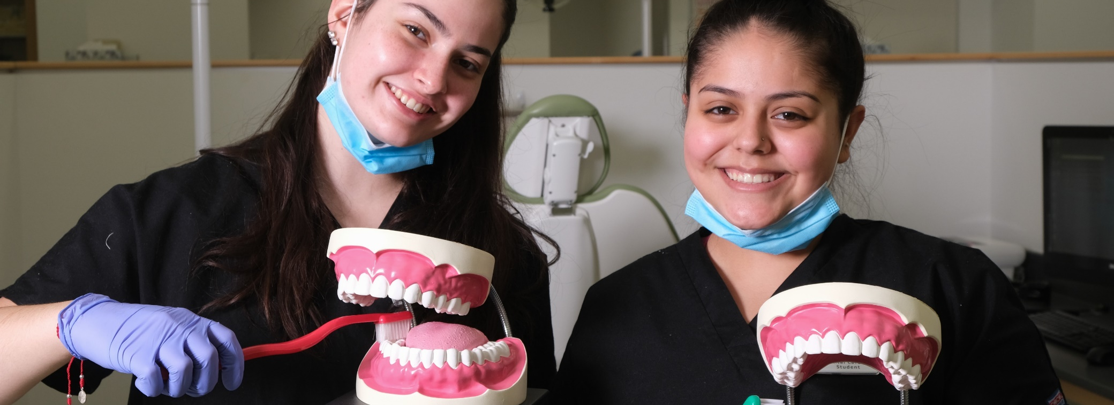
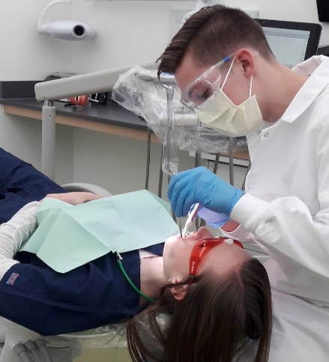
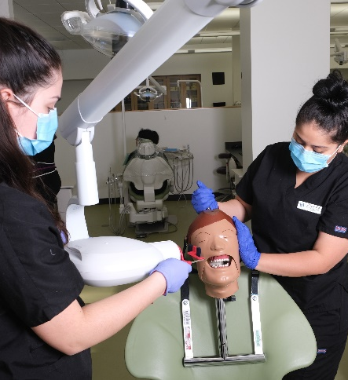
Carreras Dentales
WANIC @ LWTech
Explore las oportunidades de carreras dentales. Aprenda sobre instrumentos, procedimientos, esterilización, radiografía, anatomía, control de infecciones, etc. Laboratorio y equipos dentales de última generación.
Certificaciones de la industria obtenidas: Primeros Auxilios y RCP (pruebas adicionales opcionales)
Notes:
Dental Careers is at WANIC main site on LWTech
This class is a mix of college-level theory, hands-on skills practice in the lab, and clinical internships at dental offices.
students learn about instruments, procedures, sterilization, radiography, anatomy, infection control, and more.
A highlight of the year is when families come in for teeth-cleaning by their students!
Students earn their Basic Life Support First Aid and CPR certificate for professional caregivers.
Plus, they are prepared to test for their Dental Assisting (NELDA) certificate at the end of the school year.
NOTE: This NELDA certification is not needed in Washington State to obtain a job as a dental assistant. However, to work as dental assistant in Washington State, there are mandatory steps to take to get registered with the Department of Health. The instructor goes over these steps in class in the 4th quarter.
Successful completion of Biology is strongly recommended prior to enrolling. ​

Slide 23
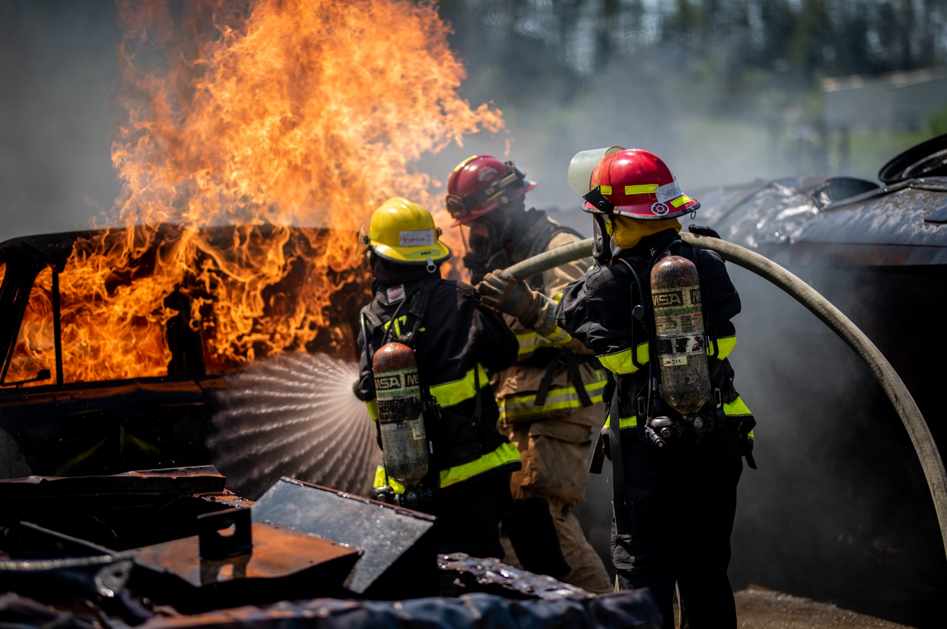
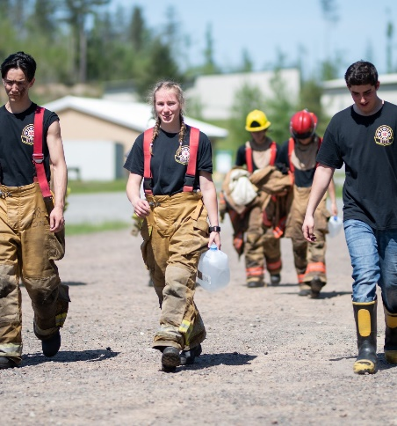
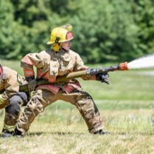
Bomberos & EMS
WANIC @ LWTech
Parte de cada semana la pasa en los departamentos de bomberos locales. La clase es una mezcla de formación práctica y académica.
Certificación de la industria obtenida: Primeros auxilios y RCP
Notes:
The Fire & EMS program is located at WANIC main site on LWTech and is taught by active off-duty firefighters
Fire & EMS prepares students for a career in the fire service and to be an integral part of a community emergency response team.
Students drill at fire stations all over the Eastside in ‘bunker gear’ to get the full experience.
The highlight of the year the ‘live fire’ event at the Washington State Fire Training Academy in North Bend, WA
The program includes college level academics combined with energetic, hands-on skills practice.
students earn their Basic Life Support First Aid and CPR certificate for professional caregivers.
Students who successfully complete Year 1 may apply to continue on with Year 2.

Slide 24
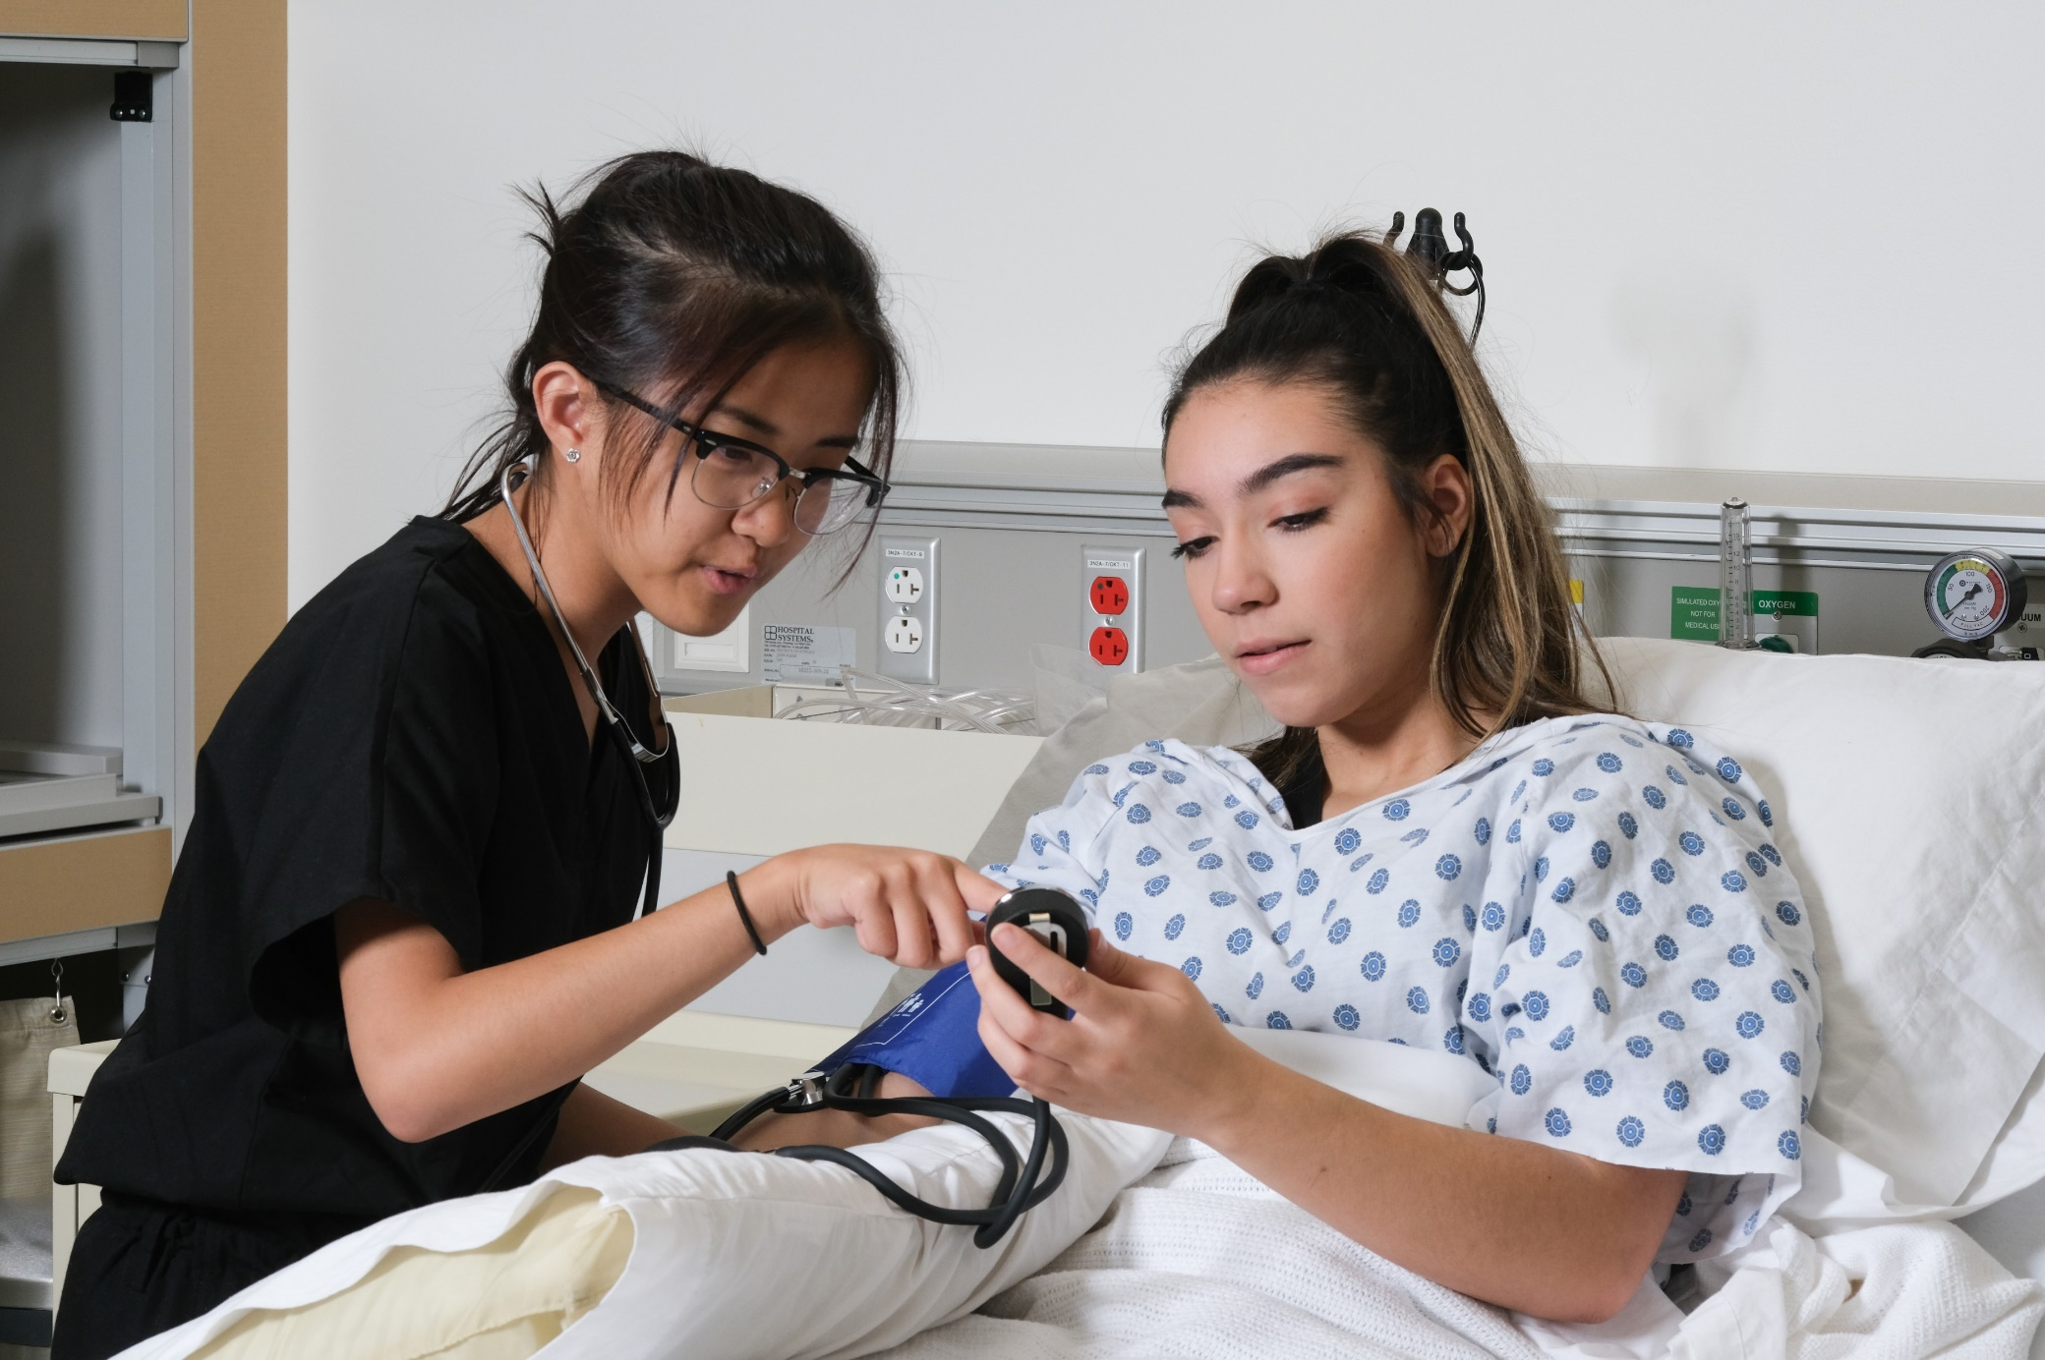
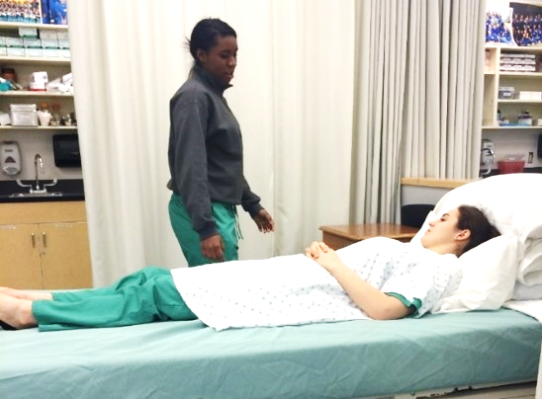
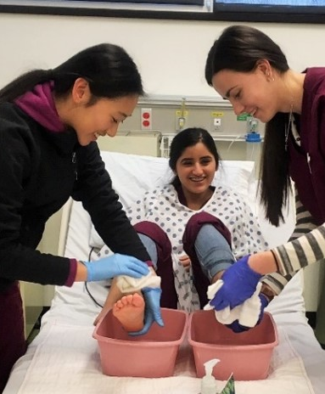
Carreras de Ciencias de la Salud (Enfermería)
WANIC @ LWTech, Sammamish HS, Woodinville HS
Experiencia de la vida real en clínicas de atención médica.
Certificación de la industria obtenida: Primeros auxilios y RCP (pruebas adicionales opcionales)
Notes:
The Nursing program is offered at three locations:
the WANIC main site on LWTech campus,
Sammamish High School (in the Bellevue School District)
Woodinville High School (in the Northshore School District)
Besides opportunity to pass the Nursing Assistant Certification (NAC), students will also earn their Basic Life Support First Aid and CPR certificate for professional caregivers.
Students practice skills in the Nursing Lab and they spend at least 40 hours at nearby health care clinics in order to meet the Nursing Assistant Certified (NAC) requirements.
In addition to college level academics, there is a robust practical component.
Successful completion of Biology is strongly recommended prior to enrolling.

Slide 25

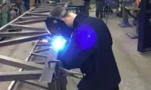
Soldadura marítima Plus
NEW
Interlake HS
  Sumérgete en el fascinante mundo de la ingeniería marítima y la soldadura. Los estudiantes tendrán una base sólida para iniciar una carrera exitosa en soldadura marítima, construcción naval o campos relacionados, con un fuerte énfasis en las prácticas de navegación responsables.
  Certificaciones de la industria: Tarjeta de seguridad para navegantes de Washington
Notes:
WANIC is excited to partner with world-renowned Institute for Systems Biology (ISB) to offer this new course
will be NEW for Fall 2023 at WANIC main site on LWTech campus
Interdisciplinary STEM and healthcare professionals are trained in biology, engineering, physics, computer science, environmental sustainability, health, big data, and technology.
Students actively engage in a series of hands-on laboratory, computer, and community-based units involving medical systems
that aim to be participatory, personalized, predictive, and preventative
Biology is a pre-requisite, requiring successful completion prior to enrollment

Slide 26

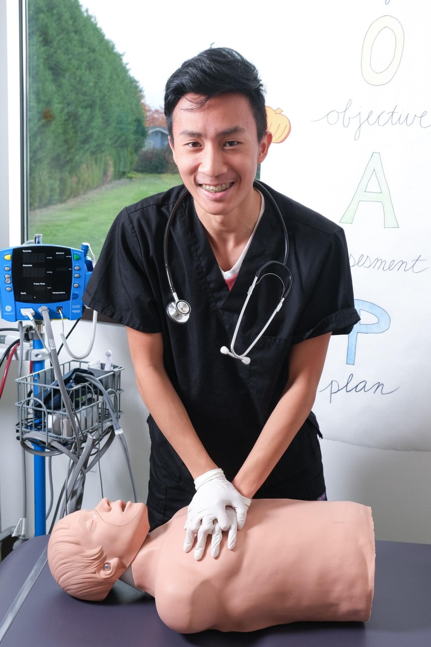
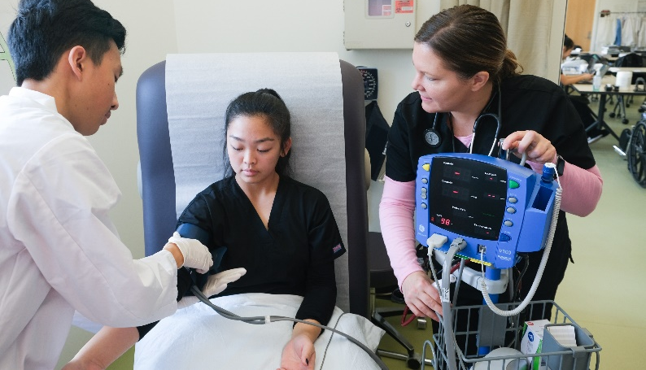
Carreras Médicas
WANIC @ LWTech
Explora los campos de la medicina y la asistencia médica.
Excursiones, sombras de trabajo, oradores invitados.
Certificación de la industria: Primeros auxilios y RCP
Notes:
The Medical Careers program is located at the WANIC main site on the LWTech campus,
Classes meet in a facility that mimics doctors’ examination rooms
students learn treatment room procedures, surgery instrument prep, office practices, vital signs, medical ethics, and more.
This course prepares students for the world of doctors, nurses, and other healthcare professionals.
After completing this program, students interested in pursuing their (Medical Assistant) MA certificate will require 4 more quarters of college.
They also earn their Basic Life Support First Aid and CPR certificate for professional caregivers.
Successful completion of Biology is strongly recommended prior to enrolling.

Slide 27
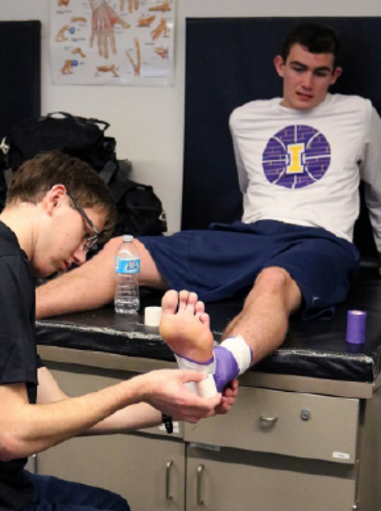

Medicina Deportiva
Issaquah HS
Aprenda anatomía, fisiología, terminología médica, nutrición, prevención de lesiones, rehabilitación, vendaje y envoltura, instrucción en el aula, participación en el laboratorio, pasantías de campo
Certificación de la industria: Primeros auxilios y RCP
Notes:
Sports Medicine is offered at Issaquah High School (in the ISD)
This is an advanced and accelerated course where students gain practical skills in the lab as well as assisting at high school sporting events
Students learn anatomy, physiology, medical terminology, First Aid & CPR, nutrition, injury prevention, rehabilitation, and taping and wrapping
All through classroom instruction, lab participation, and field internships.
Successful completion of Biology is strongly recommended prior to enrolling.
April 15th is the priority enrollment date for this program so interested students should submit an application well before this date.

Slide 28



DigiPen Arte y Animación
WANIC DigiPen Campus
Aprende habilidades para tener éxito como artista, ilustrador o animador.
Notes:
DigiPen Art & Animation provides students with the baseline skills to succeed as an artist, illustrator or animator.
In this program, students study professional production animation from traditional art theory and skills development to composition and storytelling in 2D animation and 3D modeling.
In the second year, students may submit a portfolio and possibly earn Advanced Placement (AP) credit.

Slide 29

DigiPen Diseño de juegos
WANIC DigiPen Campus
Para estudiantes de mente creativa que tienen mucha curiosidad por comprender el comportamiento y la psicología detrás de los juegos, y están ansiosos por aprender métodos para diseñar experiencias interactivas divertidas y atractivas.
Notes:
DigiPen Game Design is newer offering (2022-23) and ideal for creative-minded students who are deeply curious to understand the behavior and psychology behind designing games, and eager to learn methods for designing fun and engaging interactive experiences. It incorporates all aspects of the game design process, including computer programming and project management.

Slide 30



DigiPen Música y Diseño de Sonido
WANIC DigiPen Campus
Combina la composición musical, la historia y la teoría con la formación práctica en técnicas de grabación en estudio. Trabajar en equipo con programadores y animadores de videojuegos.
Notes:
DigiPen Music & Sound Design focuses on combining music composition, history, and theory with practical training in studio recording techniques.
Students learn to apply fundamentals in computer science, mathematics, and physics to sound design principles.
They work within teams in real-world settings to create interactive audio for video games and engaging soundtracks for film.

Slide 31


Programación de videojuegos DigiPen
WANIC DigiPen Campus
Crea juegos digitales y experiencias interactivas.
Notes:
In Video Game Programming students design and develop games using a game engine while learning the basics of programming a variety of languages.
By integrating mathematics and design theory, students immerse themselves in the game production process and explore pathways into video game careers.
Algebra 2 is a pre-requisite, requiring successful completion prior to enrollment (as this is math intensive program)
In the Year 1 program, students are prepared for and may take the AP Computer Science Principles exam to earn Advanced Placement (AP) credit.
Coursework includes the essential mathematical concepts necessary for creating 2D games and simulations using a preexisting game engine. Students code using a variety of languages and learn the logic, algorithms, and process to write programs

Slide 32
¿Quieres más información sobre los programas?
https://wanic.lwsd.org/academics/full-year-courses
Créditos de escuela secundaria obtenidos
Descripción completa
Posibles ocupaciones
Expectativas del curso

Slide 33
REGISTRO
Las solicitudes recibidas antes del 15 de abril de 2025 tienen prioridad. Los estudiantes no se inscribirán antes de esta fecha.
Se realizarán loterías y se enviarán correos electrónicos sobre la inscripción y el estado de la lista de espera para los programas de centros de habilidades de todo el año 2025-26 entre el 23 y el 30 de abril.
Después de las 3:00 p.m. del 15 de abril, solo se aceptarán solicitudes para programas con espacio disponible.
Las inscripciones para todo el año cierran a las 3:00 p.m. el martes 15 de julio.
https://applywanic.schoolmint.com/login

Slide 34


Slide 27
Applying to Skill Center Programs
WANIC
Aplicación
Estudiantes que solicitan
En todos los distritos
Cualquier estudiante que solicite participar en WANIC o DigiPen
No es un WANIC
Aplicación
Estudiantes que solicitan
Dentro de los distritos
For Issaquah School District students, the Sports Medicine (IHS) and
Aerospace Manufacturing Core Plus (LHS) programs are not WANIC applications.
Notes:
Kari
Remember, students from any of the high schools in any of the seven school districts within the WANIC consortium are eligible for a Skill Center program.
STUDENTS should work directly with their high school’s CAREER SPECIALIST and SCHOOL COUNSELOR for guidance with the registration process
in general, if a student is applying to a program in a location outside their school district, they must use the WANIC registration system. Otherwise, they must use their own building or district method to apply. There is on exception, and that is LWSD. Any LWSD student applying to ANY WANIC program in ANY location, must use the WANIC reg. system.
Students may apply to a Skill Center program that is NOT in their school district
these types of applications should come through WANIC.
It gets tricky when a student is interested in a WANIC Skill Center program that is offered within their own district:
In such cases, even though the students are applying to a WANIC Skill Center program, because these are WITHIN the student’s OWN districts, the applications do NOT come through WANIC.

Slide 35



WANIC Semestre de verano
25+ clases de CTE (y Salud)
Múltiples ubicaciones
0.5 créditos HS (afecta el GPA)... no 'Campamento'!
Estudiantes de 10º a 12º grado
Exploratorio, riguroso, de ritmo rápido, 3 semanas
Sin crédito universitario
Informes de calificaciones enviados a la escuela secundaria para transcripción oficial (no opcional)
¡GRATIS! Sin comisiones
Las inscripciones se abren en abril
Notes:
Kari
SUMMER SEMESTER: IMPORTANT DETAILS
In Summer we may have 25 or more CTE classes plus at least one Health class, which is very popular
The summer classes are offered in multiple locations, depending on which districts participate. In prior years we’ve had classes offered in Northshore, Bellevue, Lake Washington, Riverview, Mercer Island, and Issaquah school districts in addition to WANIC at LWTech.
Each is the equivalent of a high school semester (.05 credit ) packed into three weeks.
All students earn a grade which does affect their GPA. Students and families need to understand that the WANIC Summer program is actual high school – not camp!
Attendance and academic engagement is critical to the students’ success
open to all rising-9th through rising-12th graders. There are a few exceptions which exclude rising 9th graders due to their level of difficulty, for example the Biotech classes offered through our partner, the Institute of Systems Biology.
A LOT of work is covered in the three weeks of summer semester. While it is “exploratory” compared with the Academic Year classes which are ‘preparatory’ in scope, the summer classes are still quite rigorous and fast paced. It’s best if students understand this going in. There’s typically no homework given, but they do have to show up and work hard from 8am until 3pm every day for three weeks.
we do need to verify that each student is registered at the sending school and their other details are accurate. So there is a step that needs to be done by someone at the sending school, usually the Career Specialist.
There is no college credit available for summer semester classes (no ‘dual credit’ for summer)
grade reports are emailed to the sending schools where they are required to be transcribed to the students’ official records. This is not optional. All summer semester classes attempted by students must show up on their high school transcripts, even if the student or parents are not happy with the final grade.
There are no summer class fees
we can only accept students who are registered in a public high school within the WANIC consortium into the WANIC Summer Semester classes. This is part of the verification process. If a student resides with a WANIC Consortium district but is home-schooled or attends private school, they must register at their public high school to be eligible for WANIC.
Summer Semester applications open after spring break in mid to late April.

Slide 36

WANIC Semestre de verano
CONSIDERACIONES IMPORTANTES
7 horas al día durante tres semanas
Solo se permite una ausencia justificada
Los estudiantes con planes de viaje o compromisos escolares/deportivos no deben aplicar
Desafíos
Estudiantes que necesitan tiempo extra
Estudiantes ansiosos por los plazos acelerados
Notes:
Kari
Officially, allowed to miss ONLY ONE day.
CANNOT miss DAY 1 or DAY 13
13 days of class

Slide 37
Calendario verano 2025
Fechas del semestre de verano 2025: jueves 26 de junio - miércoles 16 de julio. De lunes a viernes.
Horario de clase: 8AM-3PM. Todas las clases son presenciales.
Período de solicitud: martes 25 de marzo (9:00 a.m.) - jueves 24 de abril (3:00 p.m.)
Período de solicitud secundario: martes 6 de mayo - domingo 1 de junio para las clases que tienen vacantes o listas de espera cortas; las asignaciones de asientos se asignan por orden de llegada durante este período de solicitud SECUNDARIO.
https://wanic.lwsd.org/academics/summer-courses
Notes:
Kari
Priority enrollment is for ‘Rising’ SENIORS. If more space available then ‘lottery’ will occur to fill classes
NOT a credit retrieval program
HEALTH class in summer allows students to meet required graduation credit (.5 semester)

Slide 38
CONTACTO
Ubicación de la oficina de WANIC:
Lake Washington Institute of Technology campus
11605 132nd AVE NE (Office #A108)
Kirkland, WA 98034
Email: wanic@lwsd.org
Telephone: (425) 739-8400
Website: wanic.org
Notes:
Barb
Please see detailed information on our website - wanic.org
WANIC office staff welcome your questions and are here to support students.
EMAIL is most effective way to communicate with us directly - wanic@lwsd.org

