Slide 1

Dallas SD
2025-27 Integrated Application
Presentation to Governing Board

Slide 2
Summary of Program Purpose
Centering supports from kindergarten readiness through college & career and especially for students who have experienced disparities.
High School Success (HSS) - Systems to improve graduation rates and college/career readiness.
Student Investment Account (SIA) - To meet students’ mental health, behavioral needs and increase academic achievement/reduce disparities for student focal groups.
Early Literacy Success School District Grants (ELGSSG) - To Increase early literacy for children from birth to third grade, reduce literacy academic disparities for student groups that have historically experienced academic disparities.

Slide 3
Required Planning Processes
Use of an Equity Lens
Community Engagement
Comprehensive Needs Assessment
Potential Impact on Focal Students
Development of a four-year plan with clear Outcomes, Strategies, and Activities
Review and revise the existing plan
Input from District Equity Committees
Recommendations from the Quality Education Model (QEM)
Recommendations from Statewide Student Success Act Plans
Reviewing and Using Regional CTE Consortia Inputs

Slide 4
Community Engagement and Needs Assessment Highlights
Community Engagement
Various surveys
Elementary Listening Session
Building Staff Sessions
Board Reports
Needs Assessment highlights
Class size reductions
Mental Health Support
Behavior support
Curriculum
Technology

Slide 5
Our intended outcomes are:
Increase K - 3 Literacy Proficiency
Increase K - 12 academic achievement
Meet the Social emotional needs of all students
Graduate all students
These goals are now aligned with our district strategic plan and longitudinal performance growth targets set in collaboration with ODE.

Slide 6
These key strategies will help us achieve our intended outcomes (Not intended to be an exhaustive list):
Provide professional development to all K- 3 staff aligned with best practice Science of Reading instructional strategies
Fully implement Multi - Tiered System of Support for all students
Build and maintain mental health resources for students
Grow involvement with CTE programs

Slide 7
How the State Understands Success
There are distinct performance measures used in the monitoring and evaluation process for implementation under this integrated guidance:
1. High School Success Eligibility Requirements
2. State CTE Perkins Performance Targets
3. Federal School Improvement Accountability Data
4. Longitudinal Performance Growth Targets (LPGTs)
5. Local Optional Metrics (LOMs)
6. Progress Markers

Slide 8
Longitudinal Performance Growth Targets (LPGTs)
ODE will co-develop Longitudinal Performance Growth Targets with grant recipients, based on:
  Data available for longitudinal analysis;
  Guidance established by the department; and
  Overall and disaggregated rates for the following metrics:
    Third-grade reading proficiency rates measured by ELA
    Ninth-grade on-track rates
    Regular attendance rates
    Four-year or on-time graduation rates
    Five-year completion rates
*Grantees may also set local optional metrics

Slide 9
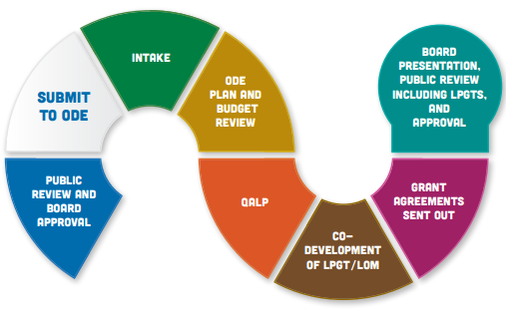
What Happens Next?
WILL RETURN TO PRESENT TO
THE BOARD
*
WE ARE HERE
‹#›
Notes:
Additional information as necessary: *QALP(Quality Assurance Learning Panel) will occur simultaneously as the ODE Plan and Budget Review for a randomly selected number of districts. QALP is composed of community members who observe as a quality measure overseeing the review process and requires no additional input from districts.

