Slide 1
Ladder Safety
W. Richard Oss
Manager, Safety & Prevention
Risk Management and Safety

Slide 2
Objectives
Identify the different types of ladders, and understand the purposes of each.
Understand how to properly inspect a ladder.
Distinguish how to appropriately set up a ladder for use.
Recognize the Dos and Don’ts of using a ladder.
Comprehend how to maintain, store and transport ladders.

Slide 3
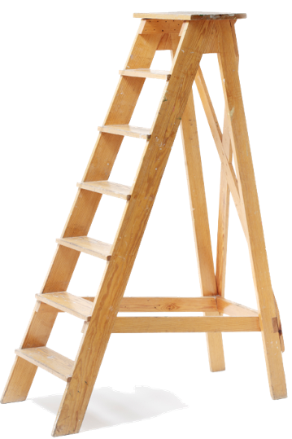
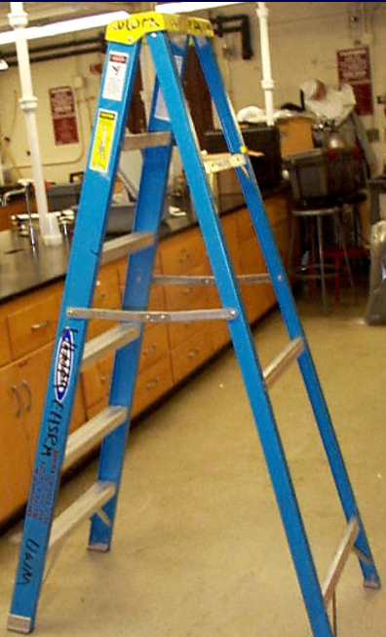
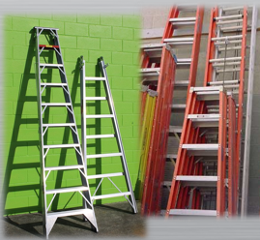
Types of Ladders
Step Ladder
Straight Ladder
Extension Ladder
Fiberglass
Metal
Wood

Slide 4
Questions To Yourself
Asking (and answering) these questions can help determine if you’re using the correct type of ladder:
  How high do I need to get to?
  What kind of hazards am I going to be working around?
  Is durability and/or weight of ladder a concern?
  Do I need tools, and do I need someplace to rest them when not in use?
  Does my ladder have the proper load limit?

Slide 5
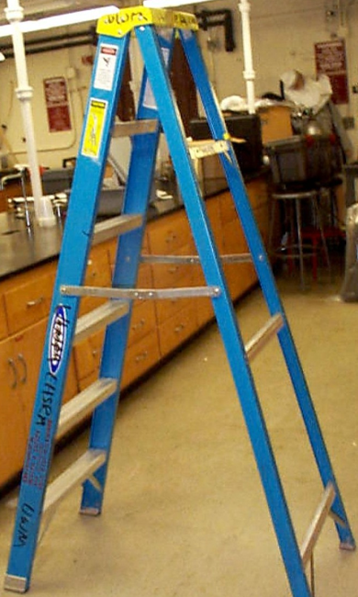
Advantages/Disadvantages of Ladder Types
Fiberglass
  Strong
  Lightweight
  Non-conductor of electricity
  More expensive than wood or metal

Slide 6
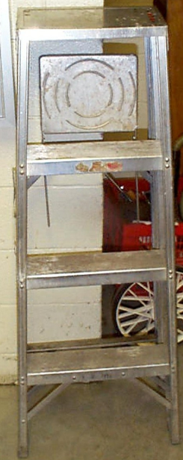
Advantages/Disadvantages of Ladder Types
Metal
  Lightweight.
  Must NOT be used anywhere near electrical sources.

Slide 7
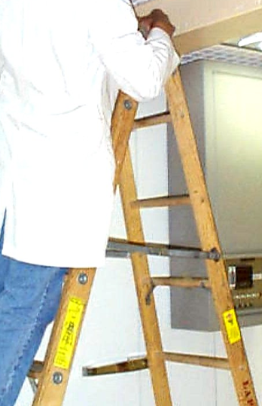
Advantages/Disadvantages of Ladder Types
Wood
  Heavier than wood or fiberglass
  Can rot
  Cheaper than fiberglass
  Non-conductor of electricity

Slide 8
Ladder Inspection
A ladder should always be inspected before use to ensure your safety.
Things to check:
  Label is readable.
  Should have clean skid resistant footings.
  Ladder is free of sharp edges, splinters, compression failures, or excessive wear.
  Spreaders should securely hold front and back sections of A-frame step ladders in open position, with no sharp points on the spreader.
  Joints between steps and side rails should be tight.
  All hardware and fittings should be securely attached.

Slide 9
Ladder Inspection
Things to check:
  Movable parts should operate freely without binding or undue play.
  Rungs should be free from slip hazards such as grease or oil.
  Feet should be in good condition with rubber anti-slip footings.
  Anti-slip footings should be clear of debris such as dirt or dust.
  Ladder should not have loose bolts or damaged welds.
  Extension ladder hooks and locks on the extension portion should function properly.
  Verify steps are parallel and level when in position for use.

Slide 10

Ladder Inspection
If you find any defects with the ladder during the inspection DO NOT USE IT!

Slide 11
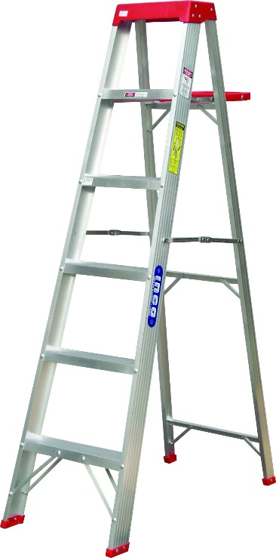
Ladder Setup
Folding “A-frame” ladders:
  Ladder should be fully extended and the arms locked into place.
  Be aware of pinch points when securing ladder.
  NEVER use a step ladder as an extension ladder.

Slide 12
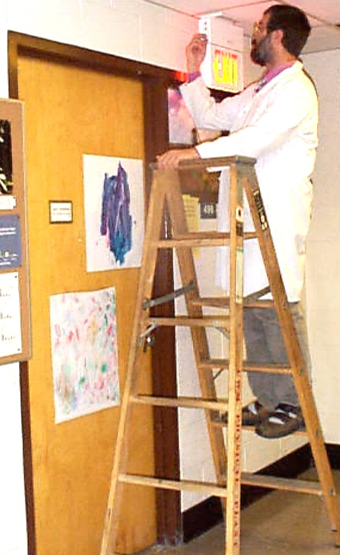
Ladder Setup
Always place ladders on a stable surface.
Ensure there is no debris in the area of use.
Secure ladder feet on an even surface.
Always secure doorways where ladders are setup.
Always extend ladders 3 and a half feet above working level.

Slide 13
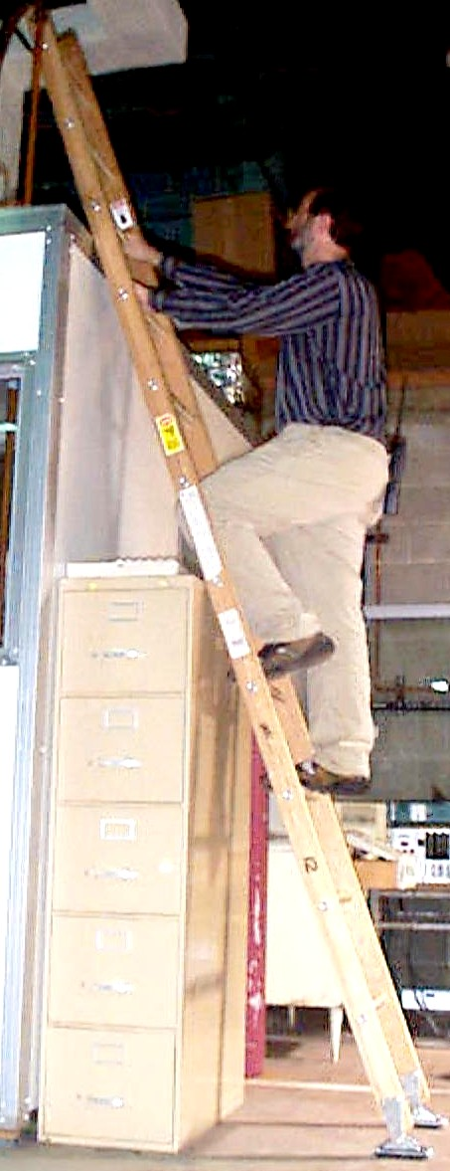
Ladder Setup - 4 to 1 Rule
Base of ladder should be 1 foot away from the wall for every 4 feet of climbing height.
Thus, an extension ladder with a 20-foot climb should have the feet set at 5 feet from the wall.
4 feet
1 foot

Slide 14
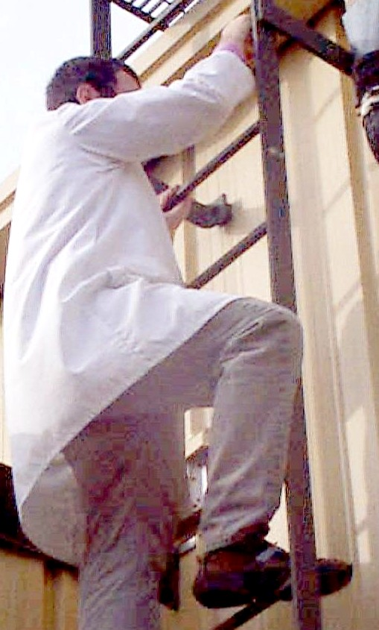
Climbing Up and Down Ladders
Don’t climb up or down while carrying items. Have someone hand them up to you or use a tool belt.
Always face the ladder.
Never have more than one person on the ladder at a time.
Ensure shoes are clean (not covered in mud, etc.)
Always maintain at least 3 points of contact (2 hands and 1 foot, or 2 feet and 1 hand).

Slide 15
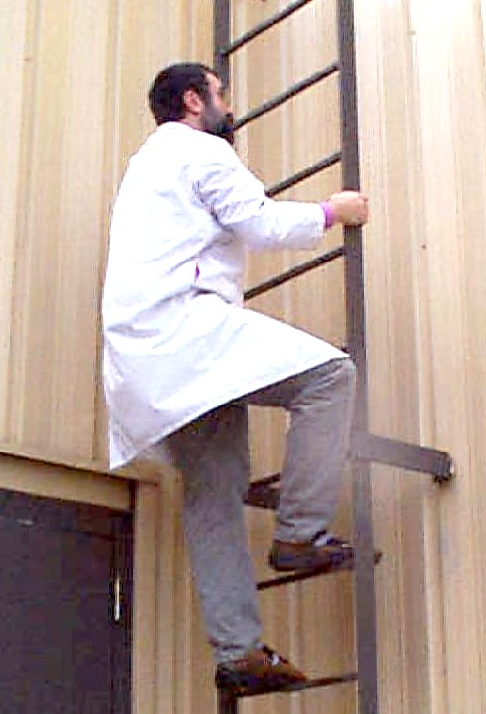
Do’s and Do Nots of Ladders
When working outdoors do not use or access ladders in high winds or storms.
Beware of cold weather conditions on exterior ladders, they can have frost on them and become slippery.

Slide 16
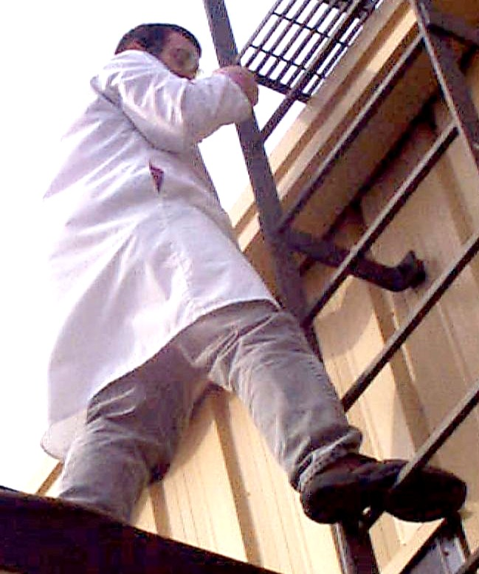

Do’s and Do Nots of Ladders
DO always climb completely past the landing before stepping over.
DO follow the “belt buckle” rule: keep your body centered between the rails of the ladder at all times.
DON’T move your “belt buckle” outside of the rails of the ladder.

Slide 17
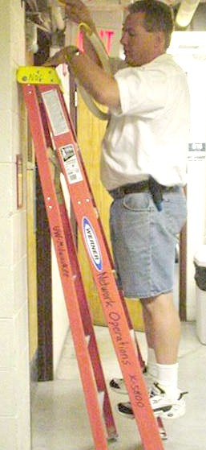
Do’s and Do Nots of Ladders
DON’T “walk” a ladder (rocking from side to side to move it).
DON’T use a step ladder as a straight ladder.

Slide 18

Do’s and Do Nots of Ladders
DON’T overreach to either side or lean too far forward or backward.

Slide 19
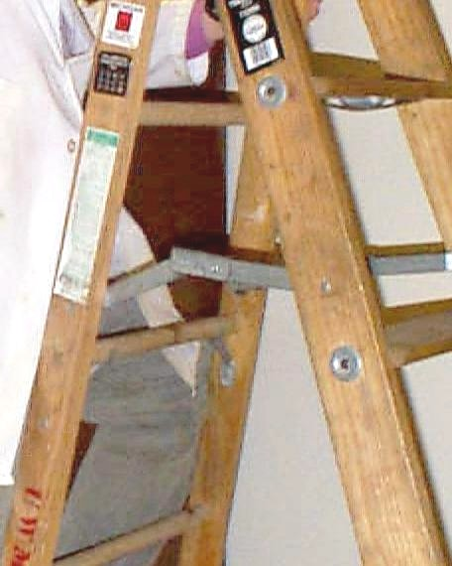
Do’s and Do Nots of Ladders
DON’T use a ladder without locking the spreader or other device in place.

Slide 20
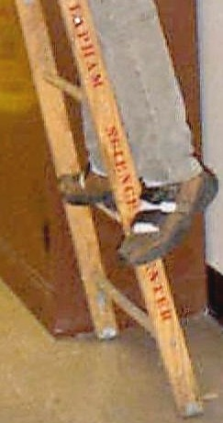
Do’s and Do Nots of Ladders
DO use the correct steps to climb up and down.
DO NOT climb using the bracing on the back legs of a step ladder.

Slide 21
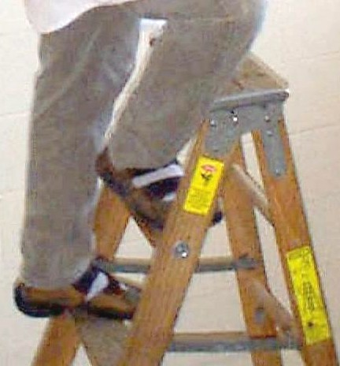

Do’s and Do Nots of Ladders
DON’T stand on the top steps of a step ladder.

Slide 22
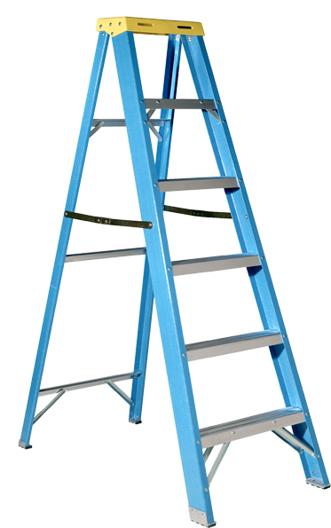
Do’s and Do Nots of Ladders
DON’T leave a ladder unattended. If you have to leave the ladder for any reason, take it down and re-setup once you’re ready to go back to work.

Slide 23
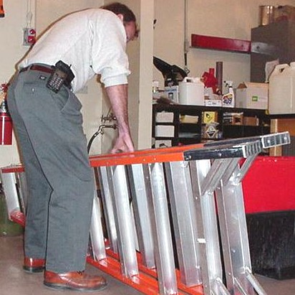
Transporting Ladders
Lift a ladder using your legs, not your back.
Carry the ladder close to your body.

Slide 24
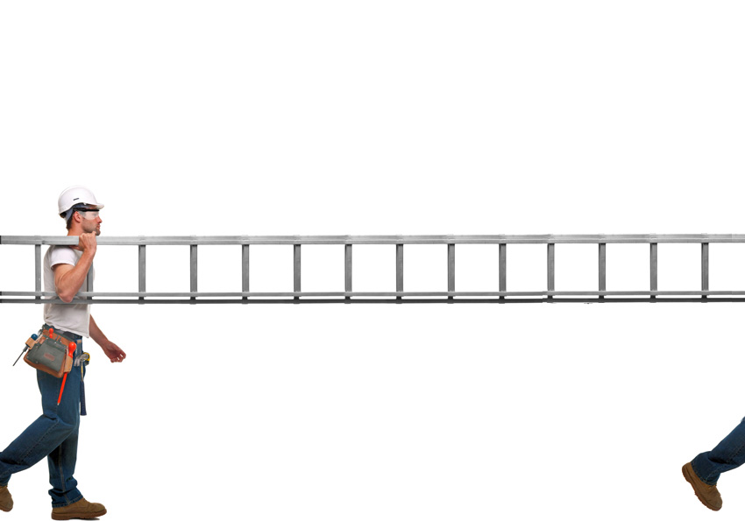
Transporting Ladders
  Pair up
  Balance the center on your shoulder
  Be careful around corners, aisles, or where others are working
  Spikes, hooks, or ladder feet should face toward the rear when being carried.
  Carry ladder horizontally to avoid overhead hazards.

Slide 25
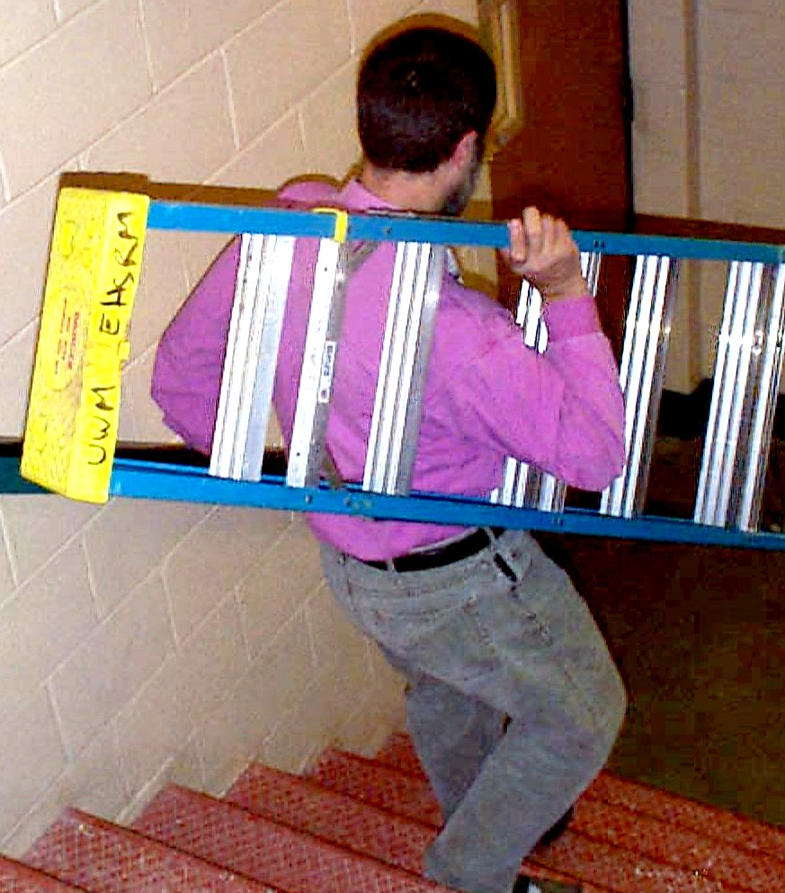
Transporting Ladders
When going up or down stairs, carry ladder with one hand and use the other hand to hold the railing.

Slide 26

Ladder Storage
Store ladders securely, out of the way.
Never store anything on top of a ladder.
Store vertically if possible; if not store horizontally but secured to prevent tip over.
Protect ladder from heat, weather, and corrosive materials.

Slide 27
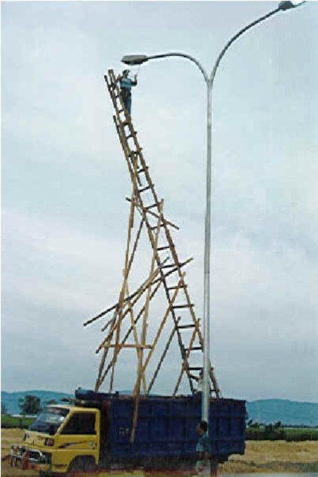
Don’t Be This Guy!

Slide 28
Questions?

