Slide 1
Civil Rights and Me
High School
Lesson 3: Gender Respect and Harassment
Notes:
Washoe County School District follows policies stating that students will receive annual training on identifying bullying in person and online, learn ways to report incidents at school and online and recognize forms of sexual and racial harassment. Every student is entitled to learn in an environment that is free of harassment, bullying, and discrimination. In Lesson 3, students will recognize personal boundaries, increase awareness of respect and equity, and promote upstander behavior.

Slide 2
Objectives
Students will be able to...
To support students in recognizing personal boundaries for themselves and their peers
To promote upstander behavior
To increase awareness of gender respect and equity

Slide 3
Working Agreements
Create and maintain a safe place for meaningful conversations.
Engage with each other and return to being present.
Speak your truth and accept these conversations MUST continue after today.
These conversations can be new and uncomfortable, Take care of yourself and each other.

Slide 4
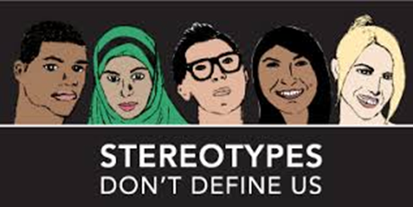
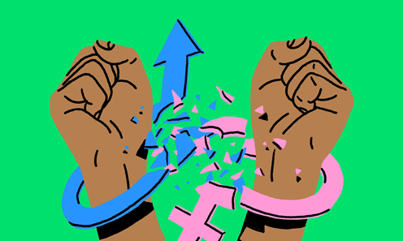
Key Vocabulary
Gender Respect
Gender Harassment
Sexual Harassment
Stereotypes
Racial discrimination
Upstander
Notes:
Gender Respect – Treating people with social and physical respect regardless of gender identities, stereotypes or societal roles
Gender Harassment – when girls, queer students, or boys are bothered, teased, or bullied because of their gender. (their gender identity, gender performance, or for breaking typical gender norms.)
Sexual Harassment – any unwelcome, unwanted pressure, verbal, visual, or physical contact of a sexual nature. It is any repeated or deliberate action or behavior that is hostile, offensive, or degrading to the recipient.
Stereotypes-Stereotypes-A stereotype is a fixed general image or set of characteristics that a lot of people believe represent a particular type of person or thing.
Race discrimination-is any discrimination against individuals on the basis of their skin color, or racial or ethnic origin.
Upstander-someone who recognizes when something is wrong and acts to make it right; a witness that acts.

Slide 5
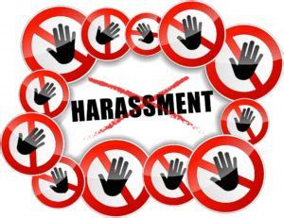
Optimistic Opener
Have you ever heard of the term harassment?
What’s your definition of harassment?

Slide 6
Class Discussion
Discuss that there are multiple forms of harassment including:
Sexual Harassment – any unwelcome, unwanted pressure, verbal, visual, or physical contact of a Gender nature. It is any repeated or deliberate action or behavior that is hostile, offensive, or degrading to the recipient.
Gender Harassment – when girls, queer students, or boys are bothered, teased, or bullied because of their gender. (their gender identity, gender performance, or for breaking typical gender norms.)
AND
Racial discrimination – is any discrimination against individuals based on their skin color, or racial or ethnic origin.

Slide 7
Think-Pair-Share
Ask students to read through the sentences and place each statement on the “Flirting/joking” to “Harassment” continuum, according to where they think each belongs.
Allow small group or partner discussion to note where they placed each statement on the continuum.
Note:
Flirting/Joking
…is wanted or welcomed
…is two-sided
…feels good
…is a compliment
Harassment
…is unwanted or unwelcomed
…is one-sided
…does not feel good
…is threatening or insulting
Notes:
Teacher will select speciﬁc statements, read them aloud and ask for volunteers to report where they placed that statement on their continuum.
To generate discussion, ask others in the class whether they placed the same statement in the same place, or closer to either ends of the continuum, and why they placed it where they did.
Ask participants to refer to their own continuums. When deciding where to place a statement, ask them:
why they considered one statement ﬂirting and another Gender harassment (and everything in between).
Ask students to decide for themselves where on their continuum does ﬂirting cross the line to Gender harassment.

Slide 8
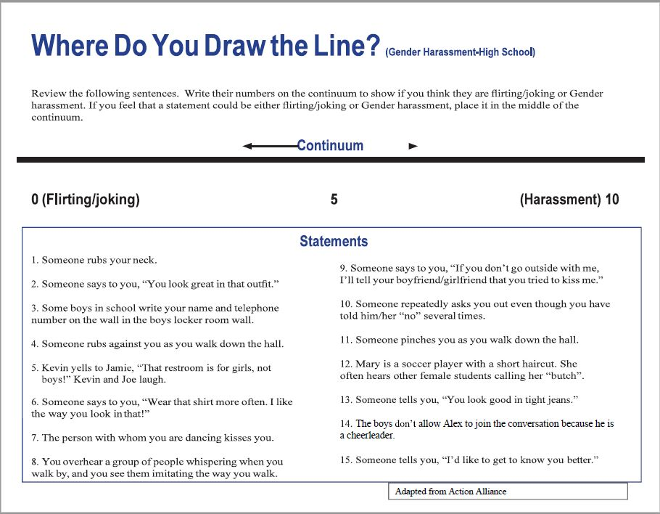
Where do you Draw the Line?

Slide 9
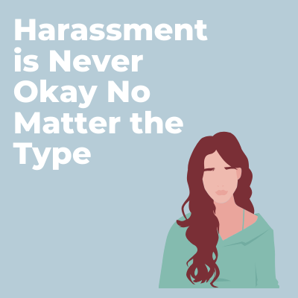
Reflective Closer
What does the “eye of the beholder” standard mean?
What are two ways you can be an upstander in situations of gender harassment?

