Slide 1
Civil Rights and Me
Middle School
Lesson 4: Embracing, Respecting, and Accepting Differences

Slide 2
Objectives
Students will be able to:
Identify and understand the importance of diversity and inclusivity in the classroom, community, and school.
Students will reflect on how any, one identity aspect shapes the way they view the world.
Students will understand the many reasons that miscommunication can occur.

Slide 3
Working Agreements
Create and maintain a safe place for meaningful conversations.
Engage with each other and return to being present.
Speak your truth and accept these conversations MUST continue after today.
These conversations can be new and uncomfortable, Take care of yourself and each other.

Slide 4
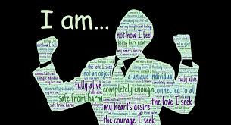
Key vocabulary
Personal Identity
Social Identity
Salient
Marginalized
Diversity
Inclusion
Acceptance
Notes:
Personal identities – individual traits that make up who you are, including your hobbies, interests, experiences, and personal choices.
Explain: Many personal identities are things that you get to choose and that you are able to shape for yourself. Personal identities might determine whether or not you have a natural inclination to go in a certain personal direction.
Social Identity- A person’s sense of who they are based on their group membership(s).
Salient- most noticeable or important
Marginalized- A person, group or concept treated as insignificant or as if they do not matter.
Inclusion-a process of addressing and responding to the diversity of needs of all
learners through increasing participation in learning, cultures and communities, and
reducing exclusion within and from education. It involves changes and modifications
in content, approaches, structures and strategies, with a common vision which covers
all children of the appropriate age range and a conviction that it is the responsibility
of the regular system to educate all children.
Diversity-recognizing that all the people are unique in their own way. Diversity refers to socioeconomics, power, privilege, class, ethnicity, language, gender, age, ability, and sexual orientation and all other aspects of culture.
Acceptance- The action or process of being respected and embraced and included in a group.

Slide 5
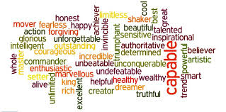
Warm-Up
Think of/write down one word that describes you.

Slide 6
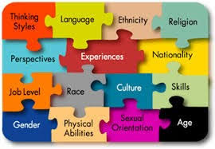
Think-Turn-Tell
What is Culture?
  The practices and beliefs shared by members of a particular group that differentiate that group from other groups.

Slide 7
Culture
Culture is inclusive of race and ethnicity but limited to.
Culture Includes all characteristics of human description including:
  age, gender identity, where you live, ancestry, religious beliefs, language, history, sexual orientation, physical and mental abilities, where you work, what you like to do and other interests.

Slide 8
My Multicultural Self Activity
Step 1:
Distribute a handout to each student and give the following directions: "Place your name in the center figure. Use the identity bubbles to name aspects of yourself that are important in defining who you are." (Such as: Race, Gender, Activities you are involved in)
Step 2:
If time permits: Invite a few students to share whole group something that they feel comfortable sharing and why that is an aspect of their identity that they find important.
Notes:
Note: Explain: The following exercise helps us to name aspects of our identity that are important and unique to each of us as individuals. It helps us identify the different pieces of our identity and how that impacts who we are.
The teacher should complete a handout in advance to serve as a model for students. Use PowerPoint or Flipchart to display the components of your multicultural self. Example:
(Using the definition of culture from above)
Mrs. Adams
Mother – Teacher – Writer – Biracial – Marathon Runner
Share how each of your identity bubbles is a lens through which you see the world.

Slide 9
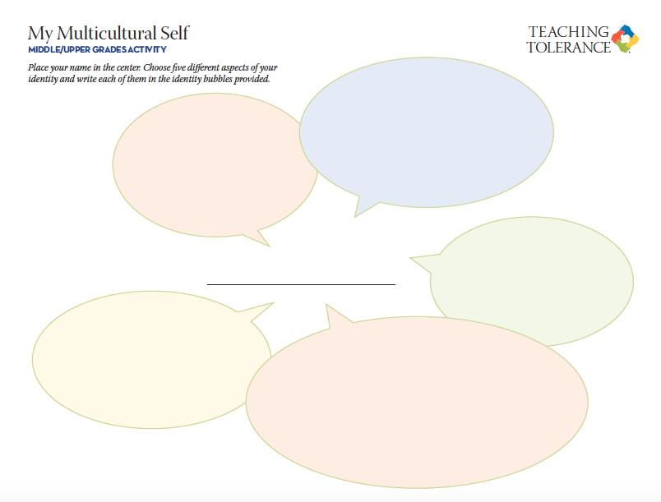
My Multicultural Self Example
Teacher
Mother
Mrs. Adams
Artist
Marathon Runner
Biracial

Slide 10
Think-Turn-Tell
Discuss as a class or in small groups:
How would you feel if someone ignored one of your multicultural identity bubbles?
Can you see how ignoring one of your identity bubbles could cause miscommunication? Can anyone give an example?
Do you have more than these 5 identities?
Notes:
Note: Explain to students that we have many identities as multicultural beings. Sometimes being unaware of our own or others' identities causes miscommunication.

Slide 11
Lesson Wrap-up
Our identities are NOT static. We are shaped and reshaped by what goes on around us, causing our identities to change constantly.
For example:
If a parent dies this reshapes the way we see the world.
If we fall in love this reshapes the way we see the world.
If our best friend moves this reshapes the way we see the world.
If we experience an act of violence this reshapes the way we see the world.

Slide 12
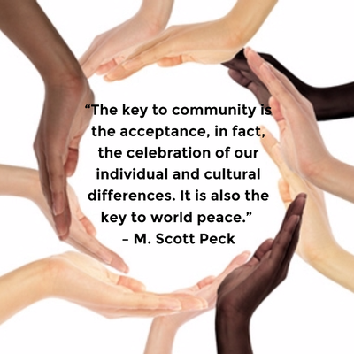
Closing
So, what we once knew to be true about ourselves and others can change over time. For this reason, we should always try to suspend judgment, ask questions of others and talk with those different from us as much as possible.

Slide 13

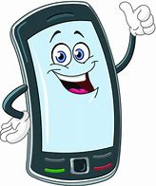

SafeVoice Anonymous Tip Reporting Now Available
SafeVoice is an anonymous place where students can report threats to their safety or their fellow students’ safety.
Report concerns about your friends, or yourself, anytime any day.
SafeVoice app
Call 833-216-7233(SAFE)
www.safevoicenv.org
Notes:
Review SafeVoice (lesson 1 information) and ways students can report incidents involving bullying, cyberbullying and racial or gender harassment.
This is a re-occurring theme in all four lessons for the Civil Rights and Me.
Reporting empowers students to make a difference and correct an issue they witness at school or in the community
Along with notifying administrators, teachers, and filing incident reports, Safe Voice is how WCSD students should report ANY form of harassment.
Reporting and Informing are different from tattling and “snitching”

