Slide 1
Civil Rights and Me
Middle School
Lesson 3 : Gender Respect and Gender Harassment
Notes:
For teachers:
Washoe County School District follows policies stating that students will receive annual training on identifying bullying in person and online, learn ways to report incidents at school and online and recognize forms of sexual and racial harassment. Every student is entitled to learn in a environment that is free of harassment, bullying, and discrimination.
Through discussion, videos, and activities this lesson is designed to meet the following objectives…
To support students in recognizing personal boundaries for themselves and their peers
To promote upstander behavior
To increase awareness of gender respect and equity

Slide 2
Objectives
Students will be able to...
To support students in recognizing personal boundaries for themselves and their peers
To promote upstander behavior
To increase awareness of gender respect and equity

Slide 3
Working Agreements
Create and maintain a safe place for meaningful conversations.
Engage with each other and return to being present.
Speak your truth and accept these conversations MUST continue after today.
These conversations can be new and uncomfortable, Take care of yourself and each other.

Slide 4
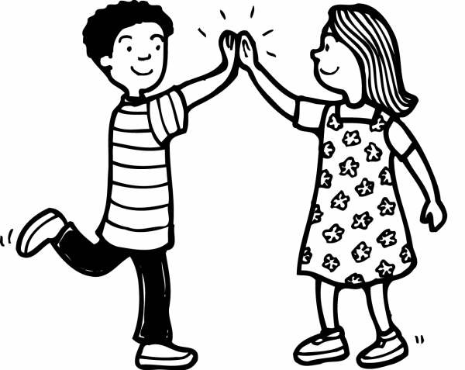
Warm-Up
Review working Agreements
Review the Upstander Definition
Introduce Topic: Gender Harassment and Gender Respect

Slide 5
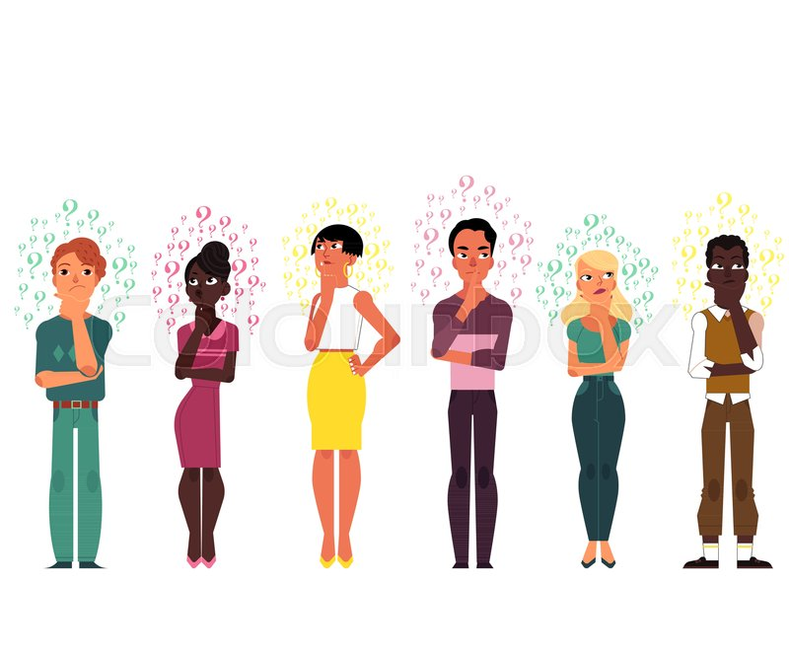
Think-Turn-Tell
What’s your definition of…
  Gender Harassment
  Gender Respect
  Stereotypes
Notes:
Note: Ask students for their definitions to see how they envision the terms.

Slide 6


Key Vocabulary
Gender Harassment
Gender Respect
Sexual Harassment
Stereotypes
Racial Discrimination
Notes:
Gender Harassment-is when girls or boys are bothered, teased, or bullied because they act differently from most girls or boys, or because they may be gay, lesbian, bisexual, or transgender.
Gender Respect-Treating people with social and physical respect regardless of gender identities, stereotypes or societal roles.
Sexual Harassment – any unwelcome, unwanted pressure, verbal, visual, or physical contact of a sexual nature. It is any repeated or deliberate action or behavior that is hostile, offensive, or degrading to the recipient.
Stereotypes-A stereotype is a fixed general image or set of characteristics that a lot of people believe represent a particular type of person or thing.
Race discrimination-is any discrimination against individuals on the basis of their skin color, or racial or ethnic origin.
Upstander-someone who recognizes when something is wrong and acts to make it right; a witness that acts.

Slide 7
Activity
Create three posters to put around the room with the three terms
Paste sticky notes of their definitions to Gender Harassment, Gender Respect, and Upstander to the posters.
Notes:
Note: Have some discussion with students around the purpose of the lesson. Consider asking why do you think we are discussing these three terms together? What can be done to ensure that we are all treated respectfully and equally? Discuss examples of different types of harassment.

Slide 8
Activity Scenarios
You will be put into groups and assigned a scenario.
You will read through their scenario and answer the questions associated with their scenarios.

Slide 9

Wrap-Up: Popcorn Closing
Share a word to describe how you feel about today’s lesson.
Notes:
Students will share this whole group.

Slide 10



SafeVoice Anonymous Tip Reporting Now Available
SafeVoice is an anonymous place where students can report threats to their safety or their fellow students’ safety.
Report concerns about your friends, or yourself, anytime any day.
SafeVoice app
Call 833-216-7233(SAFE)
www.safevoicenv.org
Notes:
Review SafeVoice (lesson 1 information) and ways students can report incidents involving bullying, cyberbullying and racial or gender harassment.
This is a re-occurring theme in all four lessons for the Civil Rights and Me.
Reporting empowers students to make a difference and correct an issue they witness at school or in the community
Along with notifying administrators, teachers, and filing incident reports, Safe Voice is how WCSD students should report ANY form of harassment.
Reporting and Informing are different from tattling and “snitching”

