Slide 1

Transition Services and Supports for Students with an IEP
ESE Parent Advisory Committee
April 15, 2025

Slide 2
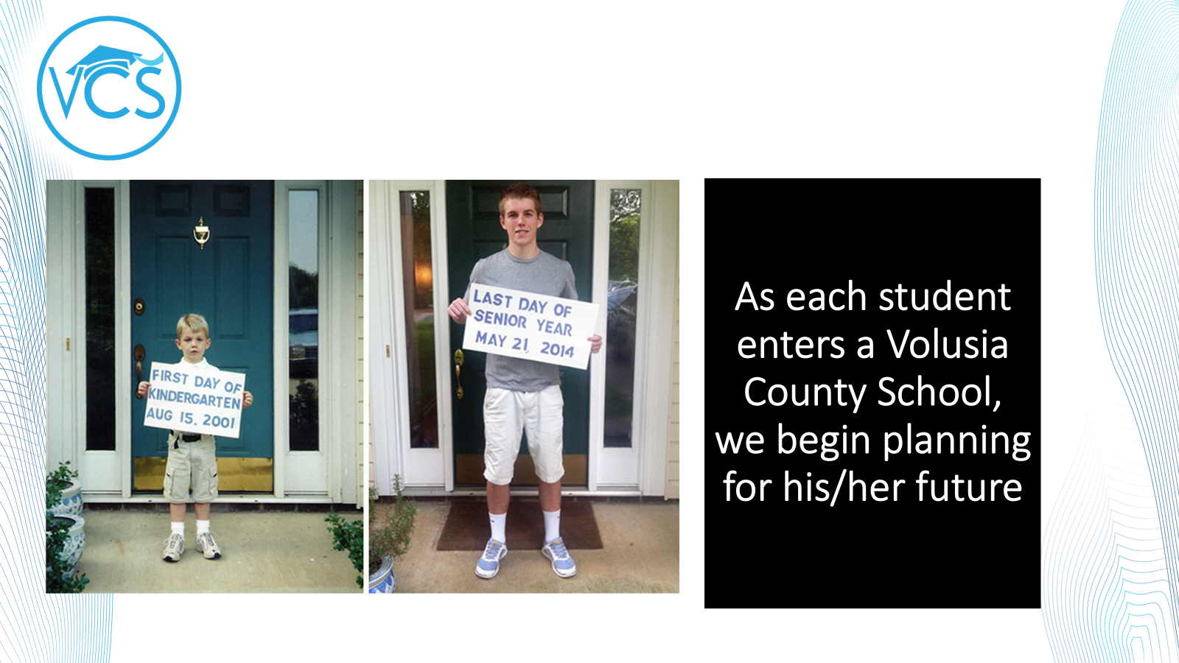

Slide 3


Slide 4
Transition Requirements
In Florida, transition planning for students with disabilities begins during the seventh-grade year or when the student turns 12, whichever comes first, according to Florida law. This planning process focuses on helping students prepare for life after high school, including postsecondary education, employment, and independent living.

Slide 5


Slide 6


Slide 7


Slide 8
Transition Services and Supports
Merit/Scholar Designations
Dual Enrollment
VR Employment Services Provider
VR Pre-ETS Grant
Supported Employment/WBLE
Project SEARCH
Florida Consortium for Inclusive Higher Education
CTE/
Career Academies

Slide 9
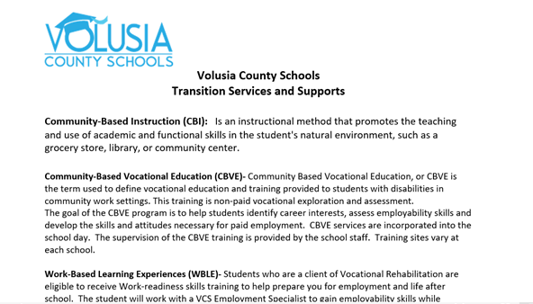

Slide 10
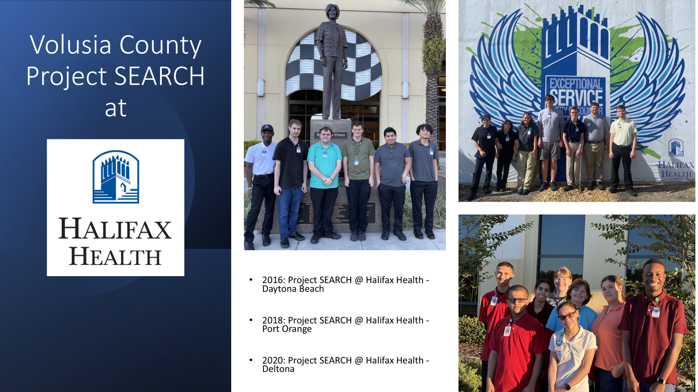

Slide 11
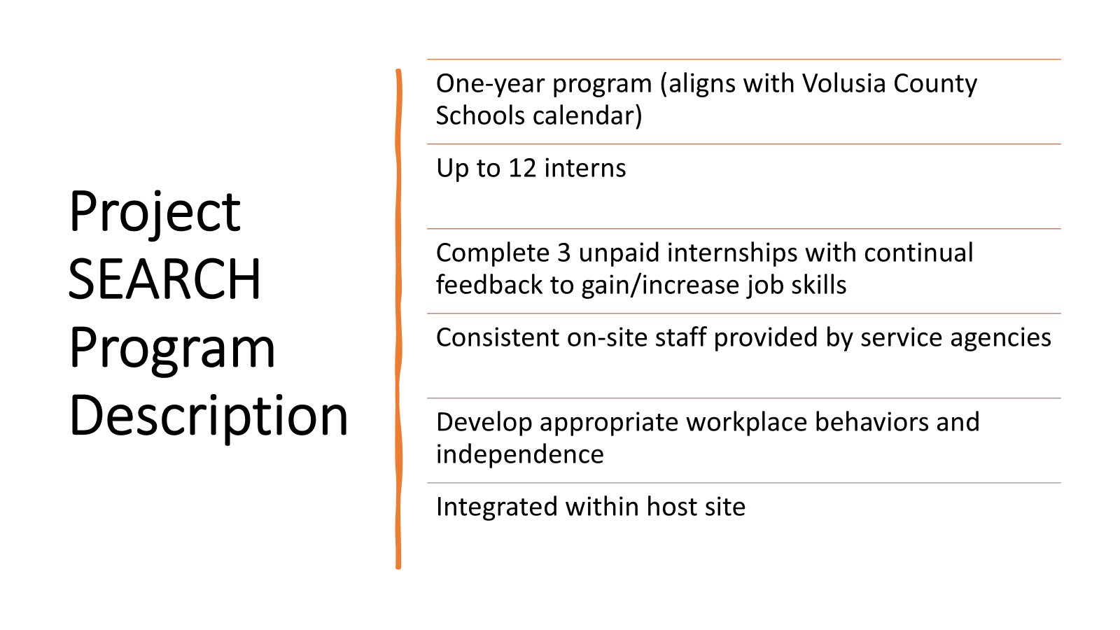

Slide 12
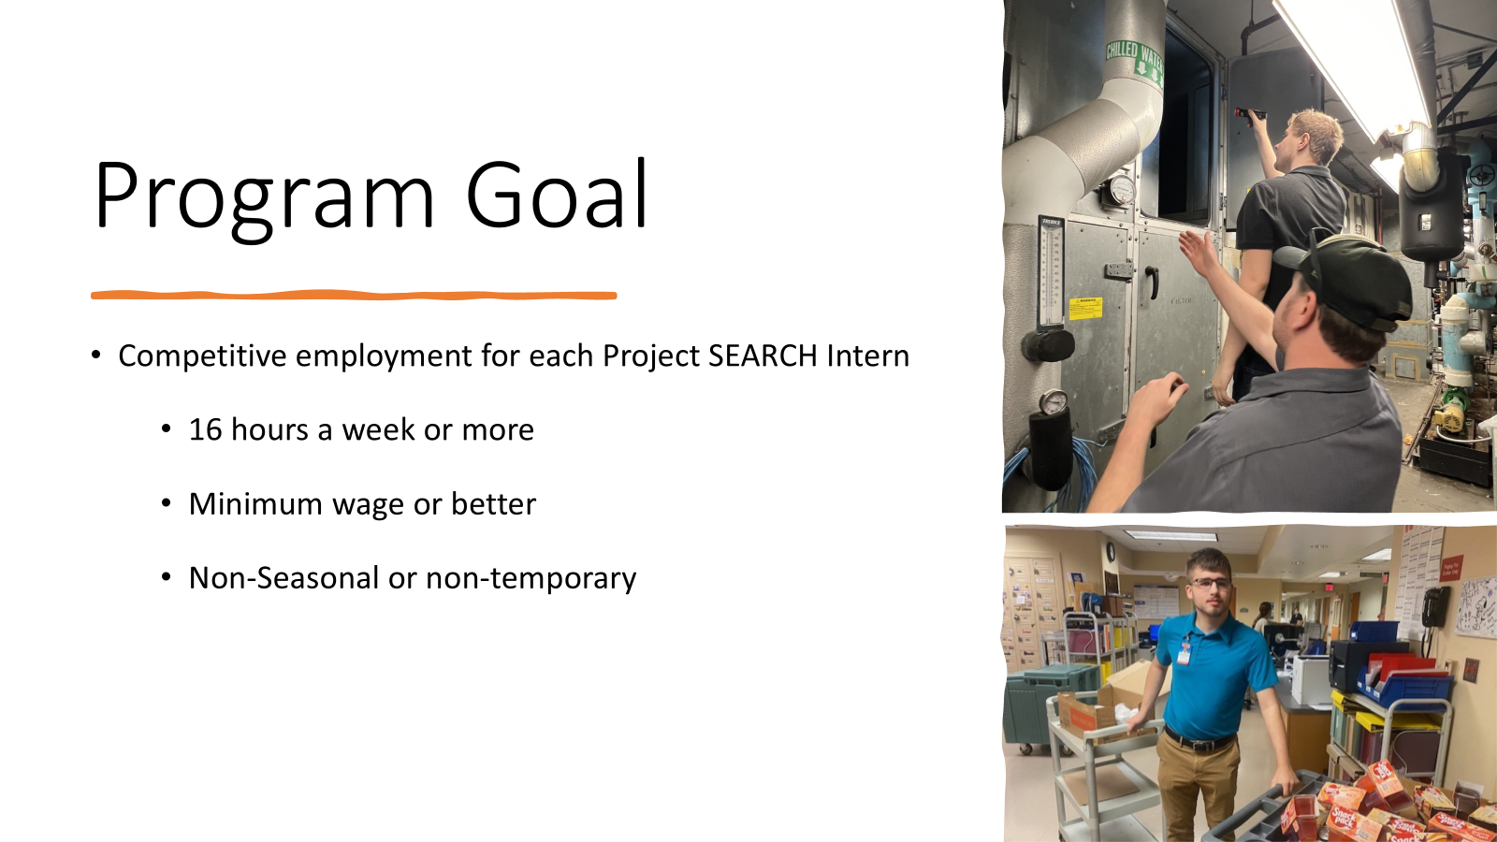

Slide 13



Slide 14
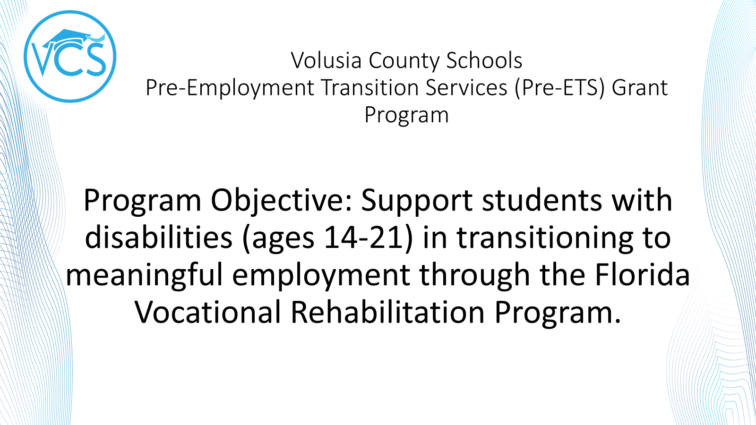

Slide 15


Slide 16


Slide 17


