Slide 1

Volunteering & PTO Parent Meeting
Hamilton Elementary School
Monday, September 25, 2023

Slide 2

Hamilton Elementary Goals
Increase student, family, and community involvement
Build upon a positive school culture for students, staff, and families
Develop and expand relationships with outside organizations
Recruit and develop new PTO members/leadership
Create a shared vision between Hamilton Elementary Special Events Committee and Hamilton Elementary PTO

Slide 3
Volunteering at HES
What can volunteers do?
Work directly with students
  One on one, small groups
  Flashcards, repeated practice, reading and math support
Support teachers and classrooms
  Copies, projects, laminating, cutting, etc.
  Some of these things can be done from home!
Work, setup, and support building and classroom events
Plan, run, and develop special events, fundraisers, and more

Slide 4
How do I become a volunteer?
Complete the Volunteer Checklist Packet available on our website under Parents tab, Important Forms & Info Links.
Make an appointment with Chrysis Thompson to complete background check at district office. She can be contacted at CThompson@hlsd.org or 614-491-8044 ext. 1202.
Background check has a fee of $27 or $30 depending on the type of check required. Background check turnaround is typically 24-48 hours but can take up to six weeks.
Once approved, contact front office and/or PTO to express interest in volunteering.

Slide 5
Hamilton Elementary PTO
PTO Objectives
Develop within the school and community a spirit of pride in school and country
Enhance the educational facilities and opportunities for the students of Hamilton Elementary that are not otherwise provided in the school corporation budgets
To serve as a liaison for better school/community relations

Slide 6
Hamilton Elementary PTO
What has Hamilton Elementary PTO done in the past?
Fun Day (end of the year)
Author/Illustrator Visits
3rd Grade Moving On Celebrations
Holiday Concerts
Teacher Appreciation Week
Kindergarten Thanksgiving Feast
Holiday Shop
Columbus Zoo Visit
Winter Wonderland
Fall Fest
Read Across America Week
Indoor Recess Games and Supplies
Book Fairs
Holiday Crafts
HTHS Football Tailgate
Parent/Teacher Conferences
Fundraising, Fundraising, Fundraising!

Slide 7
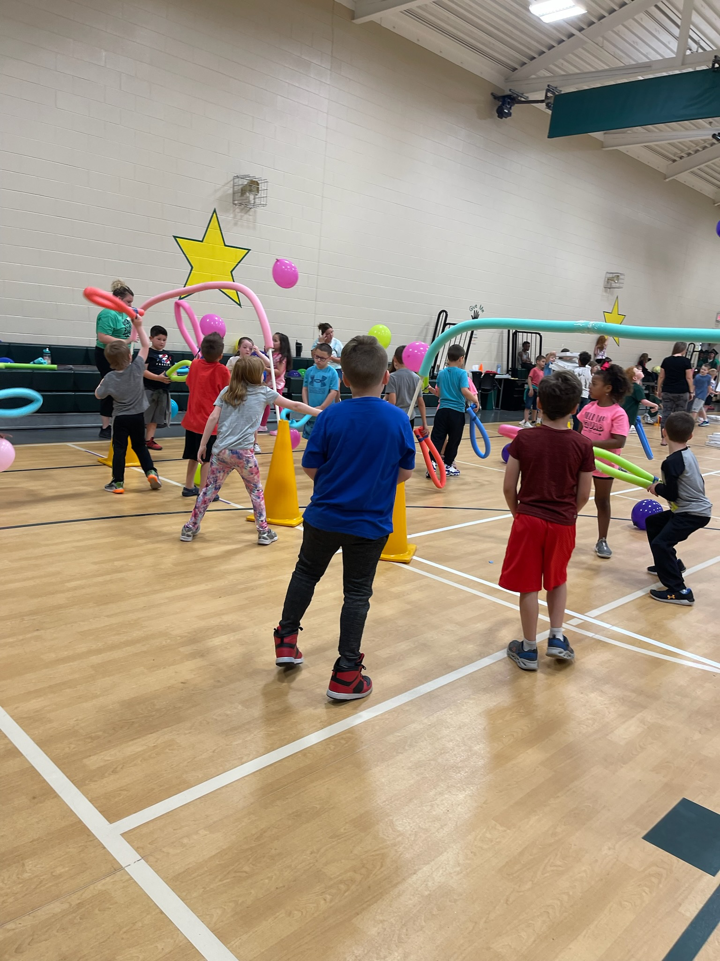
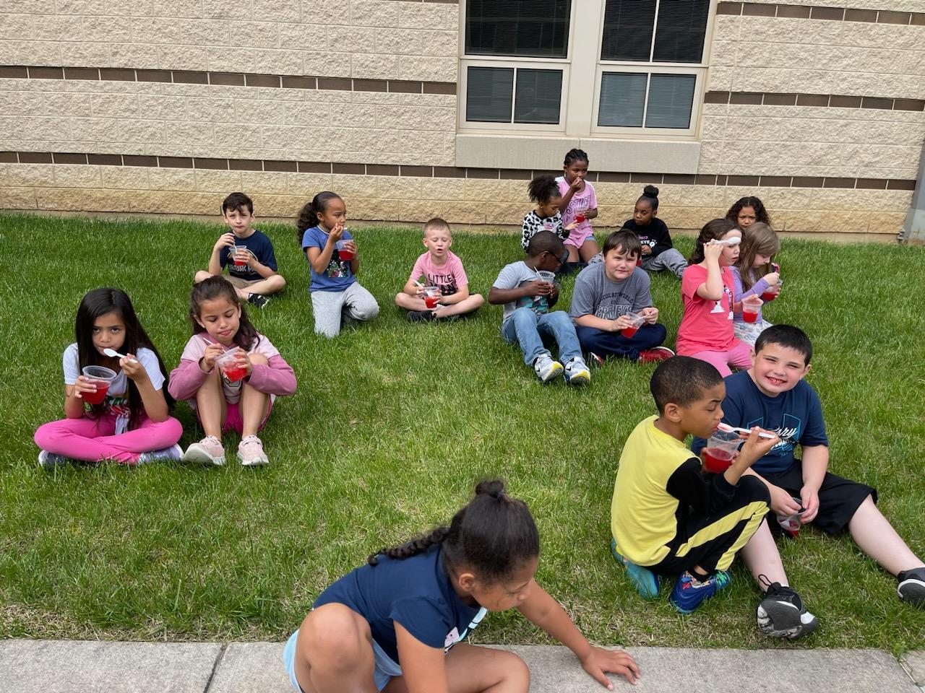
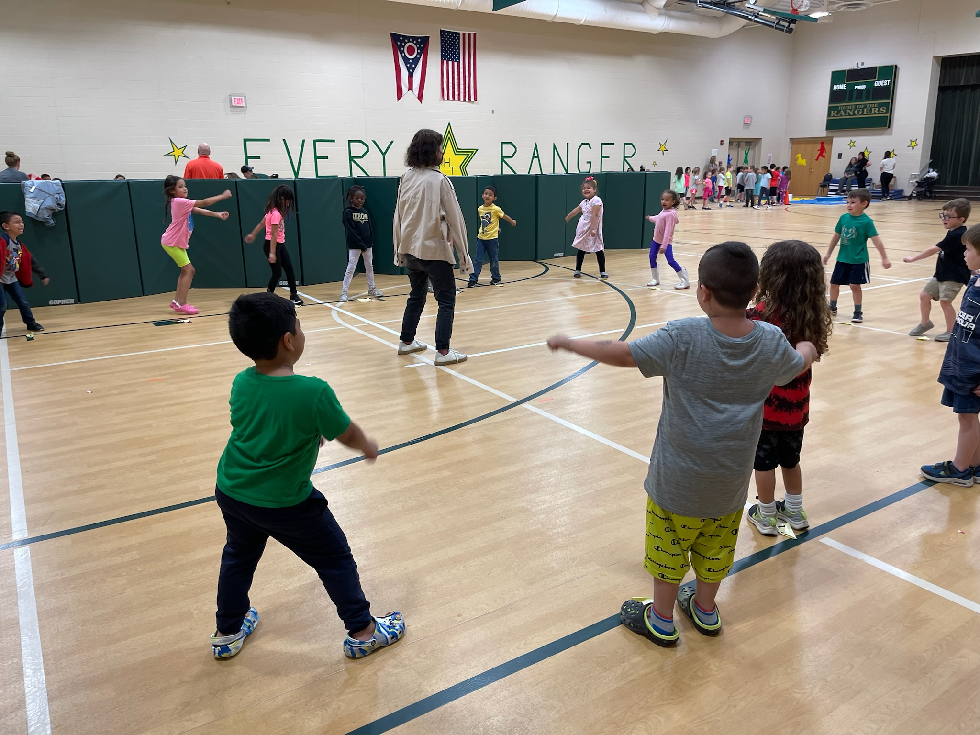
Hamilton Elementary PTO

Slide 8
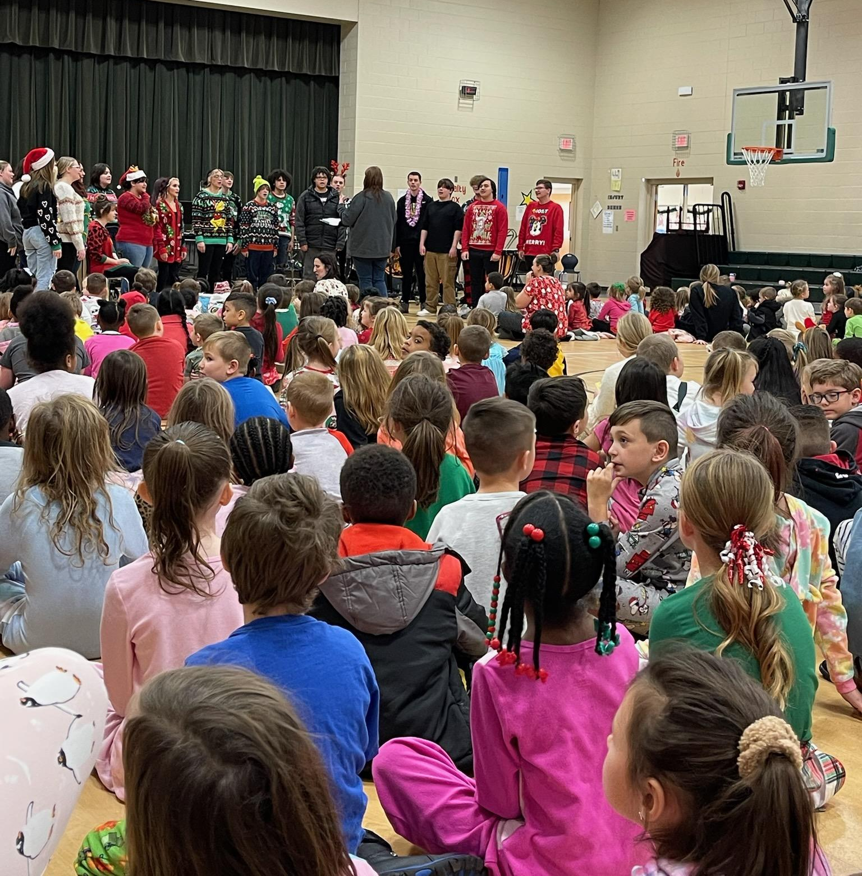
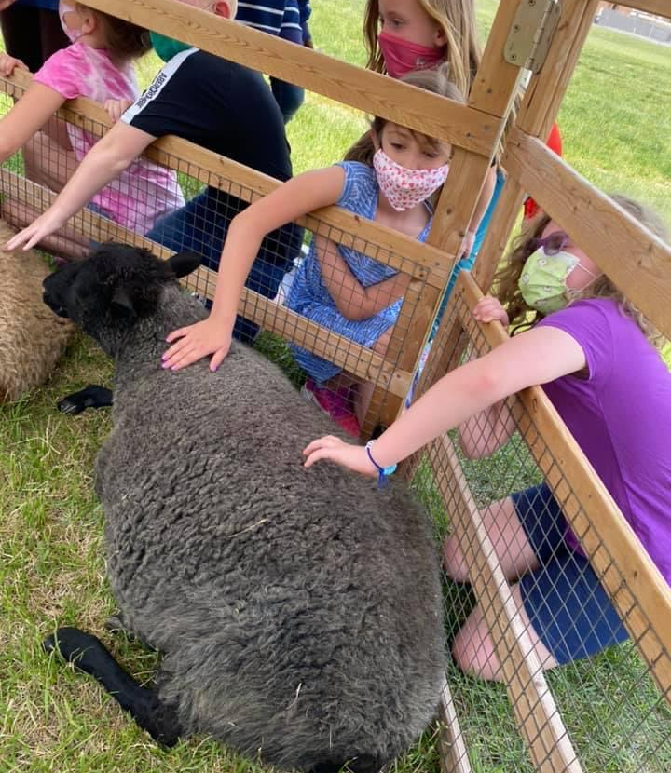
Hamilton Elementary PTO

Slide 9
Hamilton Elementary PTO
PTO Membership
“Any person interested in the objectives of the Hamilton Elementary Parent-Teacher Organization and who is willing to uphold its basic policies and to abide by its bylaws may become a member.”
Membership - At any PTO meeting, fill out and submit the
PTO Membership Card

Slide 10
Hamilton Elementary PTO
Hamilton Elementary PTO Officers and Roles
President - Preside over all meetings, coordinate officers and committees, set meeting agendas, oversee PTO
Vice-President - Aide the president in duties and assume duties when president is unable, send cards and gift cards as outlined in bylaws, keep records of solicitations and donations received
Treasurer - Receive all monies, keep accurate financial records, present financial statements each meeting, manage PTO accounts and payments
Secretary - Keep minutes of each meeting, accurate accounting of membership roles
2nd Vice-President - Building Principal

Slide 11
Hamilton Elementary PTO
Officer Nomination Process
Fill out the PTO Officer Nomination Card and submit during the nomination window at a PTO meeting or via email to hamiltonelementarypto23@gmail.com.
Nominees for positions must be set and made available seven days prior to the election date.
PTO members are required to vote in person (proxy voting is not allowed).
All officer nominees must submit and pass a background check.
Voting will be completed at our next PTO meeting on:
Monday, October 23rd at 5:30pm

