Slide 1

Activity Funds Refresher 2024-2025
Presentation Prepared by: Business Office Professionals
Presenters: Rene Cavazos, Accountant
Deborah Rodriguez, Executive Director-Payroll, Bond, & Finance
rjcavazos@wisd.us
ddrodriguez@wisd.us
Business Office Website

Slide 2

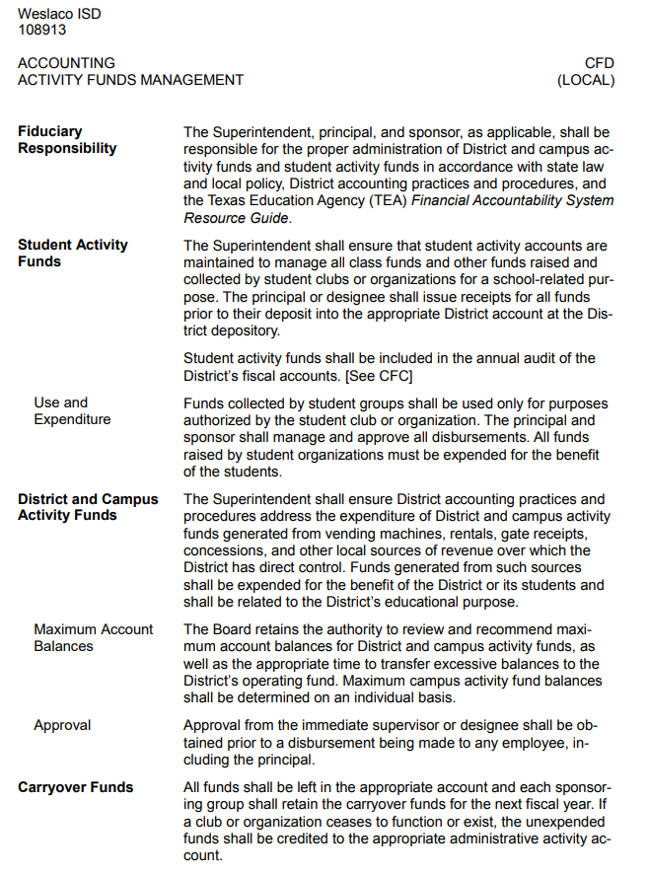
Governance – Board Policy CFD Local

Slide 3
Activity Funds Overview
Activity funds are used to account for monies used to support co-curricular and extra-curricular student activities and student organizations.
There are two types of activity funds
  District / Campus Activity Funds (CAF - 461)
  Student Activity Funds (SAF - 865)

Slide 4

Campus Activity Funds (CAF)
Campus Activity Funds (CAF) are public funds not in the custody and control of student or employee groups and used for the general operations of the school or facility.
Funds belong to the Campus / District – campus wide
Money raised locally at the campus or donated to the school
Accounts include school office and departmental accounts
Expenditures should benefit student body or promote campus goals, such as improving student & employee morale
Approval of disbursing funds rests with school district employees (Ex: Principal, Planning Committees, Department Chairperson)

Slide 5
(CAF) 461 – Campus Wide Allowable Uses
Direct or indirect benefit to students
  Field trips – admission fees
  Awards/incentives such as perfect attendance, academic awards, etc… (individual limit of $25 per semester)
  Teacher appreciation & awards (individual limit of $25 per semester)
  Classroom or office supplies that will benefit a particular event or purpose. For example, tickets to be used for the Fall Festival. Not to be confused with your normal pens or paper.

Slide 6
Student Activity Funds (SAF)
Student activity funds consist of money which is received and held by the school as trustee. Student Activity Funds are funds generated by specific student groups, not by the district or campus.
Decisions about the expenditure of SAF are made by the student organizations with the assistance of a school district employee sponsor.
These funds shall be used exclusively for the benefit of the students.

Slide 7
(SAF) 865 - Allowable Uses
Direct benefit to students
  Student trip related expenses such as meals, entry fees, lodging, transportation, etc…
  Awards/incentives (individual limit of $25 per semester)
  Club supplies that will benefit the students or club purpose
  Rentals such as equipment for events by that specific club
  Contracted Services such as DJ Services, motivational speaker, photographer, etc. for events hosted by that specific club
  Training / meeting refreshments (for in-service and staff meetings, retirement receptions) *Faculty account to be used on staff only.

Slide 8
Student Activity Vs. Campus Activity
STUDENT ACTIVITY (865)
Funds raised by specific group of students must be used to benefit that particular group.
Bank account for your campus
Use school check for purchases (with approved payment voucher)
No Purchase Order Required
Payment Voucher REQUIRED with ALL required signatures (sponsor & principal) for purchases.
Theses funds CANNOT be used in place of a purchase order even if it is a LOAN.
Administrative Assistant is responsible for monthly bank reconciliation report which is submitted to the Business Office.
All documentation for deposits and purchaes will be uploaded to the shared folder set up by the Business Office.
CAMPUS ACTIVITY (461)
Funds raised by the campus as a whole and are expended for the entire student body.
All money is deposited into the 461 bank account (main bank account of the District) and the deposit slips with backup documentation will be uploaded to the shared folder set up by the Business Office.
REQUIRES a purchase order – please plan ahead for timely approvals.

Slide 9
Principal’s Responsibilities
The campus principal is personally responsible for the proper collection, disbursement, and control of all activity funds at the school. This responsibility includes providing for the safekeeping of monies in the school; it also includes the proper accounting and disbursements of funds.

Slide 10
Administrative Asst/Bookkeeper Responsibilities
Records SAF & CAF transactions to include receipts, deposits, and disbursements.
Deposits funds in bank TIMELY.
Prepares a monthly bank reconciliation and sales tax report (Assistance from Business Office).
Assists Sponsors.
Informs Principal of problems and concerns.

Slide 11
Sponsor Responsibilities
Activity Fund Sponsors are responsible for managing their respective activity funds.
  Attends annual training (Sign Sponsor Form)
  Maintains records of their respective club (copies, spreadsheet)
  Submit cash collections daily to the Admin Asst/Bookkeeper
  Submit requests to conduct fundraisers to Principal
    Completes Fundraiser Projection / Actual Forms
  Submit completed payment vouchers with documentation (quotes) to Principal for final approval and signature.
  Submit any final receipts or purchasing documentation to Admin Asst/Bookkeeper in a timely manner.

Slide 12
Fundraising Activities
All money raised by a student organization must be expended for the benefit of the students.
All fund raising activities need approval from Principal. (Projection form)
Determine if the fundraiser will be a campus wide event or a specific club event. Advertise accordingly.
Keep it to a limit of 2 per group
It is advised for the Principal not to allow fundraisers during the month of May.

Slide 13
Steps to a Successful Fundraiser
Sponsor or teacher needs to get written approval from the Principal via email or projection sheet.
Sponsor prepares Projection Sheet prior to the start of the sale.
Advertise accordingly. Fundraiser takes place.
Keep track of who turns in what. Daily class receipt record if needed.
Monies are turned in to the Admin Asst / Bookkeeper to deposit into the proper bank account. DO NOT KEEP MONEY IN YOUR CLASSROOM.
At the conclusion of the fundraiser, the sponsor prepares a statement of actual revenues and expenditures to be submitted to the Principal.

Slide 14
Allowable Vs. Unallowable
Allowable Fundraisers
Cherrydale
Catalog sale
Popcorn sale
Dances
Pictures
Snack sales - see TDA Guidance
Candy apples sale
Yearbook Sales
T Shirt Sales
Unallowable Fundraisers
Raffles
Gambling
Bingo
Loteria
Fundraisers for personal benefit
When selling food, please check with Food Service Department that you are in compliance
  Becky Gracia - Food & Nutrition Services Director

Slide 15
Cash Management
Teachers and sponsors collecting cash from students
Class Receipt Record must be filled out - It is Mandatory to use it, listing student names and the amount of money being turned in. Form must be signed by teacher/sponsor verifying the total. (Two staff preferably)
Collections MUST be submitted to the Admin Asst / Bookkeeper daily.
Money must be counted and verified when submitted & the sponsor/teacher will get a signed receipt at that time.
Do not allow deposits to be dropped off without counting, verifying, and issuing a receipt.
Good practice is having the sponsor/teacher sign the receipt so a record of approval shows in your receipt book.
Suggestion – set up designated deposit drop off times.

Slide 16
Cash Management continued…
Postdated checks should not be accepted.
If money is being received in the front office, there should be established procedures on how to handle such instances. The person dropping off any money should receive a receipt at that moment.
Two signatures on documents are important.
Admin Asst/Bookkeeper should not keep the money in his/her office for days or weeks.
If an office safe is available, use it for all cash safekeeping during the day. If not, use a cabinet or drawer that locks.
Admin Asst/Bookkeeper or designee is the only authorized person that should be going to deposit cash or checks to the bank.

Slide 17
Payment Process – Student Activity Fund
PAYMENT VOUCHER PROCESS/ PREPARING A CHECK
You need to have this form filled out before a school check is prepared.
Detailed purpose for expenditure must be filled out.
Sponsor AND Principal signatures are required.
Supporting documentation must be attached. (Invoice, quotes, receipts, club meeting minutes approving expense etc…)

Slide 18
District Forms
Class Receipt Record Form
Payment Voucher
Fundraiser Projection Sheet
Fundraiser Actual Revenue & Expenditure Form
Sponsor Form
FORMS CAN BE FOUND IN THE BUSINESS OFFICE DEPARTMENT DOCUMENTS AND FORMS
ON THE DISTRICT WEBSITE.

Slide 19
Sponsor Form
All teachers and sponsors need to complete this form at beginning of school year.
Schedule your training session for your teachers and sponsors at your campus.
See and click link below:
Sponsor Form

Slide 20
Don’t be afraid to ask questions…
CONTACT INFORMATION:
Business Office Contact Information
Rene Cavazos – rjcavazos@wisd.us
Deborah Rodriguez – ddrodriguez@wisd.us
David Robledo – darobledo@wisd.us
Email is best so we have a chance to respond if we are not immediately available. Feel free to add URGENT to the subject line so we know to respond right away.
THANK YOU FOR YOUR TIME AND ATTENTION THIS MORNING!

