Slide 1
Instructions
Click on the sound your student is struggling with on the next slide
Use the cues to help your student produce the sound correctly
Use the listed words for practice
Have your student watch the linked video for more descriptions on how to produce the sound and practice
Feel free to share the slide or video with parents

Slide 2
Speech Sounds
P
H
Final Sounds
TH
Z
B
N
K
CH
R
T
M
G
SH
D
F
S-blends
J
W
V
L
S
Notes:
You can add your own categories and points values to this game board. Enter your questions and answers in the slides we’ve provided.
When you’re in slide show view, select the underlined text to go to that question, then move to the answer slide. Use the left triangle to return to this game board slide.

Slide 3
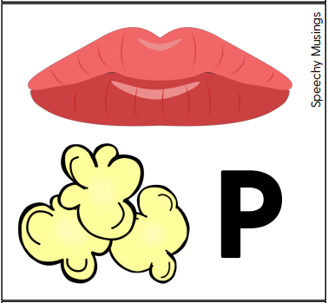
P-Popcorn popping sound
How to make the P Sound:
•Put lips together
•Let air build up
•Release puff of air
•Voice is off
Words: pop, puff, pig, pot, pin
Back to speech sound list
Learn more about making your P sound here!

Slide 4
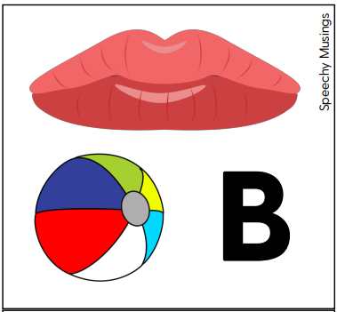
B- Ball bouncing sound
How to make the B Sound:
•Put lips together
•Voice is on
•Release your sound
Words: ball, bone, boot, buy
Back to speech sound list
Learn more making your B sound here!

Slide 5

T-Clock ticking sound
How to make the T Sound:
•Lift your tongue up behind your teeth.
•Build up air behind your tongue and release your sound.
•Voice is off.
Words: top, toy, time, tall
Back to speech sound list
Learn more about making your T sound here!

Slide 6
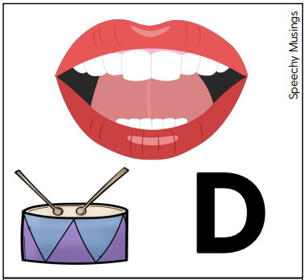
D-Drum tapping sound
How to make the D Sound:
•Lift your tongue up behind your teeth.
•Build up air behind your tongue and release your sound.
•Voice is on.
Words: dog, doll, door, dice
Learn more about making your D sound here!
Back to speech sound list

Slide 7

W- Windy Sound
How to make the W Sound:
•Back of tongue up a little
•Lips start off round
•Glide into the next sound
•Voice is on
Words: wet, wall, we, wipe
Back to speech sound list
Learn more about making your W sound here!

Slide 8
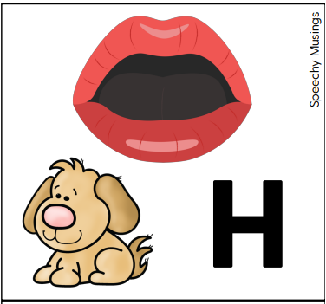
H- dog panting sound
How to make the H Sound:
•Open mouth a little
•Let air flow through your mouth
Words: hi, hot, hit, heat
Back to speech sound list
Learn more about making your H sound here!

Slide 9
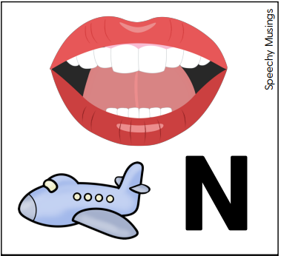
N- airplane sound
How to make the N Sound:
•Lift your tongue tip up to the bumpy top of your mouth behind your teeth
•Sides of your tongue should be up too
•Voice is on.
•Air goes through your nose
Words: no, nap, net, nail
Back to speech sound list
Learn more about making your N sound here!

Slide 10
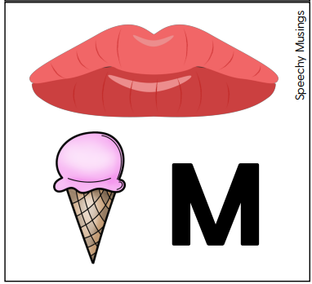
M- Yummy “mmm-mmm” sound
How to make the M Sound:
•Put lips together
•Voice is on.
•Air goes through your nose
Words: mail, mat, mop, mice
Back to speech sound list
Learn more about making your M sound here!

Slide 11
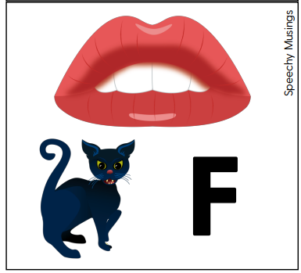
F- Angry cat sound
How to make the F Sound:
•Lightly bite your bottom lip
•Blow air over your bottom lip
•Voice is off
Words: fall, fin, foot, fan
Learn more about making your F sound here!
Back to speech sound list

Slide 12
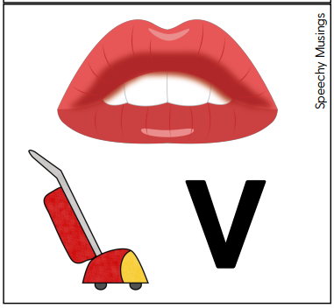
V- Vacuum sound
How to make the M Sound:
•Lightly bite your bottom lip
•Blow air over your bottom lip
•Voice is on
Words: van, voice, vet, vote
Back to speech sound list
Learn more about making your V sound here!

Slide 13
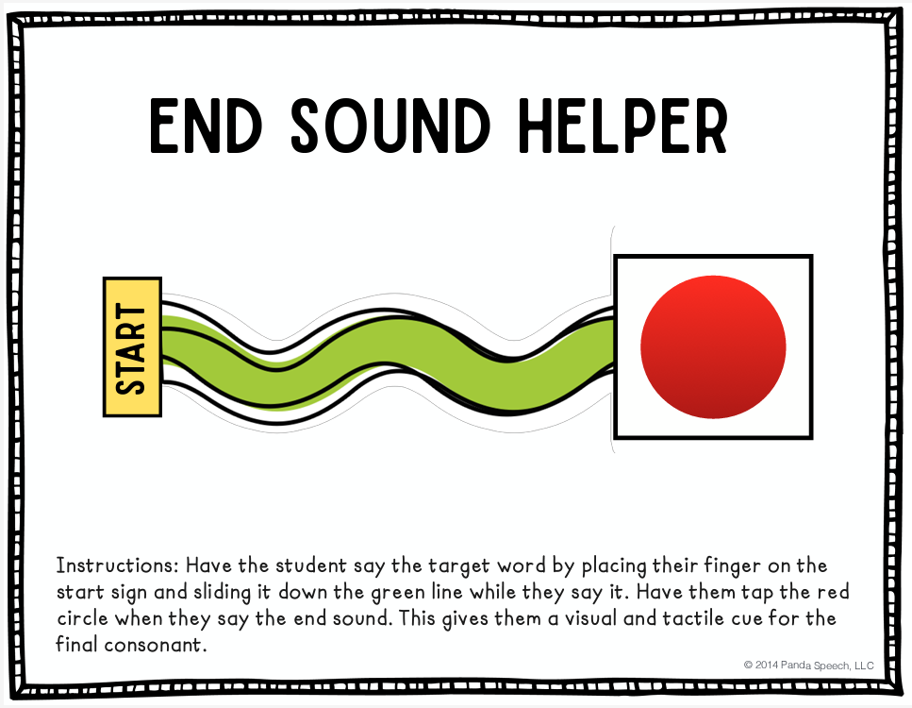
Final SOunds
Parent/teacher uses the one strategy that best fits the moment:
Provide a good Model of the word by saying it again slowly and clearly: “Nap.”
Provide a Visual Cue: Point to your lips and emphasizing the /P/ sound as you say “Nap.”
Provide a Verbal Cue: “Listen to the /P/ sound. Napppp. I use my lips to make the /P/”
Provide Feedback: “I didn’t see the /ppp/ when you said nap.”
Use a Communication Breakdown technique: “Do you mean “na” or “nap?”
Learn more about making your final sounds here!
Back to speech sound list

Slide 14
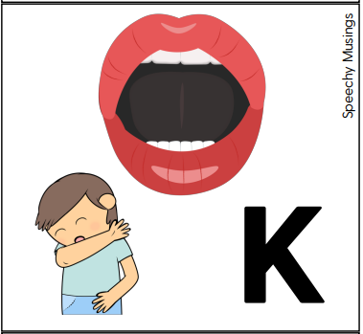
K-Coughing sound
How to make the K Sound:
•Lift the back of your tongue to the back of your mouth or the soft palate.
•Keep your tongue tip down.
•Release a burst of air
•Voice is off.
Words: call, key, cone, cow
Back to speech sound list
Learn more about making your K sound here!

Slide 15
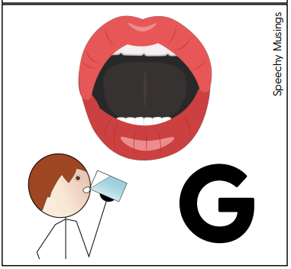
G- Gulping water sound
How to make the G Sound:
•Lift the back of your tongue to the back of your mouth or the soft palate.
•Keep your tongue tip down.
•Release a burst of air
•Voice is on.
Words: go, goat, gift, guy
Back to speech sound list
Learn more about making your G sound here!

Slide 16

S-blends
Provide a Visual Cue: Point to your mouth and emphasize the /s/ as you draw your finger away from your mouth and say “Ssssmile.”
Provide a Verbal Cue: “Close your teeth and say ssssssmile”
Provide Feedback: “I didn’t hear the /sssss/ when you said sssmile.”
Use a Communication Breakdown technique: “Do you mean “mile” or “sssssmile?”
Sm words: smile, smart, smash
St words: store, stay, stop
Sp words: spot, spy, spell
Sn words: snake, snack, snap
Learn more about making your s-blends here!
Back to speech sound list

Slide 17
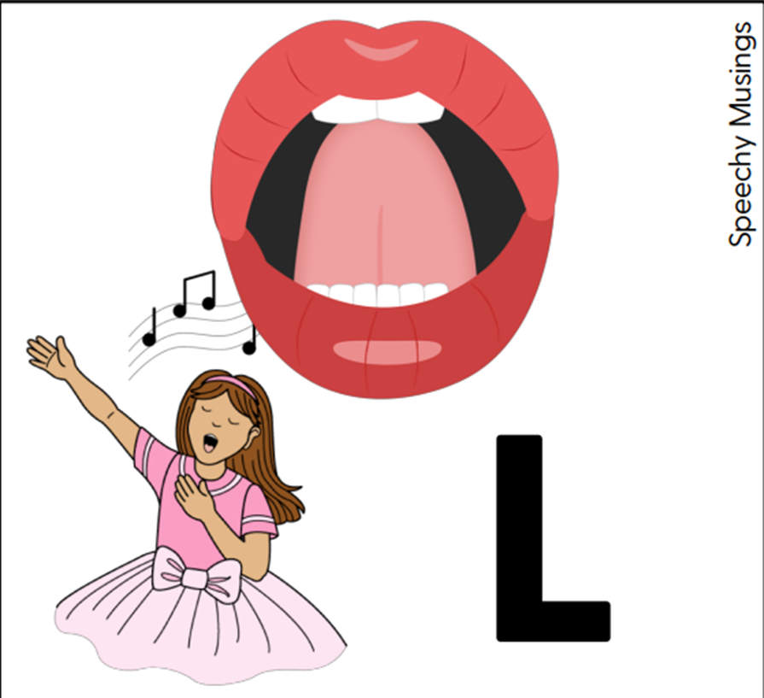
L- Singing “lah-lah-lah” sound
How to make the L Sound:
•Lift your tongue up behind your teeth.
•Let the air flow out the sides of your mouth.
•Voice is on.
Words: Left, Let, Line, Look, List
Learn more about making your L sound here!
Back to speech sound list

Slide 18
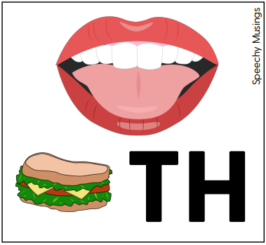
Th- Tongue sandwich sound
How to make the TH Sound:
•Tongue between your teeth
•Blow air over your tongue
•TH can be voiceless where the voice is off or voiced where the voice is on
Voiceless TH Words: thumb, three, think, thorn
Voiced TH Words: they, the, them, this
Learn more about making your TH sound here!
Back to speech sound list

Slide 19
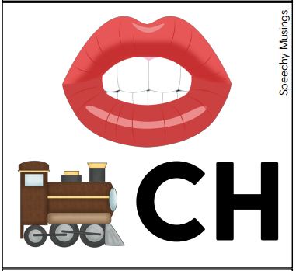
CH- Train “choo-choo” sound
How to make the CH Sound:
•Tongue tip on the bumpy spot behind your teeth, sides of tongue along your molars.
•Round your lips.
•Push tongue forward to release a burst of air.
•Voice is off
Words: chin, chip, child, chop
Back to speech sound list
Learn more about making your CH sound here!

Slide 20
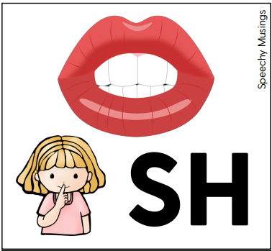
SH- Quiet “shhh” sound
How to make the SH Sound:
•Tongue tip on the bumpy spot behind your teeth then pull it back just a little bit, sides of tongue along your molars.
•Round your lips.
•Let air flow over the top of your tongue
•Voice is off
Words: she, shell, shop, shy
Learn more about making your SH sound here!
Back to speech sound list

Slide 21
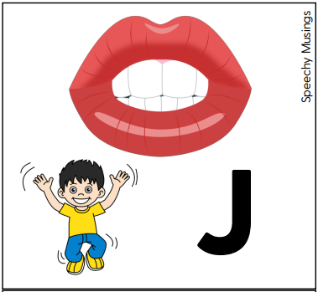
J- Jumping sound
How to make the J Sound:
•Tongue tip on the bumpy spot behind your teeth, sides of tongue along your molars.
•Round your lips.
•Push tongue forward to release a burst of air.
•Voice is on
Words: jump, joy, jet, juice
Learn more about making your J sound here!
Back to speech sound list

Slide 22
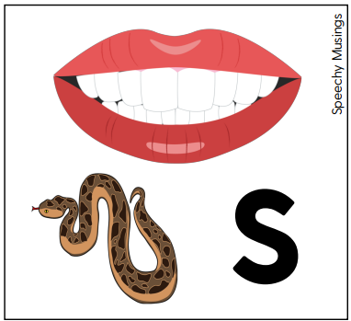
S- Snake hissing sound
How to make the S Sound:
•Tongue is at the top of your mouth
•Tongue should be behind your teeth with teeth closed
•Air flows over the tongue
•Voice is off
Words: sad, soup, sit, sing
Back to speech sound list
Learn more about making your S sound here!

Slide 23
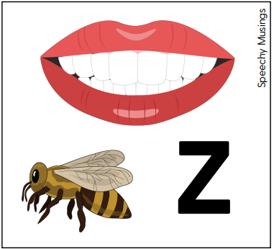
Z- Bee buzzing sound
How to make the Z Sound:
•Tongue is at the top of your mouth
•Tongue should be behind your teeth with teeth closed
•Air flows over the tongue
•Voice is on
Words: zip, zoo, zone, zero
Back to speech sound list
Learn more about making your Z sound here!

Slide 24
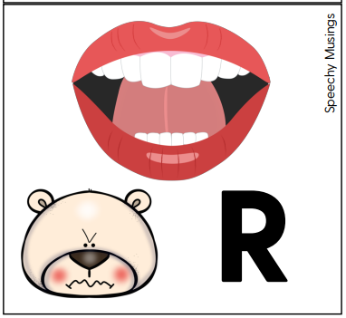
R- Angry bear sound
There are two different ways you can make the R sound. One is called the bunched and one is called retroflex or tongue tip. Try both out to see which is easier for your student to make.
Bunched
Retroflex
Back to speech sound list

Slide 25
Bunched R- Angry bear sound
How to make the R Sound:
•Back sides of tongue are touching the inside of your back teeth
•Pull tongue back
•Tongue will be tight and high
•Voice is on
•Sometimes saying gr helps to find the right spot
•Lips should be still
Words: right, rock, rope, run, rag
Back to speech sound list
Learn more about making your R sound here!

Slide 26
Retroflex R- Angry bear sound
How to make the R Sound:
•Back sides of tongue are touching the inside of your back teeth
•Tip of tongue curls back
•Tongue will be tight and high
•Voice is on
•Lips should be still
Words: right, rock, rope, run, rag
Back to speech sound list
Learn more about making your R sound here!

