Slide 1


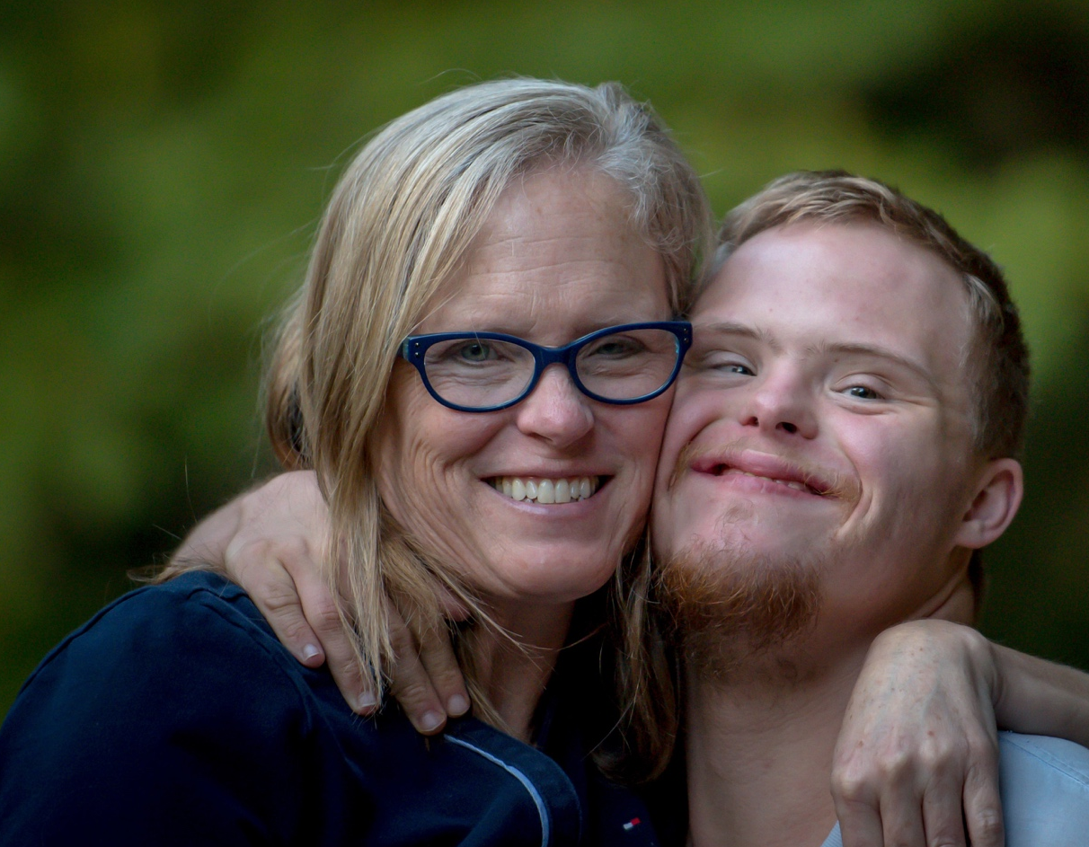

The Division of Vocational Rehabilitation (DVR)
Information Session
Notes:
DVR is an entity of the Department of Social and Health services, supporting individuals across Washington.

Slide 2

DVR
A statewide resource for people with disabilities.
Assists individuals with disabilities in getting and keeping a job.
Funded by both federal and state grants.

Slide 3
Who Does DVR Serve?
DVR may serve an individual when they:
Have a physical, mental or sensory disability that makes it difficult to get a job or keep a job that matches your skills, potential, and interest;
Need services and support, such as counseling, training, or assistance with a job search, in order to get or keep a job; and
Are capable of working as a result of receiving DVR services.

Slide 4



DVR
Voluntary Program
Individuals participating in services provided by DVR do so on a voluntary basis.
DVR provides informed choice when making decisions on whether or not to participate in services or select a provider of service.
Individuals receiving DDA services may choose to apply to DVR.

Slide 5
The Vocational Rehabilitation Process
Application
Eligibility
Vocational Assessment
Individualize Plan for Employment
Successful Employment
Case Closure

Slide 6
Application
DVR will provide information about vocational rehabilitation services.
An application must be completed before individualized services begin.
Application and records will be reviewed to determine eligibility for services.

Slide 7
Eligibility
An individual is eligible for DVR services if they:
Have a physical, mental or sensory disability that makes it difficult to get a job or keep a job that matches your skills, potential, and interest;
Need services and support, such as counseling, training, or assistance with a job search, in order to get or keep a job; and
Are capable of working as a result of receiving DVR services.

Slide 8
Eligibility Timeframe & Documentation
A VR Counselor has up to 60 days to collect and review records that document identity, disability, and work status.
If there is not enough information available, DVR will pay for required assessments in order to verify or support eligibility.
Notes:
Eligibility:
The DVR counseling team collects records to document identity, disability, and work status.
If no records about the claimed disabling condition exist, additional medical examinations or tests may be needed to verify or support eligibility.
If there is not enough information available, DVR will pay for required assessments in order to verify or support eligibility. A VR Counselor has up to 60 days to collect and review records that document identity, disability, and work status.
Information provided to DVR is kept confidential. Information is shared with others only with written consent, except in very limited circumstances. If a file includes mental health records, HIV/ AIDS and/or STI test results, diagnosis or treatment, and/or chemical dependency services, specific consent would be required for DVR to release the information.

Slide 9
OOS
Waitlist Information
A waiting list is a result of a closed priority category or multiple categories.
Customers are released from the waiting list based on priority category and the date of application for DVR services.
Waiting list customers will receive DVR Information & Referral (I&R) services.
Using a waiting list is how DVR manages limited resources.

Slide 10
OOS
Eligibility Determination & Priority of Service Category
After customers are determined eligible, they are assigned a priority of service category based on the significance of their disability. The priority of service category is based on the impact of the disability, not the type of disability.

Slide 11
Assigning a Category: Considered Criteria
OOS
DVR looks at seven distinct functional areas:
Mobility
Work Tolerance
Communication
Self-Care
Interpersonal (ability to get along with others)
Cognition and Learning (Self-Direction)
Work Skills

Slide 12
OOS
Service Categories
Category 1 – Most Significant Disabilities (MSD)
Category 2 – Significant Disabilities (3 areas of functional loss)
Category 3 – Significant Disabilities (2 areas of functional loss)
Category 4 – Significant Disabilities (1 area of functional loss)
Category 5 – All Other Eligible Individuals with Disabilities who do not meet the criteria for categories 1-4.
Note: DVR serves people who are MSD first.

Slide 13
Vocational Assessment
Information is collected and reviewed by the VR counselor and the customer to determine a job goal that best matches an individuals strengths, abilities, and interests.
  Including work history (paid & unpaid), labor market analysis, interest and aptitudes, criminal background, Community-based Assessments, disability related factors, social supports, etc.

Slide 14
Individual Plan for Employment (IPE)
Selecting a job goal:
    The agreed upon employment goal must be consistent with the information and results of the vocational assessment(s), as well as the customer’s VR needs.
An Individual Plan for Employment (IPE) is written to outline the steps and services needed to reach the job goal:
    Least cost to meet the customer’s needs
Individualized services may include:
    Training & education, job search, job placement assistance, time-limited supports to keep a job.

Slide 15
Successful Employment
Once employed, DVR will keep a case open for at least 90 days to ensure the job is a good match.
Cases are closed after 90 days of successful employment and when no other services are needed. Together, the customer and counselor decide when to close the case.

Slide 16


Questions or Comments?
DVR State Office
4565 7th Avenue SE
Lacey, WA 98503-1044
Toll free: 1-800-637-5627
Spanish Toll Free: 1-866-217-2964
Voice: (360) 725-3636
FAX: (360) 438-8007
Washington Relay: 711
THANK YOU!

