Slide 1
Area D Main Entry

Slide 2
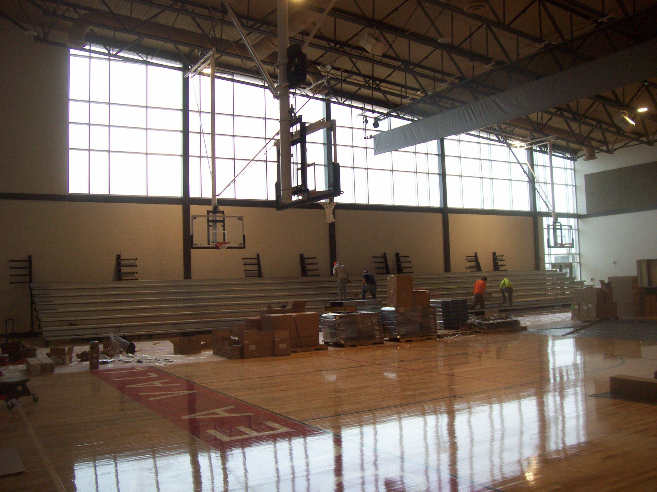
Area A - Auxillary Gym Bleachers

Slide 3
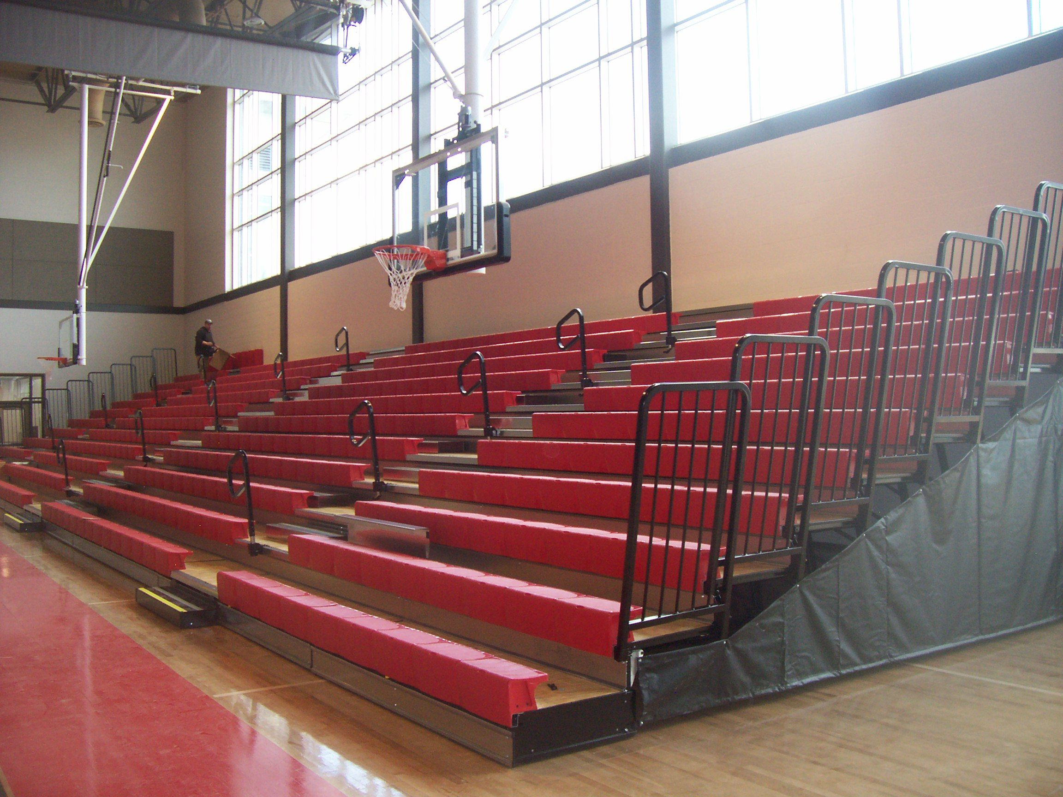
Area A Main Gym Bleachers

Slide 4
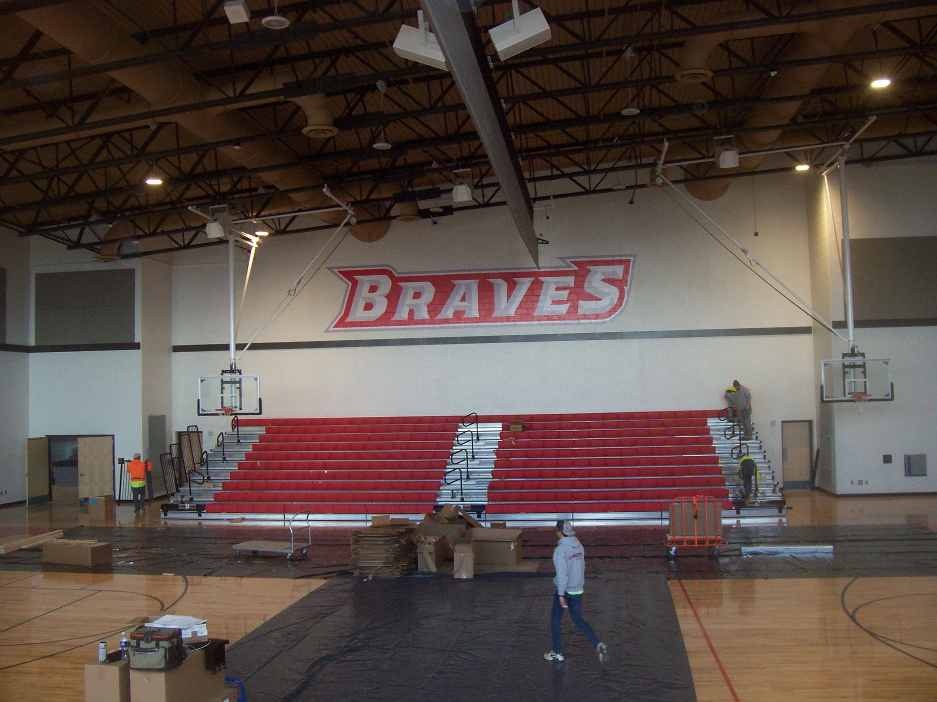
Area A Main Gym

Slide 5
Area A - Gym
Area A – Strength & Conditioning

Slide 6
Area A – Boys Restroom
Area C – Boys Locker Room

Slide 7
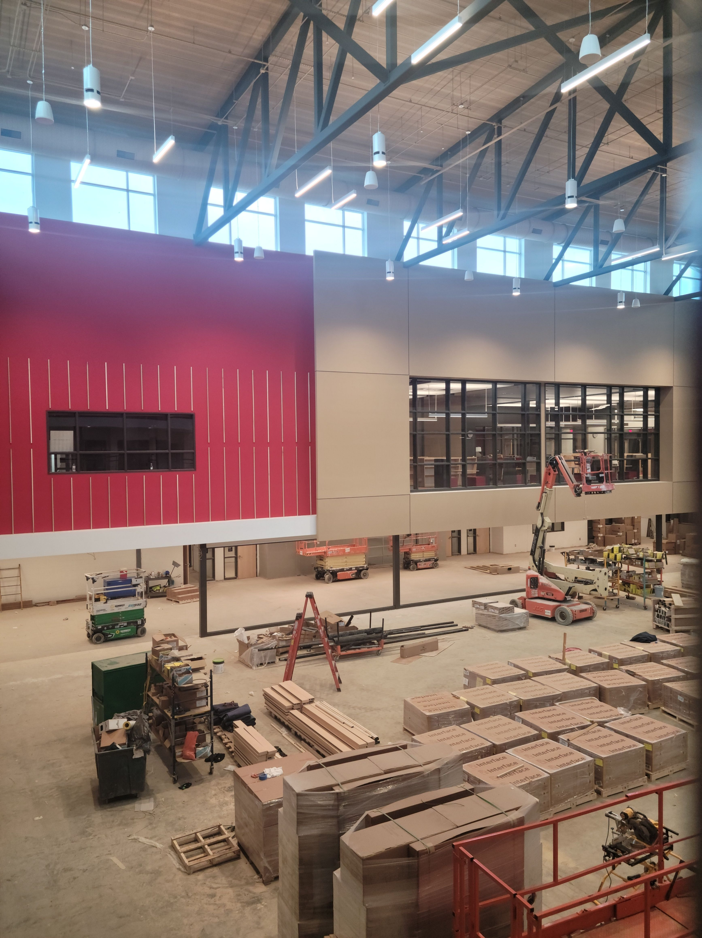
Area B - Cafeteria
Area B – Cafeteria North Wall
Area B – Corridor Looking South over Cafeteria

Slide 8
Dish Washing Area
Kitchen

Slide 9
Loading Dock Walk-in Cooler
Loading Dock

Slide 10
Area B – Corridor
Area B – Corridor Outside of LGI Rooms

Slide 11
Area A – Looking at Stair E
Area C – Corridor

Slide 12
STEM Room
Wood Shop

Slide 13
Area D – Second Floor CLA

Slide 14
Area A – Adaptive PE
Area A – Art Room

Slide 15
Area A - Stage
Band Room

Slide 16
Media Center

Slide 17
Media Center

Slide 18
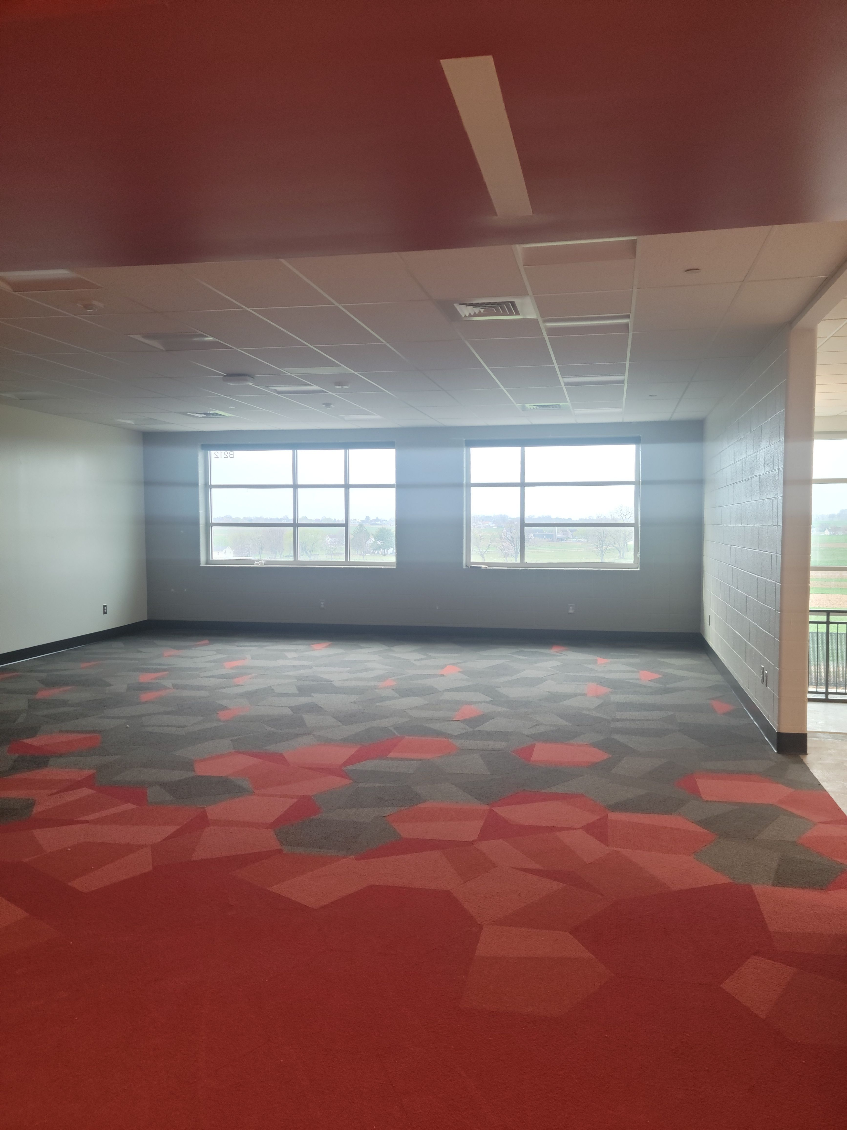
Area D - Classroom
Area B - CLA

Slide 19
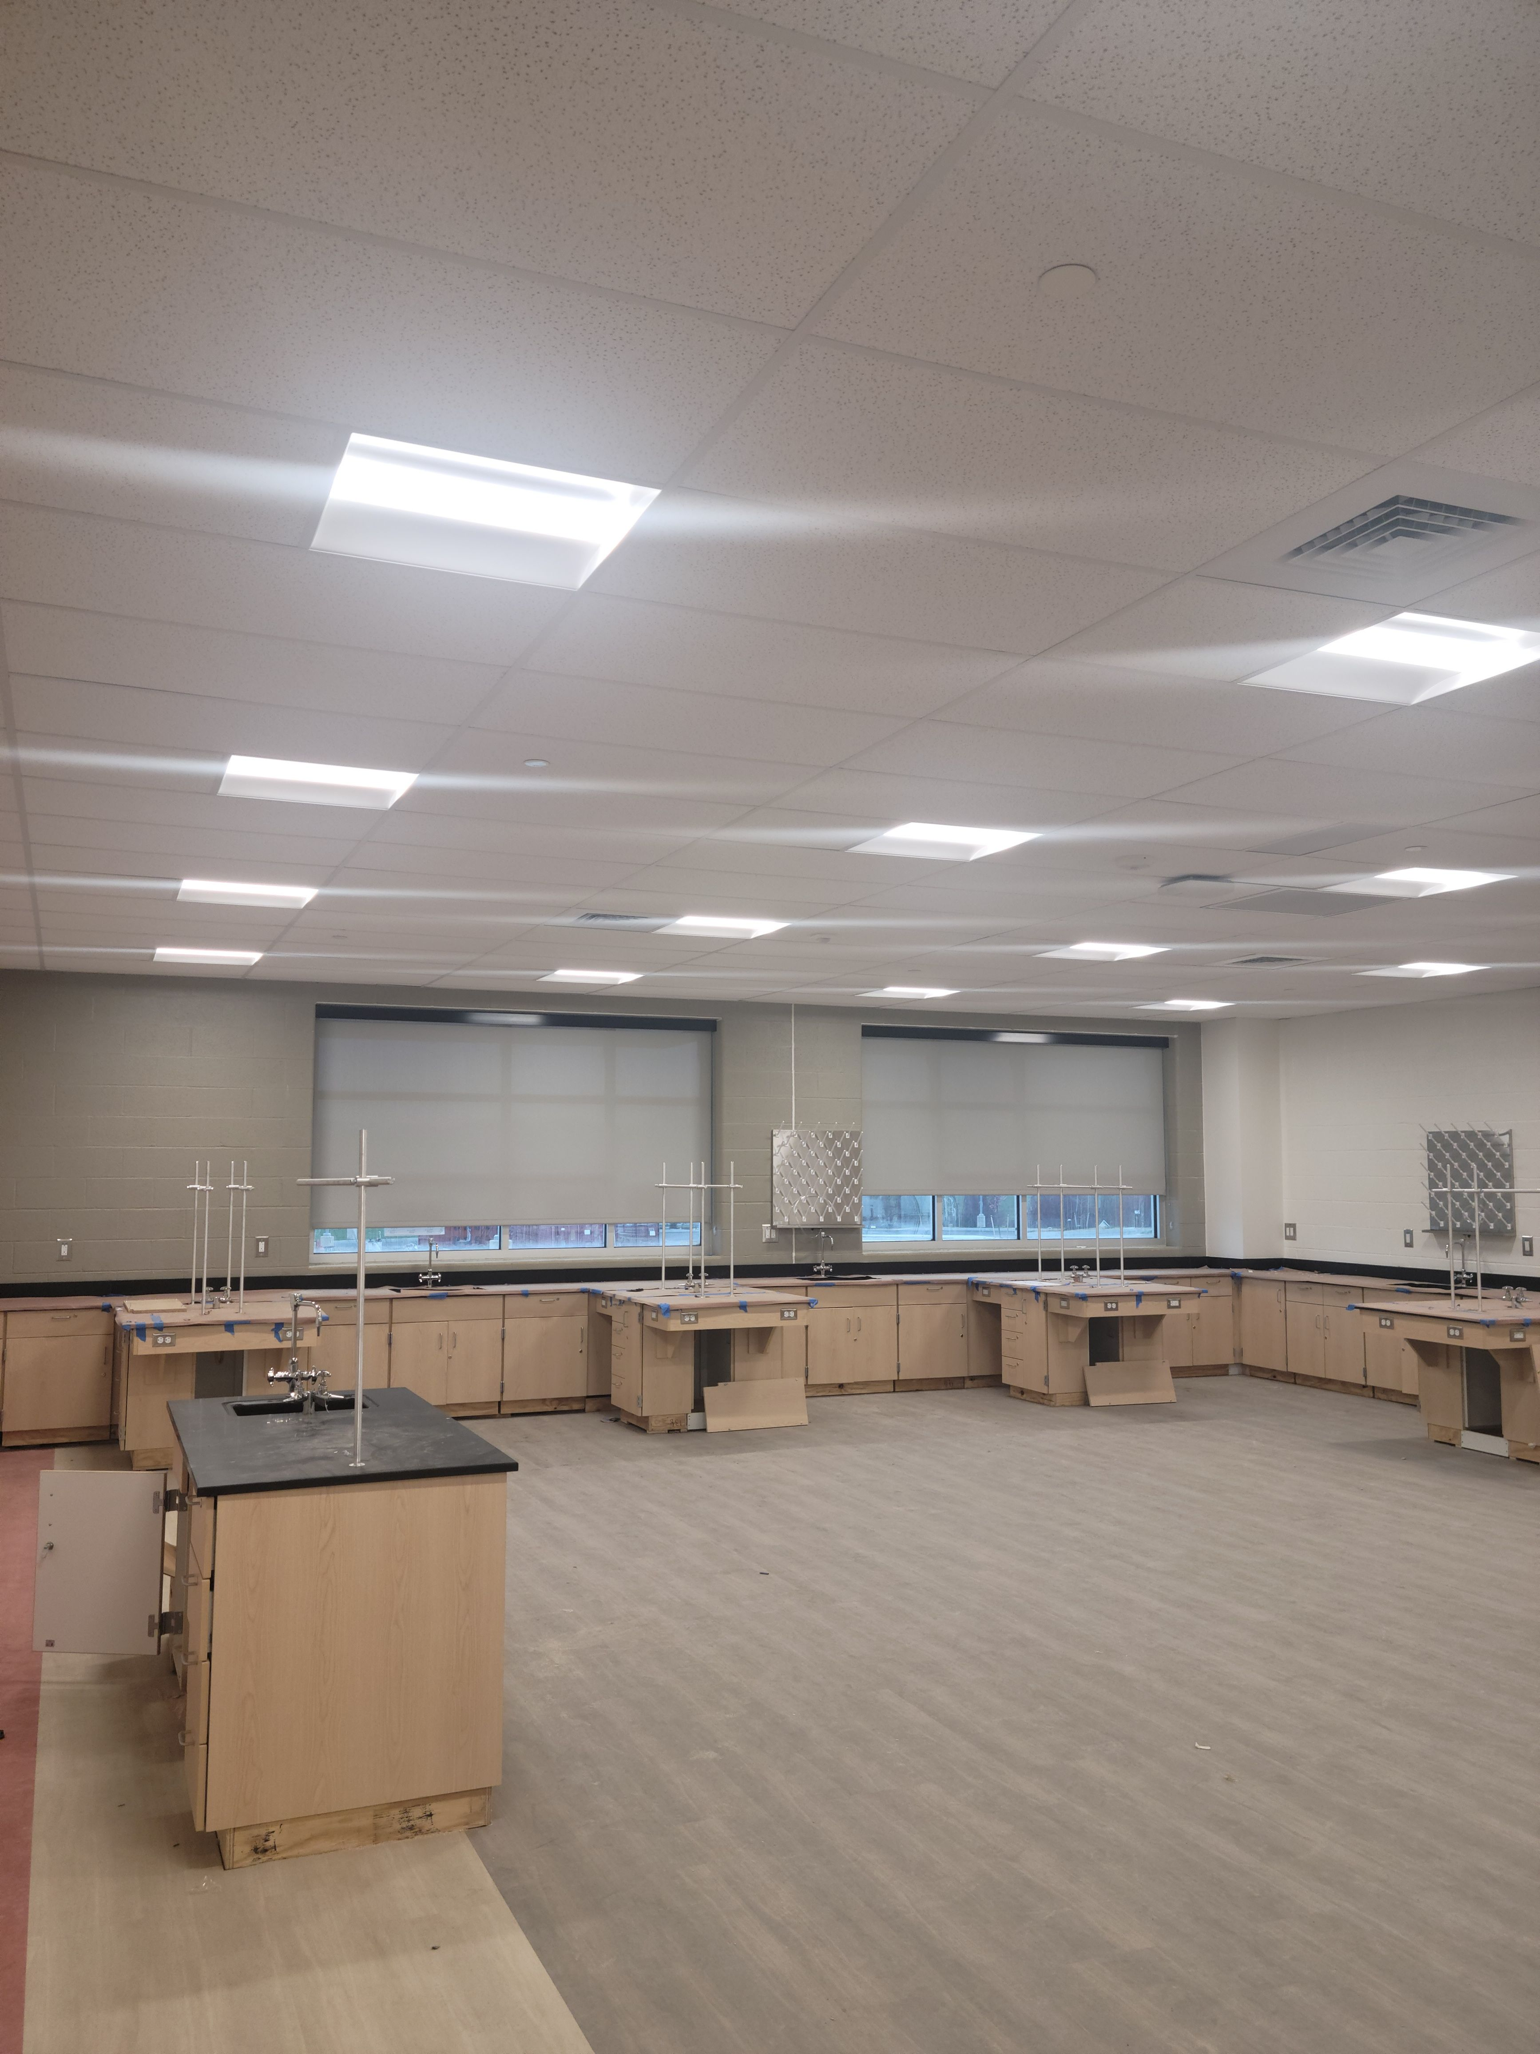
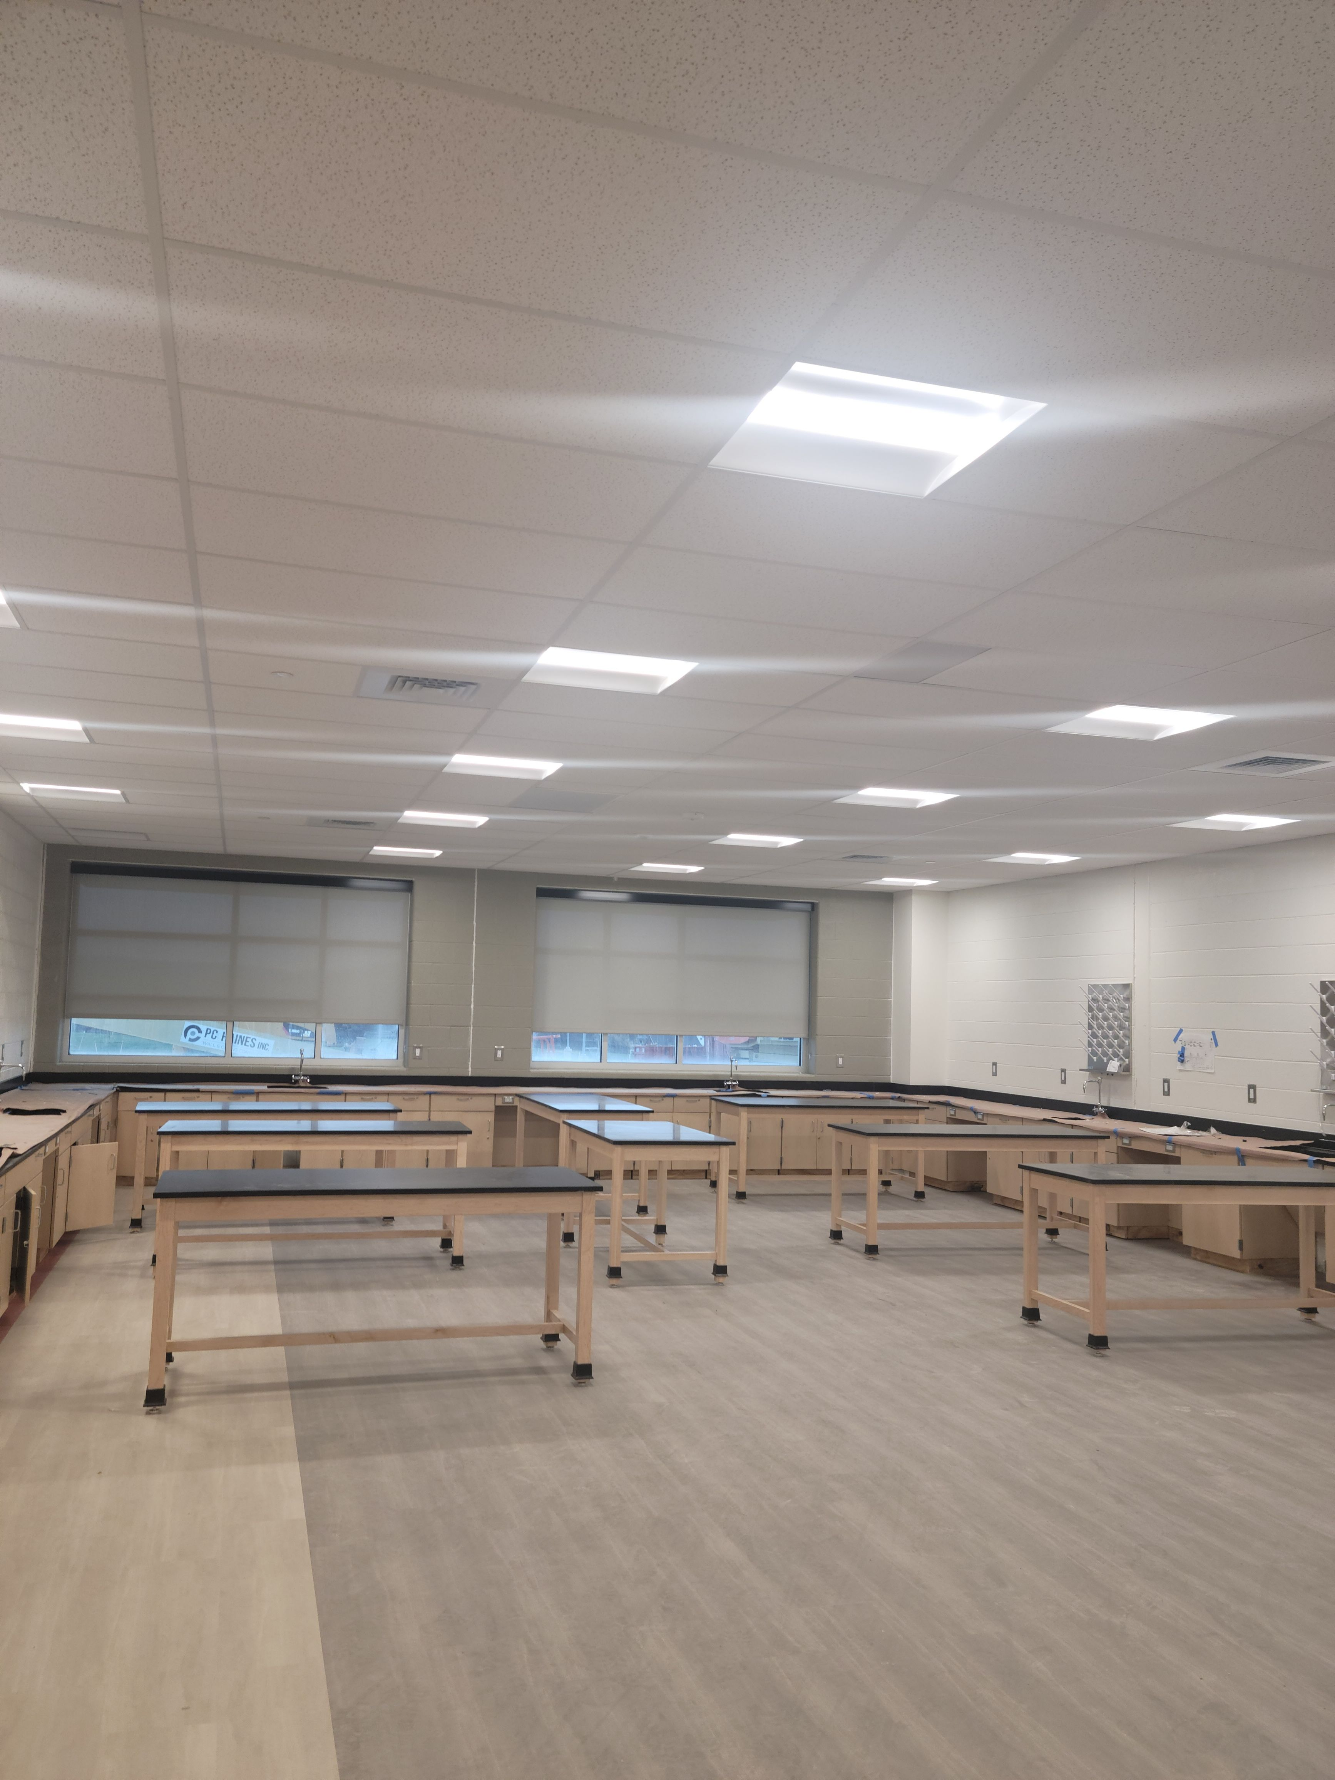
Chemistry Room
Science Room

Slide 20
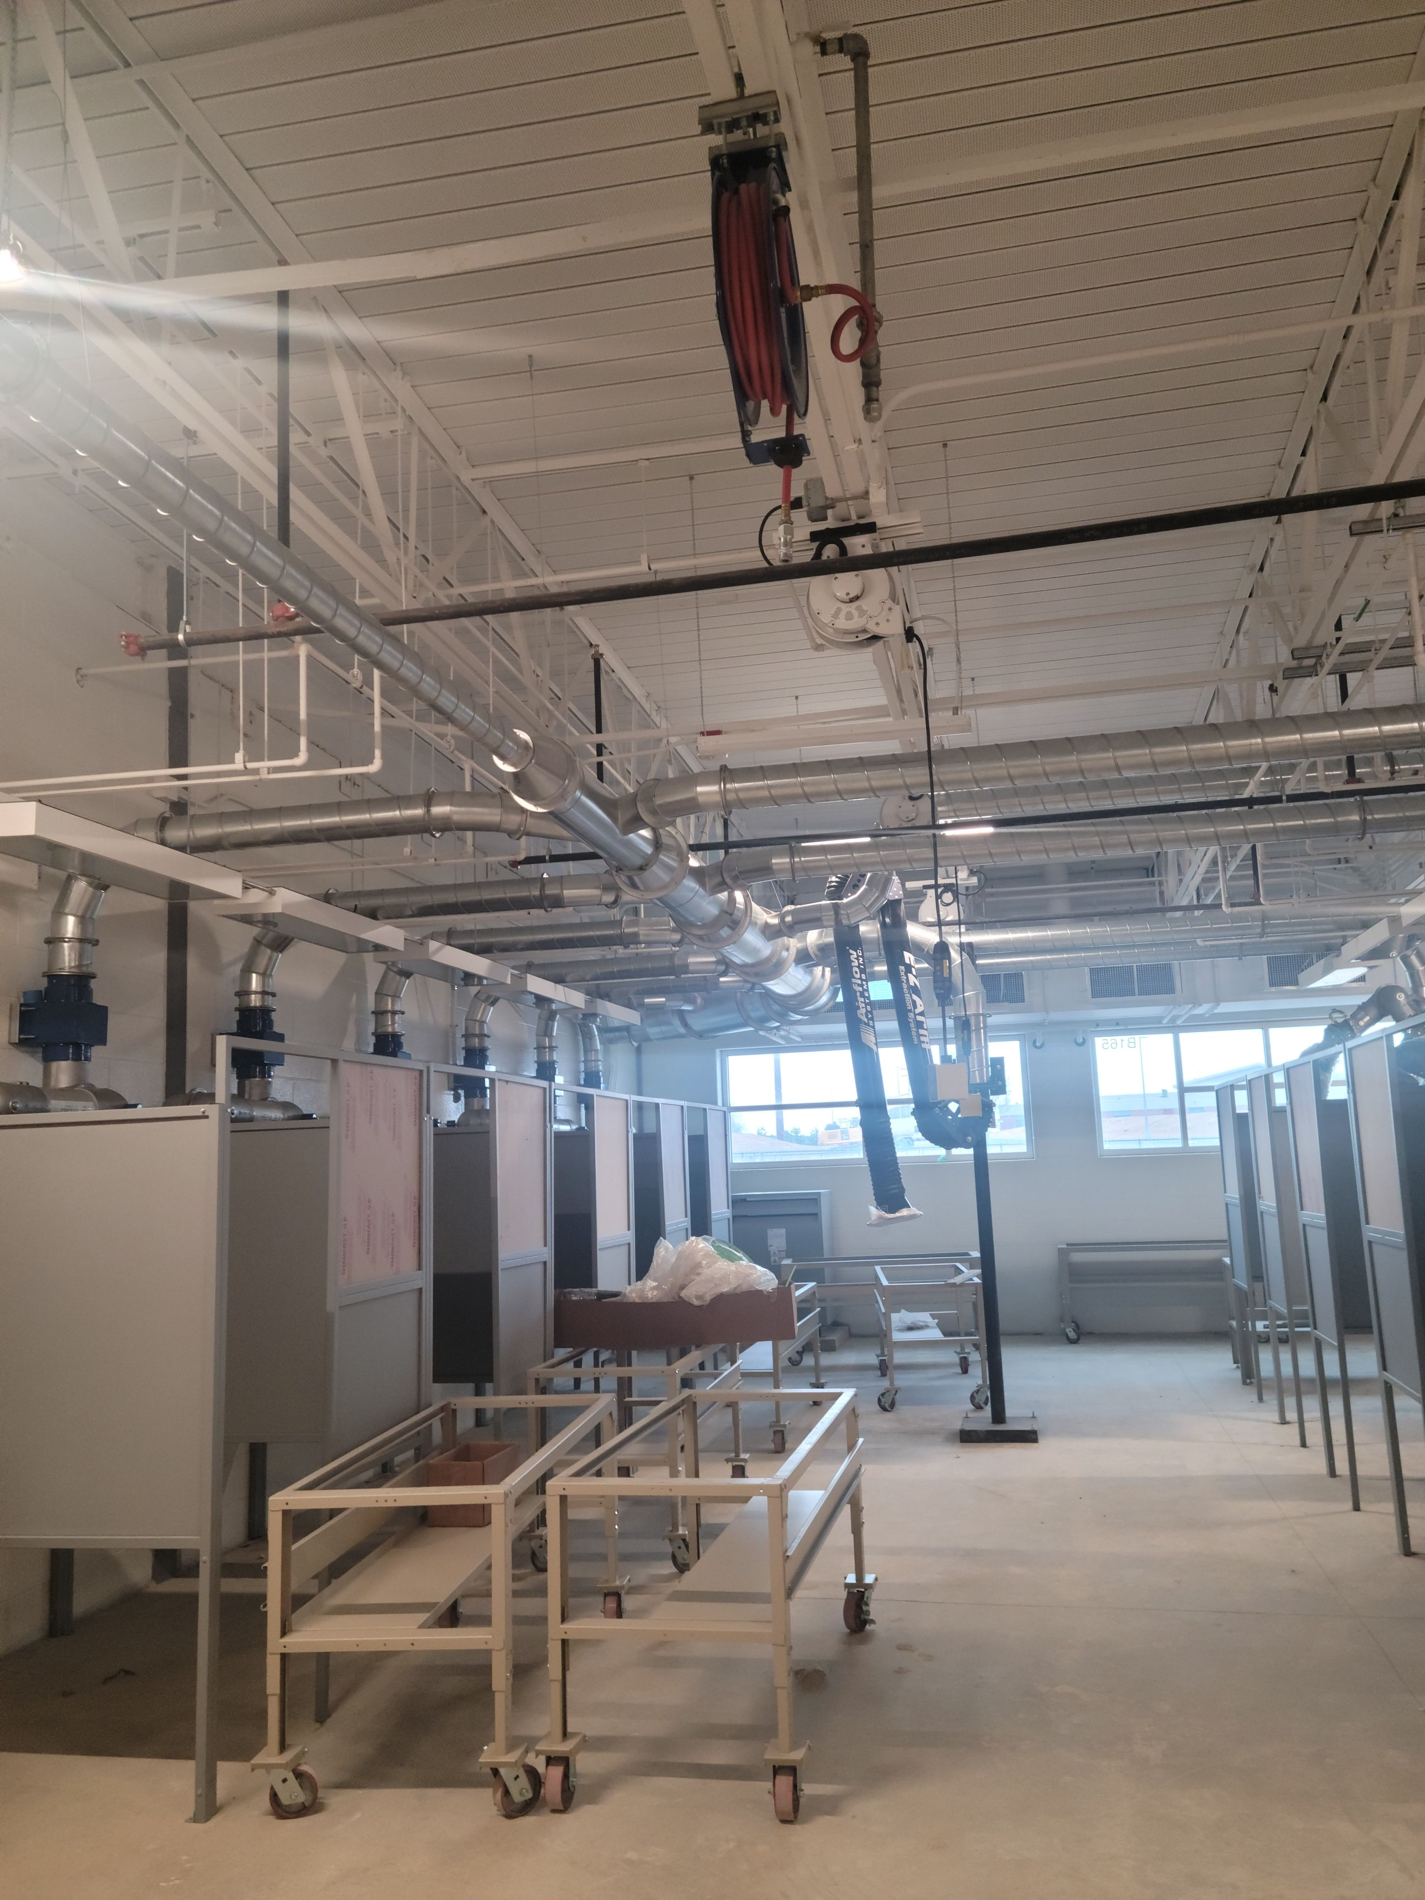
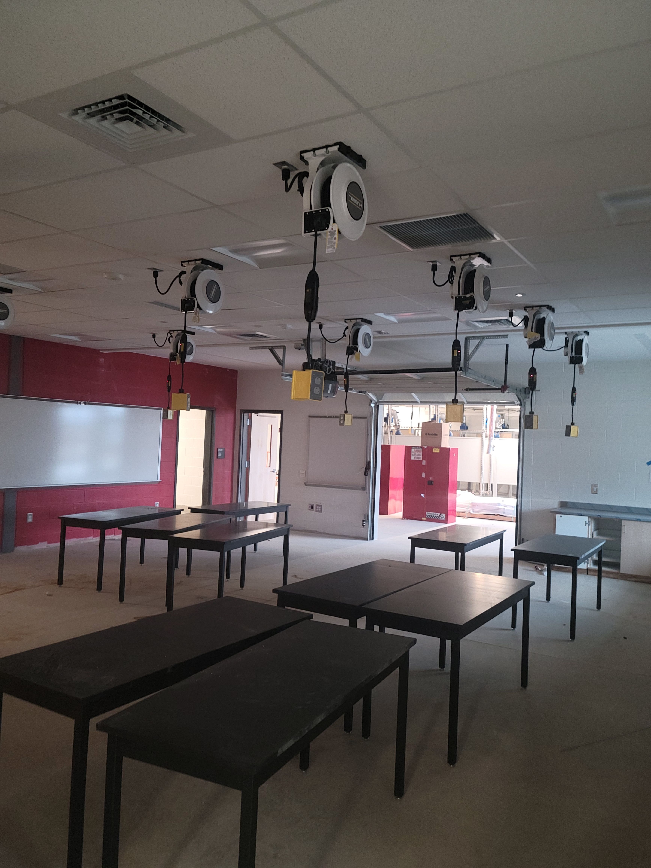
Area B – Ag Mechanical Room
Area D – Ag Science Room

Slide 21
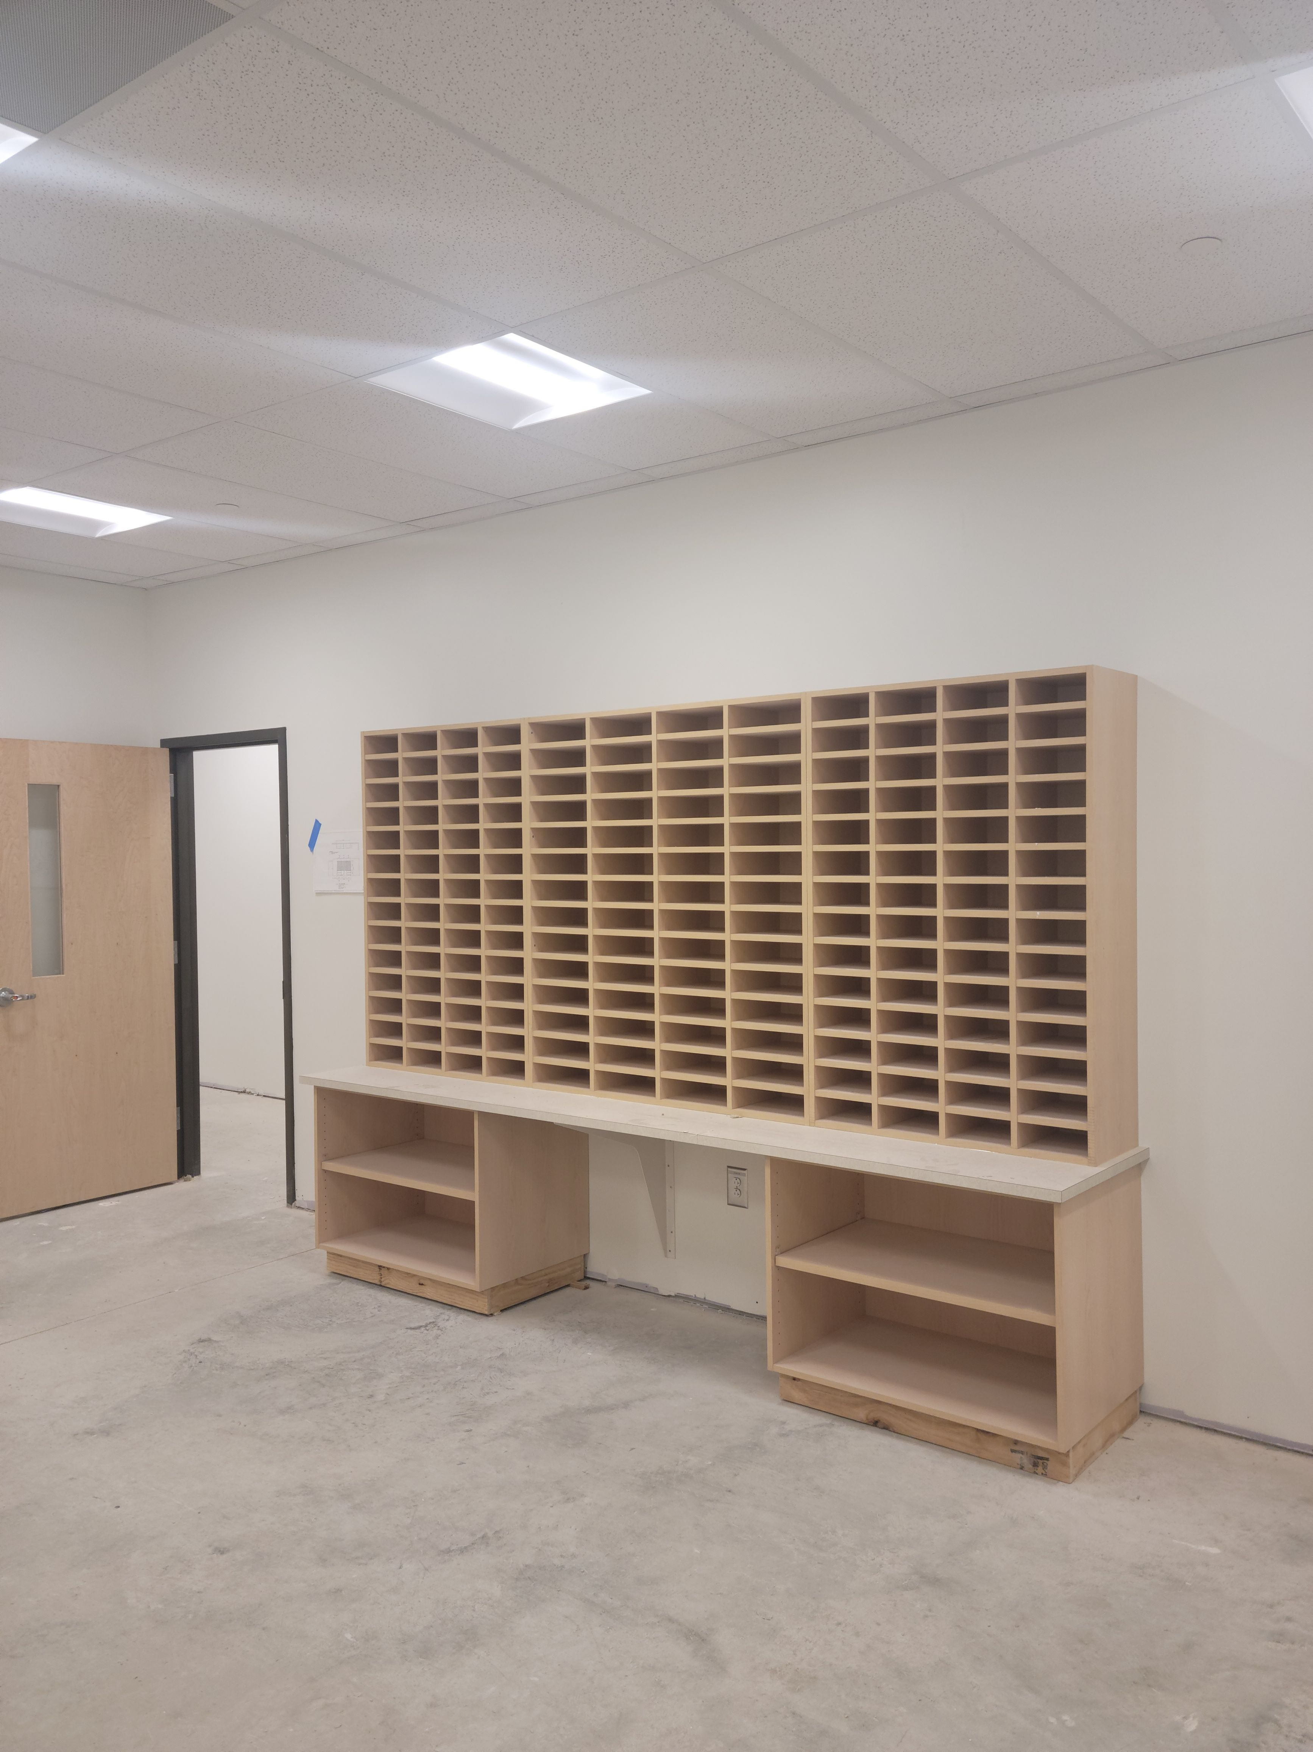
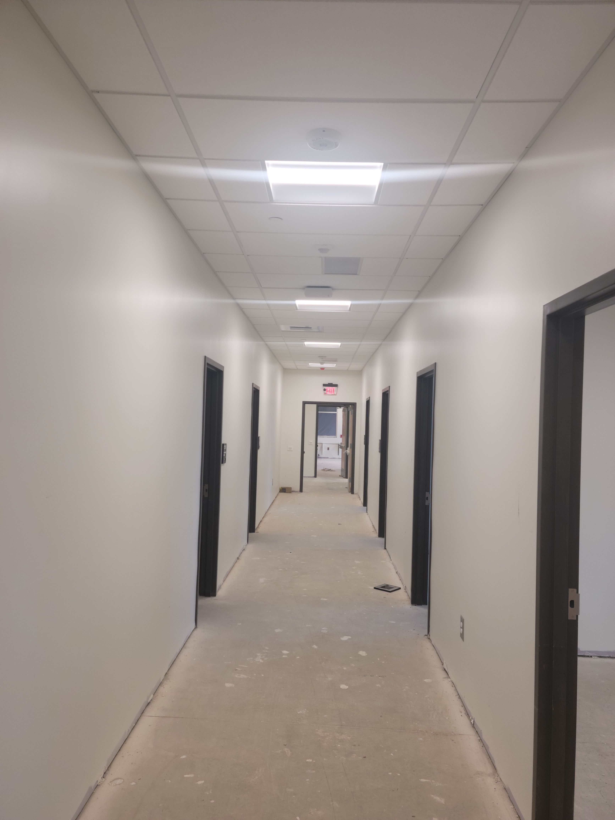
Work Room
Corridor to Reception Area

Slide 22
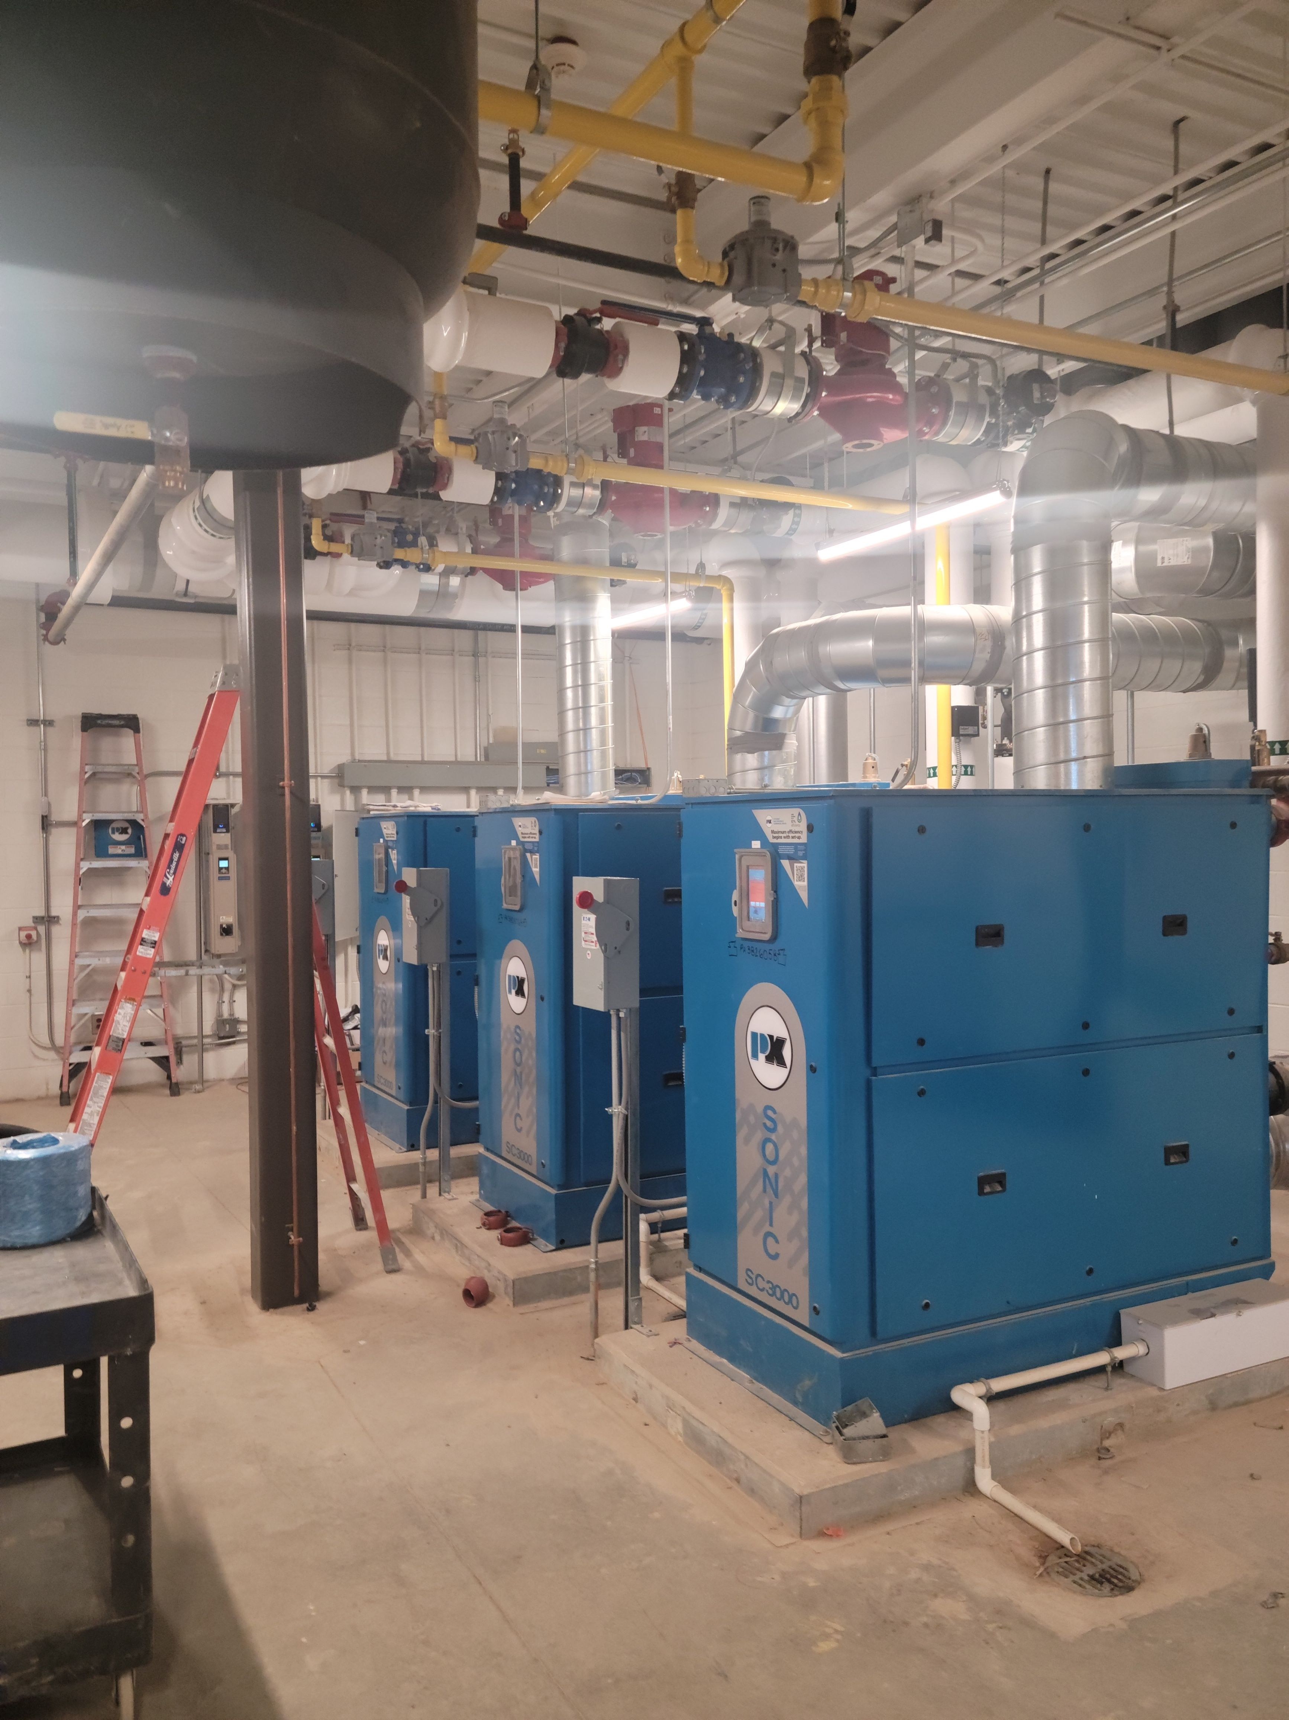
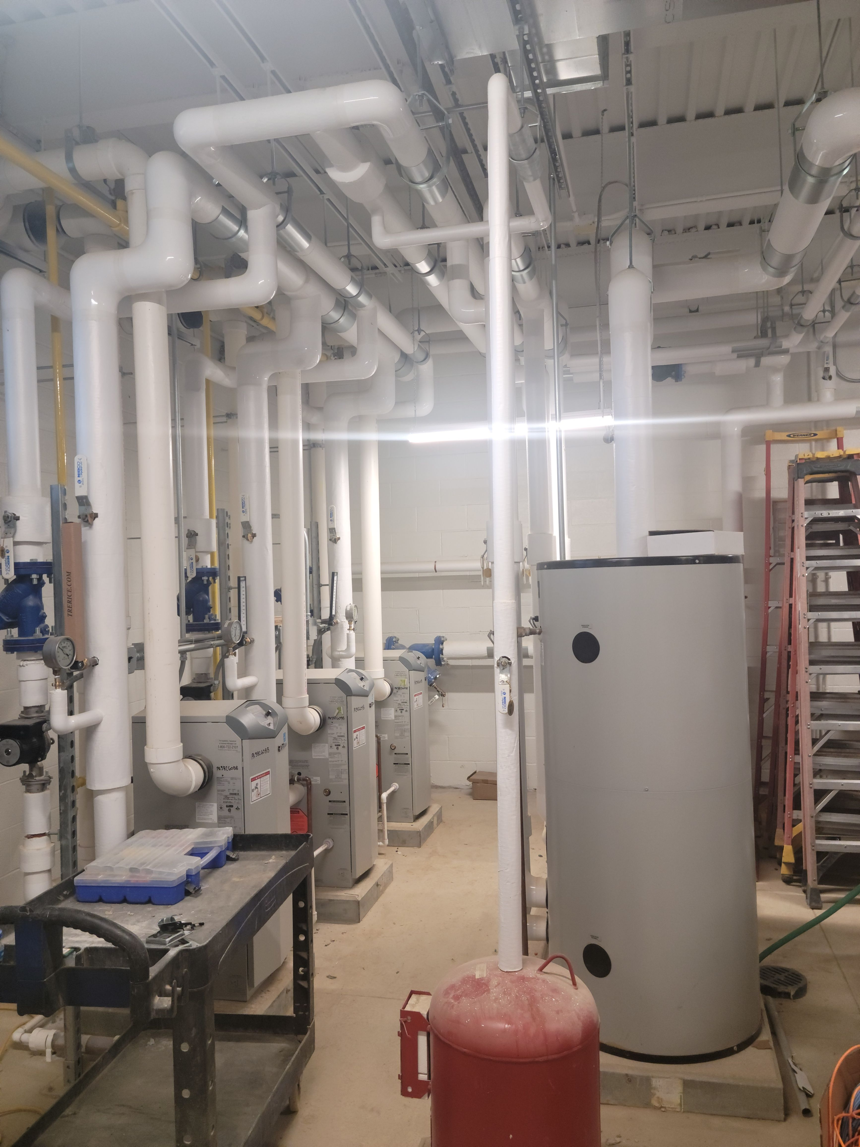
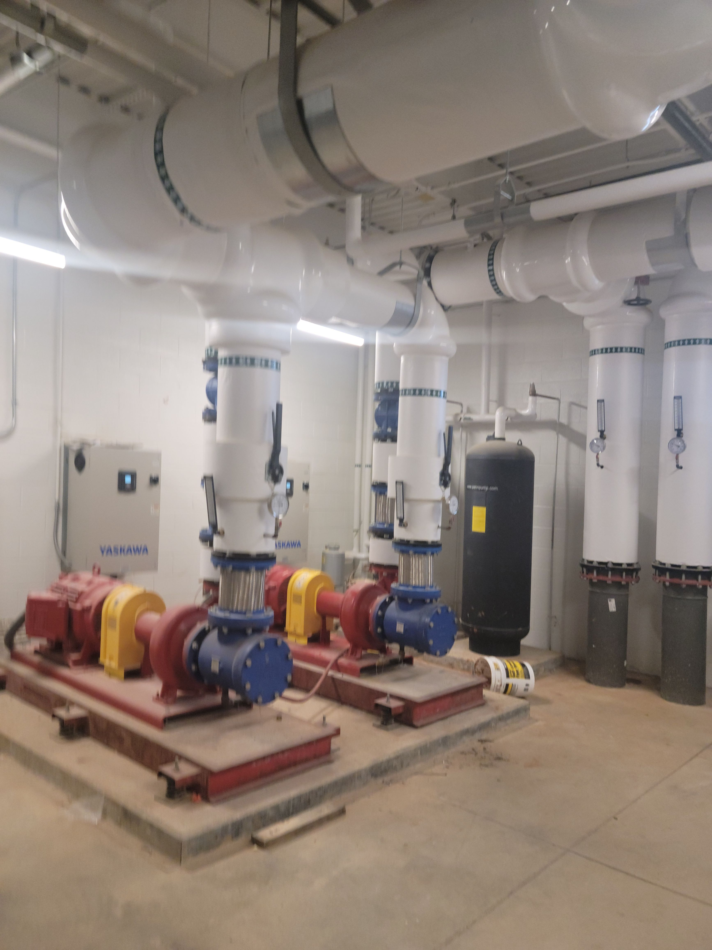
Mechanical Room – HVAC Boilers
Mechanical Room – HVAC Water Heaters
Mechanical Room – HVAC Pumps

Slide 23
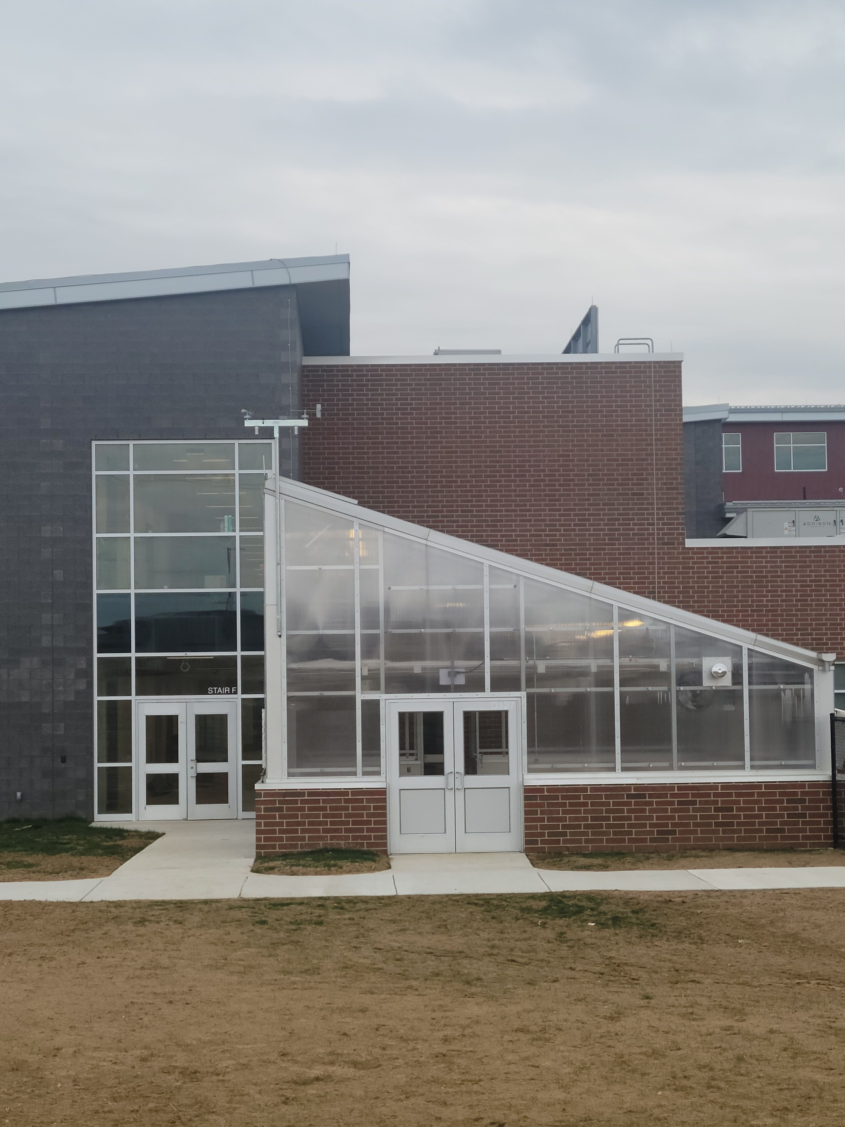
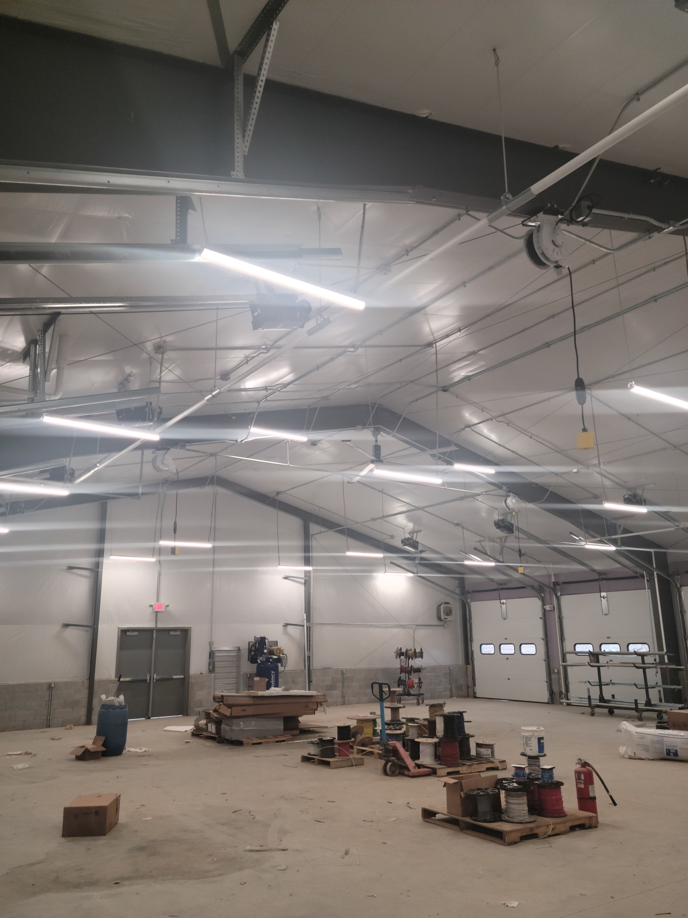
Greenhouse
Maintenance Building

