Slide 1
Running Start
Career & Technical Education,
School Counseling, & Family Partnership Departments
Issaquah School District
March 2025

Slide 2
Purpose
Provide a brief overview of the Running Start program
Provide insight to help students & families determine if Running Start is an option they might want to consider
Provide next steps that students & families can take to learn more, and then possibly enroll in the Running Start program

Slide 3
What is Running Start?
WA state program that allows students to attend college-level classes at a local college – tuition free
Eligibility begins the summer after 10th grade.
Student earns grades/credits at both high school & college (Dual Credit)
Your student continues to be an ISD student.
Student can continue to participate in HS sports, clubs, activities, events.
Students access HS counselors (academic, social emotional, and/or career/college support)

Slide 4
College Class schedule
Students can take either a full-time or part-time schedule.
Full time schedule means students take at least three 5-credit college classes each quarter (15 college credits = 3 HS credits).
Part-time schedule – some high school classes and some Running Start classes.
Three quarters per year
  Fall quarter -- Late September to December
  Winter quarter – January to March
  Spring quarter – March to late June
Optional Summer Quarter is shorter – 8 weeks, July-August

Slide 5
When can a student begin Running Start?
Students can begin the summer after 10th grade, or later
Three quarters during school year, and optional summer quarter
Students can choose:
  attend just during school year (junior &/or senior)
  attend just during summer quarter (after 10th &/or 11th)
  attend both during the school year and in summer quarter
Students can participate in Running Start Program for up to 1.4 FTE (max of 21 credits per quarter, or 63 college credits per year)
Counselor can clarify credit rules and limits.
Notes:
Meaning ISD will not pay for any credits beyond those allotted per quarter.

Slide 6
Running Start college schedule
College classes start time can vary – as early at 6:30 am to nearly 10 pm
Classes maybe in person, online or hybrid
Class selection and class schedules may vary each quarter
Classes composed of people ages between 16-40+
No separate classes in for students in the Running Start program (high school students learn alongside adult students)
Student schedule – student choice (what works best for them), within limits of space availability.
Notes:
)

Slide 7
Colleges most ISD students attend for Running Start
Bellevue College
Central Washington University – Sammamish Campus
Renton Technical College
Lake Washington Institute of Technology
Green River Community College
Other options exist – talk to your school counselor

Slide 8
Cost of Running Start
Full-time Running Start program pays for up to 21 college credits per quarter (15 credits is a full load, 21 credits is a very heavy schedule).
The number of college credits available for part-time student will vary – consult with your school counselor.
Textbooks fees
Some classes have class fees – art supplies, automotive class at RTC
No transportation provided - (all students under age 18 can access free Orca (bus) pass)
Incidental costs – meals
Student can apply for financial aid at the college for cost of textbooks, fees, etc

Slide 9
What classes can a student take?
Classes that are 100-level or higher – all are college-level classes.
English – begins with ENGL101, many composition and literature options available.
Social Studies – specific courses can meet World, Civics, US History, and NW Studies requirements. Several additional Social Science departments available (Psychology, Sociology, Geography, Political Science, etc.)
Math – college-level math is above Algebra 2
    Students need to complete Algebra 2 before taking math in Running Start
Science – students need to be ready for college-level curriculum and pacing; there are many science departments, check for prerequisites
    Chemistry and Physics students may need to demonstrate a level of math proficiency
Array of courses/departments/class availability depends on the college – check their course catalogs or ask your school counselor.
*School Counselors provide an equivalency sheet that explain which college courses will meet each high school graduation requirement. Not all colleges have an offering for every graduation requirement.

Slide 10
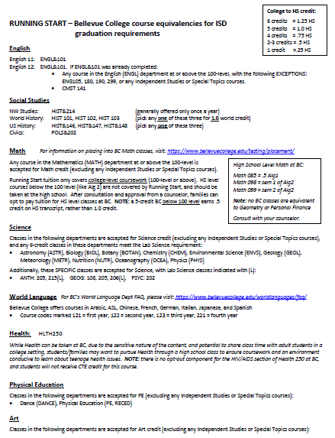
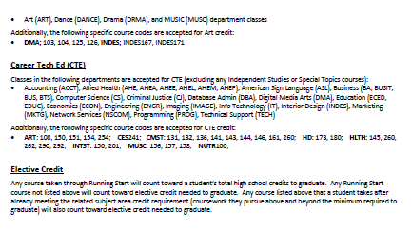
Example

Slide 11
Classes and credits
Some classes in colleges meet every day
Some classes meet 2 or 3 times per week
Students can take any class offered college, prioritize a plan for meeting graduation requirements.
For some classes, students may need to meet prerequisites or score a certain level on the placement test to be eligible (see college course catalog, talk with school counselor)
A 5-credit college quarter class = 1.0 high school credit (like a full-year HS class).
A 3-credit college quarter class = 0.5 high school credit (like a semester class).

Slide 12
Balancing part-time Running Start schedule
College quarters do not align with high school semesters. Students need to make a year-long commitment (little flexibility to make big changes)
Each quarter, part-time Running Start students need to register college classes that do not conflict with their high school schedule. Requires flexibility, planning & timely action.
Students need to be mindful of travel time.
Students need to communicate with college professor and high school teacher in the event of a schedule conflict (should be very rare).

Slide 13
Why Running Start?
Some common reasons students consider doing Running Start...
  Want faster paced, higher rigor college course &/or subjects not offered at HS
  Want to save $$ and get ahead, earning college credit while in high school
  Want a change of social environment, with more diverse adult community
  Want a change in academic setting...
    Take fewer classes at a time, with each class going into greater depth and ending sooner. College quarter: 15 credits is like 3 year-long HS classes in 11 weeks.
    More scheduling options (early morning, late evening, hybrid and online)
    Less visibility for others (parent/guardian/counselor) to monitor progress

Slide 14
Successful students in Running Start are…
Organized – aware of deadlines for homework, class registration, tuition, etc
Flexible – find and schedule classes based on what is needed to graduate, adjust plans when a certain class is full
Committed to attending classes regularly and on time
Disciplined and self-motivated, without family or HS intervention
Independently responsible for their own schoolwork, grades, and progress
Ready for working independently in an adult setting, with older peers, and with less teacher support.
Ready for transportation – drive self, take bus, carpool or family rides
Notes:
For full time RS students, no attendance is tracked. Part time RS students will have attendance tracked for time at the high school.

Slide 15
Students must be Independent
Apply for program.
Initiate meeting with high school counselor to plan which classes to take.
Bring form to school counselor to sign each quarter – this pays tuition, cannot register without it.
Register for classes on time - find classes you want/need at times that work for your schedule.
Plan and be aware of important dates (start of quarter, enrollment deadlines, etc)
Regularly monitor email communication from the college and the high school.
Identify when they need supports from the college and then use them.
Schedule to meet with high school counselor to each quarter to ensure they are on track to graduate.

Slide 16
Role of High School and School Counselor
School counselor specifies needed graduation requirements & which college classes meet them, and can offer suggestions about other college class options
School counselor signs the enrollment (RSEVF) form each quarter (student must schedule appointment and bring form, then submit form to college)
High school pays tuition – student must submit signed RSEVF form for college to receive tuition.
  No Winter quarter form turned in = no Winter quarter tuition paid.
High School will add college grades to HS transcript, once college sends them.
  All RST grades received must be entered onto HS transcript – by state law
School counselor does not have access to college at all. Can support student in completing their tasks, does not have any access or power to do it for them.

Slide 17
Role of Running Start College
Communicates with student only (not HS or families) regarding registration, deadlines, performance
Running Start students are considered regular college students (no special treatment)
College does NOT share the following information with either school or parents:
  Attendance
  Grades in progress
  Student behavior, etc.
Colleges have support services – which are accessible to enrolled HS Running Start students.
College sends final grade at end of quarter to the high school.

Slide 18
Challenges and Surprises reported by students
Fast-paced since one 5-credit class covers a whole year of HS curriculum
Classes have more homework/reading than HS
Colleges report that students are often reluctant to contact the college office for assistance.
Students don't always realize they can meet with college advisor for guidance on college pathways and requirements.
College on quarter system and high school on semester
  Breaks and vacations (except Winter break in December) don't line up
  Cannot drop out of a class and sign up for high school class easily

Slide 19
How can families monitor progress and grades?
You must ask your student to show you.
  Running Start classes not on HS Canvas
  Running Start attendance not on Family Access
School has no access to student grade until college sends the final grade. *High school has no insight about student progress – only gets the final grade in the classes.
After each quarter, families can check Family Access to see final grades once they are posted (may take a few weeks to appear).
High School transcripts will include the final grades once posted.
Students are responsible for sharing progress and grades with families.

Slide 20
Students with IEPs or 504s
Students seeking accommodations must apply with the college – college determines supports on their own campus
Contact college’s disability services office well in advance of any published deadlines to apply
College may require documentation as a part of the application.
Students with an IEP: start by discussing Running Start with school IEP team well in advance. IEP team can provide additional support and guidance.

Slide 21
Summer Running Start
Shorter quarter – 8 weeks instead of 11 weeks, 10 credits is a full load
All 10th graders will qualify for up to 10 credits, consider starting with 5 credits (full year of college-level high school content in 8 weeks).
11th graders – many will qualify for up to 10 credits, but it depends.
  Juniors who have not done Running Start this year will qualify for 10 credits.
  Juniors in Running Start consult with counselor to see what funding remains.
12th graders
  Who are not eligible to graduate in June may qualify for summer Running Start – which could allow them tuition free option to graduate in August!

Slide 22
Next Steps (for summer OR fall)
Visit colleges' websites to learn about their info sessions, enrollment processes & timelines.
Visit Running Start page on Counseling website for more details about preparing to enroll, expectations, timelines
Start enrollment process with College.
THEN, in late April/early May, schedule an appointment with counselor to sign form.
Turn form into College & register (mid-May to early June)

Slide 23
Student & Family Information Session
Summer & Fall 2025 Quarter Bellevue College
These information sessions are for students that are currently a sophomore or junior in high school and a parent/guardian. Running Start (RS) Information Session Schedule :: Running Start (bellevuecollege.edu)
Upcoming Saturday Dates:
March 29: 10am & 1pm – in person Session Signup
April 5: 10am – Teams (online) Join Here
April 19: 10am & 1pm – in person Session Signup
May 3: 9am & 1pm – in person Session Signup
May 17: 9am & 1pm – in person Session Signup
June 7: 10am – Teams (online) Join Here

Slide 24
Additional Resources
IHS: https://issaquahhigh.isd411.org/student-life/counseling/running-start
SHS: https://skyline.isd411.org/student-life/counseling/running-start
LHS: https://liberty.isd411.org/student-life/counseling/running-start
OSPI Running Start site
OSPI Running Start FAQs October 2024

Slide 25
Additional Resources
Bellevue College
  Running Start, Course Catalog
CWU – Sammamish
  Running Start
Lake Washington Institute of Technology
  Running Start, Course Catalog
Renton Technical College
  Running Start, Course Catalog
Green River Community College
  Running Start, Course Catalog

Slide 26
Thank you!
High School students – select a full HS schedule of classes for next year during course request process. Requests can be adjusted later, once you’ve successfully registered for Fall quarter.

