Slide 1



The webinar will begin soon!
Please make sure your
volume is adjusted
to hear the music.

Slide 2

Welcome to the parents as Partners STAAR/EOC InformationAl Session
Notes:
AA

Slide 3
Purpose
To have an understanding of the STAAR/EOC assessments and how to support my student.

Slide 4
TEA’s assessment system includes both STAAR and EOC tests. Both of these are summative, meaning they are used to determine mastery of a breadth of knowledge and skills.
Notes:
AH

Slide 5
Who takes the STAAR test?
3rd & 4th | 5th | 6th & 7th | 8th
Math & Reading Language Arts | Math, Reading Language Arts, & Science | Math & Reading Language Arts | Math, Reading Language Arts, Science, & Social Studies
Notes:
AH
Windows are open mid-April to mid-May. Watch for specific communication from your child’s campus about the exact dates of testing.

Slide 6
Who takes the EOC test?
English I & II
Algebra I
Biology
US History
Notes:
AH

Slide 7

Notes:
AH

Slide 8
State and Federal laws required a redesign of Texas’s state summative assessments effective 2022-23
Notes:
AH

Slide 9

Notes:
AH

Slide 10
The changes are designed to help improve alignment to classroom practices while remaining focused on accurately measuring student mastery.
Notes:
AH

Slide 11
What Comprises STAAR?
01
02
03
04
100% Online
New Question Types
(at least 25% of the test)
Cross Curricular Passages
Tools and Accommodations
Evidence-Based Writing
Notes:
AH
Studies show no significant difference in testing scores on paper vs online.
Students consistently choose online as a preference.
Open ended questions requiring writing allows a student to answer in their own words. Two human raters and a standardized rubric. Must be certified teachers with experience. Must go through training.

Slide 12

Notes:
Amy Armstrong
Cambium
Login
5th math
Choose text to speech
Question 1 - let parents listen normally then use settings wheel upper right corner to show rate
Show navigation in upper left corner
Question 2 - show how students can use the number pad or keyboard to enter
If you do not answer, the system will show an alert message
Show each of the green tools in upper right corner
Show the help tool (? in upper right corner)
8th grade RLA
Show how to adjust passage for size
Notice the question numbers in the upper right corner
Go through each of the first 6 questions
Show green tools in upper right corner
Show how the highlight tool works (three lines above the passage next to arrows)
9th grade Biology
Tools
Look at Q3-6
US History
Q8, 9

Slide 13
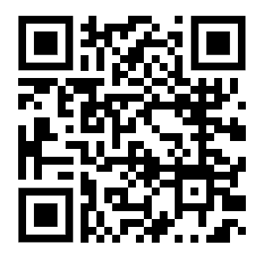
Student and Parent TEA STAAR Resources
Notes:
Amy Armstrong
Cambium
Login
5th math
Choose text to speech
Question 1 - let parents listen normally then use settings wheel upper right corner to show rate
Show navigation in upper left corner
Question 2 - show how students can use the number pad or keyboard to enter
If you do not answer, the system will show an alert message
Show each of the green tools in upper right corner
Show the help tool (? in upper right corner)
8th grade RLA
Show how to adjust passage for size
Notice the question numbers in the upper right corner
Go through each of the first 6 questions
Show green tools in upper right corner
Show how the highlight tool works (three lines above the passage next to arrows)
9th grade Biology
Tools
Look at Q3-6
US History
Q8, 9

Slide 14
How are BISD teachers supporting the changes?
Using online practice portals for new question types
  Classroom Assessments
Online interim tests that mirror STAAR testing
Focus on answering the prompt and using text evidence in writing
Introducing students to the online tools
Providing guidance about best practice of taking tests online
Notes:
AH
TEA - a number of sites with interactive practice questions just like the real test
Performance Matters for summative assessments - teachers are building the new question types

Slide 15
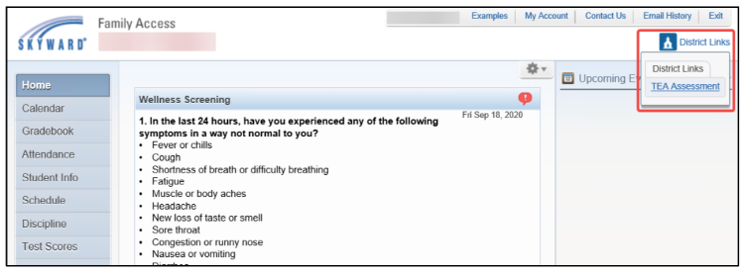
Texasassessment.gov
Accessing STAAR Scores
Login into Skyward Family Access
Top Right Corner Click on District Links
Click on TEA Assessment
This will take you directly to your Student’s scores
Notes:
AA

Slide 16
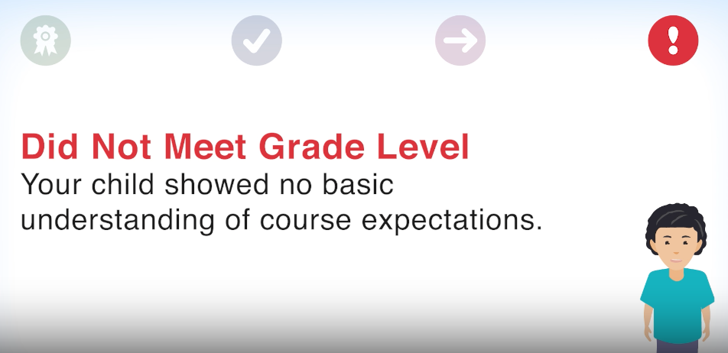
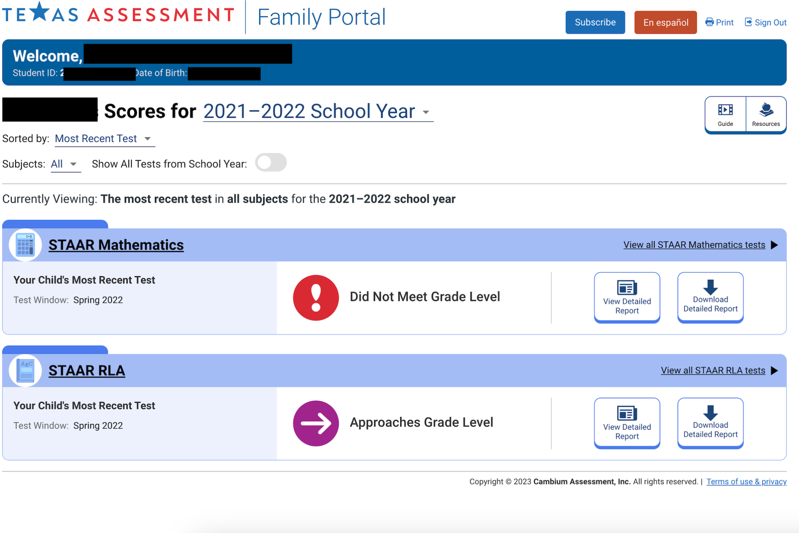
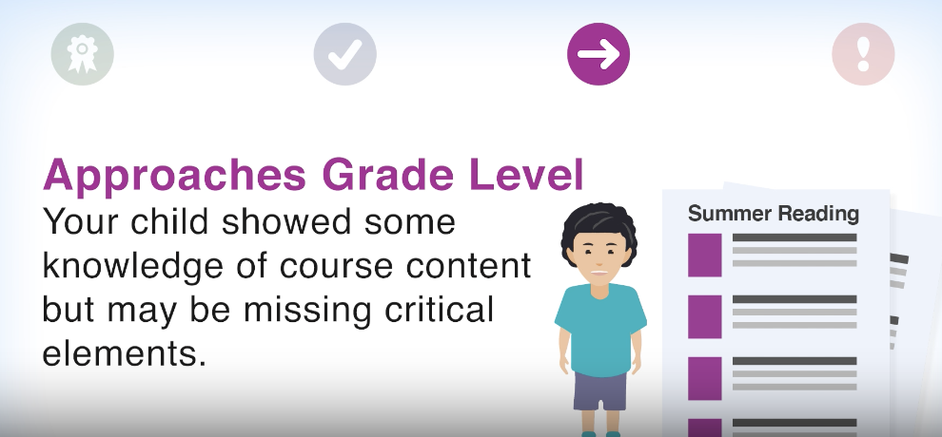
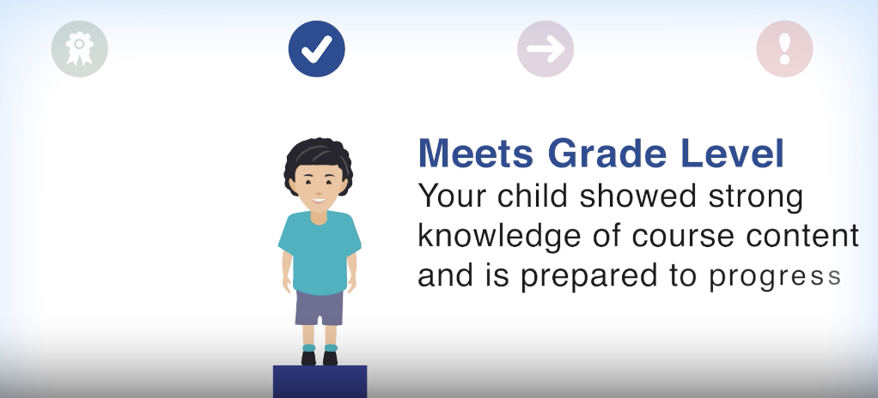
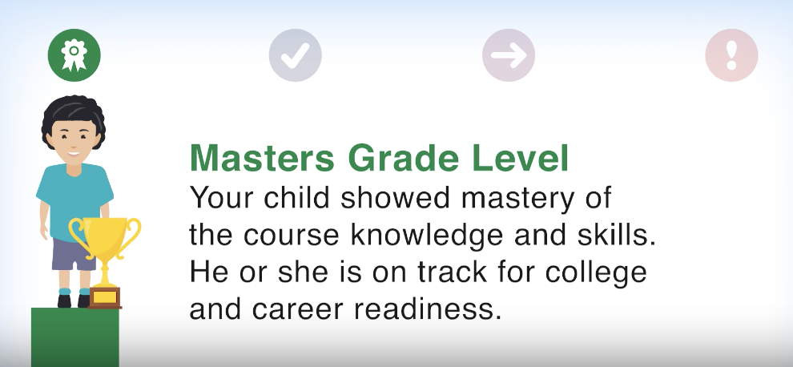
locating your child’s test score
Access Your Student’s STAAR Scores through Skyward

Slide 17
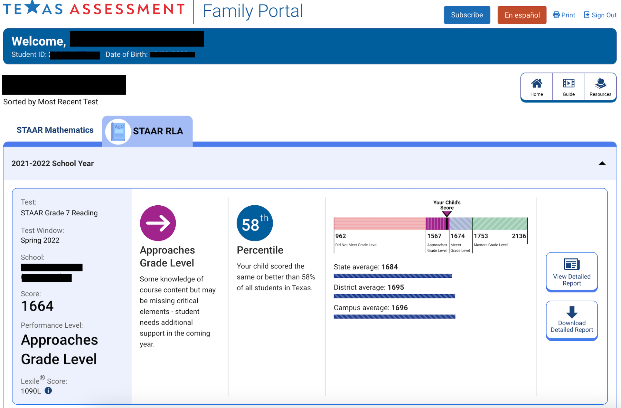
Finding your child’s test score
You can click here for a copy of your child’s report card.
Notes:
AA

Slide 18
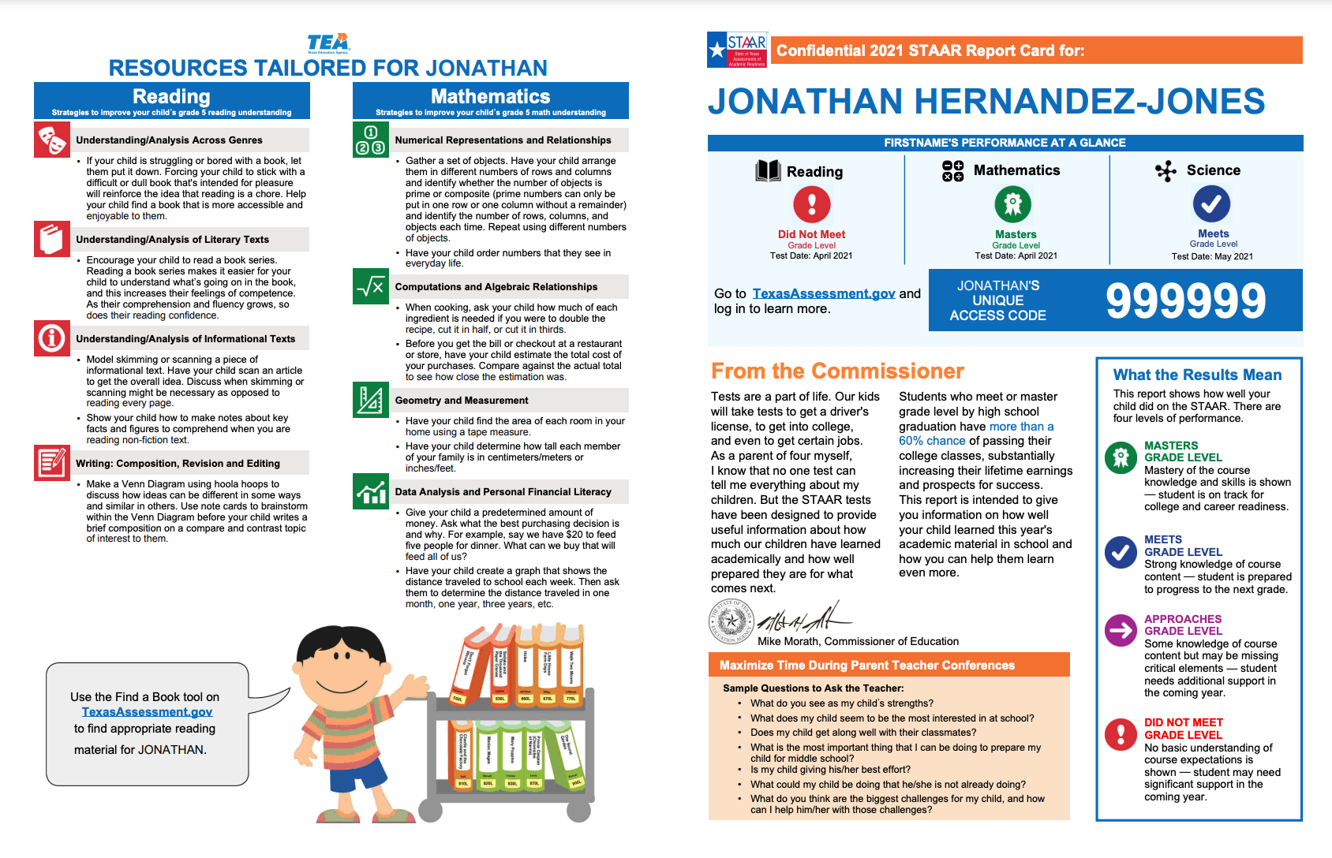
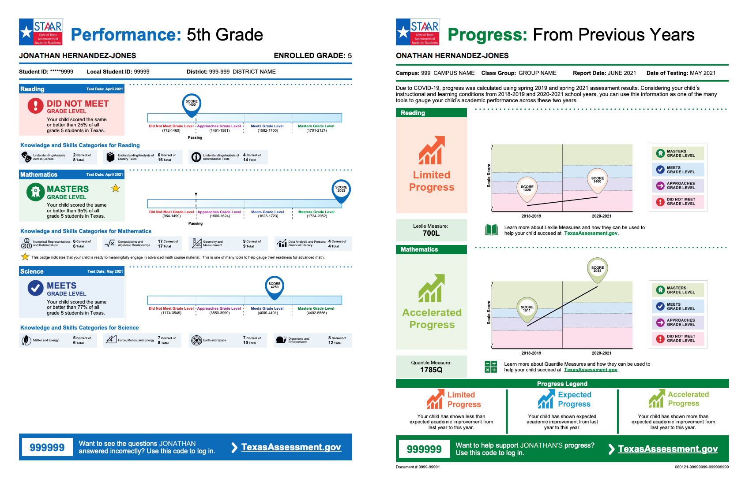
Watch for your child’s report card to come this year!
Notes:
AA

Slide 19
What can parents do?
What can parents do?
Prior to Testing
Communicate with teacher
Support learning at home
Review school or homework with your child
Encourage reading every night
Use Freckle for math practice
Day of Testing
Be sure your child gets a good night’s sleep
Double check medication, glasses, hearing aids, etc.
Be on time to school
Solid breakfast
Notes:
AH
Practice math facts.
Ask who, what, when, where, and why questions. Practice using text evidence.
texasassessment.gov

Slide 20
Most importantly encourage and empower your child!
Notes:
AH

Slide 21


ADDITIONAl helpful Resources
TEA Understanding Your Child’s Score
Texas Schools Resources
Texas Assessment for Students and Families
Source for all information in this presentation can be found on the TEA website.

Slide 22
Contact Information
Holly Moore
Director of Accountability, Assessment, and Intervention
Holly.Moore@bisd.net
Notes:
AA

Slide 23


