Slide 1


FAFSA Fundamentals for High School Students
2025 - 2026

Slide 2




Slide 3

Introduction to Financial Aid
Introduction to Financial Aid
Introduction to Financial Aid

Slide 4
Financial Aid = Money for College
Grants
Scholarships
Work-Study
Student Loans
Notes:
Financial aid can be described as any money that you receive to help you pay for the costs of higher education that’s not contributed by you or your family.
There are four different types of financial aid shown here. We’ll talk more about the types of aid later.

Slide 5

What is the FAFSA?
Free Application for Federal Student Aid
Available at FAFSA.gov
Snapshot of your family’s current financial situation
Helps determine your eligibility for federal and state aid
Notes:
FAFSA stands for Free Application for Federal Student Aid. The FAFSA is basically a snapshot of your family’s current financial situation and is used to determine your need for various types of federal and state aid. Each FAFSA covers one academic year, so you’ll need to renew it each year that you need money for college.

Slide 6
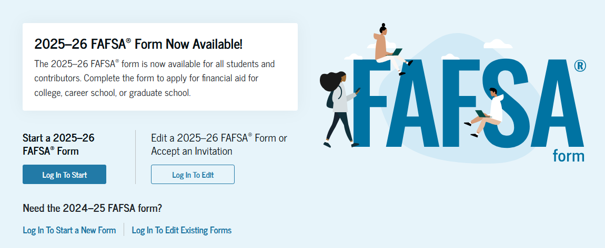
FAFSA.gov
Always free
Available now
Notes:
Remember that the first F in FAFSA stands for free, so you should never have to pay to submit it. It will always be free at FAFSA.gov. This year’s FAFSA became available late in November. After this year, it should be available each October 1.

Slide 7
Why apply online?
Faster processing time
Save and finish later
Built-in error catcher
Sign electronically
Notes:
An online FAFSA can be processed, corrected and reprocessed in a matter of days.
If you don’t finish it in one sitting, you can save it and return to it later.
The built-in error catcher helps to avoid delays in processing time, and you’ll be able to sign electronically by using a username and password that you create.

Slide 8
Introduction to Financial Aid
Introduction to Financial Aid
StudentAid.gov Accounts

Slide 9
What’s a StudentAid.gov account?
Your electronic signature
Username and password
Once created, it can be used each year to renew your FAFSA
Each Contributor will be able to reuse their account each year
  For FAFSA renewal
  A parent can use the same username and password to sign your sibling’s FAFSA
Notes:
When you create a StudentAid.gov account, you’ll create a username and password required to complete and submit your FAFSA. You will use it to:
Log in to StudentAid.gov
Sign your FAFSA, certifying that you’re supplying information that is true and correct
Access other Federal Student Aid websites (ex: applying for a student loan)
Each person required to report financial information on a FAFSA is called a ‘Contributor.’

Slide 10


Who needs a StudentAid.gov account?
You, the student, need a StudentAid.gov account
If you’re a dependent student, one or both parents will need their own StudentAid.gov account
Notes:
Think of it this way: If your parents filed their tax returns separately in 2023, both parents will need to create their own account.
We’ll discuss dependency status in a few minutes.

Slide 11
Which parent?
If parents are married
  If married, filing jointly in 2023 and still married to each other, only one parent needs to create an account
  If they didn’t file jointly in 2023, both parents may each need an account of their own. Examples:
      Married, filing separately
      Not married, but living together
      Remarried since 2023

Slide 12
Which parent?
If parents are divorced or separated
  The parent who gave you the most financial support in the last 12 months will be the one to contribute their information
  If that parent has remarried, your parent and step-parent must both contribute their information
A new FAFSA tool is available to help you decide who needs to be on your FAFSA: https://studentaid.gov/fafsa-apply/parents
Notes:
If the parents contributed an equal amount of financial support, the parent with the higher income should be the Contributor.
If the divorced parent who provided the most support to the student has re-married since 2023, that parent and the step-parent must each create a StudentAid.gov account. Once again, consider the number of tax returns—each filer will need to authorize the transfer from the IRS.
.

Slide 13
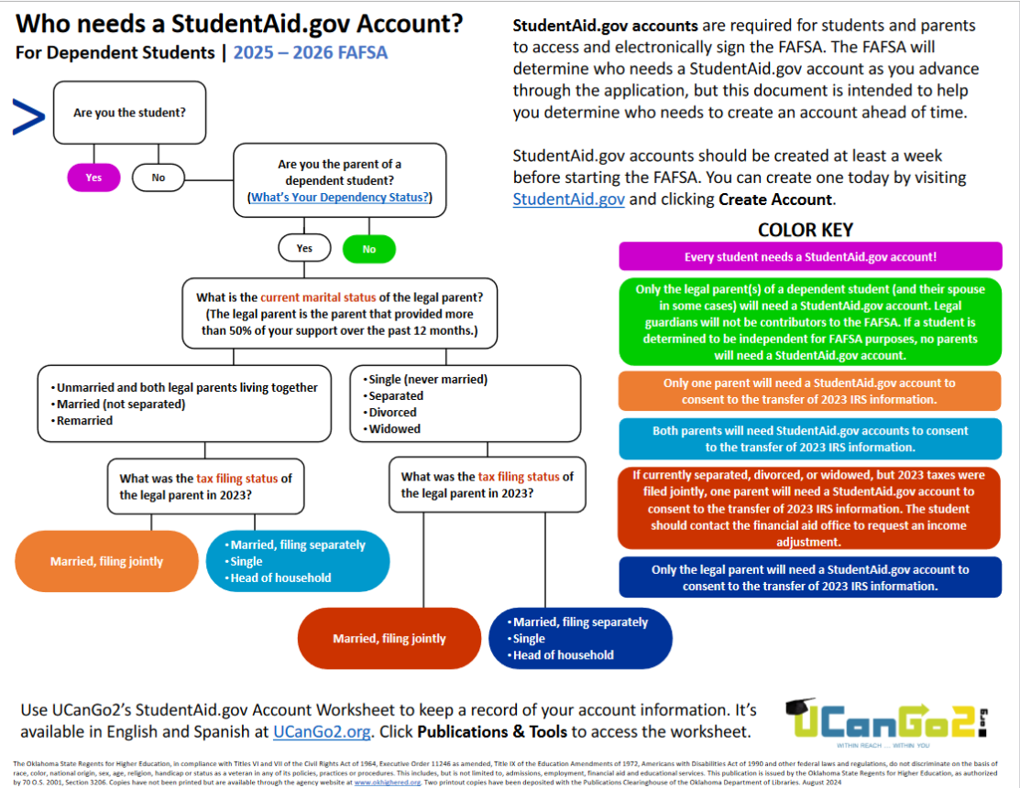
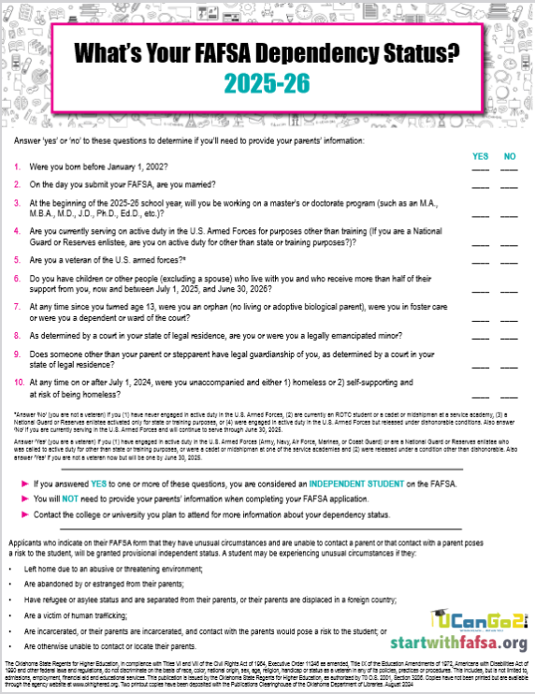
Dependency Status
https://ucango2.org/publications/fafsa/Who_Needs_StudentAidAccount.pdf
https://ucango2.org/publications/fafsa/DependencyQA.pdf
Notes:
The resources you see here are in the FAFSA Publications section at UCanGo2.org. They can help you determine whether you’ll be considered a dependent or independent student, and will help you know who will need a StudentAid.gov account prior to the day you start your FAFSA.

Slide 14
Important!
In your part of the FAFSA (student section), you’ll be asked to provide the full legal name, birthdate, social security number and email address of your parent(s)
Before doing this, make sure to ask your parents exactly how their information appears on their StudentAid.gov accounts
If all information doesn’t match, your FAFSA will need corrections before being fully processed

Slide 15
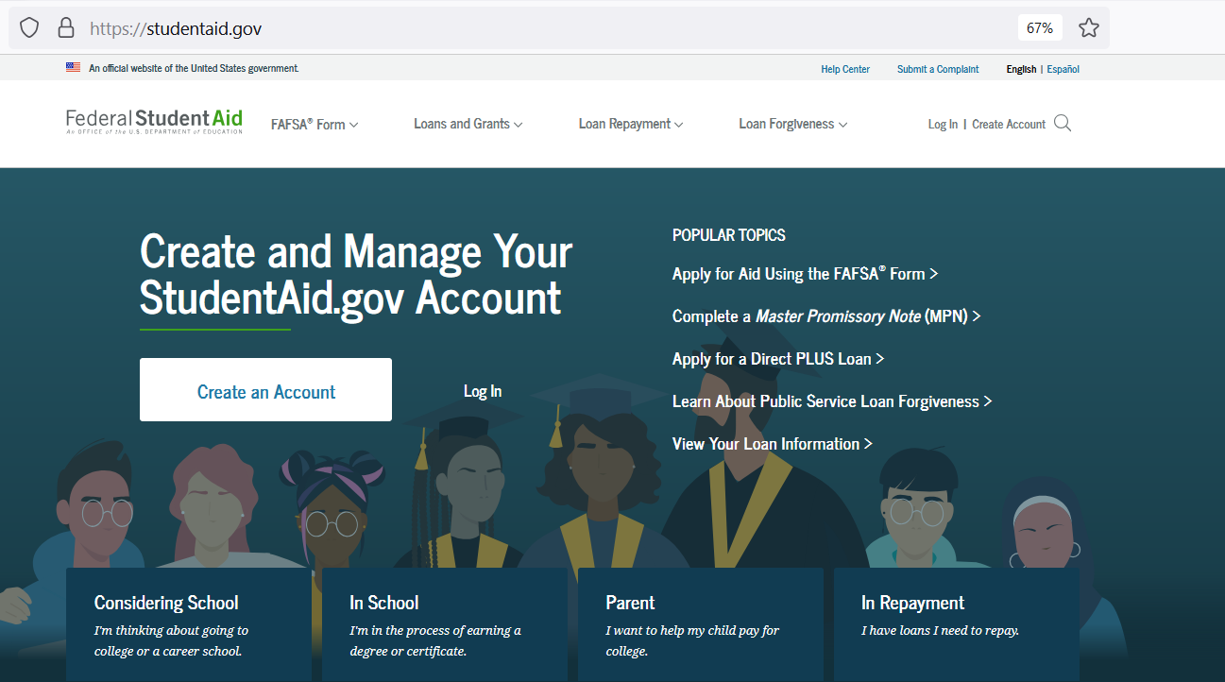

Create Your StudentAid.gov Account
Visit StudentAid.gov and choose Create Account

Slide 16
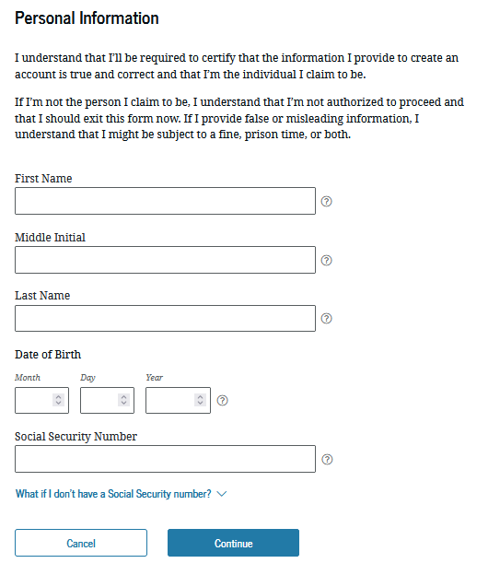
StudentAid.gov Account Tips
Use your personal email account
Never share your username and password with anyone, not even your parents
Never include your birthdate in any password
Notes:
-While creating your account, it’s important to use your personal email address on the application. It needs to be an address that you use and will check often.
-The username and password work as your unique legal signature. Therefore, you should never share it with anyone else, not even your parents.
-Please don’t ever use your birthdate in any password.
-When a parent without a SSN creates their new account, they should click the hyperlink below the SSN field that says, “What if I don’t have a Social Security number?” This will take them through a process that will ask some more questions to verify their identity. If all answers match with information found in the TransUnion system, they should be able to create their username and password right away and contribute their information to your FAFSA immediately.

Slide 17
Homelessness
If you’re not currently living with a parent/legal guardian and you are considered to be homeless, or self-supporting and at risk of being homeless:
OR
Always ask permission first!
Use mailing address of an adult relative or friend
Use address at one of the college offices
Notes:
Self-supporting means you are receiving no financial help from your parent or legal guardian.

Slide 18
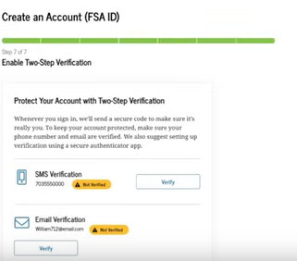
Verify Email and Cell Phone Information
You’ll be required to provide a unique email address
You’ll receive a message saying FSA (Federal Student Aid) sent you a secure code
Retrieve the message from your inbox and enter it as shown
Another code will be sent to your cell phone (optional) to verify your phone number
Notes:
You will be required to submit an email address. We suggest providing your email address and cell phone number so that Federal Student Aid can send you important notifications related to your FAFSA that you’ll receive in a timely manner.
If you should receive a message that your cell number is already associated with another account, national college access organizations are suggesting you remove the cell number from your application in order to proceed. While not as secure, this will avoid delays in processing the information you provide.
If you use both an email address and a cell number, you’ll need to verify that both are correct by using secure codes that are sent to you while setting up your account.
If you don’t have a cell phone number that’s different than your parent’s, you can use an authenticator app. (Next slide)

Slide 19
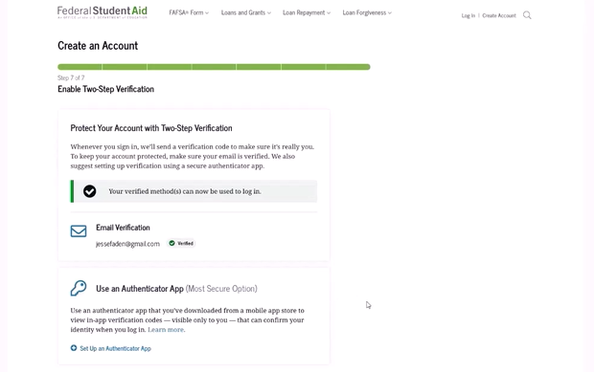
Two-Step Verification
Installing an authenticator app isn’t required, but it’s an additional way to keep your information secure
Download your own, or set one up here
Notes:
You’re not required to download an authenticator app, but you can if you wish.

Slide 20
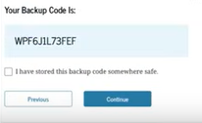
One-Use Backup Code
You’ll be given a one-use backup code when you’ve finished your new account application. This can be used if the 2-step verification isn’t successful. Store it somewhere safe.
If it gets lost, log in to your account and select “Generate a New Backup Code” under “Two-Step Verification” in Settings.
NOTE: Your backup code can only be used once.
For assistance, contact Federal Student Aid at 1-800-4-FED-AID or 1-800-433-3243.
Notes:
You’ll be allowed to generate a new backup code only once. For assistance, call 1-800-4-FED-AID (1-800-433-3243).

Slide 21
Create Your StudentAid.gov Account Early
You, the student, need a StudentAid.gov account
At least two weeks before you start your FAFSA
  The sooner the better
  You can even create it today
Information goes through a match with the Social Security Administration
  Matching process can take 5-7 days
  A contributor will be notified if the match fails
Until information matches are complete:
  A contributor will not be able to complete and sign their portion of the FAFSA
Notes:
We recommend that Contributors should create their accounts at least 2 weeks in advance.

Slide 22
Parent StudentAid.gov Account
Both parents may need an ID
Parent email addresses and mobile numbers can only be associated with one StudentAid.gov account – neither can match yours
Notes:
While you may be required to provide both parents’ 2023 income information, only one parent is required to have a StudentAid.gov account, IF they filed their taxes as ‘Married, Filing Jointly’ in 2023, and they are still married to each other.
A parent will create his/her own account by using the same website that you used to create yours. While creating an account, there is no distinction between a student and a parent.
Your parent cannot use the same email address or cell phone number that you used to create your account. Remember, this is a unique signature.

Slide 23
No Social Security Number?
Parents without Social Security numbers are able to create StudentAid.gov accounts
Since there won’t be a Social Security number to verify, their StudentAid.gov accounts can be created right before they contribute their information
They may need to provide documentation to verify their identity
Notes:
Parents without Social Security numbers will be able to create a new StudentAid.gov account.
Your parents’ citizenship status is not considered when determining your eligibility for financial aid.

Slide 24
Introduction to Financial Aid
Introduction to Financial Aid
Complete
Your FAFSA

Slide 25
Gather Your Information
Your Social Security or Permanent Resident Card
Your 2023 tax return/W-2s
Your parent(s)’ name, date of birth, Social Security number and email address
Notes:
To avoid errors in processing, please have your Social Security or Permanent Resident card with you when you enter this information. The full LEGAL name must match what is on the card.
Each year, the FAFSA will request information about income earned two years prior to the year that the FAFSA covers.
You’ll be required to enter the name, birthdate, Social Security Number and email address for one or both of your parents. It must match the information your parent(s) used when they created their StudentAid.gov accounts. Because of this, we encourage students and parents to work together so the information is entered accurately.

Slide 26
Helpful FAFSA Tips
No punctuation when entering your name, unless there’s punctuation on your Social Security card
Save the application frequently throughout the process
Always use the ‘Previous’ and ‘Continue’ buttons; don’t use your browser’s Back button or you may have to start over
Notes:
These tips will help your FAFSA submission go more smoothly.
Don’t use punctuation anywhere on the FAFSA—only a hyphen between last names if they appear that way on your Social Security card.
The word ‘Contributor’ may be a little misleading. While your parents may need to contribute their financial information on your FAFSA, they’re not required to help you pay for college.

Slide 27
Start Your FAFSA
Go to FAFSA.gov
Select Start a New Form
Make sure you’ve chosen the 2025-2026 FAFSA

Slide 28
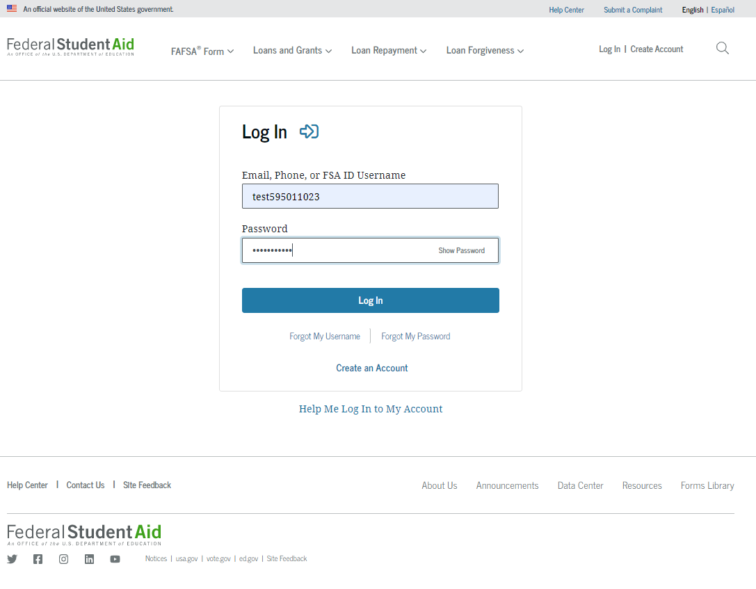
Log In
Enter your StudentAid.gov username and password
If you don’t have a StudentAid.gov account, choose ‘Create an Account’
  You won’t be able to complete your FAFSA until the matching process is complete; this could take from 5-7 days.

Slide 29
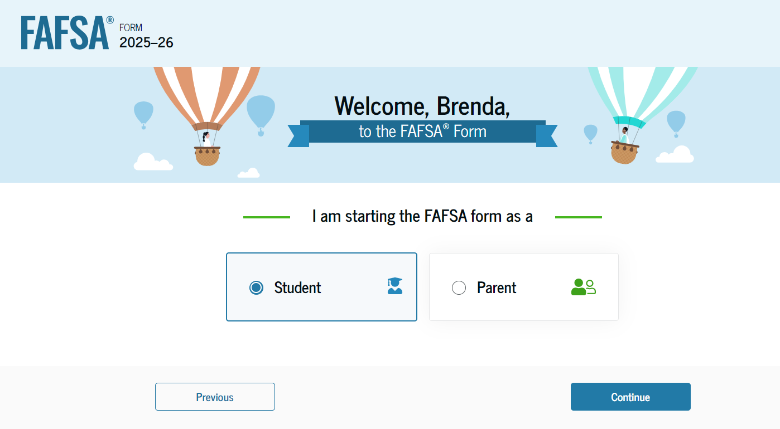
Select Your Role

Slide 30
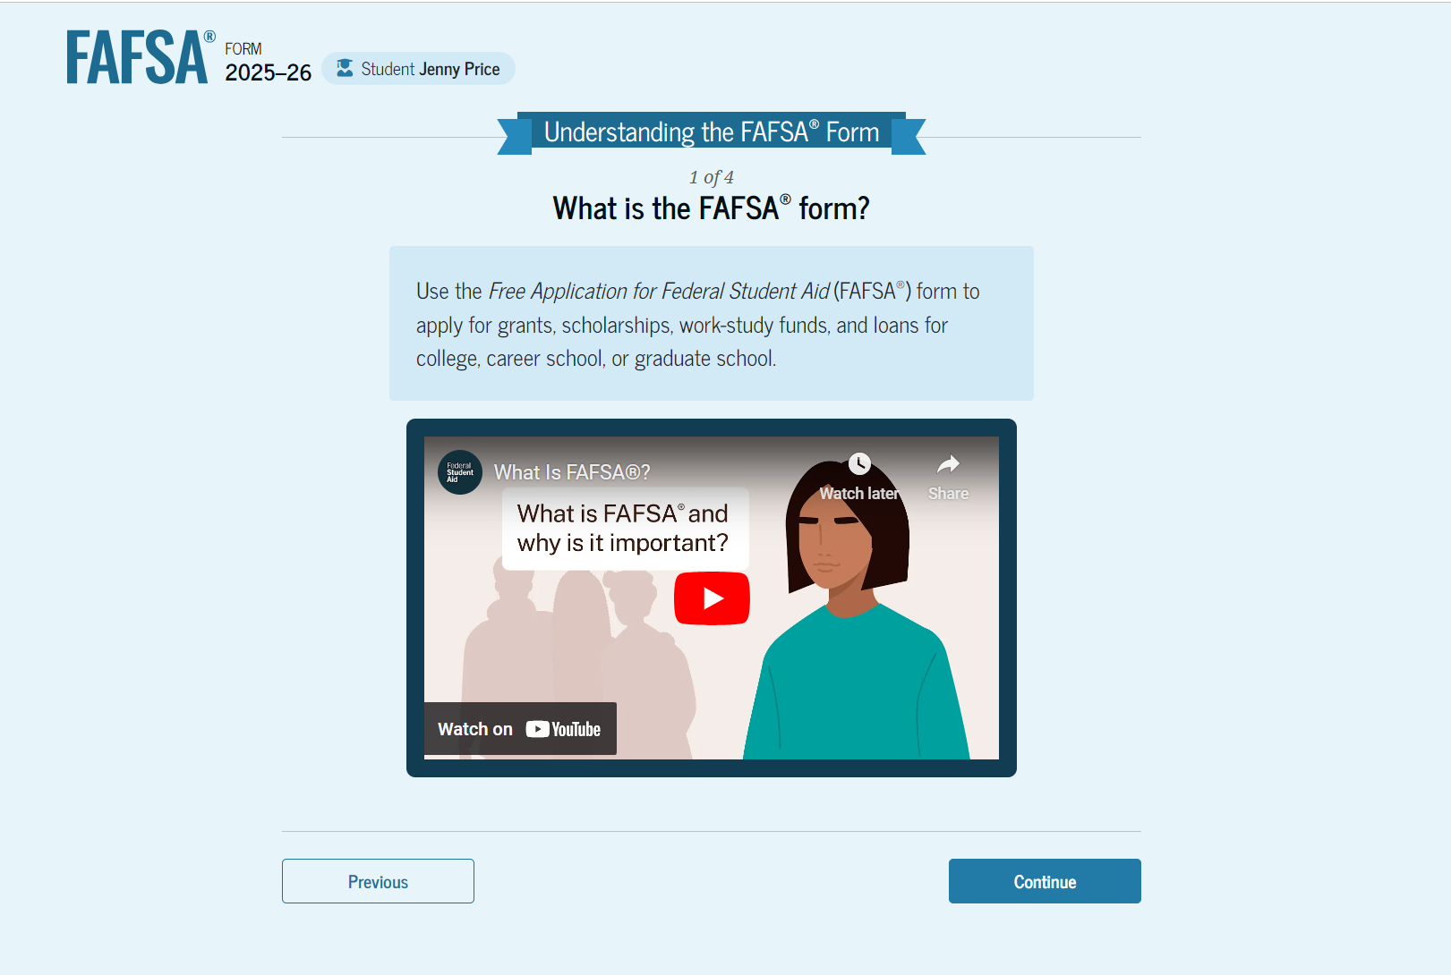
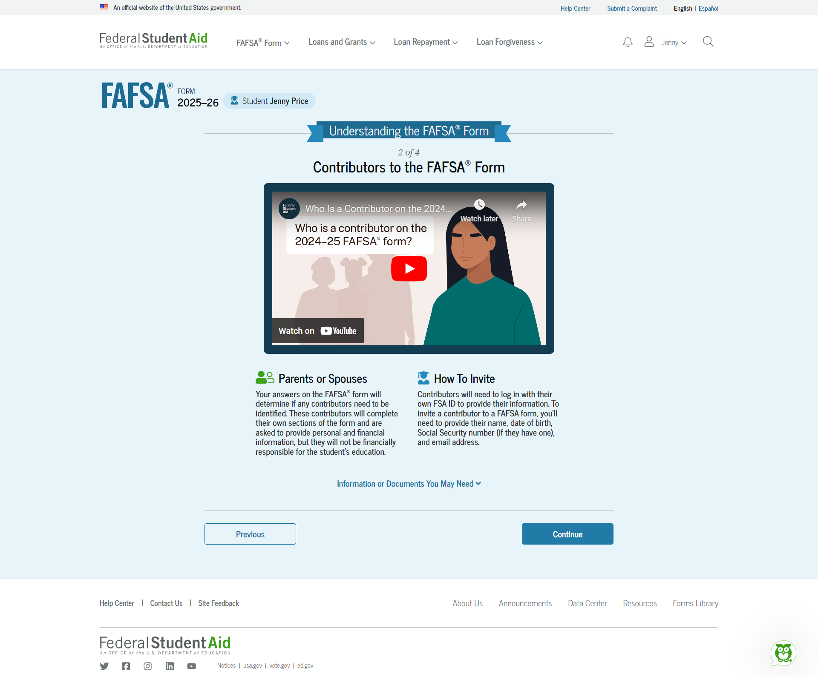
Onboarding
Watch What is the FAFSA Form? video, then ‘Continue’
Watch Contributors to the FAFSA Form video, then
‘Continue’
Notes:
First, you will have the opportunity to watch a short FAFSA overview video.
After you select ‘Continue’, the next screen will give information about others who may need to contribute their information to your FAFSA. Your parent(s), even though called ‘Contributors’, will need to supply their personal and financial information, but they will not become financially responsible for your education.

Slide 31
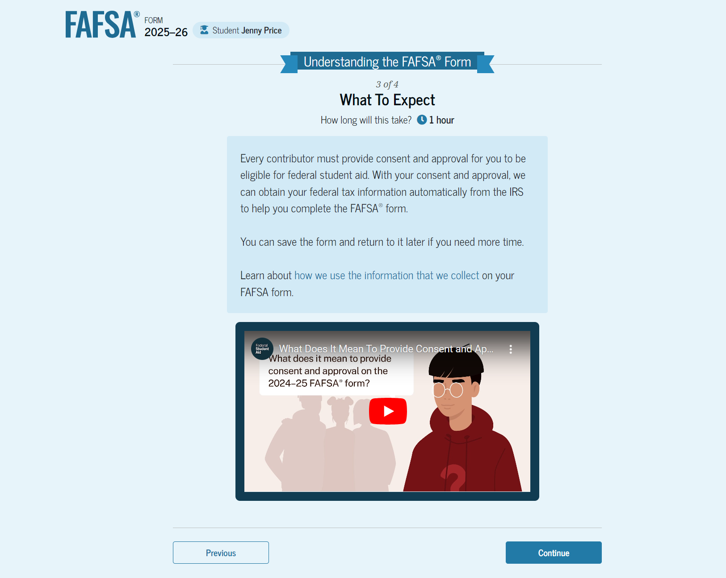
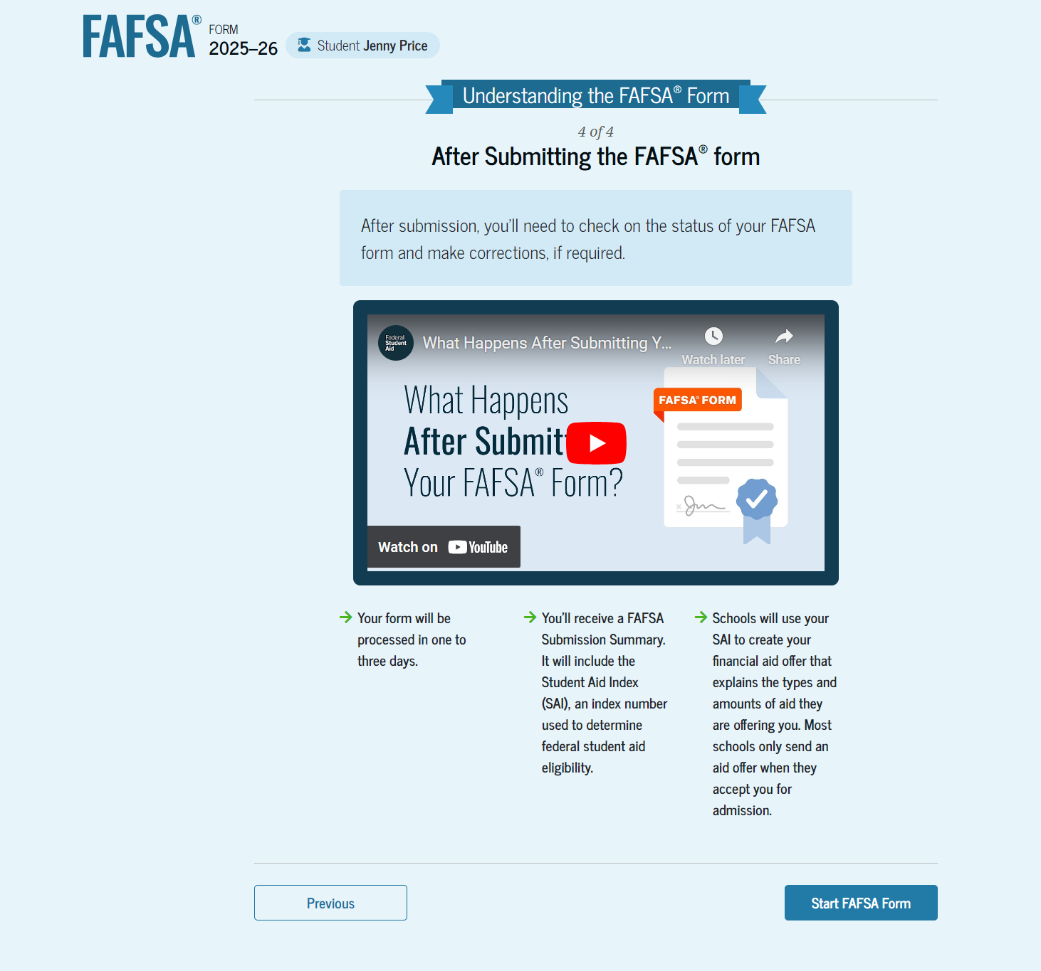
Onboarding
Watch What to Expect video, then ‘Continue’
After What Happens After? video, select ‘start FAFSA form’ to begin
Notes:
On the ‘What to Expect’ screen, it’s explained that every contributor to your FAFSA will be required to provide consent to have information from their 2023 tax return transferred automatically to your FAFSA.
There are no exceptions to this. Even if a contributor didn’t file a tax return in 2023, they’re still required to give their consent for the transfer.
If one or more contributors doesn’t give this consent, you won’t be eligible for most types of federal financial aid.
The fourth onboarding screen will explain what happens after you submit your FAFSA.

Slide 32
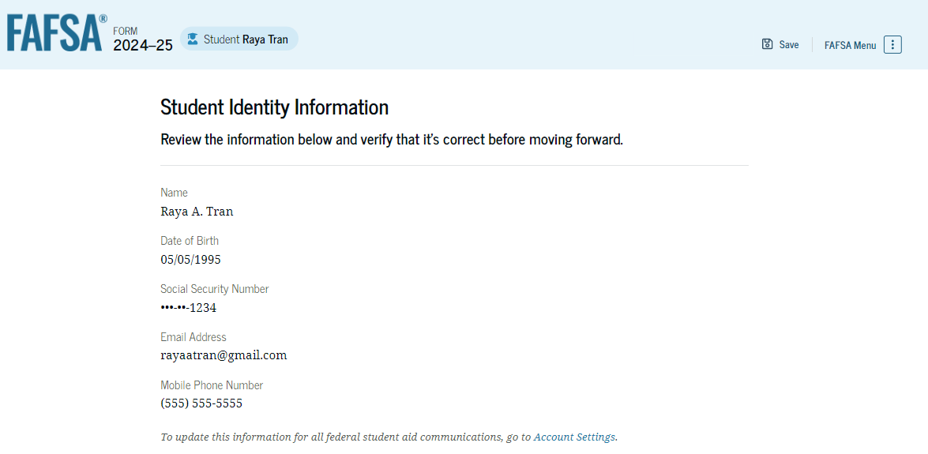
Review Identity Information
To update information, access your account settings at StudentAid.gov.
Changes to your mailing address can be made directly on this page
Notes:
Review this screen carefully. If you need to make corrections, changes to your mailing address can be made directly on this page. To change any other information, access your account settings at StudentAid.gov.

Slide 33
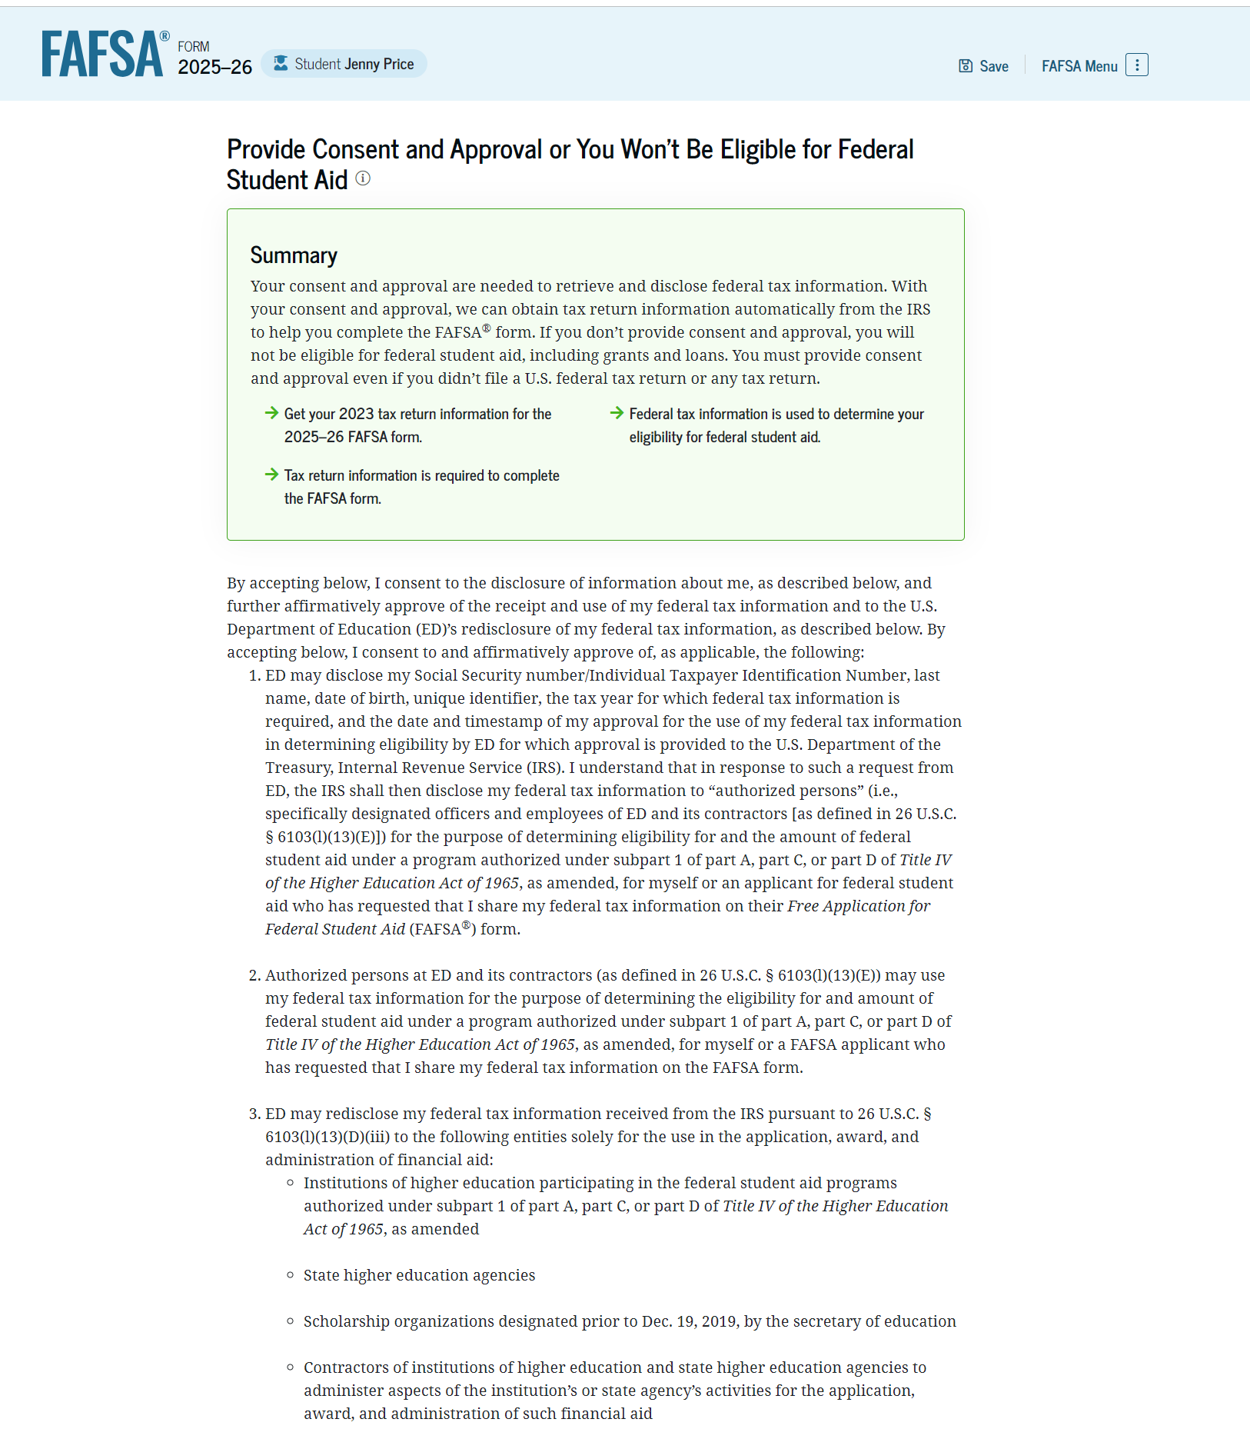
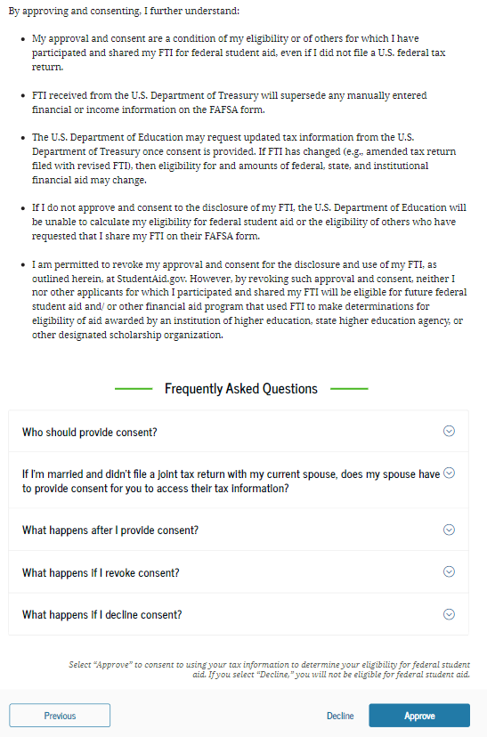
Provide Consent
Notes:
Provide your consent to have your 2023 Federal Tax Information (FTI) transferred to your FAFSA, even if you did NOT file a federal tax return in 2023.
Read these pages carefully, then choose ‘Approve’.
The first line on this page states: “Provide Consent or Be Ineligible for Federal Student Aid”.

Slide 34

Automatic Transfer
If any contributor does not choose ‘Approve’:
  The FAFSA won’t be processed
  The student will not be eligible for most types of
  federal student aid
There may be exceptions for special or unusual circumstances.

Slide 35
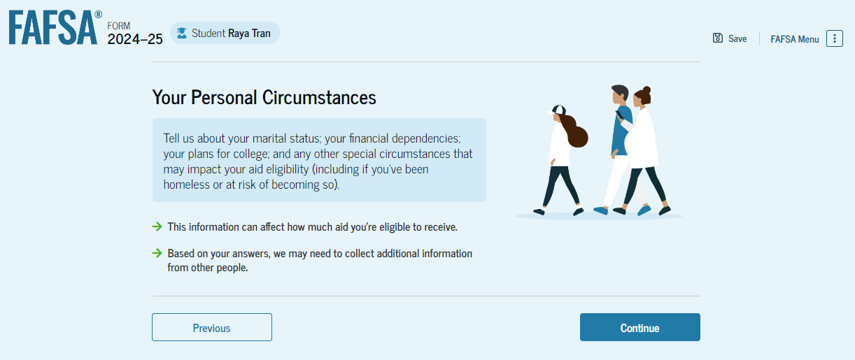

Personal Circumstances
2025-26
Notes:
You’ll be asked several questions about your personal circumstances that will eventually give Federal Student Aid the information it needs to determine how much aid you may qualify for. Each question is important, and must be answered honestly.
The questions are easy to answer, so we won’t go through all of them here. I’ll just mention a few of them briefly.

Slide 36
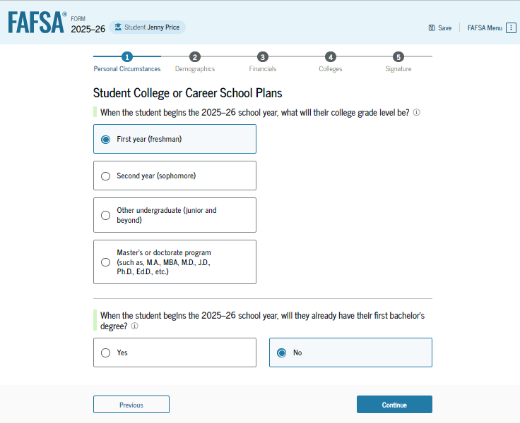
College or Career School Plans
Even if you have concurrent enrollment or AP credits, be sure to choose ‘First Year (freshman)’ as your college grade level
Notes:
Any concurrent or AP credits you have were earned while you were still in high school, and you were not yet enrolled as a college student.

Slide 37
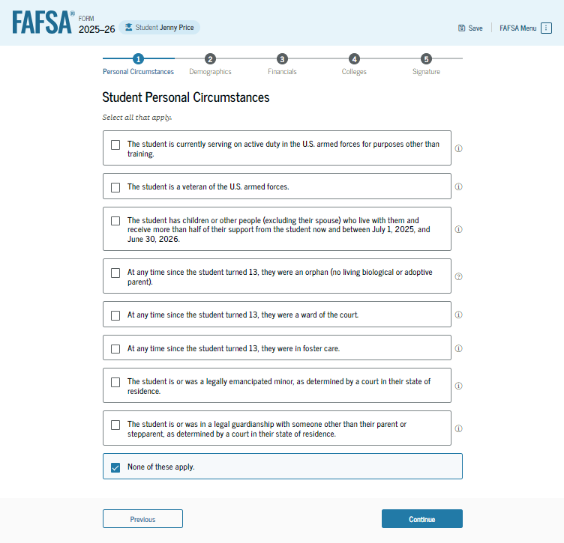
Student Personal Circumstances
Eight different situations are listed here. If none of them apply to you, click in the box next to ‘None of these apply’ and choose ‘Continue’.
Notes:
If you select just ONE of the circumstances in the gray boxes, you’ll be considered an Independent student, and you won’t be required to include your parent(s)’ information, but you will need to include information about your spouse if you’re married.

Slide 38
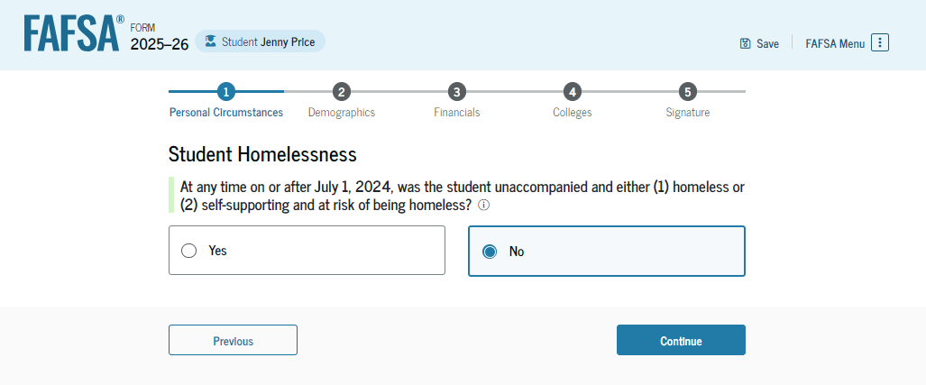
Homelessness
If you’ve been unaccompanied by a parent or legal guardian and have been homeless or at risk of being homeless any time since July 1, 2024, answer ‘Yes’ to this question

Slide 39
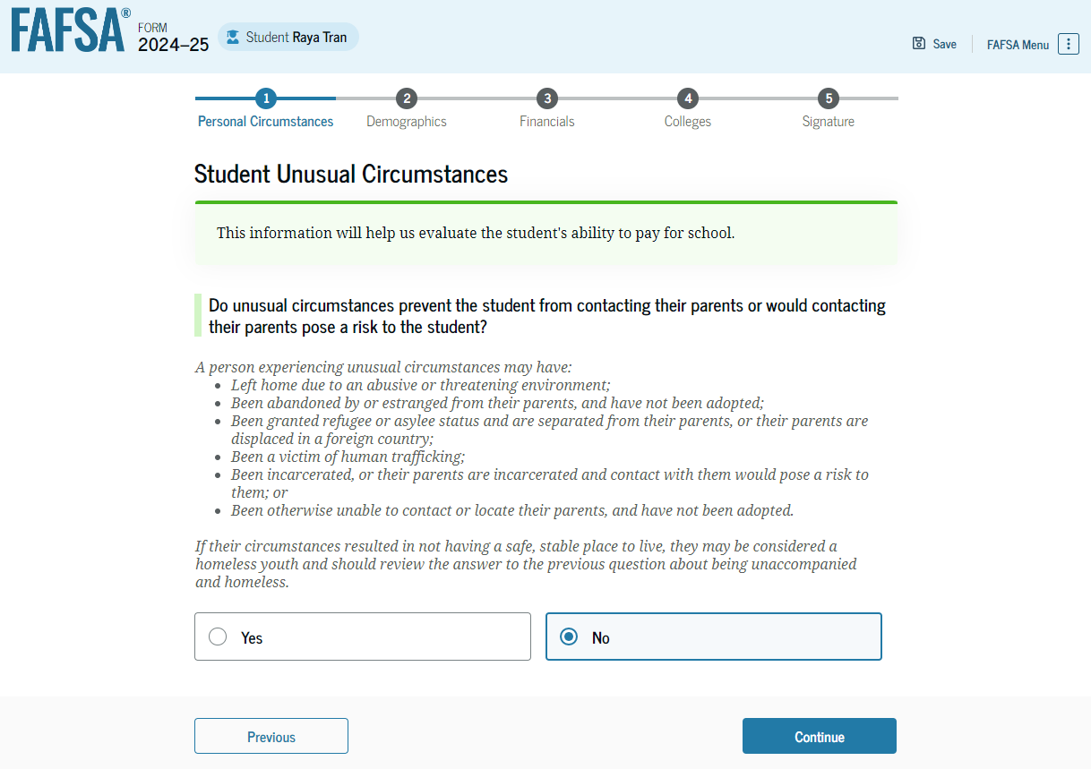
Other Unusual Circumstances
If none of these circumstances apply to you, answer the question ‘No’
Notes:
You’ll be asked if ‘unusual circumstances’ prevent you from contacting your parents.
Abuse, abandonment, neglect
Refugee or asylee status and separated from parents (perhaps in another country)
Victim of human trafficking
Incarceration, posing a risk to you if you contact them
Otherwise unable to contact your parents, and you haven’t been adopted

Slide 40
Provisionally Independent Status
If an unusual circumstance applies to you:
  You’ll be given a ‘provisionally independent’ status
  Your parents won’t be required to contribute information to your FAFSA
  The financial aid office at your college is required to ask you for documentation to verify your situation
  You must provide it by the deadline they give you
  Once verified, you will remain an independent student

Slide 41
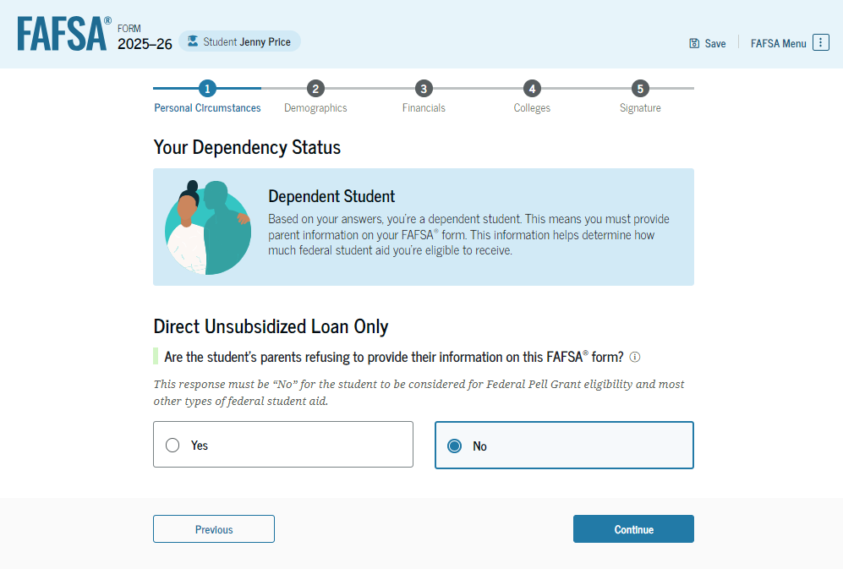
Dependent Status
If a parent is unwilling to provide information for their dependent student’s FAFSA, the student can indicate that here
Notes:
Because the student on these slides answered No to the marital status question and none of the other unusual circumstances applied to her, she will be considered a Dependent student, and her parent(s) will be required to contribute their information to her FAFSA.
If she was married, or if even one of the other circumstances did apply to her, she would probably be an Independent student, and her parents wouldn’t have to contribute their information.
If the parents of a Dependent student are unwilling to provide their information, the student will be told that they’ll only qualify for an Unsubsidized student loan.
PLEASE NOTE: The FAFSA is not an application for student loans. This information is given to let a Dependent student know what they can do if their parent(s) are unwilling to provide their information.

Slide 42
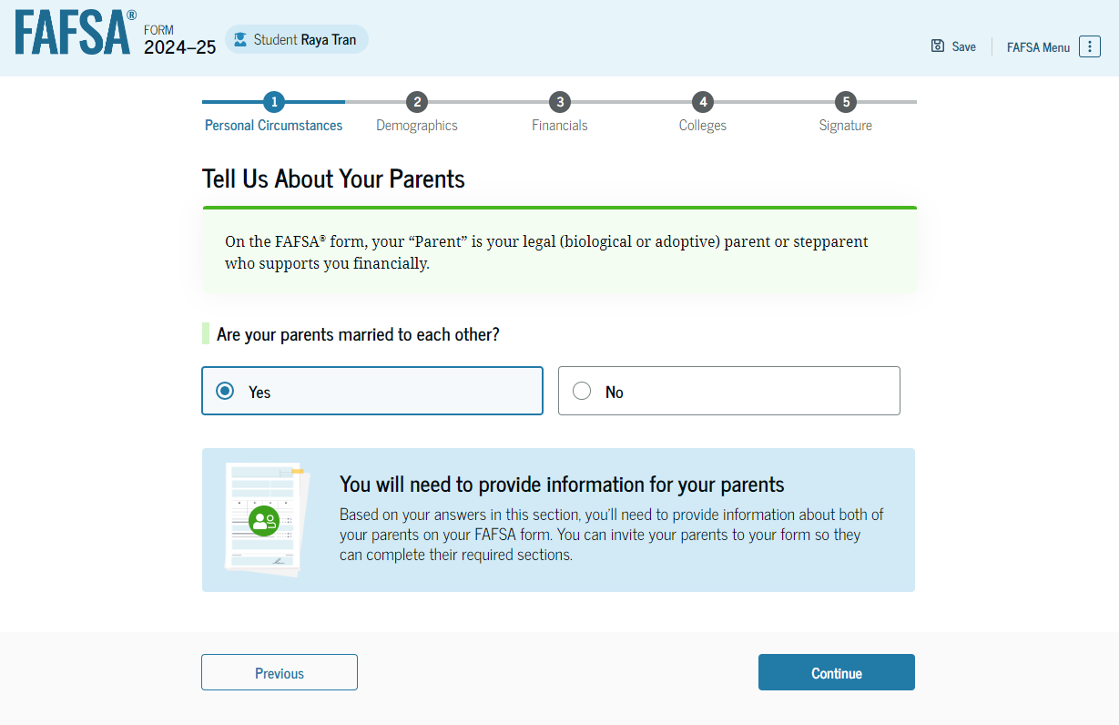
Your Parents’ Marital Status
2025-26
Notes:
This portion is called the Parent Wizard.
If you’re a dependent student, the next few questions will ask about your parents. If your parents aren’t currently married to each other, more questions will be asked to determine if one or both parents need to contribute information on your FAFSA.
In this example, the parents are married to each other, so the student is informed she’ll need to provide information about both parents.

Slide 43
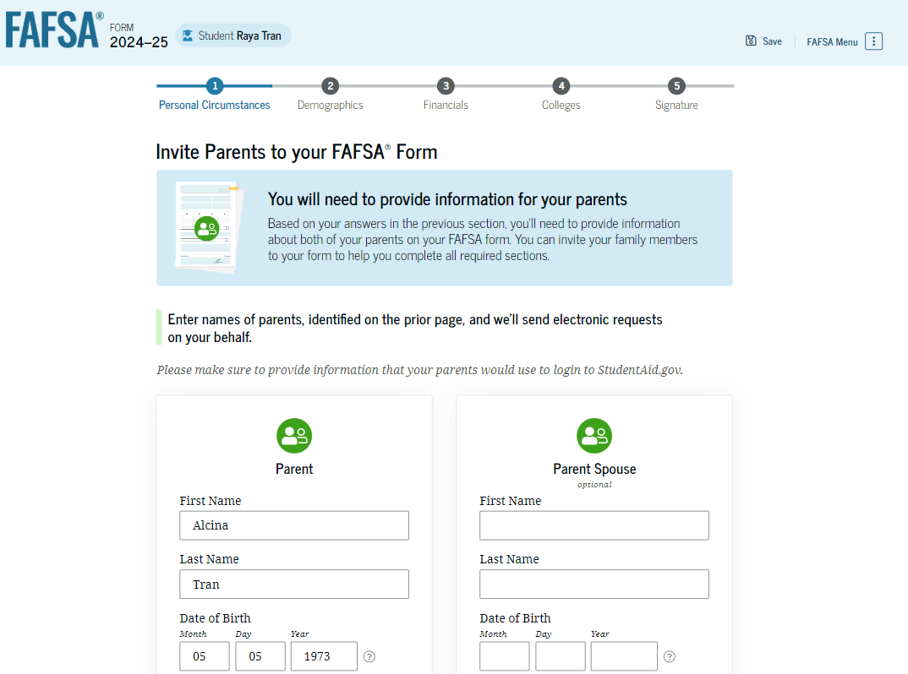
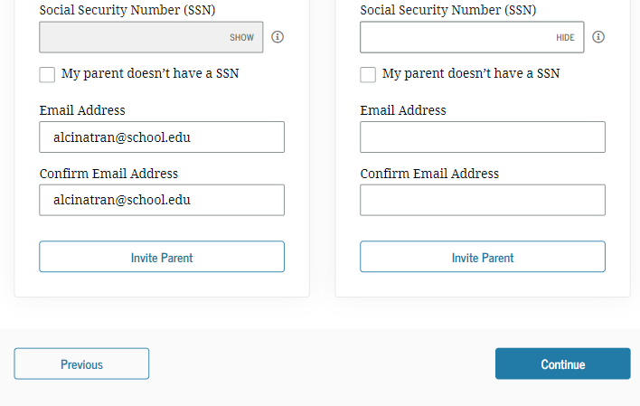
Invite Your Parents to Contribute
2025-26
Notes:
If only one parent’s signature will be required, the word ‘optional’ will appear under the “Parent Spouse” heading.
Depending on the circumstances, one or both parents will receive an email from Federal Student Aid requesting their information.
It’s very important that a student enters the parents’ information exactly as the parents entered it when they created their accounts. If one of these data fields doesn’t match what the parents have already provided, they won’t get an invitation. For this reason, we encourage the student and parent(s) to work together on the FAFSA in order to avoid problems with signing the FAFSA at the end.

Slide 44
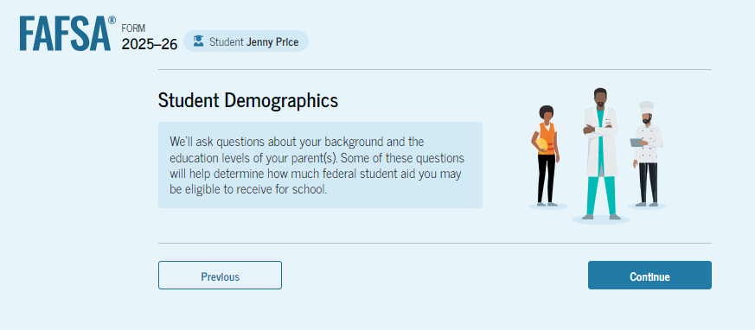

Student Demographics
You’ll be asked about your:
  Gender
  Race & ethnicity
Notes:
The answers you give on the gender, race and ethnicity questions are not used to determine your eligibility for financial aid. Those questions must be answered, but each question has an option where you can select “Prefer not to answer.”
Your citizenship status will be used to determine your eligibility, because in order to receive federal financial aid, you must either:
Be a U.S. citizen or U.S. National (born in American Samoa or Swains Island) OR
Be a Permanent Resident of the United States (in possession of a current ‘green card’) OR
Have an arrival/departure record (I-94) showing a status of Refugee, Asylum Granted, Cuban-Haitian Entrant (status pending) or Parolee; Conditional Entrants can also qualify only if the I-94 was issued before April 1, 1980 OR
Have a battered immigrant-qualified alien status
Have a T-visa or a parent with a T-1 visa

Slide 45
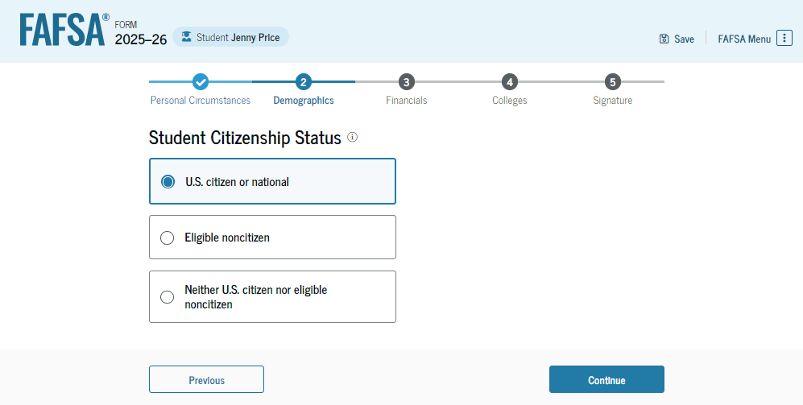
Student Citizenship Status
To receive federal financial aid, you must be:
A U.S. citizen
A U.S. national or
An eligible non-citizen (permanent resident)
Notes:
U.S. Citizens include people born in:
District of Columbia
Puerto Rico
U.S. Virgin Islands
Guam
Northern Mariana Islands
Most people born abroad to U.S. citizens
Federal Student Aid (FSA) defines a U.S. national as someone who is:
A U.S. citizen by birth or naturalization, or
A native of American Samoa or Swains Island

Slide 46
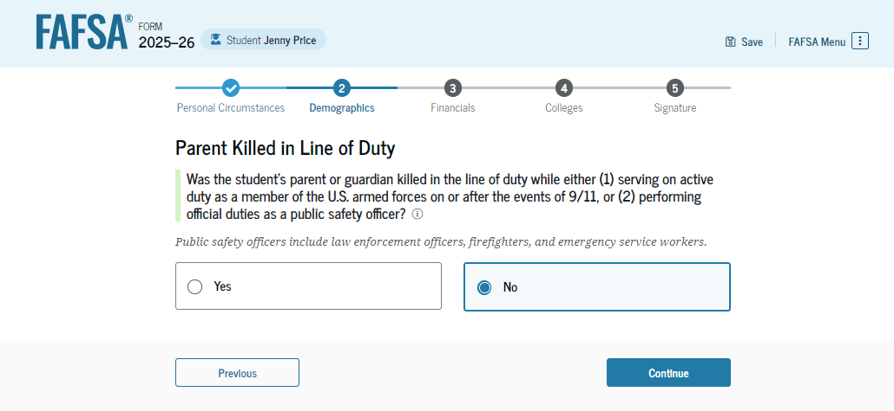
‘Fallen Heroes’ Question
If you lost a parent who:
  was killed while on active duty in the military on or after 9/11/2001
  or
  died while performing official duties as a public safety officer
You will be eligible for the full allowable Pell grant amount, which is $7,395 in the current (2024-25) academic year.
Notes:
The financial aid office is required to ask for documentation to verify the information.

Slide 47
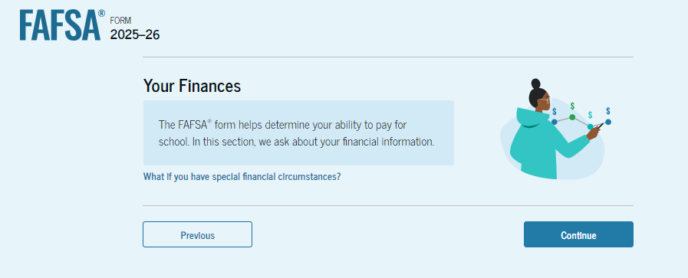
Your Financial Information
You must report any income you earned in 2023, even if you didn’t file a tax return.
If you didn’t file, you’ll be able to enter your information manually.

Slide 48
Reporting Financial Information
Report whole dollars
  No decimals
  Enter zero if a question doesn’t apply to you
Refer to your W-2s
  Find your W-2(s) before you start
  If no W-2(s), be prepared to give an estimate of your income

Slide 49
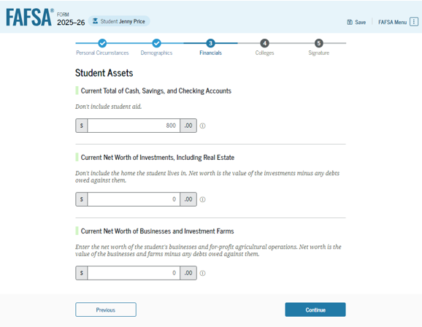
Dependent Student Assets
Current value of cash, savings & checking accounts
Current net worth of businesses and farms
Current net worth of investments, including real estate
Notes:
It’s a good idea to add up your total cash on hand and the current balances in your savings and checking accounts before you start your FAFSA.
Any question that doesn’t apply to you on this page should be answered with a zero. Remember, this is about YOUR assets, not your parents’.

Slide 50
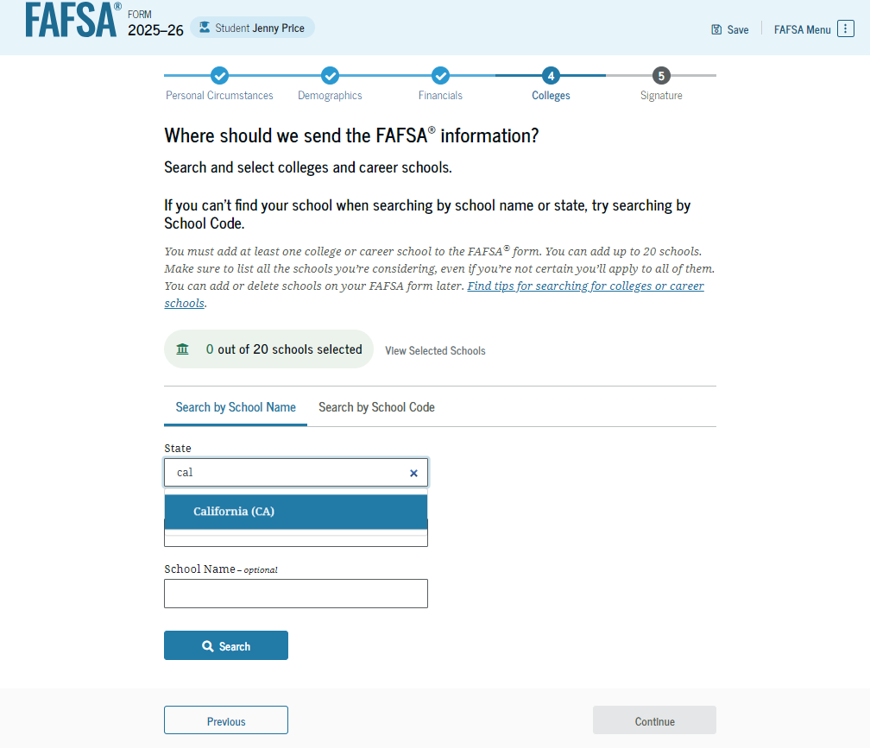
Select Your Colleges
Search for and select each college that you want to list on your FAFSA
Notes:
Select all of the colleges you are interested in learning more about.
By putting a college or career technology center on your FAFSA, you’re giving that school permission to see the information from your FAFSA so they can let you know how much financial aid you would qualify for at their school. You’re not making any commitments to the school just by listing it on your FAFSA.
You can have your FAFSA information sent to a maximum of 20 schools; you must select at least one school for your FAFSA to fully process.

Slide 51
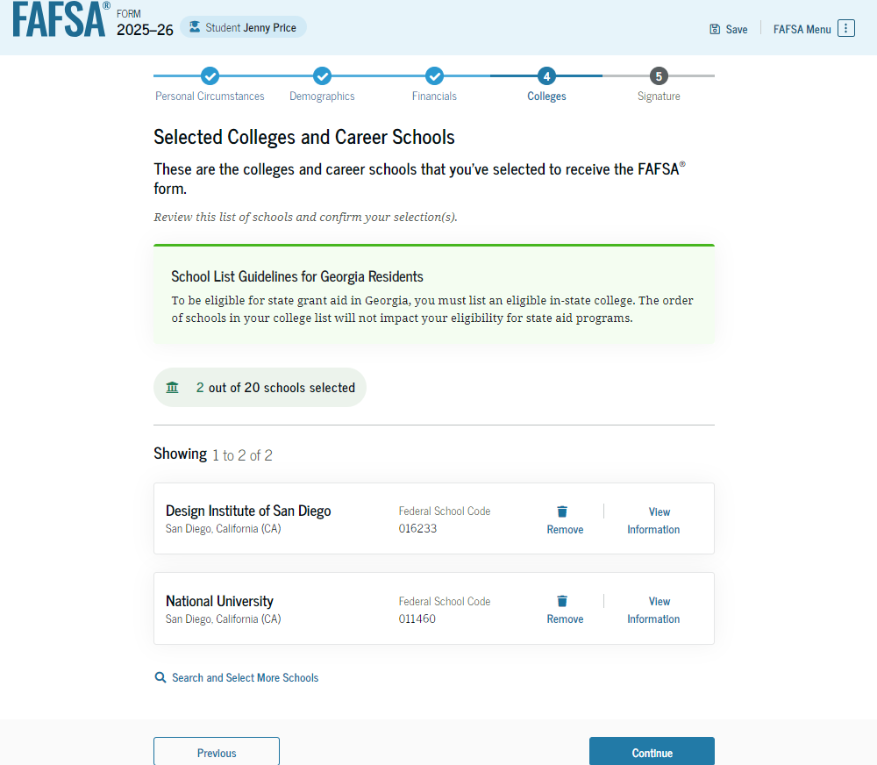
Review Your Selected Schools
Notes:
When you’re done adding schools, review your list. Notice this student has added 2 schools to their FAFSA.
To remove a school from your list, simply click ‘Remove’ next to the school’s name.
Only 10 schools are showing here. To add the remaining schools, click ‘Next’.
To add another school, click ‘Search and Select Schools’.
Students may enter up to 20 colleges/career techs on the FAFSA.

Slide 52
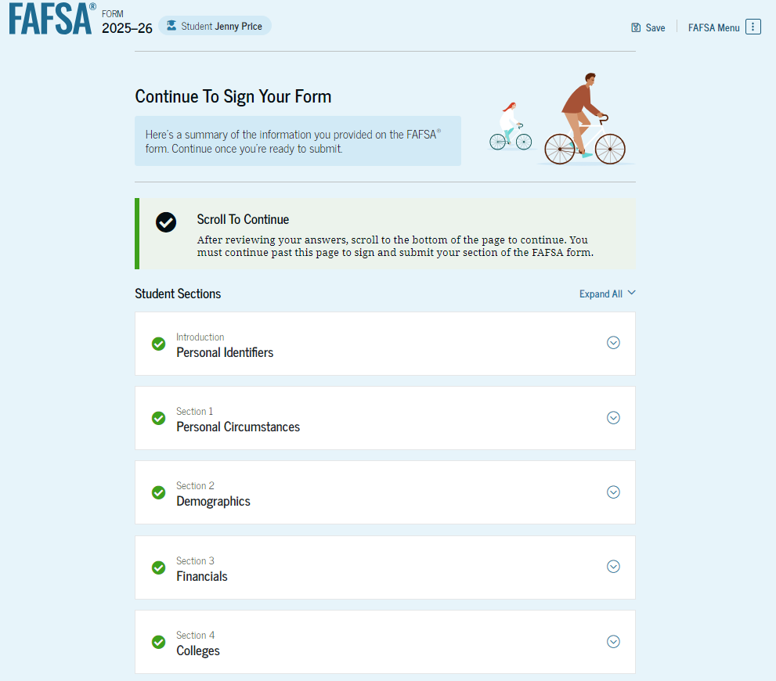
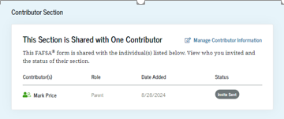
Review Page
To view all of your responses, click ‘Expand All’ or view each section individually
To edit a response, select the question’s hyperlink and you’ll be taken to the correct page
You’ll also be able to see the status of your parent(s)’ invitation

Slide 53
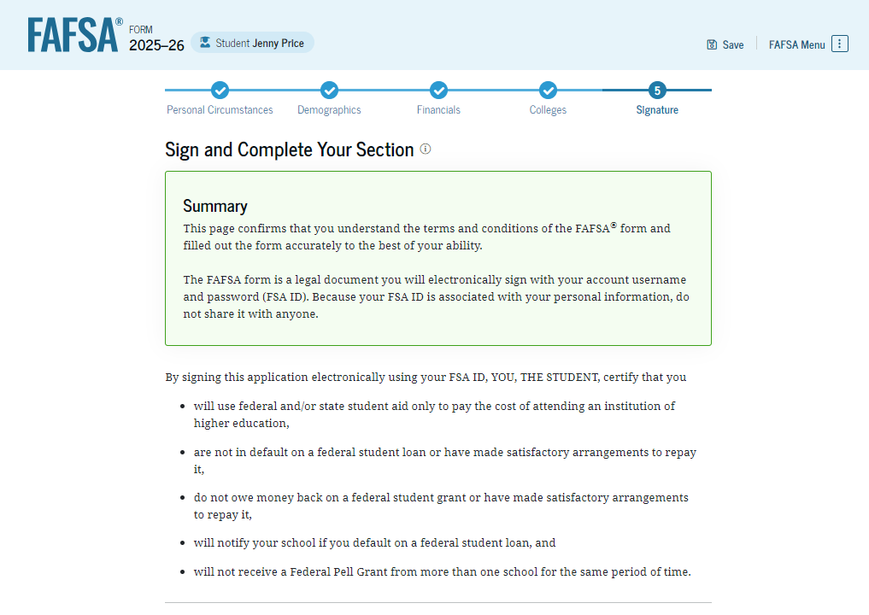
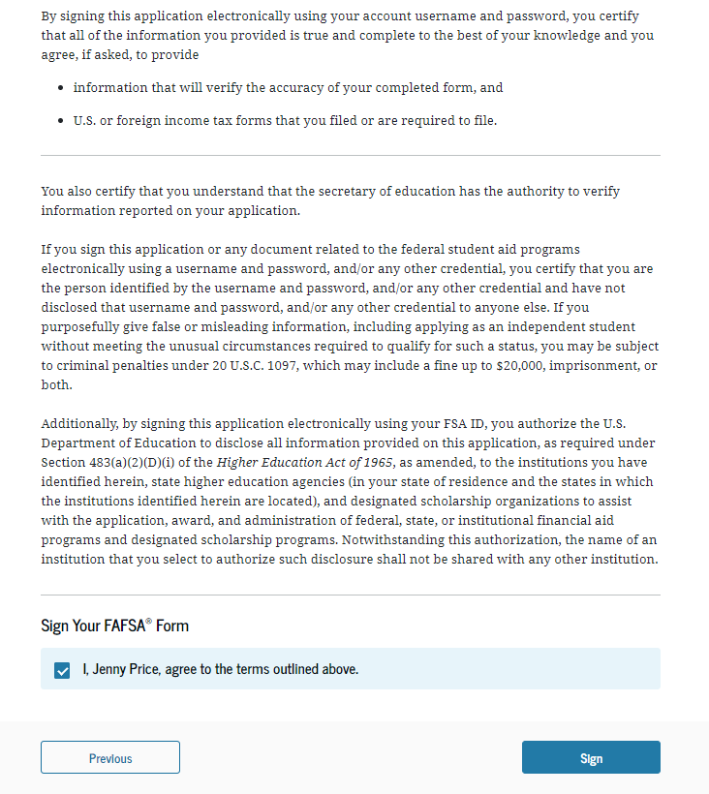
Sign Your Section of the FAFSA
Read these pages carefully
Agree to the terms
Click ‘Sign’
Notes:
You must agree to the terms in order to submit your section.
Remember that you signed in to the FAFSA with your username and password, so your signature will be applied to the form when you click ‘Sign’.
The last contributor to sign will click a blue button that says ‘Sign & Submit’. The FAFSA won’t be fully submitted until all contributors have signed.

Slide 54
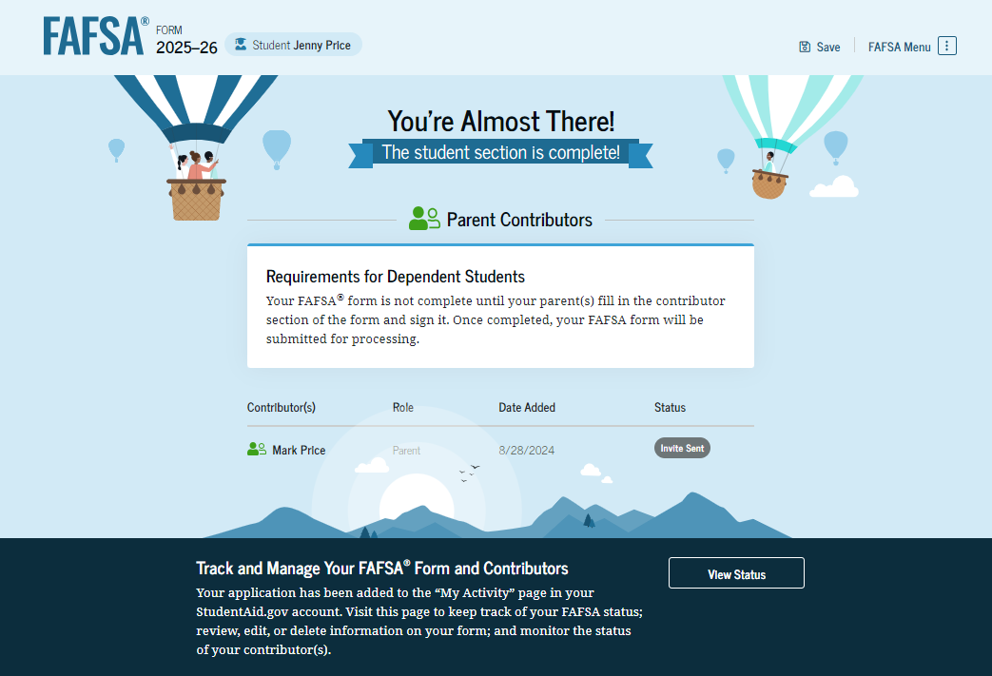
Your Part of the FAFSA is Complete!
Notes:
When you see this page, you’ll know you’re finished.
From here, you can view the status of your FAFSA and the progress made by the other contributors. All contributors have to complete their sections before the FAFSA can be fully processed.
The last bullet at the bottom of this slide mentions starting your state application at StudentAid.gov. In Oklahoma, there is no separate application for state aid. Your eligibility for state aid will be determined by the Adjusted Gross Income from one or more tax returns and your Student Aid Index.

Slide 55
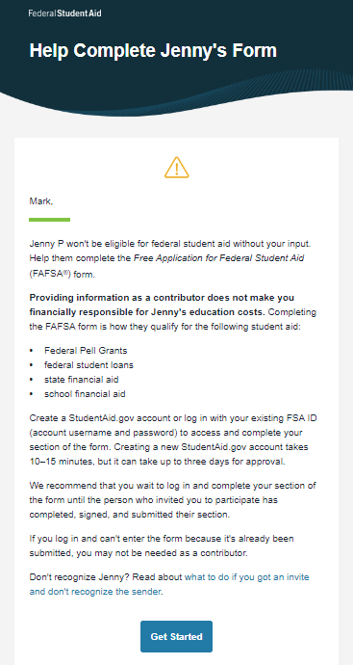
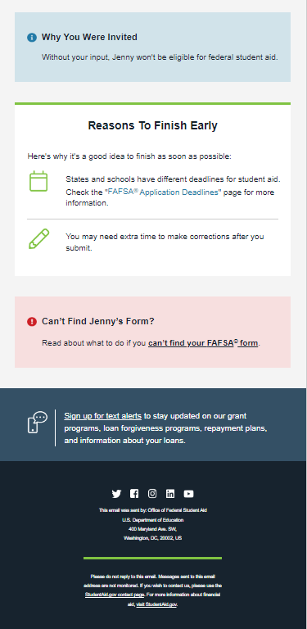
Parent Email
When you invite your parents to contribute their information, they will receive an email that looks like this.
When they click ‘Log In’, they will be taken to StudentAid.gov, where they’ll be able to enter their username and password and start their part of the application.
Notes:
You won’t see this anywhere on your FAFSA. It’s just an example of the email your parents will receive when your invitation is sent to them.

Slide 56
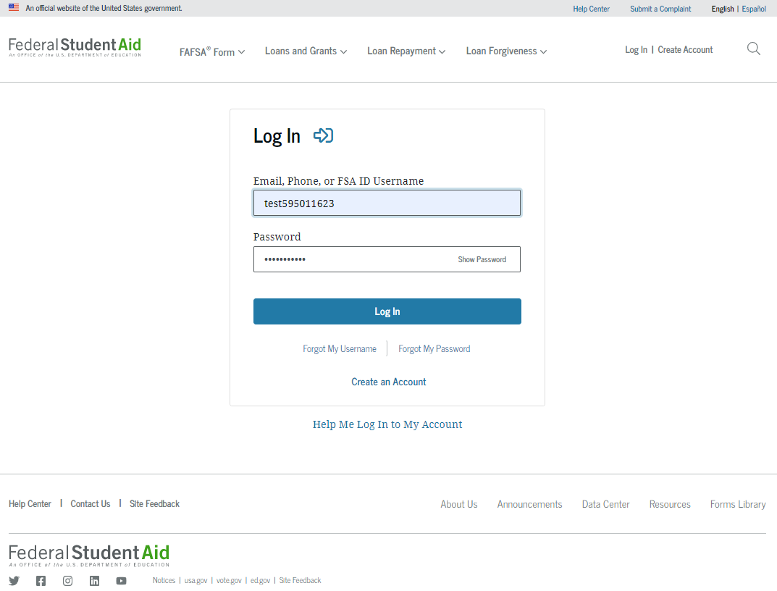
Parent Logs In to FAFSA.gov
Notes:
After receiving an invitation from the student, the parent will go to FAFSA.gov and choose the box under ‘Accept an Invitation’; then they will log in to FAFSA.gov using their own username and password.
If a parent hasn’t created a new account at StudentAid.gov yet they can click ‘Create an Account’ on this page, but the username and password they create will not be matched/verified with the SSA for a few days. Parents without SSNs should be able to create their account the same day they contribute their information to the student’s FAFSA.

Slide 57
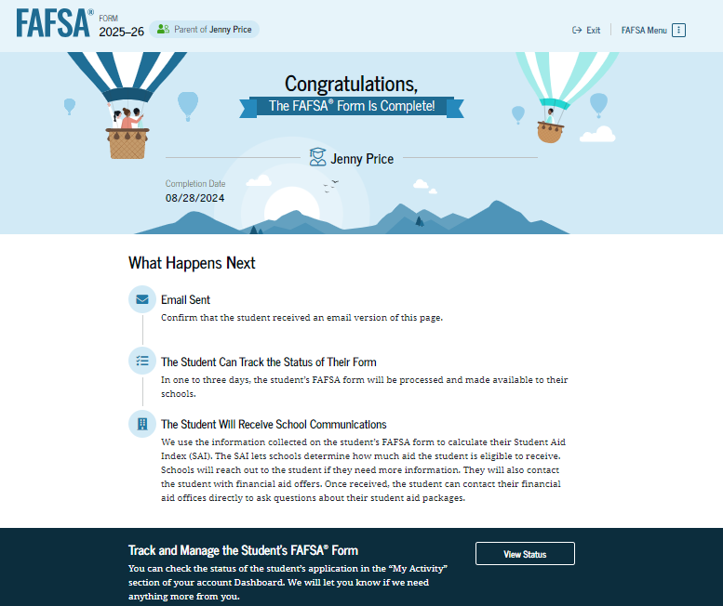
Parent Role and Confirmation
❒
●
Notes:
Parents need to use their own username and password when they log in at FAFSA.gov.
It’s important that when the parent logs in, they choose ‘Parent’ as their role, because
Logging in as the student will not allow them to proceed if they’ve used their own username and password
They should only be completing the section of the FAFSA that applies to the parent. They won’t be able to see most of the information supplied by the student.
When the final contributor is finished, they will receive a message to let them know the FAFSA is complete and will be sent for processing.
A version of this page will be emailed to the student to inform them of what happens next.

Slide 58
Introduction to Financial Aid
Introduction to Financial Aid
What’s Next?

Slide 59
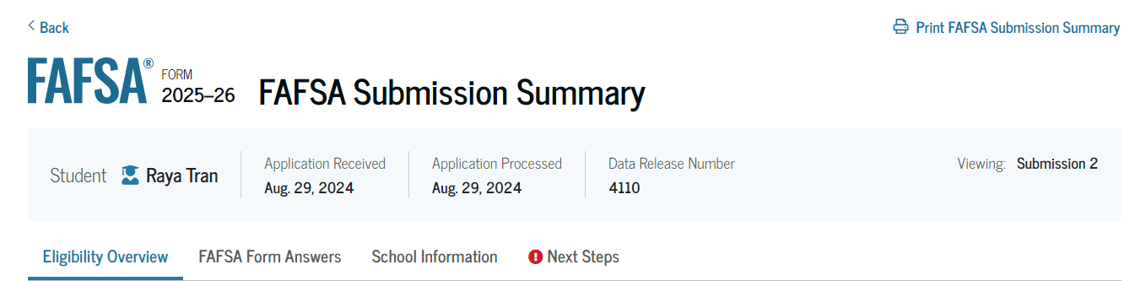
What’s Next?
Read all sections and make any corrections necessary
Print a copy and keep it in a safe place
The Data Release Number (DRN) can be very important
Notes:
There are some income figures you won’t be able to change when editing your FAFSA, so a financial aid officer may need your DRN (Data Release Number) to access your FAFSA. Never give a financial aid officer your username and password.
There is a hyperlink at the top left that you can use to print your summary if you wish.

Slide 60
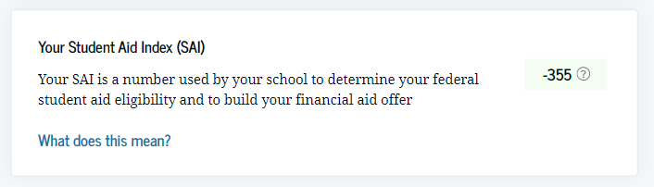
What’s Next?
Financial aid offices at the schools you listed will receive your FAFSA data
They’ll use the Student Aid Index (SAI) to determine your ‘Financial Need’
They’ll prepare a Financial Aid Offer that will list the types and amounts of aid you will qualify for at their school
Notes:
The SAI is calculated automatically based on the data you and other contributors provided on your FAFSA.
An SAI can range anywhere from -1,500 to 999,999. The lower the SAI, the more aid you may be eligible to receive.
A student with a negative or zero SAI is eligible for the full Pell grant award--$7,395 for this next school year

Slide 61
Special Circumstances
If your family has experienced a loss of income since 2023, such as:
  Loss of job or reduction of hours
  Loss of income due to divorce, separation or death of parent
  Unusual medical expenses
  Larger income in 2023 that is not expected again
Discuss this with your financial aid office; it’s possible they can adjust your income level to represent your current circumstances; this is called a ‘Professional Judgment’.
Notes:
If your family has experienced any of these circumstances since 2023 that resulted in a lower income for the family, you may be eligible for an income adjustment, known as a ‘Professional Judgment’.
Only a financial aid officer can make this adjustment.
They will need your DRN, which appears on your FAFSA Submission Summary, to access your FAFSA. Do not give them your StudentAid.gov account information.

Slide 62
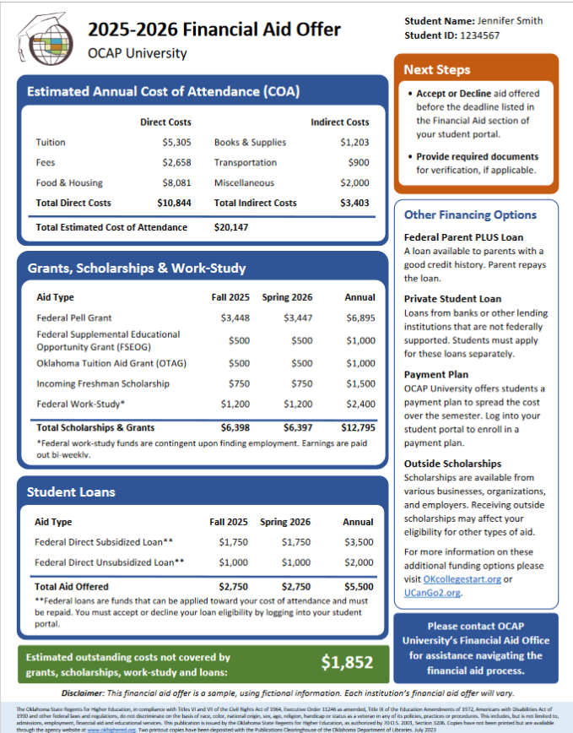
Financial Aid Offer
Shows the total Cost of Attendance for one year at that institution
Shows the types and amounts of aid the student is eligible to receive
You’re not required to accept all of the aid that’s offered
Know the deadline to accept/decline any of the aid
Notes:
The green section at the bottom of this offer shows an amount that’s not expected to be covered by financial aid. One of your best options to cover this difference is to apply for scholarships.

Slide 63
Introduction to Financial Aid
Introduction to Financial Aid
Scholarships

Slide 64
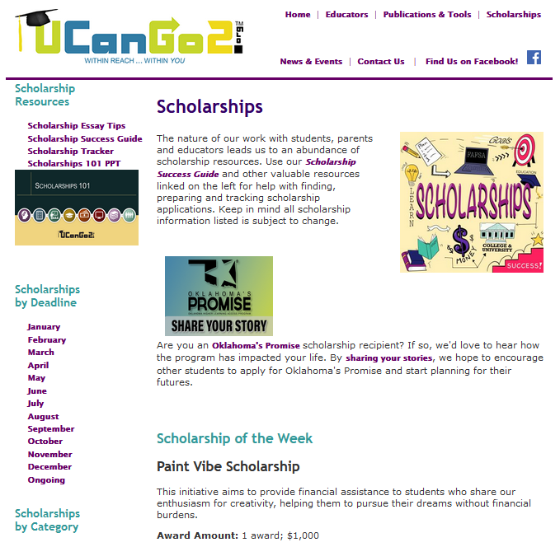
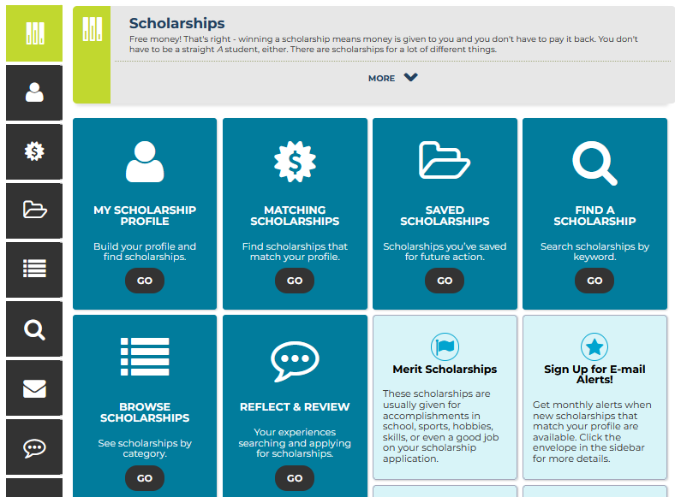
Scholarships
Ask your high school counselor for assistance!
College websites
UCanGo2.org
OKcollegestart.org
OCCF.org
TulsaCF.org
Search online for:
  Brand names
  Restaurants
  Beverage companies
  Scholarships for _____ (insert personal circumstance here!)
Notes:
Apply for as many scholarships as you can.
There are many different places to search.
You won’t win every scholarship you apply for, so the more applications, the better your chances of winning.
Do a thorough search for ‘local’ scholarships, since less people will be competing for them.
Pay close attention to the deadline for each application—they can land any time throughout the year.

Slide 65

Oklahoma’s Promise
Must have applied in the 8th, 9th, 10th or 11th grade
Must graduate from high school with two separate GPAs of 2.50 or higher
Must begin college within three years after HS graduation
Once you begin college, OKP will pay for five continuous years of education, 129 credit hours, or until you earn your bachelor’s degree, whichever comes first
Visit OKPromise.org for more information!
Notes:
The three-year and five-year time limits can be extended for any student who leaves college to serve in active military duty during that time.

Slide 66


Questions?
LeUCanGo2 Outreach Team
UCanGo2.org
866.443.7420
405.234.4239
UCanGo2@ocap.org
This presentation is for educational purposes only and is not intended to be construed as financial, investment, legal and/or tax advice.

