Slide 1

Holland Central
School District
2025-2026 BUDGET PRESENTATION
#3
March 24, 2025

Slide 2
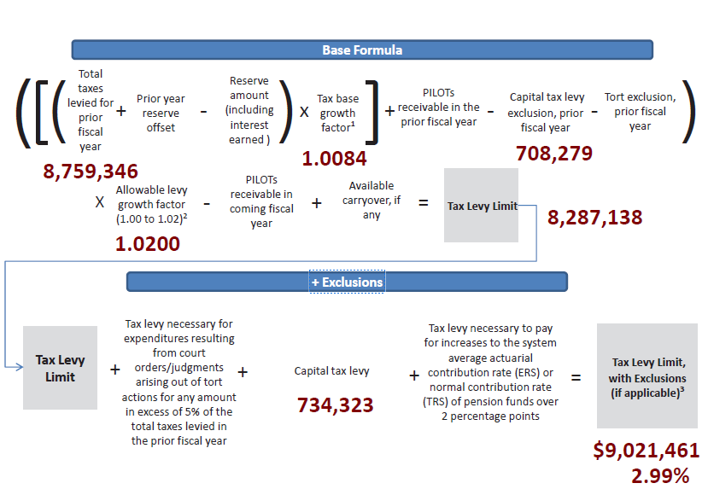
Tax Levy 2025-26
PRESENTATION OVERVIEW
Tax Levy: $9,021,461
Increase % from 24-25: 2.99%
Increase $ from 24-25: $262,115
Does NOT require supermajority vote

Slide 3
Ten-Year Tax Levy History
PRESENTATION OVERVIEW
Year | Levy %
2016-2017 | 0.00%
2017-2018 | 0.00%
2018-2019 | 1.98%
2019-2020 | 2.73%
2020-2021 | 3.33%
2021-2022 | 1.90%
2022-2023 | 2.99%
2023-2024 | 3.08%
2024-2025 | 3.98%
2025-2026 | 2.99%

Slide 4
10 Year K-12 Enrollment Data
PRESENTATION OVERVIEW
 | 14-15 | 15-16 | 16-17 | 17-18 | 18-19 | 19-20 | 20-21 | 21-22 | 22-23 | 23-24
Enrollment | 893 | 885 | 870 | 881 | 864 | 829 | 758 | 727 | 732 | 684
 |  | -8 | -15 | 11 | -17 | -35 | -71 | -31 | 5 | -48
data.nysed.com

Slide 5
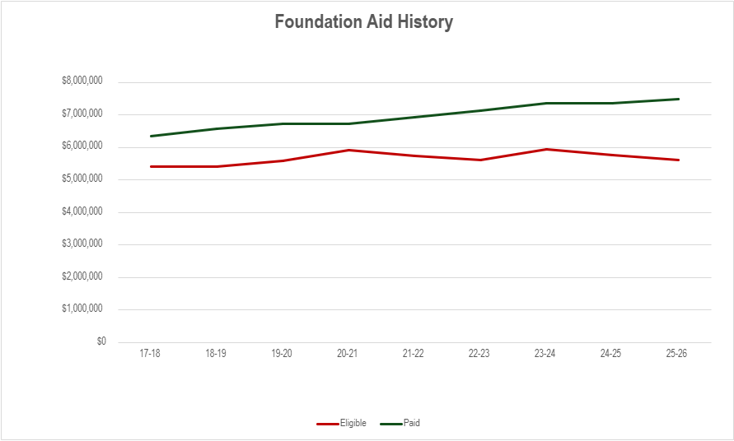

Slide 6
25-26 Revenues
PRESENTATION OVERVIEW
 | 2024-2025 | 1st Draft 2025-2026 | 2nd Draft 2025-2026 | $ Change from 24-25
Interfund Transfers & Appropriated Fund Balance | $663,296 | $350,000 | $1,100,425 | $437,129
Misc. Revenues | $465,240 | $586,830 | $586,830 | $121,590
Property Tax Levy | $8,759,346 | $9,021,461 | $9,021,461 | $262,115
Sales Tax | $1,150,000 | $1,020,000 | $1,076,000 | ($56,000)
State Aid | ($11,614,565) $11,371,399 | $11,279,287 | $11,280,623 | ($90,776)
Total | $22,652,447 | $22,257,578 | $23,065,339 | $412,892

Slide 7
25-26 Expenditures
PRESENTATION OVERVIEW
 | 2024-2025 | 1st Draft 2025-2026 | 2nd Draft 2025-2026 | $ Change from 24-25
General Support | $2,960,696​ | $3,146,104 | $2,973,347 | $12,651
Instructional | $11,730,080​ | $12,241,118 | $11,493,375 | ($236,705)
Transportation | $1,119,849​ | $1,160,903 | $1,160,903 | $41,054
Employee Benefits | $4,596,100​ | $5,110,293 | $4,983,293 | $387,193
Debt Service | $2,245,722​ | $2,454,421 | $2,454,421 | $208,699
Total | $22,652,447 | $24,112,840 | $23,065,339 | $412,892

Slide 8
24-25 Programming & Personnel Reductions
PRESENTATION OVERVIEW
Instructional FTE | Non-Instructional FTE
2 P-Tech Slots ENL – pulling in house Portion of Virtual French Software Summer Curriculum (non-grant funded) PD Day Cut w/ BOCES Curriculum Budget Department Chairs 1 Instructional FTE through attrition AIS FTE PD Budget Half-Day UPK Program - .5 FTE, 1 Support Staff Project Learn Field Trips Pupil Personnel Services Summer Academy 7/8 After School Help BOCES Adirondack Trip | Community Swimming Fitness Center Varsity Bowling Girls/Boys Assistant Swimming Coach Ice Hockey Athletics Equipment (hurdles) Student Supplies Building Supply Budgets

Slide 9
25-26 Anticipated Personnel Reductions
PRESENTATION OVERVIEW
Instructional FTE | Non-Instructional FTE
Administrator 0.5 – Business ELA Elementary Elementary Library 3 – Music Physical Education Science (by way of reduction in elementary due to accrued seniority) Social Studies Special Education | Buildings and Grounds Laborer Clerical (via attrition) School Resource Officer

Slide 10
Current Budget Gap
PRESENTATION OVERVIEW
Total Revenues $23,065,339
Total Expenditures $23,065,339
Budget Gap -----------------

Slide 11
Contingency Budget
PRESENTATION OVERVIEW
Would require an approximate reduction of $500,541 from the proposed budget
  Levies a tax no greater than current fiscal year of $8,759,346 ($262,115), would require additional staffing reductions
  Student Supplies and Materials ($53,926)
  Non-Essential Capital Work ($100,000 aided at 81%)
  Equipment Purchases ($74,500)
  Expenses Attributed to Public Use of School Buildings & Grounds ($10,000)

Slide 12
Vehicle Proposition - $363,043
PRESENTATION OVERVIEW
Diesel Type C, 64 Pupil Front-Engine Bus $181,521.27
Diesel Type C, 64 Pupil Front-Engine Bus $181,521.27
Total Vehicle Proposition $363,043

Slide 13
Board of Education Seats
PRESENTATION OVERVIEW
An election for member of the Board shall be held to fill one (1) at-large position on the Board resulting from the expiration, on June 30, 2025, of the term of Gerald Vella. The candidate receiving the highest vote total will be elected to a five (5) year term commencing July 1, 2025 and ending on June 30, 2030.
Candidates:

Slide 14
2025-2026 Proposed Budget
PRESENTATION OVERVIEW
$23,065,339
Overall Increase: $412,892 or 1.8%
Budget Vote
May 20, 2025
7am – 8pm
Holland Community Center
3 Legion Drive, Holland NY
Notes:
Reminder – last year’s budget to budget increase was 102,442 or .45%

