Slide 1
MCSD Construction Update
March 10, 2025
Ward Odom
Executive Director of Facilities and Capital Planning

Slide 2
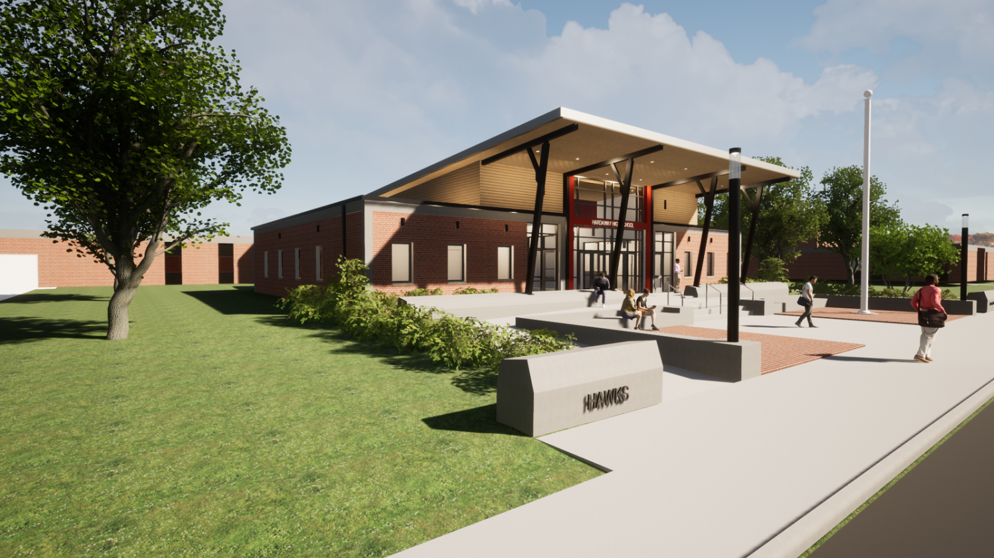
Hardaway Addition/Upgrade
Estimated Completion: Winter 2024/2025
Rendering

Slide 3
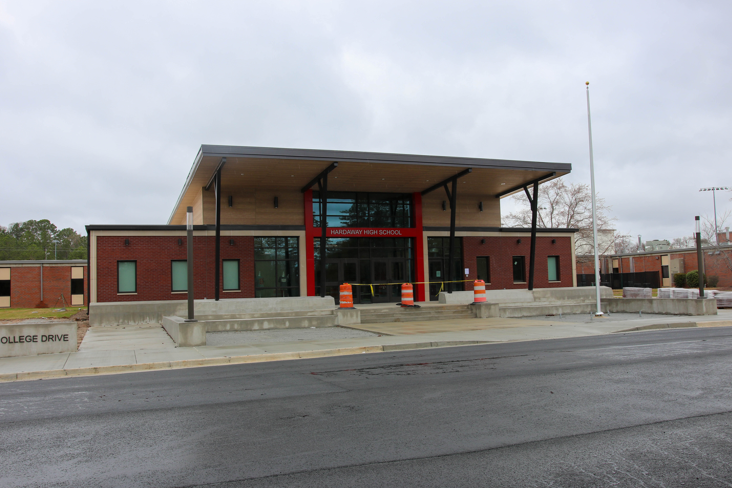
Hardaway Addition/Upgrade
Estimated Completion: Winter 2024/2025

Slide 4
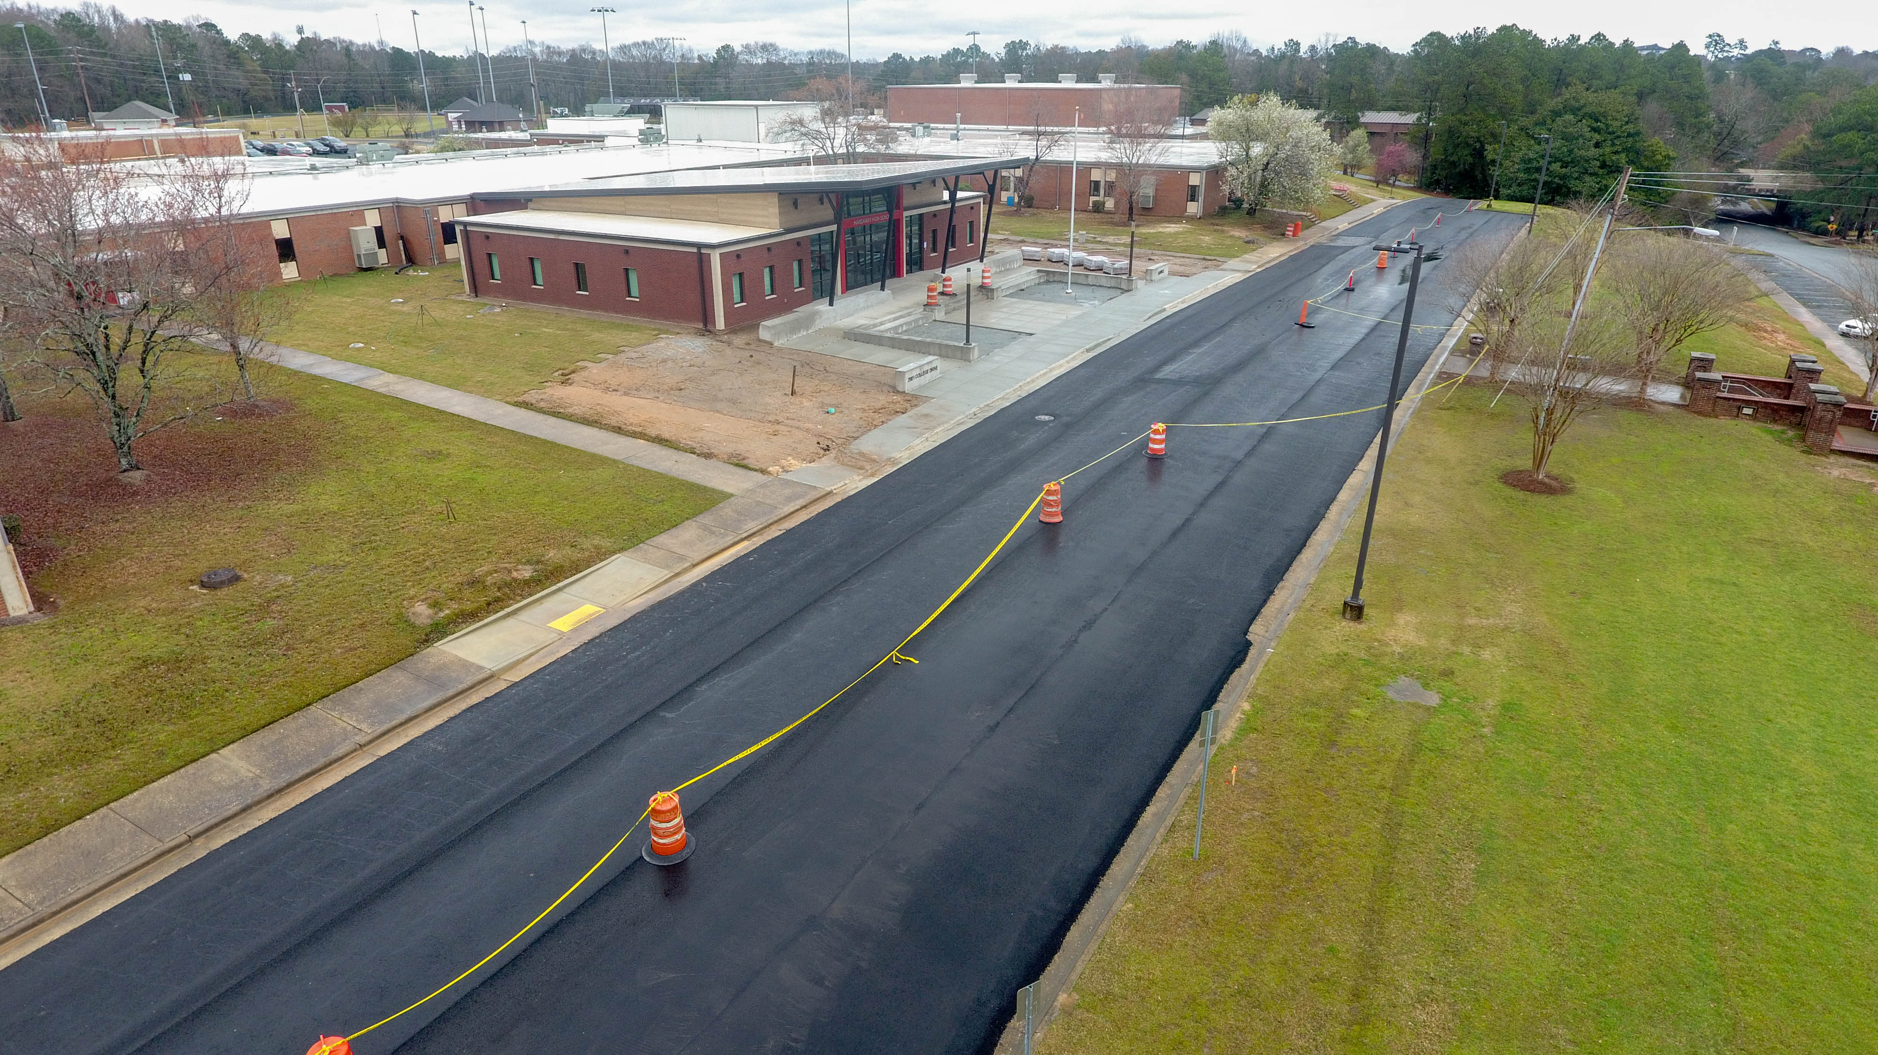
Hardaway Addition/Upgrade
Estimated Completion: Winter 2024/2025

Slide 5

Additional Projects
  Blackmon Road Middle HVAC Cooling Tower
    Estimated Completion (Phase 1): TBD
  COP 2026 Dimon, Fox, Richards and Rothschild HVAC
    Estimated Completion: TBD
  Double Churches Elementary Upgrade
    Estimated Completion: TBD
  Downtown Elementary HVAC Cooling Tower
    Estimated Completion: TBD
  Georgetown Elementary HVAC
    Estimated Completion: Fall 2025
  Kinnett Stadium Upgrade
    Estimated Completion: TBD
  Secure Vestibules
    Estimated Completion (Phase I): Winter 2025/2026

Slide 6
E-SPLOST

