Slide 1



Preparing for High School

Slide 2
Wendy Batek A-Fe
wbatek@calallen.org
Veronica Espinoza Ff-Le
vespinoza@calallen.org
Erika Vazquez Lf-Ri
evazquez@calallen.org
Gloria Saenz Rj-Z
gloria.saenz@calallen.org
Larissa Duke-College and Career
lduke@calallen.org
Calallen High School Counseling Staff

Slide 3
New Terms for
High School
Credit
All high school courses are tied to credit
A grade of a 70 must be earned to obtain credit
You earn 7 credits each school year
Semester System
Half credits are awarded at the end of each semester
Semester grades will be averaged for a final average
Classification
Grade level is determined by credits earned
  10th – 6 credits
  11th- 12 credits
  12th- 19 credits

Slide 4
New Terms for
High School
Continued
GPA- Grade Point Average
Sum of all semester course grades throughout High School career divided by total number of credits
A new GPA is calculated at the end of each semester
Class Rank
After all GPAs are calculated, ranks are assigned based on highest GPA to the lowest GPA
Transcript
Official document showing all high school semester grades and credits earned

Slide 5
Graduation Plans
Foundation
Foundation with Endorsements
Distinguished Level of Achievement
Performance Acknowledgements

Slide 6
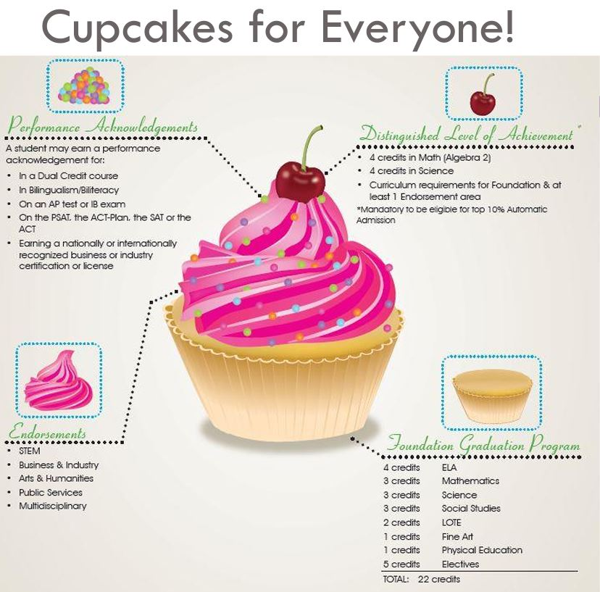

Slide 7

Let's start with the base...
These are the BASE credits needed for graduation.
Core Classes:
English classes
Math classes
Science classes
History classes
Calallen ISD Requirements:
Students are required 26 TOTAL CREDITS for graduation with an endorsement.
Additional credits:
Health (half credit) Speech (half credit)
Technology Physical Education
Lote (2 years) Electives
*22 credit graduates require special approval

Slide 8
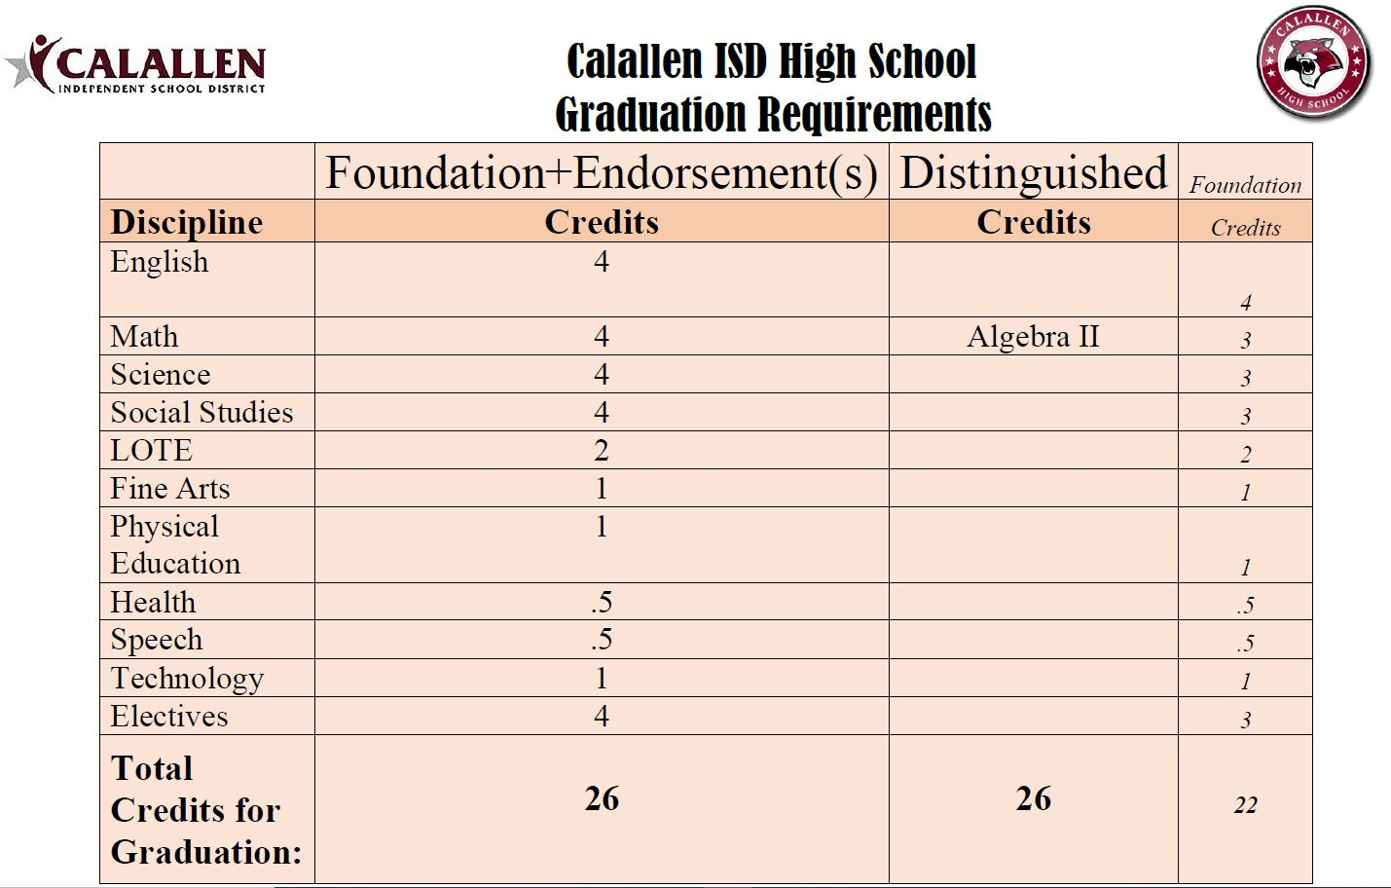

Slide 9
Course Levels​
Regular​ (GPA Unweighted)
PAC​ (GPA weighted + 10)
AP and Dual Credit (GPA weighted + 15)

Slide 10
Course Levels
Regular
PAC
AP
Dual Credit
Regular courses are standard curriculum.
PAC stands for Preparatory Advanced Course and has a more rigorous curriculum than regular.
AP stands for Advanced Placement and is taught at the highest rigor. These are taught at a college level and students can earn college credit through taking the AP exam at the end of the course.
Dual Credit courses are taught at the highest rigor. These are college courses taken through Del Mar College and students earn college credit and high school credit at the same time.

Slide 11
9th Grade Required Core Courses
English Credit
English 1
PAC English 1
Social Studies Credit
World Geography
PAC World Geography
World History
*World History AP
PAC World History
*European History AP
Math Credit
Algebra 1
PAC Algebra 1
Science Credit
Biology
Integrated Physics and Chemistry (IPC)
PAC Biology
Geometry
PAC Geometry
*These courses will have summer assignments: Please look at the Calallen High School website for the specific summer reading.

Slide 12

Additional Required Courses
Physical Education- 1 credit
Technology- 1 credit
Fine Art- 1 credit
Language other than English (LOTE)- 2 credits
Speech- ½ credit
Health-½ credit

Slide 13
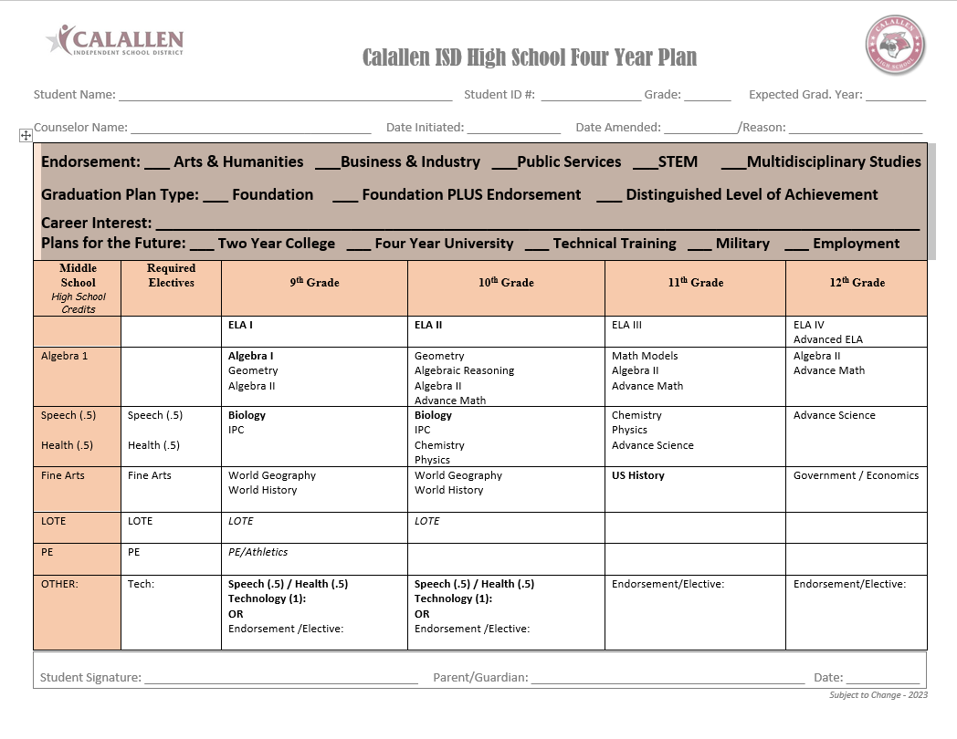

Slide 14
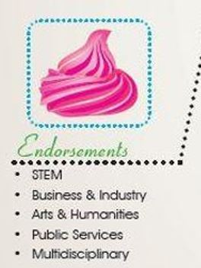
Now, the frosting...
Choose your ENDORSEMENT and PROGRAM OF STUDY based on what type of career you are interested in after high school. Your endorsement must be declared at registration.
Don't panic! If you change your mind, we will work with you.
Your Endorsement and Program of Study selection will determine 4 of your electives throughout high school.
**That does not mean you can't take electives from other endorsements!
For top 10% automatic college admission, you MUST graduate with an endorsement & take Algebra 2.
**The endorsement you earn DOES NOT MATTER for admission, just that you have one!
ALL students are automatically placed on the Foundation + Endorsement Plan

Slide 15
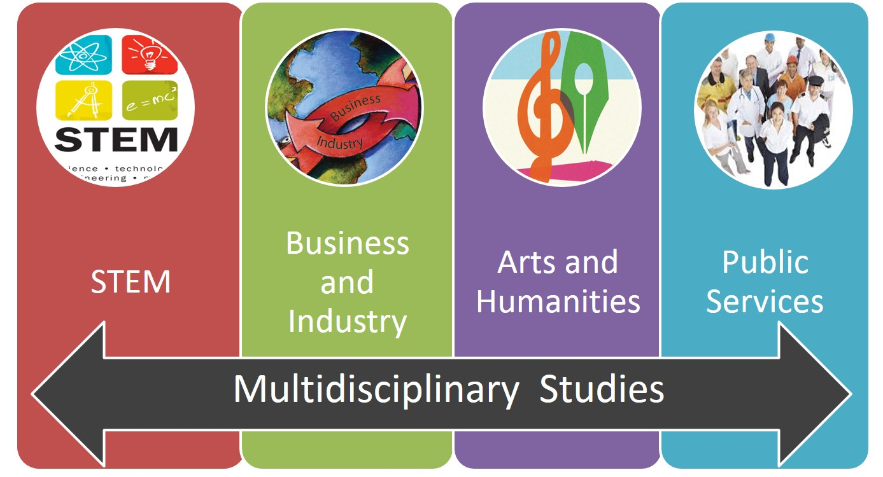

Slide 16

Programs of Study:
A sequence of courses equaling four credits within a students area of interest
Programs of Study connect high school classes to college, industry certifications, and careers
Programs of Study can be found on pages
46-64 in the 2024-2025 course catalog

Slide 17
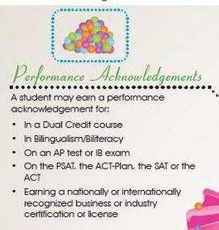
Anyone want Sprinkles?
Don't stress about this part!
These are acknowledgements that will happen naturally based on your academic interests and successes.

Slide 18
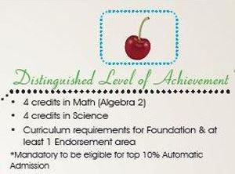
Last is the Cherry on top!
EVERYONE is automatically placed on the Foundation with Endorsement Plan. Therefore, all students are on track to receive a Distinguished Level of Achievement!

Slide 19
STATE TESTING
STAAR ---> End of Course Exam (EOC)
All students must take and pass the following EOC's to graduate:
English I
English II
Biology
Algebra I
United States History

Slide 20
Things to start thinking about...
Programs of Study
Careers
Certification Programs
Del Mar & CRAFT
Dual Credit
Del Mar College
Academic Core Courses
Certification/License Programs
Volunteering
Get INVOLVED
Clubs
Organizations
4-year Univeristy
Career Options/Goals
How to reach your goals?
Military
Community College
Technical Training School

Slide 21

Cosmetology ​
Welding​
Electrical​
Instrumentation​
Pipefitting​
AutoCAD, Revit, Inventor, Solidworks​
HVAC​
Court Reporting​
Automotive/Diesel Mechanic​
Phlebotomy​
EKG Technician​
Pharmacy Technician ​
Certified Medical Assistant​
Patient Care Technician​
EMT & Fire Science​
​Non-Destructive Testing
Process Technology
Certification Programs!

Slide 22



Remember:
There is only 24 hours per day!
Balance your life
  Coursework
  Activities/Clubs
  Extracurricular
  Family
  Friends
  Enjoy the Experience!

Slide 23
What’s Next??
3/21- Counselors will talk to all 8th grade students through English classes. Students will receive date and time of individual counselor meeting.
Review the registration information on the CHS Counseling Department website
Complete 4-year plan and course selection sheet
Write down questions for your counselor
3/25 – 3/27- One on one meeting with counselor: parents are invited to join, 8-10 minutes per student

Slide 24
QUESTIONS??

