Slide 1


Slide 2
What is Orange Shirt Day?
A day to remember the victims and survivors of the government run residential school’s Indigenous people in Canada were forced to attend. These schools were also in the United States, but called boarding schools)
These schools were cruelly designed to strip away Indigenous cultures, languages, religious beliefs, and the child’s knowledge of traditional ways of life.
Unfortunately, hundreds of children died at these schools. Some we have known about as they were put in a school cemetery. Hundreds others were hidden in unmarked graves that we are just now discovering.

Slide 3
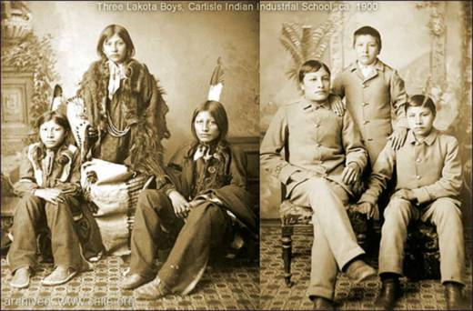
Children were not allowed to speak with their families, wear their traditional clothes, eat their traditional foods, or practice their own spiritual beliefs.
Children suffered physically and mentally. Many became sick and did not survive.
Those that did survive came home unrecognizable to their culture and families. This has affected entire family systems for generations.
Notes:
THese

Slide 4
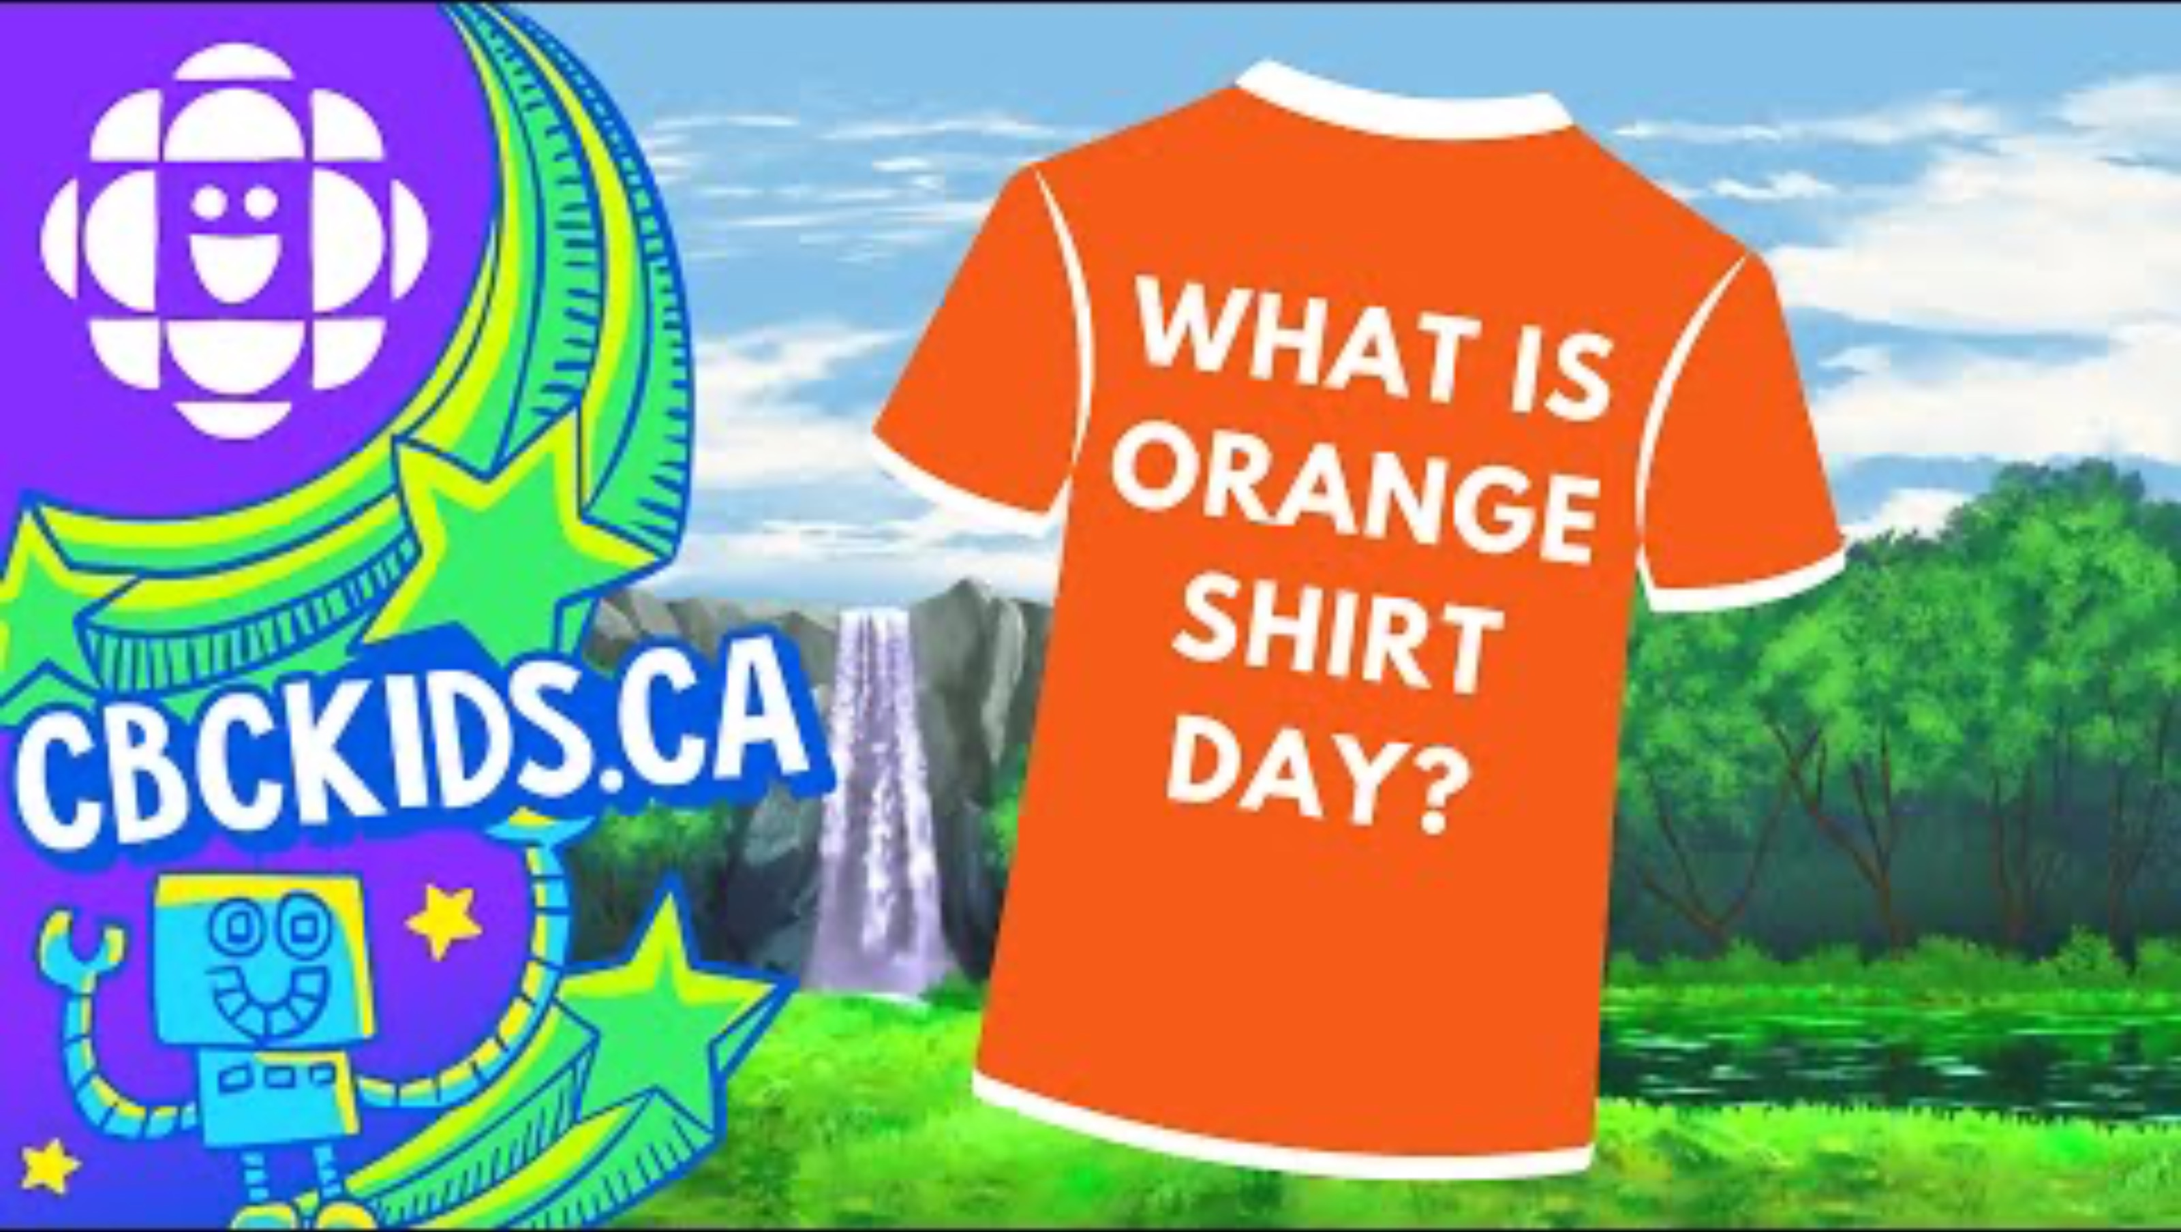
Short video about the meaning and origin of Orange Shirt Day

Slide 5
It happened here too!
An estimated 150,000 children were taken and forced to go to Canadian residential schools and over 300,000 children in the United States
There were 150 residential schools across Canada and 408 schools in United States between 1889 – 1969
In May 2020 219 unmarked graves were discovered at an old school in Canada, which led to more searches and discoveries in other residential schools and the United States then started a search.
Representation Matters: The current U.S. Secretary of the Interior is a Native American woman named Deb Haaland (Pueblo of Laguna). She is the first Native American person to hold the job in 150 years. A job whose role it is oversee and support Native lands and relationships (!)
In 2021 Haaland commissioned an investigation into U.S. boarding schools. In May 2022 a report was released and was the first official document admitting the reason for boarding schools.
Notes:
Parent thought I was teaching about private, rich, New England-type boarding schools.

Slide 6
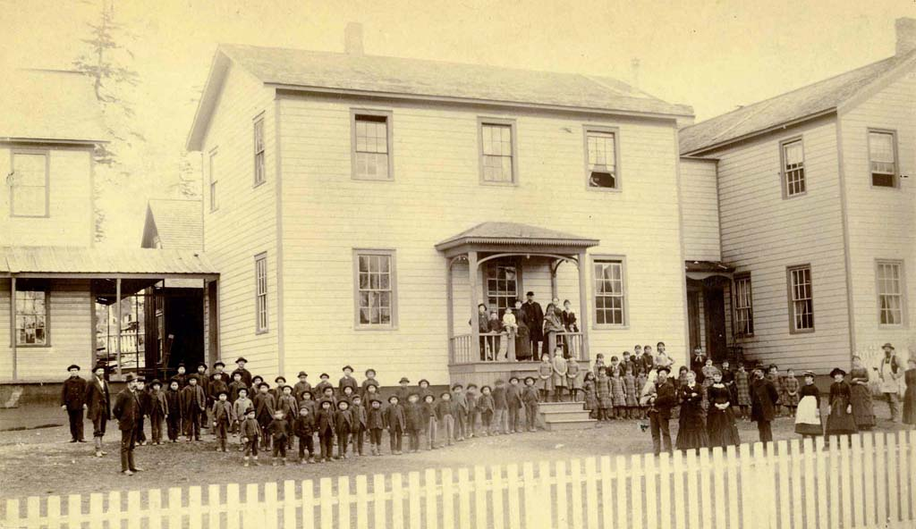
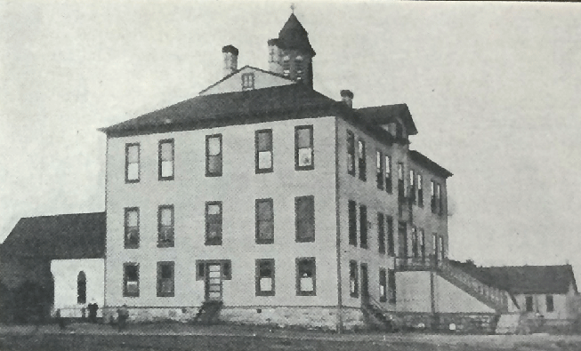
Boarding schools started on the east coast and children were sent off to those schools. Eventually, hundreds were built around the country, closer to tribal lands. Our region had several, including:
- Cushman Indian School (Tacoma)
- St. George’s Catholic Indian School (Seattle)

Slide 7
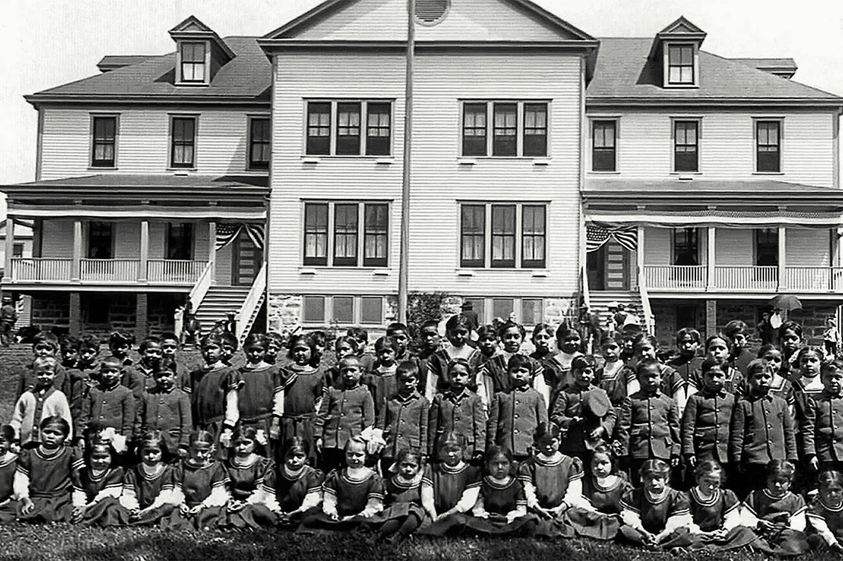
Notes:
THese

Slide 8
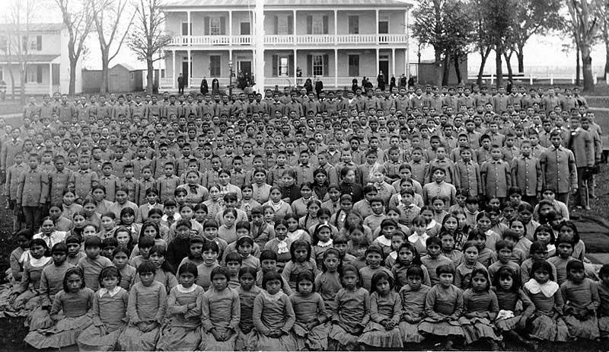

Slide 9
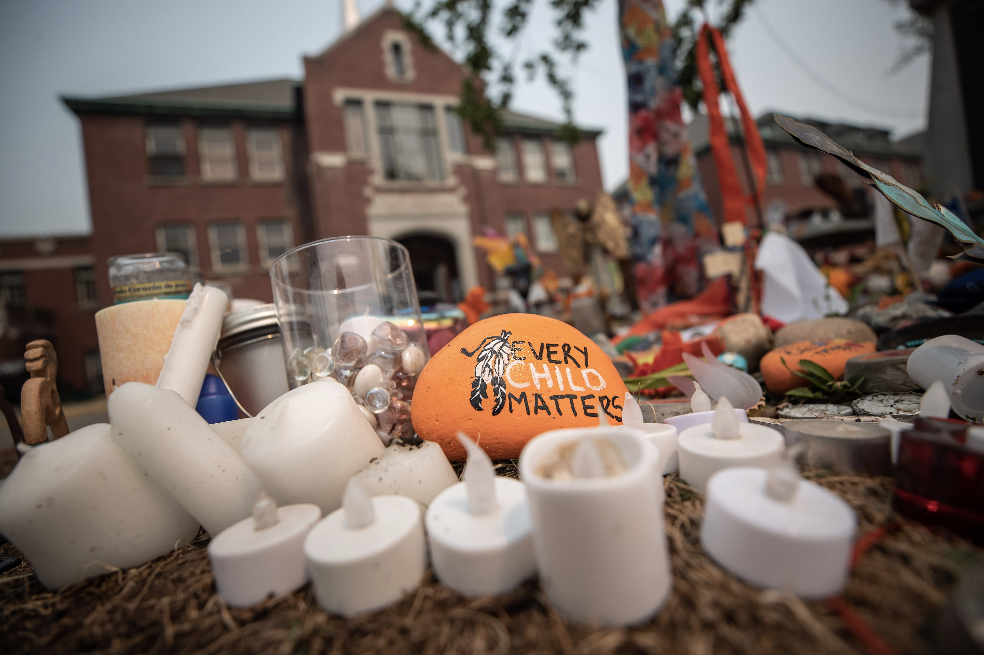
On September 30th, we honor and remember the survivors of Indian Boarding Schools.

Slide 10
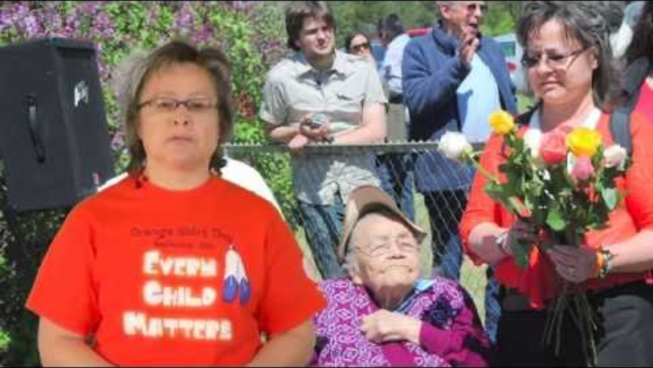
2 min video for middle and high school students of Phyllis discussing residential school life

Slide 11

Video ( < 2 min) for young students of Orange Shirt founder reading a short picture book

Slide 12
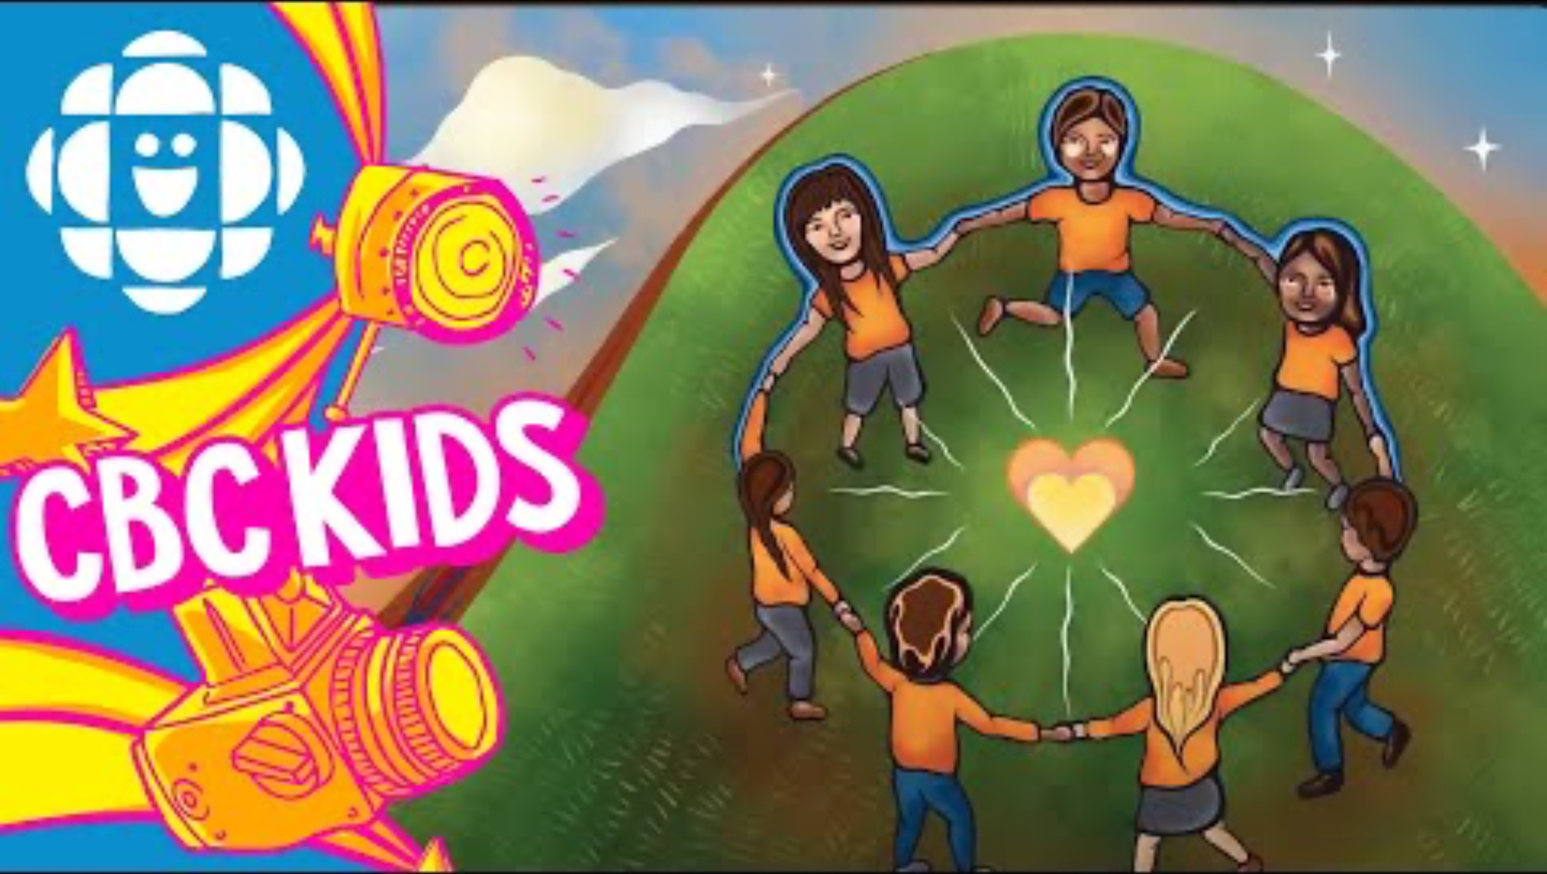
A second video (< 2 mins) of Phyllis reading and talking about Orange Shirt Day

Slide 13
We invite you to wear orange on Monday with us!

Slide 14
