Slide 1
OJHS DRESS CODE
AND UNIFORM POLICY
2024 - 2025
SCHOOL YEAR

Slide 2
WHERE CAN I FIND THE DRESS CODE POLICY?
The OJHS DRESS CODE POLICY, UNIFORM POLICY, CELL PHONE POLICY AND HANDBOOK ARE ON OUR SCHOOL WEBSITE
GO TO WWW. OPSB.NET
CLICK ON ‘SELECT SCHOOL’
CLICK ON OUACHITA JUNIOR HIGH
EACH OF THESE ARE ON THE MAIN PAGE OF OUR WEBSITE

Slide 3
WHAT IS THE PURPOSE OF UNIFORMS
LESS DISTRACTIONS
STUDENTS EASILY RECOGNIZABLE
UNIFORMITY
STUDENTS ALL FEEL EQUAL
EASE OF DRESS IN THE MORNINGS
MUCH CHEAPER THAN REGUALAR CLOTHING

Slide 4
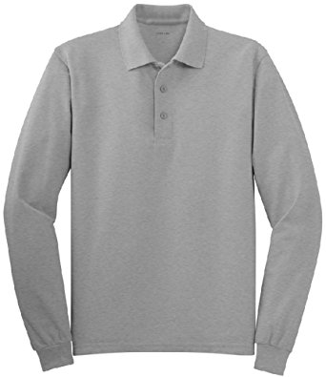
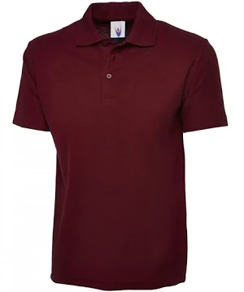
UNIFORM SHIRTS
GRAY,MAROON, BLACK, or WHITE polo style shirts, with a collar
REGULAR “POLO” STYLE SHIRTS WITH A COLLAR THAT FIT CORRECTLY. SHIRTS CANNOT BE EXCESSIVELY LARGE OR TOO SMALL
All students can wear one of the following colors. Maroon, Gray, Black
UNIFORM SHIRTS MUST ALWAYS BE WORN, EVEN UNDER HOODIES AND JACKETS

Slide 5
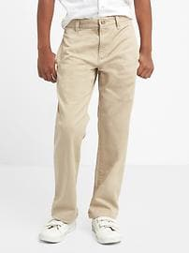
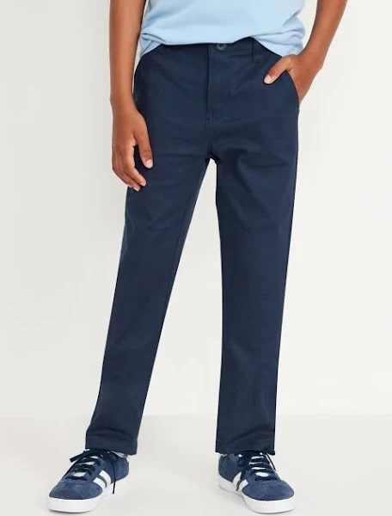
BOYS UNIFORM BOTTOMS
MALE STUDENTS WILL WEAR LOOSE FITTING UNIFORM STYLE KHAKI OR NAVY PANTS OR SHORTS
NO JEAN MATERIAL
NO HOLES OR RIPS OR SHREDED AREAS OF ANY KIND
SAGGING OF PANTS AT ANY TIME IS UNACCEPTABLE
ALL PANTS MUST HAVE BELT LOOPS
CORRECT STYLE PANTS

Slide 6
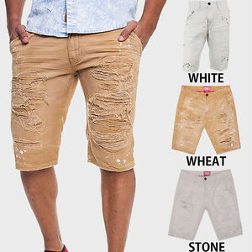
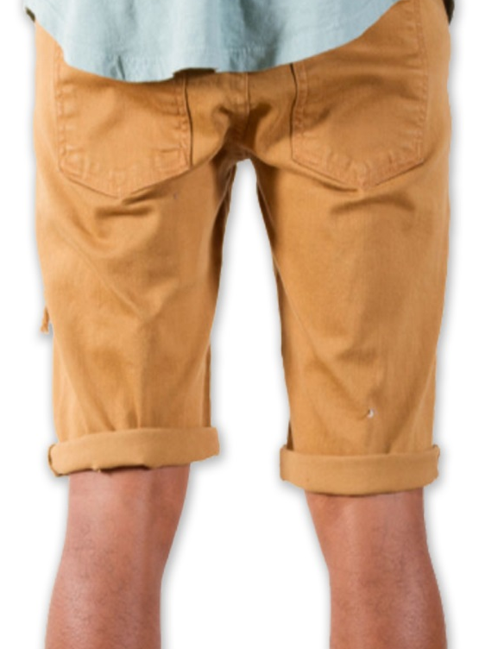
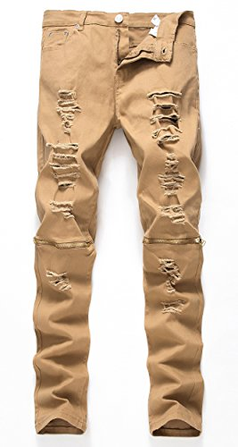
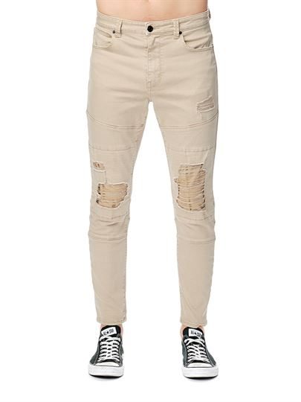
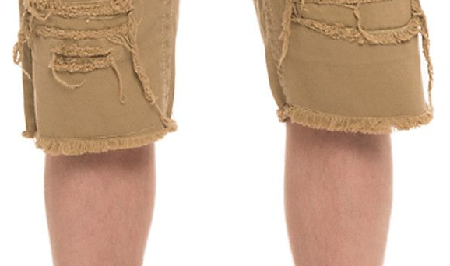
OUT OF DRESS CODE PANTS
SHREDDED OR HOLES

Slide 7
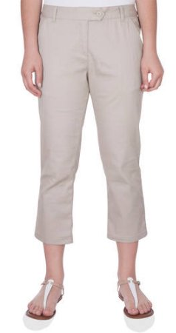
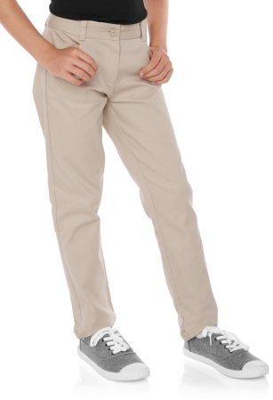
GIRLS UNIFORM BOTTOMS
GIRLS WILL WEAR KHAKI OR NAVY REGULAR LOOSE FITTING UNIFORM PANTS OR SHORTS.
GIRLS MAY WEAR LOOSE FITTING CAPRI PANTS
NO JEAN MATERIAL
Excessively tight PANTS, SHORTS, OR CAPRI’S ARE NOT PERMITTED
ANY BOTTOMS MADE OF STRECHY TIGHT FITTING COTTON OR SPANDEX MATERIAL ARE NOT PERMITTED
ONLY TWILL UNIFORM PANTS AND SHORTS
NO RIPS, SHREDDING, OR HOLES OF ANY KIND
NO CUT OFF SHORTS OR SHORTS BOUGHT WITH SHREDDED EDGES
NO ROLLED UP SHORTS
SHORTS MUST BE VERY CLOSE TO KNEE
SHORTS MAY NOT BE TIGHT

Slide 8
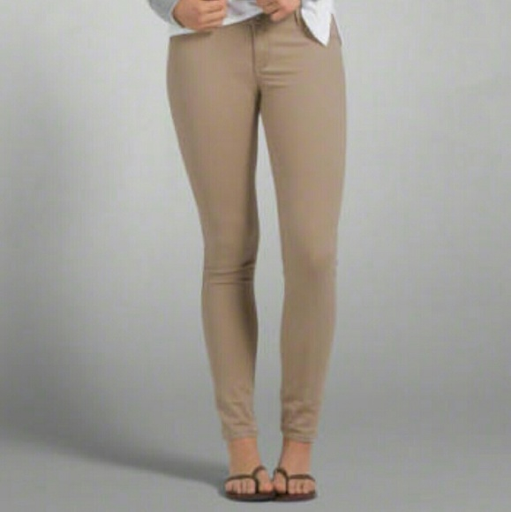
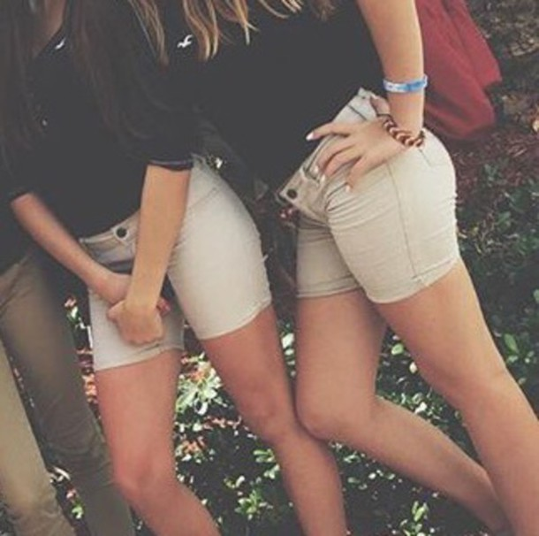
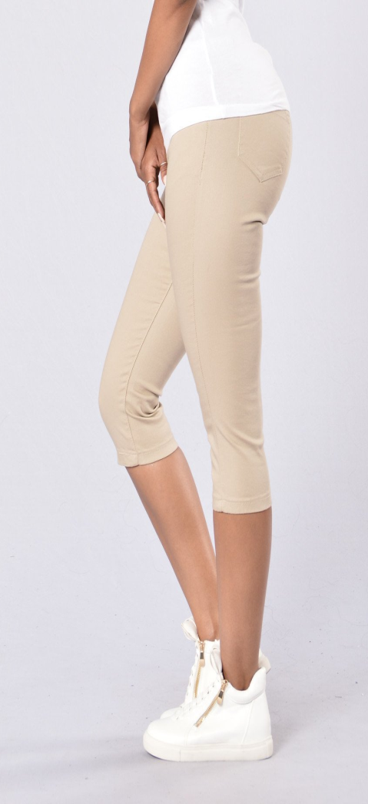
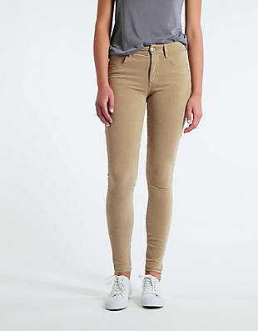
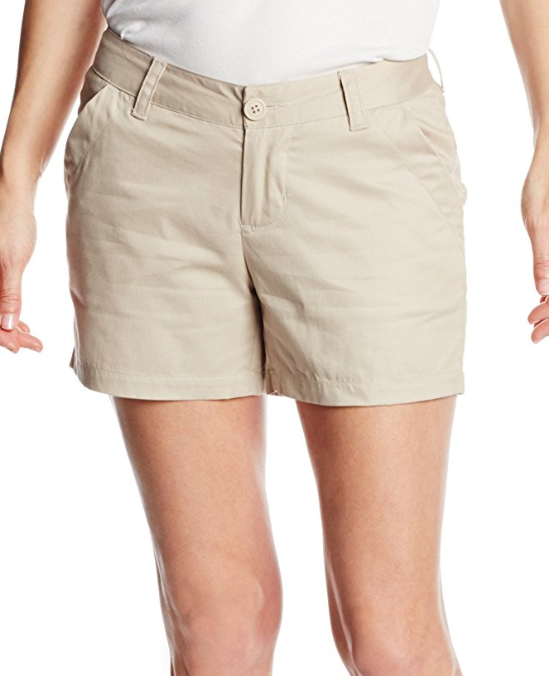
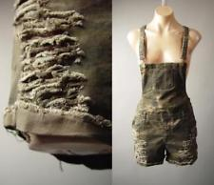
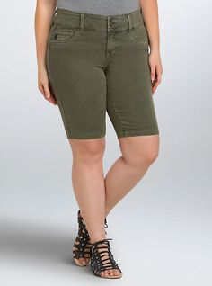
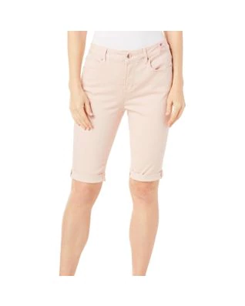
OUT OF DRESS CODE PANTS/SHORTS

Slide 9
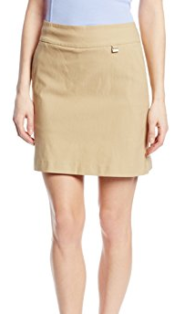
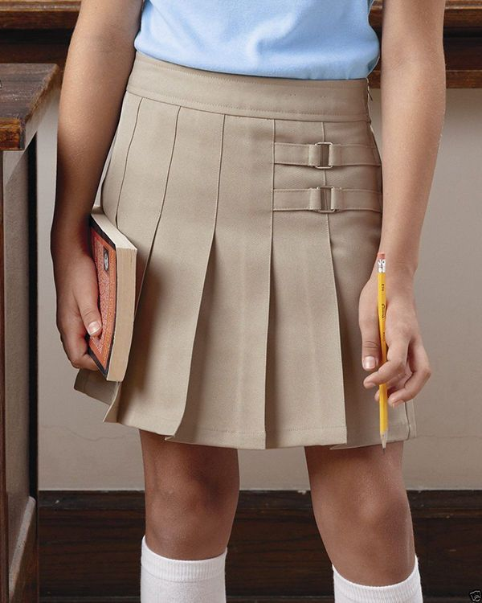
GIRLS SKORTS
GIRLS MAY NOT WEAR SKIRTS (with the exception of religious purposes)
GIRLS MAY WEAR KHAKI/NAVY SKORTS
THEY MUST BE VERY CLOSE TO KNEE
GIRLS MAY WEAR TIGHTS UNDER SKORTS ONLY

Slide 10
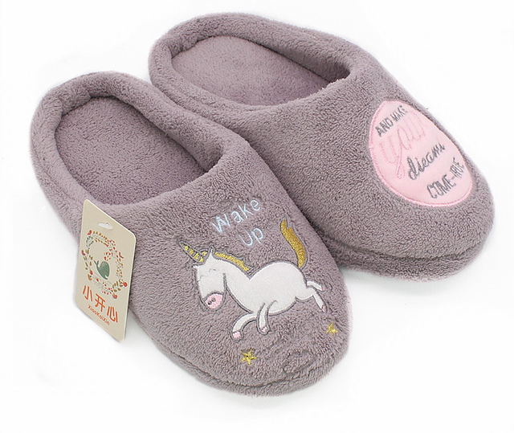
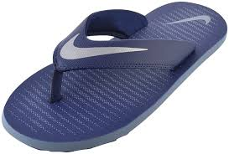
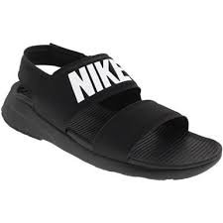
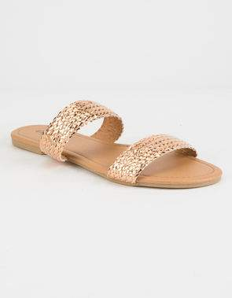
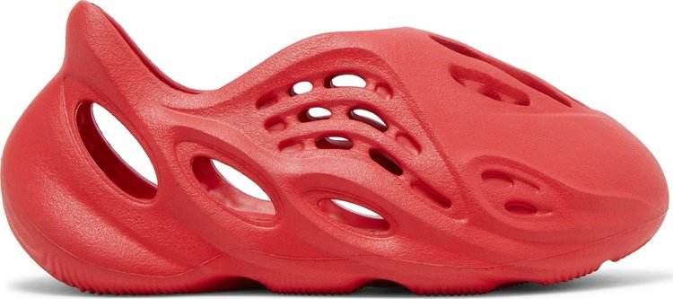
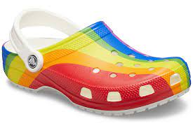
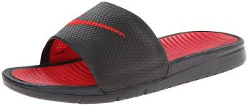
SHOES
SHOES MUST HAVE BACKS
NO SLIPPERS
NO FLIP FLOPS
NO DRESS SANDALS WITHOUT BACKS
NO HOUSE SHOES
NO HEELS OVER 2”
NO CROCKS
NO ATHLETIC TYPE SANDALS
NO "YEEZY" Foam Runner shoes
OUT OF DRESS CODE:

Slide 11
HEAD BANDS
Boys:
GIRLS:
MAY WEAR THIN BLACK HEADBANDS IN HAIR TO HOLD BACK HAIR
NO WIDE BANDS, COLORED BANDS, OR SWEAT BANDS
NO BANDANA’S
NO HAIR WRAPS
NO WINTER HATS
NO HOODIES ON HEAD IN BUILDING
NO BANDANAS OR SCARVES WORN WIDE IN BACK OR TIED IN FRONT
NO SWEAT BANDS
GIRLS MAY WEAR WIDE OR THIN HAIR BANDS
NOTHING THAT TIES IN FRONT
NO HEAD WRAPS
NO WINTER BANDS
NO HOODIES ON HEAD IN BUILDING

Slide 12
HAIR AND JEWELRY
HAIR MUST BE KEPT CLEAN
NO OUTLANDISH HAIR STYLES THAT DETRACT FROM THE EDUCATIONAL SETTING
NO NOSE PEIRCING
METAL HAIR PICS AND LONG HANDLED COMBS OR EDGE BRUSHES ARE NOT ALLOWED AT SCHOOL AND WILL BE CONFISCATED.

Slide 13
HOODIES
STUDENTS MAY WEAR HOODIES AND JACKETS THAT ARE THEIR GRADE COLOR ONLY IN THE BUILDING
ALL STUDENTS CAN WEAR
GRAY, MAROO, BLACK, OR WHITE HOODIES ONLY
IF A JACKET IS NOT THE CORRECT COLOR IT MUST BE PUT IN BOOKBAG UNLESS GOING OUTSIDE
STUDENTS WHO HAVE TO BE CONTINUALLY TOLD ABOUT HOODIES/JACKETS WILL BE SENT TO AN ADMINISTRATOR.

Slide 14
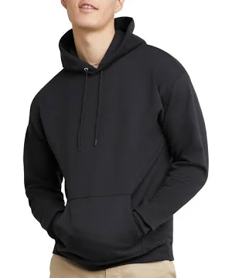
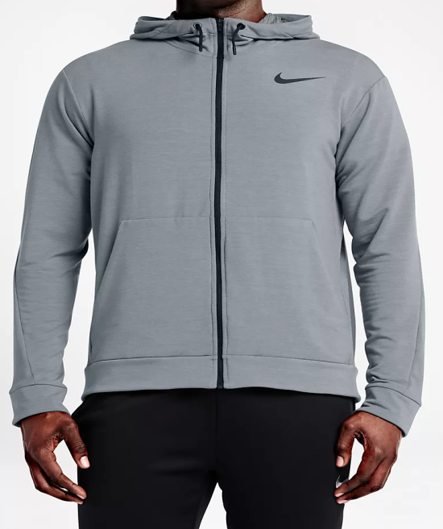
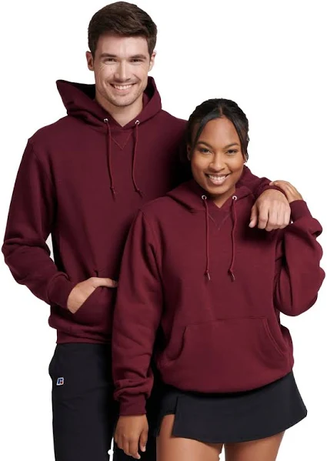
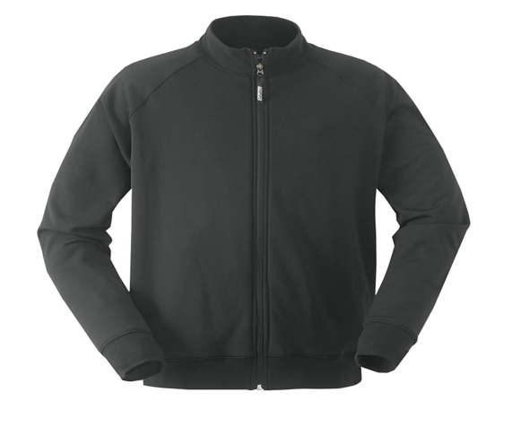
HOODIE/JACKET RULES
MUST BE CORRECT GRADE COLOR AND SOLID IN COLOR
BLUE JEAN JACKETS ARE NOT ALLOWED
HOODIE CAN HAVE NO WRITING OR EMBLEMS
SCHOOL SPONSORED TEAM HOODIE/JACKETS ARE ALLOWED DURING THAT SEASON OF PLAY
ONE SMALL LOGO IS ALLOWED ON LAPEL. NOTHING ON SLEEVES, BACK OR FRONT
NO RIPS OR SHREDS IN JACKET
JACKET/HOODIE MUST BE KEPT CLEAN

Slide 15
UNDER SHIRTS AND TIGHTS
BOYS MAY NOT WEAR TIGHTS UNDER SHORTS
GIRLS MAY ONLY WEAR TIGHTS UNDER SKORTS, GIRLS CANNOT WEAR TIGHTS UNDER SHORTS
LONG SLEEVE POLO SHIRTS ARE FINE

Slide 16
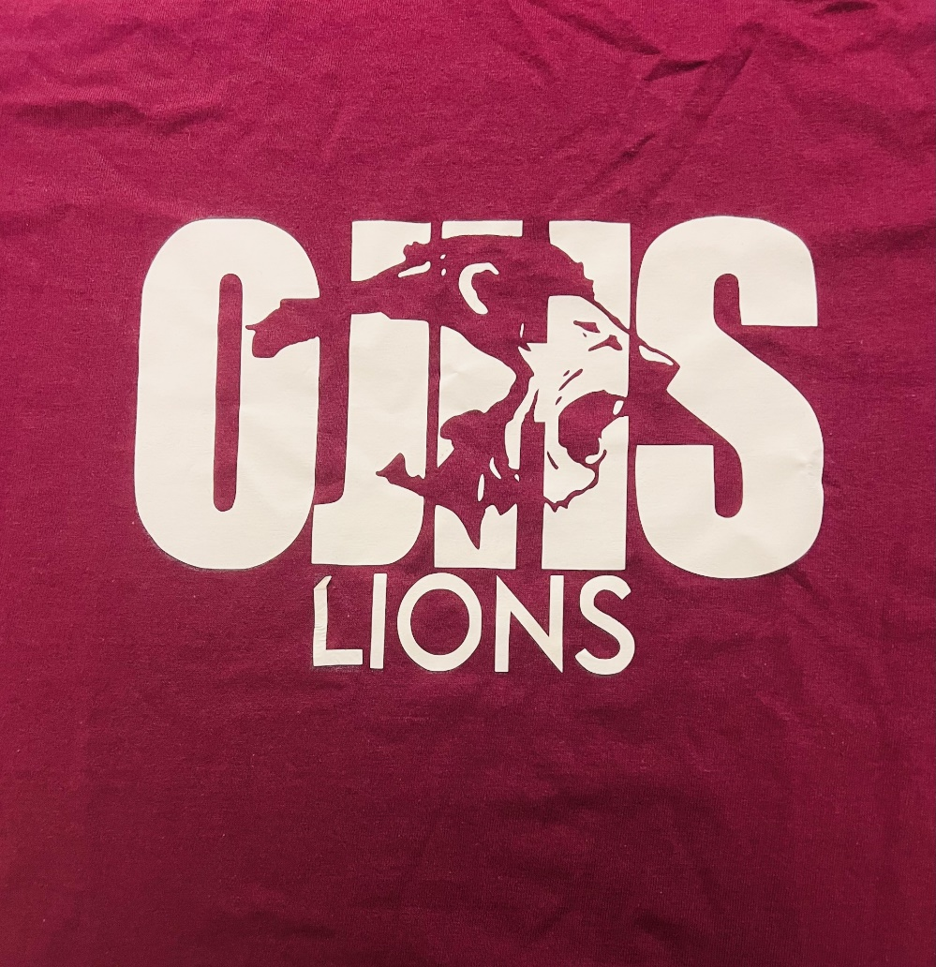
SPIRIT SHIRT DAY
UNIFORM OR JEAN BOTTOMS
ONLY PURCHACED OJHS DESIGNATED SPIRIT SHIRT IS ALLOWED TO BE ABLE TO PARTICIPATE IN SPIRIT
NO OTHER SHIRTS ARE ALLOWED
NO RIPS OR TEARS OR SHREDS IN ANY CLOTHING

Slide 17
JEAN DAY DRESS
These days can only be awarded by admin at various times during the year.
JEANS ONLY
CAN ALWAYS WEAR UNIFORM APPROPRIATE ATTIRE
NO RIPS, SHREDS, OR HOLES IN ANY CLOTHING
FOLLOW BASIC DRESS REGUALTIONS:
  NOTHING SHORT, TIGHT, OR REVEALING ANY PART OF UNDERGARMENTS
  NOTHING VULGAR OR DISTASTEFUL

Slide 18
ITEMS NEVER ALLOWED
SWEAT PANTS ARE NEVER ALLOWED
COTTON JOGGERS ARE NEVER ALLOWED
TIGHTS ARE NEVER ALLOWED
ATHLETIC SHORTS ARE NEVER ALLOWED
PAJAMA PANTS ARE NEVER ALLOWED
TIGHT STRETCH OR SPANDEX PANTS (JEGGINGS) ARE NEVER ALLOWED
SHEER, SEE THROUGH TOPS, OR TOPS THAT REVEAL UNDERGARMENTS ARE NEVER ALLOWED
CROP TOPS ARE NEVER ALLOWED
ANY CLOTHING WITH RIPS, HOLES OR SHREDS IS NEVER ALLOWED.

Slide 19
EXTRAS
IF A TEACHER HAS A DESIGNATED AREA IN THE CLASSROOM FOR BOOKBAGS OR PURSES, THEY MUST BE KEPT IN THAT AREA AT ALL TIMES
CHEER/DANCE/ SPORTS BAGS MUST BE KEPT IN THAT COACHES ROOM/DESIGNATED AREA UNTIL GOING TO THAT CLASS
THIS IS NOT THE ENTIRE DRESS CODE POLICY. PLEASE SEE OUR WEBSITE AND LOOK AT OUR HANDBOOK FOR THE OJHS HANDBOOK FOR MORE INFORMATION.

Slide 20
IF THERE IS DOUBT…
IF A STUDENT QUESTIONS WHAT THEY WANT TO WEAR, THEY SHOULD NOT WEAR IT TO SCHOOL
STUDENTS CAN BRING ANY GARMENT TO MRS. CRAIN AND ASK THE DAY BEFORE.
IF A STUDENT TRIES TO TEST THE DRESS CODE AND PACKS SUITABLE CLOTHING IN BACK PACK, THIS IS AUTOMATIC LD.
IF IT HAPPENS ON A REGULAR BASIS, STUDENT WILL BE IN ISS.
SIMPLY ASK BEFORE YOU WEAR IT.

Slide 21
QUESTIONS
PLEASE UNDERSTAND THE DRESS CODE IS A
WORKING DOCUMENT.
OJHS ADMINISTRATION HAS THE RIGHT TO MAKE
CHANGES AT WILL.
THE POLICY WILL BE GONE OVER WITH STUDENTS
DURING HOMEROOM, AND WILL BE
ON THE SCHOOL WEBSITE FOR REFERENCE.
IF CHANGES ARE MADE TO THE DRESS CODE THIS
POWERPOINT WILL AMENDED ON THE WEBSITE
AND STUDENTS WILL BE NOTIFIED
IF YOU HAVE QUESTIONS CONCERNING
THE DRESS CODE PLEASE CONTACT
THE SCHOOL AT 432-2200

