Slide 1

Identification and Management of an Acute Allergic Reaction in the School Setting

Slide 2



Allergies occur when your immune system becomes unusually sensitive and overreacts to common substances such as pollen, mould, dust or food.
When these substances cause an allergic reaction, they are called allergens.

Slide 3



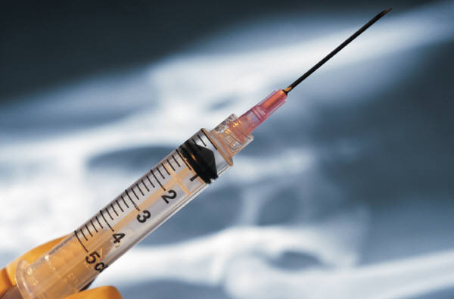
Allergens enter the body through:
The Mouth
The Nose
Touch
Injection

Slide 4
Anaphylaxis is a sudden, severe, potentially life-threatening allergic reaction that may involve the skin, respiratory tract, gastrointestinal tract and/or cardiovascular system.

Slide 5

Common Causes of
Anaphylaxis
Food
Medications
Insect Venom
Latex
EpiPen
Notes:
5

Slide 6

Allergic reactions can
occur in the:
upper respiratory system
lower respiratory system
skin
digestive system
as a generalized reaction called anaphylaxis
Notes:
6
As little as 1/70,000 of a peanut kernel can cause a reaction
Consumption can happen in many different situations ie. When kids trade lunches at school or When they are unaware of ‘hidden’ allergens on food labels
Inhalation can occur with allergies such as pollens, but can also happen with food allergies : i.e. on a field trip to the zoo, the trails are coated in walnut shells – when people walk on them, minute particles of the shell become suspended in the air and are inhaled
Injection most often occurs with insect stings or medication allergies i.e. bee sting or penicillin allergies
Contact can happen when a child picks up or brushes against their allergen. Playing with a balloon (latex allergy)
It can also occur through contact with other children ie.in a game of basketball when the forward had a peanut butter sandwich for lunch and forgot to was their hands

Slide 7
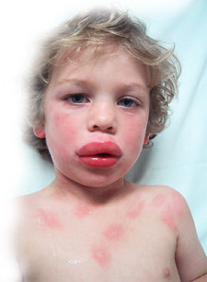
Symptoms of An
Anaphylactic Reaction
The most distinctive symptoms include:
hives
swelling of the throat, lips, tongue or around the eyes
difficulty breathing or
swallowing
* Hives may be entirely absent, especially in severe or near-fatal cases of anaphylaxis.
Notes:
7
upper respiratory system (hay fever)
lower respiratory system (asthma-like symptoms)
skin (swelling, hives)
digestive system
(nausea, vomiting, diarrhea)
as a generalized reaction called anaphylaxis

Slide 8
Children may describe their symptoms as
“My tongue is hot”
“My tongue and mouth itch”
“There’s something stuck in my throat”
“My food is too spicy”
Notes:
8
Reaction within the body mediated by massive release of histamine into the body

Slide 9
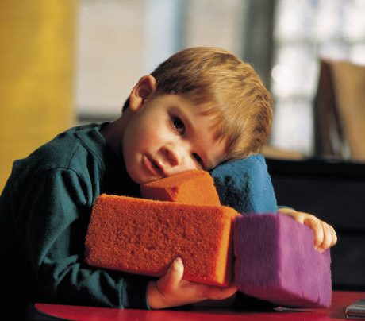
Symptoms of An
Anaphylactic Reaction
Other common symptoms include:
a metallic taste or tingling in the mouth
flushing, itching, or redness of the skin
nausea, vomiting, or diarrhea
dizziness or lightheadedness
increased heart rate
feelings of fear or panic
loss of consciousness
Notes:
9
Peanuts, tree nuts, eggs, milk/dairy, seafood

Slide 10
Remember…
It can take only 1 to 2 minutes for a mild allergic reaction to escalate to anaphylaxis
Notes:
10

Slide 11

When is anaphylaxis most likely to occur?
New situations
Normal daily routines are interrupted eg. birthday parties and school trips
During teenage years
(increasing independence,
relaxed precautions,
reluctance to carry
medication)
Notes:
11
An individual may have different symptoms at different times, and they may vary from reaction to reaction
All of these symptoms need not be present in an anaphylactic reaction
A child will usually know when they are having and allergic reaction – Believe them when they tell you

Slide 12

Preventing Anaphylaxis
1. Awareness
2. Avoidance
  Do not let student come in contact with allergen
  Check ingredients every time
    if unsure, do not let student eat it
    offer students an alternative choice in food
  Do not let students share lunches, snacks, containers or utensils
  Avoid bulk foods
  Monitor foods used in class parties/Assure supplies for arts and crafts are safe
  Be aware of cross-contamination - wash surfaces with board approved solutions
3. Action
  Administer EpiPen & Call 911
Notes:
12

Slide 13
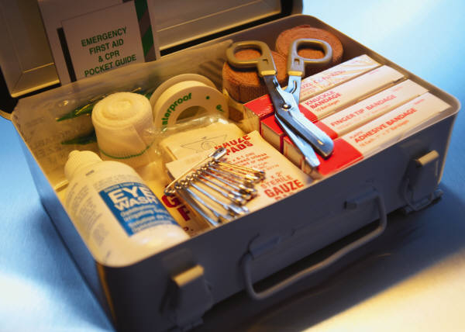
Have An Emergency Plan
A child with a life-threatening allergy should have immediate access to an EpiPen at all times!!
It is important to have one EpiPen available for every 5-10 minutes if symptoms return or persist.
Notes:
13
New situations call for heightened awareness to allergens. The environment is unknown or has changed and has not been screened for potential allergens
Although anaphylaxis is more common in childhood, teenagers are at greater risk. They are often embarrassed about their allergies and do not tell others about them. If they are having a reaction, they may go to a secluded place to avoid embarrassment in front of their friends. Teenagers are asserting their independence, and may forget or leave their epipen behind

Slide 14

What is an EpiPen?
An EpiPen is a disposable drug delivery system with a spring-activated, concealed needle designed for emergency administration.
EpiPens are available in 2 strengths:
  EpiPen Jr Smaller amount of epinephrine
  EpiPen Larger amount of epinephrine

Slide 15

What is in an EpiPen?
EpiPens are an effective way to administer a drug called Epinephrine (Adrenaline)
Epinephrine by injection is the treatment of choice for anaphylactic reactions.
Epinephrine works quickly to:
  constrict blood vessels
  relax smooth muscles in the
  lungs to improve breathing
  stimulate the heart beat
  reverse hives and swelling
  around the face and lips.
Notes:
15
3-4% bleach solution is (½ tsp bleach in 4 cups water)

Slide 16
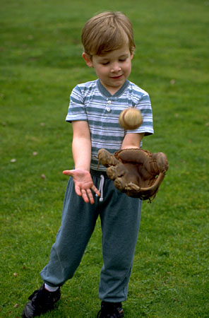
After the Administration of the EpiPen
Seek emergency medical attention as EpiPen is being administered
If symptoms return or there is no improvement in 10-20 minutes a second dose may be required.
Side effects of Epinephrine include:
  Nervousness
  Increased heart rate
  Sweating
  Nausea / Vomiting
  Headache
  Dizziness
Notes:
16
Ideally, a child who is diagnosed with a life-threatening allergy and requires an EpiPen should carry one with them at all times.
A second EpiPen should be kept in an unlocked, convenient, central location that everyone knows.
*do not attempt to take a child who is having an anaphylactic reaction in your car to the hospital
*always call 911
*most 911 call are responded to be ambulance with 16 minutes in Perth County (maximum of 23 minutes)

Slide 17
Special Tips About Using
EpiPens
If you suspect an anaphylactic emergency, administer the EpiPen and call 911
The effects of epinephrine when not needed:
  Increased Heart Rate
  Nervousness
The possible effect of not administering epinephrine in anaphylaxis:
  Death
*Always seek medical attention
after the administration of an EpiPen

Slide 18

Questions?
References:
Anaphylaxis: An ExtremeAllergic Emergency; Meridian Medical Technology/DEY
Managing Allergies and Anaphylaxis at School by Sandra Montgomery
The Food Allergy and Anaphylaxis Network

