Slide 1
Welcome to
El Toro High School!
Incoming Freshman Family Night
Presented by ETHS Counselors

Slide 2


The PSTO is the ONLY parent run group on campus that supports EVERY student at
El Toro High School
Join the ETHS PSTO Today!

Slide 3
What does PSTO do?
Family Education Nights
Student Support
Education Boosters
Staff/Teacher Appreciation Luncheons
Parent & Student Volunteer Opportunities
6 General Meetings
Join the ETHS PSTO Today!
Notes:
Family Education Nights
Student support: Finals Treats, Bullring Welcome and Awards Celebrations
Classroom needs through Education Boosters
3 Staff/Teacher Appreciation Luncheons
Parent & Student Volunteer Opportunities
6 General Meetings

Slide 4
Student Support Programs
*New This Year* Career Expo
SVUSD College & Trade Fair @ ETHS in Fall 2025
Finals Treats
Awards Celebrations
Senior Scholarships for Post-HS Plans
Grad Nite & Senior Breakfast & Prizes
Join the ETHS PSTO Today!

Slide 5
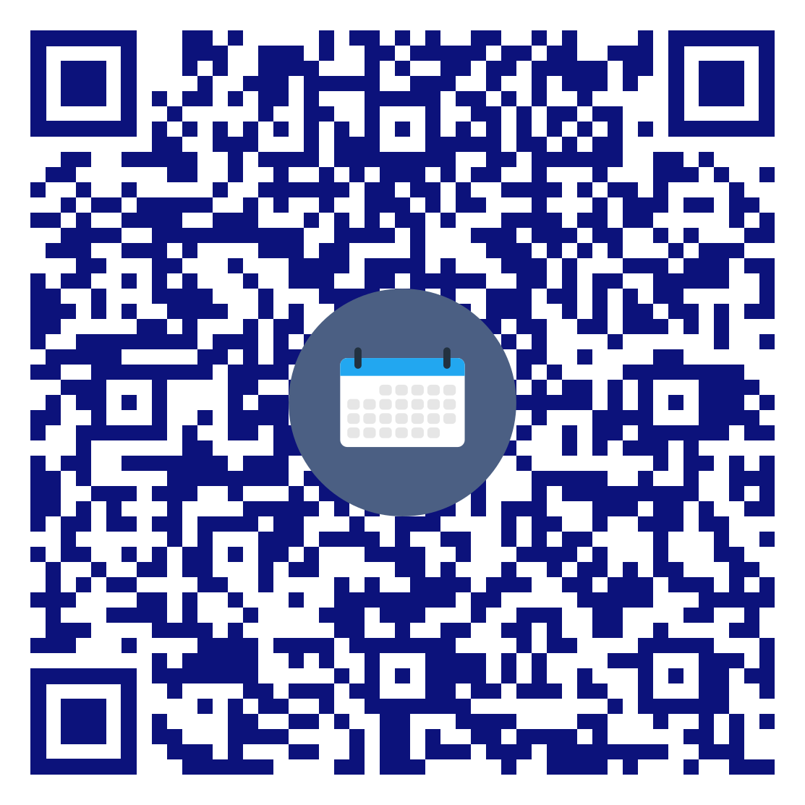
PSTO Family Education Night
Thurs 3/27 @ 6:30pm at Bailey Innovation Center
Light refreshments provided
Please RSVP!
PSTO General Meeting & elections followed by Stephanie Foundoulis from Success Forward College Planning to share information about preparing for college and applications.

Slide 6

PSTO Parliamentarian, Thorey Bauer thoreybauer@gmail.com 714-642-3834
Elected Board Positions President VP Membership VP Ed Booster VP Grad Nite VP Charger 5K Secretary Treasurer Auditor | Appointed Chair Positions College Fair Grad Nite Co Chair Scholarship Chair Webmaster Hospitality Chair Hospitality Co-Chair Sign Up Genius Engagement Chair

Slide 7


OCT Driving Academy Fundraiser
Use code “ETHS” and the PSTO will receive $50 when you sign up!

Slide 8

Get involved with PSTO
Become a Member- Only $25/family annually (July-June)
  NEW Membership Incentives this year
Come to a General Meeting
Read the Charger Weekly Newsletter
Volunteer (NOT required with membership)
Volunteer Today!

Slide 9
Connect with PSTO
Join the PSTO Family Remind Group text “@pstofamily” to 81010
Follow us on Instagram and Facebook
  @ETHSPSTO and @ElToroChargers5K
Visit us at www.ethsPSTO.org
Tina Fellers - president@ETHSPSTO.org
Join the ETHS PSTO today!

Slide 10

Agenda
  Meet the ETHS Counseling Team
  Transitioning to High School
  How to Be Successful in High School
  Upcoming Registration Information → Stick around to complete Registration with the Counselors!

Slide 11
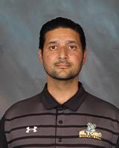
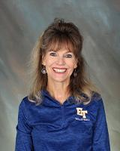
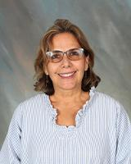
Meet the Guidance Staff
Mr. Hosseinzadeh
Mrs. Tettemer
Mrs. Kazemi
AP of Guidance and Curriculum
Guidance/ Curriculum Secretary
Community Liaison

Slide 12
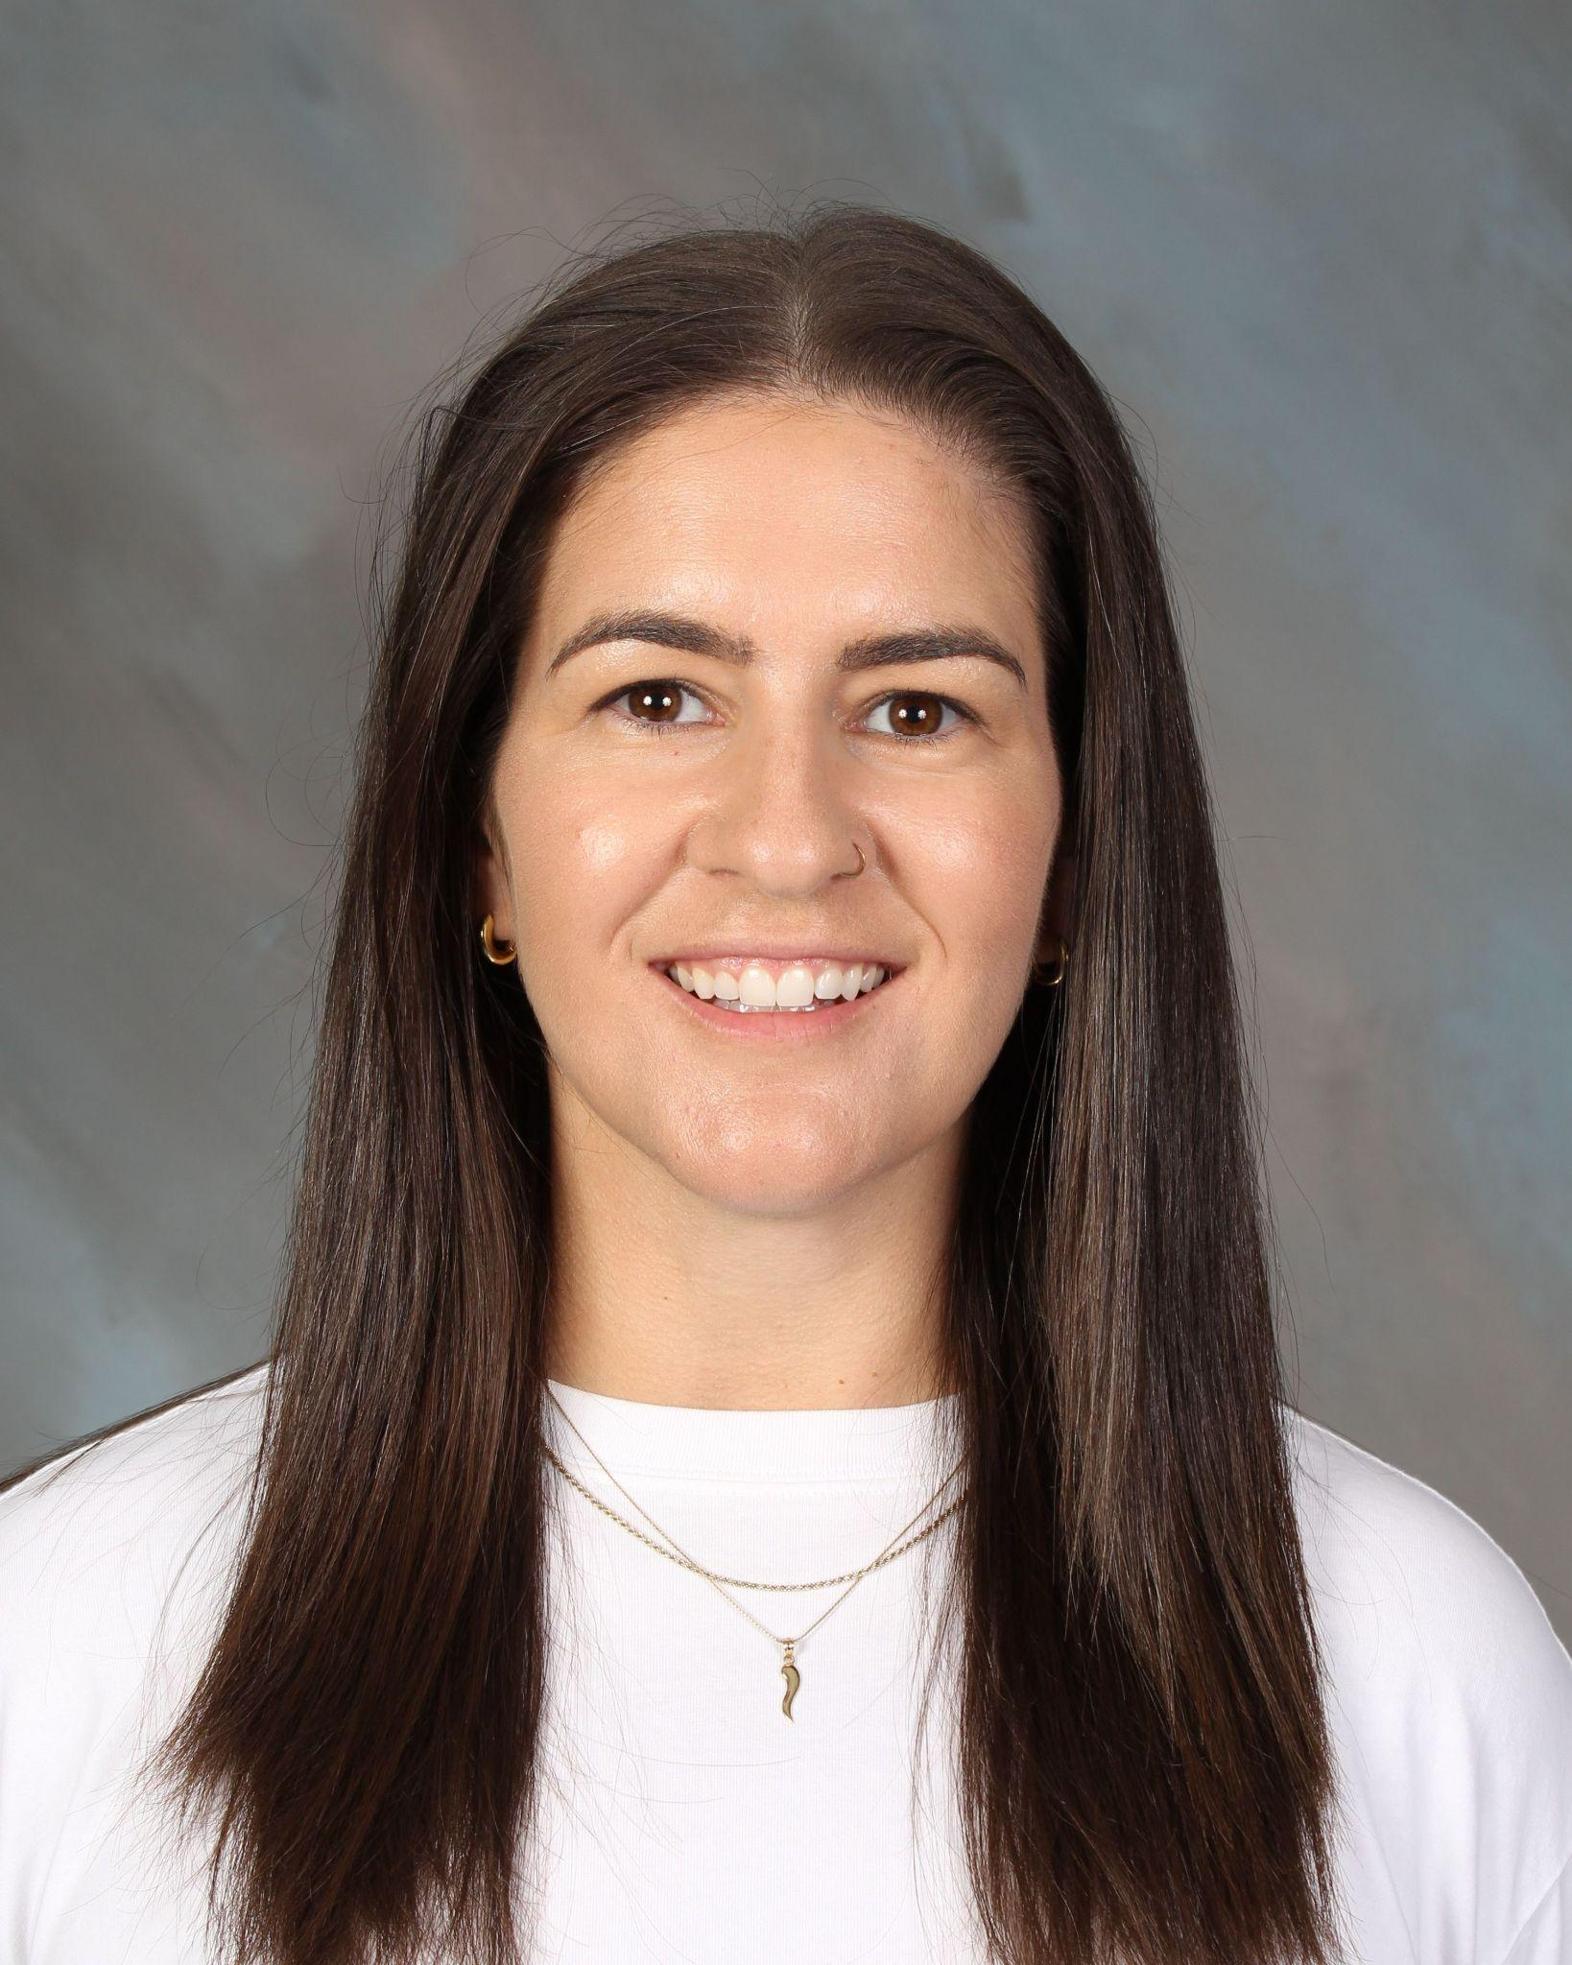
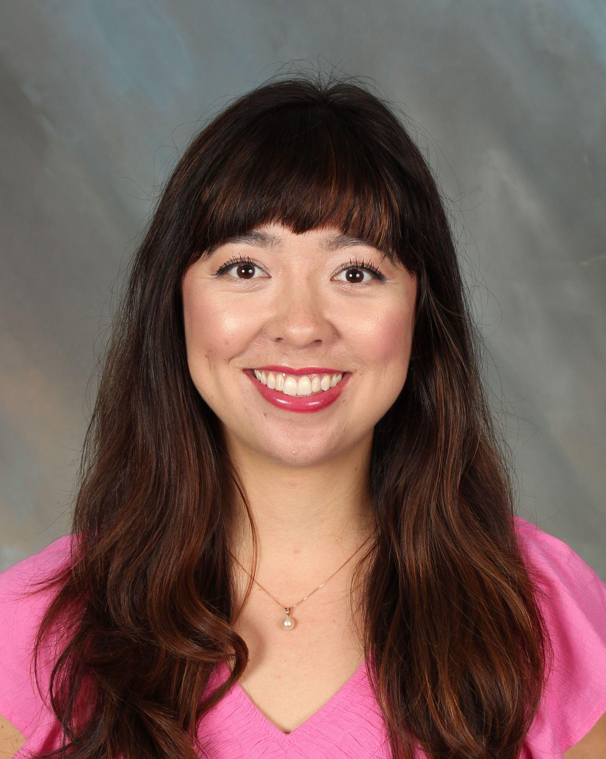
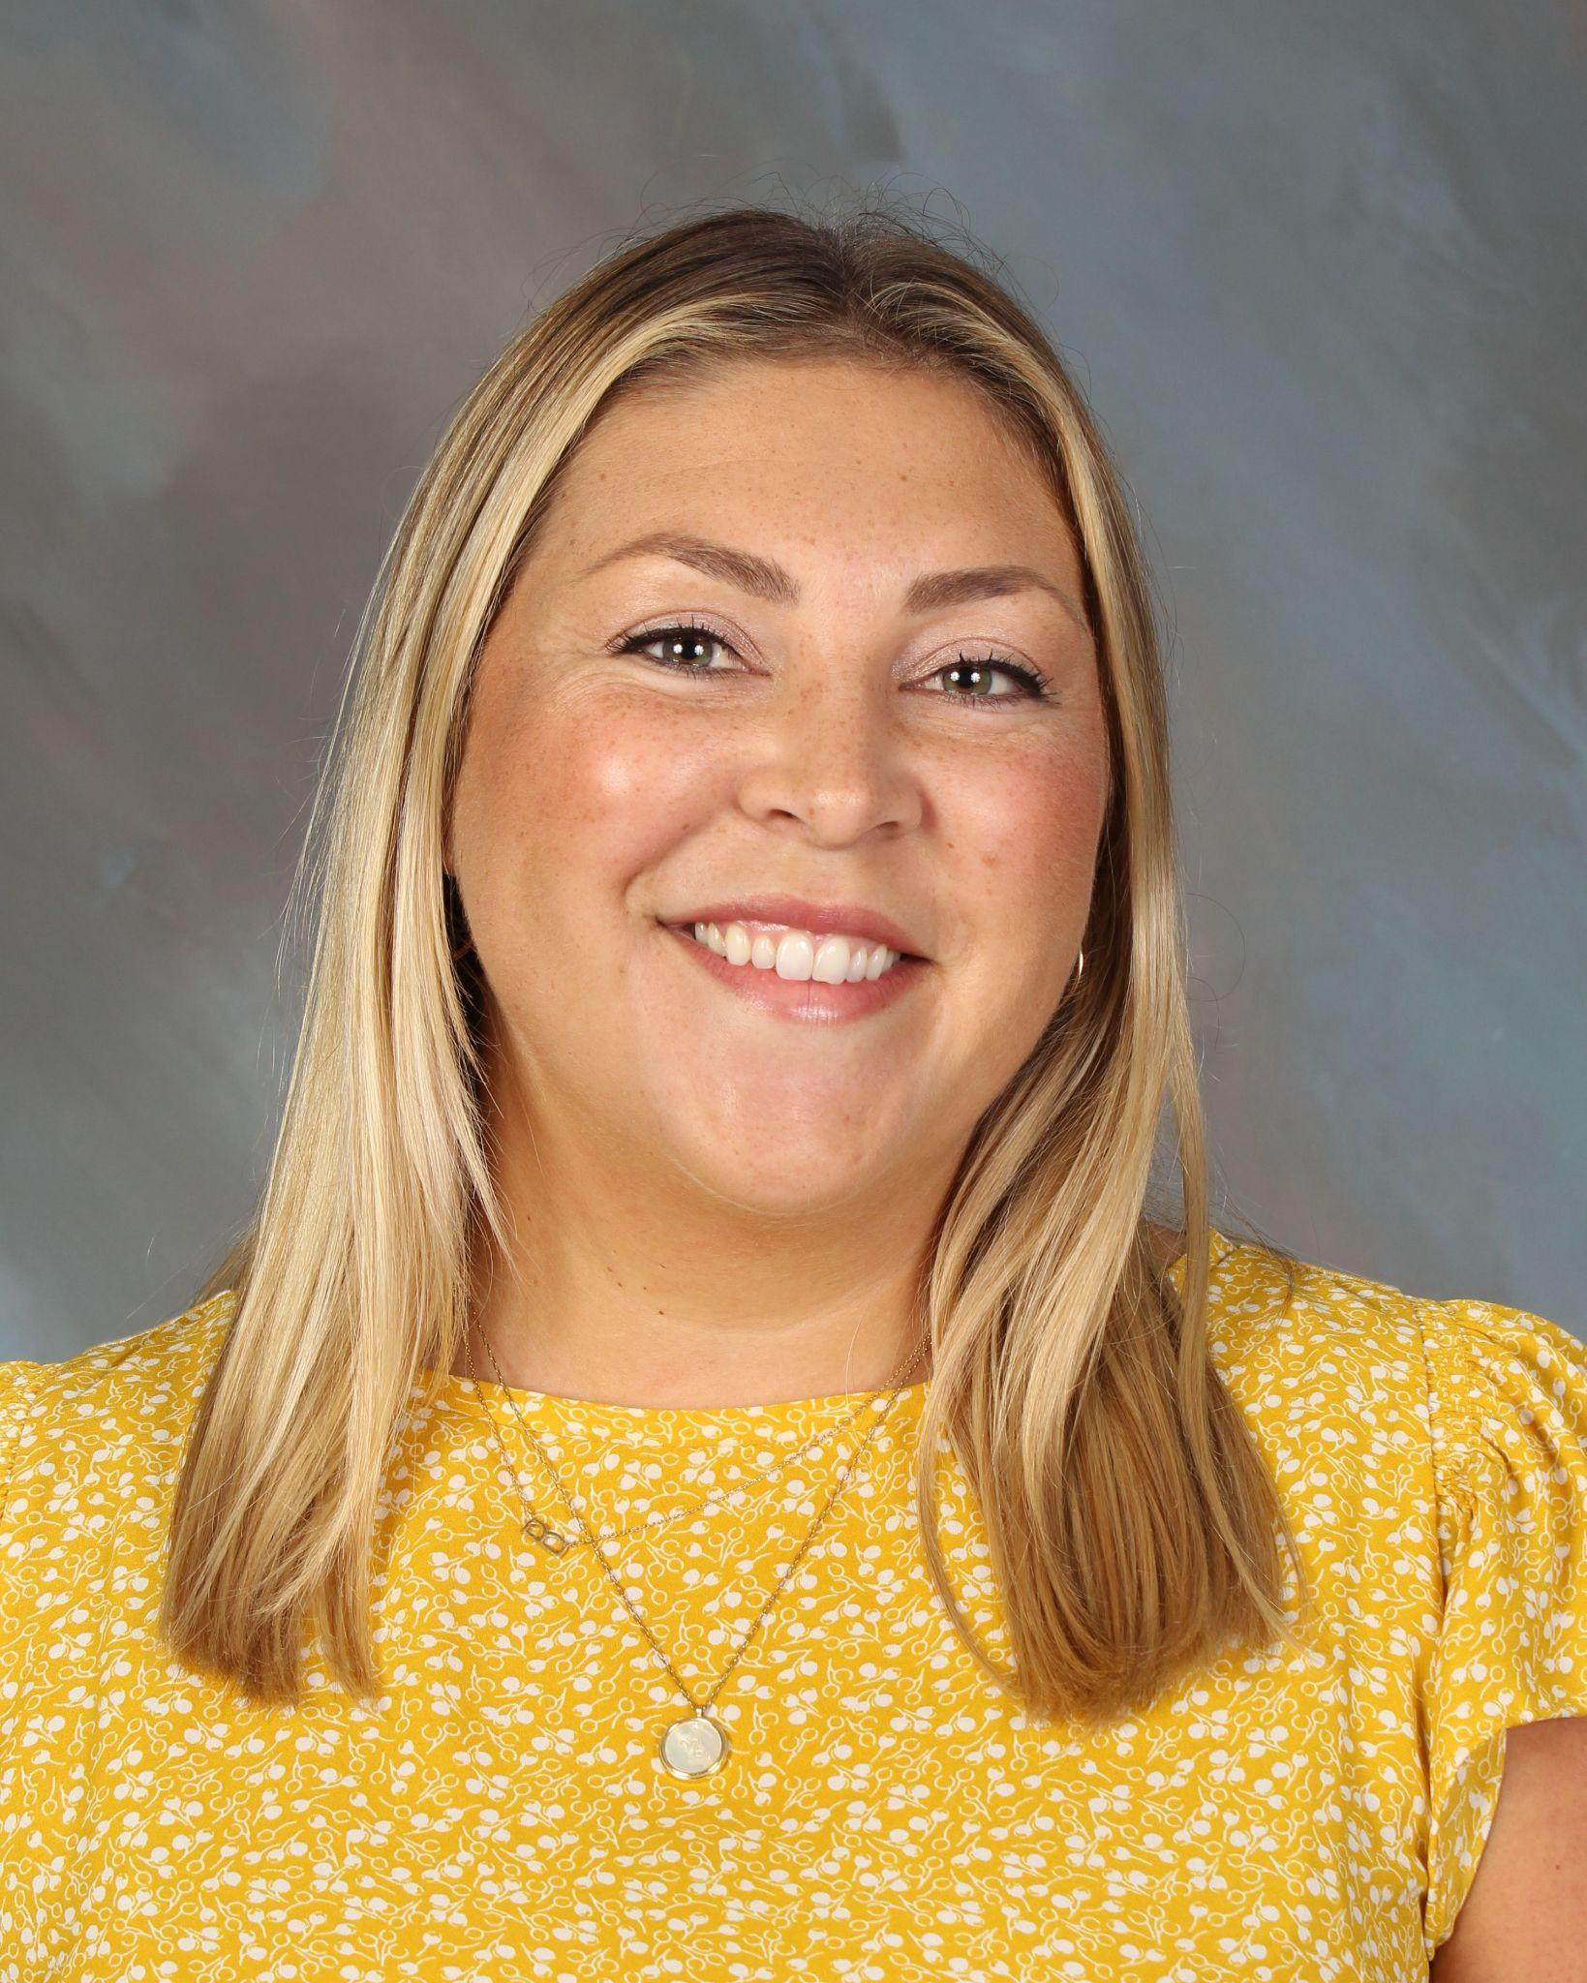
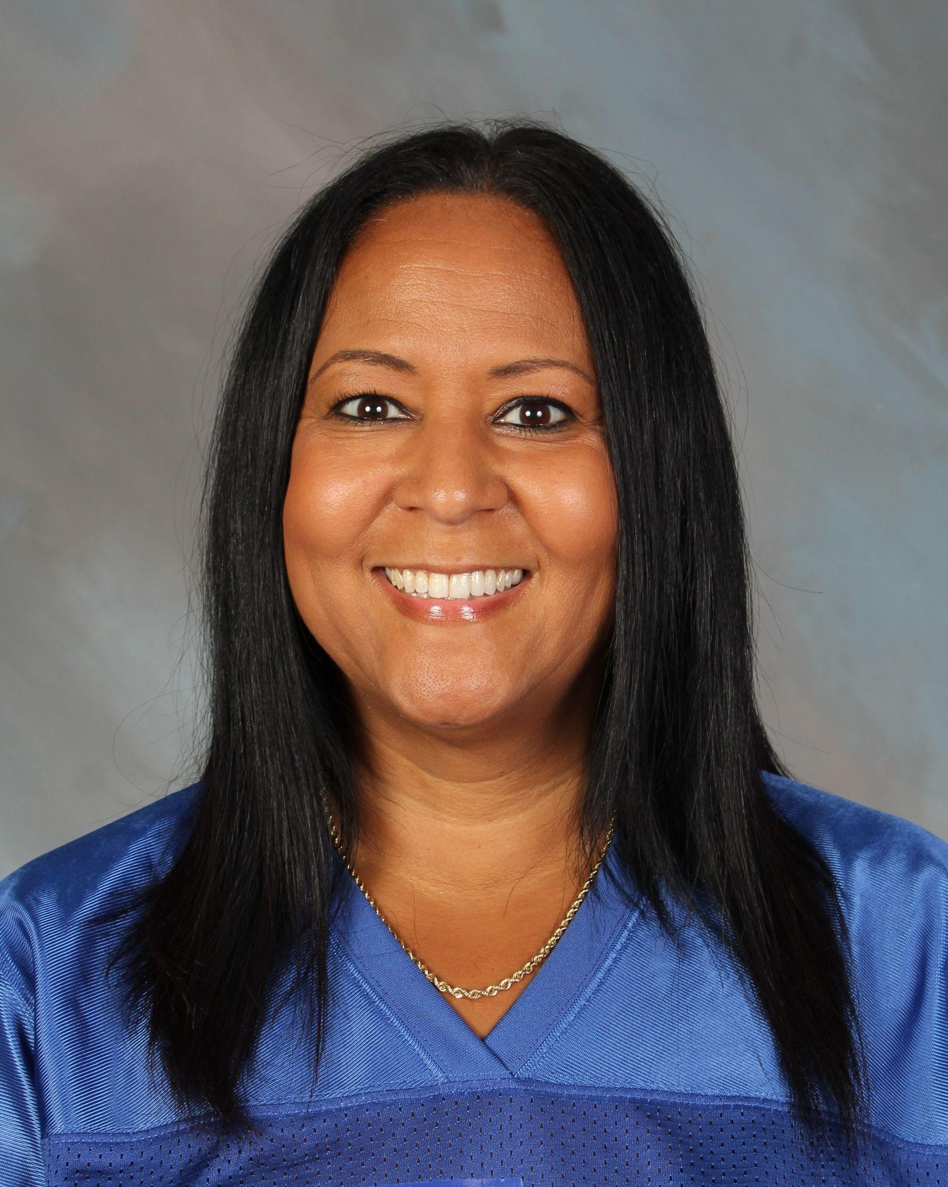
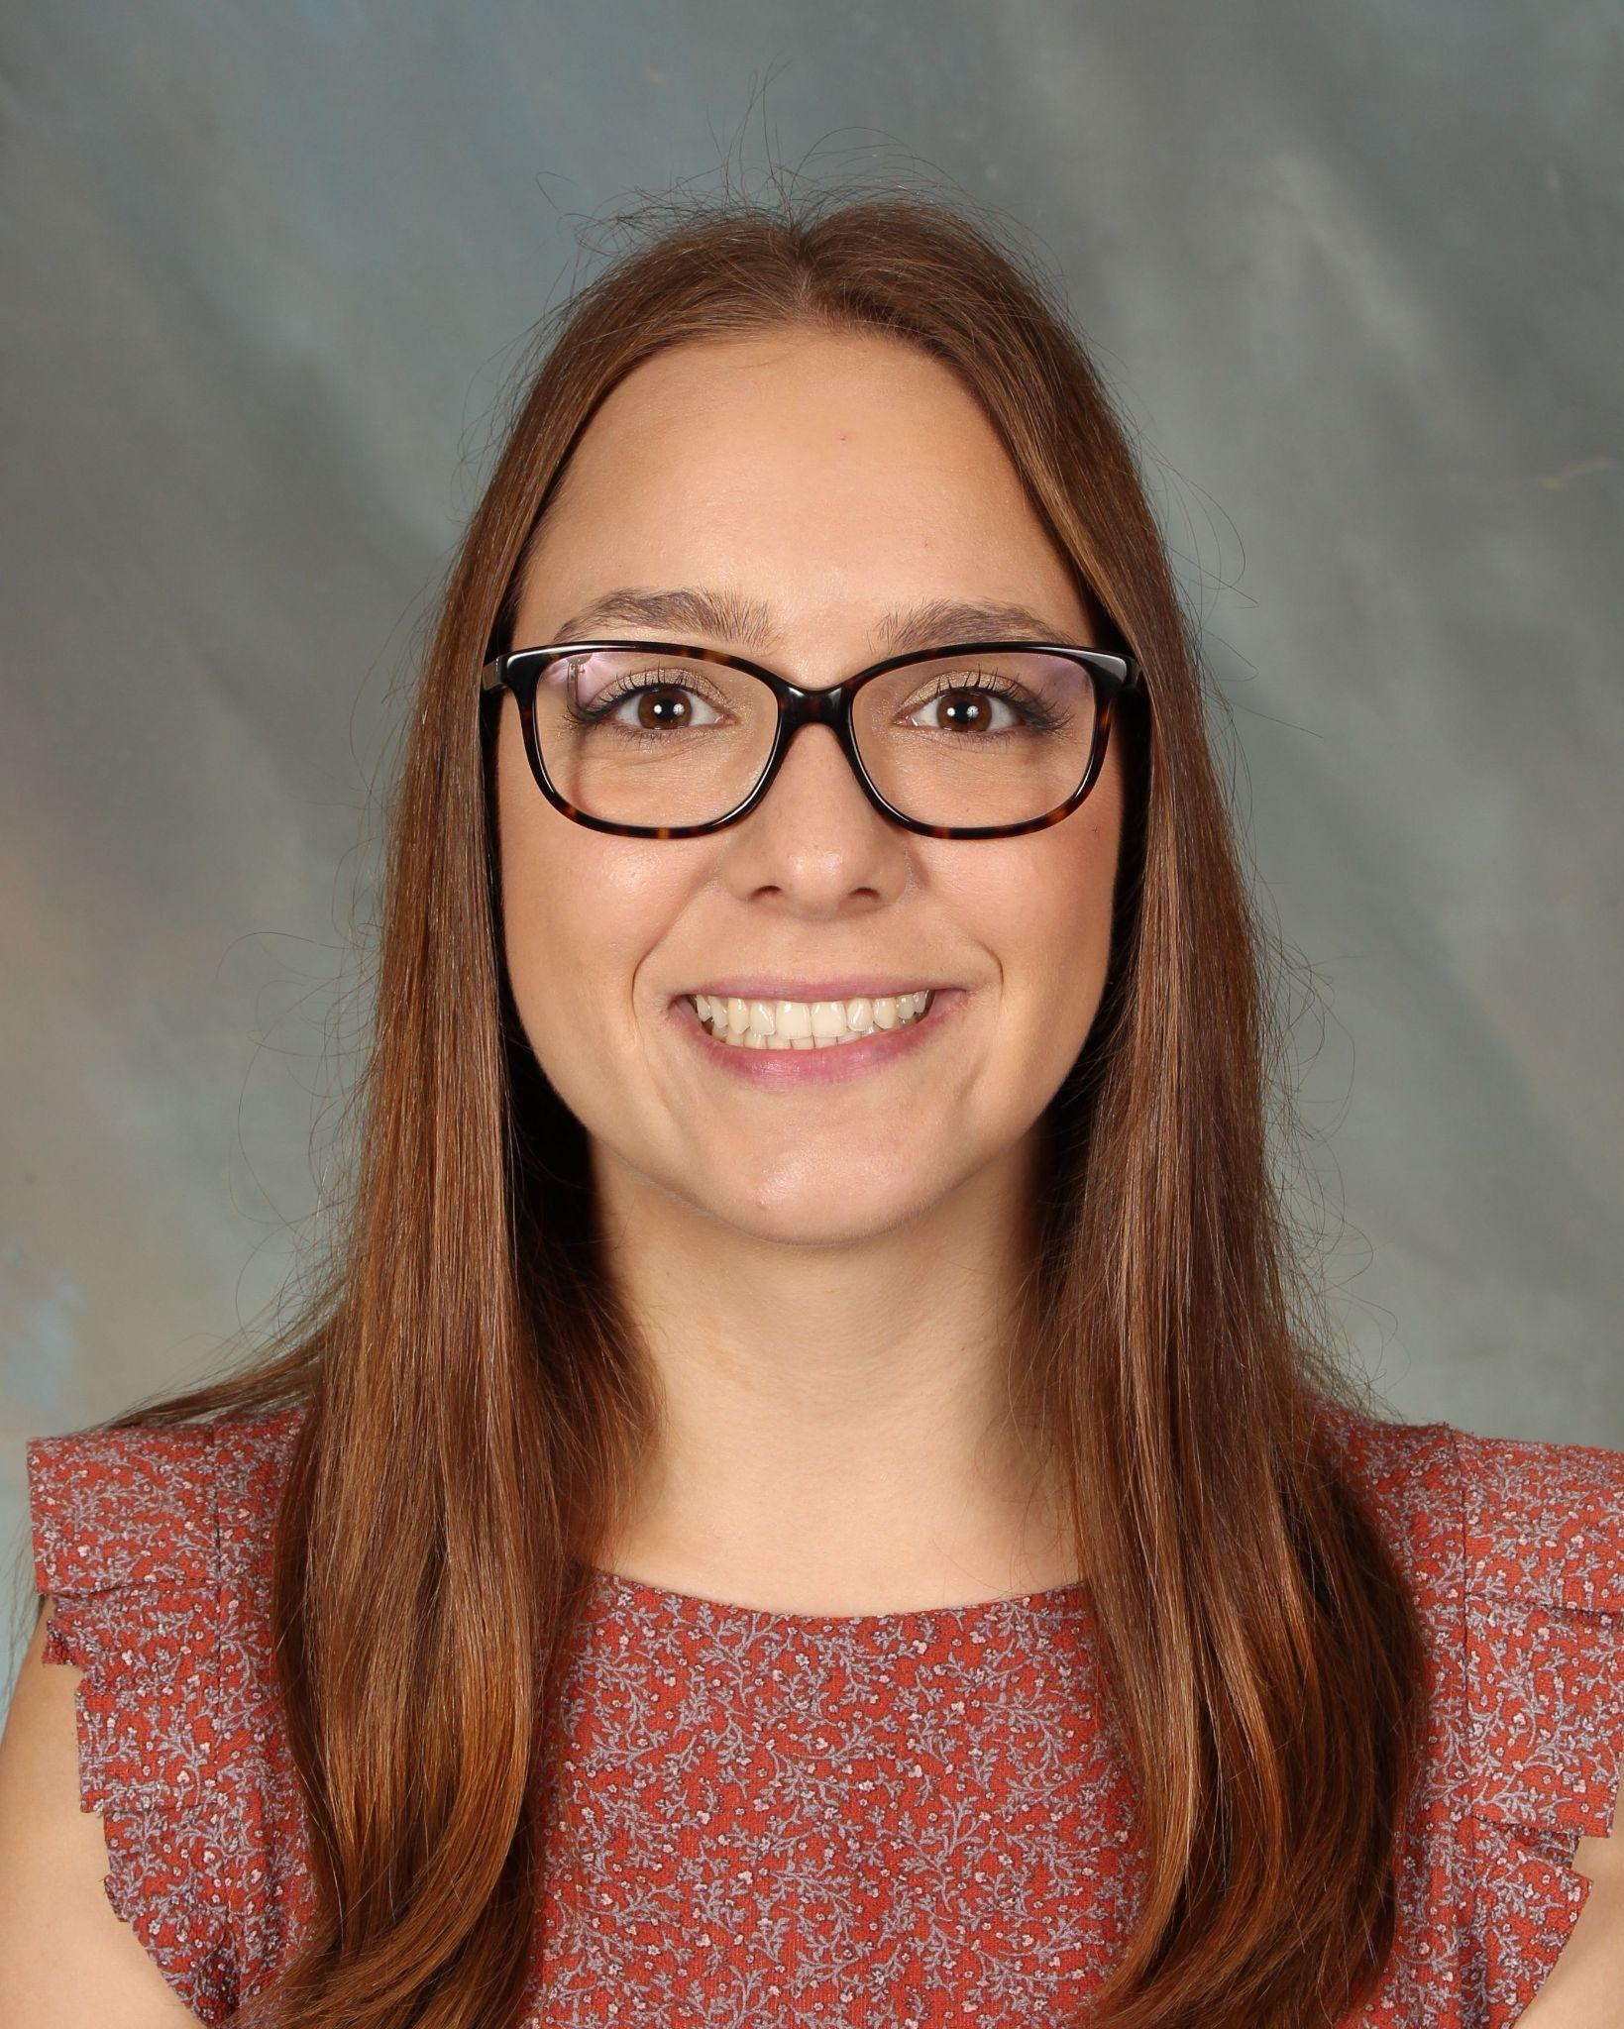
Meet the School Counselors
Ms. Cognetti
Ms. Kurisu
Mrs. Baker
Mrs. Coleman
Ms. O’Neil
A-Cro
Cru-Hern
Herr-Mom
Mon-R
S-Z

Slide 13
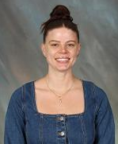
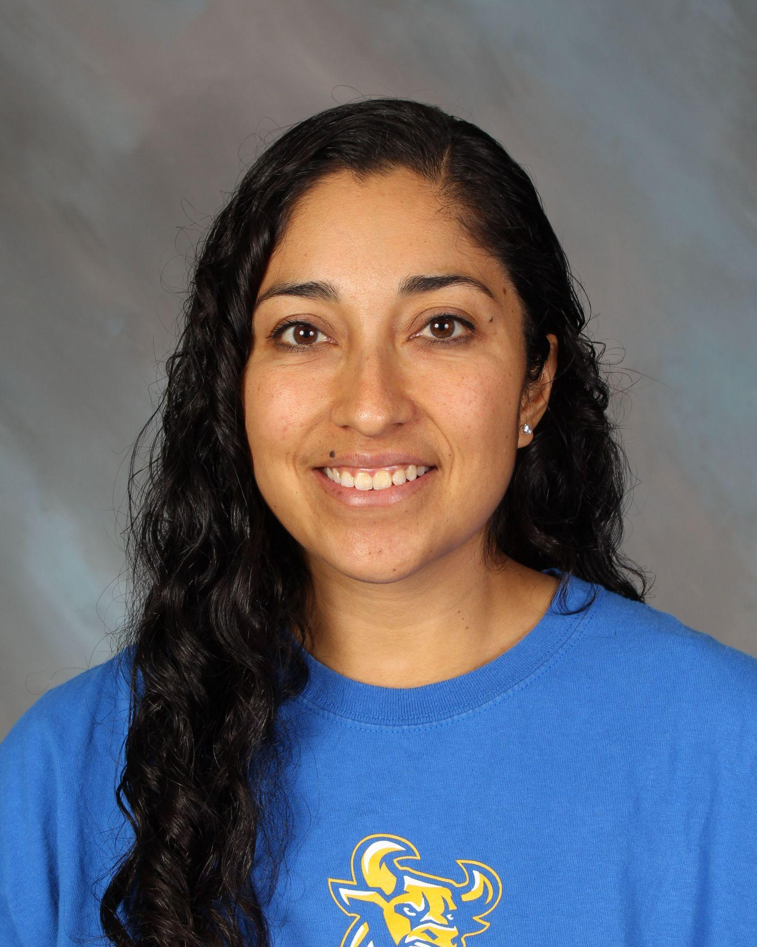
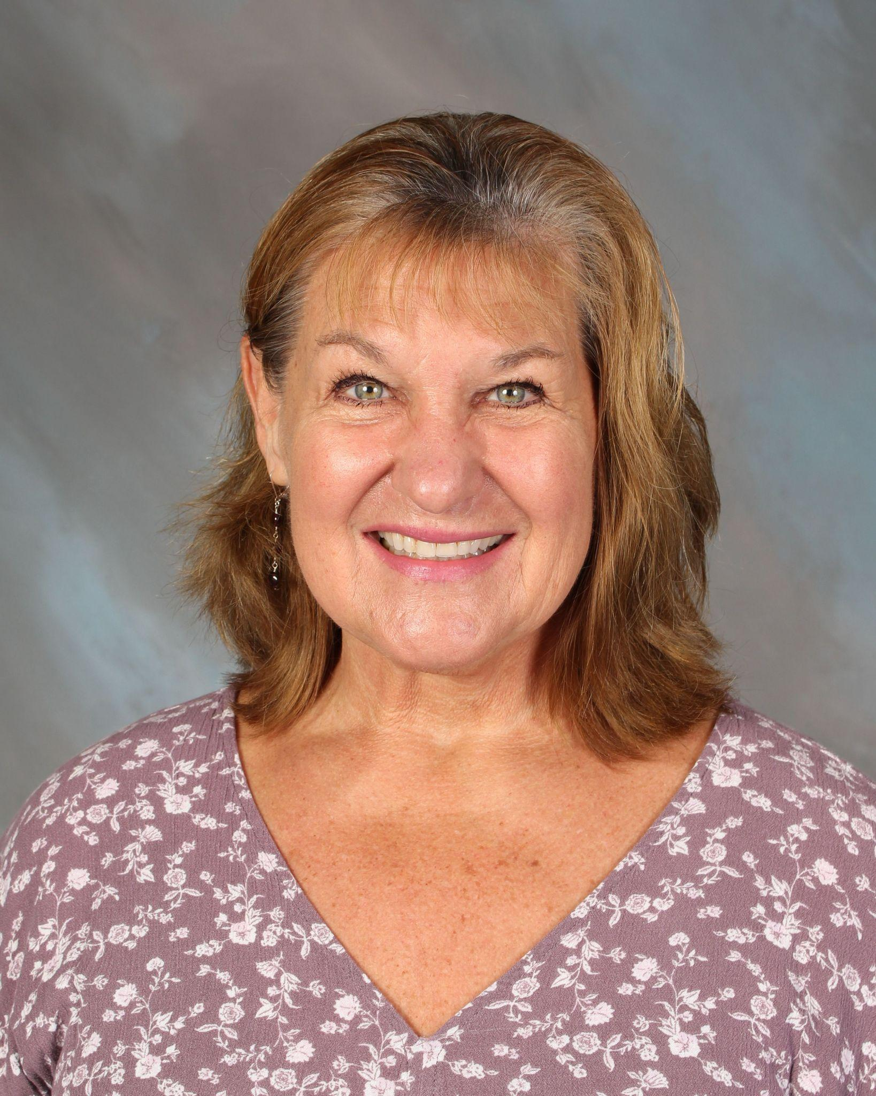
Meet the Student Service Technicians
Ms. Graham
Mrs. Gomez
Mrs. Dickelman
A-Ga
Ge-N
O-Z

Slide 14
School Counselor versus SST
School Counselor: Helps with academic concerns, college planning, career guidance, and personal concerns
SST: Helps with new student enrollment, scheduling, credit recovery, and community service hours

Slide 15
Additional Counseling Services
One-on-One Counseling
Counselors provide one-on-one counseling for academic planning, college and career exploration, and more
Classroom Lessons
Counselors visit classrooms to present on various topics such as time management, healthy coping skills, and post-secondary planning
Social-Emotional Support
Counselors provide students a safe space to share and process their thoughts and feelings in a judgement-free environment.
College/Career Support
Counselors advise students on college applications, including letters of recommendations and financial aid applications

Slide 16
Do you have a question about…
SCHOOL COUNSELOR
Tools for academic success?
How to practice self-care and practice good mental health?
What options are available after high school?
What college/career is best for your student?

Slide 17
Do you have a question about…
STUDENT SERVICE
TECHNICIAN
Making changes to your schedule?
How to make up a class/Summer School?
Official documents/records?
Community service hour verification?

Slide 18



The Transition to High School
The Basics of High School
Credits/High School Graduation Requirements
Post-Secondary Options

Slide 19
How is high school different?
Two semesters (Fall and Spring)
  Each class per semester = 5 credits
  Must take 6 classes per semester
Most classes are year-long
Is the class required to graduate?
  Must pass with a D or higher
  Must retake failed classes
Final semester grades on Transcript (Report Card)
All 9th grade students are required to take:
  English*
  Math*
  Biology*
  PE
    Athletics, Marching Band, Color Guard, Pep Squad also count for PE credit
2 Electives
*Honors courses available

Slide 20
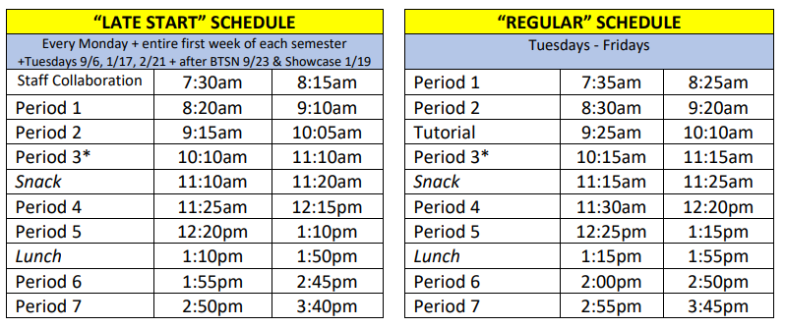
Bell Schedule (Example)
Most students attend school Periods 2-7. All Athletics are Period 7.

Slide 21
What else does ETHS offer?
A program designed for students who want an education that integrates Science, Technology, Engineering, Arts, and Math.
A simulation of the United Nations; debate world issues and compete against other schools. Required classes in Soph. and Junior year (Freshman and Senior year optional, but recommended).
AP Capstone
AVID
A College Board program that equips students with skills valued by colleges. Required Classes in Junior and Senior Year.
Model United Nations
A rigorous 4-year college prep program for 1st generation students seeking a college education.
STEAM

Slide 22
And more!
  ASB
  On-campus clubs
  Athletics
  CTE Pathways
  Engaging electives

Slide 23
Graduation vs A-G Requirements
Graduation Requirements are all the required classes SVUSD students must pass with a D or higher in order to get their diploma.
A-G Requirements are the classes UC/CSU/4-year universities require students to pass with a C or higher to be considered for admission.

Slide 24
Graduation Requirements
220 credits (break down on next slide)
  1-year long course = 10 credits
8 hours of community service
Did your student earn an F in a required class during high school?
Credit Recovery Options
  Summer school
  Credit recovery (night school or virtual during the school year)
  Retake the class in-seat

Slide 25
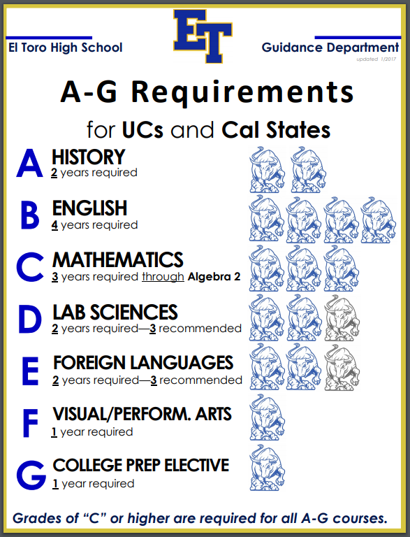
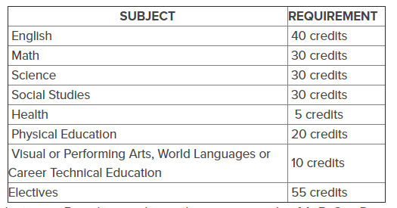
SVUSD Graduation Requirements
What classes count for PE credit?
PE
Power Walking, Weight Training (10th - 12th)
Athletics, Pep Squad
Marching Band, Color Guard

Slide 26
What can my student do after graduating from ETHS?
The opportunities are endless!
4-Year University | 2-Year Community College
Military | Trade/Technical School | Workforce

Slide 27

How to Be Successful in High School
Student Edition

Slide 28
Be sure to balance life and school
Use time management skills
Check your student email daily
Practice good physical and mental health
Ask for help and communicate with your teachers
Follow a routine

Slide 29

How to Be Successful in High School
Family Edition

Slide 30
Talk with your student about post-HS plans
Provide a quiet, relaxing space to study
Check Parent Portal once a week for grades
Ensure your student is attending school

Slide 31
Want to learn more?
Google Slides
PowerPoint
Visit the ETHS Guidance website
View our monthly Guidance Newsletters on our website
Follow the El Toro Instagram page: @eltorohs
  Click on the "Google Slides" button below this presentation preview.
  Click on "Make a copy."
  Start editing your presentation.
  You need to sign in to your Google account.
  Click on the "PowerPoint" button below this presentation preview.
  Start editing your presentation.
  Download and install the fonts used in this presentation as listed on the next page.
Follow the Counseling Instagram page: @eths_counselors

Slide 32
Frequently Asked Questions
Can my student take 7 classes?
Yes, although most students only take 6 classes (periods 2-7).
Can my student take summer school before starting Grade 9?
Community College classes - yes
Online Health - no
Can my student take a VAPA or World Language class at a community college?
Yes, but one or the other MUST be taken at ETHS.
My child is in competitive sports outside of school. Can that count as PE credit?
If your student is a nationally ranked athlete, yes.

Slide 33
Frequently Asked Questions
How does my student join ASB?
ASB Applications will be sent to Intermediate schools in April.
How does my student join an Athletic team? How do we know when tryouts are?
You can place an Athletic hold in your Academic Plan (see the last page of the Registration Packet).
Please contact the Coach directly with any questions about joining their sport (ETHS Website > Athletics > Athletic Directory).
My student is not in the STEAM Academy currently, but would like to join.
Students interested in joining the STEAM program should contact their Counselor to be added to the Waitlist.

Slide 34
Frequently Asked Questions
What time does Period 1 start?
8:20 am (Monday)
7:35 am (Tuesday-Friday)
My student is not a current SVUSD student and registers after the current SVUSD students. Will my child lose out on classes because they are the last to register?
No, our meetings with students are for course requests. Schedules are not finalized until all course requests are in.
Does my student need World Language AND VAPA to graduate?
SVUSD Requirements: One year of one or the other
A-G Requirements: Two years World Language AND One year VAPA

Slide 35
Registration: SVUSD Families
Read the Registration Packet thoroughly
Students complete the Google Form (must use Student SVUSD email)
Families input courses into Aeries Academic Plan (must use Parent Portal)
  Complete BOTH steps by March 17
Counselors visit Intermediate classes and meet with students one-on-one
  La Paz (March 24), Los Alisos (March 25), RSM (March 31)
  Serrano: March 19 - 21

Slide 36
Registration: Families New to SVUSD
All steps on ETHS Website > Guidance > New Student Enrollment
Please complete the steps by Thursday, March 28.
Step 1
Gather the necessary documentation
Step 2
Register online and enter data related to your student
Print two copies of your online registration
Step 3
Email your student’s SST to set up a registration meeting
New to SVUSD Registration at ETHS:
- April 1 from 8-11:30am
- April 4 from 12-3pm

Slide 37
Thank you!
Ms. Cognetti (A-Cro) hannah.cognetti@svusd.org
Please stay if you are interested in completing the Registration steps with the ETHS Counselors. They will be here to answer questions and provide recommendations. We will conclude Registration support at 7:30 PM.
Ms. Kurisu (Cru-Hern) kami.kurisu@svusd.org
Mrs. Baker (Herr-Mom) carlyn.morones@svusd.org
Mrs. Coleman (Mon-R) dionne.coleman@svusd.org
Ms. O’Neil (S-Z) dasha.oneil@svusd.org

Slide 38
Registration Steps
STEP 1: Review the Incoming 9th Grade Registration Packet (ETHS Website → Guidance → ETHS Registration)
STEP 2: Submit course selection via Google Form (must be accessed via SVUSD student email)
STEP 3: Submit course selection via Aeries Parent Portal (must be accessed via Parent/Guardian login)

